Slide 1

HOTEL RESERVATION SYSTEM

Slide 2
ABSTRACT
The Hotel Reservation System is a Java-based console application that automates hotel booking operations. It allows users to explore available hotels, check room availability, make and manage reservations, and view billing details. The main aim of this project is to simplify and digitize hotel booking processes, reducing manual effort and minimizing human error while ensuring a smooth user experience.

Slide 3
TECH STACK
Java
MySQL
JDBC
JUnit
Logging
Exception Handling

Slide 4
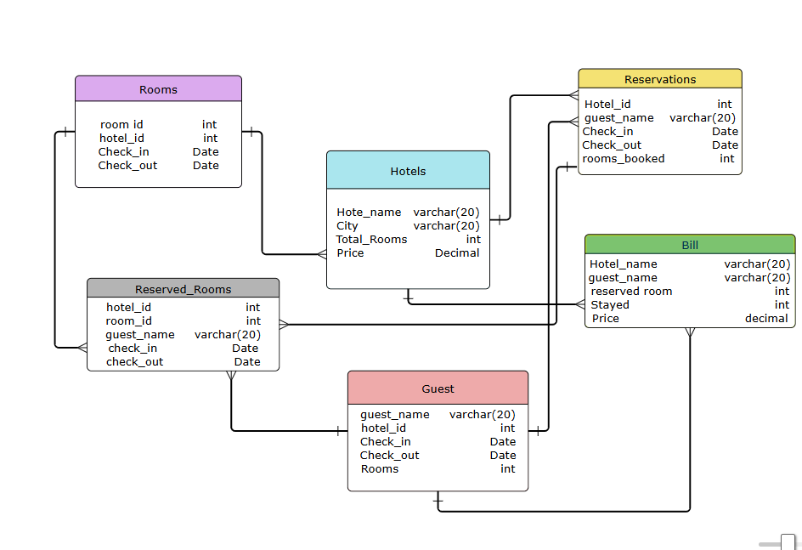
ER-DIAGRAM

Slide 5
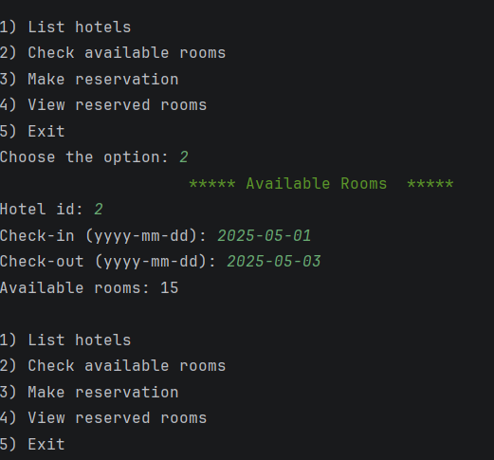
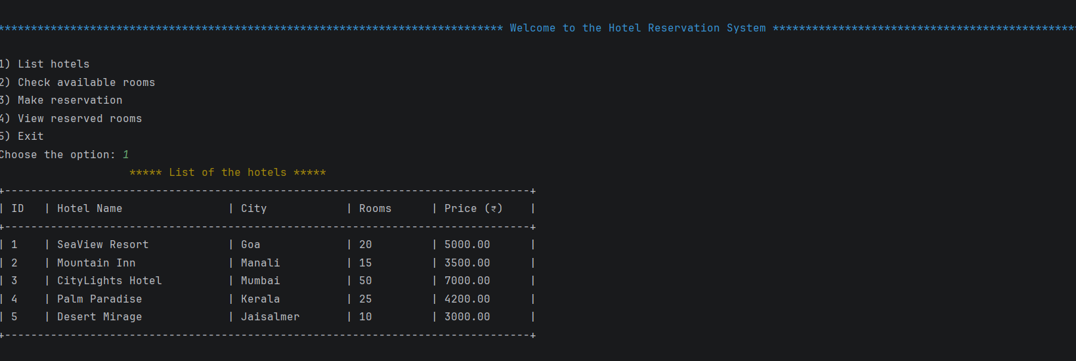
OUTPUT

Slide 6
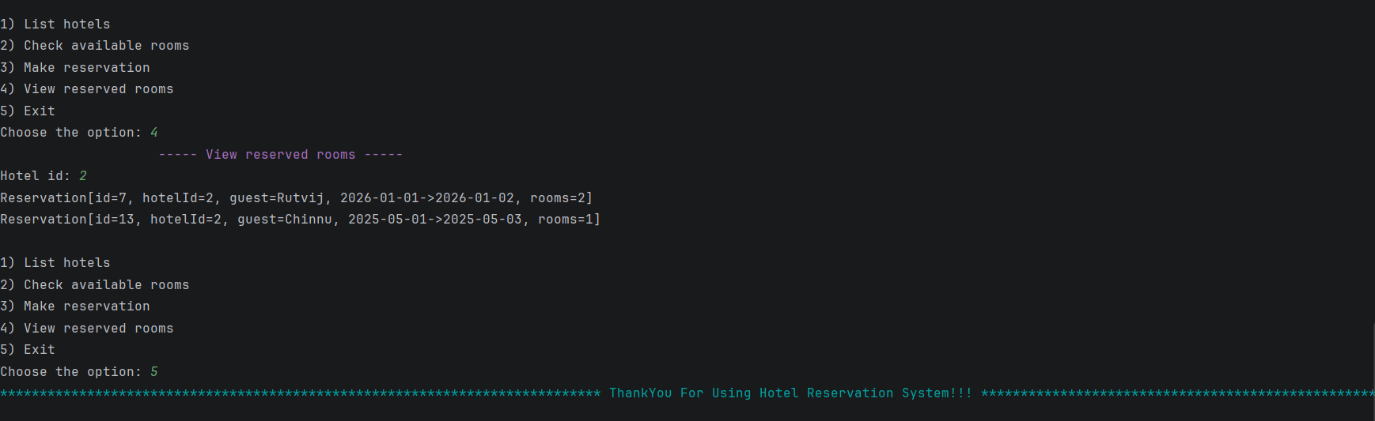
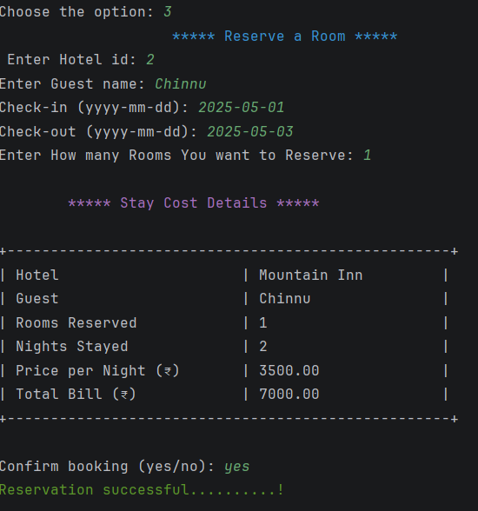

Slide 7
Thank you

