Slide 1


Slide 2
What is Apache Spark?
Apache Spark is an open-source big data processing and analytics framework. It is a platform that can process and analyze large datasets in a parallel and fast manner, providing high scalability for various data processing tasks. Apache Spark has a broad ecosystem and is utilized in many application domains, including big data analytics, data mining, data processing, machine learning, real-time analytics, and graph processing.

Slide 3
Spark Use Cases
Analyzing stream data analysis in real time
Graph-parallel processing to model data
All ML applications
Data mining
ETL processes

Slide 4
Advantages
Speed: Spark accelerates processing by storing intermediate data in memory. This feature allows for fast iterative algorithms and interactive data exploration.
High-Level APIs: Spark provides high-level APIs in Java, Scala, Python, and R, making it accessible to developers with different language preferences.
Fault Tolerance: Spark uses RDDs, which are fault-tolerant, immutable distributed collections of objects. In case of node failures, Spark can recover lost data by recomputing it from the lineage information stored in RDDs.

Slide 5
Spark Architecture
The Spark follows the master-slave architecture. Its cluster consists of a single master and multiple slaves.
The Spark architecture depends upon two abstractions:
Resilient Distributed Dataset (RDD)
Directed Acyclic Graph (DAG)

Slide 6
RDD (Resilient Distributed Datasets)
Fundamental data structure in Apache Spark that can be stored in-memory on worker nodes.

Slide 7
RDD Features
Immutability: Once created, RDDs are immutable, meaning their content cannot be changed. However, you can apply transformations to create new RDDs.
Distributed: RDDs are distributed across multiple nodes in a cluster, allowing parallel processing of data.
Resilience: RDDs are fault-tolerant. If a partition of an RDD is lost due to a node failure, Spark can recompute it using the lineage information, which is a record of the transformations applied to the base data.

Slide 8
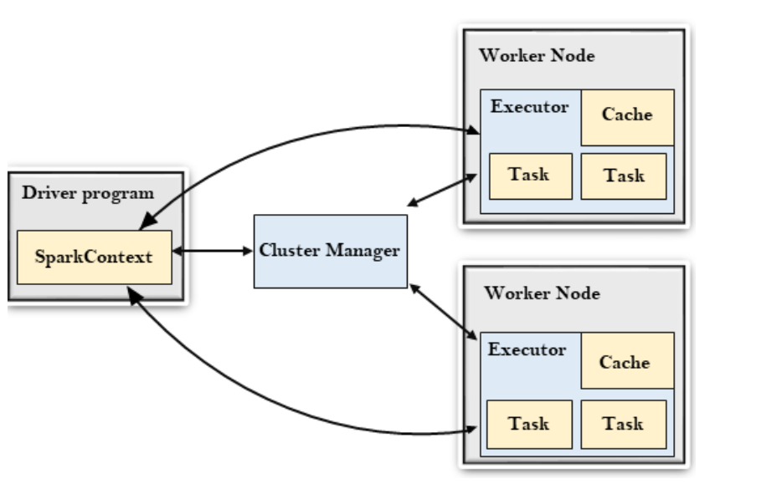
Architecture
The Driver Program: is a process that runs the main() function of the application and creates the SparkContext object. The purpose of SparkContext is to coordinate the spark applications.
Cluster Manager: The role of the cluster manager is to allocate resources across applications.
Worker Node: Its role is to run the application code in the cluster.
Executer: An executor is a process launched for an application on a worker node.

Slide 9
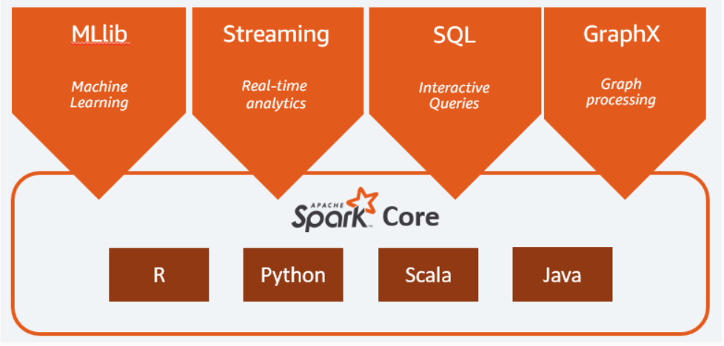
Ecosystem

Slide 10
Spark SQL
Spark SQL is a module in Apache Spark used for running SQL queries on Spark. It is designed to transform data into DataFrame structures, making it easier to apply SQL-like queries and facilitating data manipulation.

Slide 11
Spark Streaming
It is an add-on to core Spark API which allows scalable, high-throughput, fault-tolerant stream processing of live data streams. Spark can access data from sources like Kafka, Flume, Kinesis or TCP socket.

Slide 12
How does Spark Streaming Works?
Gathering:
Basic sources: These are the sources which are available in the StreamingContext API. Examples: file systems, and socket connections.
Advanced sources: Spark access data from different sources like Kafka, Flume, Kinesis, or TCP sockets.
Processing: The gathered data is processed using complex algorithms expressed with a high-level function. For example, map, reduce, join and window.
Data Storage: The Processed data is pushed out to file systems, databases, and live dashboards.

Slide 13
Spark MLlib
MLlib in Spark is a scalable Machine learning library that discusses both high-quality algorithm and high speed. The motive behind MLlib creation is to make machine learning scalable and easy.

Slide 14
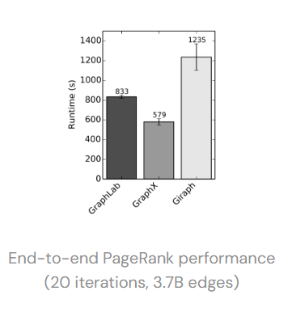
Spark GraphX
GraphX in Spark is API for graphs and graph parallel execution.
Seamlessly work with both graphs and collections.

Slide 15
Apache Hadoop
Apache Hadoop is an open-source software utility that allows users to manage big data sets. It is a highly scalable, cost-effective solution that stores and processes structured, semi-structured and unstructured data.

Slide 16
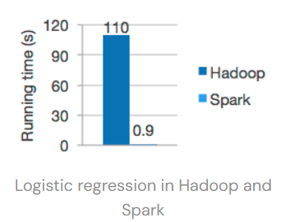
Spark vs Hadoop
Performance: Spark is faster because it uses random access memory (RAM) instead of reading and writing intermediate data to disks. Hadoop stores data on multiple sources and processes it in batches via MapReduce.
Processing: Though both platforms process data in a distributed environment, Hadoop is ideal for batch processing and linear data processing. Spark is ideal for real-time processing and processing live unstructured data streams.

Slide 17



Project
ETL PROCESS
Load
Transform
Extract
Load

