Slide 1

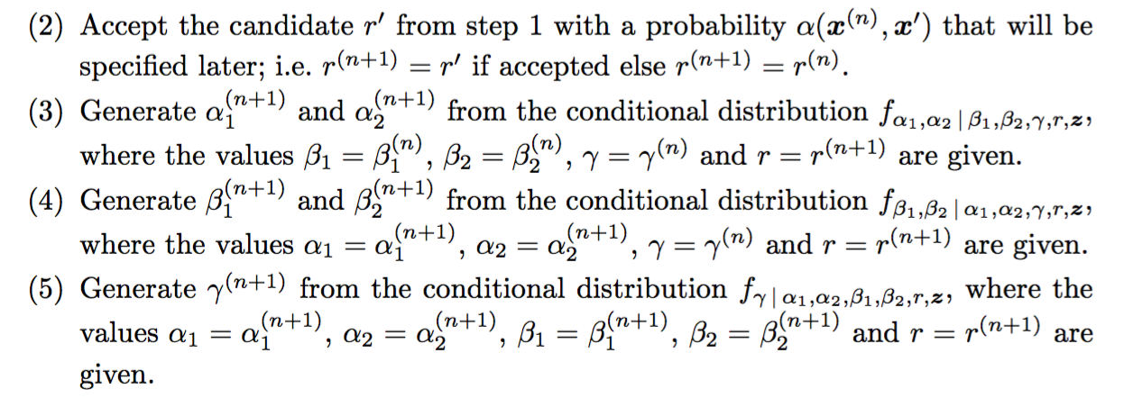

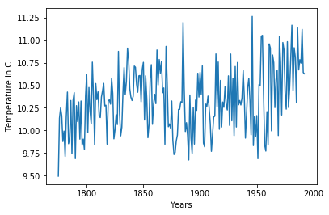
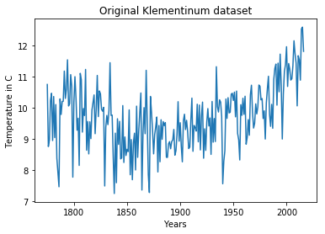
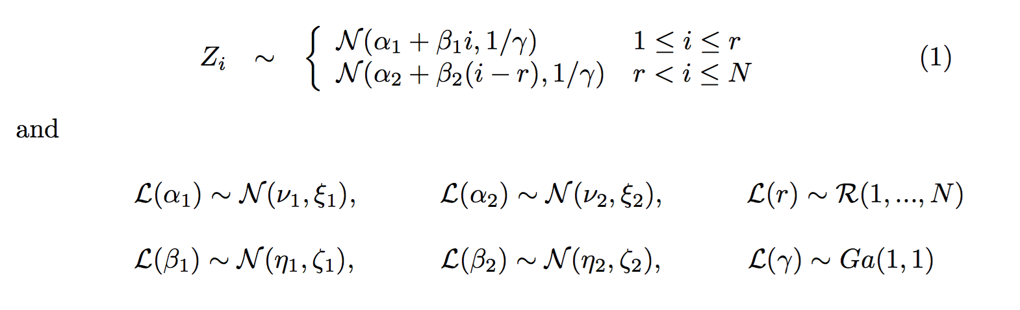
Application of MCMC to Changepoint Detection
On Klementinum Temperature Series
Guneykan Ozgul¹, B. Sc. Computer Eng; Kemal Berk Kocabagli² B. Sc. Computer Eng
Bogazici University
ABSTRACT
INTRODUCTION
ALGORITHM
RESULTS
The temperature data coming from Klementinum meteorology station in Prague is well known and many methods have been proposed to find a change point in it. An interesting and different approach to detect such a change point is through MCMC. In this project, we implemented an MCMC algorithm on both the original Klementinum data and a synthetic copy of it that we generated under our proposed model.
A change point can be defined as the point at which an abrupt change occurs in the generative parameters of a data sequence. Detection of such points is an important problem in various application areas such as finance, biometrics and robotics. It is also a popular subject among statisticians for many years and numerous different techniques are proposed until today.
PROBLEM STATEMENT
Suppose we observe some data that has exactly one noticeable change point, which forms a boundary between two different distributions the data comes from. It is difficult to estimate the parameters of these two distributions and the location of the change point efficiently.
Markov chains are generated from the posterior distribution of these parameters using MCMC and desired results are derived from the chains obtained. The formulas for the posterior distributions can be found in [1].
Iteration logic
Original parameters of synthetic data
 | alpha1 | alpha2 | beta1 | beta2 | gamma | r
Synthetic data | 10.09 | 10.04 | 0.005 | 0.005 | 8.83 | 1873
Original data | 9.81 | 8.44 | -0.0003 | 0.014 | 1.43 | 1836
OBJECTIVE
In this project, our objective is to analyze and implement a less usual approach to change point detection, which uses Bayesian Statistics and MCMC to increase efficiency. We modeled the problem as a two-phase linear jump. Our assumption is that the data comes from two different Gaussian distributions with linearly changing mean and a constant variance. The related work can be found in [1].
DATA
CONCLUSIONS
Figure 1. Synthetic data created from our proposed model
Changepoint oldugu belli olsun yoksa bulamiyo
Global warming
Monte Carlo oldugu icin hep ayni sonucu bulmuyo. Yakin buluyo. Programi daha cok calistirip frequencye bakmak lazim.
Goodenoughi cok arttirinca sanstan yanlisa zorlaniyo, cok az olunca initial point etkisi domine ediyo. Denge lazim.
MODEL
Data points will be denoted by Z_{1,} ..., Z_{N} where N is the number of data points and index of the change point will be denoted by r. To simplify results we also used the parametrization γ = ^{1/}_{σ}². The linear change of expected values are allowed in both parts of the data. We used a two-phase linear model with a jump, assuming exactly one change point.
The generative model is,
CONTACT
Figure 2. Original data coming from Klementinum station
Kemal Berk Kocabagli, Guneykan Ozgul
Bogazici University
Email: kberkkocabagli@gmail.com, guneykanozgul@gmail.com
Project GitHub link: https://github.com/berk94/MCMC-Changepoint-Detection-Klementinum
REFERENCES
Jarom ́ır Antoch, David Leg ́at: Application of MCMC to change point detec- tion. In: Applications of Mathematics, Vol. 53 (2008), No. 4, 281–296.

