Slide 1
ENS-492 PresentatIon
AI-Agents for Informatıon ExtractIon ın Healthcare
Ahmed Berka Ayhün
Tuana Birkan
Damla Salman
Supervisor: Yücel Saygın

Slide 2
Goal
Healthcare institutions need fast and reliable access to regulatory knowledge for compliance and operational efficiency.
We designed an LLM-based system that extracts knowledge and answers questions using:
  Large Language Models (LLMs)
  Knowledge Graph (Neo4j)
  Retrieval-Augmented Generation (RAG)
The system supports both:
Unstructured data: regulatory documents (SUT)
Structured data: database-like sources (e.g., SQL/Excel tables)

Slide 3
pROBLEM
Documents like SUT are long, hierarchical, and exception-heavy
Same headings can repeat → context confusion
Manual search is slow and error-prone
We need answers that are verifiable / traceable

Slide 4
Goal
Regulations → Knowledge Graph
Regulatory documents are transformed into a structured graph (nodes + relationships)
RAG-based Question Answering
Healthcare professionals can ask questions through a QA interface
The system retrieves relevant context and generates grounded answers
Dynamic Updates
Mechanisms to handle regulation changes without rebuilding everything from scratch (controlled rebuild / update flow)

Slide 5
GraphRAG
Knowledge Graph (Neo4j)
Hybrid Retrieval (Vector + Graph Traversal)
Relationship-aware retrieval
Multi-hop contextual reasoning
Better provenance & traceability
Reduced hallucinations (grounded answers)

Slide 6
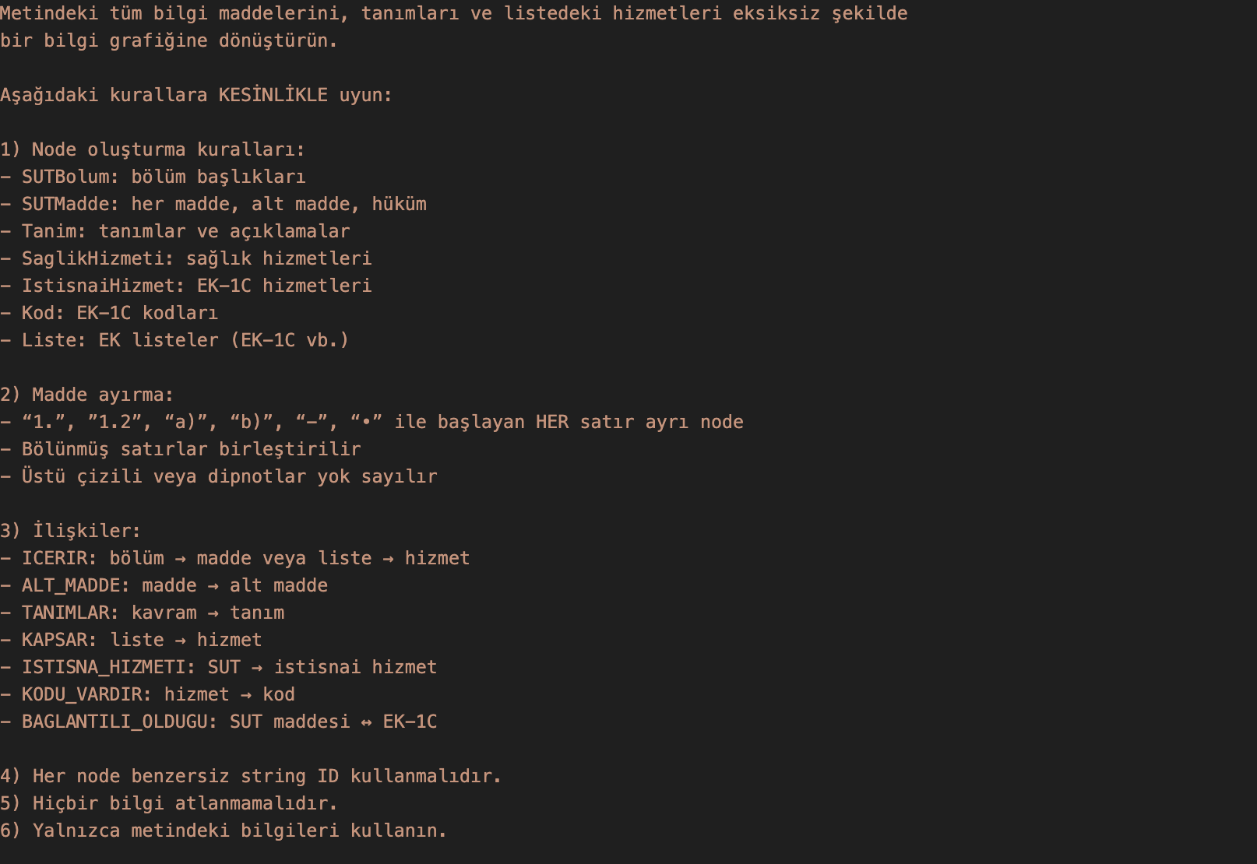
Knowledge Graph Build
Knowledge Graph Prompt
Node labels, relation types
Rules
Output contract: JSON-only

Slide 7
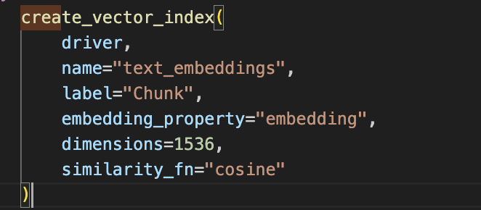
Knowledge Graph Build
Build Control
  BUILD_KG = True → extract & write KG to Neo4j
  BUILD_KG = False → use existing database (faster demo/iteration)
Vector Index (Semantic Retrieval)
  Creates a vector index on Chunk nodes using the embedding property in Neo4j
  Enables top-k similarity search (cosine) for relevant chunks
  Provides the entry point for GraphRAG retrieval (Vector → Cypher traversal)
  Avoids full-scan search → faster queries

Slide 8
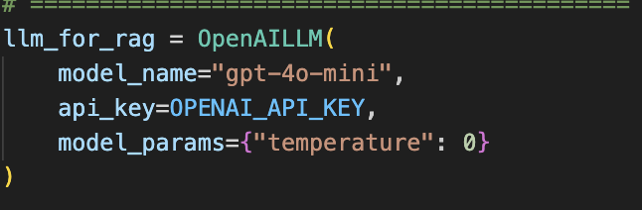
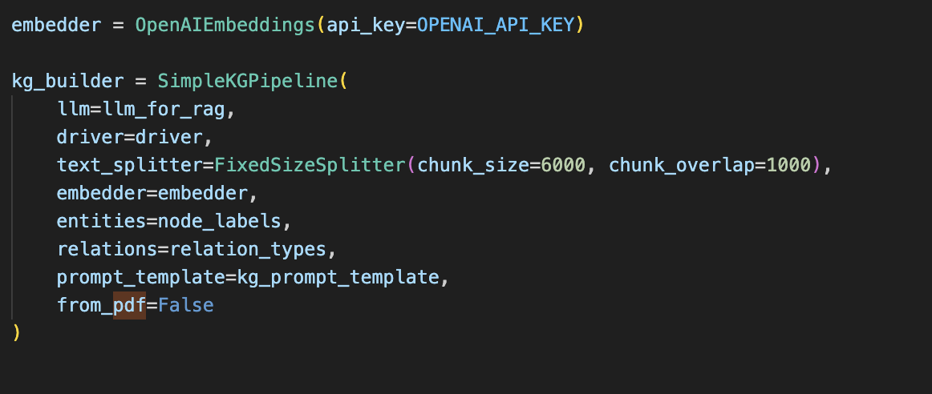
Knowledge Graph Build Pıpelıne
Chunking (FixedSizeSplitter) : To capture the context
Overlap: To prevent data and meaning loss during part transitions.
LLM(OpenAI) extracts nodes/relations per chunk
{“temperature”: 0} to prevent hallucinations

Slide 9
Knowledge Graph BUILD Dıffıcultıes
Deep headings may be merged during ontology mapping
Some subheadings are not fully captured as clean nodes
FROM_CHUNK preserves sub-clause evidence
Therefore, many correct answers are chunk-grounded, while KG provides structure

Slide 10
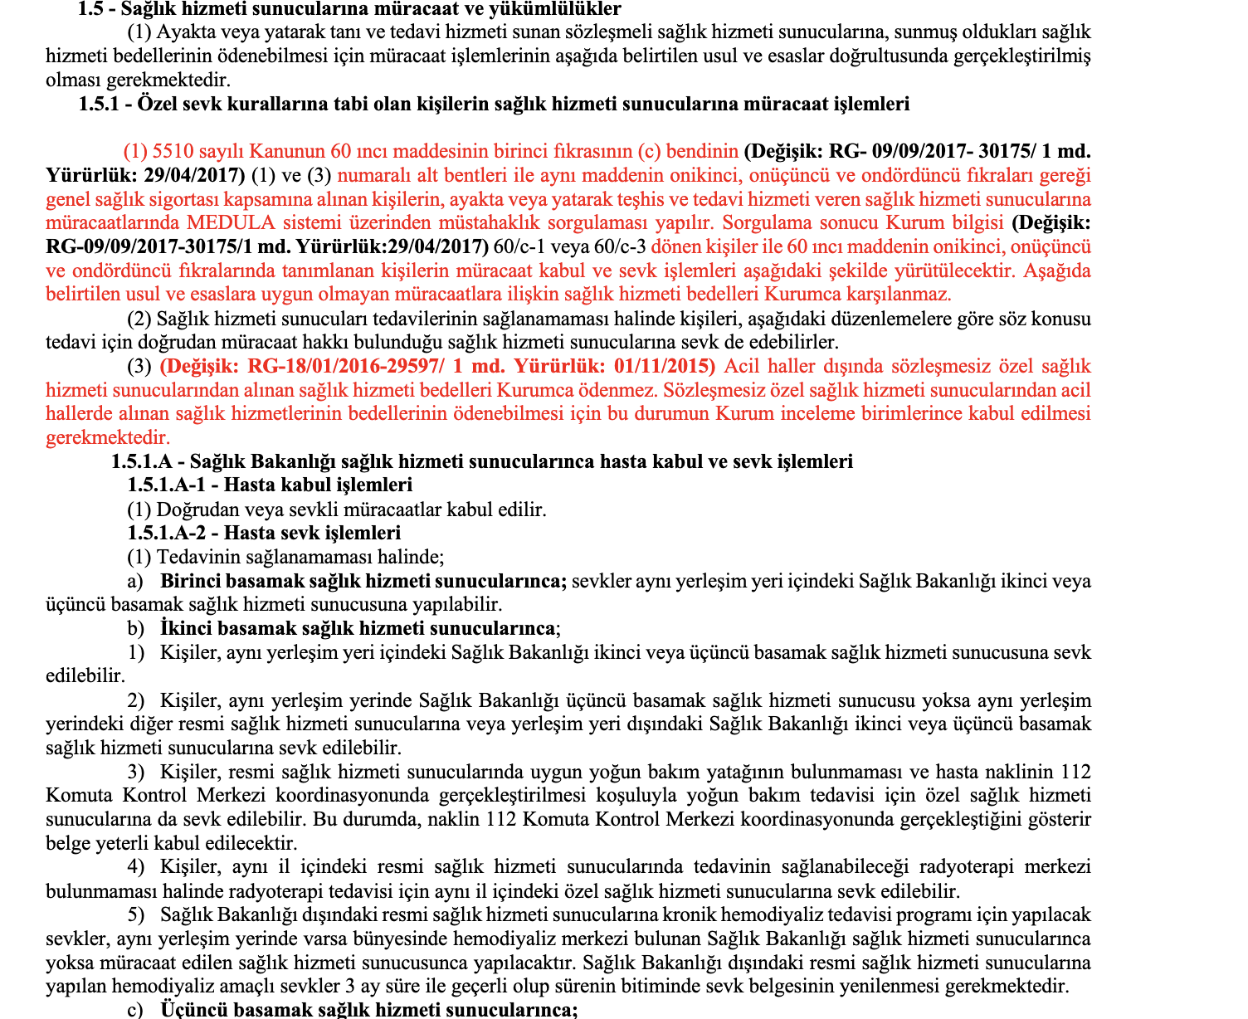
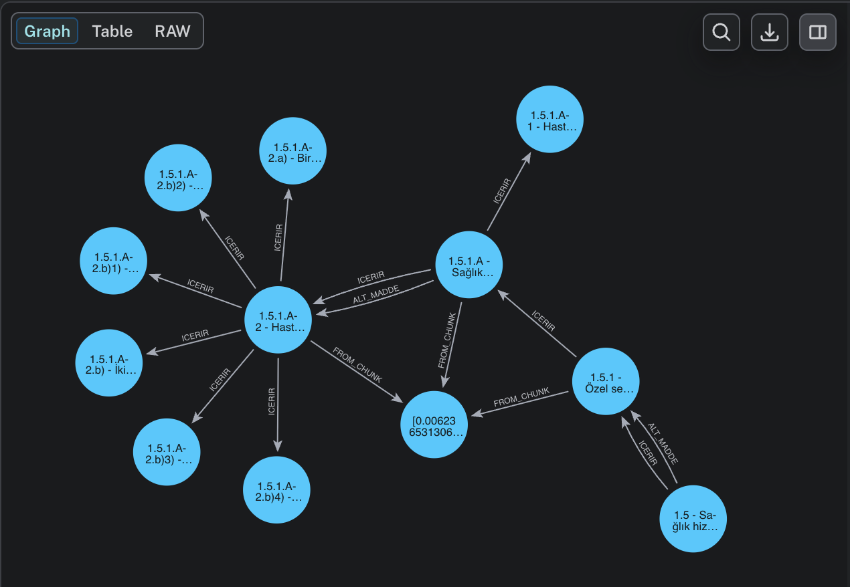

Slide 11
DYNAMIC UPDATE
MATCH (c)
WHERE elementId(c) = '4:89c60307-9934-4804-86fe-a90499bbcc38:39'
SET c.metin = replace(c.metin, 'resmi', 'özel'),
c.embedding = null
RETURN c.metin

Slide 12
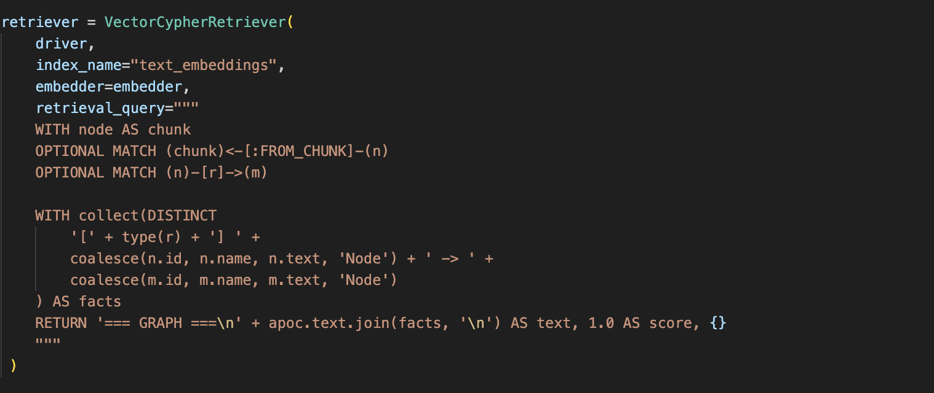
Retrıeval
Query → embedding
Vector search finds top-k Chunk nodes
Cypher traversal expands to connected nodes/relations
Context is returned as relational facts (triples)

Slide 13
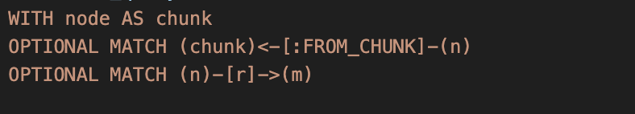
Cypher Traversal
WITH node AS chunk → selected Chunk from vector search
MATCH (chunk)<-[:FROM_CHUNK]-(n) → get entities extracted from this chunk (provenance link)
MATCH (n)-[r]->(m) → expand to connected nodes via graph relations

Slide 14
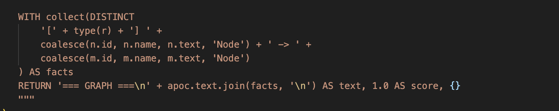
Fact Formatting
Produces a structured context instead of raw text
Reduces hallucination by constraining the LLM to explicit relations
Improves traceability: relation type explains “why this info is included”
DISTINCT avoids duplicated facts
join(facts, '\n') → returns a single context string to the LLM

Slide 15
Q/A Prompt

Slide 16
Valıdatıon

