Slide 1
Two Dimensional Plots-vol(1)
Prepared by Dr. Aysun GÜRAN

Slide 2
In this lesson you will:
Read multiple variables from a .mat file.
Plot arrays using line graphs.
Use the colon operator (:) to extract rows and columns.

Slide 3

DATA FOR THIS LESSON
File | Description
NYCDiseases.mat | The data set contains the monthly totals of the number of new cases of measles, mumps, and chicken pox for New York City during the years 1931-1971. The file is organized into the following variables: measles - an array containing the monthly cases of measles mumps - an array containing the monthly cases of mumps chickenPox - an array containing the monthly cases of chicken pox years - a vector containing the years 1931 through 1971 The data was extracted from the Hipel-McLeod Time Series Datasets Collection, available at http://www.stats.uwo.ca/faculty/aim/epubs/mhsets/readme-mhsets.html. The data was first published in: Yorke, J.A. and London, W.P. (1973). "Recurrent Outbreaks of Measles, Chickenpox and Mumps", American Journal of Epidemiology, Vol. 98, pp. 469.
Notes:
**How to create “xx.mat” file in matlab?
Example=
X=1:2:9
Y=2:2:10
Save trial.mat X Y
**How to load trial.mat
Example=
load trial.mat

Slide 4
EXAMPLE 1: Load NYC contagious disease data set
You should see 4 variables in the Workspace Browser:
measles - an array containing the monthly cases of measles
mumps - an array containing the monthly cases of mumps
chickenPox - an array containing the monthly cases of chicken pox
years - a vector containing the years 1931 through 1971

Slide 5
EXAMPLE 2: Define variables for analysis (pick out rows and columns)
Create a new cell in which you type and execute:

Slide 6
EXAMPLE 3: Plot the measles cases for 1931 (basic plot in new figure)
Create a new cell in which you type and execute:

Slide 7
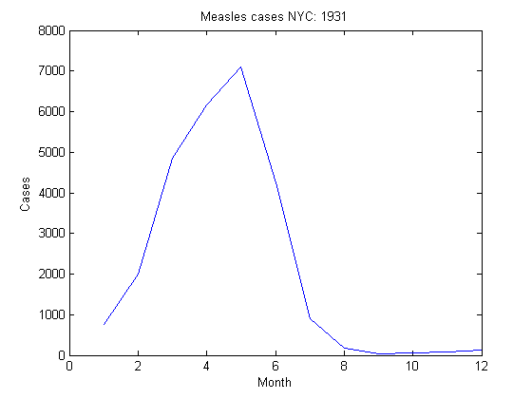
You should see a Figure Window with the measles cases for 1931:

Slide 8
EXAMPLE 4: Rescale the measles cases before plotting (basic rescaling)
Create a new cell in which you type and execute:

Slide 9
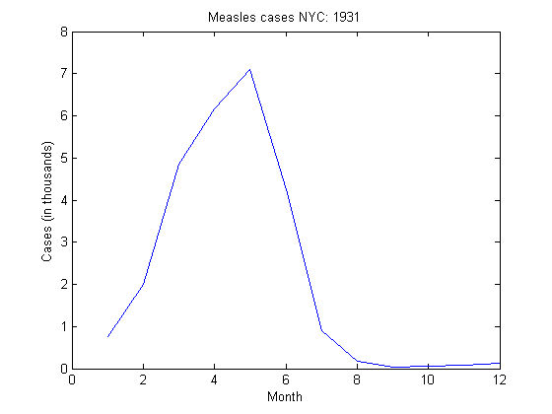
You should see a Figure Window with the measles cases for 1931:

Slide 10
EXAMPLE 5: Plot the measles cases for the month of May (give x values explicitly)
Create a new cell in which you type and execute:

Slide 11
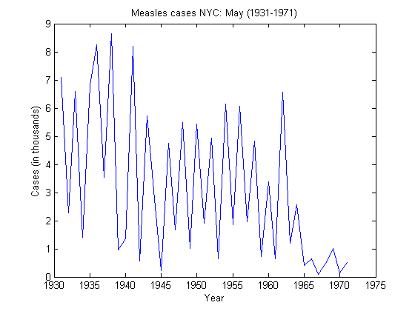
You should see a Figure Window with a single line graph:

Slide 12
EXAMPLE 6: Compare measles cases for 1931 and 1941 (multiple plots same figure)
Create a new cell in which you type and execute:

Slide 13
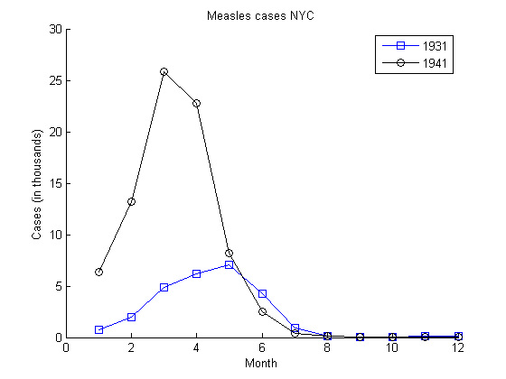
You should see a Figure Window with a two line graphs:

Slide 14
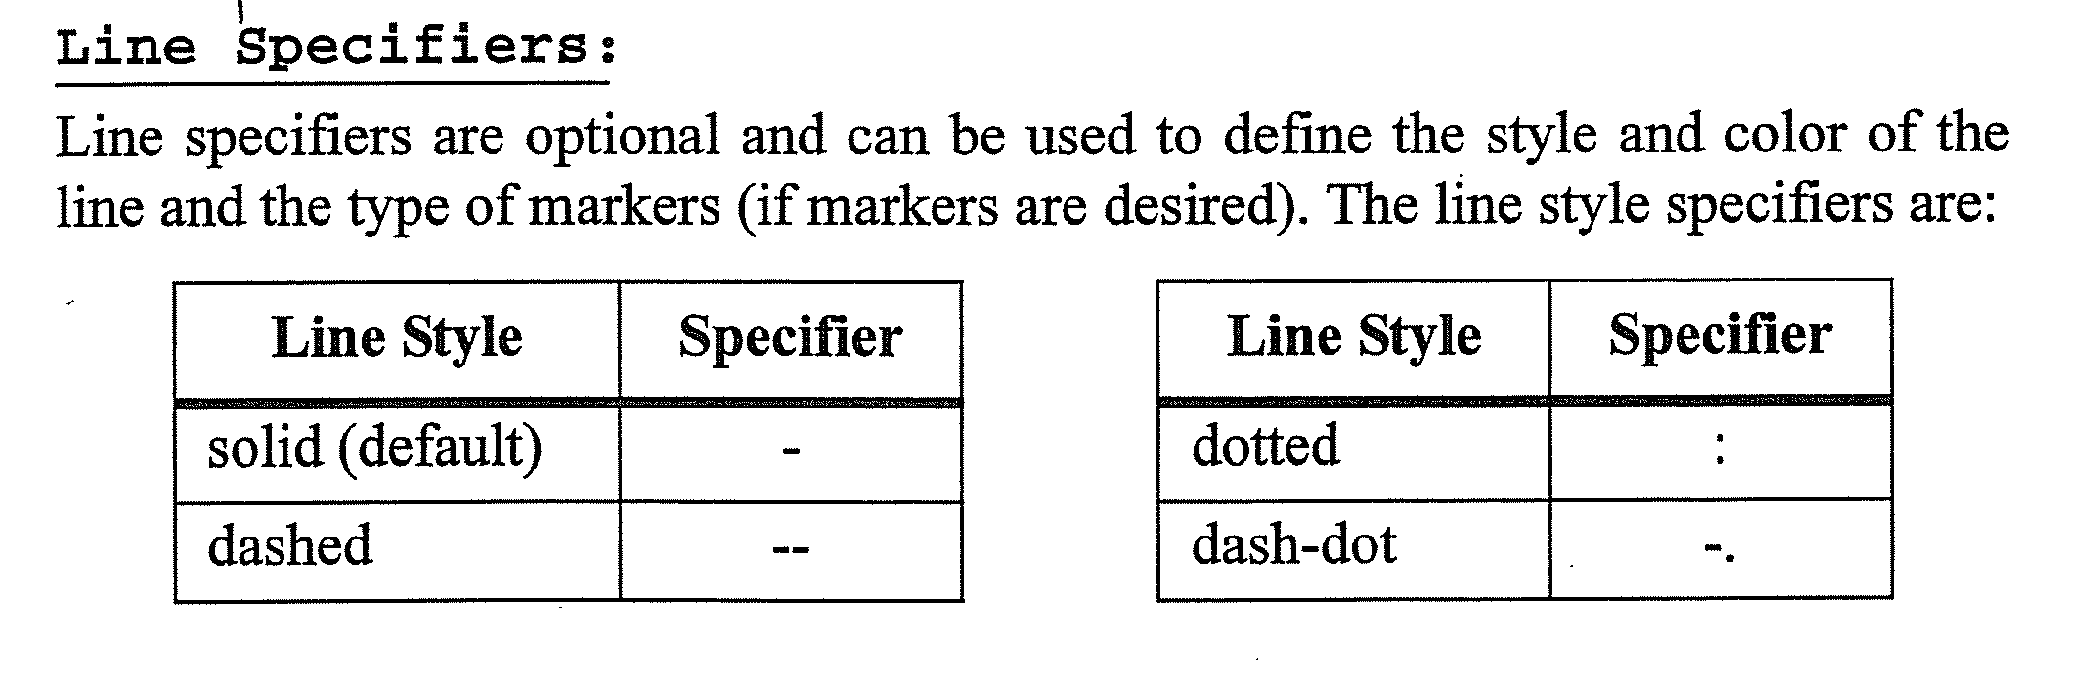
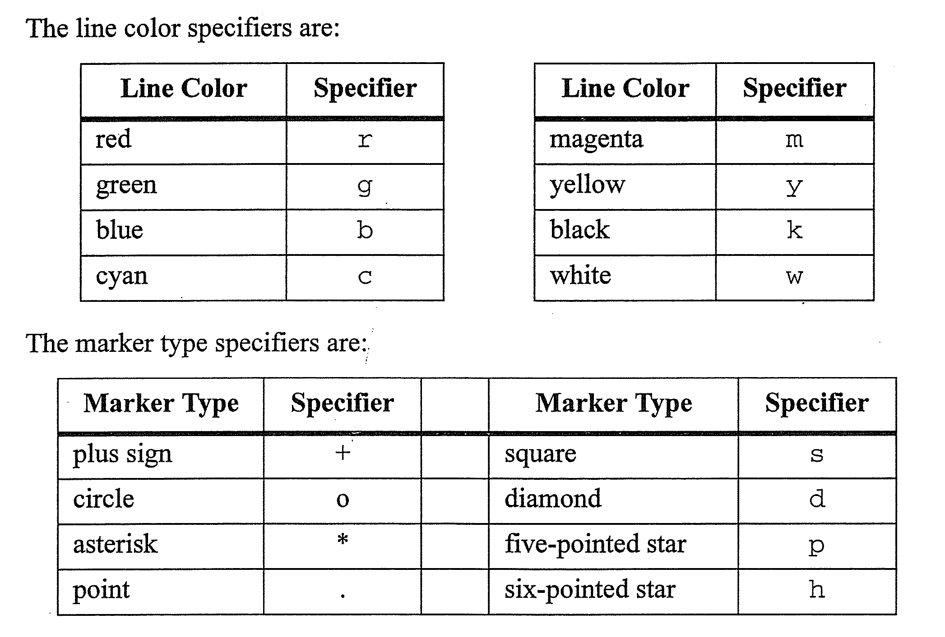

Slide 15
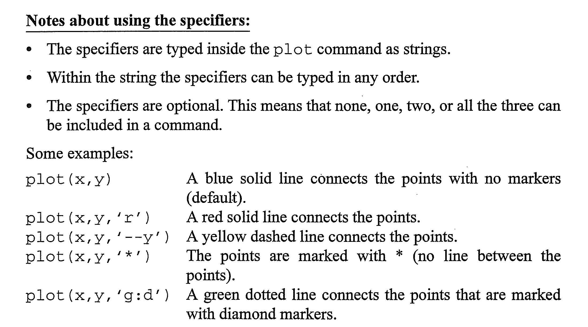

Slide 16
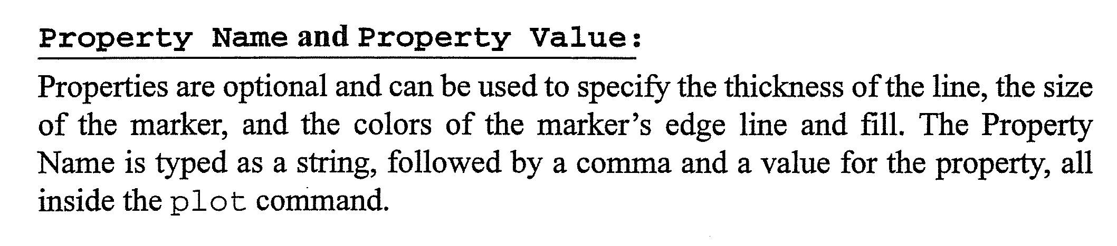
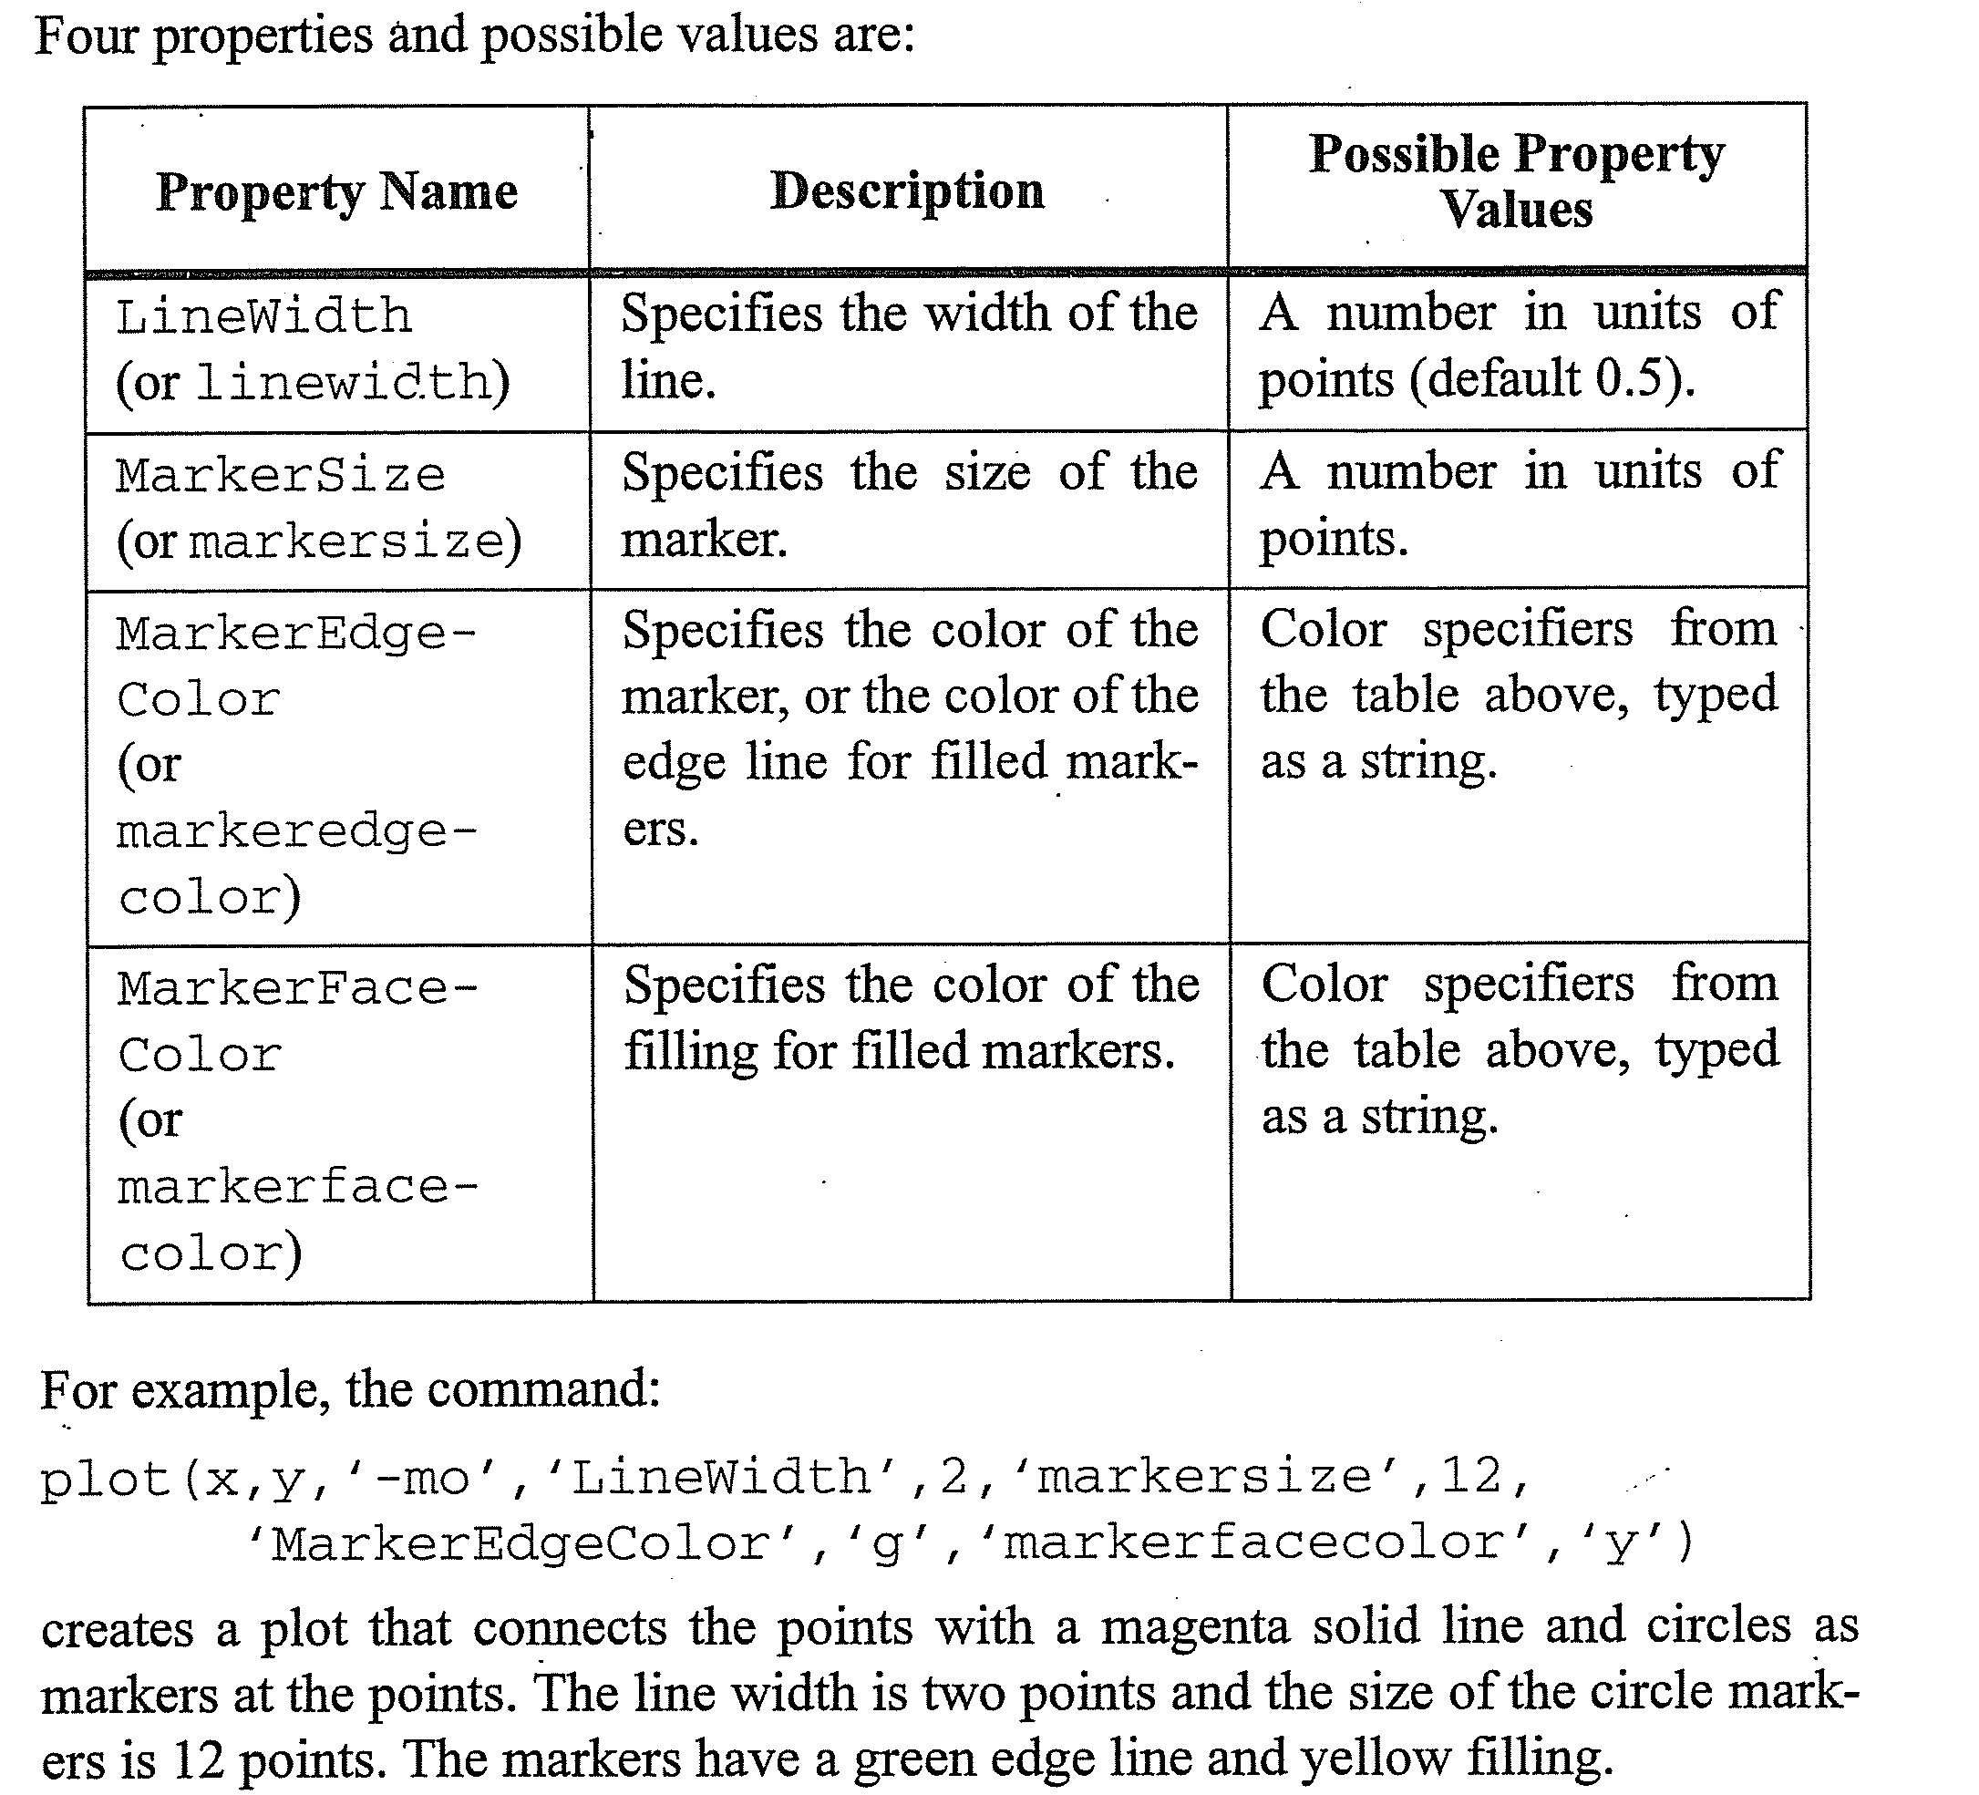

Slide 17
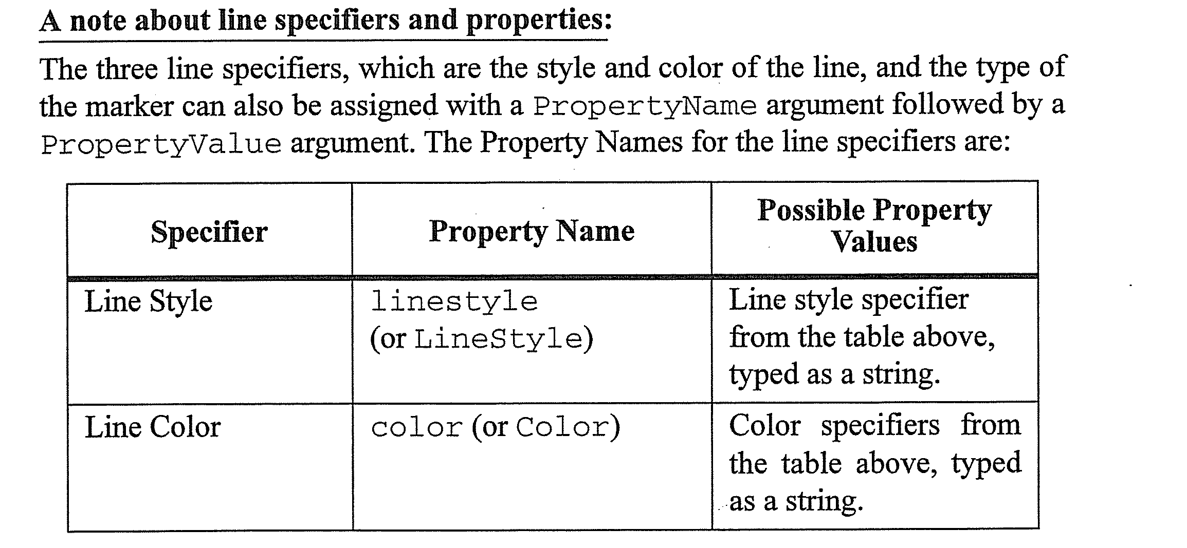
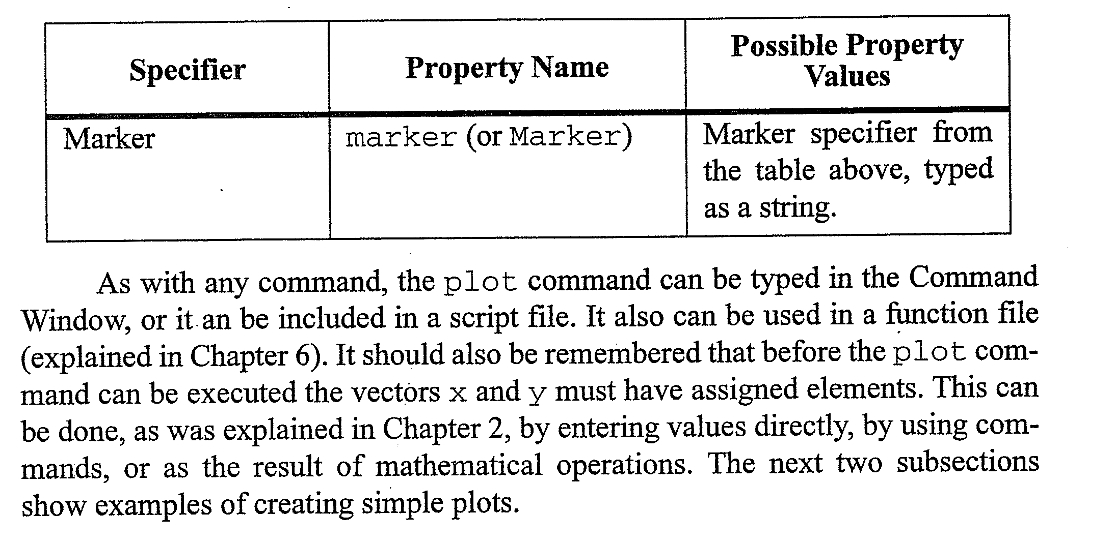

Slide 18
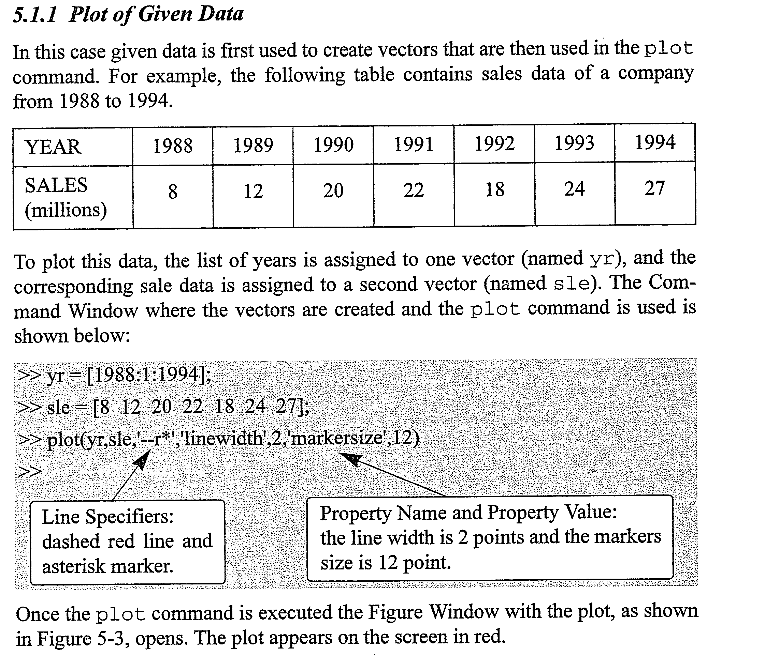

Slide 19
EXAMPLE 7: Plot the spring measles cases (plot multiple columns of an array)
Create a new cell in which you type and execute:

Slide 20
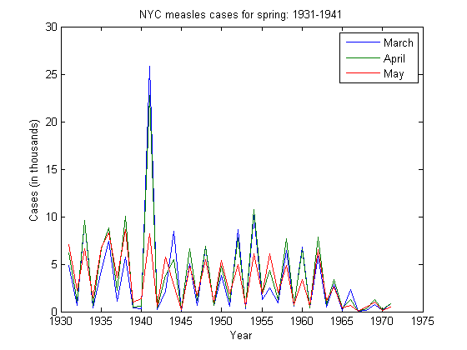
You should see a Figure Window with a single line graph:

Slide 21
SUMMARY OF SYNTAX

