Slide 1
Two Dimensional Plots-vol(4)
Prepared by Dr. Aysun GÜRAN

Slide 2
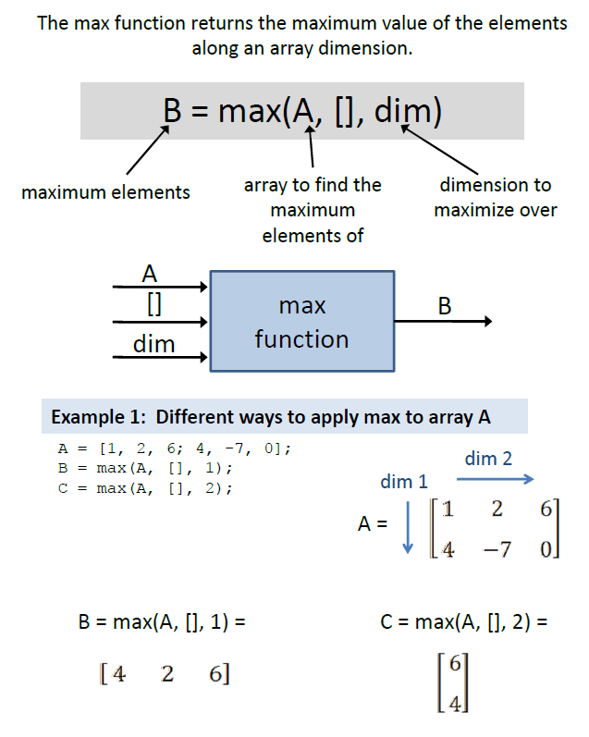
Matlab Max() Function

Slide 3
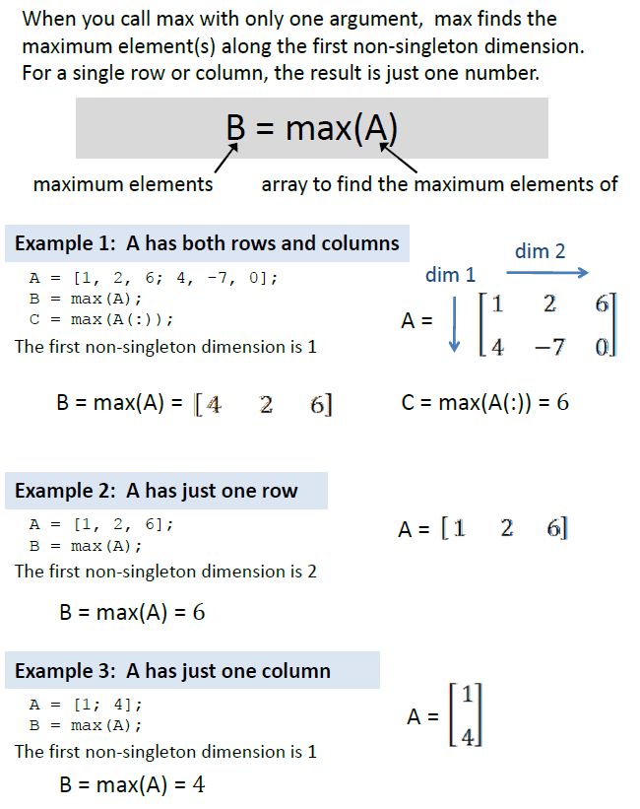
Matlab Max() Function

Slide 4
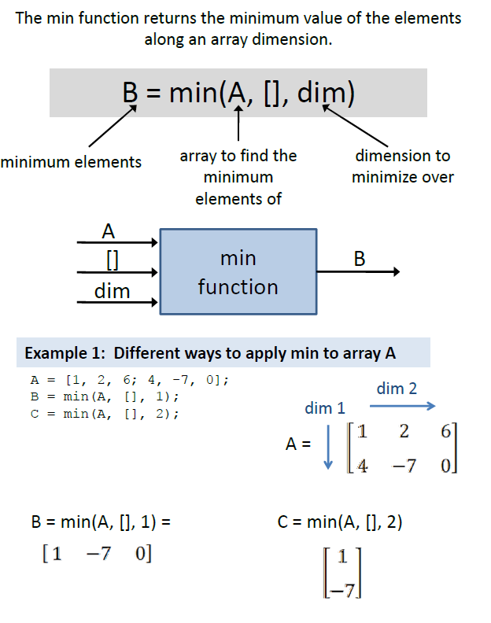
Matlab Min() Function

Slide 5
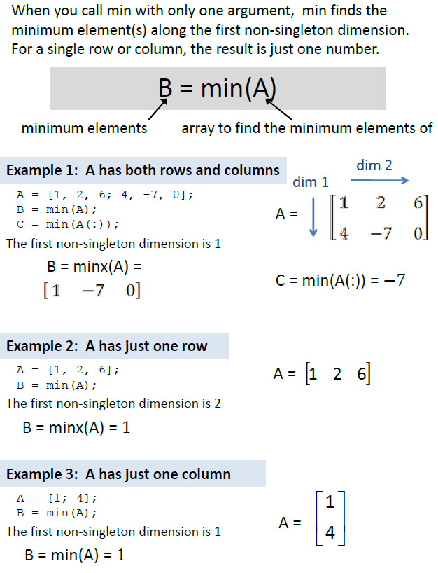
Matlab Min() Function

Slide 6
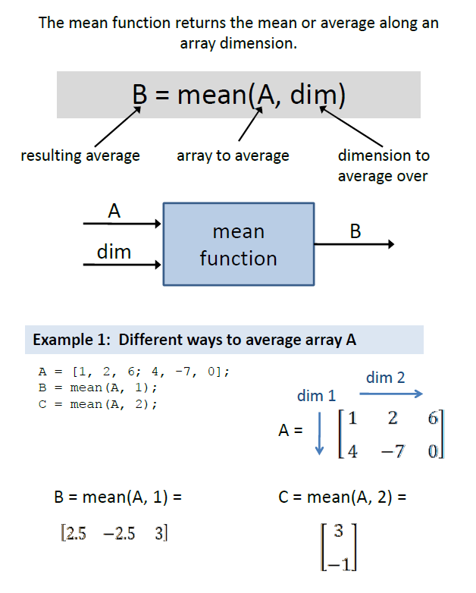
Matlab Mean() Function

Slide 7
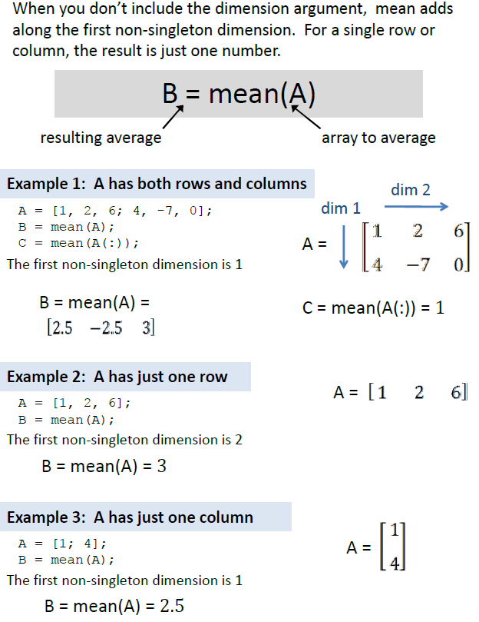
Matlab Mean() Function

Slide 8
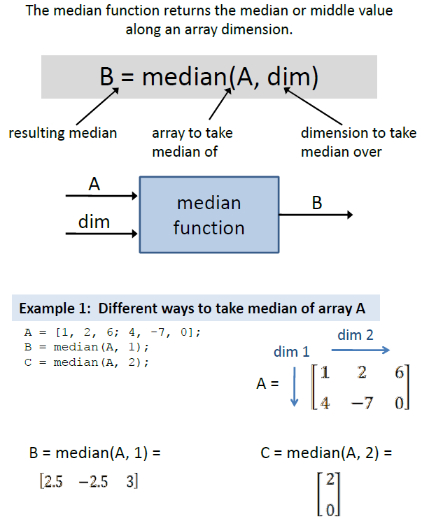
Matlab Median() Function

Slide 9
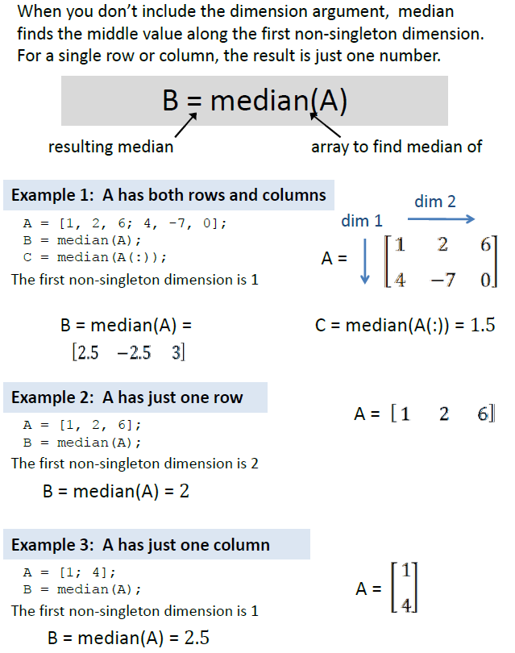
Matlab Median() Function

Slide 10
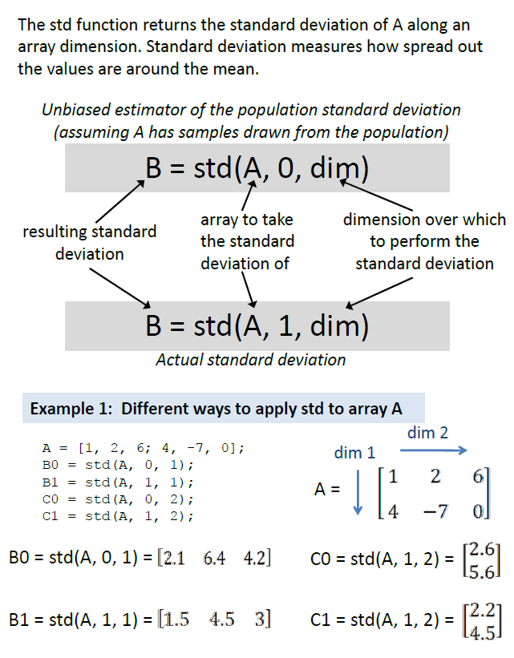
Matlab std() Function

Slide 11
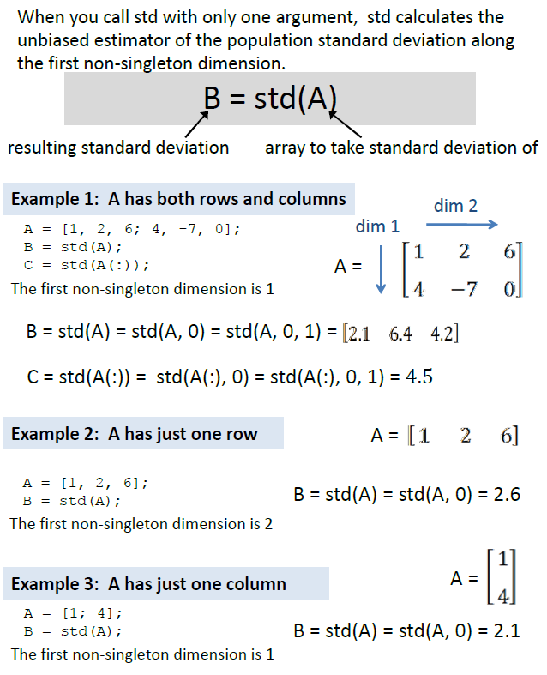
Matlab std() Function

Slide 12
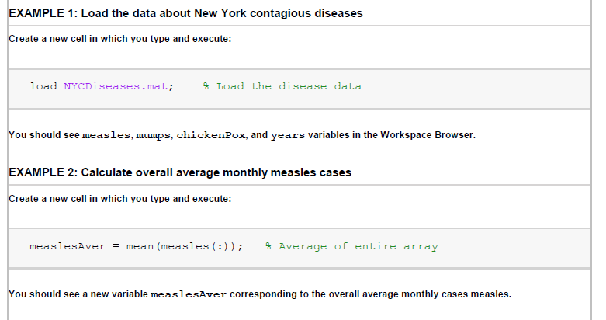


Slide 13
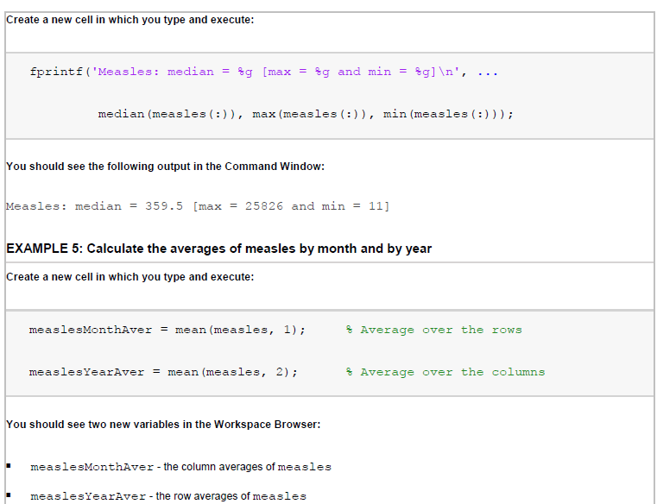

Slide 14
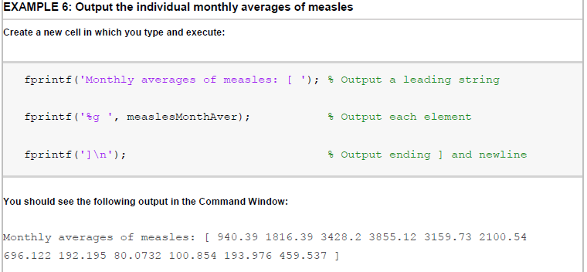

Slide 15



Slide 16
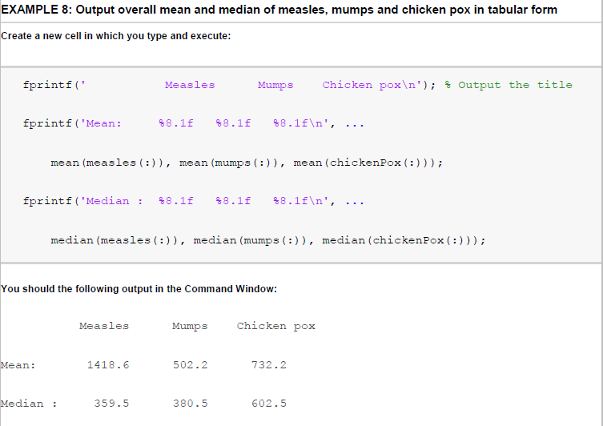

Slide 17

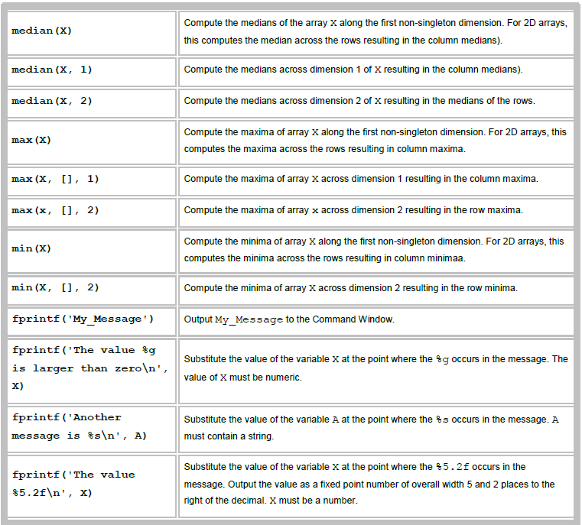

Slide 18

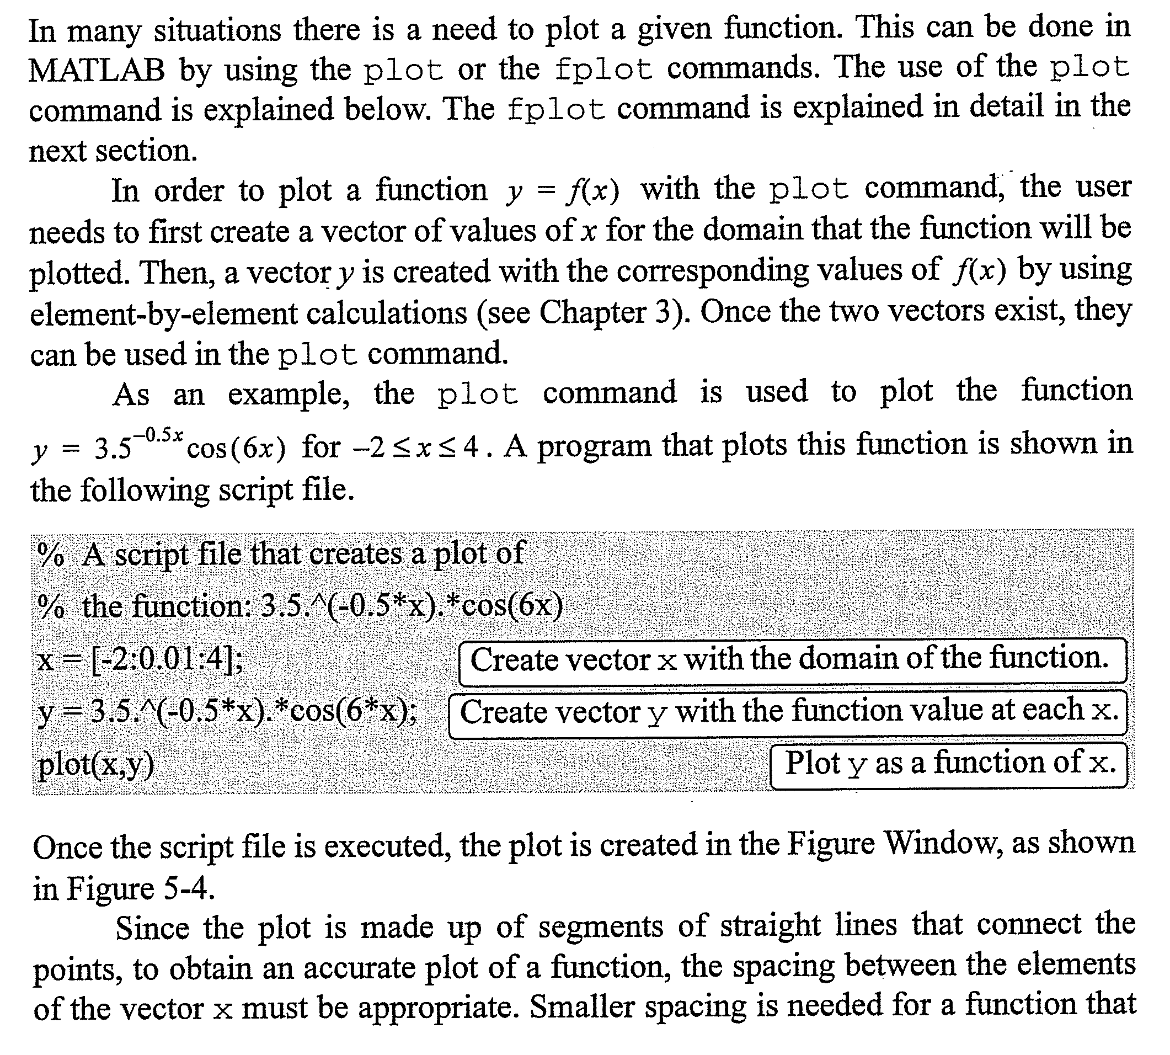

Slide 19
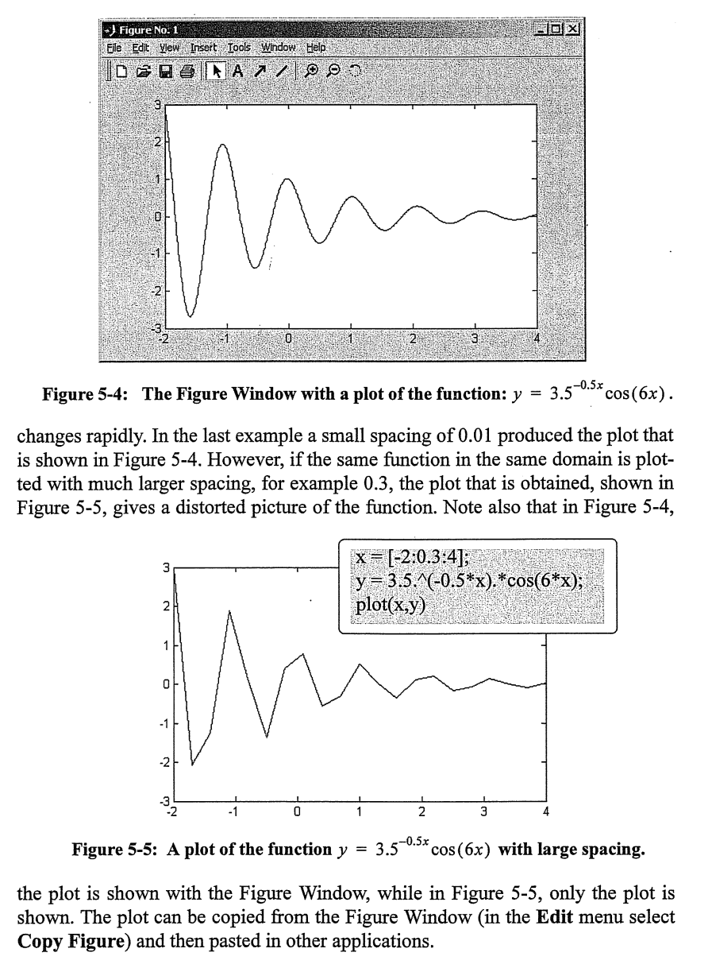

Slide 20

