Slide 1
Computer Programming with MATLAB (Control Statements)
Prepared by Dr. Aysun GÜRAN

Slide 2
Objectives
By the end of the session you should:
know the form of conditional expressions
know how to use the if-then-else statement to execute statements conditionally.

Slide 3
Conditional Expressions
We have seen a number of arithmetical expressions using operators such as +, – and *.
We can also create “logical” or “conditional” expressions using comparison and Boolean operators.
Such expressions always produce a numerical result that is either 1 for true expressions, or 0 for false expressions.
The comparison operators are
‘<’, ‘<=’, ‘==’, ‘>=’, ‘>’ and ‘~=’.
The Boolean operators are ‘&’ (and), ‘|’ (or), ‘~’ (not).
You can use parentheses to bracket expressions to force an evaluation order. For example:

Slide 4
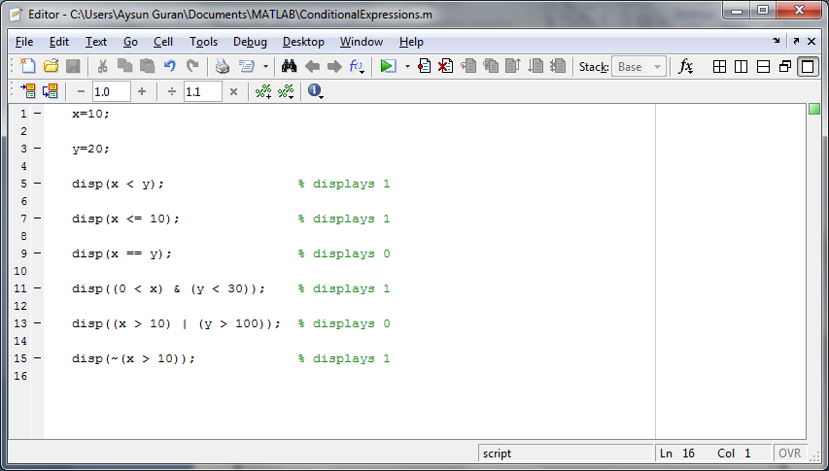
Example:

Slide 5
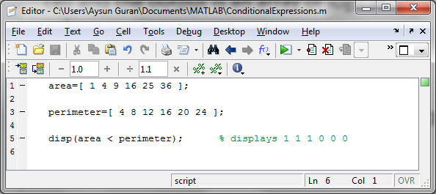
You can even perform logical operations on arrays. The operations are performed cell-by-cell and the output is an array of logical values:

Slide 6
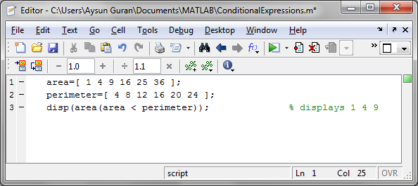
Finally, you can use a logical array to select elements from a numerical array. Cells from the numerical array that match true values in the logical array are extracted. Just use the logical array in the place of the subscript operator, e.g.:

Slide 7
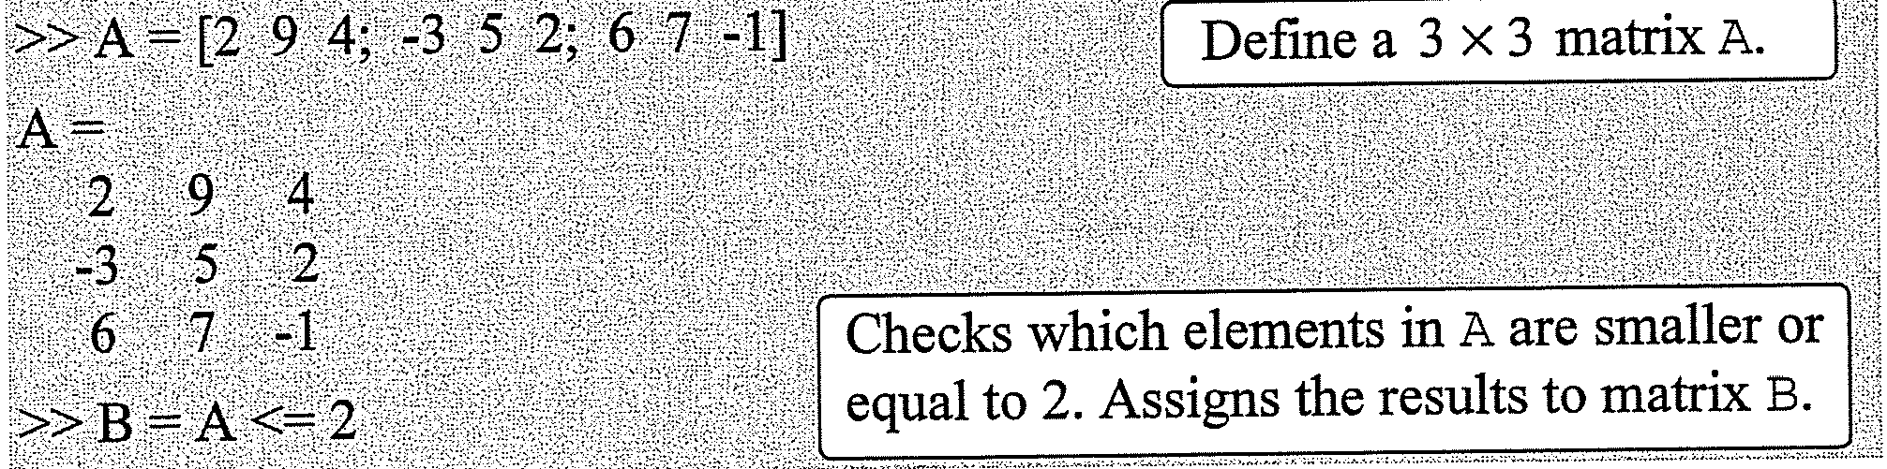
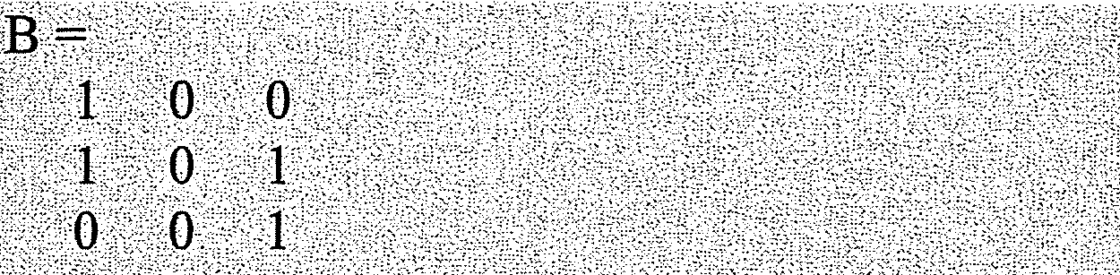
Examples

Slide 8
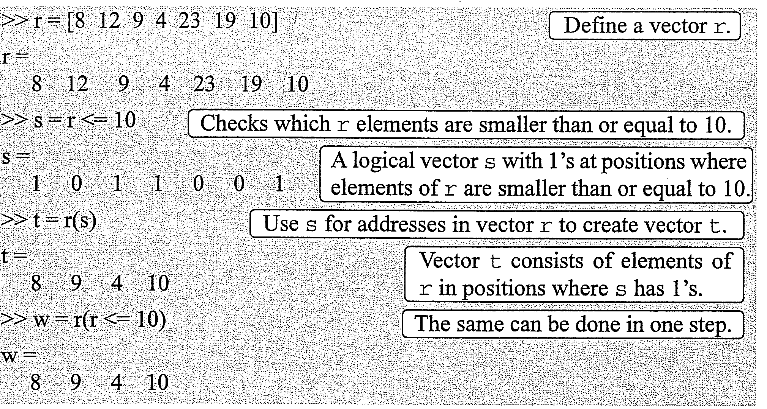
Examples

Slide 9
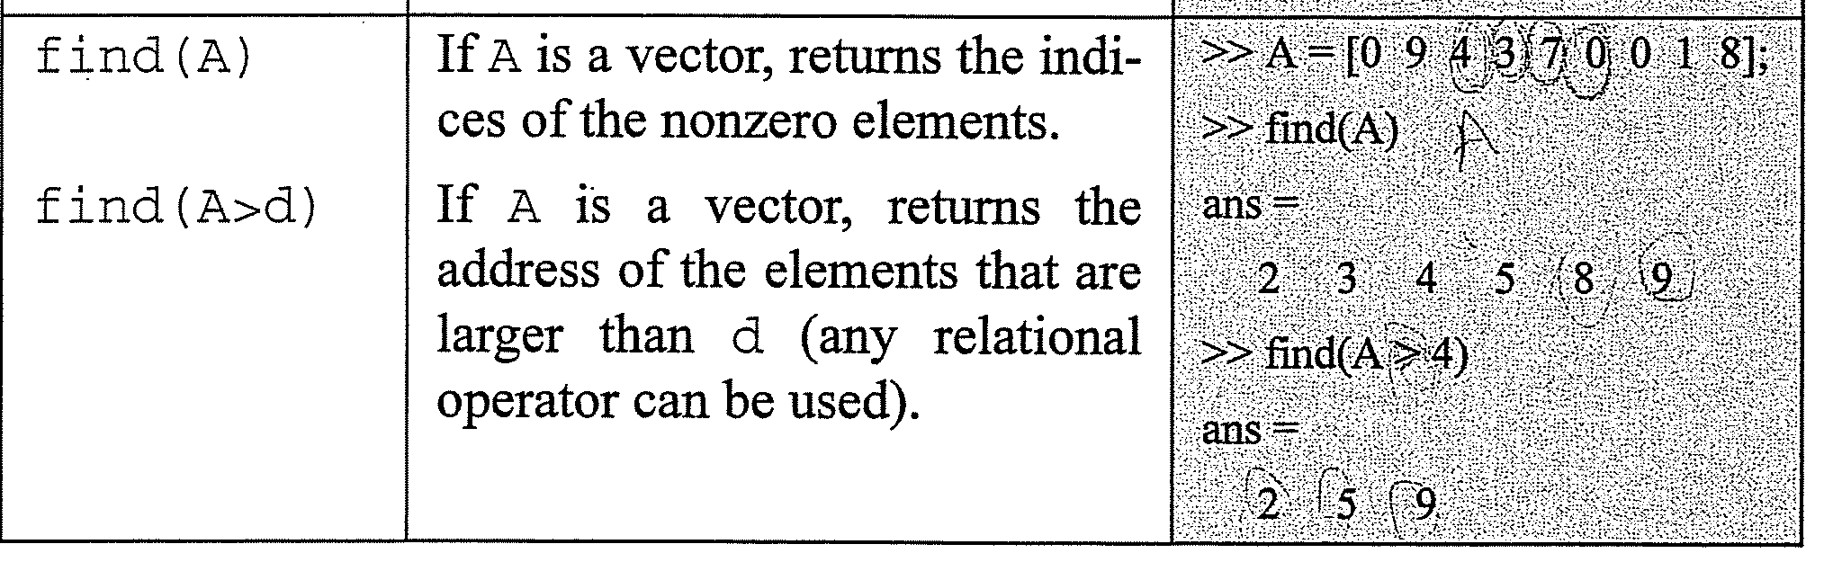
About the find() function

Slide 10

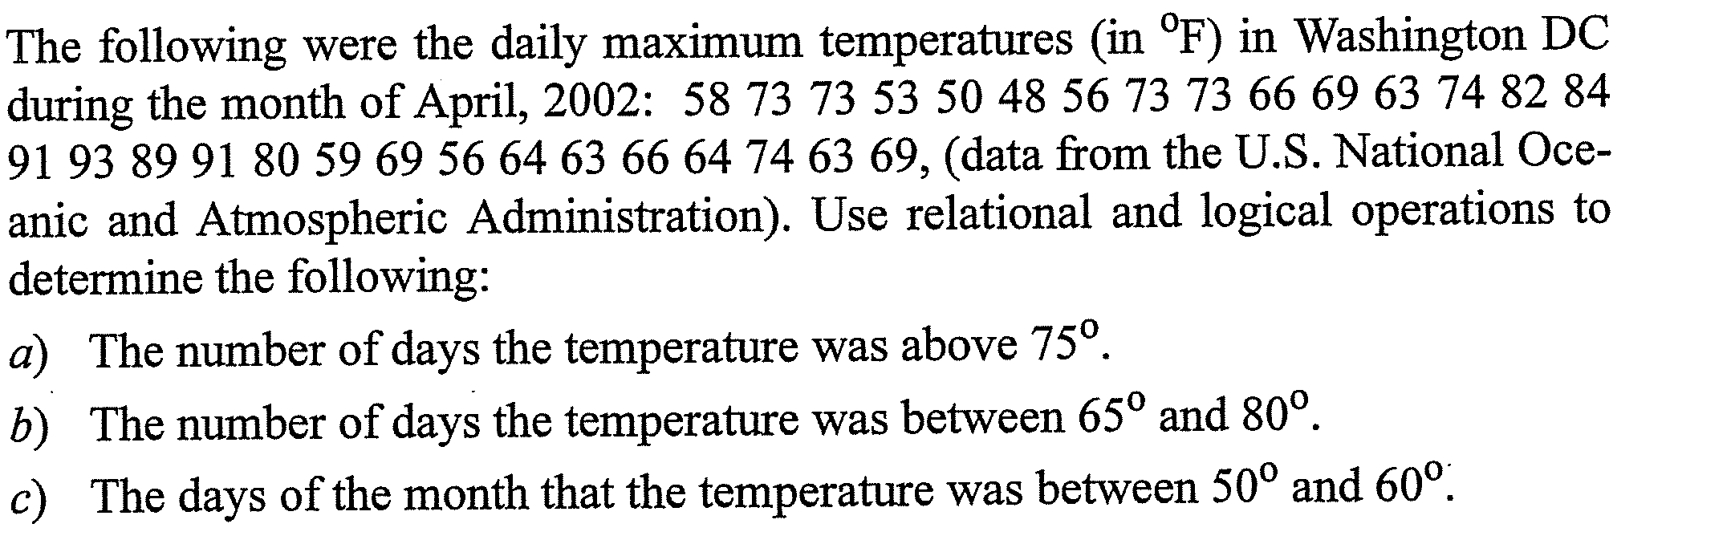

Slide 11
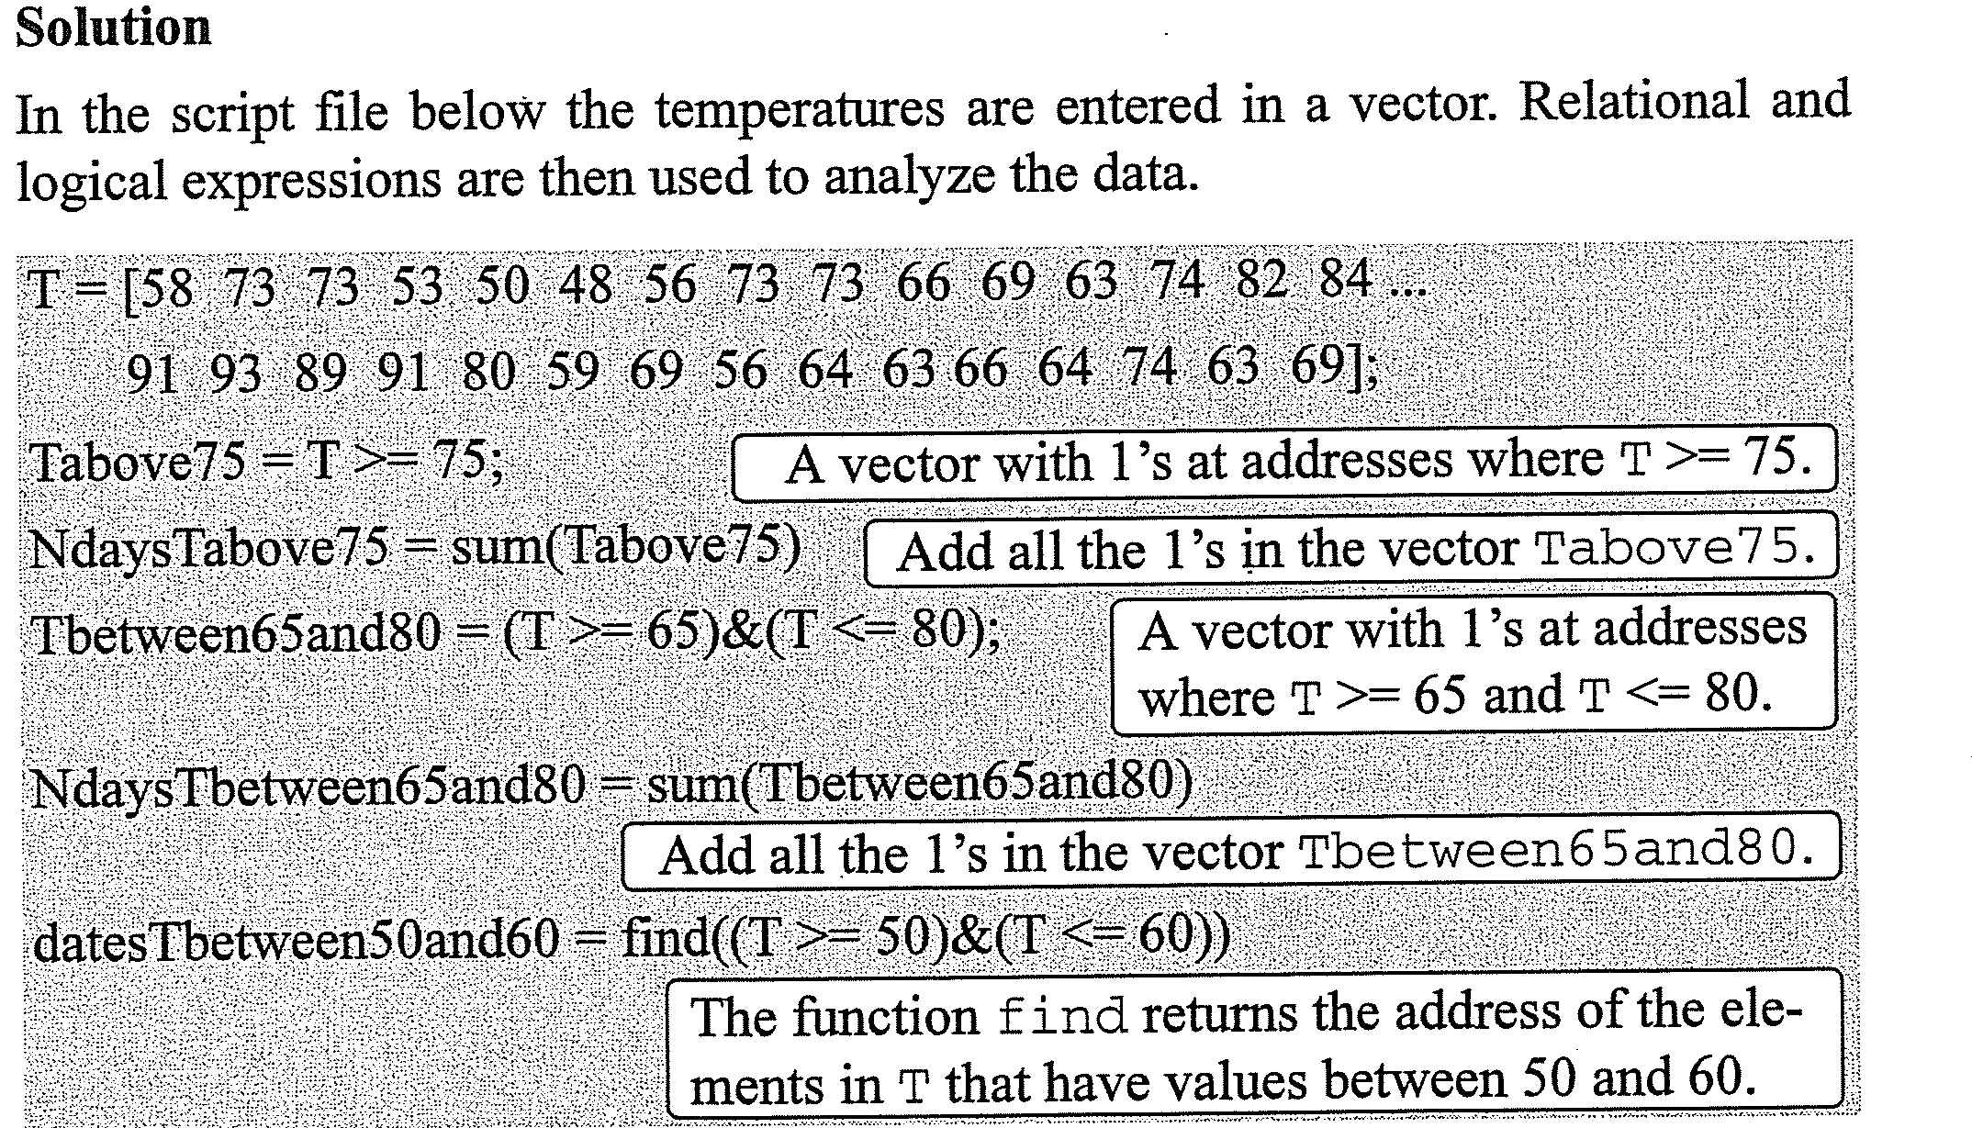

Slide 12
If Statement
In the programs we have written so far, every statement is executed every time the program is run. The conditional statement ‘if condition statement end’ only executes the statement if the condition evaluates to true. The condition should be a logical expression evaluating to true or false. For example:

Slide 13
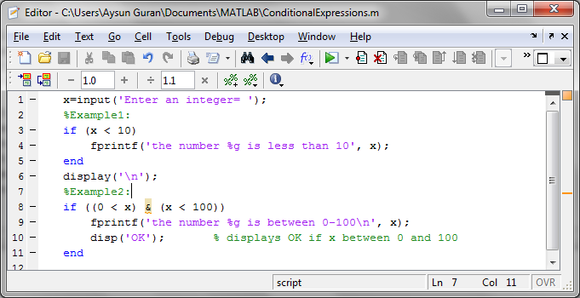
Example:

Slide 14
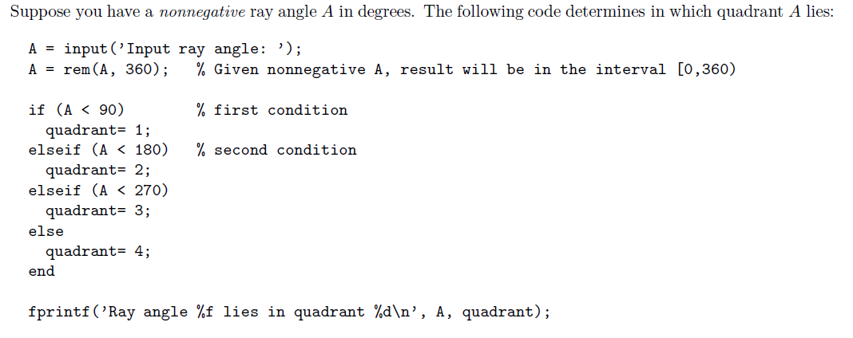
Example:

Slide 15
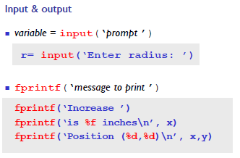
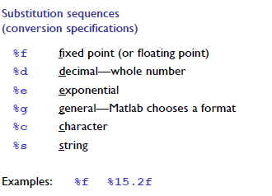

Slide 16
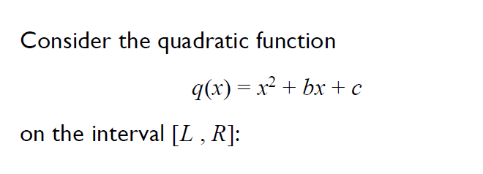
Example

Slide 17
% Find min of q(x)=x^2+bx+c given b,c and random L,R. Plot the function.
close all; % clear all previous figures
b= 2; c= -1.5; % coefficients of q(x)
L= rand*10 - 8; % left end of interval, random in (-8,2)
R= L + 1 + rand*10; % right end of interval, random in (-7,13)
xc = -b/2; % critical value
if (L<=xc && xc<=R)
qMin= -b*b/4+c; % q(xc)
xMin= xc;
else
qL= L*L + b*L + c; % q(L)
qR= R*R + b*R + c; % q(R)
if (qL < qR)
qMin= qL;
xMin= L;
else
qMin= qR;
xMin= R;
end
end
disp('Quadratic function q(x) = x^2 + bx + c')
fprintf(' b=%.2f c=%.2f\n', b,c)
fprintf('The minimum value in [%.2f,%.2f] is %.4f\n\n', L,R,qMin)
% Plot the graph (just for fun)
xvector= linspace(L, R);
qvector= xvector.^2 + b*xvector + c;
plot(xvector,qvector, xMin,qMin,'o')
title(sprintf('q(x) from x=%.1f to x=%.1f', L, R))

Slide 18
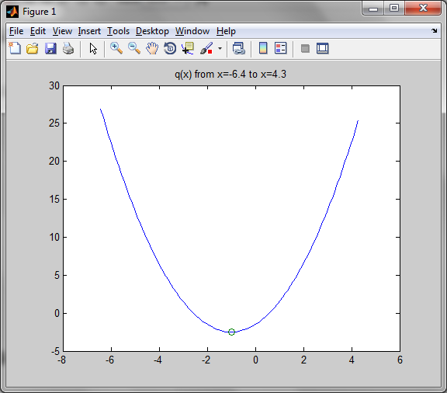
Output

Slide 19
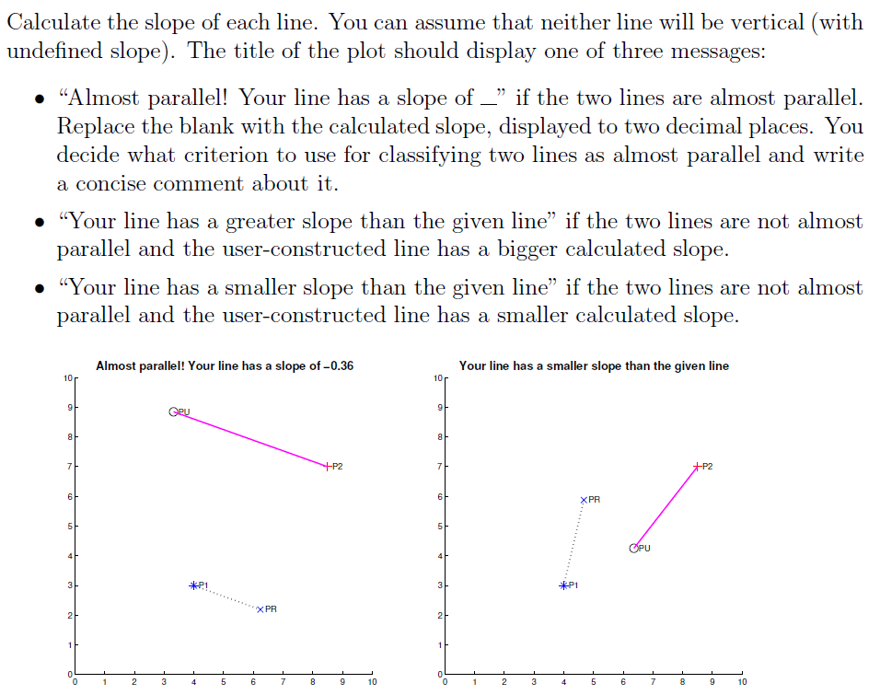
Example

Slide 20
% Script pLines
% Determine whether two lines are parallel.
% Set up the window
close all % Close all previous figure windows
figure % Start a new figure window
hold on % Keep the same set of axes (multiple plots on same axes)
axis equal % unit lengths on x- and y-axis are equal
axis([0 10 0 10]) % x-axis limits [0,10], y-axis limits [0,10]
% First point
x1=4; y1=3;
plot(x1, y1, 'b*')
text(x1, y1, ' P1')
%%% Do not change the code above %%%
%%%%%%%%%%%%%%%%%%%%%%%%%%%%%%%%%%%%
%%% Modify the code below %%%%%%%%%%
% Second point
x2=8.5; y2=7;
plot(x2, y2, 'r+')
text(x2, y2, ' P2')
% Random point, connected to P1
xr= rand*6+2;
yr= rand*6+2;
plot(xr, yr, 'bx')
text(xr, yr, ' PR')
plot([xr x1],[yr y1],'k:')

Slide 21
% User-clicked point, connected to P2
title('Click on the plot below')
[xu, yu]= ginput(1);
plot(xu, yu, 'ko')
text(xu, yu, ' PU')
plot([xu x2],[yu y2],'m-')
% Compare the slope of the lines
slope1r= (y1-yr)/(x1-xr);
slope2u= (y2-yu)/(x2-xu);
tol= 0.2; % Simple tolerance for the slopes of the lines.
% Relative difference would be a better criterion.
% This criterion does not work well for two almost vertical
% lines with opposite slopes (signs).
if abs(slope1r-slope2u) < tol
mess= sprintf('Almost parallel! Your line has a slope of %.2f', ...
slope2u);
elseif slope2u > slope1r
mess= sprintf('Your line has a greater slope value than the given line');
else
mess= sprintf('Your line has a smaller slope value than the given line');
end
title(mess)
%%%%%%%%%%%%%%%%%%%%%%%%%%%%%%%%%%%%
%%% Do not change the code below %%%
hold off

Slide 22
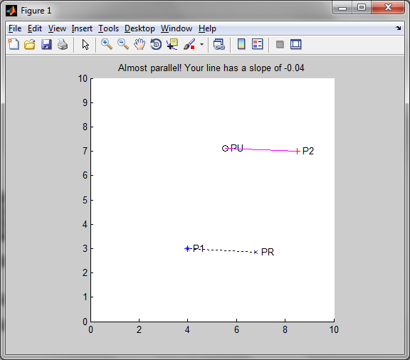
Output

