Slide 1
Loops
Prepared By Dr. Aysun GÜRAN

Slide 2

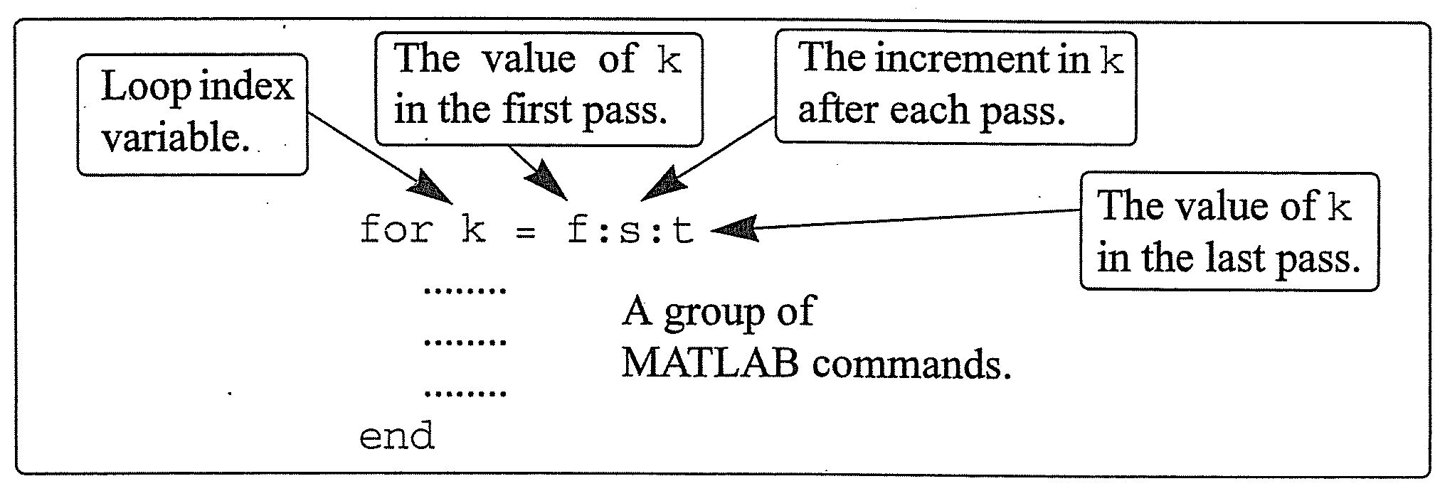
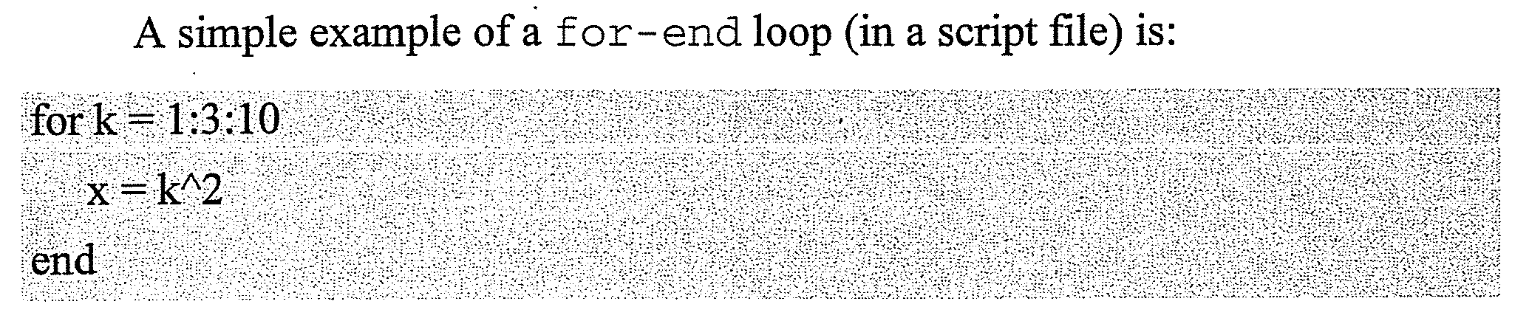

Slide 3

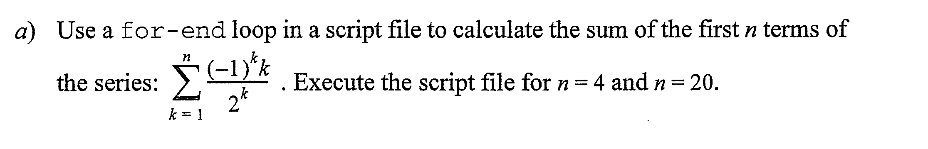

Slide 4
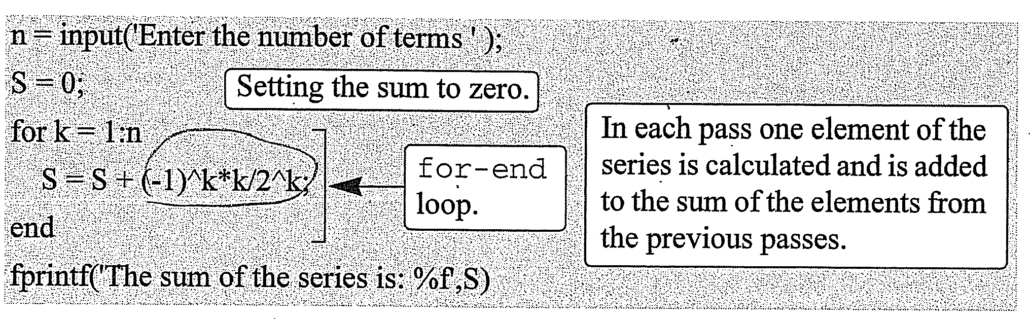
Solution

Slide 5

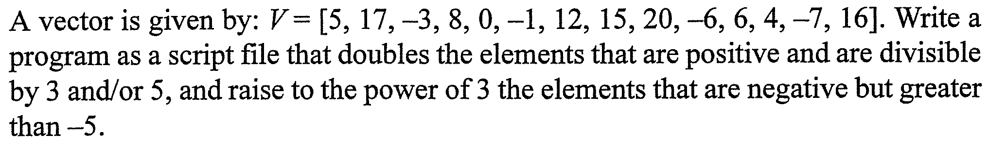
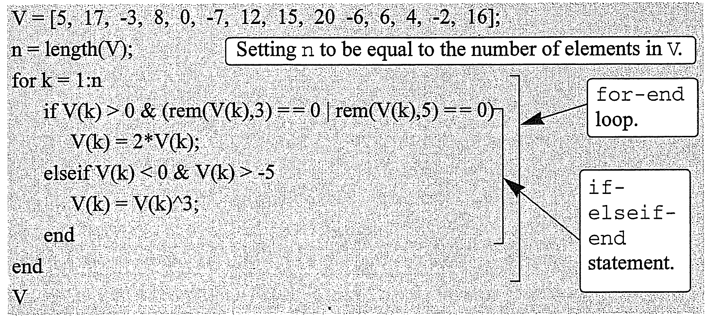

Slide 6

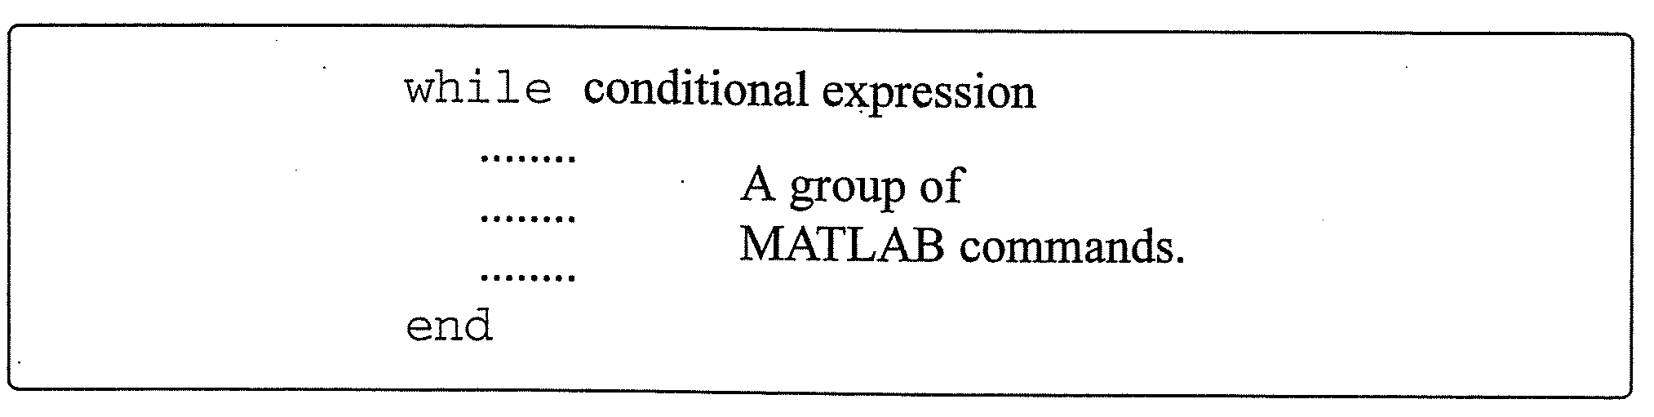
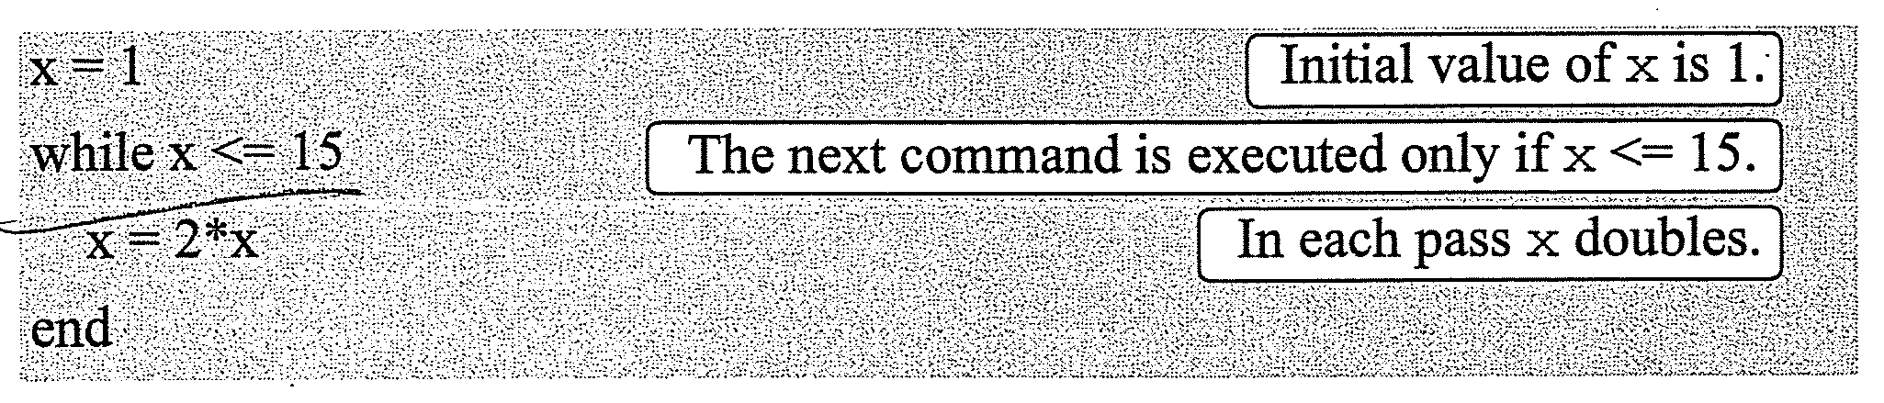

Slide 7

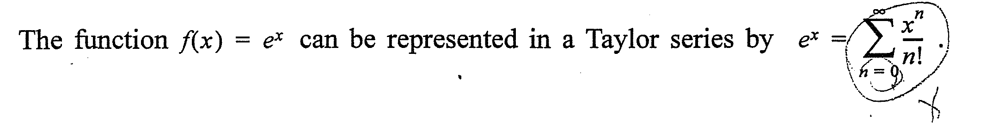
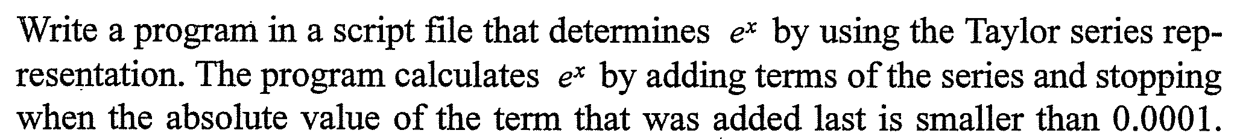
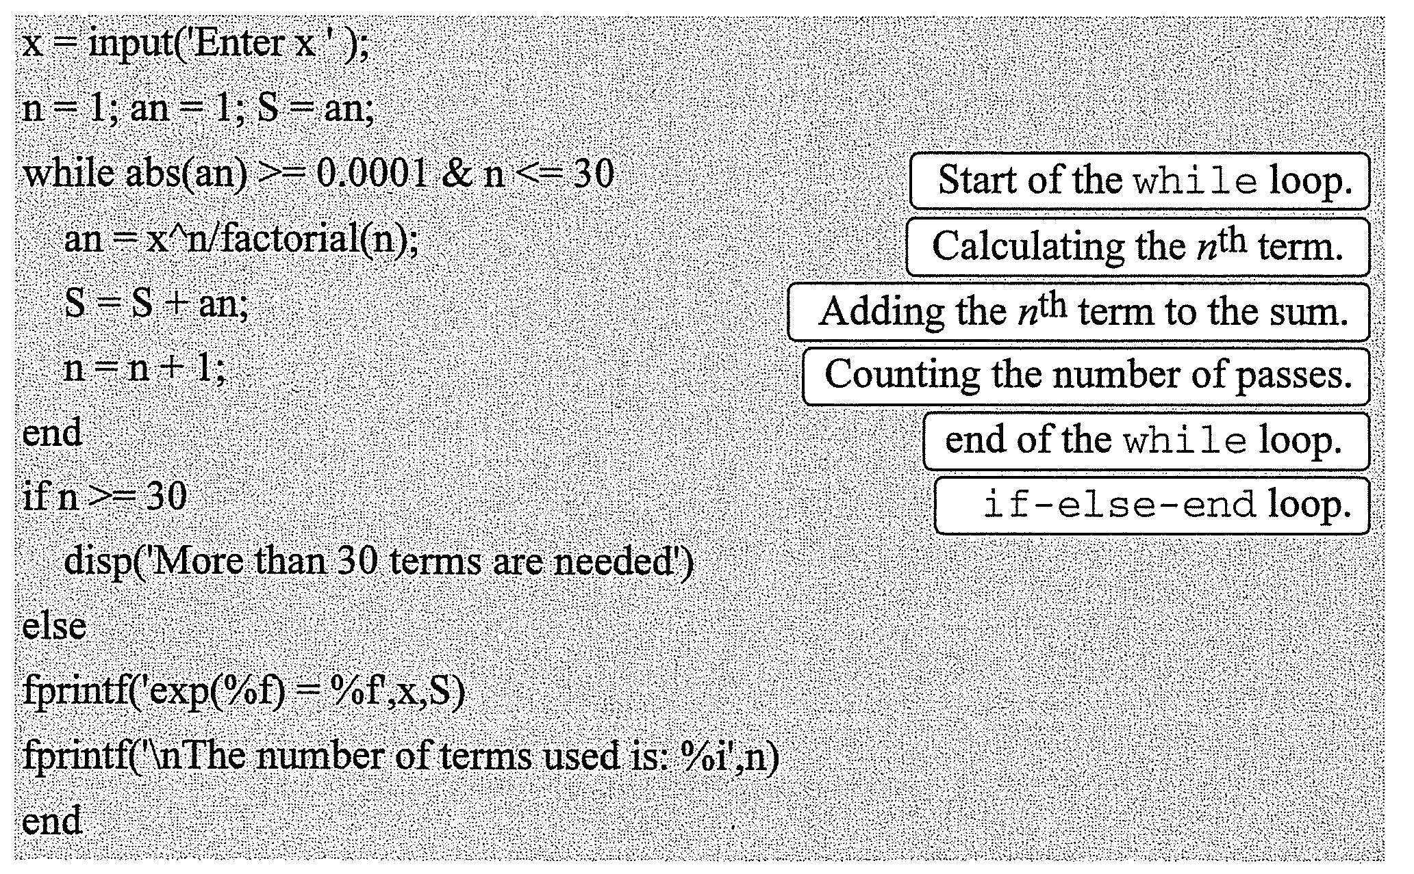

Slide 8
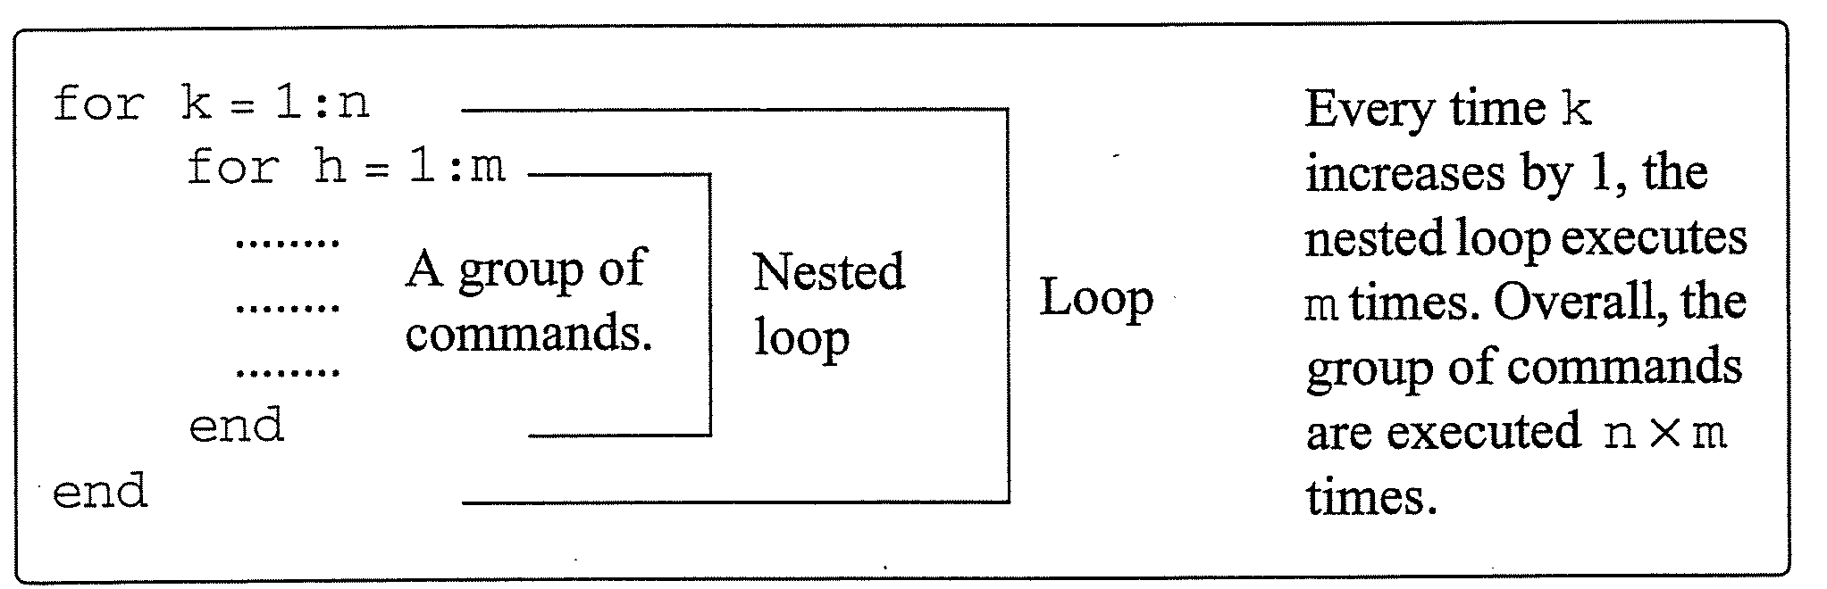

Slide 9

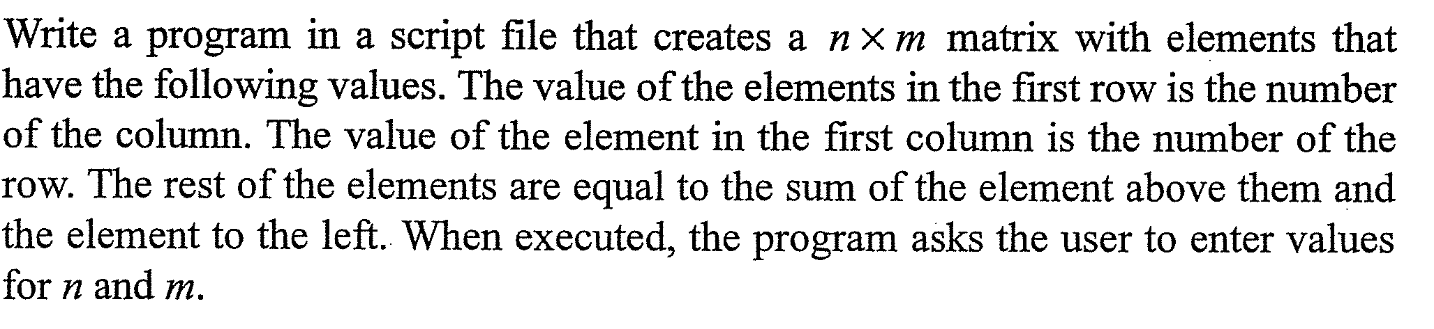

Slide 10
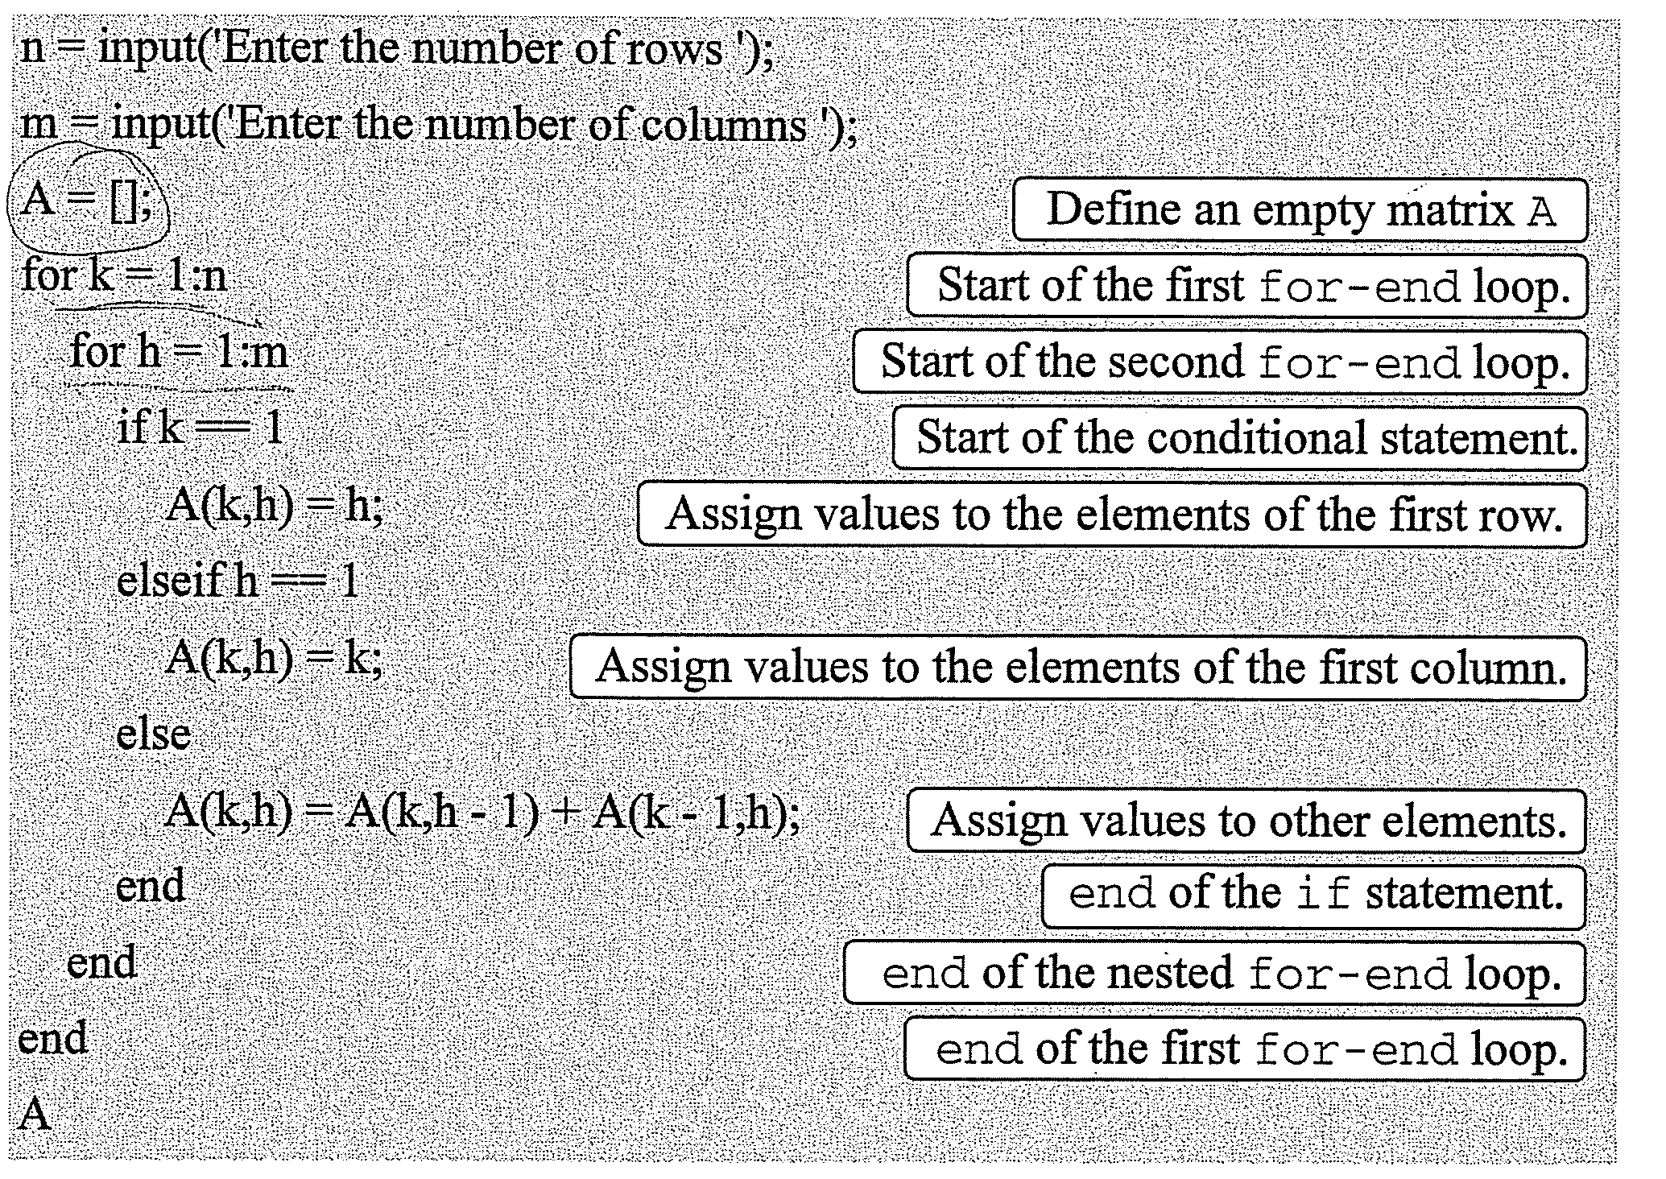

Slide 11
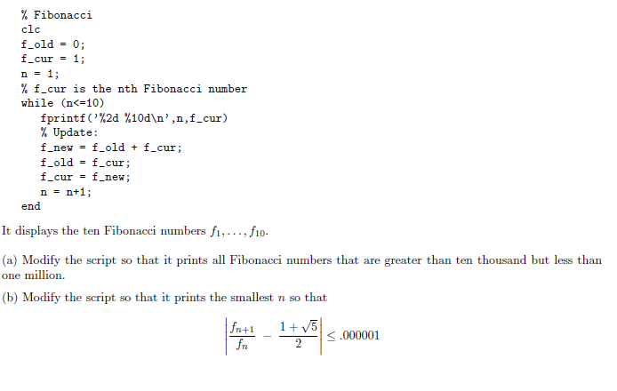
Example

Slide 12
% Solutions to questions on Fibonacci numbers
%%%%%%%%%%%%%%%%%%%%%%%%%%%%%%%%%%%%%
% Part (a)...
clc
disp('All Fibonacci numbers bigger than 10000 but less than 1000000.')
disp(' ')
f_old = 0; f_cur = 1; n = 1;
% f_cur is always the nth Fibonacci number
while (f_cur < 1000000)
if f_cur>10000
% Only print the current fibonacci number if it is bigger than 10000
fprintf('%2d %10d\n',n,f_cur)
end
% Update:
f_new = f_old + f_cur;
f_old = f_cur;
f_cur = f_new;
n = n+1;
end
pause
%%%%%%%%%%%%%%%%%%%%%%%%%%%%%%%%%
% Part (b)
clc
disp('Part (b):' )
disp(' ')
f_old = 1; f_cur = 1; n = 1;
% f_cur is always the nth Fibonacci number
% f_cur + f_old is always the n+1st Fibonacci number.
while ( abs( ((f_cur+f_old)/f_cur) -(1+sqrt(5))/2 ) >.000001 )
% Update:
f_new = f_old + f_cur;
f_old = f_cur;
f_cur = f_new;
n = n+1;
end
fprintf('n = %1d\n\n\n',n)
%%%%%%%%%%%%%%%%%%%%%%%%%%%%%%%%%%%%%

Slide 13

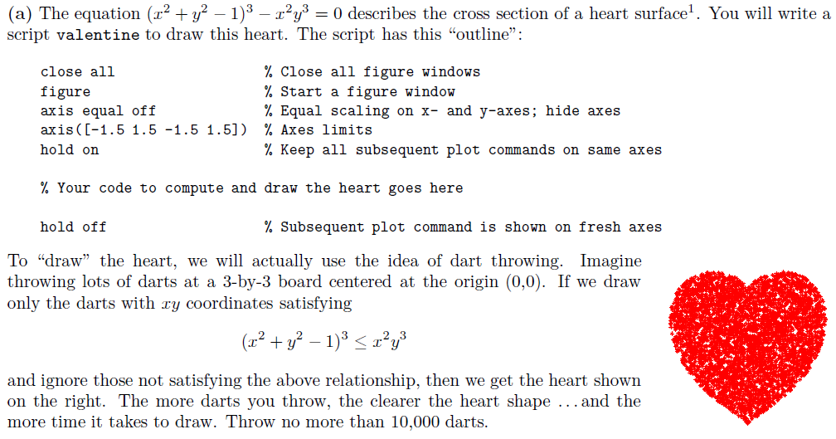

Slide 14
Solution a)
close all
figure
axis equal off
xlo= -1.5; xhi= 1.5;
ylo= -1.5; yhi= 1.5;
axis([xlo xhi ylo yhi])
hold on
% Draw heart by random dart throws
N= 10000;
for k= 1:N
x= rand(1)*3-1.5;
y= rand(1)*2.8-1.2;
xSquared= x^2;
ySquared= y^2;
if (xSquared+ySquared-1)^3 <= xSquared*ySquared*y
plot(x,y,'r*')
end
end

Slide 15
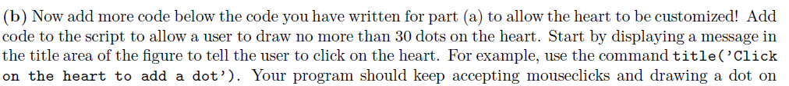
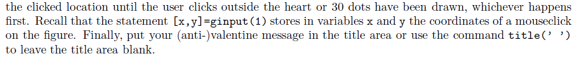


Slide 16
Solution b)
%continue from the previous code...
% Customize heart by allowing up to 30 clicks
title('Click inside the heart')
maxDots= 30;
[x,y]= ginput(1);
k= 1;
while k<=maxDots && (x^2+y^2-1)^3 < (x^2)*(y^3)
plot(x,y,'yo','MarkerFacecolor','y','MarkerSize',20)
[x,y]= ginput(1);
k= k+1;
end
title('')
hold off

