Slide 1

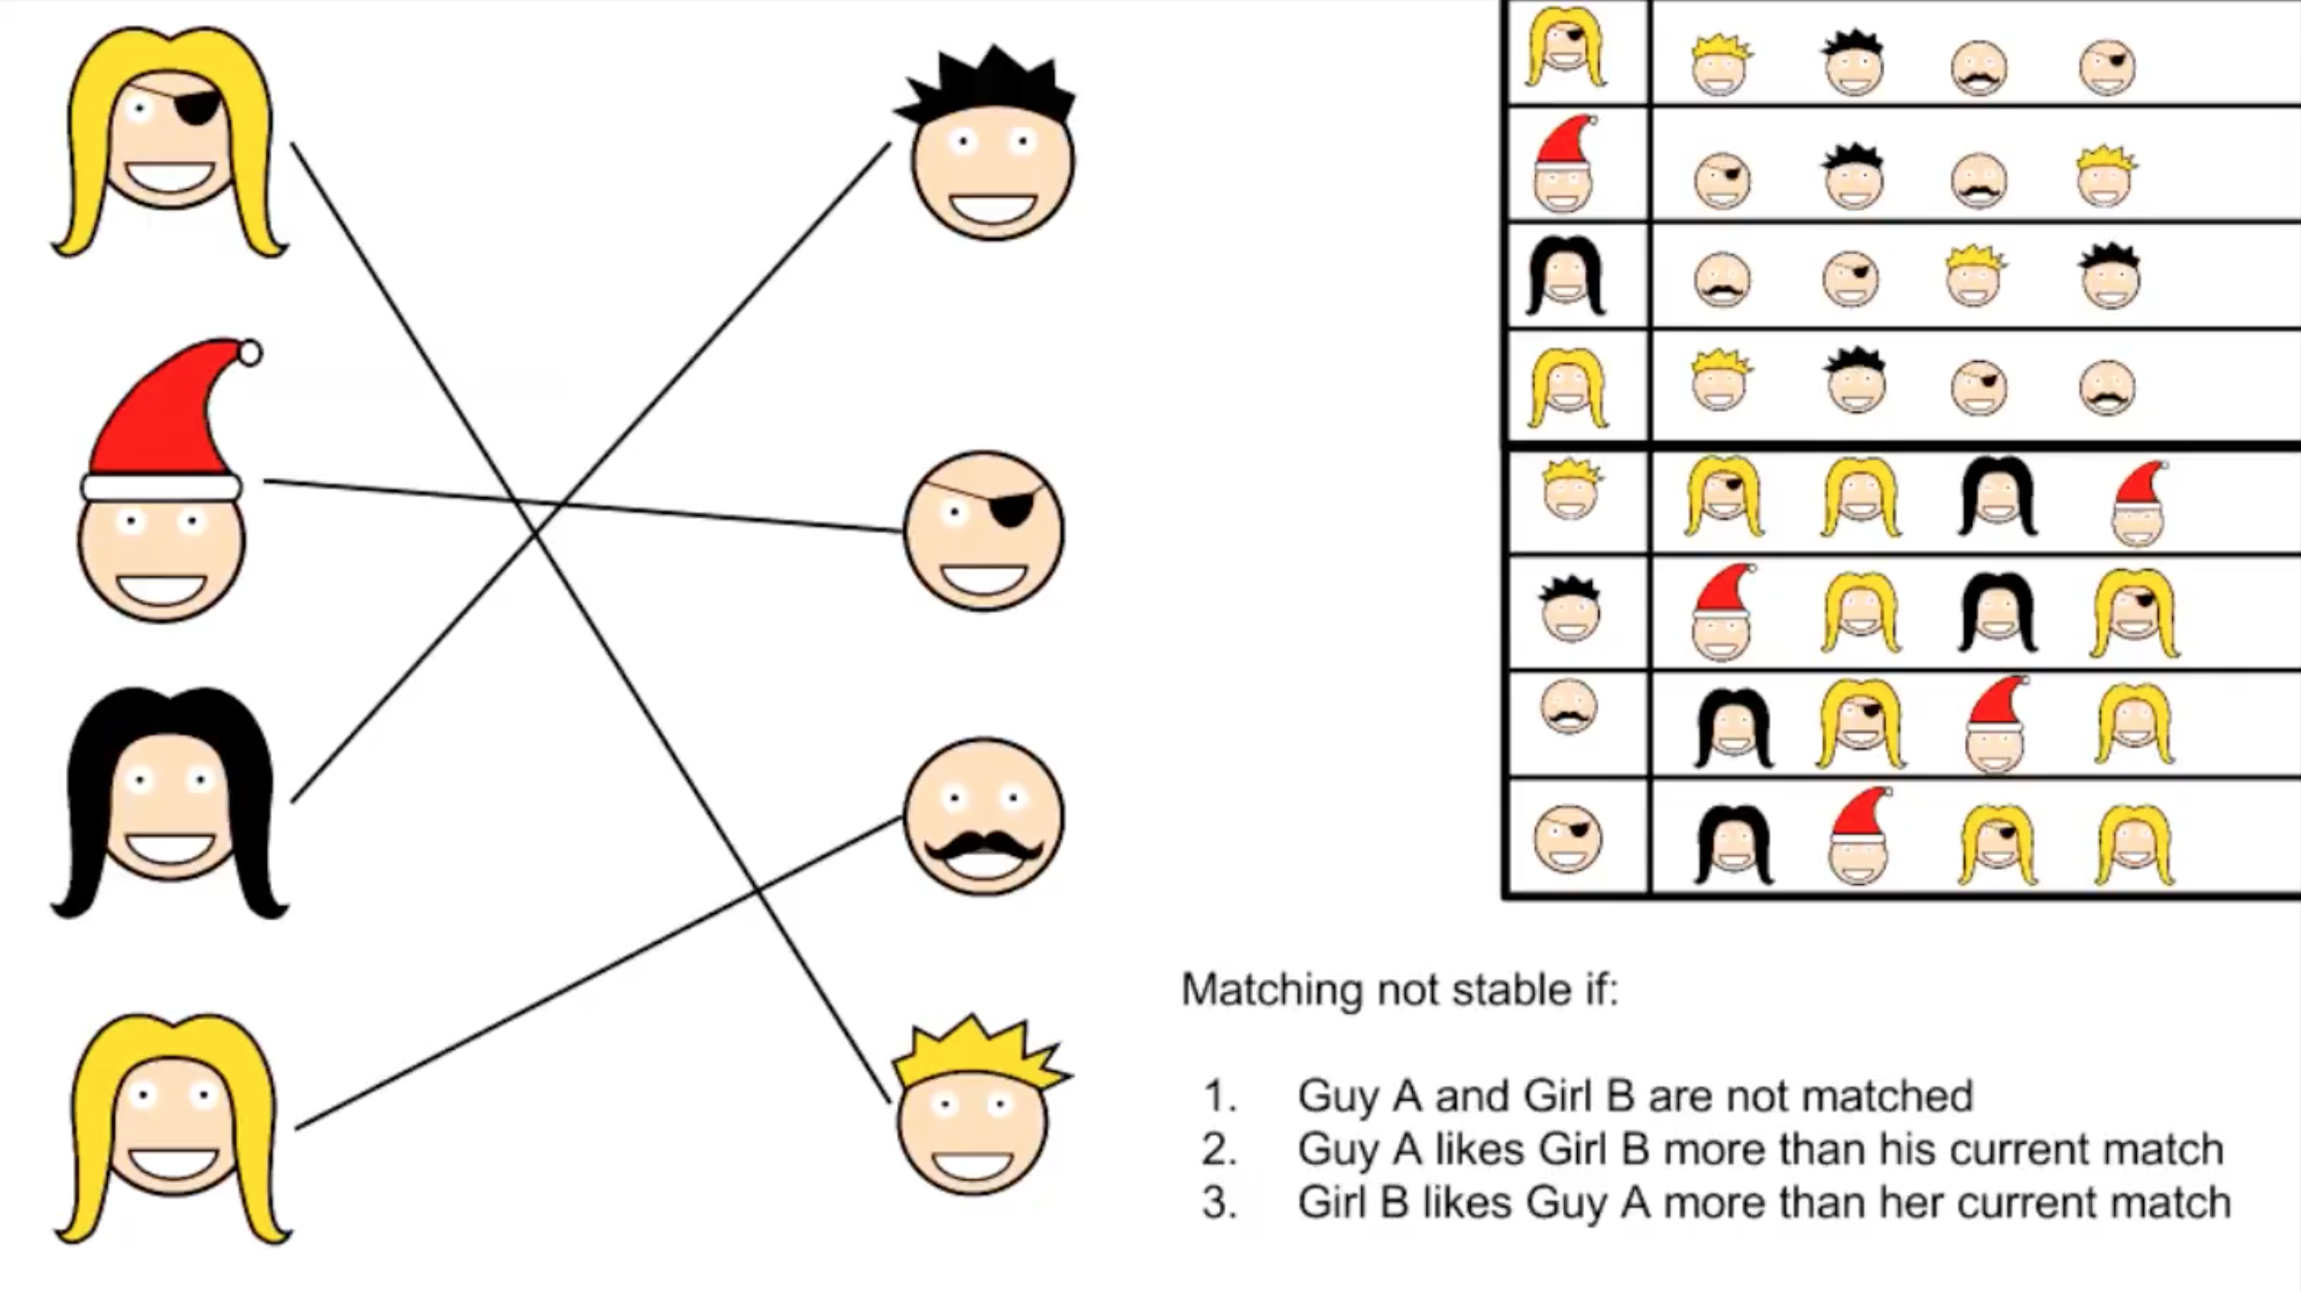
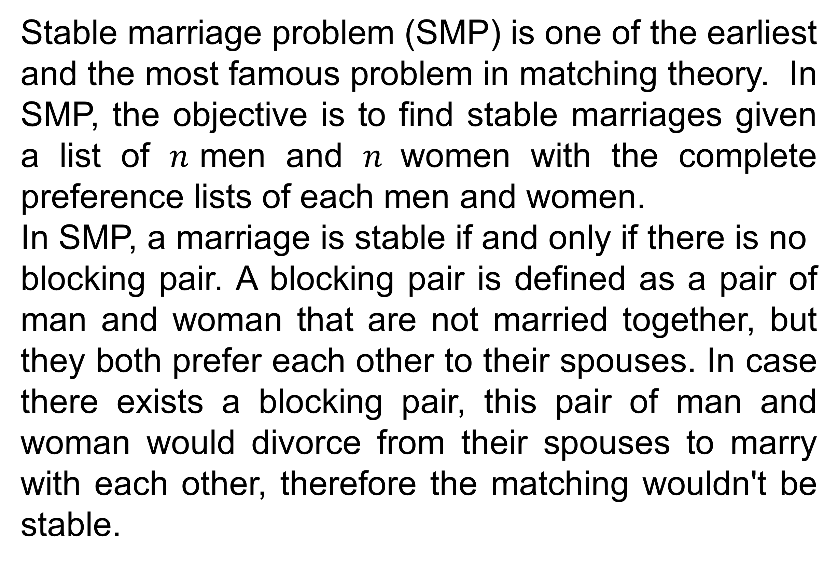
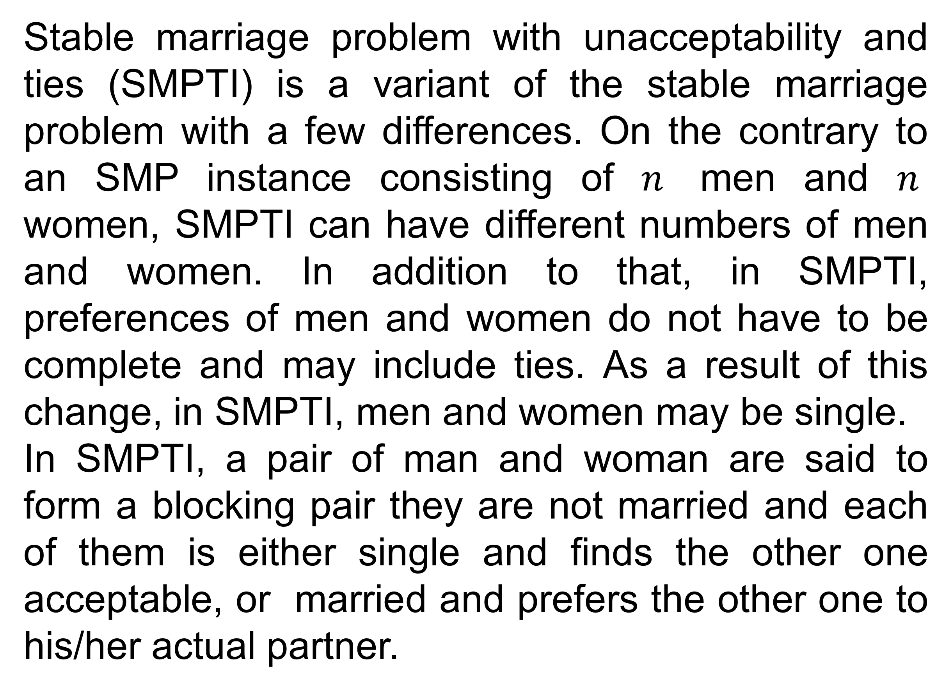
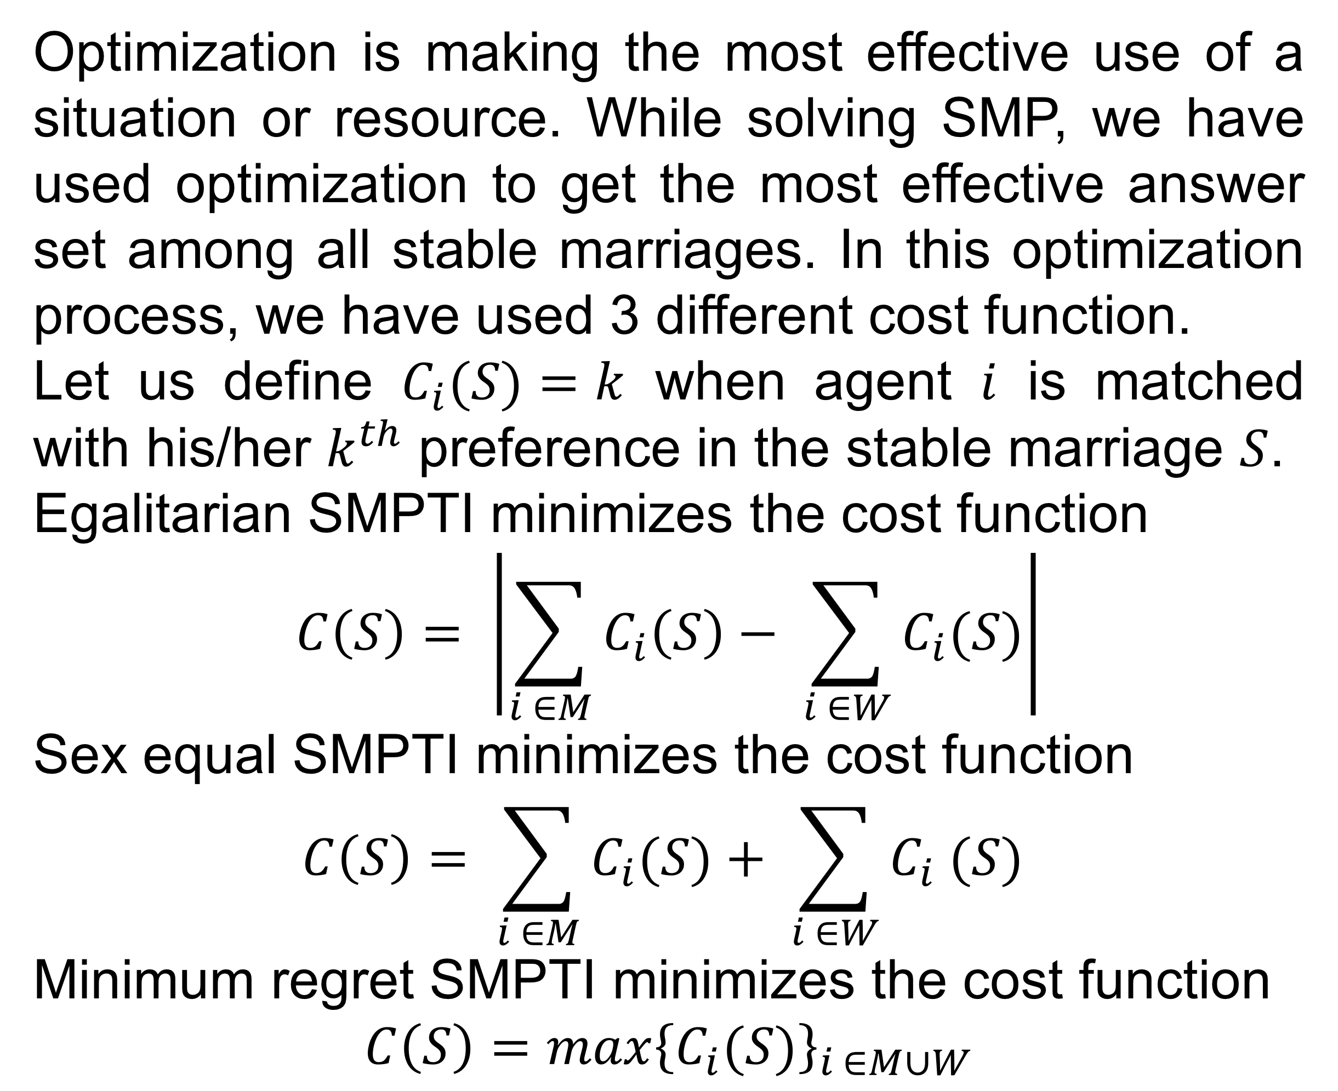
Solving Stable Marriage Problems using Answer Set Programming
Berkan Teber, Özgün Özerk, Selin Eyüpoğlu, Talha Şamil Çakır, Zeynep Melis Meriç
Supervised by Ahmet Alkan, Esra Erdem
Abstract
♦ SMP with Unacceptability
Matching is a daily process for most individuals, institutions, and within the last century, robots. We match all sort of objects and individuals with other objects and individuals to find answers for questions such as “who gets what”, “who works where” or “who goes to which school”.
Stable marriage problem with unacceptability and ties (SMPTI) is a variant of the stable marriage problem with a few differences. On the contrary to an SMP instance consisting of $n$ men and $n$ women, SMPTI can have different numbers of men and women. In addition to that, in SMPTI, preferences of men and women do not have to be complete and may include ties. As a result of this change, in SMPTI, men and women may be single.
In SMPTI, a pair of man and woman are said to form a blocking pair they are not married and each of them is either single and finds the other one acceptable, or married and prefers the other one to his/her actual partner.
♦ Objectives
To come up with an alternative method to matching problems, we have used artificial intelligence methods on matching problems, for the first time in the literature as we are aware of. In this project, we have studied one of the most famous matching problems, the stable marriage problem.
♦ Stable Marriage Problem
♦Optimization Variants
Stable marriage problem (SMP) is one of the earliest and the most famous problem in matching theory. In SMP, the objective is to find stable marriages given a list of $n$men and $n$women with the complete preference lists of each men and women.
In SMP, a marriage is stable if and only if there is no
blocking pair. A blocking pair is defined as a pair of man and woman that are not married together, but they both prefer each other to their spouses. In case there exists a blocking pair, this pair of man and woman would divorce from their spouses to marry with each other, therefore the matching wouldn't be stable.
Optimization is making the most effective use of a situation or resource. While solving SMP, we have used optimization to get the most effective answer set among all stable marriages. In this optimization process, we have used 3 different cost function.
Let us define $C_{i}(S)=k$ when agent $i$ is matched with his/her $k^{th}$ preference in the stable marriage $S$.
Egalitarian SMPTI minimizes the cost function
$$C\left(S\right)= \left|\sum_{i ∈M}{C_{i}\left(S\right)− \sum_{i ∈W}{C_{i}(S)}}\right|$$
Sex equal SMPTI minimizes the cost function
$$C\left(S\right)= \sum_{i ∈M}{C_{i}(S)}+ \sum_{i ∈W}{C_{i} (S)}$$
Minimum regret SMPTI minimizes the cost function
$$C\left(S\right)=max{\left\{C_{i}(S)\right\}}_{i ∈M∪W}$$
♦ Conclusions
Our main focus was on how matching as a real life problem can be interpreted and represented as a mathematical question. For this purpose, we have designed programs to solve and optimize variants of stable marriage problem with respect to equality of individuals and sexes.
Our work will be continued in Spring ’18 and we plan to solve more real life problems in the future.
Source: https://www.youtube.com/watch?v=Dm7OQr53xKY
♦ References
Gale, D., & Shapley, L. (1962). College Admissions and the Stability of Marriage. The American Mathematical Monthly, 69(1), 9-15.
Gelfond, M., & Lifschitz, V. (1988). The stable model semantics for logic programming. In Proceedings of International Logic Programming Conference and Symposium, pp. 1070-1080.
Gebser, M., Kaminski, R., Kaufmann, B., & Schaub, T. (2014). Clingo = ASP + Control: Preliminary Report. In proceedings of the 2014 Technical Communications of the Thirtieth International Conference on Logic Programming, 14(4-5).
Giannakopoulos, I., Karras, P., Tsoumakos, D., Doka, K., & Koziris, N. (2015). An Equitable Solution to the Stable Marriage Problem. In Proceedings of the 2015 IEEE 27th International Conference on Tools with Articial Intelligence, pp. 989-996.

