Slide 1
Oracle Indexes - Performance Tuning & Tips

Slide 2
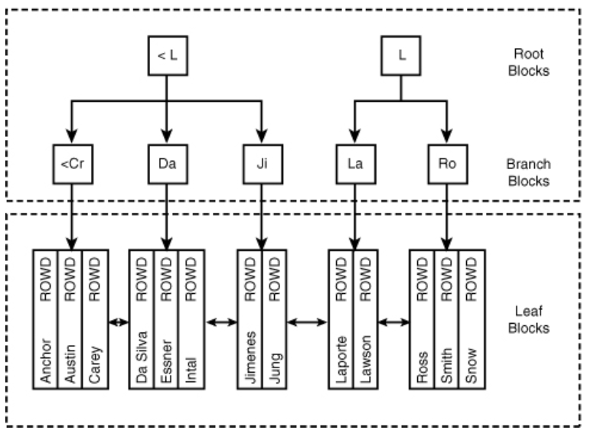
Indexes
The B-Tree Index

Slide 3
Creating an Index
  SELECT course_no, section_no, start_date_time, location
  FROM section
  WHERE location = ‘L206’;
  CREATE INDEX sect_location_i
  ON section(location);
Composite Indexes
  CREATE INDEX course_description_cost_i
  ON course (description, cost)

Slide 4
Index Considerations
NULLs and Indexes
  SELECT student_id, first_name
  FROM student
  WHERE first_name IS NULL;
Functions and Indexes
  SELECT student_id, last_name, first_name
  FROM student
  WHERE UPPER(last_name) = 'SMITH‘;
  CREATE INDEX stud_last_name_i
  ON student(UPPER(last_name));

Slide 5
Index Considerations
Indexes and Constraints
  Primary Key
  Unique
Indexes and Foreign Keys
Dropping an Index
  DROP INDEX sect_location_i;
When you drop a table, all associated indexes are dropped automatically

Slide 6
Altering an Index
REBUILD
ALTER INDEX stu_zip_fk_i REBUILD;
ALTER INDEX stu_zip_fk_i REBUILD ONLINE;
Indexes and SQL Developer
Indexes and Statistics

