Slide 1
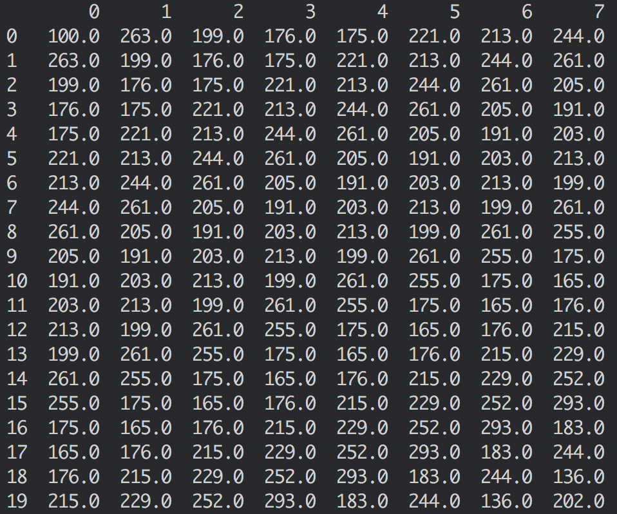
Raw_data
7 day’s forecast

Slide 2
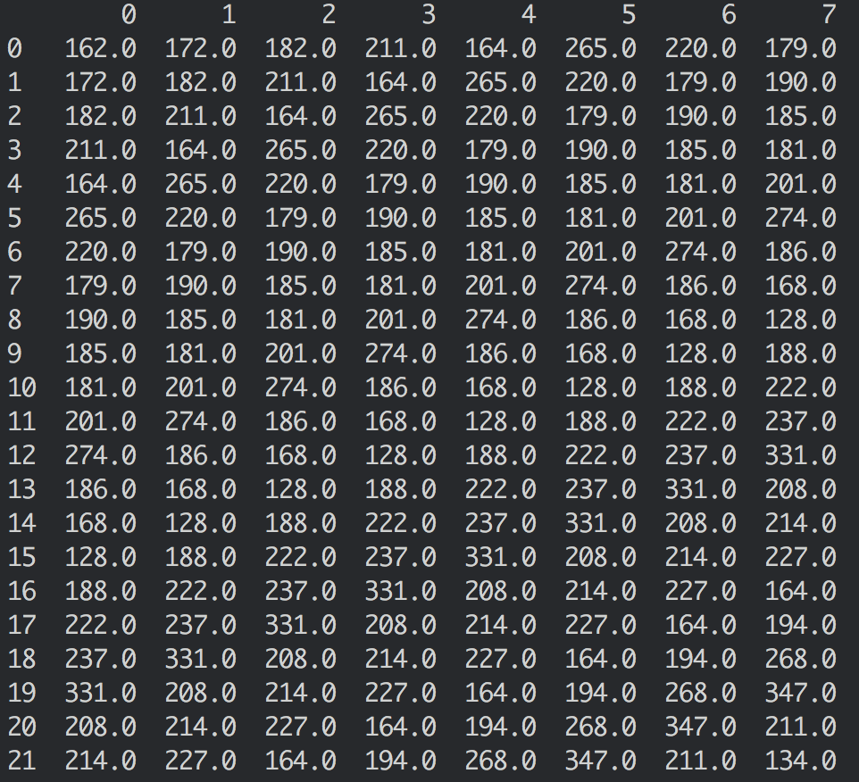
7 day’s forecast
For the last 28 days
Raw_data

