Slide 1
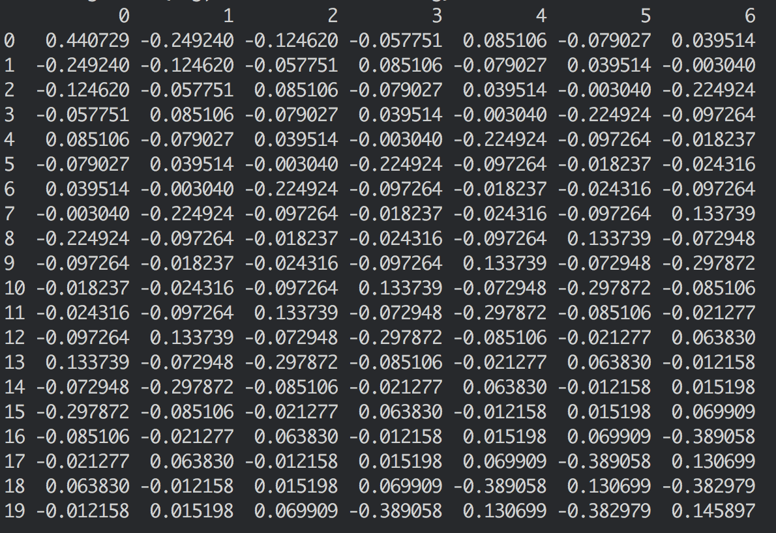
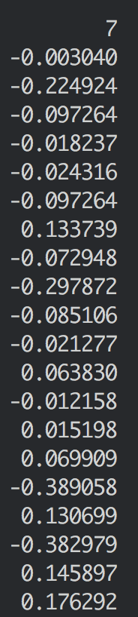
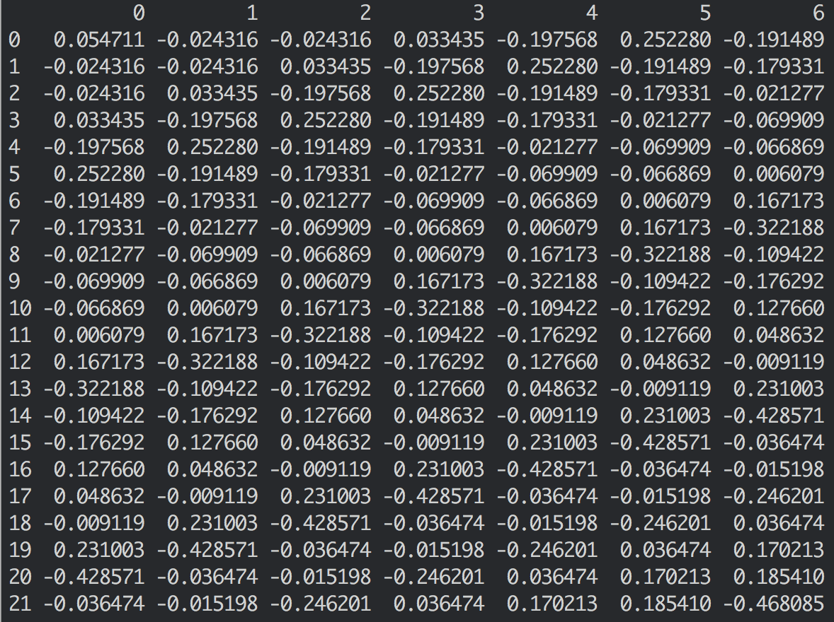
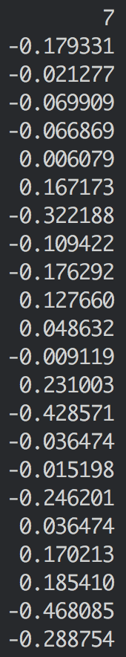
Scaled training dataset
Scaled testing dataset

Slide 3
Original Day | Predict Day +1 | Predict Day +2 | Predict Day +3 | Predict Day +4 | Predict Day +5 | Predict Day +6 | Predict Day +7
Mon | Tue | Wed | Thu | Fri | Sat | Sun | Mon
Tue | Wed | Thu | Fri | Sat | Sun | Mon | Tue
Sun | Mon | Tue | Wed | Thu | Fri | Sat | Sun
Mon | Tue | Wed | Thu | Fri | Sat | Sun | Mon
Feb 6, 2018
The first day to be forecasted
Mar 5, 2018
The last day to be forecasted

