Slide 1

Spell Corrector Project
Marius Mafteuta
Berkay URAS
Sude YILMAZ

Slide 2
Introduction
This project explores the development of a spell corrector using multiple approaches including SymSpell, SpellChecker, and contextual correction with spaCy. The project aims to create an efficient spell correction tool and evaluate its effectiveness. A graphical user interface (GUI) is also developed to provide an interactive platform for users.

Slide 3
Introduction
Aim: Develop an effective spell correction tool using multiple methodologies.
Scope: Implement and compare SymSpell, SpellChecker, and contextual correction with spaCy. Develop a user-friendly GUI.

Slide 4
Methodology
SymSpell: Fast, efficient, precomputed dictionary, edit distance.
SpellChecker: Frequency-based, simple, effective, edit distance.
SpaCy: Context-aware corrections, considers semantic context.
Implementation of NLP techniques by using Shakespeare’s Works as a train data for the corrector.

Slide 5
Spelling Correction System Using NLP
Data Preparation:
Load Text: Read Shakespeare's works
Preprocess: Lowercase, split into words
Vocabulary: Unique words list
Frequencies: Count word occurrences
Probabilities: Calculate word likelihoods
Edit Operations:
Delete: Remove one letter
Switch: Swap adjacent letters
Replace: Change letters
Insert: Add letters
Generating Suggestions:
Edit One/Two Letters: Generate candidate words
Check Vocabulary: Keep real words
Rank by Probability: Suggest most likely corrections

Slide 6
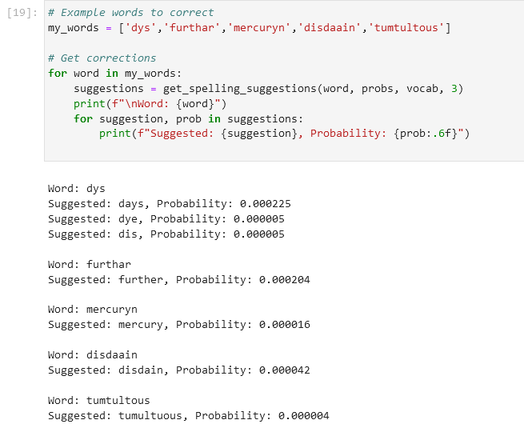

Slide 7
SymSpell Implementation
Initialization: SymSpell object setup with parameters.
Dictionary Loading: Precompiled dictionary of words and frequencies.
Correction Process: lookup_compound function for suggesting corrections.

Slide 8
SpellChecker Implementation
Initialization: SpellChecker object with default English dictionary.
Correction Process: Uses frequency and edit distance to find likely correct words.

Slide 9
GUI Development
Built with tkinter.
Features: Input fields, correction buttons, display area for history.

Slide 10
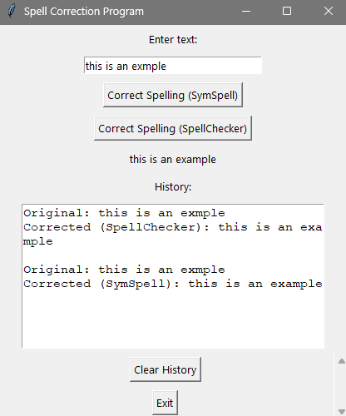

Slide 11
Contextual Correction with SpaCy
Model Setup: Loading spaCy model and integrating contextualSpellCheck using the model “en_core_web_sm”.
Correction Process: Context-aware suggestions and corrections.
Example Usage: Demonstrates corrections while maintaining sentence context.

Slide 12
n_core_web_sm: NLP Model by spaCy
Tokenization: Splits text into individual units like words and punctuation.
Part-of-Speech Tagging (POS): Identifies grammatical roles (e.g., nouns, verbs).
Dependency Parsing: Analyzes syntactic structure and relationships between words.
Named Entity Recognition (NER): Detects entities like names, dates, and organizations.
Lemmatization: Reduces words to their base forms for normalization.

Slide 14
Results
SymSpell: Fast and efficient.
SpellChecker: Simple and effective.
SpaCy: Accurate in complex sentences.
GUI: Enhances usability and accessibility.

Slide 15
Conlusions
Achievements: Developed versatile spell correction tool.
Strengths: Each method's strengths highlighted.
Future Improvements: Integrate advanced NLP techniques, expand dictionary. Build model.

Slide 16

Thank you!

