Slide 1

Invent Analytics
Promotion Bump Assignment
Berkay AKTÜRK

Slide 2
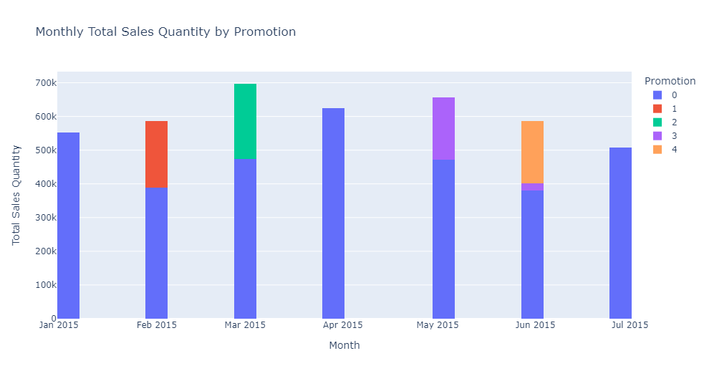

PromotIon dates
We can examine the monthly graph of total sales quantities according to the promotion status and the table of promotion averages. These averages' effects are statistically different from each other, and the highest sales average is achieved with promotion 4. It can be seen that the lowest sales quantity is owned when no promotion is made.

Slide 3
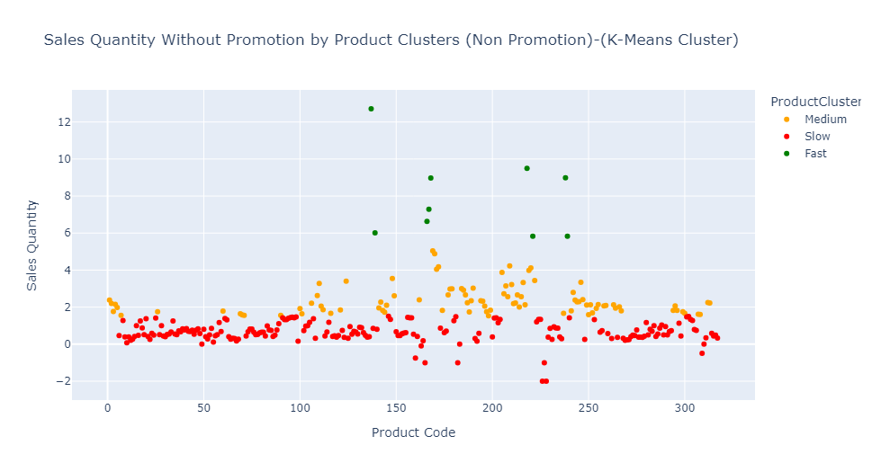
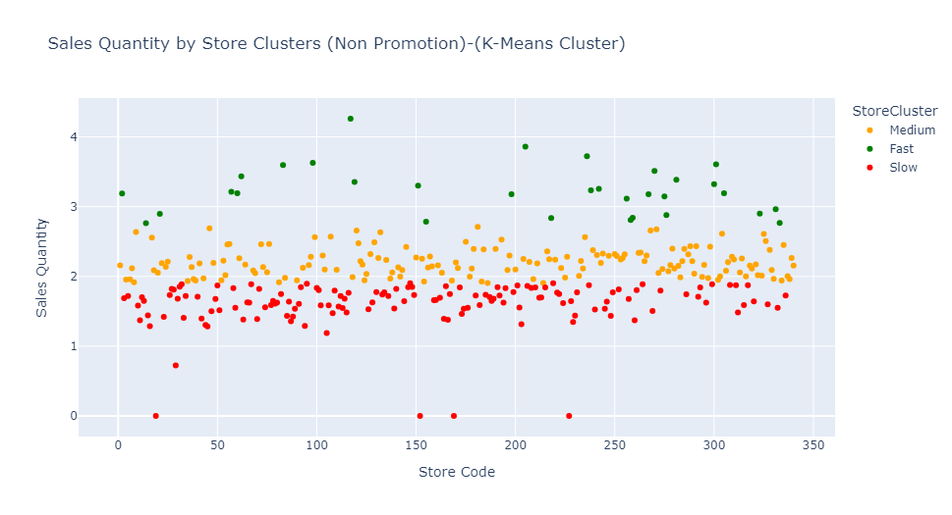
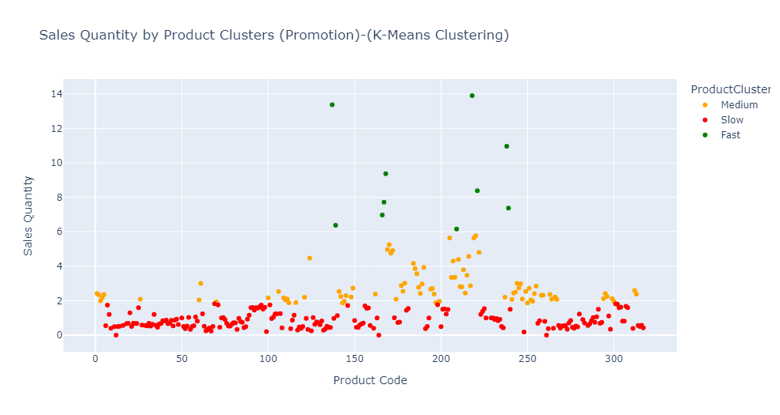
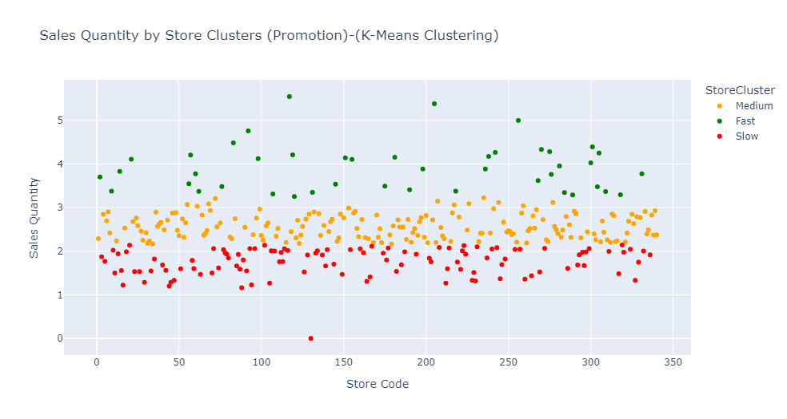
CLUSTERING
We can examine the clusters of weekly average sales when there is no promotion and when there is a promotion. If we want to examine in detail which product and store belong to which cluster, it will be necessary to look at the Jupyter file.

Slide 4
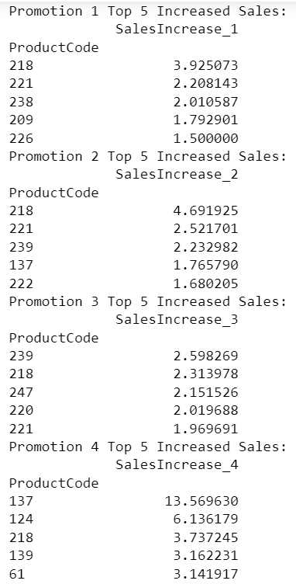
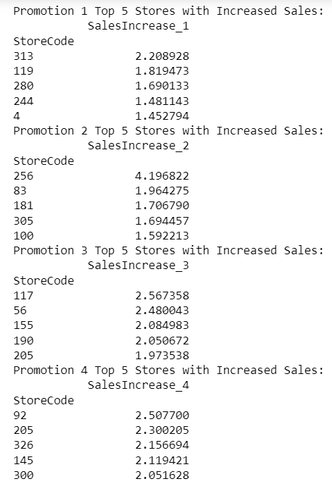
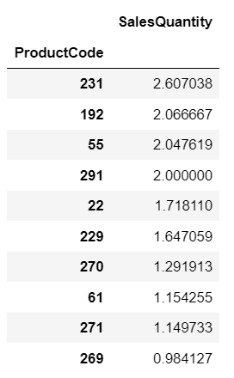
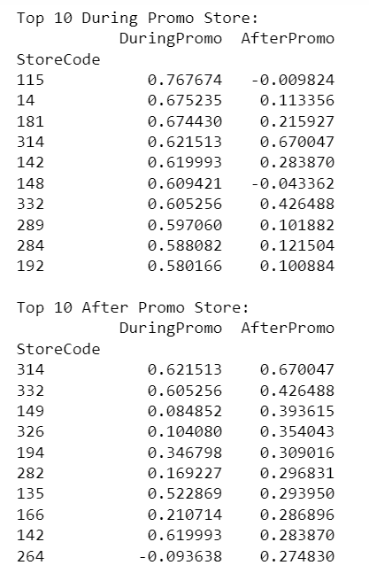
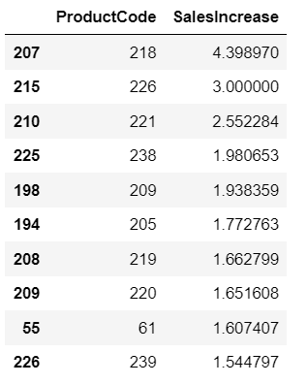
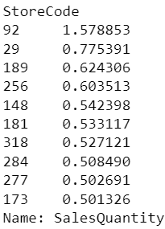
Products and stores
Best-selling products during and after promotions Stores with the Best Response to Promotions

Slide 5
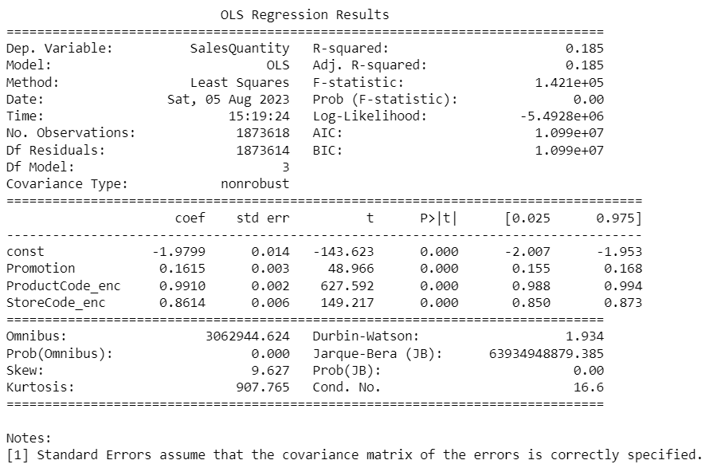
PROMOTION sales
Promotion sales can be affected differently by the type of promotions, such as discount rates, gifts, loyalty points. Stores' location and type, and their response to promotions, can influence this condition. However, if we want to examine this situation according to the data we have, we can refer to the regression table below. (Please refer to the Word or PDF file for a detailed explanation.)

Slide 6




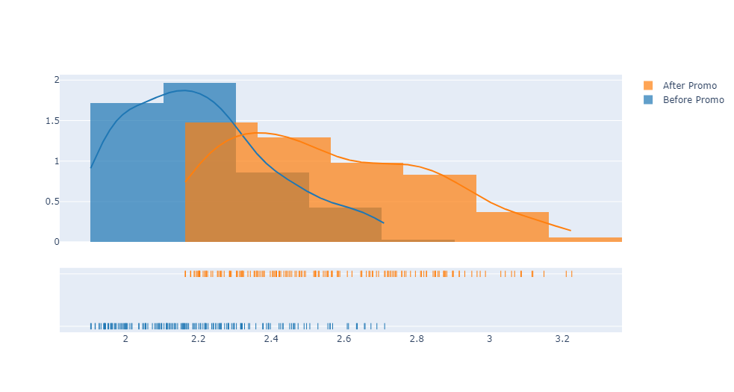
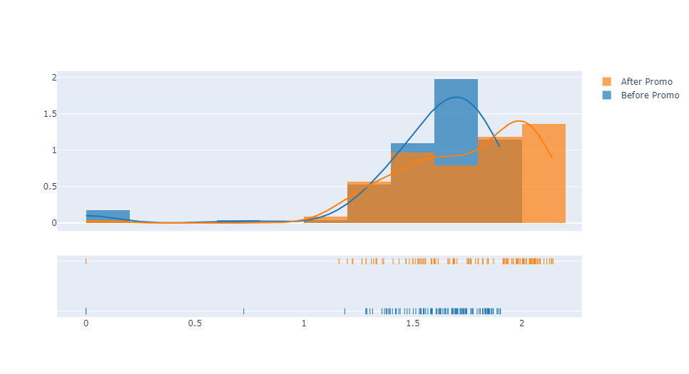
Comparison of grouped products and stores
The products and stores have been analyzed according to the Fast, Medium, and Slow groups. There is a significant difference between the Fast and Slow groups. More importantly, from a statistical analysis standpoint, there isn't a significant difference among the fast groups of products when there is a promotion versus when there isn't. However, when other groups are compared, significant differences are observed in both promotional and non-promotional situations. Except for high-selling products, there's a significant increase in all other scenarios (products and stores) during promotions. For detailed results, please refer to the Word or PDF file.

Slide 7
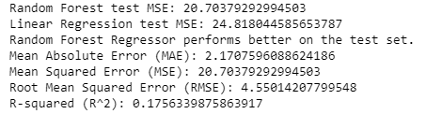
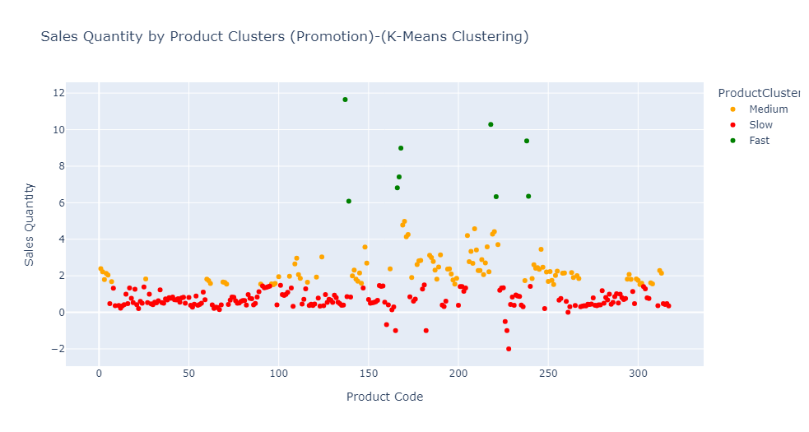
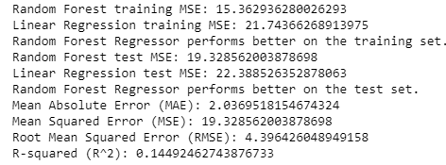

Model comparıson
"Goodness of fit" is a measure of how well a statistical model predicts a data set. In regression analysis and prediction models, R-Squared, RMSE, MAE, and MSE values are used. In Clustering Analysis, the Silhouette Score is a metric that shows how well the clusters are separated. In statistical tests, the Chi-Square goodness of fit test is used. The model is constructed on new data to arrive at step 2. The effect of Promotion 5 is compared on sample store and product pairs through the creation of an effect and prediction model, along with the necessary metric values.
Step 1
Step 2
Promotion 5

Slide 8

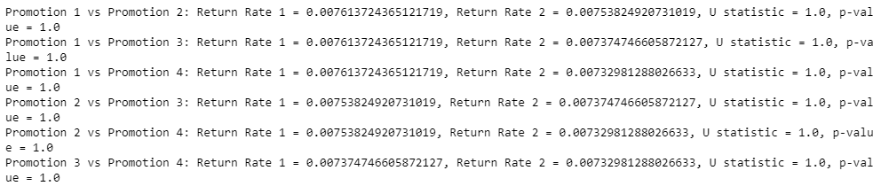
Product return rates after promotions
The return rates of products after promotions were considered in three different scenarios. In the first scenario, there was no statistically significant difference between the ratio of products returned to products sold according to promotions. In the second scenario, the return rate for the non-promotion period and the return rates for each promotion code were calculated, and these proportional results showed no difference between promotions. Lastly, product return rates were compared after the relevant promotions, and no significant difference was found. In short, no difference was found between the rates of products returned after promotions. It was observed that similar product returns were experienced after each promotion.

Slide 9
Thank you for Revıew
BERKAY AKTÜRK
Analytics Consultant

