Slide 1
Introduction
A graphical user interface (GUI) allows a user to interact visually with a program
GUI’s are built from GUI controls
GUI controls are objects that can display information on screen or enable users to interact with app via Mouse keyboard or some other form of input.

Slide 2
Windows Forms
Windows forms are used to create a GUI.
A Form is a graphical element that appears on the desktop. It can be dialog a window or multiple document interface. It’s a container for controls and components
A control is a component that has a graphical representation at runtime.
Some components does not have a grapical representation (timers)
When there are several Windows on screen, the active Windows is the frontmost. Active window is said to «have focus»

Slide 3
Event Handling
Normally, a user interacts with an app’s GUI to indicate task that the app should perform.
GUI’s are event driven.
When user interacts with a GUI component, the interaction –event- drives program to perform a task. Common events incclude a Button, typing a textbox or selecting item on menu.
A method that performs a task in response to an event is called event handler.

Slide 4
Event Handling
Event handler receives two parameters when it is called.
First one is object reference -> Reference to the object that generated event.
The second is reference to event arguments type on EventArgs.

Slide 5
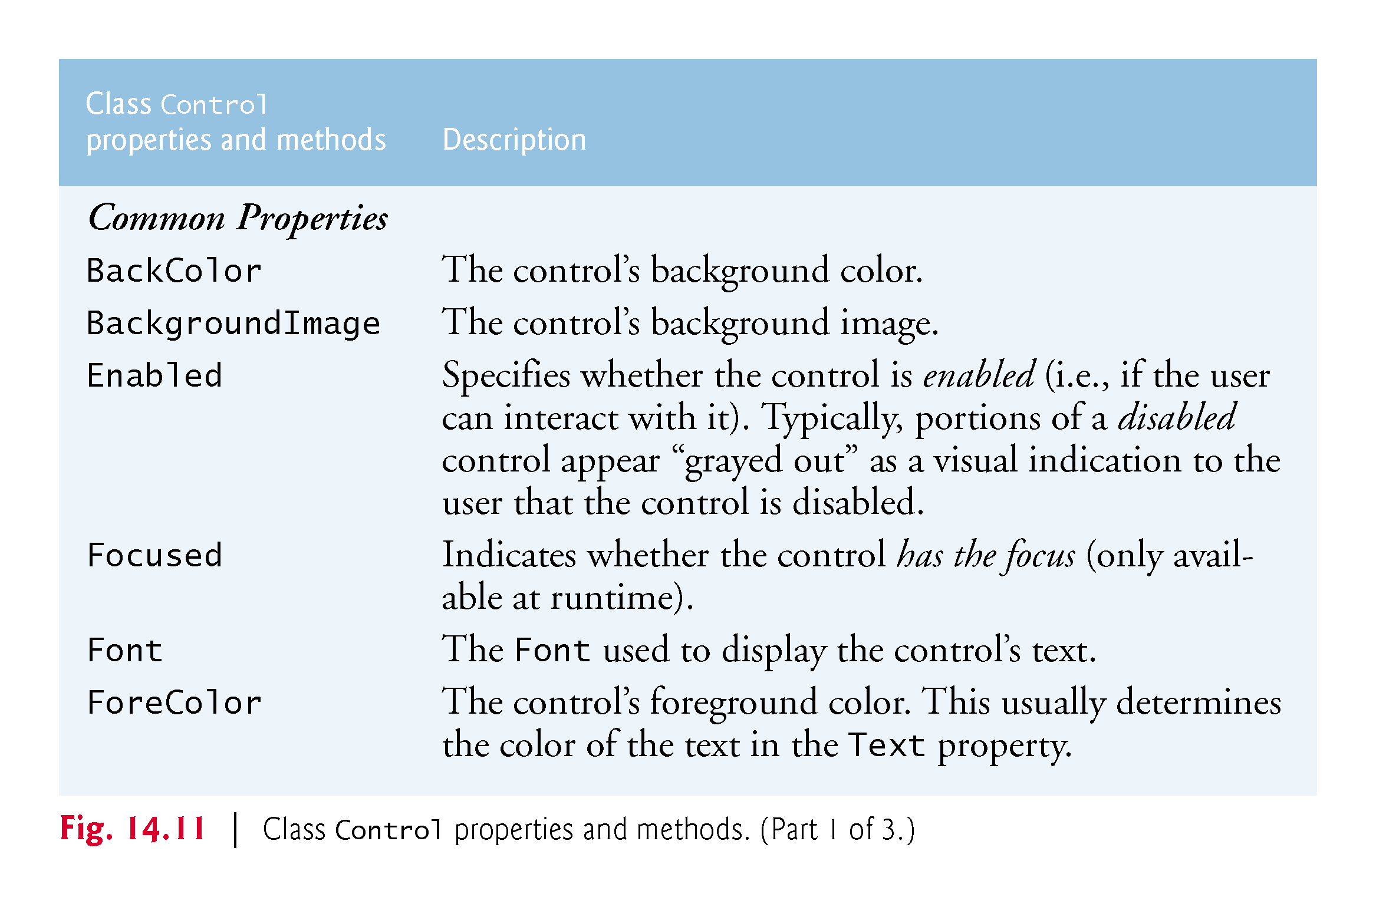
Control Properties

Slide 6
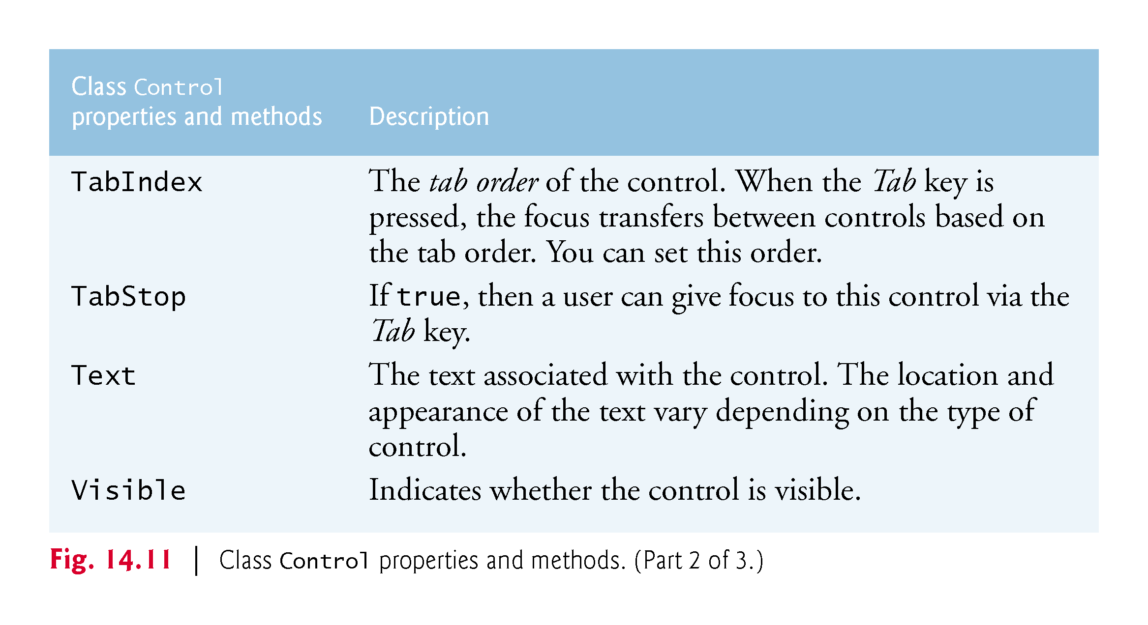
Control Properties

Slide 7
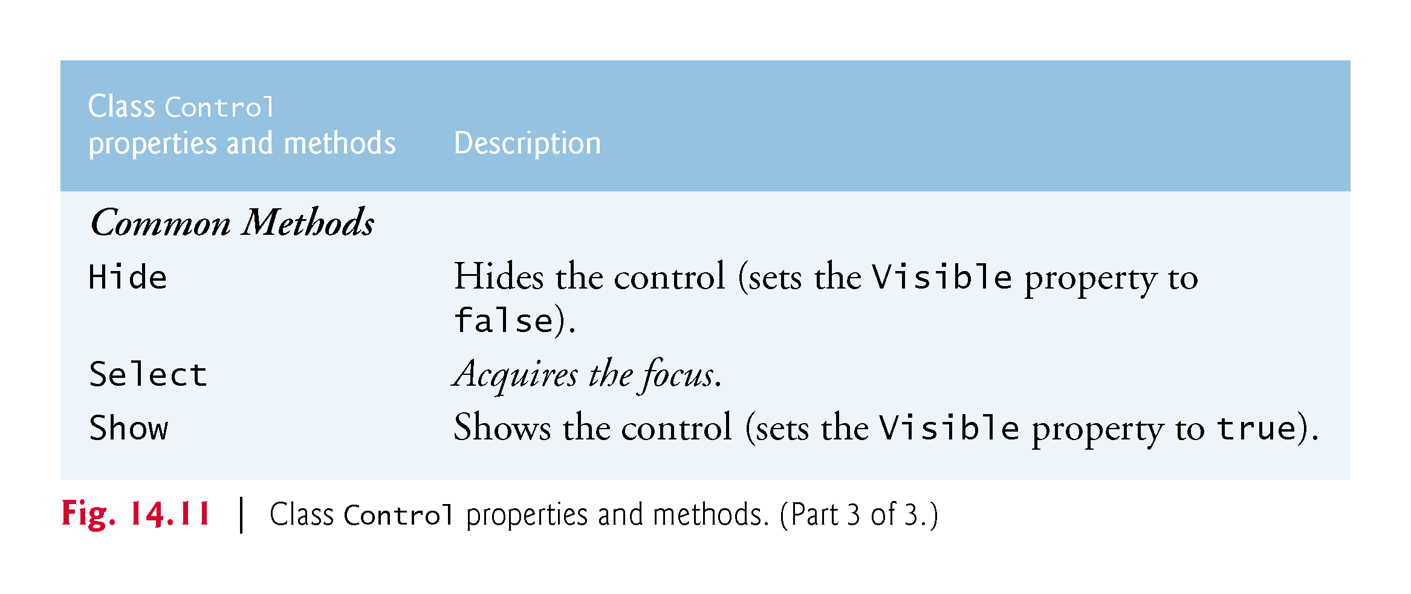
Control Methods

Slide 8
Control Layout
Docking : Attaches control to a cotainer such that the control stretches across an entire side.
Anchoring : It causes control to remain fixed distnce from sides.
Padding : Specifies distance between the docked controls an the edges.

Slide 9
Labels, Textboxes and Buttons
Labels provide text information that user cannot directly modify.
Textbox is an area in which text either can be displayed by a program or in which user can type text via keyboard.
Button is a control that the user clicks to trigger an action.

Slide 10
Groupboxes and Panels
Groupboxes and panels arrange controls on a GUI.
Typically used to group several controls with similiar functionality.
Groupboxes have a captions and doesnt include scrollbars whereas panels include scrollbars.
In order to activate scroll bars, you have to set AutoScroll propery of Panel

Slide 11
Checkboxes and Radio Buttons
CheckBox and RadioButtons can be in the on/off true/false states.
Checkbox is a small square either is blank or contains a check mark. Any number of Checkboxes can be selected at a time.
It can be checked, unchecked or indeterminted.
Radiobuttons are similar but they have two states: Checked or unchecked.
Radiobuttons are normally placed in group and one button can be selected at a time.

Slide 12
ToolTips
Tool tips help you become familiat with Form’s features and can be used as a remainder.
Tooltip component is placed in component tray-the gray region below the Form in Design mode.

Slide 13
NumericUpDown Control
At times you will want to restrict users input choices to specific range of numeric values.
Apeears as a textbox, with two small buttons on rights side. One with an up arrow and one with down arrow.
Maximum and minimum property set range.
Increment property specifies by how much the current number in the control changes.

Slide 14
Mouse Event Handling
Mouse events, such as clicks and moves are generated when mouse interacts with control.
Whenever user
holds down mouse button -> MouseDown event.
Releases mouse button -> MouseUp event.
Moves over control -> MouseMove event.

Slide 15
Keyboard-Event Handling
Key events ocur when keys on keyboard are pressed and released.
Three events are available. KeyPress, KeyUp, KeyDown.
Key press event occurs when user presses a character key, or the space or backspace. Special key can be determined with KeyChar of event argument.
Keypress event does not indicate whether modifier keys were presed or not. If it is important use KeyUp or KeyDown

