Slide 1

Student management system
berkay oner, hamza bder

Slide 2
Team members
Berkay Öner - 220209075
Hamza Bder - 200209479

Slide 3
ABOUT STUDENT MANAGEMENT SYSTEM
It's an application we have made from scratch for students to see the grades, for teachers to editing grades in a simple way.
This application might be used as source code for future projects and might be connected to a school system for faster access.

Slide 4
The pages we have used
Signup page
Login page
Student page
Teacher page

Slide 5

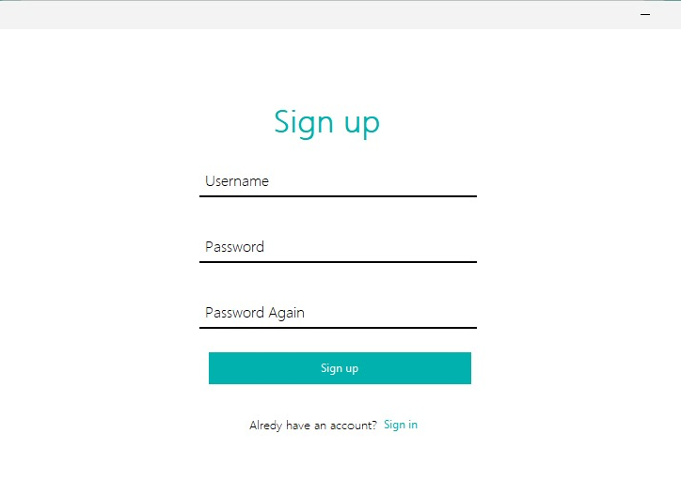
Sign up page

Slide 6
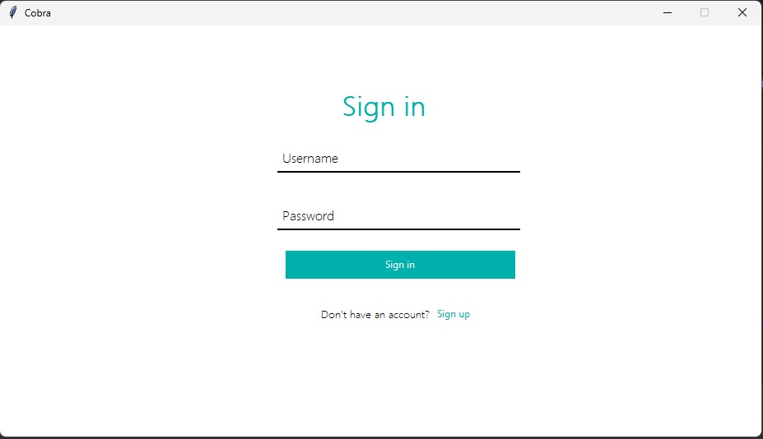
Sign in page

Slide 7
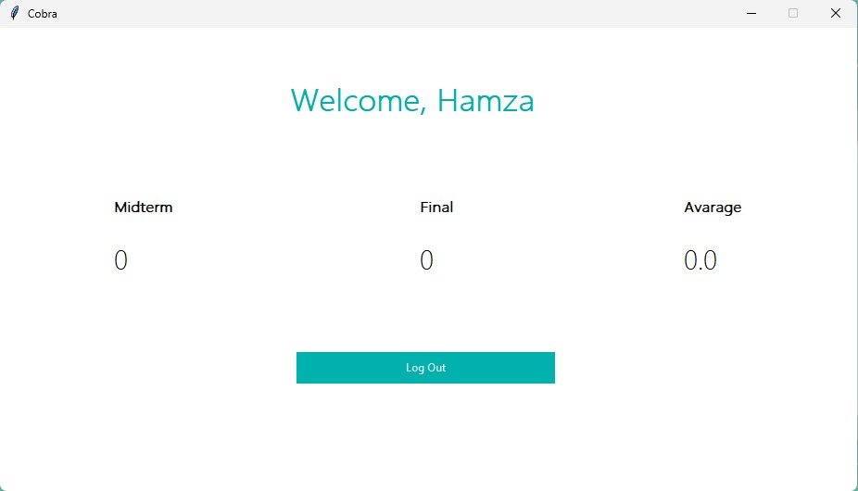
Student page

Slide 8
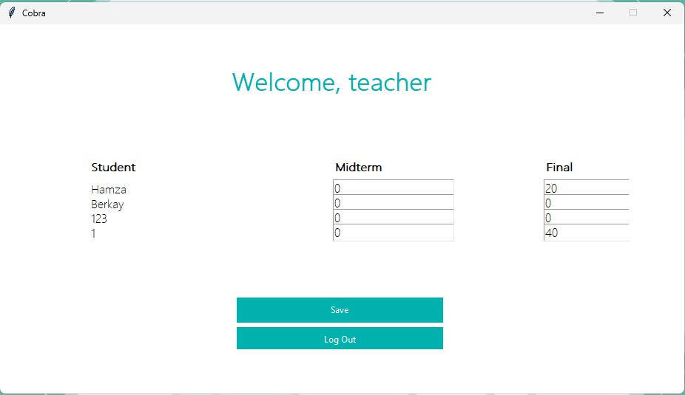
Teacher page

Slide 9
USED LIBRARIES
Tkinter: This plugin helps the user to design a GUI application. User needs a lot of testing and calculating for finding the perfect locations for the GUI Widgets because there is no graphical help or preview.
MySQL Connector: This plugin helps the user to connect MySQL database, execute querys, read-write datas.

Slide 10
PROBLEMS WE HAD
Customtkinter Plugin: We started developing the project with customtkinter plugin instead of tkinter plugin. This plugin is a new and changed version of tkinter plugin. New codes, new graphical changes, more professional design. But the problem we had was changed codes and lack of documentaries. We had some errors on placing the widgets. When we researched it in the internet, there wasn’t an exact solvation. So we had to restart the project with tkinter.

Slide 11
PROBLEMS WE HAD
TXT File as a Database: We used file reading and writing system as the database. When we wanted to make the project have more professional features, we chaged the database to MySQL.

