Slide 1
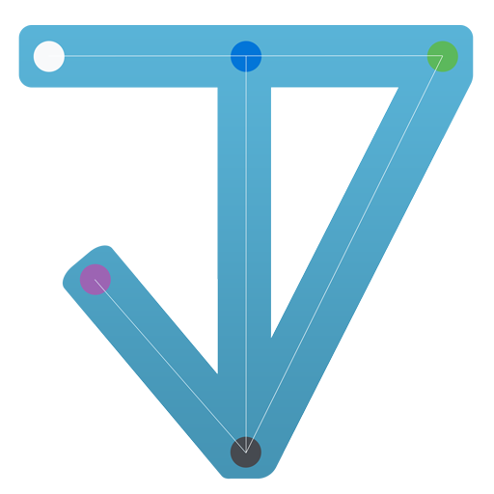
TASKY
cross platform project management tool
Berke Biten – Oguz Kaan Yazan

Slide 2
Table of contents

Slide 3
INTRODUCTION
What is the problem

Slide 4
INTRODUCTION
Scope of the project

Slide 5
CURRENT SYSTEMS
Current systems, jira-clickup-Trello-azure

Slide 6
PROPOSED SYSTEM
Giris

Slide 7
PROPOSED SYSTEM
Concepts

Slide 8
METHODS & ARCHITECTURE
LAYERS

Slide 9
CONCLUSION
sonuc

