Slide 1


FENS401 DESIGN PROJECT
PROPOSAL
WEARABLE SMART DEVICE FOR
VISUALLY IMPAIRED PEOPLE
20201706011 BERKE KAYA (EEE)
20201706014 BERKAY SARI (EEE)
20201706016 SAMET KARTLAR (EEE)
20221804017 HAKAN ÇANAKÇI (EEE)

Slide 2
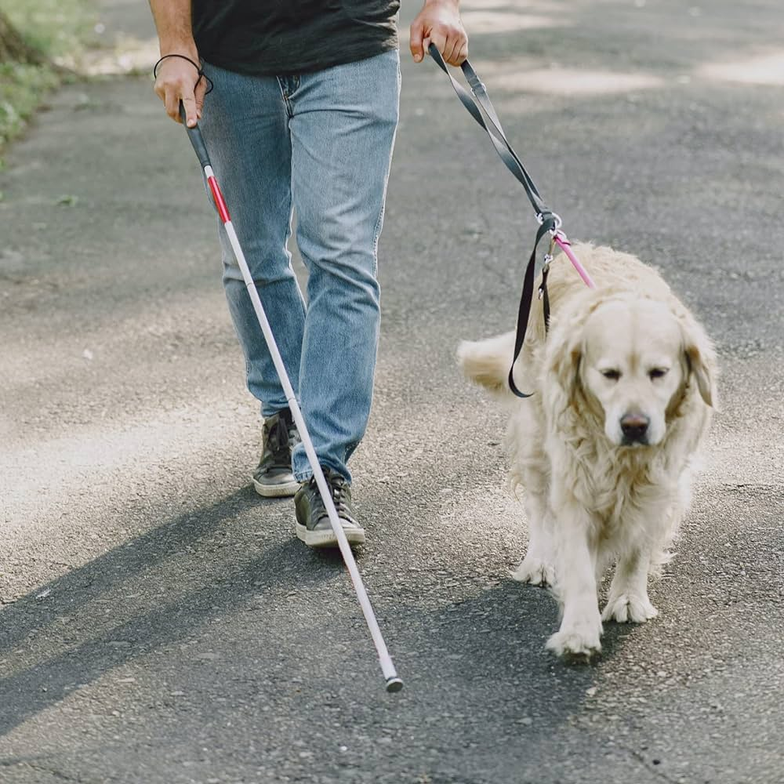
Problem Definition
285 million visually impaired individuals worldwide (WHO, 2021). [1]
215,076 visually impaired individuals in Turkey. [2]
Challenges Faced by Visually Impaired Individuals:
High Accident Risk: Navigating complex urban environments can lead to collisions, falls, or traffic-related accidents.
Limitations of White Canes: Conventional canes offer only partial information about immediate obstacles, lacking precise distance and directional feedback.
Guide Dog Constraints: Training periods are long, costs are high, and availability is limited, making guide dogs inaccessible for many.
Existing Solutions: Many current aids do not provide real-time, multi-sensory feedback or holistic navigation support, resulting in a need for more independent, secure, and efficient tools.
Figure 1: White cane and guide dog for visually impaired people
Why a Better Solution Is Needed
Enhanced Safety: Real-time detection and avoidance of obstacles can significantly reduce accident rates.
Greater Independence: Access to effective assistive technologies helps promote self-sufficiency and improves quality of life.

Slide 3
Aim
Develop a wearable, AI-powered system for real-time obstacle detection and body activity monitoring by using wearable sensors.
Utilize various sensors and a microcontroller-based control unit; collect and store data for processing.
Detect obstacles in real time to determine location and distance, and provide audio and vibration alerts to the user.
Use machine learning algorithms to predict the user’s activity status (sitting, lying down, walking, running, etc.) and detect anomalies (e.g., falls).
In dangerous situations, send alert messages with location information to registered contacts (e.g., family members, caregivers, or relevant authorities).
Project Objectives
Real Time Obstacle Detection and Alerts: The wearable smart device uses information from sensors to detect obstacles around the user in real time (distance, direction) and provide feedback to the user in the form of vibration and sound warning.
Activity Recognition and Analysis: Categorize body activities (such as sitting, lying, walking, and running) and detect anomalies (such as sudden falls) by using machine learning techniques and sensor data.
Location Tracking and Emergency Notifications: Use GPS to notify the user's location and registered persons such as family members, caregivers or relevant authorities in the event of a fall or other potential danger.

Slide 4
Parameters for Objectives
We have set the parameters for the objectives
Objectives | Parameters
Detection Range | 2.5m
Detection Accuracy | Accuracy 80%, F1 score 0.8
Response Time | 2 seconds or less
Activity and Location Reporting Time | 3 seconds or less
Battery Life | 1.5 hours
Device Weight | < 1 kilo
Table 1: Parameters of Project Objectives

Slide 5
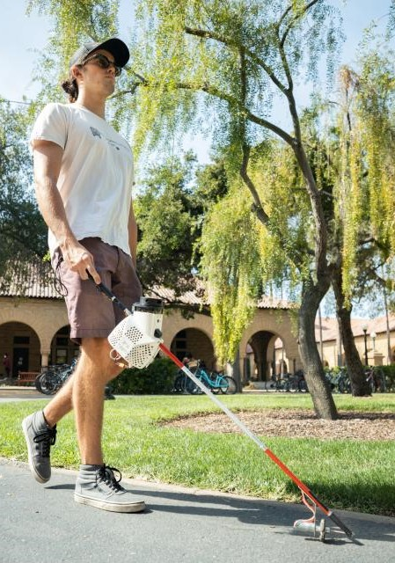
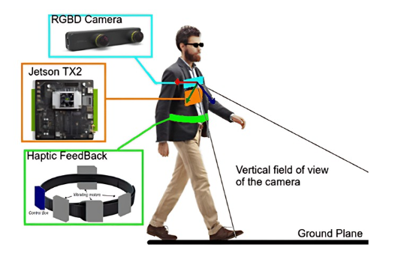
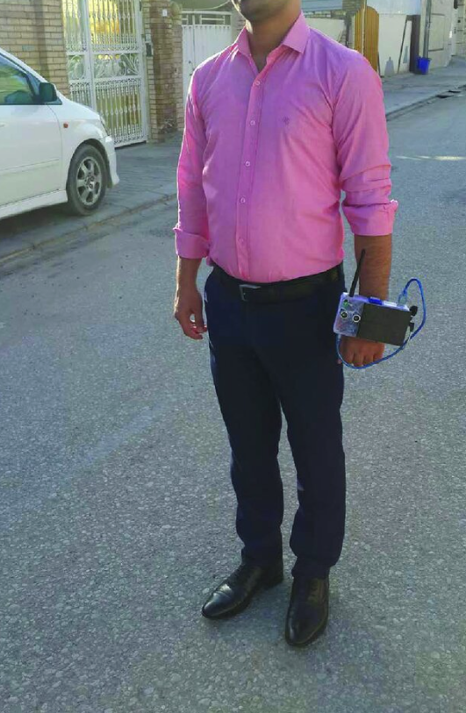
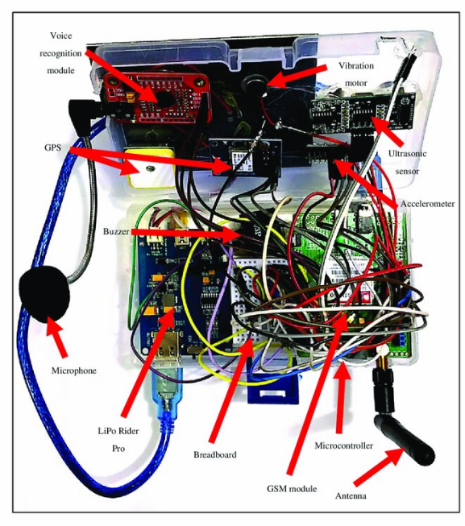
Literature Review
Figure 2: Self-Navigating Smart Cane
Devoleped by Stanford Researchers [3]
Figure 3: RGBD Camera , Nvidia processor and haptic feedback belt system [4]
Figure 4: Wearable wristwatch-like smart system for obstacle detection [5]

Slide 6
Obstacle Detection
Obstacle detection aims to enhance the spatial awareness and mobility of visually impaired users by identifying objects in their surroundings and providing real-time feedback. This system ensures user safety and independence through timely audio and haptic alerts about environmental elements.
Component | Advantages | Disadvantages
Ultrasonic Sensor | Affordable, energy efficient. Performs well on various surfaces. | Struggles on soft/absorbing surfaces. Needs proper angle placement.
Lidar Sensor | Highly accurate and fast. Suitable for complex environments. | Expensive. High energy consumption.
Infrared Sensor | Low cost, compact. Ideal for short- range detection. | Reduced accuracy under bright light. Less precise than ultrasonic sensors.
Laser Sensor | Long-range detection. Compact and lightweight design. | Relatively expensive. May require additional processing power for data handling.
Camera with Image Processing | Provides detailed visual data. Effective in dynamic environments. | Requires high processing power. Poor performance in low light.
Table 2 : Comparison of Obstacle Detection Sensors

Slide 7
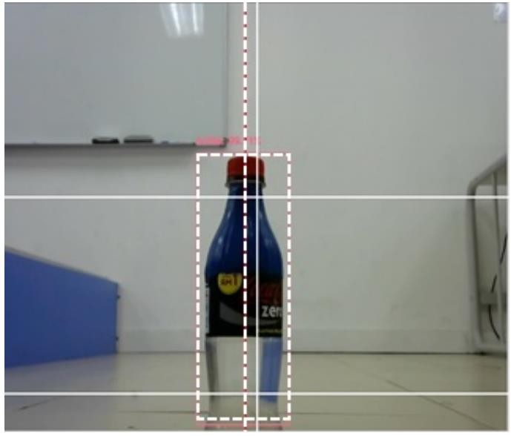
Obstacle Detection
We will employ advanced methods such as YOLOv5 and the COCO dataset, combined with Python and OpenCV, to ensure precise and real-time obstacle detection. The integration of these tools guarantees efficient object identification and seamless communication with the user via sound and haptic feedback.
Key Points:
Use YOLOv5, a deep learning model for object detection, and the COCO dataset for training.
Process real-time images with Raspberry Pi, OpenCV, and Python libraries.
Detect objects and provide alerts via sound and haptic feedback.
Ensure fast and accurate detection with lightweight and adaptable technologies.
Figure 5: Center of obstacle detection output with Python and OpenCV [6].

Slide 8
Activity Monitoring
Activity monitoring focuses on ensuring user safety by detecting and alerting them about potentially hazardous situations like falls or irregular movements. By providing real-time feedback and fostering independence, this system supports users in safely performing daily activities.
Accurate Recognition: Identify various movements such as walking, falling, or running from a 3-axis accelerometer.
Anomaly Detection: Detect deviations from normal movement patterns, ensuring early intervention in case of abnormalities.
Component | Advantages | Disadvantages
Accelerometer | Small, lightweight, energy efficient. High accuracy in detecting acceleration. | Noisy data requires signal processing. It can’t classify all movements on its own.
Gyroscope | High accuracy in rotation/orientation detection. Complement accelerometer data. | Higher energy consumption. Requires calibration for accuracy.
Table 3 : Activity Monitoring Sensor
Component | Advantages | Disadvantages
ESP32 | Dual-core processor. Integrated Wi-Fi/Bluetooth. Cost-effective. | Limited for complex algorithms. Energy optimization required.
Arduino Nano | Compact, BLE for low power use. Easy to develop. | Limited processing power. No Wi-Fi support.
Raspberry Pi | High-performance dual core. Affordable with many I/O pins. | No wireless communication (requires external modules). Less energy efficient.
STM32 | High processing power, energy efficiency. Versatile for many applications. | Complex development. Needs external modules for Wi-Fi/BLE.
Table 4 : Comparison of Microcontrollers for Project

Slide 9
Activity Monitoring
LSTM Model:
Analyze time-series data to classify movement types using sequential pattern recognition.
3-Axis Accelerometer:
Monitor movements across x, y, z axes to track activities like walking, falling, or reaching.
Data Collection & Labeling:
Gather labeled data (e.g., "walking," "falling") in CSV format with timestamps and velocity values.
Training Phase:
Train LSTM model with diverse, labeled datasets to generalize under various conditions.
Anomaly Detection:
Detect fall anomalies (sudden acceleration spike and stillness) and irregular movement patterns.
Real-Time Alerts:
Provide immediate audio warnings for detected anomalies to ensure quick responses.

Slide 10
Risk Management
Effective risk management ensures that additional options are available if initial aims are not met.
Obstacle Detection:
Combine camera-based image processing with depth sensors like LiDAR.
Use sensor fusion if image processing fails due to poor lighting or computational issues.
Activity Monitoring:
Use multi-axis accelerometer and gyroscope for tracking.
Simplify to a single accelerometer if sensor data becomes too complex.
Microcontroller Failure:
Use Raspberry Pi as the main controller to handle both functions.
Employ two microcontrollers if Raspberry Pi is insufficient.
Slightly increase weight and power but enable separate functions for reliability.
Short Budget and Component Failure:
Use lower-quality components if the budget is insufficient.
Adjust system requirements to match reduced component quality.

Slide 11
Requirements
We determined the requirements that the final product must meet.
REQUIREMENTS | Initial Aim | Risk Adjustment
Detection Range | 2.5m | 1.2m
Detection Accuracy | Accuracy 80%, F1 score 0.8 | Accuracy 65%, F1 score 0.65
Response Time | 2 seconds or less | 5 seconds or less
Activity and Location Reporting Time | 3 seconds or less | 10 seconds or less
Battery Time | 1.5 hours | 30 to 45 minutes
Device Weight | < 1 kilo | < 2 kilos
Table 5 : Risk Adjustment Table of Objectives Parameters
This proactive strategy ensures that the project can adjust to problems and continue functionality even if its initial objectives are not completely accomplished.

Slide 12
Work Packages

Slide 13
Work Packages

Slide 14
Team Members Contribution
We calculated the maximum hours to be spent throughout the project and divided them according to workload. Since we wanted all members to do equal workload, we shared all work packages.
Name, Surname | Work Packages |  |  |  |  |  |  |  | Total
 | I |  | II |  | III |  | IV
 | h | % | h | % | h | % | h | % | h | %
Berkay Sarı | 10 | 1.6 | 40 | 5 | 60 | 10 | 50 | 8.3 | 150 | 25
Berke Kaya | 10 | 1.6 | 40 | 5 | 60 | 10 | 50 | 8.3 | 150 | 25
Hakan Çanakçı | 10 | 1.6 | 40 | 5 | 60 | 10 | 50 | 8.3 | 150 | 25
Samet Kartlar | 10 | 1.6 | 40 | 5 | 60 | 10 | 50 | 8.3 | 150 | 25
Total | 40 | 6.6 | 120 | 20 | 240 | 40 | 200 | 33.3 | 600 | 100
Table 6: Contributions of the Team Members

Slide 15
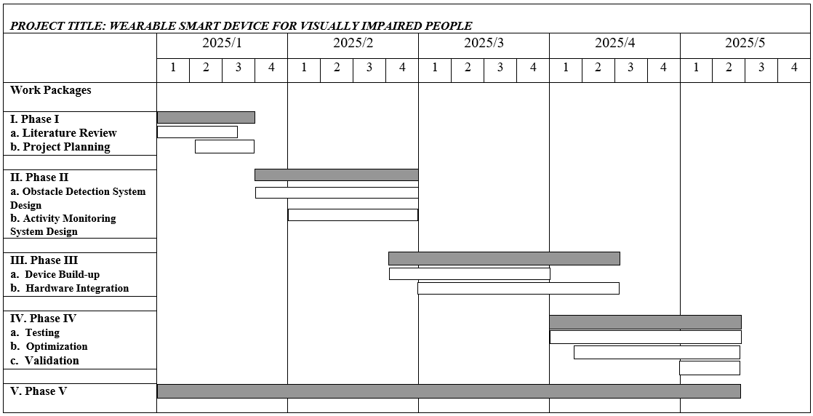
Project Calendar
We have created the project calendar according to the time intervals specified in the work packages.
Table 7: Project Calendar

Slide 16
Infrastructure Requirements
Laboratory:
Kadir Has Electrical and Electronics Lab (Phase II - III and IV)
We will need to use the Lab for building the prototype and tests.
Computer(s):
Phase II-III-IV:
Individual Laptops (Provided by team members) for coding, hardware integration and testing.
Personnel:
-
Equipment:
Lab Components (Phase II and III):
DC Source
Oscilloscope
Multimeter
Soldering Machine
3D Printer (Phase III)
We will need to use DC source and oscilloscope in the Lab for prototyping, testing and optimization. If we choose to design the physical body of the product, we will print it with a 3D printer.

Slide 17
Budget
 | Work Packages
 | I | II | III | IV | V | TOTAL
Equipment | - | ₺14000 | ₺400 | - | - | ₺14400
Consumable goods | - | ₺700 | ₺1800 | - | - | ₺2500
Publications/Software | - | - | - | - | - | ₺0
Transportation | - | - | - | - | - | ₺0
Services | - | - | ₺1500 | - | - | ₺1500
TOTAL | ₺0 | ₺14700 | ₺4000 | ₺0 | ₺0 | ₺18400
Main Components:
Raspberry Pi Model 4 or 5 8GB - ₺4000
Rechargeable Battery - ₺1800
Cables: Power cable and USB Cable - ₺700
For Obstacle Detection
Raspberry Pi Camera - ₺1800
Depth Sensor or LiDAR - ₺3500
Coin-Type Vibration Motor x4 – ₺400
Speaker + Wired Headphones for response - ₺550
Services:
3D Printing Service – To print the designed CAD - ₺1500
Table 8: Project Budget
For Activity Monitoring Purpose
Multi-axis Accelerometer, Gyroscope - ₺900
GPS Module - ₺1050
Consumable goods:
All necessary cables - ₺400
Solder, tape, glue, and other small assembly items. - ₺1800

Slide 18
References
[1] World Health Organization, “Blindness and Vision Impairment,” Who.int, Oct. 11, 2021. Retrieved from https://www.who.int/news-room/fact- sheets/detail/blindness-and-visual-impairment
[2]Aile ve Sosyal Hizmetler Bakanlığı. (2023). Engelli ve yaşlı istatistik bülteni – Kasım 2023.Retrieved from https://www.aile.gov.tr/media/151788/eyhgm_istatistik_bulteni_kasim_23.pdf
[3] Stanford Institute for Human-Centered Artificial Intelligence. (2021). Stanford researchers build $400 self-navigating smart cane. Stanford HAI. Retrieved from https://hai.stanford.edu/news/stanford-researchers-build-400-self-navigating-smart-cane
[4] A. A. Diaz Toro, S. E. Campaña Bastidas and E. F. Caicedo Bravo, "Methodology to Build a Wearable System for Assisting Blind People in Purposeful Navigation," 2020 3rd International Conference on Information and Computer Technologies (ICICT), San Jose, CA, USA, 2020, pp. 205-212, doi: 10.1109/ICICT50521.2020.00039.
[5] Ramadhan, A. J. (2018). Wearable Smart System for Visually Impaired People. Sensors, 18(3), 843. https://doi.org/10.3390/s18030843
[6] Y. K. Lee, S. Deen Tan, Y. H. Goh and C. Hong Lim, "Comparative Study on Obstacle Detection and Avoidance System by Using Real-Time Image Processing and Artificial Intelligence in Autonomous Wheelchair Application," 2019 IEEE 3rd Advanced Information Management, Communicates, Electronic and Automation Control Conference (IMCEC), Chongqing, China, 2019, pp. 1361-1366, doi: 10.1109/IMCEC46724.2019.8984067. https://ieeexplore.ieee.org/document/8984067

