Slide 1

FENS402 DESIGN PROJECT II
PROGRESS PRESENTATION 3, APRIL 18
WEARABLE SMART DEVICE FOR
VISUALLY IMPAIRED PEOPLE
Project Advisor: Assist. Prof. Dr. Arif Selçuk Öğrenci
20201706011 BERKE KAYA (EEE)
20201706014 BERKAY SARI (EEE)
20201706016 SAMET KARTLAR (EEE)
20221804017 HAKAN ÇANAKÇI (EEE)

Slide 2
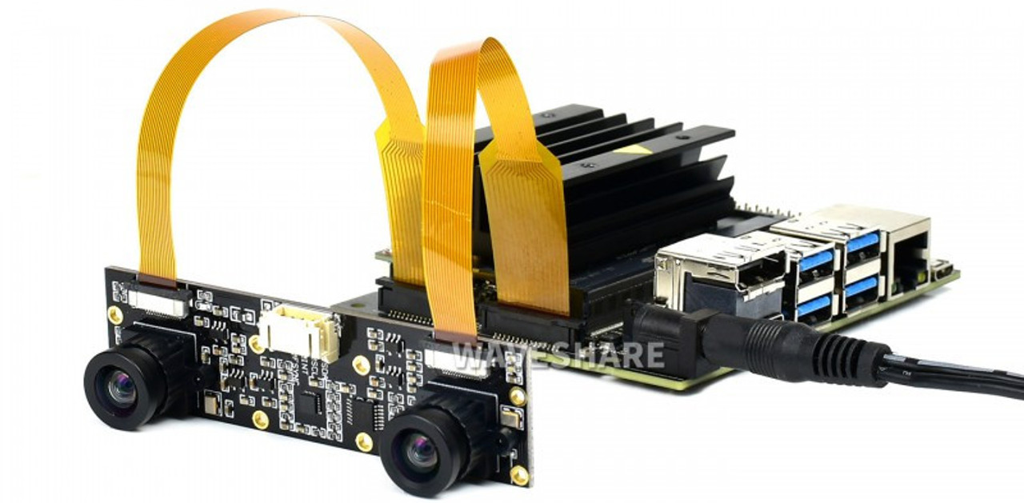
OBSTACLE DETECTION / OBSTACLE RECOGNITION
We had previously worked on obstacle detection and recognition using the YOLO library.
Since depth perception cannot be achieved with a single camera, distance measurement was not possible.
We have decided to use a stereo camera module that includes dual cameras.
We will integrate our distance measuring system with object recognition to complete the functionality of the product.
IMX219-83 Binocular Camera

Slide 3
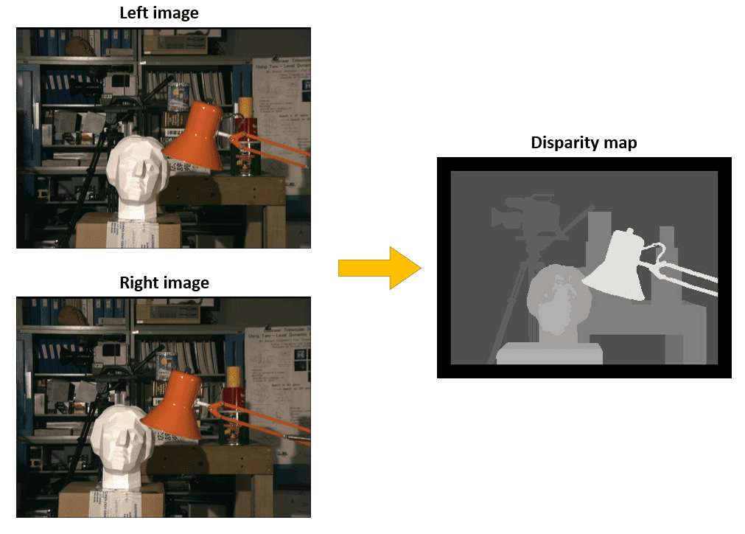
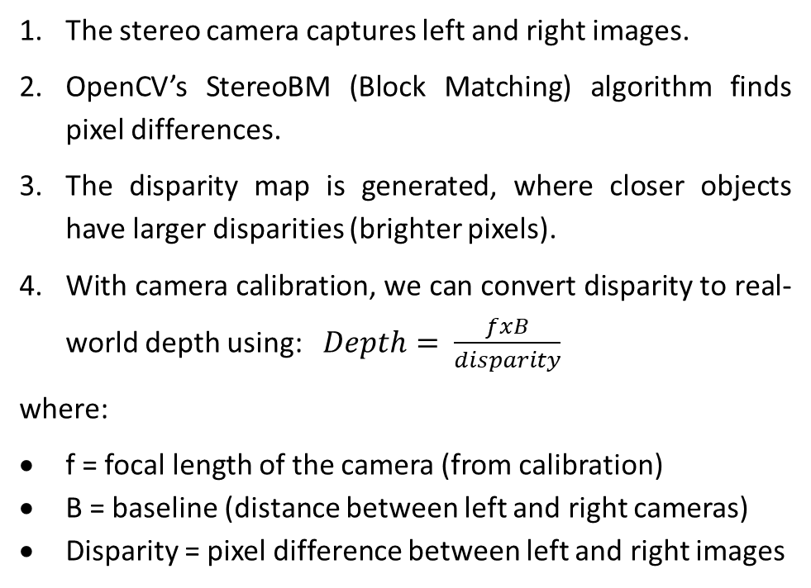
DISTANCE DETECTION
Stereo Camera can estimate depth by using stereo vision, where two cameras capture slightly different perspectives of the same scene. Depth is calculated using disparity map (finding the distances between corresponding pixels from two stero images).
The stereo camera captures left and right images.
OpenCV’s StereoBM (Block Matching) algorithm finds pixel differences.
The disparity map is generated, where closer objects have larger disparities (brighter pixels).
With camera calibration, we can convert disparity to real-world depth using: $Depth= \frac{fxB}{disparity}$
where:
f = focal length of the camera (from calibration)
B = baseline (distance between left and right cameras)
Disparity = pixel difference between left and right images

Slide 4
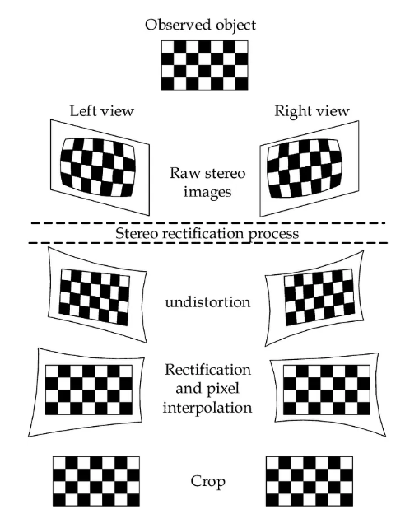
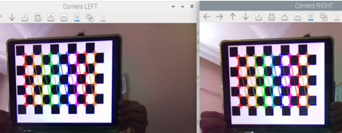
DISPARITY MAP
30 pairs of chessboard images are captured, from various angles and distances.
The removal of radial and tangential distortion that images suffer from due to camera lenses and rectification of the stereo camera are done.
The inner corners of the chessboard are identified in each frame, yielding the 2-D position of each corner in the image.
The photos are resampled so that the correspinding points are in the same horizontal row, and the search is limited to the x-axis.
Each pixel's horizontal counterpart in the left and right images is looked for, and the pixel shift (disparity) is determined.

Slide 5
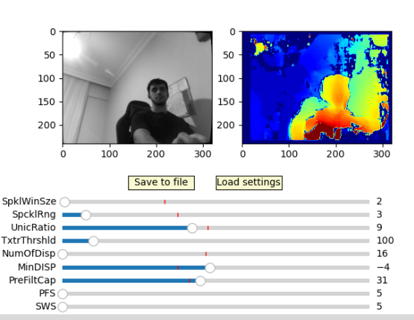
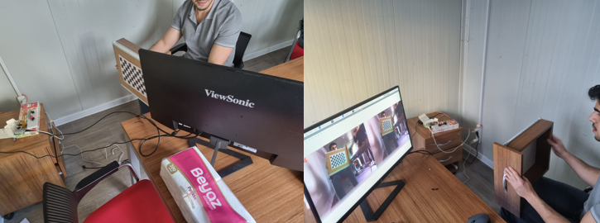
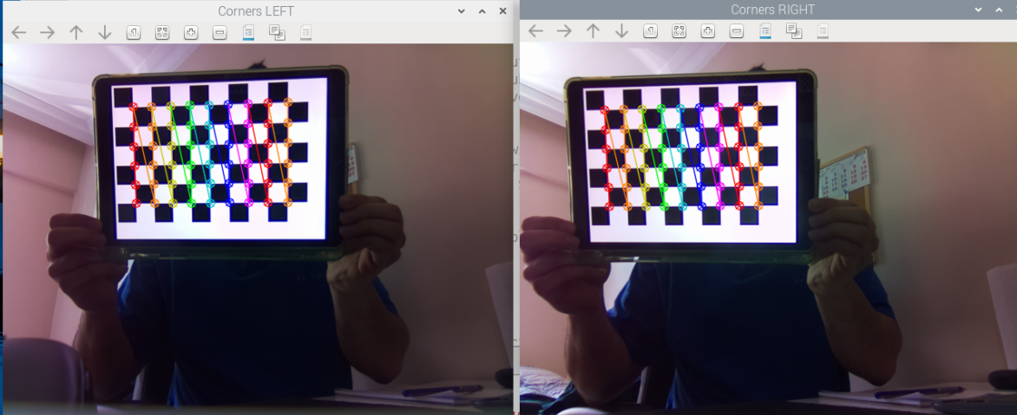
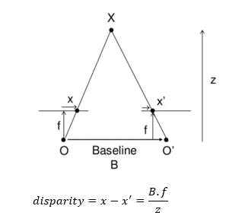
DISPARITY MAP
We did these steps in order. Below figures shows the steps required to create a disparity map.

Slide 6
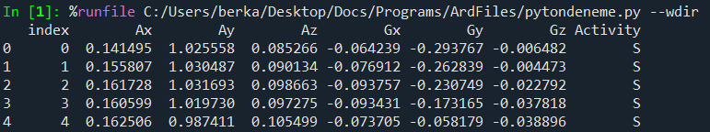

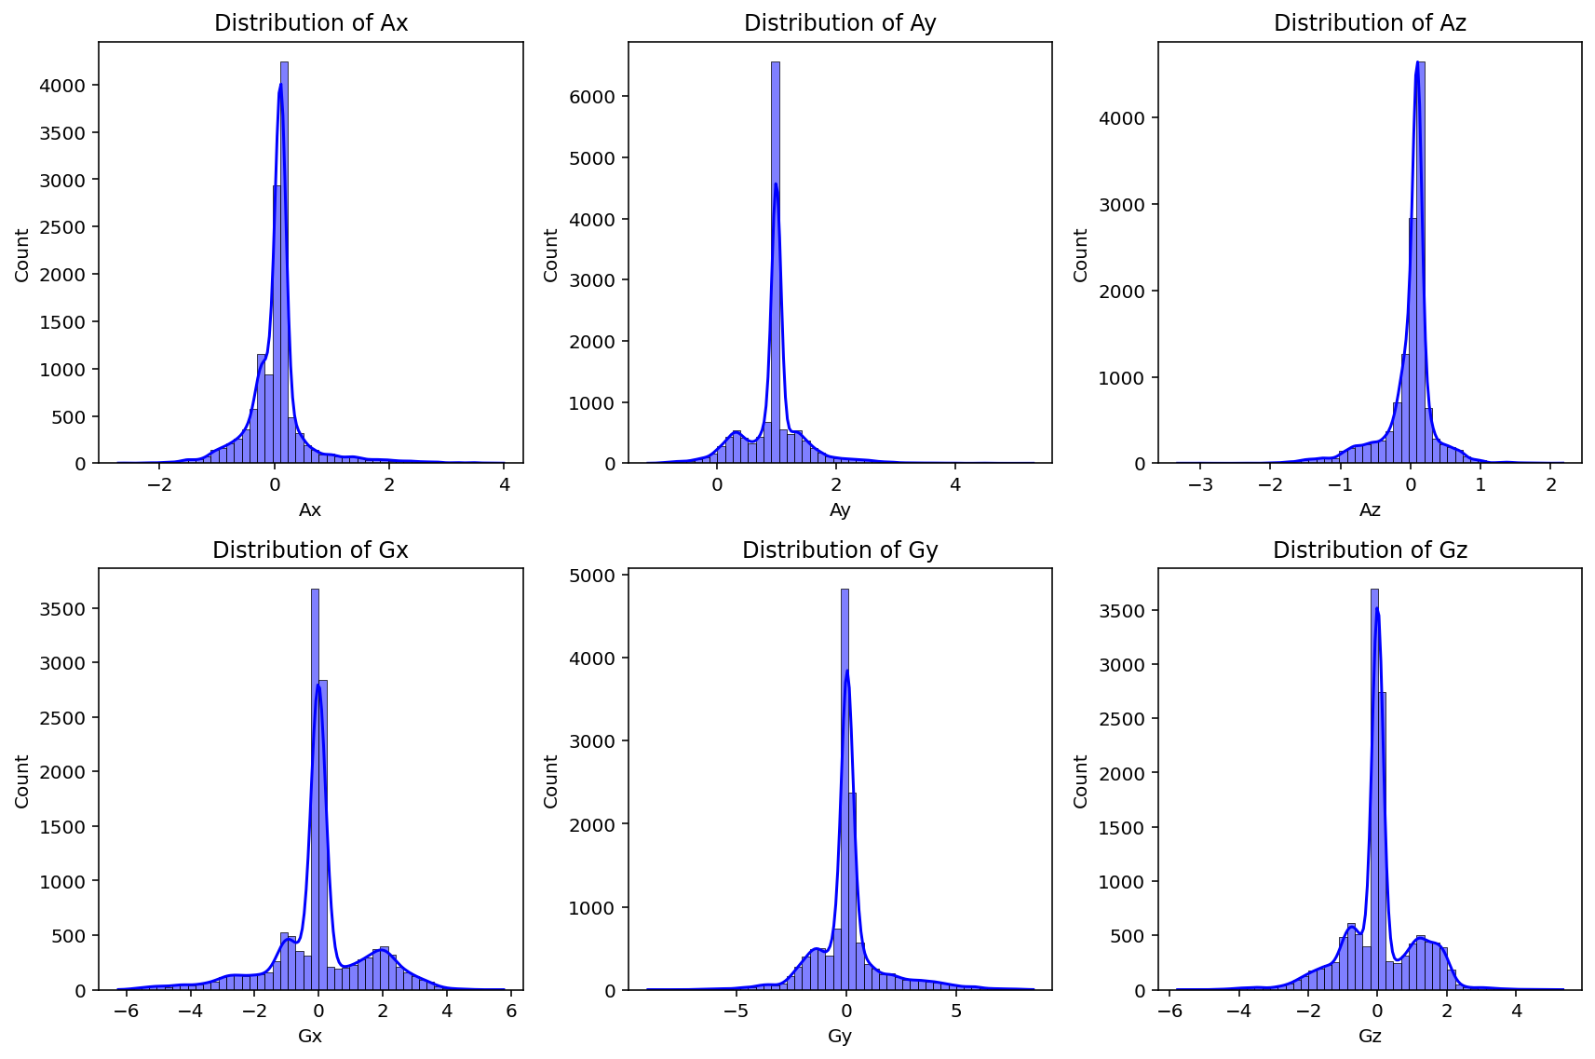
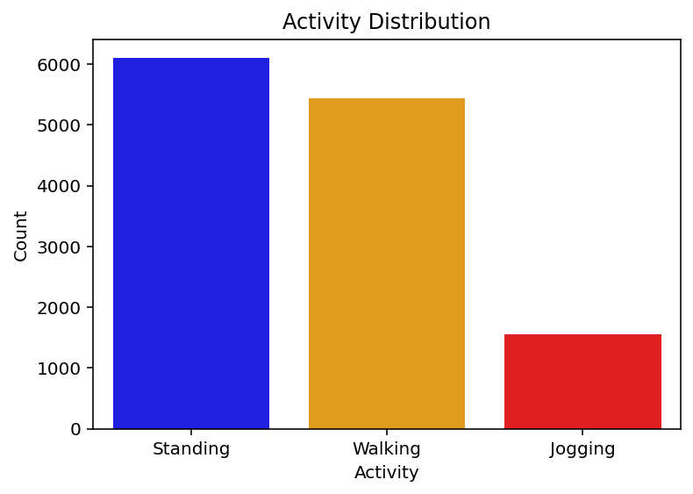
ACTIVITY MONITORING PROGRESS

Slide 7
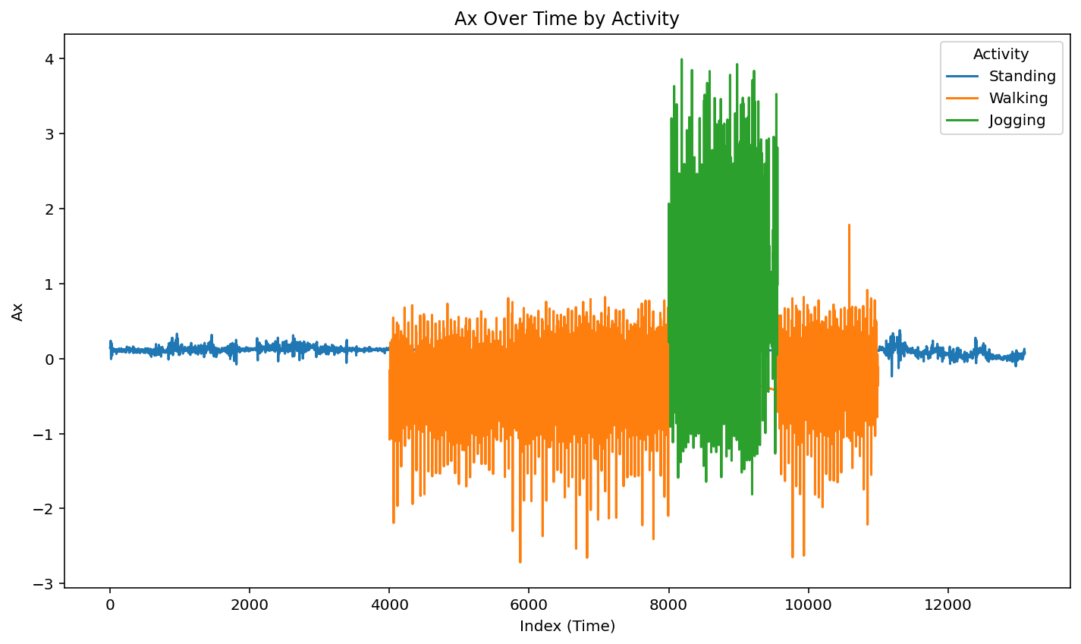
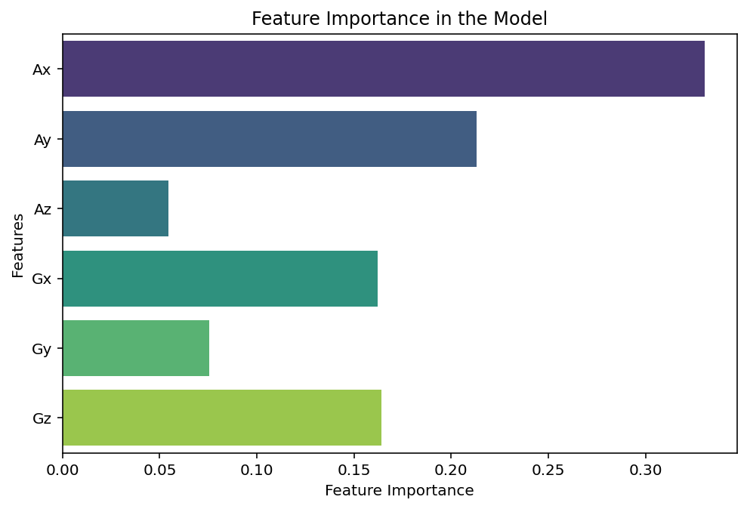
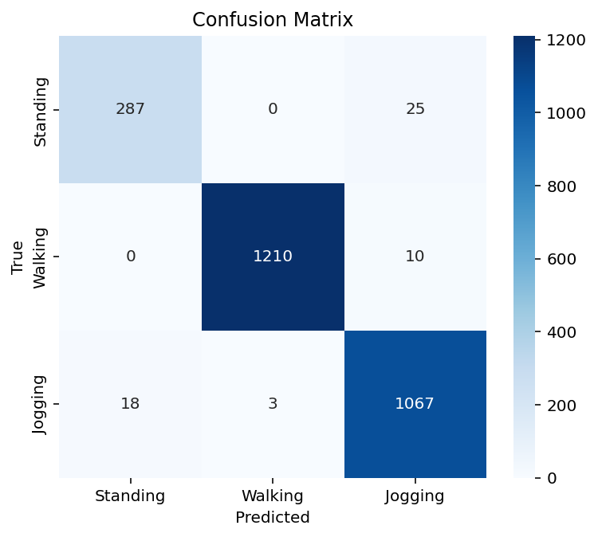
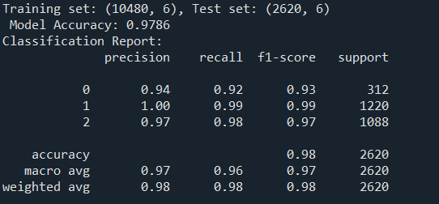
MODEL PERFORMANCE

Slide 8
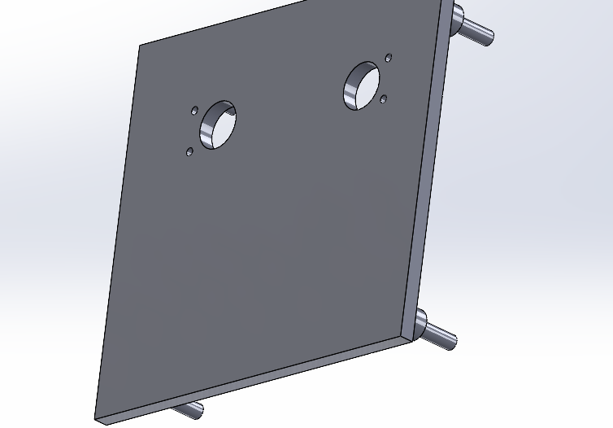
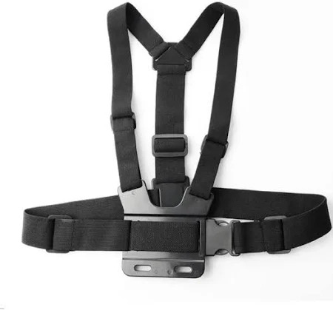
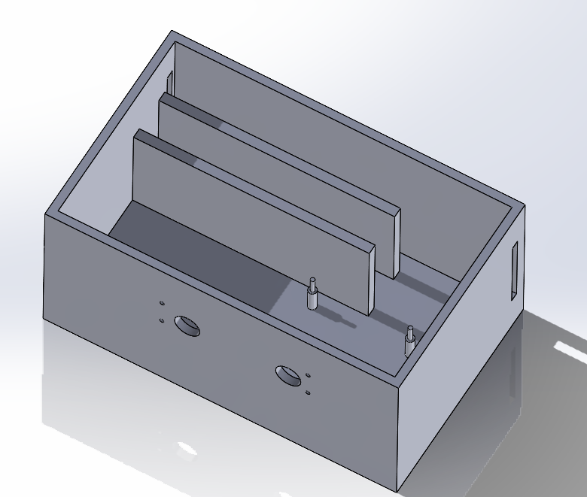
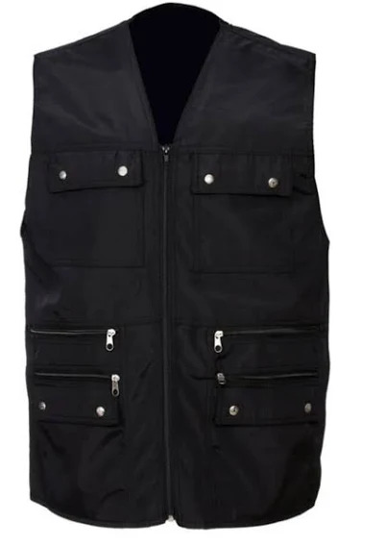
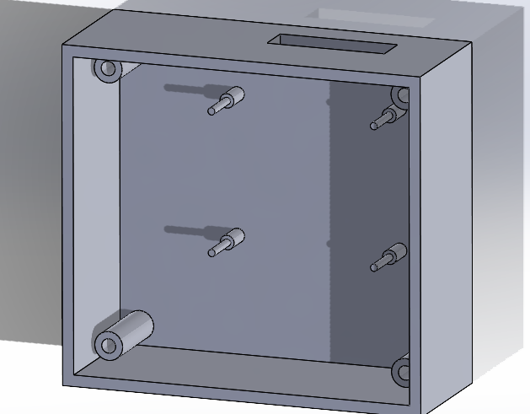
PRODUCT DESIGN
20x12x10
Rapberry PI
8x5 Breadboard
IMU Sensor
Powerbank
With straps
12x5x11
Rapberry PI
Mini Breadboard
IMU Sensor
With a vest

Slide 9
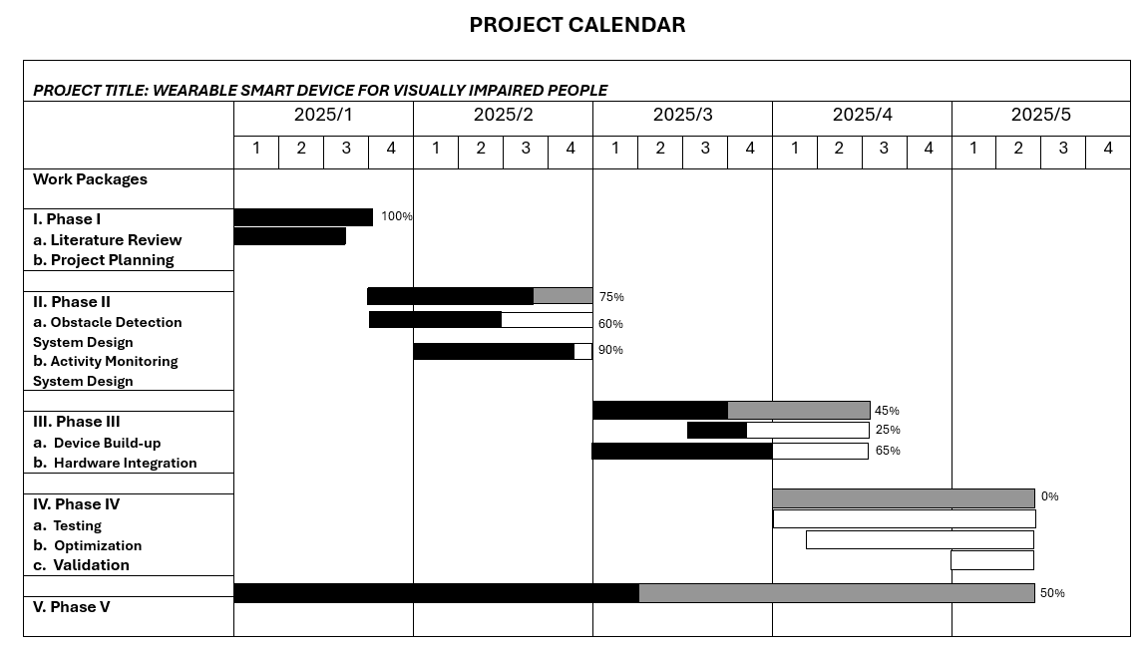
PROJECT CALENDAR

Slide 10
EXPENDITURES
 | Work Packages
 | I | II | III | IV | TOTAL
Equipment | - | 9850 TL | - | - | 9850 TL
Consumable goods | - | - | - | - | 0
Publications/Software | - | - | - | - | 0
Transportation | - | - | - | - | 0
Services | - | - | - | - | 0
TOTAL | 0 | 9850 TL | 0 | 0 | 9850 TL
Equipment:
Raspberry Pi 5 8GB with Active Cooling – 4.142,30 TL
IMX219-83 Stereo Camera - 2.901,64 TL
BNO055 IMU Sensor – 1.842 TL
Raspberry Pi 5 SD Card and HDMI Cable – 965,42 TL

