Slide 1
Servlet Filters and Chains Outline
Servlet Filters
Order of the Filter Chain - I
Order of the Filter Chain – II
FilterChainProxy – I
FilterChainProxy – II
FilterChainProxy – III
DelegatingFilterProxy
SecurityFilterChain

Slide 2
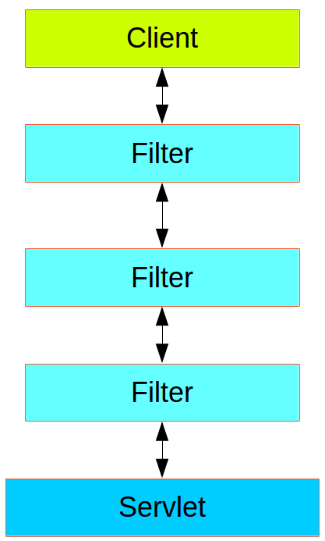
Servlet Filters
Spring Security in the web tier is based on Servlet Filters.
The client sends a request to the application
The container decides which filters and which servlet apply to it based on the path of the request URI.
At most, one servlet can handle a single request, but filters form a chain, so they are ordered.
In fact, a filter can veto the rest of the chain if it wants to handle the request itself.
A filter can also modify the request, or the response used in the downstream filters and servlet.
Typical layering of the handlers for a single HTTP request.

Slide 3
Order of the Filter Chain - I
The order of the filter chain is very important, and Spring Boot manages it through two mechanisms:
@Beans of type Filter can
Be part of a FilterRegistrationBean that itself has an order as part of its API
Be annotated by the @Order annotation
Implement the Ordered interface
<<interface>>
Ordered
<<interface>>
IS-A
Ordered
<<abstract class>>
RegistrationBean
public interface Ordered { int HIGHEST_PRECEDENCE = Integer.MIN_VALUE; int LOWEST_PRECEDENCE = Integer.MAX_VALUE; int getOrder(); }
IS-A
<<abstract class>>
DynamicRegistrationBean
IS-A
<<class>>
<<abstract class>>
FilterRegistrationBean
AbstractFilterRegistrationBean
IS-A

Slide 4
Order of the Filter Chain - II
Some off-the-shelf filters define their own constants to help signal what order they like to be in relative to each other:
SessionRepositoryFilter has a DEFAULT_ORDER of Integer.MIN_VALUE + 50,
which tells us it likes to be early in the chain, but it does not rule out other filters coming before it.
<<class>>
SessionRepositoryFilter
@Order(SessionRepositoryFilter.DEFAULT_ORDER)
public class SessionRepositoryFilter<S extends Session> extends OncePerRequestFilter {
. . . // intentionally skipped
public static final int DEFAULT_ORDER = Integer.MIN_VALUE + 50;
. . . // intentionally skipped
}

Slide 5
FilterChainProxy - I
Spring Security is installed as a single Filter in the chain, and its concrete type is FilterChainProxy.
public interface Filter { default void init(FilterConfig filterConfig) throws ServletException { } void doFilter(ServletRequest request, ServletResponse response, FilterChain chain)
throws IOException, ServletException; default void destroy() { } }
<<interface>>
Filter
jakarta.servlet
IS-A
<<abstract class>>
GenericFilterBean
org.springframework.web.filter
IS-A
package jakarta.servlet; import java.io.IOException; public interface FilterChain { void doFilter(ServletRequest request, ServletResponse response)
throws IOException, ServletException; }
<<class>>
FilterChainProxy
org.springframework.security.web

Slide 6
FilterChainProxy - II
In a Spring Boot application, the security filter is a @Bean in the ApplicationContext, and it is installed by default so that it is applied to every request.
It is installed at a position defined by SecurityProperties.DEFAULT_FILTER_ORDER which in turn is anchored by OrderedFilter.REQUEST_WRAPPER_FILTER_MAX_ORDER.
OrderedFilter.REQUEST_WRAPPER_FILTER_MAX_ORDER is the maximum order that a Spring Boot application expects filters to have if they wrap the request, modifying its behavior.
package org.springframework.boot.web.servlet.filter;
public interface OrderedFilter extends Filter, Ordered { int REQUEST_WRAPPER_FILTER_MAX_ORDER = 0; }
package org.springframework.boot.autoconfigure.security;
public class SecurityProperties {
. . . // intentionally skipped
public static final int DEFAULT_FILTER_ORDER = OrderedFilter.REQUEST_WRAPPER_FILTER_MAX_ORDER -100;
. . . // intentionally skipped }

Slide 7
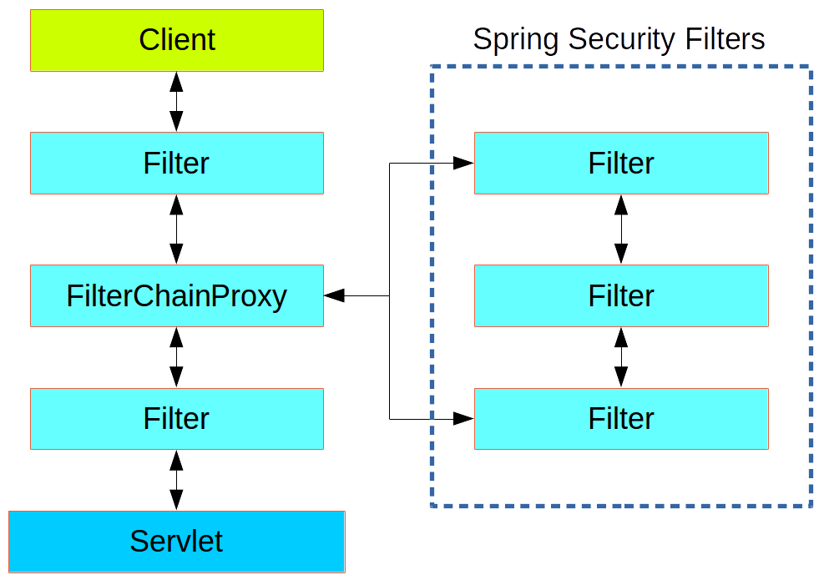
FilterChainProxy - III
From the point of view of the container, Spring Security is a single physical Filter, but, inside of it, there are additional filters, each playing a special role.
delegates processing to a chain of internal filters.
It is the FilterChainProxy that contains all the security logic arranged internally as a chain (or chains) of filters.
All the filters have the same API since they all implement the Filter interface.
They all have the opportunity to veto the rest of the chain.

Slide 8
DelegatingFilterProxy
There is even one more layer of indirection in the security filter
usually installed in the container as a DelegatingFilterProxy, which does not have to be a Spring @Bean.
delegates to a FilterChainProxy, which is always a @Bean, usually with a fixed name of springSecurityFilterChain.
<<interface>>
IS-A
<<interface>>
<<class>>
WebApplicationContext
ApplicationContext
DelegatingFilterProxy
HAS-A
<<interface>>
Filter
<<interface>>
Filter
jakarta.servlet
package org.springframework.boot.autoconfigure.security;
public class DelegatingFilterProxy extends GenericFilterBean {
. . . // intentionally skipped
private WebApplicationContext webApplicationContext;
private volatile Filter delegate;
. . . // intentionally skipped }
IS-A
<<abstract class>>
GenericFilterBean
org.springframework.web.filter
IS-A
<<class>>
DelegatingFilterProxy
org.springframework.web.filter

Slide 9
SecurityFilterChain
Defines a filter chain which is capable of being matched against an HttpServletRequest to decide whether it applies to that request.
Used to configure a FilterChainProxy.
<<interface>>
package org.springframework.security.web;
public interface SecurityFilterChain { boolean matches(HttpServletRequest request); List<Filter> getFilters(); }
SecurityFilterChain
org.springframework.security.web
IS-A
<<class>>
DefaultSecurityFilterChain
org.springframework.security.web
package org.springframework.security.web;
public interface DefaultSecurityFilterChain implements SecurityFilterChain { . . . // intentionally skipped
private final RequestMatcher requestMatcher; private final List<Filter> filters;
. . . // intentionally skipped }
<<interface>>
<<class>>
RequestMatcher
DefaultSecurityFilterChain
HAS-A
<<interface>>
Filter

