Slide 1
Web Security Outline
WebSecurityConfiguration
WebSecurity – I
WebSecurity – II
WebSecurity – III
WebSecurityConfigurerAdapter
WebSecurityConfigurer
SecurityConfigurer

Slide 2
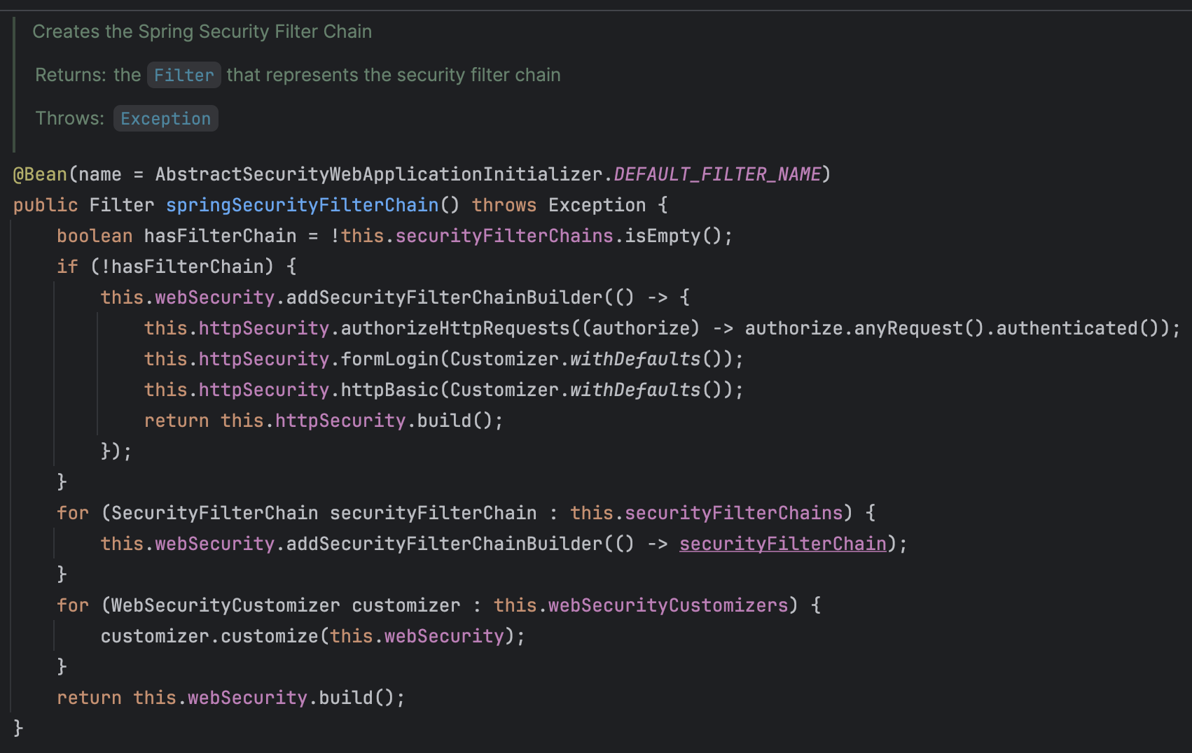
WebSecurityConfiguration
Uses a WebSecurity to create the FilterChainProxy that performs the web-based security for Spring Security.
Customizations can be made to WebSecurity
by implementing WebSecurityConfigurer and exposing it as a Configuration or
exposing a WebSecurityCustomizer bean.
This configuration is imported when using EnableWebSecurity.
package org.springframework.security.config.annotation.web.configuration;
@Configuration( proxyBeanMethods = false )
public interface WebSecurityConfiguration implements ImportAware, BeanClassLoaderAware { . . . // intentionally skipped
private WebSecurity webSecurity;
private HttpSecurity httpSecurity; private List<SecurityFilterChain> securityFilterChains = Collections.emptyList();
. . . // intentionally skipped }

Slide 3
WebSecurity - I
The WebSecurity is created by WebSecurityConfiguration to create the FilterChainProxy known as the Spring Security Filter Chain (springSecurityFilterChain).
The springSecurityFilterChain is the Filter that the DelegatingFilterProxy delegates to.
Customizations to the WebSecurity can be made by
creating a WebSecurityConfigurer or
exposing a WebSecurityCustomizer bean.
package org.springframework.security.config.annotation.web.builders;
public final class WebSecurity extends AbstractConfiguredSecurityBuilder<Filter, WebSecurity> implements SecurityBuilder<Filter>, ApplicationContextAware, ServletContextAware {
. . . // intentionally skipped
private final List<RequestMatcher> ignoredRequests; private final List<SecurityBuilder<? extends SecurityFilterChain>> securityFilterChainBuilders; private HttpFirewall httpFirewall; private ServletContext servletContext;
. . . // intentionally skipped }

Slide 4
WebSecurity - II
<<interface>>
package org.springframework.security.config.annotation;
public interface SecurityBuilder<O> {
O build() throws Exception; }
SecurityBuilder
org.springframework.security.config.annotation
Builds an Object.
IS-A
<<abstract class>>
package org.springframework.security.config.annotation;
public abstract class AbstractSecurityBuilder<O> implements SecurityBuilder<O> {
private AtomicBoolean building = new AtomicBoolean();
private O object;
@Override
public final O build() throws Exception {
if (this.building.compareAndSet(false, true)) { this.object = doBuild(); return this.object; } throw new AlreadyBuiltException("This object has already been built");
}
public final O getObject() {
if (!this.building.get()) { throw new IllegalStateException("This object has not been built"); } return this.object;
}
protected abstract O doBuild() throws Exception; }
AbstractSecurityBuilder
org.springframework.security.config.annotation
IS-A
<<abstract class>>
AbstractConfiguredSecurityBuilder
org.springframework.security.config.annotation
IS-A
<<class>>
A base SecurityBuilder that ensures the object being built is only built one time.
WebSecurity
org.springframework.security.config.annotation.web.builders

Slide 5
WebSecurity - III
package org.springframework.security.config.annotation;
public abstract class AbstractConfiguredSecurityBuilder<O, B extends SecurityBuilder<O>> extends AbstractSecurityBuilder<O> {
private final LinkedHashMap<Class<? extends SecurityConfigurer<O, B>>, List<SecurityConfigurer<O, B>>> configurers;
private BuildState buildState = BuildState.UNBUILT;
. . . // intentionally skipped
@Override
protected final O doBuild() throws Exception {
synchronized (this.configurers) { this.buildState = BuildState.INITIALIZING; beforeInit(); init(); this.buildState = BuildState.CONFIGURING; beforeConfigure(); configure(); this.buildState = BuildState.BUILDING; O result = performBuild(); this.buildState = BuildState.BUILT; return result; }
}
protected abstract O performBuild() throws Exception;
. . . // intentionally skipped }
<<abstract class>>
AbstractConfiguredSecurityBuilder
IS-A
A base SecurityBuilder that allows SecurityConfigurer to be applied to it.
This makes modifying the SecurityBuilder a strategy that can be customized and broken up into several SecurityConfigurer objects that have more specific goals than that of the SecurityBuilder.
For example, a SecurityBuilder may build an DelegatingFilterProxy, but a SecurityConfigurer might populate the SecurityBuilder with the filters necessary for session management, form-based login, authorization, etc.
<<class>>
WebSecurity

Slide 6
WebSecurityConfigurerAdapter
Provides a convenient base class for creating a WebSecurityConfigurer instance.
The implementation allows customization by overriding methods.
<<interface>>
SecurityConfigurer
org.springframework.security.config.annotation
IS-A
<<abstract class>>
WebSecurityConfigurerAdapter
org.springframework.security.config.annotation.web.configuration
package org.springframework.security.config.annotation.web.configuration;
public abstract class WebSecurityConfigurerAdapter extends SecurityConfigurer<Filter, WebSecurity> {
private final AuthenticationManagerBuilder authenticationBuilder;
private final AuthenticationManagerBuilder parentAuthenticationBuilder;
. . . // intentionally skipped
private AuthenticationManager authenticationManager;
private HttpSecurity http;
. . . // intentionally skipped }
Configures the SecurityBuilder instance, i.e., WebSecurity.

Slide 7
WebSecurityConfigurer
Allows customization to the WebSecurity.
In most instances users will use EnableWebSecurity and create a Configuration that exposes a SecurityFilterChain bean.
This will automatically be applied to the WebSecurity by the EnableWebSecurity annotation.
package org.springframework.security.config.annotation.web;
public interface WebSecurityConfigurer<T extends SecurityBuilder<Filter>> extends SecurityConfigurer<Filter, T> { }

Slide 8
SecurityConfigurer
Allows for configuring a SecurityBuilder.
All SecurityConfigurer first have their init(SecurityBuilder) method invoked.
After all init(SecurityBuilder) methods have been invoked, each configure(SecurityBuilder) method is invoked.
package org.springframework.security.config.annotation.web.configuration;
// Type parameters:
// <O> – The object being built by the SecurityBuilder B
// <B> – The SecurityBuilder that builds objects of type O.
// This is also the SecurityBuilder that is being configured.
public interface SecurityConfigurer<O, B extends SecurityBuilder<O>> {
void init(B builder) throws Exception;
void configure(B builder) throws Exception;
}

