Slide 1
Customizations Outline
Dispatching Requests to the First Chain That Matches
Configuration of Filter Chains
Creating and Customizing Filter Chains - I
Creating and Customizing Filter Chains – II
Request Matching for Dispatch and Authorization
Combining Application Security Rules with Actuator Rules

Slide 2
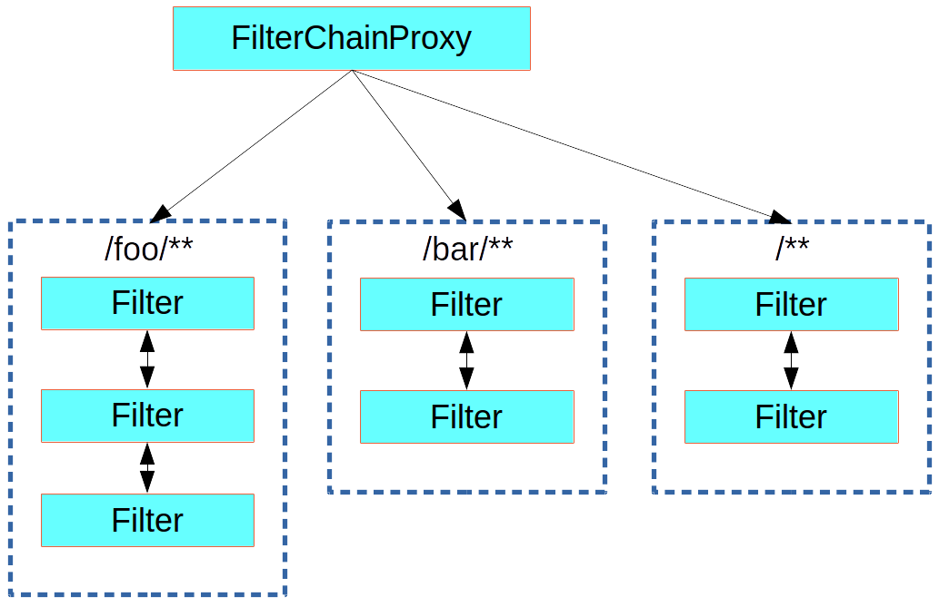
Dispatching Requests to the First Chain That Matches
There can be multiple filter chains all managed by Spring Security in the same top level FilterChainProxy and all are unknown to the container.
The Spring Security filter contains a list of filter chains and dispatches a request to the first chain that matches it.
The most important feature of this dispatch process is that only one chain ever handles a request.
The dispatch happening based on matching the request path
/foo/** matches before /**.

Slide 3
Configuration of Filter Chains
A vanilla Spring Boot application with no custom security configuration has a several (call it n) filter chains, where usually n=6.
The first (n-1) chains are there just to ignore static resource patterns, like /css/** and /images/**, and the error view: /error.
The last chain matches the catch-all path (/**) and is more active, containing logic for authentication, authorization, exception handling, session handling, header writing, and so on.
There are a total of 11 filters in this chain by default.
Users don’t have to concern themselves with which filters are used and when.
All filters internal to Spring Security are unknown to the container is important, especially in a Spring Boot application, where, by default, all @Beans of type Filter are registered automatically with the container.
If you want to add a custom filter to the security chain, you need to either
not make it be a @Bean or
wrap it in a FilterRegistrationBean that explicitly disables the container registration.

Slide 4
Creating and Customizing Filter Chains - I
The default fallback filter chain in a Spring Boot application (the one with the /** request matcher) has a predefined order of SecurityProperties.BASIC_AUTH_ORDER.
Order applied to the SecurityFilterChain that is used to configure basic authentication for application endpoints.
The actual order can be interpreted as prioritization, with the first object (with the lowest order value) having the highest priority.
package org.springframework.boot.autoconfigure.security;
public class SecurityProperties {
. . . // intentionally skipped
public static final int BASIC_AUTH_ORDER = Ordered.LOWEST_PRECEDENCE - 5;
public static final int IGNORED_ORDER = Ordered.HIGHEST_PRECEDENCE;
. . . // intentionally skipped }
SecurityProperties.IGNORED_ORDER is applied to the WebSecurityCustomizer that ignores standard static resource paths.

Slide 5
Creating and Customizing Filter Chains - II
You can switch it off completely by setting security.basic.enabled = false, or
You can use it as a fallback and define other rules with a lower order.
Add a @Bean of type WebSecurityConfigurer and
Decorate the class with @Order:
@Configuration
@Order(SecurityProperties.BASIC_AUTH_ORDER - 10)
public class ApplicationConfigurerAdapter extends WebSecurityConfigurerAdapter {
@Override
protected void configure(HttpSecurity http) throws Exception {
http.antMatcher("/match1/**")
...;
} }
This bean causes Spring Security to add a new filter chain and order it before the fallback.

Slide 6
Request Matching for Dispatch and Authorization
A security filter chain (or, equivalently, a WebSecurityConfigurerAdapter) has a request matcher that is used to decide whether to apply it to an HTTP request.
Once the decision is made to apply a particular filter chain, no others are applied.
However, within a filter chain, you can have more fine-grained control of authorization by setting additional matchers in the HttpSecurity configurer, as follows:
@Configuration
@Order(SecurityProperties.BASIC_AUTH_ORDER - 10)
public class ApplicationConfigurerAdapter extends WebSecurityConfigurerAdapter {
@Override
protected void configure(HttpSecurity http) throws Exception {
http.antMatcher("/match1/**").authorizeRequests() // this one is a request matcher for the whole filter chain
.antMatchers("/match1/user").hasRole("USER") // this one is only to choose the access rule to apply
.antMatchers("/match1/spam").hasRole("SPAM")
.anyRequest().isAuthenticated();
} }

Slide 7
Combining Application Security Rules with Actuator Rules
If you use the Spring Boot Actuator for management endpoints, you probably want them to be secure, and, by default, they are.
In fact, as soon as you add the Actuator to a secure application, you get an additional filter chain that applies only to the actuator endpoints.
It is defined with a request matcher that matches only actuator endpoints and
it has an order of ManagementServerProperties.BASIC_AUTH_ORDER, which is 5 fewer than the default SecurityProperties fallback filter, so it is consulted before the fallback.
@Configuration
@Order(ManagementServerProperties.BASIC_AUTH_ORDER + 1)
public class ApplicationConfigurerAdapter extends WebSecurityConfigurerAdapter {
@Override
protected void configure(HttpSecurity http) throws Exception {
http.antMatcher("/foo/**")
. . .;
} }
Applying Custom Application Security Rules to the Actuator Endpoints:
Add a filter chain that
is ordered earlier than the actuator one and
has a request matcher that includes all actuator endpoints.
Default Security Settings for the Actuator Endpoints
Add your own filter
later than the actuator one,
but earlier than the fallback, i.e., ManagementServerProperties.BASIC_AUTH_ORDER + 1

