Slide 1

Investing in cryptoassets
Jordan Clifford
jordan@scalar.capital

Slide 2

The internet has “changed everything”
News/media
Communications
Work
Education
Entertainment
Etc.

Slide 3
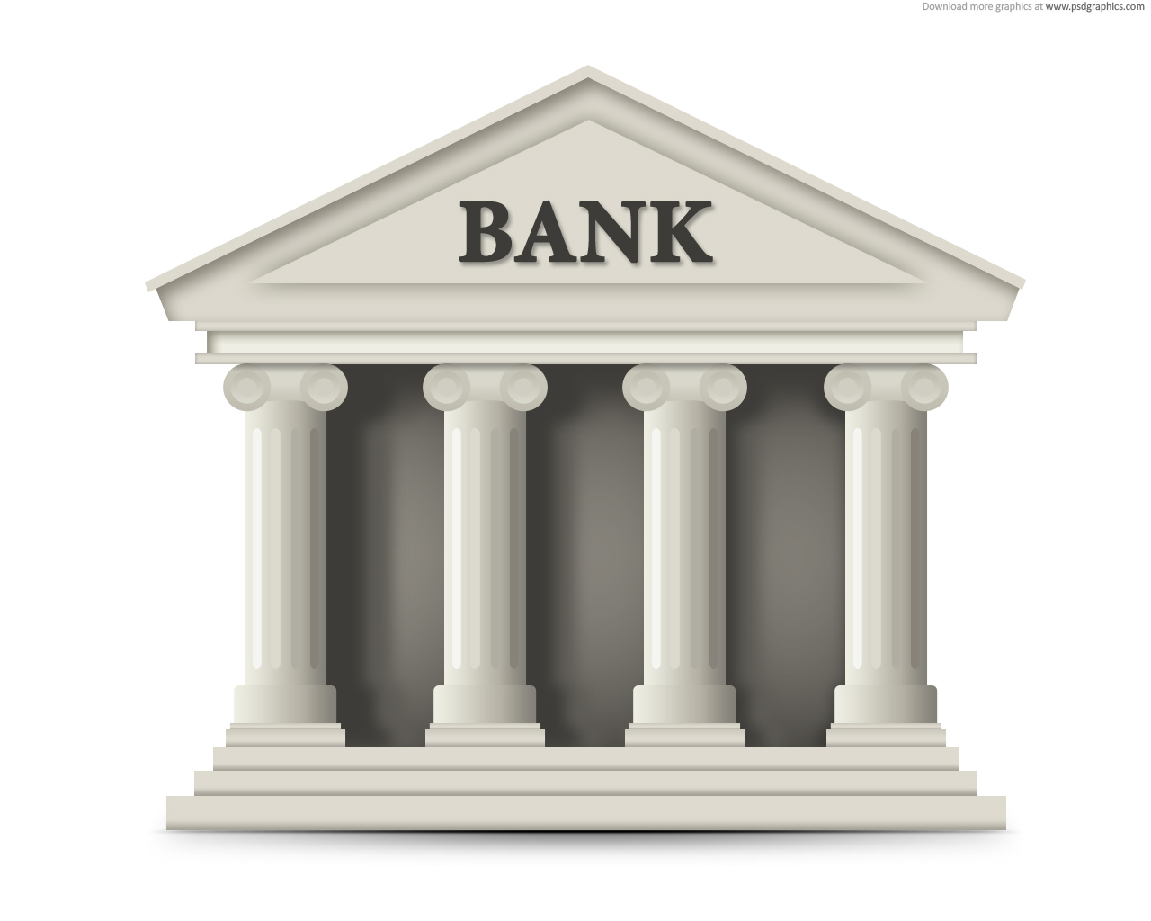
With the exception of money
Central banks of the world control the money supply with no guarantees
Money is primarily held at banks in custodial accounts
Money transmission requires
trust & permission of one or more third parties
special licensure and reporting
expensive fees ($30+ for international wires)
lots of time (4-5 business days common)
Inappropriate seizure of funds is possible, especially in underdeveloped nations

Slide 4


The cypherpunk quest for digital money
In 1983, David Chaum introduced the idea of digital money in his seminal paper, “Blind signatures for untraceable payments”
Money native to the internet would empower many people to author economic transactions without red tape
Early attempts at digital money:
1990, DigiCash
1996, E-Gold

Slide 5
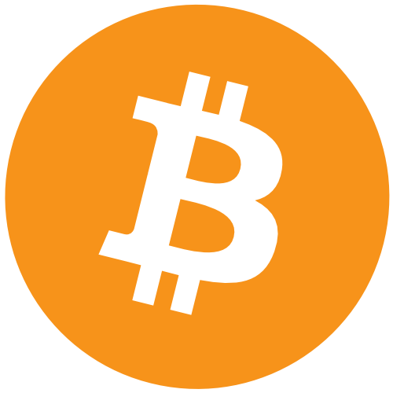
Bitcoin puts the pieces together - 2009
Earlier attempts at digital money failed due to central point of control
Without a central processor, preventing double spend was not yet understood
Bitcoin’s key breakthrough is Proof of Work Consensus
Miners are not pre-selected and may act anonymously
Miners all acting in their own self-interest, drive consensus forward

Slide 6
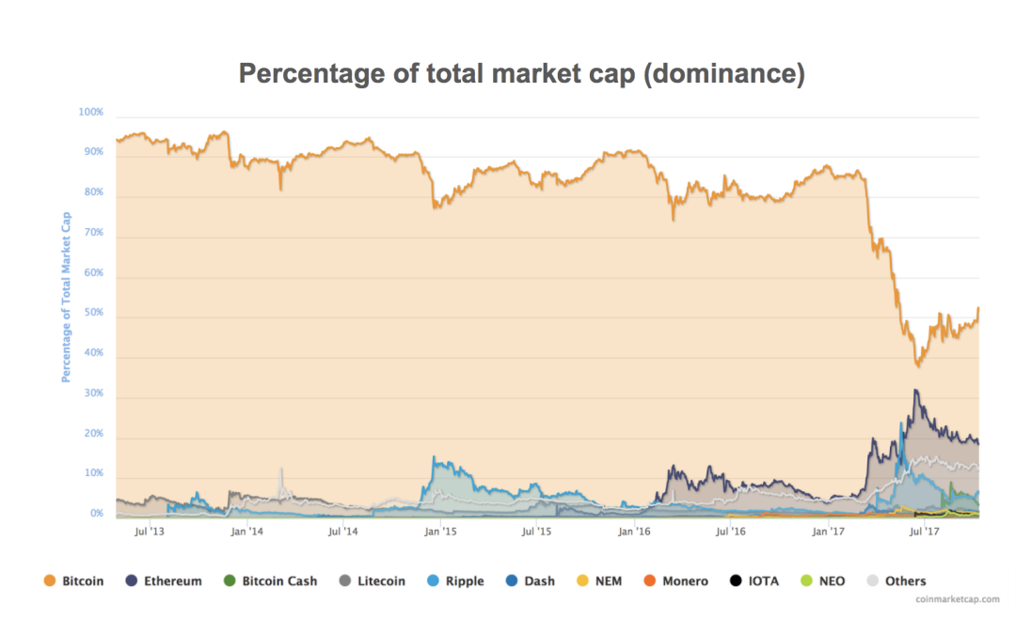
Bitcoin was first but is no longer the market

Slide 7
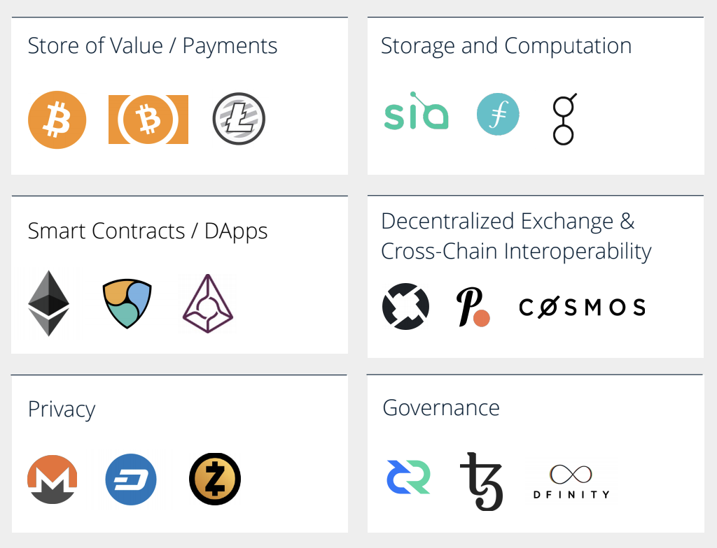
Currency is the tip of the iceberg

Slide 8


The Birth of a new asset or the “Token Generation Event”
Strategic presale
Private sale
Public sale
No “pre-mine”
One public sale / ICO
Participation
Egalitarian
Hybrid
Hierarchical
Team Funding
None / minimal
Moderate
Maximal
Centralization
Least
Most

Slide 9
Considerations when investing in cryptoassets
Target Market | Who is going to buy / hodl this token in the future? Why?
Technology | Is the technology built? Is there a credible plan if not?
Trust / Privacy | Does the system require trust or is it trust minimizing? How well does it preserve privacy?
Economics | Are there proper incentive structures to keep the players doing their job? (Miners, Relayer Nodes, Developers)
Team | Who is contributing to the project? Are they credible and do they have enough skin in the game?
Community | How big is the community? Is it growing? Productive?
Security model | Is there novel code or cryptography? Has it been peer-reviewed / hardened? Are there good testing practices?

