Slide 1
Modeling fertility over age and time as striving toward a goal: Individual behavior and aggregate rates
Ronald Lee
Berkeley Formal Demography Workshop
June 8, 2023

Slide 2
Current work on evolutionary life history theory of fertility

Slide 3
Questions
Why is age specific fertility bell shaped? (Not all biology!)
Did fert in LDCs decline due to family planning programs or decline in demand for births? (Was once a hot debate, e.g. Pritchett)
Same for US Baby Bust –contraception vs demand?
How do contraceptive efficacy and abortion access affect fertility over time?
Do fertility intensions in surveys predict future fertility?
What aggregate fertility variables to use for analysis of temporal change?

Slide 4
Perspectives on quantum and tempo
A traditional view:
Couple formulates at marriage its desired completed fertility (D) “quantum”
Constant throughout life.
A normal pattern of timing and spacing leads to outcome D. “tempo”
Period socioeconomic context may lead to changes in tempo
Tempo changes then influence period TFR.
Bongaarts-Feeney:
Reject causal force of quantum as pole star.
Focus on advancing or postponing timing.
Moving target or stock adjustment approach
Fertility is intentional effort to achieve target, but subject to accident as well.
Both target D and spacing vary with period conditions, and changing D can cause changes in timing and spacing that would show up as tempo in other frameworks.

Slide 5
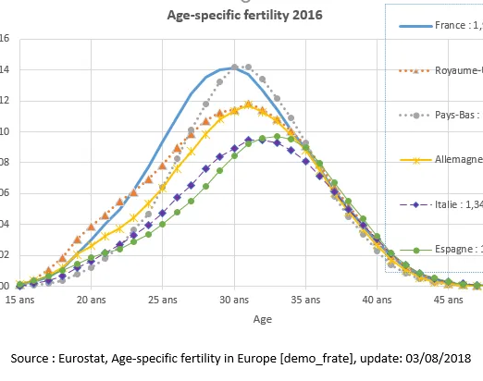
Why is fertility by age bell shaped?
Partly biology, but set that aside.
Demography
Age distribution of initiation of childbearing. (this used to be age at marriage, now much more complicated)
Distribution by duration of fertility once initiated.

Slide 6
Fertility of those who have initiated childbearing (Romania, av of 1985-2005), by union type and duration.
Other than consensual union, exponential decline is approximately right.
For direct marriage without cohab, there is delay in conception following marriage.
For married after cohab, looks like they get married following pregnancy.
Source: Copied from Hoem and Mureşan (2011)

Slide 7
I will focus on the second, fertility by duration x of “initiators”.

Slide 8
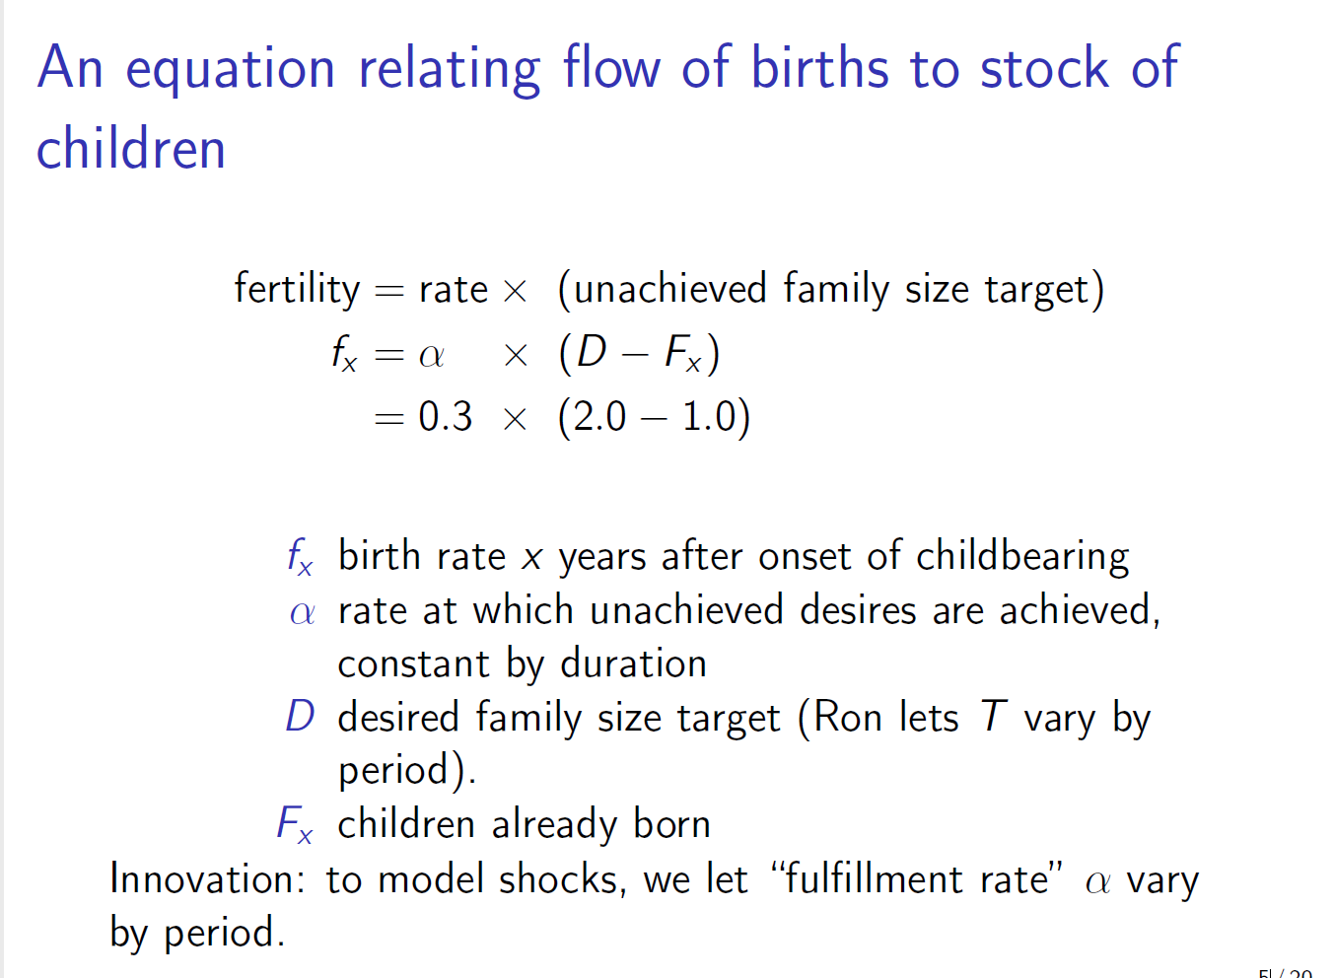
A slide from Josh and Tom. Apologies for using diff notation.

Slide 9
Basic equations of model
desired completed fertility target
Children already born
Additional children wanted
Fertility of initiators at duration x
Upper limit on x will depend on age at initiation of fertility, but for simplicity I will assume it is 20 years.

Slide 10
Fits pretty well: Marital fertility 18-39 by Additional Expected Births 18-39, 1955-75 (US married women)

Slide 11
Dynamics – longitudinal equations of motion
Rate of change of Children Ever Born at age x is fertility at age x.
This is the basic differential equation. Note D can change.
where k is chosen so
at time of initiation, A=D.
If target D is constant, then D’=0 and this becomes:
After initiation of childbearing, fertility declines exponentially. Very small at x=20; for simplicity assume 0.

Slide 12
Fertility goals changed systematically before, during, and after Baby Boom
Measures of fertility goals for US women, 1940-1980 (from Lee, 1980, “Aiming”)
Survey responses on “Ideal” and “Expected” lifetime fertility.
All measures are “period”.
“Expected” are contaminated by contraceptive number failures.
Note that cohort targets appear to change in period manner, that is all ages (birth cohorts) seem to change in same way at same time.

Slide 13
Measures of fertility goals for US women, 1940-1980 (from Lee, 1980, “Aiming”)
Remarkable longitudinal data from Detroit Area Study (DAS) show target change within a cohort and among the same women.
All are period measures except for longitudinal survey of Detroit Area Women, asked “Number of children wanted if life could be lived over again?”.
1962 3.9
1966 3.8
1977 3.1
Longitudinal declines similarly to period.

Slide 14
Dynamics with linear change in D(t)
Assume
After bunch of math we find
If b=0 then D=a and

Slide 15
That described fertility of initiation cohorts. Now get period fertility of initiators F(t)
Index each variable on x and on t.
Integrate g(x,t) over x at given t to find F(t).
After more math we find for linear case, assuming exp(lambda*20)=0:
(after x=20, fertility is 0 by assumption)
When b=0 D is constant and F(t)=D.
Evaluate for lambda=.2 and b=.1: F(t) = D(t) + 1.0.
For decline at .1 we get: F(t)=D(t) – 1.0.

Slide 16
Period total fert when D changes linearly then is constant.

Slide 17
Now dynamics with a sinusoidal variation in D, something like Baby Boom and Bust.
After some heroic math/arithmetic we find:

Slide 18
Simulated from fitted model in “Aiming” when D(t) varies from 2.1 to 3.1 over 50-year sinusoidal cycle. *Peak of TFR is 5 years after peak in D *Amplitude of swing in TFR is twice swing in D.

Slide 19
Why does TFR peak before D? Recall TFR is related to rate of change of D. TFR highest when D is rising most rapidly, and declines when it slows, well before its peak.

Slide 20
Many questioned the value of survey data on fertility expectations or intentions.
For example, Easterlin observed that period fertility rates declined well before either ideal of expected fertility, and concluded that '' ... changes in behavior precede those in attitudes, rather than vice versa" (Easterlin 1973, p.209). Easterlin's conclusion was cited with approval by Westoff (1978, p. 3).
The idea was that the survey data reflected ex post rationalizations of prior behavior.
Here we see that the earlier downturn in TFR is quite consistent with the expectations type data having real meaning.

Slide 21
Anything troubling about this analysis? Plenty.
Here are two problems:
“Does this mean that birth intervals are half as long when additional desired fertility is twice as great? That can’t be.”
“Those equations may hold when D is rising, but when D is falling they assume that women can reverse previous births, that is have negative fertility.”
Let’s explore one at a time.

Slide 22
Let’s address first problem by unpacking A
Let p(x) be the proportion of nonterminators at age x, that is, women who have not yet reached their target.
Let be the average additional wanted children at age x for nonterminators. Let m(x) be the birth rate to nonterminators.
Then: First problem: Let’s break down A, additional wanted.
Empirically, both m(x) and rise with
age, and their ratio is quite constant at .2.

Slide 23
Chart of A vs p; slope is At ages above 25, additional wanted, A(x), is a multiple of proportion wanting more, p(x).

Slide 24
Fertility is At ages above 25 marital fertility is closely related to proportion expecting more, p(x,t). Slope is about .3

Slide 25
This finesses the first problem: birth rate of nonterminators is pretty steady at .3 (from last slide). Additional wanted by nonterminators, alpha, is pretty steady at 1.5. Their ratio is steady at lambda= .2.

Slide 26
Irreversibility is a big problem. Here is a simulation of a fertility transition with declining D
Ignoring irreversibility we get this nice picture.
As D declines during the transition, the TFR drops even more, but once D stabilizes the TFR returns to its new equilibrium level.
Mean completed fertility will rise in later years.
Lambda = .1 means that completed fertility is well below D.

Slide 27
Introducing contraceptive failure
Terminators are at risk of number failure rates at rate Q₁
Nonterminators are at risk of timing failures at rate Q₂
g(x)* is “wanted fertility”, births wanted sometime.
g(x)** is “planned fertility”, neither number nor timing failures.

Slide 28
More on planned and unplanned fertility
Introduce m* the ex ante planned birth rate of nonterminators and the ex post planned rate of nonterminators g**, since nonterminators experiencing timing failures are not at risk of a planned birth in that yr.
This is all pretty complicated. Here is the expression for g:

Slide 29
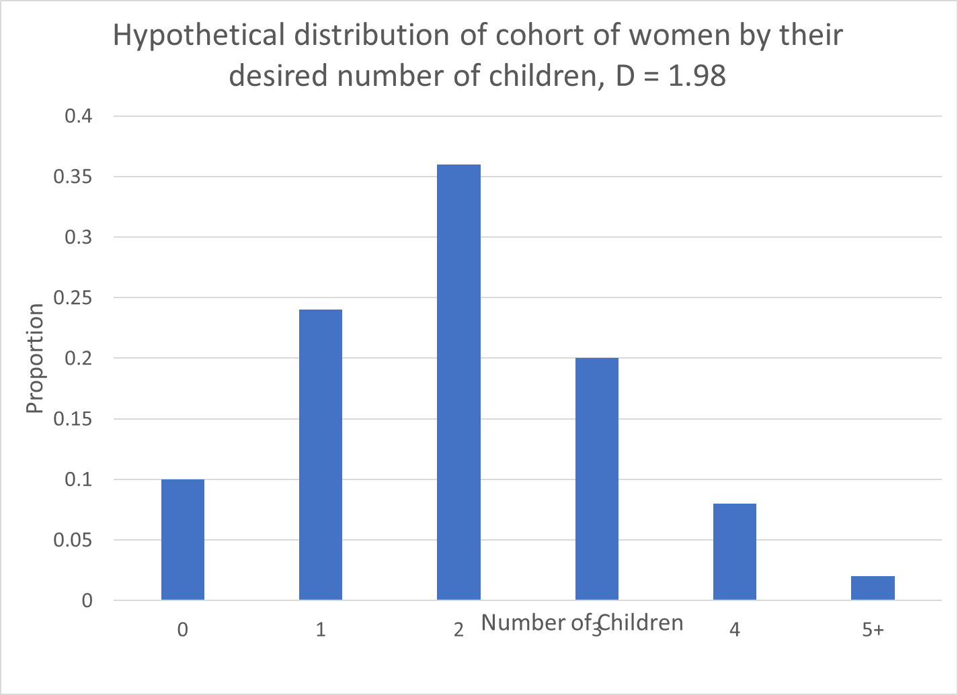
Made-up data for f(y)

Slide 30
For an initiation cohort of women with heterogeneous fertility targets (desires, demands)
y = number of births (continuous for simplicity) desired by a woman
f(y) = proportion of women wanting between y and y+dy births.
F(y) = proportion of women wanting at least y children
Integral over y of F(y) is mean of f(y), D.

Slide 31
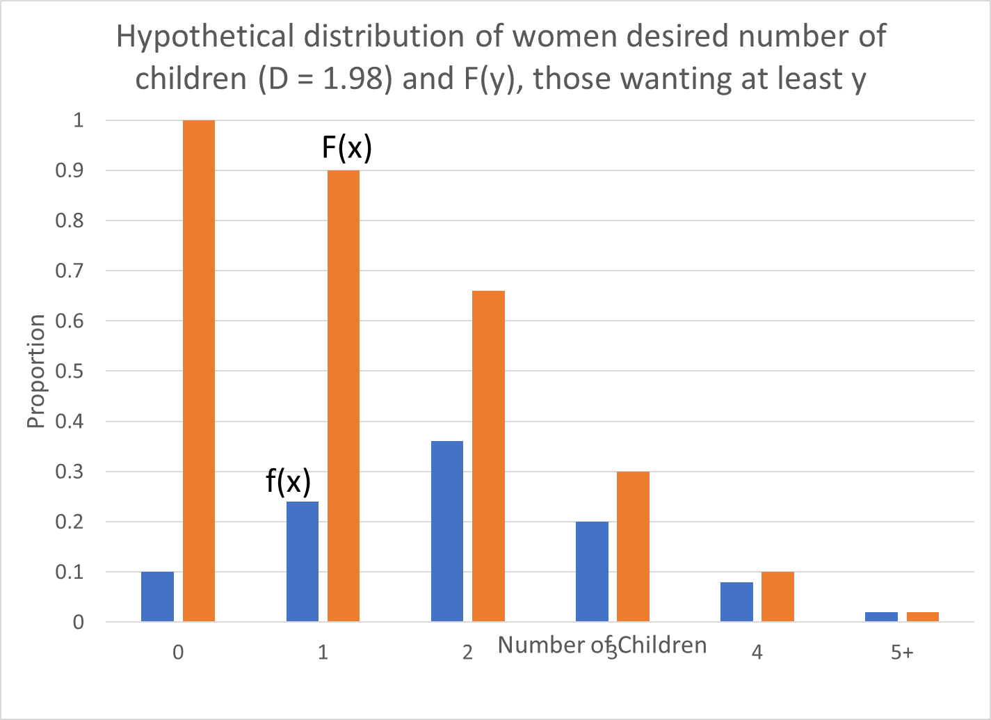
F(y) corresponding to f(y)

Slide 32
Fertility of an initiation cohort at duration x
m = birthrate of nonterminators
x years after initiating fertility a woman has mx births.
= Proportion of nonterminators after x years.
= Fertility of the cohort at duration x

Slide 33
Some implications
The shape of g(x) is identical to the shape of F(mx). An increase in f(1), or more generally in the proportion wanting few births, makes g(x) fall more rapidly at short durations.
The greater is m, the more quickly does g(x) decline with duration, and the higher is the level of fertility initially.
An increase in f(0), the proportion of women wanting no births, affects the level but not the shape of g(x).
A concentration of women at, say, a desire for 2 children will make g(x) fall more rapidly after about the first 5 years of marriage.

Slide 34
Differentiating we get:
Solving for f, and changing variables, we get:
Given an empirical age schedule for fertility by duration of marriage (e.g.) we could difference it to find the g’(x) function, and divide by m to get f(x), the distribution of fertility targets.
This actually works quite well, matching the survey data quite closely.

Slide 35
Changing goals – two strong assumptions:
At all times, all duration cohorts of women have the same distributions of family size goals
When fertility goals for women change, they change for all women by the same amount and in the same direction.
How deal with continuous change in discrete distribution?
To get D’ = .1, let 10% of women at each discrete desired number of children move up by one child more desired. Then D will increase by .1 while the distribution remains discrete.
Or – just let each category increase by .1, e.g. 1 becomes 1.1 etc. That works too.
For what follows, I assume this one. The whole distrib just slides left by .1. This requires fractional births.

Slide 36
write the distribution of y conditional on the value of its mean, thus:
Since shape of distribution is assumed invariant, write:
where h has exactly same shape as f, but is centered on mean 0 rather than D.
Similarly define
the proportion of women wanting at least y children when the mean desired completed fertility is D.

Slide 37
Now let D change over time: D(t)
divide women into two groups:
Nonterminators
Terminators who attained their desired fertility earlier but who may now want more births as a result of revising goal upwards as D rises.
First group:
x yrs after initiating reproduction a proportion P(x,t) of this group wants D(t) and has mx.
These women contribute a flow of births:

Slide 38
Integrate over all durations x for this cohort
These women were nonterminators already, so revising target upwards does not change their current behavior.
Therefore the nonterminators contribute enough births so TFR = D.

Slide 39
How about second group, the terminators?
Some will switch back to nonterminators status.
Suppose D’(t)<m, that is demand rises more slowly than the birthrate of nonterminators.
Then this group will remain constantly on the edge of terminator-nonterminator status, bearing additional children to match D’(t).
At duration x there are proportion 1-P(x,t) of these women, with birth rate D'(t).
Integrating over all durations, their contribution, k, is:

Slide 40
Where = 20 is upper duration limit to fecundity.
Combining the two groups of women we get:
With unchanging goals the second term is zero. TFR equals D(t).
With rising goals D'(t) is positive. Second term adds to TFR.
This “Acceleration effect" relates TFR to rate of change of goals, D'(t).
The greater is desired family size D, the smaller is acceleration effect, since fewer women will have become terminators.
Big enough D gives natural fertility population with no acceleration effect.

Slide 41
Illustration: when D is rising, TFR>D.
D(t) = 2.1 (replacement)
Fecund years after initiation = 20
m =.3 births/yr (for nonterminators).
Suppose D is rising .1 per year.
Acceleration effect k is
For Aiming model, the same case yields TFR=3.1. Pretty similar.

Slide 42
The TFR equals desired family size when desired family size is declining.
If D is declining, no woman switches from terminator to non-terminator status
If she wanted no children in the past, she certainly will not want more when she has reduced her overall target.
Therefore the only women bearing children will always have been nonterminators
Already shown that contribution to period fertility of nonterminators is exactly equal to D.
Therefore, when fertility goals decline TFR=D and there is no overall acceleration effect.
However, terminators are accumulating kids they would not have chosen to have.

Slide 43
The amplitude of fluctuations in the TFR exceeds the amplitude of fluctuations in desired family size.
Since TFR exceeds D when D is rising and equals D when D is falling, fluctuations in TFR have greater amplitude.

Slide 44
The peak in TFR precedes the peak in D, just as in Aiming. Amplitude of fluctuations in TFR exceeds those in D.
Consider a peak in a smoothly varying time path of desired family size, occurring at t. Then we must have D'(t) = 0 and D"(t)<0.
Differentiate wrt t:
Get:
Evaluate the result at t . Since at peak in D, D’ =0 and D”<0. So TFR’(t) <0 and it is already past its own peak and falling when D reaches its peak.
This is one of the main results from Aiming.

Slide 45
Sinusoidal case here is similar to Aiming
Details in the paper, but here is a comparison of the same example used in Aiming.
Quite remarkable given completely different models.
 | Aiming model | Present Model | Comment
Max TFR – Max D | .38 | .37 | Very similar on upswing.
Min D – Min TFR | .47 | 00 | Irreversibility gives 0 on downswing.
Lead of Max TFR over Max D in years | 5.5 | 7.7 | Very similar.

Slide 46
Adding contraceptive failure is simpler than in the Aiming model
The whole analysis is oriented around terminators vs nonterminators.
Terminators are at risk of number failures.
Nonterminators are at risk of timing failures.
Adding these to this model would be straightforward.
Increased timing failure rates
Would not have a long run effect on TFR
But would temporarily raise TFR. Longitudinally, fertility would drop faster with duration.
Higher birth rates to nonterminators earlier would be offset by reductions later.
Increased number failure rates
Would raise TFR in short term and long term.
Reduced access to abortion would be similar to increase in both number and timing failure rates. Abortions leading to timing failures would be offset by later reductions in fertility. Size of offset can be calculated by have not yet done so.

Slide 47
Contraception and the fertility transition
Declines in D (as with fertility transition) expose women to number failure rates over more years. Changes in age at initiation of childbearing (marriage age?) are also important here.
One analyst found TFR varied closely with D cross-nationally and concluded family planning programs were unimportant. But at D = 2 exposure to risk of numbers failure is perhaps 15 years whereas with D = 6 it might be only a third or less. If TFR is close to D when D differs from 6 to 2, then number failure rates must be vastly reduced when D is low.

Slide 48
Other applications (see ref list at end)
Forecasting fertility using fertility expectations data. (Probably not a good idea.) See Lee (1981) “Model for forecasting fertility…”
Using these target models to structure econometric analysis of time series of marital fertility in US. See Lee (1981) “Stock Adjustment model…”.

Slide 49
Ronald Lee (1981) “A Stock Adjustment Model of U.S. Marital Fertility, 1947-1974,” in Julian Simon and Peter Lindert, eds., Research in Population Economics, v.3 (JAI, 1981).
Ronald Lee (1981) “Model for Forecasting Fertility From Birth Expectations Data,” in Gerry Hendershot and Paul Placek, eds., Predicting Fertility: Demographic Studies of Birth Expectations (Lexington Books, 1981).
Ronald Lee (1981) “Aggregate Fertility Flows and the Distribution of Family Size Desires,” paper presented at the Meetings of the PAA in Washington, D.C., March 1981.
Ronald Lee (1980) “Aiming at a Moving Target: Period Fertility and Changing Reproductive Goals,” Population Studies, v.34, n.2 (July 1980), pp. 205-226.
Ronald Lee (1977) “Target Fertility, Contraception and Aggregate Rates: Toward a Formal Synthesis,” Demography, l4, n.4 (November 1977), pp. 455-479.
Hoem, Jan M. and Cornelia Mureşan (2011) “The Total Marital Fertility Rate and Its Extensions” European Journal of Population Vol. 27, No. 3 (August 2011), pp. 295-312. https://www.jstor.org/stable/41474433

