Slide 1
Investing for Impact
Berkeley Economics Seminar
September 12, 2017

Slide 2
What is Social Finance?
Values-Based
Investing
Environmental, Social, Governance (ESG)
Shareholder Activism
Microfinance
Social
Enterprise
Social Impact Portfolio
Corporate Social Responsibility
Zero
Profit
Positive
Screens
Financial
First
Impact
First
Socially Responsible Investing (SRI)
Negative
Screens
Venture Philanthropy
Patient
Capital
Strategic Philanthropy
Non Profit
Conscious Consumer
Notes:
Key Message: The field of social finance is new and standards are still being set
The field is awash with buzz words; lots of different approaches
Today we are presenting Athena’s view of the landscape

Slide 3
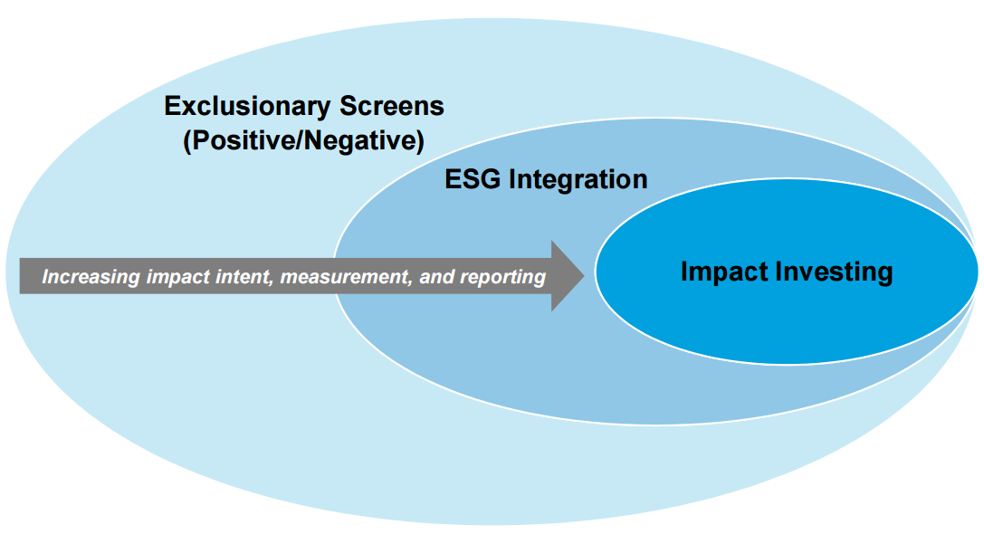
Social Finance Landscape
Image Source: World Economic Forum, “Impact Investing: A Primer for Family Offices.” December 2014.
Notes:
Key Message: The field of social finance is varied and its sub-sectors are generally defined by intentionality and measurement
What we call “Social Finance” includes any financial activity that involves the consideration of social (defined broadly) and financial factors
Sub-sectors:
SRI
ESG
Impact

Slide 4
Impact Investing – Where Did It Come From?
1744 - “Use of Money” Sermon
“We are…to gain all we can
without hurting our neighbor.”
- John Wesley, Founder of Methodism
1971 – Pax World Fund
Inspired by the social unrest of the 1960s, the fund integrated social
and environmental factors into the investment process.
1983 – Grameen Bank
Nobel Prize Winner Muhammed Yunus launches Grameen Bank to provide credit to the poor, launching the microfinance industry.
1700 s | 1920 s | 1970 s | 1980 s | 1990 s | 2000 s
1928 – Pioneer Fund
First mutual fund to implement a
screen for alcohol & tobacco companies.
1977 – Sullivan Principles
Rev. Leon Sullivan drafts principles that form the basis of a campaign urging American corporations to divest from apartheid South Africa.
2007 – Rockefeller Foundation
The term “impact investing” is coined at Rockefeller Foundation meeting to describe emergence of investment practices focused on generating social impact alongside financial return.
Notes:
Key Message: Socially-conscious investing is not new and has a long history
Religious investors were the pioneers in the field – most of the early efforts are based in religious teaching
Over time, the field expanded to include broader concerns – incorporating values, not just morals
Over the past ten years, the field has matured to include impact investing

Slide 5
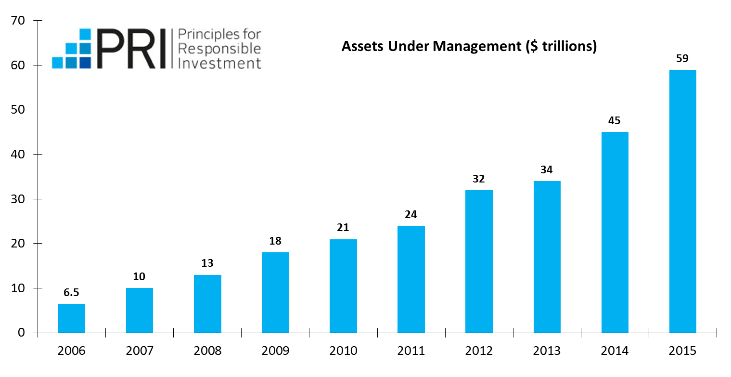
A Lasting Trend
Data Source: U.N. Principles of Responsible Investment, “PRI Factsheet” April 2015.
Notes:
Key Message: Social Finance is trendy, but it shows no signs of abating
- The field is trendy right now, but there are real dollars behind it
- PRI AUM (as proxy for field) is growing exponentially – doubled three times since its founding; now has $59 trillion of assets under management
- Looking ahead: $30 trillion transfer of wealth to Millenials over next several decades
- 71% of individual investors in Morgan Stanley survey were interest in “sustainable investing”
- millennials 2x more likely to invest in companies that target specific social or environmental outcomes than overall population

Slide 6
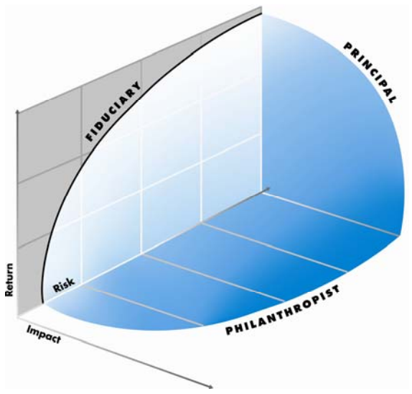
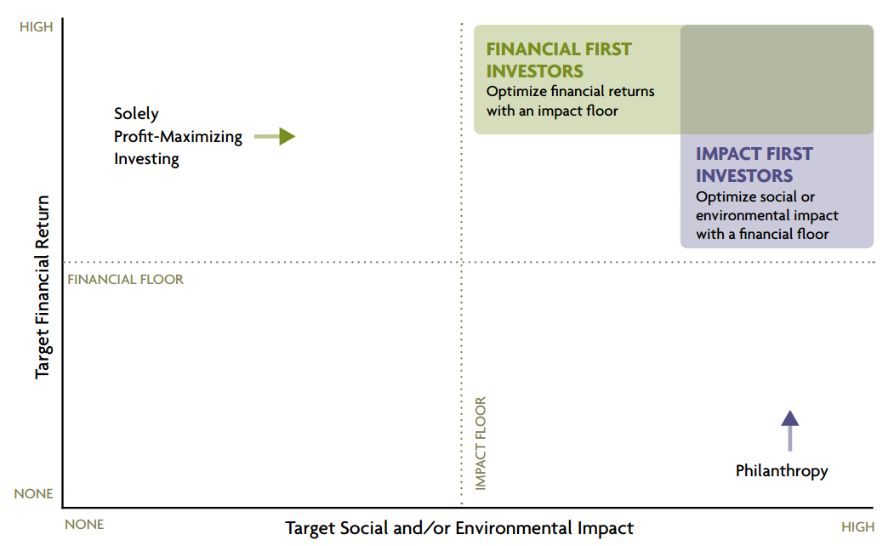
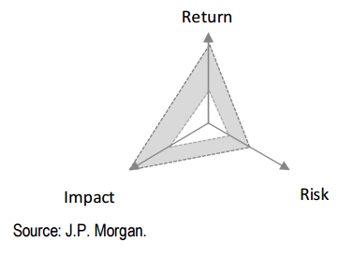
Social Finance Landscape
Image Sources (Clockwise from top-left): Dunn, Brian. “Modern Portfolio Theory –with a Twist.” August 2006.“Investing for Social & Environmental Impact.” Monitor Institute. January 2009. Saltuk, Yasemin and Idrissi, Ali. “A Portfolio Approach to Impact Investment.” J.P. Morgan. October 2012.
Notes:
Key Message: Several attempts have been made to incorporate social factors into investment management
Several key insights:
Investments should be evaluated not only on the measures of risk & return, but on the third axis of social impact
Some investors prioritize impact, while others do not – different levels of commitment of enthusiasm for impact
Strong contributions to the field, but questions still remain

Slide 7
Questions Remain
Are there quantitative methods of balancing an investment or portfolio’s social impact with its financial risk and return?
How do we deal with the fact that social impact is not “one size fits all?”
Can the impact potential of one investment be compared with that of another?
Notes:
Key Message: [Walk through what’s missing in the literature]
There are few examples in the literature – none really – that provide a quantitative framework for dealing with these issues
While the literature has devote a fair amount of attention to investor willingness to trade financial return for social impact – less time has been spent asking “what kind of impact?” Investor preferences are generally lost
Finally, there isn’t much guidance on how to go from the visual of a three-dimensional graph to actually portfolio construction
The next sections of the presentation will provide Athena’s answers to these questions
[HAND OVER TO LISETTE]

Slide 8
Social Finance and the Post-Modern Portfolio: Theory & Practice
Athena Capital’s Impact Investing Whitepaper
November 2015

Slide 9
Modern Portfolio Theory
The concepts of Modern Portfolio Theory (MPT) form the
foundation of current investment management practices.
Mean-Variance Framework
Harry Markowitz
“Portfolio Selection”
1952, Journal of Finance
Capital Asset Pricing Model (CAPM)
William Sharpe
“Capital Asset Prices – A Theory of Market Equilibrium Under Conditions of Risk”
1964, Journal of Finance
Utility = Financial Reward
Notes:
Key Message: Though there have been innovations through the years, the field of investment management is founded on several key concepts that have come to be known as “Modern Portfolio Theory”
Modern Portfolio Theory is the cornerstone of the investment management industry
Markowitz began in 1952 with the introduction of the mean-variance framework
Sharpe followed in 1964 with the Capital Asset Pricing Model
Both models are fundamentally about maximizing individual utility – generating the greatest reward for the lowest amount of risk
Utility is measured by financial returns

Slide 10
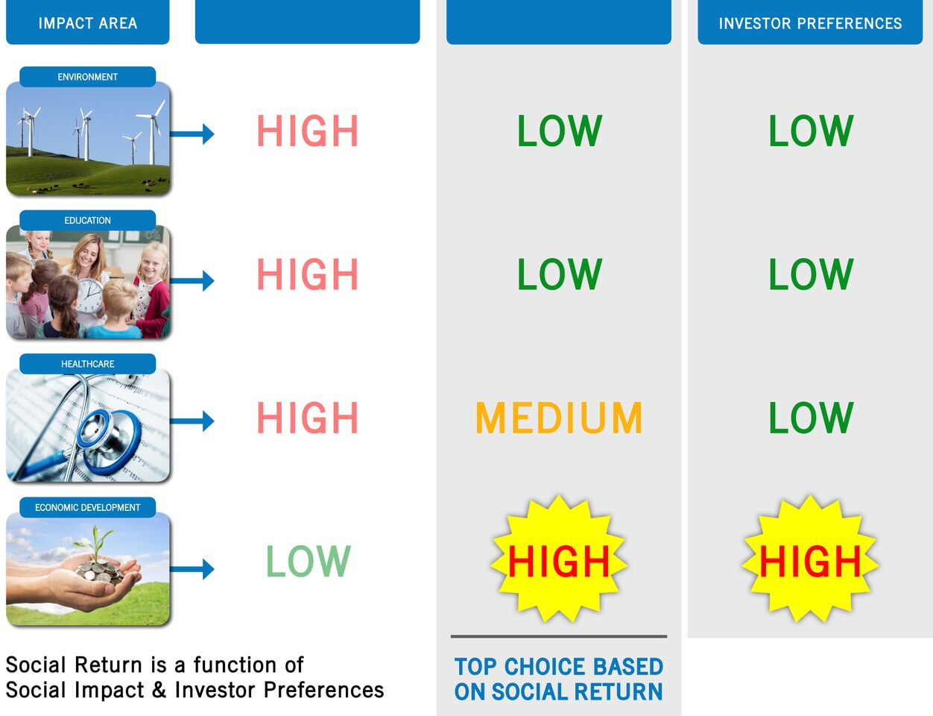
Revisiting Utility: Social Impact or Social Return
Company A
Company B
Notes:
Key Message: Social return is a function of Social Impact AND investor preferences
Company A may have broader and higher impact overall
But Company B provides high impact in the category the investor cares most about
Social Impact is a public good; Social Return is a private good
[HAND OVER TO JEREMY]

Slide 11
Revisiting Utility: Social Impact or Social Return
Company A
Company B
Notes:
Key Message: Social return is a function of Social Impact AND investor preferences
Company A may have broader and higher impact overall
But Company B provides high impact in the category the investor cares most about
Social Impact is a public good; Social Return is a private good
[HAND OVER TO JEREMY]

Slide 12
CAPM – Definition of Model
MPT assumes investors are rational and risk averse:
Single period model
“Perfect Markets”
Given investors k = 1, …, M
Given risky assets i = 1, …, N, with returns vector r
Given a riskless asset with return r_{f}
Assume all investors agree on e = E(r) and C = Var(r) (“Homogeneous Expectations”)
Each investor k solves:

Slide 13
CAPM Derivation
Write down Lagrangian and take the F.O.C.
Substituting from EQ2 into EQ3, we get:
Therefore, all investors choose weights wk, where:

Slide 14
CAPM Derivation (cont.)
Every investor holds the same risky portfolio (The Separation Theorem)
“Clear the market”, i.e. net borrowing/lending must sum to 0. Hence:

Slide 15
CAPM with Heterogeneous Expectations
Homogeneous Expectations was the major objection to the original CAPM.
Extension to Heterogeneous Expectations (e.g. Gerber & Hens [2009])
Replace e and C by weighted averages of all investors’ e_{k} and C_{k}. Weights depend on relative wealth and relative risk-aversion of each investor.
We are interested only in the version in which e is heterogeneous, but C is homogeneous.
Notes:
Generalize CAP to heterogeneous expectations. Some people familiar with CAPM may not be familiar with this.

Slide 16
CAPM with Heterogeneous ERs
If all investors agree on C, and only have different vectors e of ER, then from Gerber & Hens:

Slide 17
Gerber & Hens (cont.)
Notes:
Last equation is key. Security Market Line is the "same" as CAPM, but expectations are replaced by "consensus averages".

Slide 18
Modified Objective Function
Assume investors are now interested in Mean/Variance of:
Where s denotes “social return”, as opposed to financial return, r.
We need to include s in the objective function, so must define how it will appear in both the linear and quadratic terms.
Notes:
Set up new "enhanced" objective function. Trivially derive e.

Slide 19
Linear Term
Assume L social metrics, and an NxL matrix, V, of expected social impacts for asset i in [1:N] on metric j in [1:L]. We assume homogeneous V, but can easily allow for heterogeneous V.
Assume that every investor k has a preference L-vector, p_{k}, of weights that sum to 1.
Then we can model the linear contribution of s as:

Slide 20
What about Quadratic Term?
Virtually impossible to “measure” variances and covariances for social returns;
Assume covariances of social returns and financial returns are 0; Impossible to reject this null hypothesis!!
Notes:
Justify collapsing the Covariance term to C, the VCV or FinRets. Key assumption of model!

Slide 21
Quadratic Term (cont.)
We can write
And
where λ² << λ¹
Hence
If Ω and/or λ_{k}² is small, then
Notes:
Justify collapsing the Covariance term to C, the VCV or FinRets. Key assumption of model!

Slide 22
Social CAPM (PMPT)
Therefore, our modified objective function becomes:
Note that we assumed homogeneous expectations for financial and social returns. Only variations among investors is w.r.t. p and φ. Applying Gerber & Hens, we get:
Implication: Assets with higher social ER will have lower financial ER!! “Clientele” effect (like Munis).
Notes:
We get modified Security Market Line. Emphasize the role of positive phi, and how this will induce a clientele effect. Emphasize similarity to Munis and the tax effect.

Slide 23
Implications of the Model
Do we see a clientele effect in the market?
Studies have shown that investment strategies that incorporate social and environmental factors “perform” as well as traditional strategies
Why not?
Size of the Market: Impact investing represents just 0.08% of global assets under management
Imperfect information: Determining the social impact of an investment is difficult, which may prevent social investors from clustering
Long-term vs. short-term: Social investors may tend to select investments on the basis of a longer time horizon than traditional investors

Slide 24
Implementation
Athena Capital’s Approach to Impact Investing
Notes:
[HAND OVER TO LISETTE]

Slide 25

Investment Management Process
Investment Policy Statement (IPS)
Establish risk and return requirements as well as investment constraints
Develop Capital Market Expectations
Establish risk and return expectations for each of the asset classes in the investable universe
Monitor & Report
Assess the performance of each investment and the role it plays in the portfolio
Investment Selection
Select the best investment opportunities within each asset class in order to reach target allocation
Asset Allocation
Using the IPS as a guide, determine how much of the portfolio to allocate to each asset class based on its risk and return characteristics
Notes:
Key Message: Investment management is a process with multiple steps; social return is integrated primarily in three
The investment management process begins with the Investment Policy Statement
Establishes the risk and return requirements of the investor as well as any additional constraints that must be imposed on the portfolio
Next, investment managers assess the risk and return characteristics of the various segments of the market and record their expectations
Next, based on those expectations, they decide how much to allocate to each of the various segments
With allocations made, they then select investments within each of those segments
Finally, managers monitor the performance of those investments
The process is a cycle

Slide 26
Investment Management Process
Investment Policy Statement (IPS)
Establish risk and return requirements as well as investment constraints
Develop Capital Market Expectations
Establish risk and return expectations for each of the asset classes in the investable universe
Monitor & Report
Assess the performance of each investment and the role it plays in the portfolio
Investment Selection
Select the best investment opportunities within each asset class in order to reach target allocation
Asset Allocation
Using the IPS as a guide, determine how much of the portfolio to allocate to each asset class based on its risk and return characteristics
Notes:
Key Message: Investment management is a process with multiple steps; social return is integrated primarily in three
The investment management process begins with the Investment Policy Statement
Establishes the risk and return requirements of the investor as well as any additional constraints that must be imposed on the portfolio
Next, investment managers assess the risk and return characteristics of the various segments of the market and record their expectations
Next, based on those expectations, they decide how much to allocate to each of the various segments
With allocations made, they then select investments within each of those segments
Finally, managers monitor the performance of those investments
The process is a cycle

Slide 27
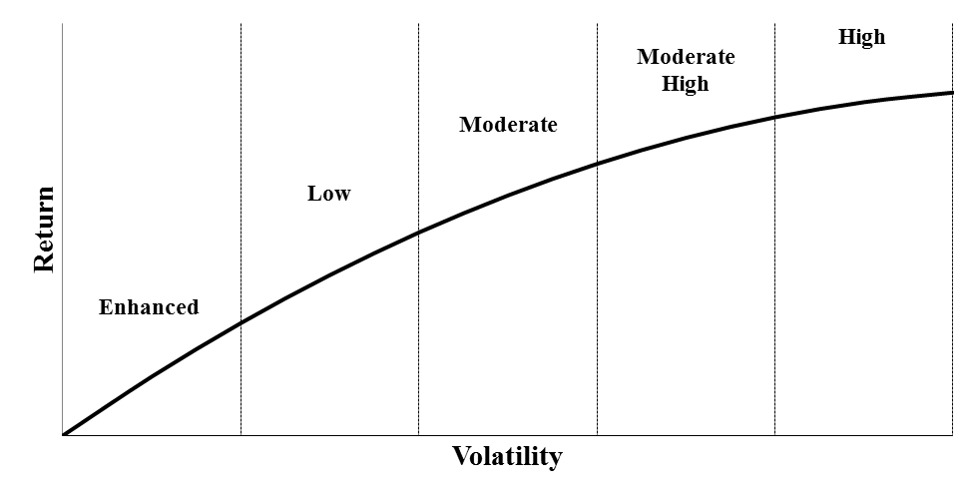

Investor Policy Statement (IPS): Impact Enthusiasm
Risk Aversion: A Practical Approach to Determining
$$λ$$
Notes:
Key Message: The IPS is also the point at which investors identify their level of impact enthusiasm
Social Investors can be categorized based on what kind of utility, or return, they want from their investment portfolio
Graph has two axes:
Vertical axes is a measure of risk-adjusted financial return.
Horizontal axes is a measure of social return
Investor types:
Financial Only
Financial First
Blend
Impact First
Philanthropists
Shape of the Curve:
Proponents, including some Blend Investors – Curve A (never sacrifice)
Skeptics of social finance – Curve B (always sacrifice)
Industry Consensus – Curve C (sacrifice at some point; inflection point & steepness of slope unclear)

Slide 28
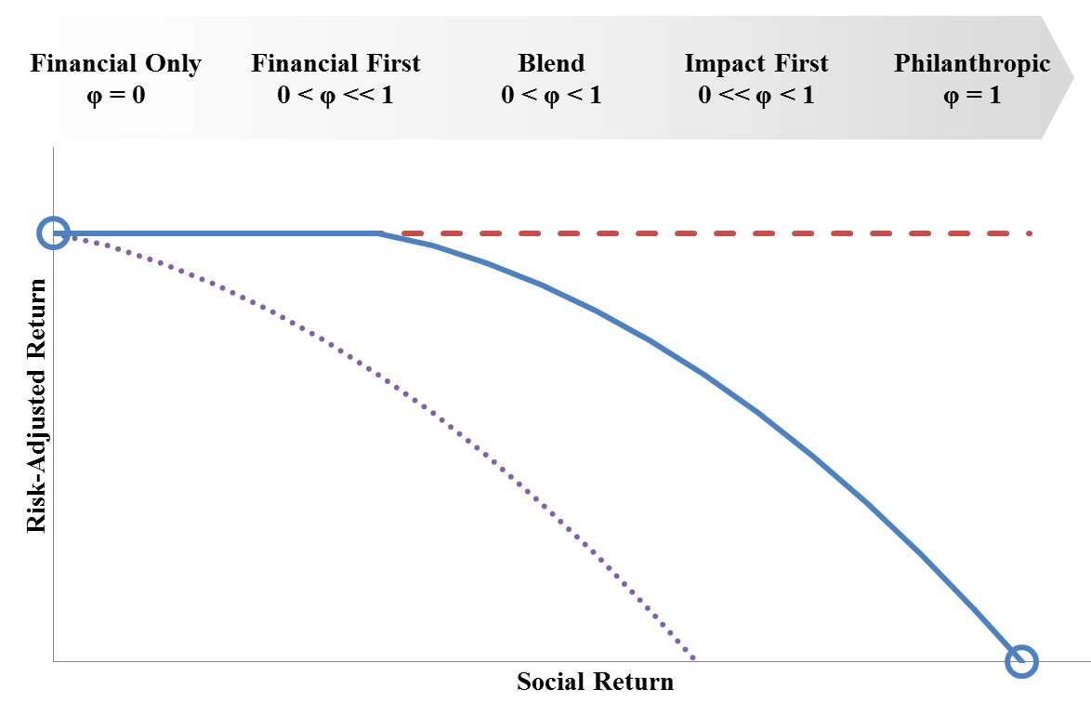
Investor Policy Statement (IPS): Impact Enthusiasm
Notes:
Key Message: The IPS is also the point at which investors identify their level of impact enthusiasm
Social Investors can be categorized based on what kind of utility, or return, they want from their investment portfolio
Graph has two axes:
Vertical axes is a measure of risk-adjusted financial return.
Horizontal axes is a measure of social return
Investor types:
Financial Only
Financial First
Blend
Impact First
Philanthropists
Shape of the Curve:
Proponents, including some Blend Investors – Curve A (never sacrifice)
Skeptics of social finance – Curve B (always sacrifice)
Industry Consensus – Curve C (sacrifice at some point; inflection point & steepness of slope unclear)

Slide 29
Investment Policy Statement (IPS): Investor Preferences
HOW WOULD YOU DISTRIBUTE $100 AMONGST
VARIOUS IMPACT INVESTING CATEGORIES?
ENVIRONMENT | EDUCATION | HEALTH | ECONOMIC DEVELOPMENT | GENDER & SOCIAL EQUALITY
$ 50 | $ 0 | $ 10 | $ 10 | $ 30
Notes:
Key Message: The IPS is where investors record their preferences, the p vector in the model
Investors may be tempted to take an “I know it when I see it” approach to impact
To help investors identify their priorities, Athena proposes the following exercise
Ask an investor to “invest” $100 dollars in a menu of different issue areas
The issue areas that receive the greatest investments are those they care the most about
This investor cares the most about the environment and has placed 50% of her capital in that category
- These preferences are critical to determining the social return of an investment

Slide 30
Investment Management Process
Investment Policy Statement (IPS)
Establish risk and return requirements as well as investment constraints
Develop Capital Market Expectations
Establish risk and return expectations for each of the asset classes in the investable universe
Monitor & Report
Assess the performance of each investment and the role it plays in the portfolio
Investment Selection
Select the best investment opportunities within each asset class in order to reach target allocation
Asset Allocation
Using the IPS as a guide, determine how much of the portfolio to allocate to each asset class based on its risk and return characteristics
Notes:
Key Message: Investment management is a process with multiple steps; social return is integrated primarily in three
The investment management process begins with the Investment Policy Statement
Establishes the risk and return requirements of the investor as well as any additional constraints that must be imposed on the portfolio
Next, investment managers assess the risk and return characteristics of the various segments of the market and record their expectations
Next, based on those expectations, they decide how much to allocate to each of the various segments
With allocations made, they then select investments within each of those segments
Finally, managers monitor the performance of those investments
The process is a cycle

Slide 31
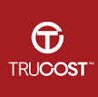
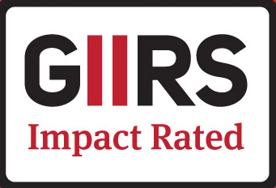


Selecting Investments & Building a Portfolio
How to determine the ‘V’ matrix: The $1 million Question
Option 1: “Off-the-Shelf” Industry Ratings:
Option 2: In-house analysis
Establish Issue Areas:
What do investors care about?
What issues is the market addressing?
Assess Investments
Relative Ranking
Probability weight
Select Units:
Express impact assessments as rates of social return
Notes:
Key Message: The social return calculations combines an objective assessment of an investment’s social impact with an investor’s unique preferences
Consider two investors, one cares about the environment and women’s empowerment; the other is passionate about their local community
Both of these investors are looking at this hypothetical private equity fund: Eco-Investors Fund I, which invests in energy efficiency firms that work with small businesses
Athena has assessed the social impact potential of the investment across each of these five categories
Generally, Athena may use a scale of -2 to +2 to score these investments, but they have been converted here into measure of return ranging from -20% to +20%
Eco-Investors Fund I is, very strong on the environment, but it has little to no effect in the other categories

Slide 32
Selecting Investments & Building a Portfolio
Calculating Social Return: (V x p)
Client A
“Environment
& Gender Equality”
Client B
“Community
Development”
Notes:
Key Message: The social return calculations combines an objective assessment of an investment’s social impact with an investor’s unique preferences
Consider two investors, one cares about the environment and women’s empowerment; the other is passionate about their local community
Both of these investors are looking at this hypothetical private equity fund: Eco-Investors Fund I, which invests in energy efficiency firms that work with small businesses
Athena has assessed the social impact potential of the investment across each of these five categories
Generally, Athena may use a scale of -2 to +2 to score these investments, but they have been converted here into measure of return ranging from -20% to +20%
Eco-Investors Fund I is, very strong on the environment, but it has little to no effect in the other categories

Slide 33
Selecting Investments & Building a Portfolio
Calculating Social Return: (V x p)
Client A
“Environment
& Gender Equality”
Client B
“Community
Development”
Notes:
Key Message: The social return calculations combines an objective assessment of an investment’s social impact with an investor’s unique preferences
Consider two investors, one cares about the environment and women’s empowerment; the other is passionate about their local community
Both of these investors are looking at this hypothetical private equity fund: Eco-Investors Fund I, which invests in energy efficiency firms that work with small businesses
Athena has assessed the social impact potential of the investment across each of these five categories
Generally, Athena may use a scale of -2 to +2 to score these investments, but they have been converted here into measure of return ranging from -20% to +20%
Eco-Investors Fund I is, very strong on the environment, but it has little to no effect in the other categories

Slide 34
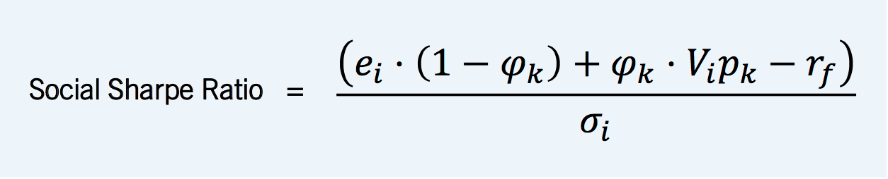
Selecting Investments & Building a Portfolio
Choosing among investments: Bringing it all Together
φ_{k}
V
p_{k}
Impact
Enthusiasm
Social Impact
Investor
Preferences
A measure of social and financial return earned per unit of financial risk
Notes:
Key Message: All these variables, impact enthusiasm, social impact and investor preferences are brought together in the investment selection process with the Social Sharpe
The Social Sharpe is an equation that measures the total return of an investment, from social and financial sources, per unit of financial risk
The higher the social sharpe, the greater the utility for the investor

Slide 35
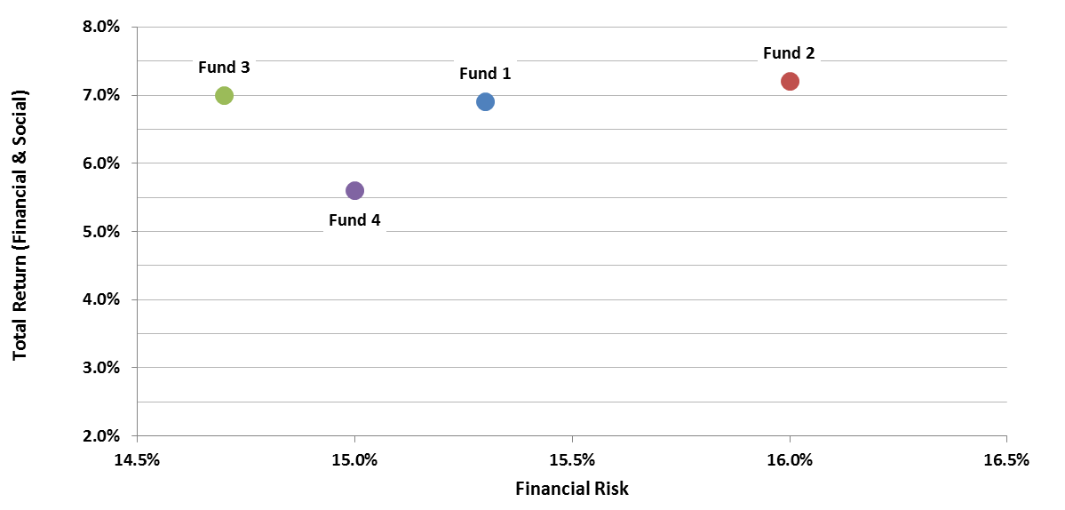
Selecting Investments & Building a Portfolio
Notes:
Key Message: Example of how these variables come together to select investments
In the first scenario, the investor is choosing amongst 4 funds, each of which deliver varying amounts of risk and return
Based on the Social Sharpe ratio, Fund 1 is the best option for the investor
The investor has a low impact enthusiasm and is probably a Financial First investor
She is not willing to sacrifice much financial return in order to earn social return
Fund 1 offers the right combination

Slide 36
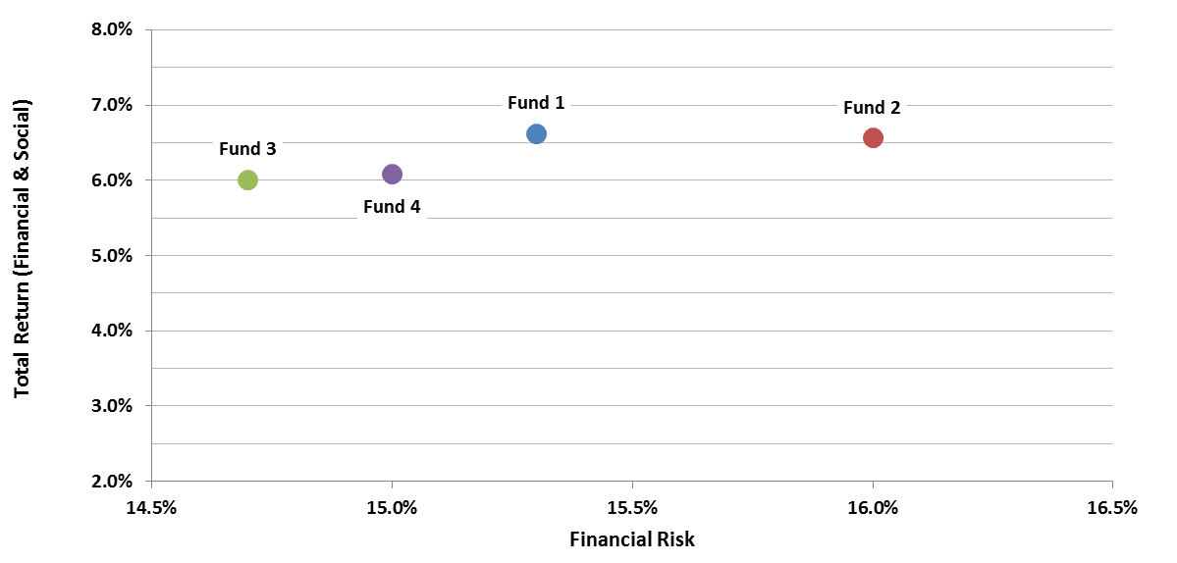
Selecting Investments & Building a Portfolio
Notes:
Key Message: Example of how these variables come together to select investments
In the first scenario, the investor is choosing amongst 4 funds, each of which deliver varying amounts of risk and return
Based on the Social Sharpe ratio, Fund 1 is the best option for the investor
The investor has a low impact enthusiasm and is probably a Financial First investor
She is not willing to sacrifice much financial return in order to earn social return
Fund 1 offers the right combination

Slide 37
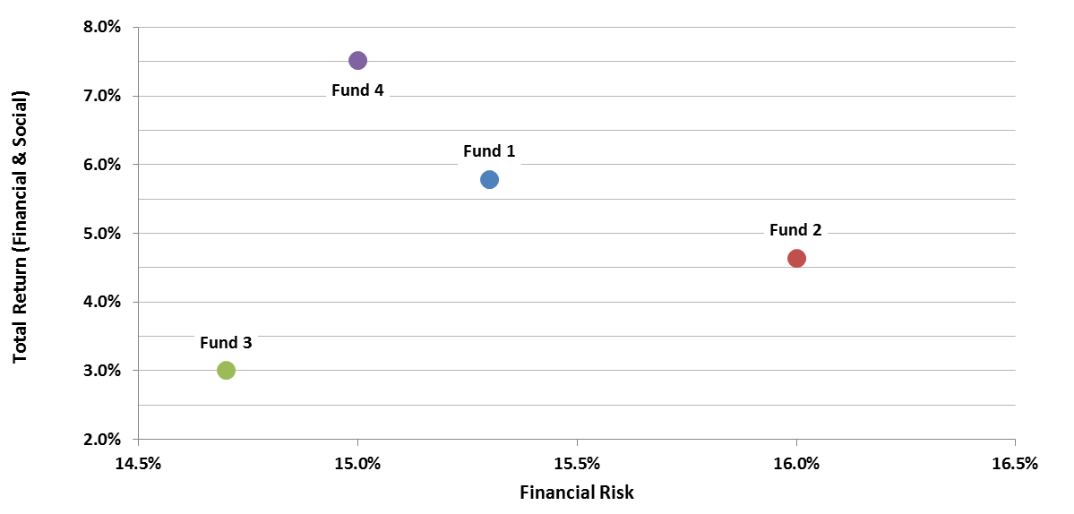
Selecting Investments & Building a Portfolio
Notes:
Key Message: Example of how these variables come together to select investments
In the second scenario, the investor has a high impact enthusiasm coefficient, which is consistent with an Impact-First investor
Based on the Social Sharpe ratio, Fund 4 is the best option for the investor
Though it has the lowest financial return, it has the highest social return
The investor prioritizes that social return above other factors, making Fund 4 the best choice

Slide 38
Investment Management Process
Investment Policy Statement (IPS)
Establish risk and return requirements as well as investment constraints
Develop Capital Market Expectations
Establish risk and return expectations for each of the asset classes in the investable universe
Monitor & Report
Assess the performance of each investment and the role it plays in the portfolio
Investment Selection
Select the best investment opportunities within each asset class in order to reach target allocation
Asset Allocation
Using the IPS as a guide, determine how much of the portfolio to allocate to each asset class based on its risk and return characteristics
Notes:
Key Message: Investment management is a process with multiple steps; social return is integrated primarily in three
The investment management process begins with the Investment Policy Statement
Establishes the risk and return requirements of the investor as well as any additional constraints that must be imposed on the portfolio
Next, investment managers assess the risk and return characteristics of the various segments of the market and record their expectations
Next, based on those expectations, they decide how much to allocate to each of the various segments
With allocations made, they then select investments within each of those segments
Finally, managers monitor the performance of those investments
The process is a cycle

Slide 39
Reporting
Notes:
Key Message: Much of social finance is about intentionality, but investors are also interested in the impact achieved with their capital
This sample report gives you an idea of how the social return concept can be reported to investors
The top left table is typical of portfolio reports – it shows an investor’s actual allocations versus their target
This helps investors and investment managers maintain the appropriate balance between risk and return in a portfolio
Social return can be presented in a similar fashion
This table shows the investor what percentage of their overall social return is coming from each issue area
Finally, investors want to know what actual impact their capital has generated
These are examples of some metrics that can be provided by issue area

Slide 40
Thank You
Notes:
[CONCLUDE FOR QUESTIONS]
Case Studies available if there is interest in learning about what types of investments Athena has made

Slide 41
Case Studies
Notes:
[CONCLUDE FOR QUESTIONS]
Case Studies available if there is interest in learning about what types of investments Athena has made

Slide 42


Case Study: Private Real Estate – Rose Value-Add Office Retrofit Fund
Jonathan Rose, a pioneer in green building and urban planning, manages this fund
Focus on improving energy efficiency in the commercial office market while also targeting some of the fastest growing tenants
Strategy
Renovates and repositions older office buildings in attractive locations through green retrofits and tenant lifestyle improvements in order to increase occupancy and operating income
Impact
Targeted impact outcomes include reduced energy costs for tenants, mitigated emissions, and overall healthier working environments.
Focused on “smart growth” locations which have a smaller carbon footprint
The Yeon Building in Portland, OR
Notes:
2011 VY fund, marked at a 23% net IRR vs peers at a 12% net IRR Direct Deal -

Slide 43

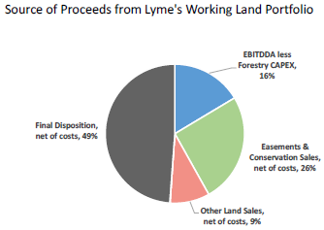

Case Study: Private Real Estate – Lyme Forest Fund
Lyme Timber is a leader in the field of conservation investment and sustainable forest and land management.
Natural resources fund with a focus on conservation while also achieving attractive risk-adjusted returns
Strategy
Lyme’s primary conservation strategy is buying land and subsequently structuring and selling conservation easements or options to conservation organizations which seek to protect endangered species, wetlands, and/or general conservation goals.
Easements and conservation fee sales have reduced Lyme’s investment basis by over 40%, resulting in cash yields of 5.5% following conservation sales
Impact
The team has completed more than 100 transactions with land conservation NGOs and public agencies allowing Lyme Timber to permanently conserve 750,000+ acres through its investment activities.
Red pine plantation on Lyme’s St. Croix property in Wisconsin

Slide 44

Case Study: Private Equity - SJF Ventures III
Social and environmental private equity fund with a double bottom line goal of both creating strong impact and delivering top quartile returns across sectors
Strategy
Investments in high growth, positive impact, and capital-efficient companies in the resource efficiency & sustainability and tech-enhanced services sectors
Impact
SJF targets multiple areas of impact within their underlying portfolio companies and has a well built out impact measurement and reporting platform.
Impact outcomes primarily focus on the environment, job creation/enhancement and community
Notes:
. SJF seeks to deploy growth capital used for expansions at inflection points, rather than early-stage venture capital to fund technology development and market creation.
Environment: solar installations, recycling of cell phones, energy efficiency solutions
Job creation/enhancement: creating new jobs in lower income demographic areas, adding benefits such as healthcare insurance, stock option plans, profit sharing and retirement plans
Community: health & wellness and improved educational outcomes, facilitating work between local yet disadvantaged contractor companies and large retailers

Slide 45
Appendix

Slide 46



Biographies
Lisette Cooper, CFA, PhD Founder, CEO, Chief Investment Officer | Lisette Cooper is the Chief Executive Officer and Chief Investment Officer of Athena Capital Advisors, an investment advisory firm that serves sophisticated private investors, endowments, and foundations. As CEO, she sets the firm’s overall direction and leads Athena’s Investment Committee. Lisette founded the firm in 1993, and, using techniques that were then available only to the largest institutional investors, helped a wide range of investors manage complex portfolios. Prior to founding Athena, Lisette served as Manager of Consulting Services for Barra Inc., now MSCI Barra. She and her team specialized in modeling risk and developing investment solutions for institutional investors. She spent five years as a Senior Strategist at Merrill Lynch, where she analyzed, designed, and marketed innovative securities to money managers, banks, and pension funds such as Bank of America, California Public Employees’ Retirement System and the Colorado PERA. Lisette has extensive experience in the hedge fund industry. She earned a Ph.D. from Harvard University and holds a bachelor's degree from Wesleyan University. In 2007 she and her co-authors were granted a patent titled “Deriving a Probability Distribution of a Value of an Asset at a Future Time.” Lisette is a CFA charterholder.
Jeremy Evnine, PhD Senior Advisor, Quantitative Research | Jeremy Evnine provides guidance to the Athena team in the areas of quantitative research and risk management. Jeremy is currently CEO of Evnine & Associates, Inc., a consulting and Investment Advisory firm engaged in quantitative strategies since 1992. From 1991 to 2003, Jeremy was also a partner in Iris Financial Engineering and Systems, a financial software firm specializing in providing high-end trading and risk systems to top-tier investment banks. He sold his interest in Iris in 2003. From 1984-1990, Jeremy was SVP in charge of research at WFIA (subsequently Barclays Global Investors, now BlackRock). In this capacity, he worked with such people as Fischer Black and Myron Scholes, Bill Sharpe, and Michael Brennan and Eduardo Schwartz. From 1980-1984, Jeremy was a consultant at Barra, where he developed the firm’s option products. Jeremy earned his B.Sc. in Mathematics at Manchester University in England, his M.Sc. in Pure Mathematics at the Hebrew University of Jerusalem, and his Ph.D. in Operations Research and Finance at U.C. Berkeley. He has taught courses in finance at U.C. Berkeley, published articles in the financial literature on option pricing and tactical asset allocation, and lectured in the United States and abroad.
Jeff Finkelman, CFA Research Associate | Jeff Finkelman is an Impact Investment Associate focusing on impact and ESG-related investment opportunities across asset classes. Prior to joining Athena, Jeff was an Investment Officer with the Office of Investment and Innovation at the U.S. Small Business Administration, an agency of the federal government. Jeff’s primary responsibility involved reviewing and completing due diligence on private equity funds for the Small Business Investment Company (SBIC) program, a public-private investment fund. During his time in government, Jeff also helped draft the investment policy governing SBA’s Impact Investment Fund and spent six months as a Presidential Management Fellow with the Office of African Nations at the U.S. Department of the Treasury. Previously, Jeff served as a Volunteer with the U.S. Peace Corps, living and working in the small West African nation of Togo. Jeff earned a B.A. in International Relations from Tufts University and an M.A. in International Finance and Development from the Johns Hopkins School of Advanced International Studies. He is a CFA charterholder and recently became a member of the Boston Security Analysts Society.

Slide 47
Contact Information
Athena Capital Advisors Athena Capital Advisors 55 Old Bedford Road, Suite 302 767 Third Avenue, 21st Floor Lincoln, MA 01773 New York, NY 10017 781.274.9300 212.897.9640
Tyler P. Rodday
Vice President, Private Client Services
trodday@athenacapital.com
www.athenacapital.com

Slide 48
Disclosures and Disclaimers
This summary description and the information included here was prepared by Athena Capital Advisors LLC (“Athena”) solely for the person to whom it has been given for informational and discussion purposes only. This document and the information contained herein are strictly confidential and may not be reproduced, distributed or communicated to any third party without the express written approval of Athena. Athena reserves the right at any time to amend or change the contents of this document without notice. The information and opinions herein reflect the views and opinions of Athena as of the date hereof and not as of any future date.
Past and present performance is not necessarily indicative of future results, nor does it ensure that investors will not incur a loss with respect to their investment. An investment with Athena involves substantial risks and there can be no assurance that the investment objectives described herein will be achieved.
The investment examples contained herein are for informational and illustrative purposes only and should not be construed as a guarantee of actual or future performance results. Individual investment results may vary considerably based on various factors such as fees, expenses and the timing of capital contributions.
Circular 230 Disclosure: To ensure compliance with Treasury Department regulations, we inform you that, unless specifically indicated otherwise, any tax advice contained herein was not intended or written to be used and cannot be used, for the purpose of (i) avoiding penalties under the Internal Revenue Code or applicable state or local tax provisions, or (ii) promoting, marketing or recommending to another party any transaction or matter addressed herein. Athena does not provide legal advice and the information contained herein should only be used in consultation with your legal, accounting and tax advisors.

