Slide 1
The role of dynamic and static volatility interruption: Evidence from the Korean stock markets March 1, 2018
Risk Seminar at UC Berkeley
Kyung Yoon Kwon (KAIST/University of Strathclyde) Kyong Shik Eom (CRMR, Berkeley) Sung Chae La (KRX) Jong-Ho Park (Suncheon National University)

Slide 2
Volatility Interruption (VI)
What is VI?
A microstructure mechanism providing cooling-off periods and effective price discovery during brief periods of abnormal volatility for individual stocks.
Dynamic VI is activated when a price fluctuation due to a single order exceeds a predetermined threshold range, e.g., ±2~6%.
Static VI is activated when the cumulative price fluctuation due to multiple orders/transactions exceeds a predetermined threshold range, e.g., ±10%.
Cooling-off process: All transactions for the individual stock are stopped, a call auction process starts to work for a predetermined short period of time, e.g., 2~5 minutes and ends with a random-end (RE; e.g., within another 30 seconds) trading mechanism. Then the price is set, and the continuous trading resumes.

Slide 3
VI: A (General) Example

Slide 4
Price-Stabilization Mechanisms for Individual Stocks in the KRX
Pre-existing price-limit system
Since its earlier days, the KRX has used a price-limit system, limiting price movements for the day to a specified percentage.
VIs
On September 1, 2014, the KRX first adopted only the dynamic VI, while leaving the price limit unchanged.
On June 15, 2015, the KRX added the static VI and simultaneously expanded the price limit (±15% to±30%).
The KRX purpose of VIs
To improve price formation, and to limit damage to investors from brief periods of abnormal volatility, for individual stocks.

Slide 5
A Price Limit System
1
2
Magnet effect
Price
Restricted price discovery
Reference Price
(Previous day closing price)
3
Delayed (not reduced) volatility
Delayed trading activity
Time

Slide 6
VI Time Line in the KRX

Slide 7
Research Questions
Effectiveness of VI?
The separate contributions of the two components of VI to price stabilization and price discovery
The separate contributions of the newly-introduced VIs (in particular, static VI) and the extant price-limit system

Slide 8
Related Literature and Our Contributions
Circuit Breakers (in a broad sense)
① Market-wide trading halts (circuit breakers in a narrow sense)
Exchanges and practitioners use circuit breakers only for this
② Individual-stock trading halts
Rule-based trading halts, e.g., VI
Discretionary (voluntary) trading halts, e.g., occurring when an individual firm requests that trading be suspended before the release of material information
③ Price-limit systems (for individual stocks)

Slide 9
Related Literature and Our Contributions
Circuit Breakers (in a broad sense) in Global Equity Exchanges (Brugler and Linton, 2014, Table 1)

Slide 10
Related Literature and Our Contributions
Theoretical studies
Mitigation of information asymmetry (Spiegel and Subrahmanyam 2000)
Reduction in transactional risk (Greenwald and Stein, 1991; Kodres and O’Brien, 1994)
Reduction of counter-party risk in derivatives markets and for leveraged investors (Chowdhry and Nanda, 1998; Brennan 1986)
Delay of price discovery (Fama, 1989); the magnet effect (Subrahmanyam, 1994)
Limitations to the gains from market manipulation (Kim and Park, 2010) and the associated costs of monitoring market manipulation (Deb, Kalev, and Marisetty, 2010)
Reduction of volatility and price deviations from fundamentals driven by noise traders (Westerhoff, 2003)
No VI

Slide 11
Related Literature and Our Contributions
Empirical findings
Market-wide circuit breakers (Goldstein and Kavajecz, 2014)
News-specific, i.e., discretionary, trading halts (Jiang, McInish, and Upson, 2009)
Price-limit systems (Kim and Rhee, 1997; Cho, Russell, Tiao, and Tsay, 2003, among many others)
Delay of price discovery, delay of trading, volatility spillover, and the magnet effect
Discretionary trading halts vs. price-limit systems (Kim, Yagüe, and Yang, 2008)
VI (Abad and Pascual, 2010; Zimmermann, 2013; Burgler and Linton, 2014)
There are only three papers related to the VIs, and their results are even mixed.
Research on European markets; Static VI; Artificial counterfactual required

Slide 12
Related Literature and Our Contributions
Our Paper’s Contributions
The sequential introductions of dynamic and static VIs to the Korean stock markets allow us to separate the effects of these two components of VIs and compare their effectiveness.
The sequential introductions of dynamic and static VIs allows us to clearly measure the difference in market state with dynamic VI vs. no VI, and with dynamic and static VI vs. only dynamic VI.
Thus, we avoid one of the main pitfalls of the circuit-breaker literature, the need to control for an artificial counterfactual that well describes what the status of the market would have been if VI had not been triggered.
The pre-existing price-limit system on the Korean stock markets allows us separate the effects of price-limit systems and VIs.

Slide 13
Empirical Design
Events and Test Windows
The sequential introductions of dynamic VI and static VI
We focus on 45 trading days before and after each event and investigate the effects of the events.
Effects of turmoil on the Shanghai Stock Exchange around the end of Aug. 2015 and the “mini Flash Crash” on the NYSE

Slide 14
Empirical Design
Empirical Analysis
<Preliminary Analysis>
Descriptive statistics on dynamic and static VI occurrences and their relationships to firm characteristics
<Main Analyses>
The price-stabilization effects of VIs (binomial distribution analysis of two consecutive price changes)
The price-discovery effect (two-step regression)
Relation between the occurrences of VIs and those of the price-limit hit (panel-logit regression)

Slide 15
Main Findings
Occurrences of VIs
Both VIs are invoked more often in small, low-priced, and highly volatile stocks.
Price stabilization
Only dynamic VI significantly contributes to price stabilization.
Price discovery
The contribution of dynamic VI to price discovery is substantially larger than that of static VI.
Relation with the price-limit system
Static VI and the price-limit system are triggered by the same kind of circumstances.

Slide 16
Data
Sample data
1,791 stocks (common and preferred) in 2014 and 1,842 in 2015, which are listed on KOSPI and KOSDAQ markets in the KRX
Sample periods
Introduction of dynamic VI
(Pre-event period in 2014: from June 27, 2014 to August 29, 2014)
Post-event period in 2014: from September 1, 2014 to November 7, 2014
Introduction of static VI
Pre-event period in 2015: from April 8, 2015 to June 12, 2015
Post-event period in 2015: from June 15, 2015 to August 21, 2015

Slide 17
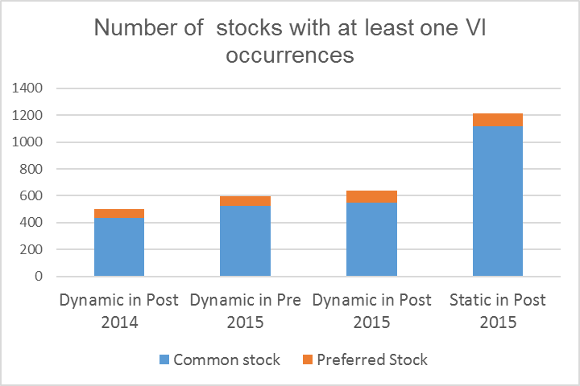
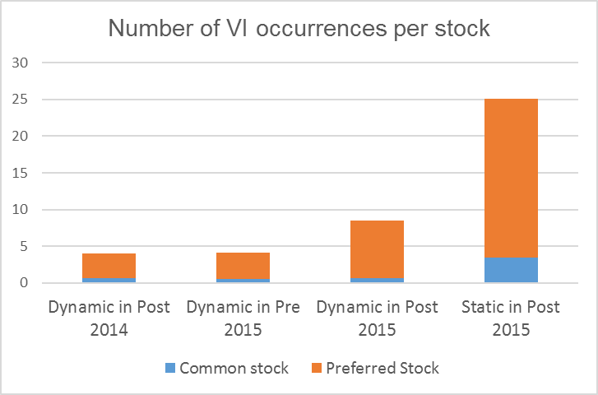
Descriptive Statistics on VI Occurrences
Number of VI occurrences

Slide 18
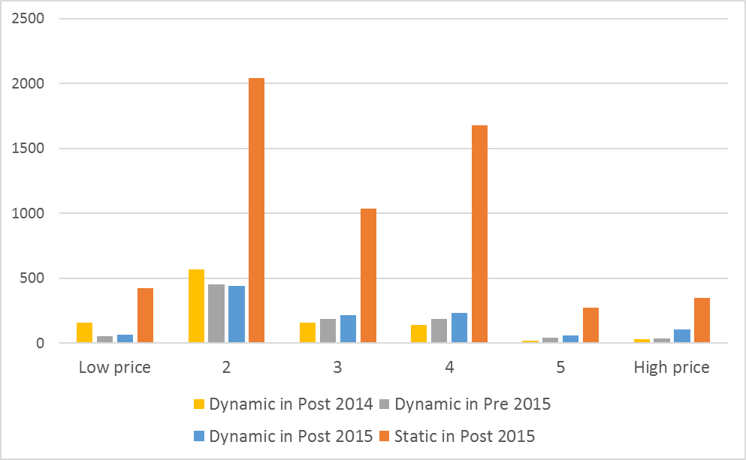
Descriptive Statistics on VI Occurrences
Distribution of VI Occurrences across Prices in Each Subsample Period
For common stocks, most VIs occur in stocks whose prices are between 1,000 KRW and 50,000 KRW (Groups 2~4)
Particularly, VI occurrences are concentrated in the price range between 1,000 KRW and 5,000 KRW (Group 2)
The distribution of dynamic VI becomes somewhat flatter after the introduction of static VI
This change could be attributed to the introduction of static VI

Slide 19
Descriptive Statistics on VI Occurrences
Relationships with Firm Characteristics
Firm characteristics
Trading volume in shares (volume_share) and in KRW (volume_value)
Firm size measured by market capitalization (mkt_cap)
Closing price (prc)
Volatility measured by the standard deviation of daily returns (std_dev) and the daily highest and lowest price (intra_vol)

Slide 20
Descriptive Statistics on VI Occurrences
Relationships with Firm Characteristics
(An example: the 2015 post-event period)
Both dynamic and static VI occurrences are negatively correlated with firm size and price, and positively correlated with volatility. However, the correlation of static VI occurrences with volatility is much larger.
Dynamic VI occurrences are negatively correlated with liquidity variables while static VI occurrences are positively correlated with trading volume in shares and KRW.
 | Number of static VI occurrences | volume_share | volume_value | mkt_cap | prc | Volatility
 |  |  |  |  |  | std_dev | intra_vol
Number of dynamic VI occurrences | 0.3122*** | -0.1113*** | -0.1175*** | -0.2361*** | -0.0169 | 0.2946*** | 0.2346***
Number of static VI occurrences |  | 0.2325*** | 0.1834*** | -0.1862*** | -0.0676*** | 0.7330*** | 0.6979***

Slide 21
Price Stabilization
Test Method: Binomial Distribution Analysis (Eom and Park, 2016)
If dynamic (static) VI effectively stabilize the price, then two consecutive price changes surrounding the potential execution price,
the one between the last execution (last call auction) price and the potential execution price
the other one between the potential execution price and the call auction price,
will tend to show a reversal.

Slide 22
Price Stabilization

Slide 23
Price Stabilization
To test this,
If dynamic (static) VI effectively stabilize the price, then two consecutive price changes,
the one between the last execution (last call auction) price and the potential execution price
the other one between the potential execution price and the call auction price, will tend to show a reversal.
⇒ Count the number of reversals (stabilization) / continuations (destabilization).
(The potential execution price reflects a temporary imbalance of supply and demand).
⇒ And then, compare them using binomial distribution analysis.
If the potential execution price accurately reflects information available to the market, the probability of reversal should be equal to the probability of continuation.

Slide 24
Price Stabilization
Results from binomial distribution analysis
For dynamic VI, the proportion of reversals is indeed significantly greater than 0.5 (≈ 0.8) for common stocks during the opening and closing auctions, but not for static VI

Slide 25
Price Stabilization
To test this,
Percentage measures of price stabilization and continuation (destabilzation)
(call auction price - potential execution price)×100
(potential execution price – last execution or last call auction price)
over the set of reversals and continuations, respectively.
Net price-stabilization effect
- (call auction price - potential execution price)×100
(potential execution price – last execution or last call auction price)
over the combined set of reversals and continuations.

Slide 26
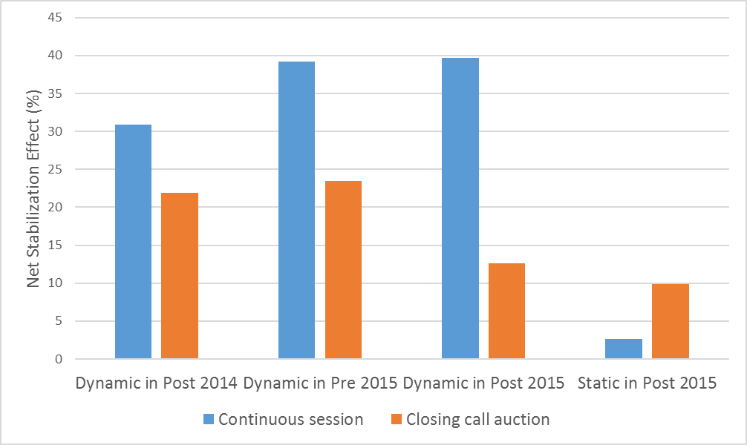
Price Stabilization
Net price-stabilization effect
The net price-stabilization effect of dynamic VI is substantially higher during the continuous session than in the closing call auction.
The result during the continuous session in the pre- and post-event periods of 2015 appears similar.
The net price-stabilization effects of static VI are much weaker than those of dynamic VI.
Static VI seems to have a negligible net price-stabilization effect during the continuous session, and a modest effect during the closing call auction.

Slide 27
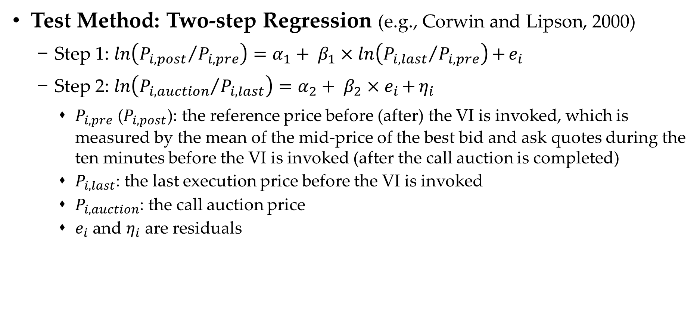
Price Discovery
Test Method: Two-step Regression (e.g., Corwin and Lipson, 2000)
Step 1: $\ln\left({P_{i,post}}/{P_{i,pre}}\right)=α_{1}+ β_{1}×\ln\left({P_{i,last}}/{P_{i,pre}}\right){+}e_{i}$
Step 2: $\ln\left({P_{i,auction}}/{P_{i,last}}\right)=α_{2}+ β_{2}×e_{i}{+}η_{i}$
$P_{i,pre}$ ($P_{i,post}$): the reference price before (after) the VI is invoked, which is measured by the mean of the mid-price of the best bid and ask quotes during the ten minutes before the VI is invoked (after the call auction is completed)
$P_{i,last}$: the last execution price before the VI is invoked
$P_{i,auction}$: the call auction price
$e_{i}$ and $η_{i}$ are residuals

Slide 28
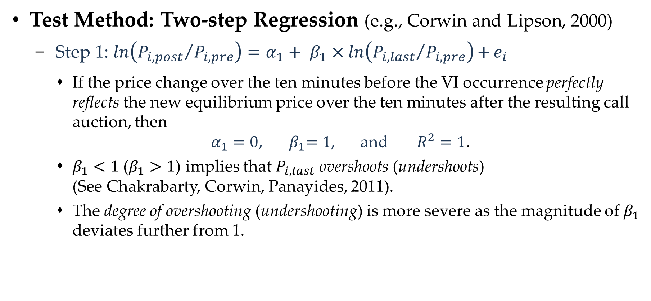
Price Discovery
Test Method: Two-step Regression (e.g., Corwin and Lipson, 2000)
Step 1: $\ln\left({P_{i,post}}/{P_{i,pre}}\right)=α_{1}+ β_{1}×\ln\left({P_{i,last}}/{P_{i,pre}}\right){+}e_{i}$
If the price change over the ten minutes before the VI occurrence perfectly reflects the new equilibrium price over the ten minutes after the resulting call auction, then
$α_{1}=0$, ${ β}_{1}=1$, and $R^{2}=1$.
$β_{1}<1$ ($β_{1}>1$) implies that $P_{i,last}$ overshoots (undershoots) (See Chakrabarty, Corwin, Panayides, 2011).
The degree of overshooting (undershooting) is more severe as the magnitude of $β_{1}$ deviates further from 1.

Slide 29
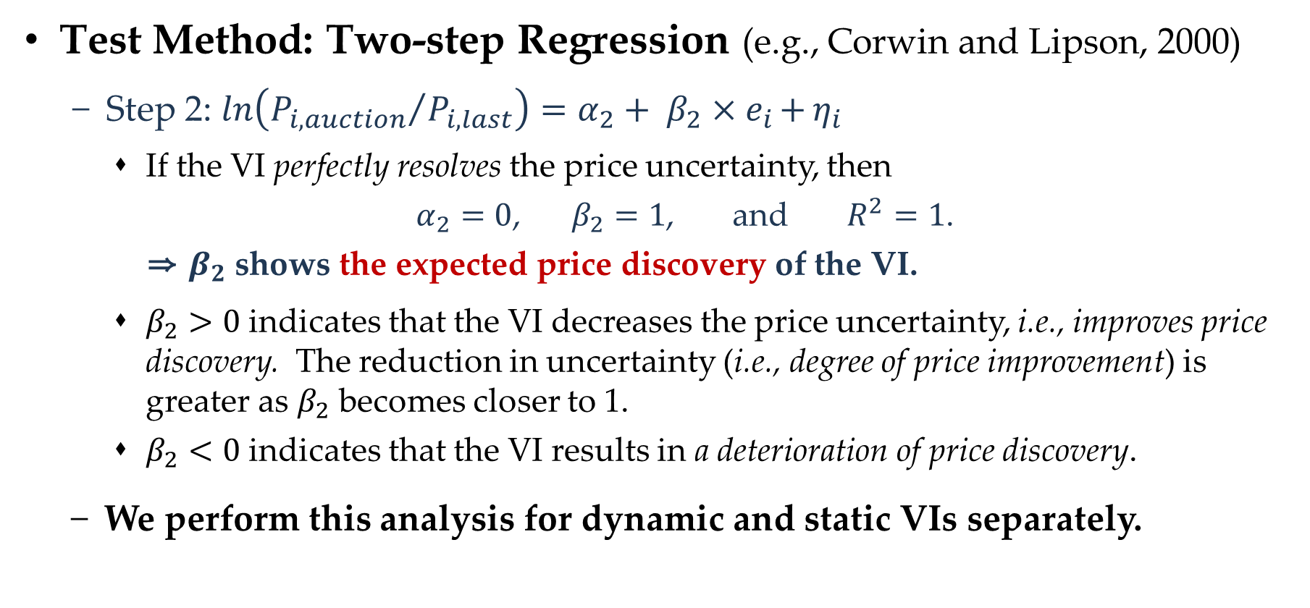
Price Discovery
Test Method: Two-step Regression (e.g., Corwin and Lipson, 2000)
Step 2: $\ln\left({P_{i,auction}}/{P_{i,last}}\right)=α_{2}+ β_{2}×e_{i}{+}η_{i}$
If the VI perfectly resolves the price uncertainty, then
$α_{2}=0$, $β_{2}=1$, and $R^{2}=1$.
⇒ $β_{2}$ shows the expected price discovery of the VI.
$β_{2}>0$ indicates that the VI decreases the price uncertainty, i.e., improves price discovery. The reduction in uncertainty (i.e., degree of price improvement) is greater as $β_{2}$ becomes closer to 1.
$β_{2}<0$ indicates that the VI results in a deterioration of price discovery.
We perform this analysis for dynamic and static VIs separately.

Slide 30
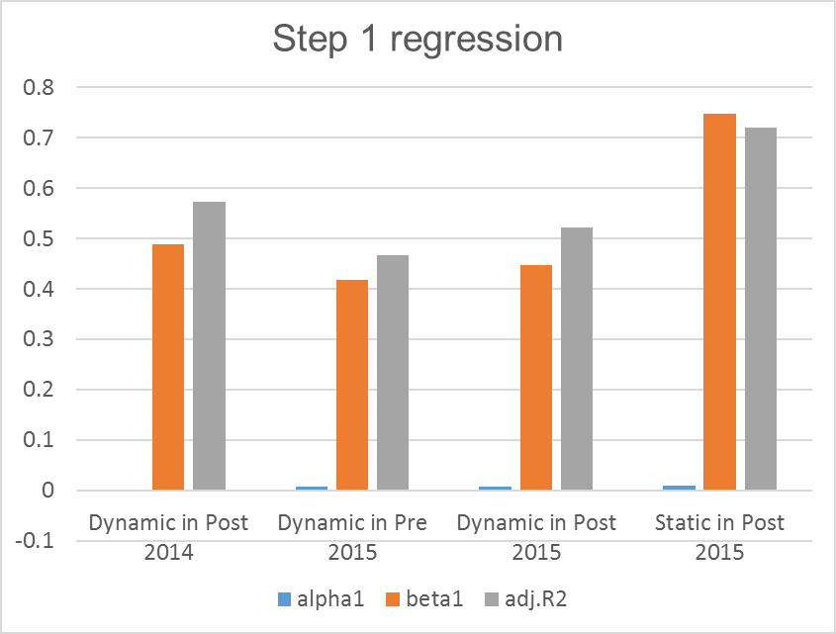
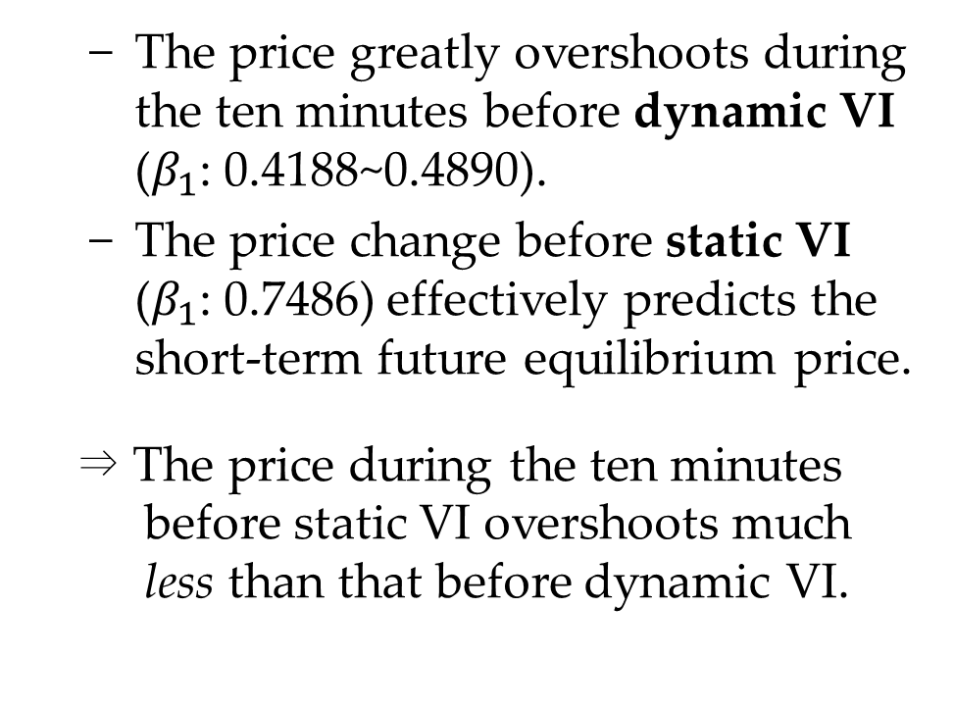
Price Discovery
Regression results
The price greatly overshoots during the ten minutes before dynamic VI ($β_{1}$: 0.4188~0.4890).
The price change before static VI ($β_{1}$: 0.7486) effectively predicts the short-term future equilibrium price.
⇒ The price during the ten minutes before static VI overshoots much less than that before dynamic VI.

Slide 31
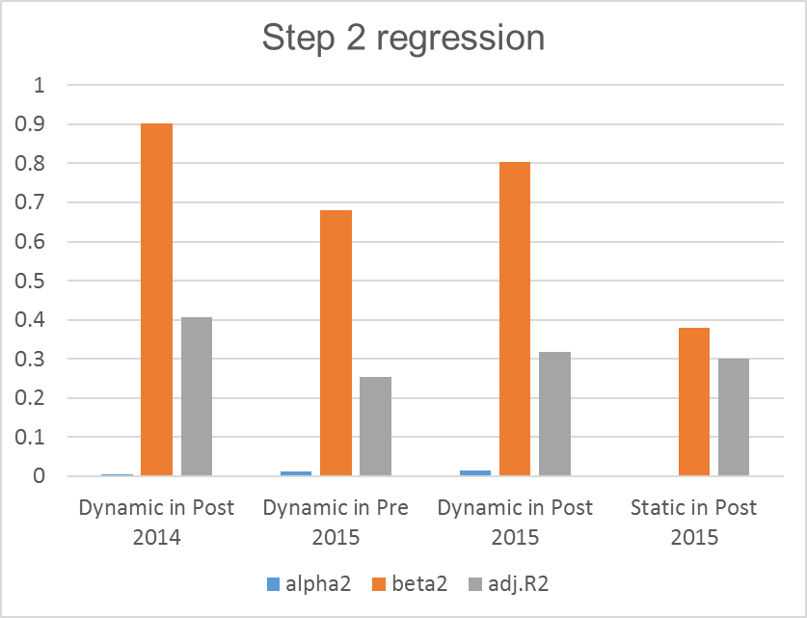

Price Discovery
Regression results
Dynamic VI resolves a substantial part of price uncertainty ($β_{2}$: 0.9017, 0.6810, 0.8042).
Dynamic VI generates a notable effect in price discovery. Moreover, this beneficial effects is maintained even after the introduction of static VI.

Slide 32

Price Discovery
Regression results
For static VI, the price discovery ($β_{2}$) is 0.3787. The degree of price improvement in static VI is much smaller than in dyamic VI (0.8042).

Slide 33
Relationship of VIs with Price-Limit System
For this test, focus on the 2015 event
The definition of static VI is closely related to the price-limit system.
The price limit was doubled from ±15% to ±30% in the 2015 event.
We want to control for the effect of this change in order to clearly understand the economic function of static VI.
Categorization of the VI occurrences into two groups
“Increasing” (“decreasing”) dynamic/static VI: the positive (negative) price change that invoked the dynamic/static VI
We also classify price-limit hits into upper and lower price-limit hits.

Slide 34
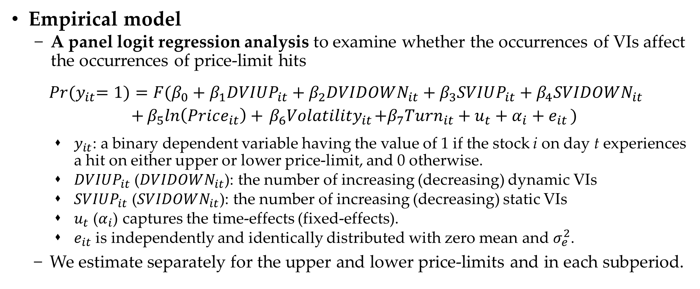
Relationship of VIs with Price-Limit System
Empirical model
A panel logit regression analysis to examine whether the occurrences of VIs affect the occurrences of price-limit hits
$$\operatorname{Pr}{{(y}_{it}=1)}=F(β_{0}+β_{1}DVIUP_{it}+β_{2}DVIDOWN_{it}+β_{3}SVIUP_{it}+β_{4}SVIDOWN_{it}$$
$$+β_{5}ln\left(Price_{it}\right)+{ β_{6}Volatility}_{it}+{β_{7}Turn}_{it}+u_{t}+α_{i}+e_{it })$$
$y_{it}$: a binary dependent variable having the value of 1 if the stock i on day t experiences a hit on either upper or lower price-limit, and 0 otherwise.
$DVIUP_{it}$ ($DVIDOWN_{it}$): the number of increasing (decreasing) dynamic VIs
$SVIUP_{it}$ ($SVIDOWN_{it}$): the number of increasing (decreasing) static VIs
$u_{t}$ ($α_{i}$) captures the time-effects (fixed-effects).
$e_{it}$ is independently and identically distributed with zero mean and $σ_{e}^{2}$.
We estimate separately for the upper and lower price-limits and in each subperiod.

Slide 35
Relationship of VIs with Price-Limit System
Estimation results
For dynamic VI, the occurrences of upper-limit hits are positively related to the occurrences of increasing dynamic VIs, while the occurrences of lower-limit hits are positively related to the occurrences of decreasing dynamic VIs.
Statistical significance are relatively weak.

Slide 36
Relationship of VIs with Price-Limit System
Estimation results
For static VI, the occurrences of upper-limit hits are positively related to the occurrences of increasing static VIs, while the occurrences of lower-limit hits are positively related to the occurrences of decreasing dynamic VIs.
The magnitudes and statistical significances are much stronger.

Slide 37
Concluding Remarks
Sequential introductions of VIs
The KRX sequential introductions of dynamic and static VIs allowed us to separate the effects of these two types of VIs and compare their effectiveness.
The pre-existing price-limit system on the Korean stock markets allowed us to separate the effects of price-limit systems and VIs.
Different effectiveness of two types of VIs
Dynamic VI shows larger and more significant contribution on price stabilization and price discovery than static VI.
The limited effects of static VI come from its similar functionality to the existing price-limit system.

