Slide 1
Uncooperative parasites:
Solving the prisoners’ dilemma in the active / passive house of correction
David Buckle
(Unaffiliated these days)
David.j.buckle@live.co.uk
CDAR
University of California, Berkeley 18/4/2023

Slide 2
The agenda
Setting the investment scene
Refresher on conventional model
What values for Sharpe Ratio and Information Ratio?
A revised conventional model when investors impact the market
What if investors collaborate?
What if they don’t?
Forcing responsible behaviour

Slide 3
The agency model of asset management
single period manager selection
INVESTOR
Time
Allocation of wealth
multi period security selection
ASSET MANAGER
Time

Slide 4
There are two types of asset manager
Active managers
Managers who dynamically change their portfolio based on security analysis
Passive managers
Managers who buy and hold the market portfolio

Slide 5
There are two types of asset manager
Active managers
Managers who dynamically change their portfolio based on security analysis
Passive managers
Managers who buy and hold the market portfolio
Active managers are the only traders in the investment window
They clear the market: price discovery
Their aggregate investment forms a portfolio
Passive managers buy this portfolio
Therefore this portfolio must be the market (cap weighted) portfolio

Slide 6
There are two types of asset manager
Active managers
Managers who dynamically change their portfolio based on security analysis
Passive managers
Managers who buy and hold the market portfolio
Active managers are the only traders in the investment window
They clear the market: price discovery
Their aggregate investment forms a portfolio
Passive managers buy this portfolio
Therefore this portfolio must be the market (cap weighted) portfolio
Active managers
Form the market portfolio
Passive managers
Use the market portfolio

Slide 7
There are two types of asset manager
Active managers
Managers who dynamically change their portfolio based on security analysis
Passive managers
Managers who buy and hold the market portfolio
Active managers are the only traders in the investment window
They clear the market: price discovery
Their aggregate investment forms a portfolio
Passive managers buy this portfolio
Therefore this portfolio must be the market (cap weighted) portfolio
Active managers
Form the market portfolio
Passive managers
Use the market portfolio
Freeloaders

Slide 8

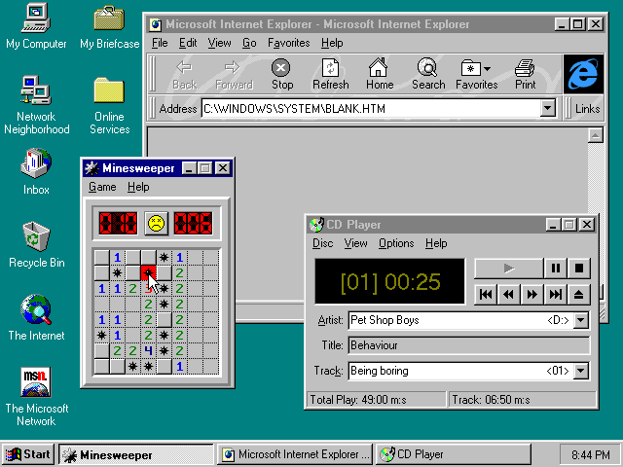
How agents discover prices
Case study: Microsoft introduces Windows
Assume there are 2 active managers

Slide 9
Price target of manager A
Price target of manager B

Slide 12
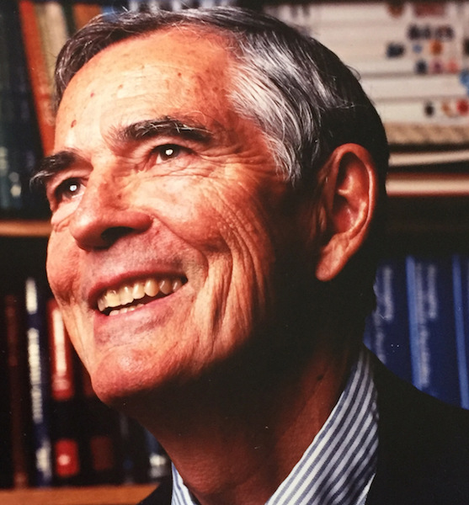
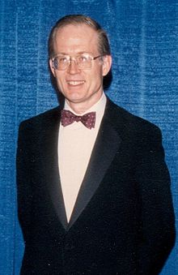
How are they not Nobel Laureates?!?
Jack Treynor
Fischer Black

Slide 13
Treynor J. and Black F. (1973) “How to use security analysis to improve portfolio selection” Journal of Business, 46(1), 66-85.
Concept:
Separation of security return into alpha and beta
Active portfolios constructed from alpha
Terminology
Sharpe ratio
Passive portfolio, active portfolio
Other ideas in the paper
Information ratio
Information coefficient
Market neutral portfolios, portable alpha, leveraged portfolios, incorporating analysts’ views
The dual role of securities for active management and to form the market
Passive investors need not forecast the market

Slide 14
Treynor and Black security analysis - the model
r_{F} denotes risk-free rate of return
r_{M} denotes market return
r_{A} denotes return on active portfolio of securities
r_{A} = r_{F} + β(r_{M} – r_{F}) + θ
where β is set such that r_{M} and θ are uncorrelated
r_{P} denotes investor’s return (with x% of wealth allocated to the market and y% allocated to the active portfolio)
r_{P} = (1 – x – y)r_{F} + x r_{M} + y r_{A}
= r_{F} + w(r_{M} – r_{F}) + y θ

Slide 15
Treynor and Black security analysis – the results
E[r_{M} – r_{F}] = μ V[r_{M}] = σ² SR = μ/σ
E[θ] = α V[θ] = ν² IR = α/ν
E[r_{P} – r_{F}]
SR_{P} = √V[r_{P}]
Optimise the objective function f(w,y) = E[r_{P} – r_{F}] – ½ λ V[r_{P}]
= wμ + yα – ½ λ (w²σ² + y²ν²) where λ is coefficient of risk aversion
w* = μ = SR
λσ² λσ
y* = α = IR
λν² λν
SR_{P}* = √ (SR² + IR²)

Slide 16
Typical values used for μ, σ, and λ
Long term capital market assumptions
 | μ | σ | SR (=μ/σ)
UBS | 6.0% | 14.7% | 0.41
Invesco | 6.5% | 16.5% | 0.39
BlackRock | 5.0% | 15.7% | 0.32
JP Morgan | 4.9% | 15.9% | 0.31
Fidelity | 3.8% | 18.2% | 0.21
Vanguard | 3.3% | 16.5% | 0.20
AVERAGE | 4.9% | 16.2% | 0.30

Slide 17
Typical values used for μ, σ, and λ
Long term capital market assumptions
 | μ | σ | SR (=μ/σ)
UBS | 6.0% | 14.7% | 0.41
Invesco | 6.5% | 16.5% | 0.39
BlackRock | 5.0% | 15.7% | 0.32
JP Morgan | 4.9% | 15.9% | 0.31
Fidelity | 3.8% | 18.2% | 0.21
Vanguard | 3.3% | 16.5% | 0.20
AVERAGE | 4.9% | 16.2% | 0.30
In this presentation, I will use
μ = 5% σ = 16.666% ⇒ SR = 0.3

Slide 18
Typical values used for μ, σ, and λ
Long term capital market assumptions
 | μ | σ | SR (=μ/σ)
UBS | 6.0% | 14.7% | 0.41
Invesco | 6.5% | 16.5% | 0.39
BlackRock | 5.0% | 15.7% | 0.32
JP Morgan | 4.9% | 15.9% | 0.31
Fidelity | 3.8% | 18.2% | 0.21
Vanguard | 3.3% | 16.5% | 0.20
AVERAGE | 4.9% | 16.2% | 0.30
In this presentation, I will use
μ = 5% σ = 16.666% ⇒ SR = 0.3
λ = 3 ⇒ Optimal market exposure = SR = 60%
λσ

Slide 19
Typical values used for α, ν
Active risk tends to be approximately ν = 5%
Optimal active exposure = IR
λν

Slide 20
Typical values used for α, ν
Active risk tends to be approximately ν = 5%
Optimal active exposure = IR
λν
BUT, λν = 15%.
Therefore IR is a very sensitive parameter.
No active management
>100% active management

Slide 21
Typical values used for α, ν
Active risk tends to be approximately ν = 5%
Optimal active exposure = IR
λν
BUT, λν = 15%.
Therefore IR is a very sensitive parameter.
Often, IR values of 1 are claimed by active managers
That would imply active exposure of …
No active management
>100% active management

Slide 22

Typical values used for α, ν
Active risk tends to be approximately ν = 5%
Optimal active exposure = IR
λν
BUT, λν = 15%.
Therefore IR is a very sensitive parameter.
Often, IR values of 1 are claimed by active managers
That would imply active exposure of …
No active management
>100% active management
666%

Slide 23
Is α = 0?
The conventional argument (α=0)
The aggregate alpha of active managers is zero
If one manager has positive alpha…
…another manager has negative alpha (cannot persist in equilibrium)

Slide 24
Is α > 0?
Possible exceptions to the argument that α = 0
Some agents are allocated wealth – irrespective of their alpha
Eg: Some investors are their own agents
Eg: Companies manage their own capital stack
BUT…if commercial asset managers must have positive alpha, the above must be the fall-guys
There is no equilibrium
Asset manager has alpha ⇒ more allocation ⇒ becomes the market ⇒ less alpha ⇒ less alloc
Investors tactically allocate to asset managers
But…
α > 0 inconsistent with trend to passive

Slide 25
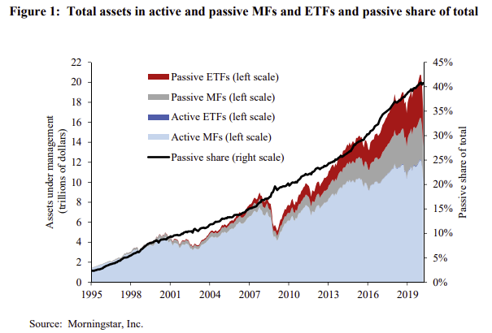
Investors don’t appear to believe the claims of active managers

Slide 26
Is α < 0?
Information has a cost
Grossman-Stiglitz paradox
This presentation may explain the paradox
In our case, cost is the active fund’s expense ratio

Slide 27
What if active managers improve the market?
Fraser-Jenkins’ Passive investing is worse than Marxism
 | Capitalism with active managers | Marxism | Capitalism with only passive managers
Number of analysts | Many | 1 | 0

Slide 28
What if active managers improve the market?
Fraser-Jenkins’ Passive investing is worse than Marxism
 | Capitalism with active managers | Marxism | Capitalism with only passive managers
Number of analysts | Many | 1 | 0
What if the market performance deteriorates when less analysts analyse securities?

Slide 29
What would the market look like if no active managers?
Absolute Zero:
The market constituents frozen in time

Slide 30

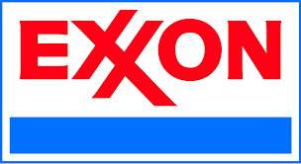








What would the market look like if no active managers?
1985

Slide 31






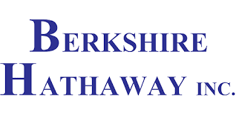



What would the market look like if no active managers?
1985
2022

Slide 32
What if active managers improve the market Sharpe ratio?

Slide 33
What if active managers improve the market Sharpe ratio?
Assumption
Analysts take the “analytic oath” - First do no harm
SR’(p) ≥ 0 for all p

Slide 34
If active managers improve the market Sharpe ratio
Passive managers
Freeloaders

Slide 35
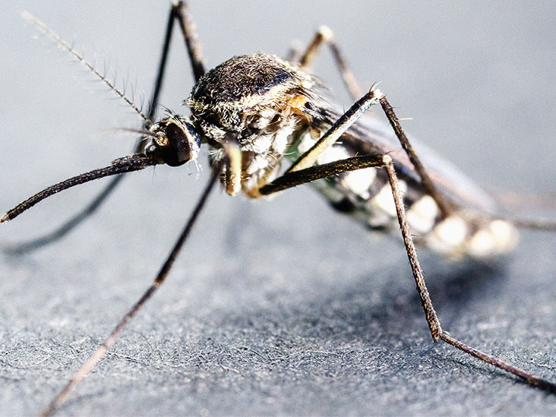
If active managers improve the market Sharpe ratio
Passive managers
Parasites

Slide 36

The virus
Passive investing

Slide 37
The virus
Passive investing
The carrier
Passive managers

Slide 38

The virus
Passive investing
The carrier
The host
Passive managers
Active managers

Slide 39
What if investors collaborate?
Assumption
All investors build active portfolios to have the same α and ν.
This is less strict than the “homogeneity of expectations” of the CAPM

Slide 40
What if investors collaborate?
Assumption
All investors build active portfolios to have the same α and ν.
This is less strict than the “homogeneity of expectations” of the CAPM
Assumption
All investors know SR(p)

Slide 41
What if investors collaborate?
Assumption
All investors build active portfolios to have the same α and ν.
This is less strict than the “homogeneity of expectations” of the CAPM
Assumption
All investors know SR(p)
⇒ y*/w* is the same for every investor
⇒ p = y*/w*

Slide 42
When investors collaborate
f(w,y) = wμ(p) + yα – ½ λ (w²σ² + y²ν²) where p = y/w
w* = μ(p*) – p* μ’(p*) = SR(p*) – p* SR’(p*)
λσ² λσ
y* = α + μ’(p*) = IR + c SR’(p*) where c = σ/ν
λν² λν

Slide 43
When investors collaborate
f(w,y) = wμ(p) + yα – ½ λ (w²σ² + y²ν²) where p = y/w
w* = μ(p*) – p* μ’(p*) = SR(p*) – p* SR’(p*)
λσ² λσ
y* = α + μ’(p*) = IR + c SR’(p*) where c = σ/ν
λν² λν
SR* = √ (SR_{alt}² + IR_{alt}²) where SR_{alt} = SR(p*) – p*SR’(p*) and IR_{alt} = IR + c SR’(p*)

Slide 44
When investors collaborate
f(w,y) = wμ(p) + yα – ½ λ (w²σ² + y²ν²) where p = y/w
w* = μ(p*) – p* μ’(p*) = SR(p*) – p* SR’(p*)
λσ² λσ
y* = α + μ’(p*) = IR + c SR’(p*) where c = σ/ν
λν² λν
SR* = √ (SR_{alt}² + IR_{alt}²) where SR_{alt} = SR(p*) – p*SR’(p*) and IR_{alt} = IR + c SR’(p*)
Observations
The critical function is not SR(p) but SR’(p).
SR’ acts like extra ‘supercharged’ IR
Miniscule gradient is required to move to 100% proportion of active (SR’ > 0.045)
μ’ must exceed -α
If SR(p) is constant, then Treynor and Black is recovered

Slide 45
When SR(p) is piecewise linear
SR_{min} if p < p_{lo}
SR(p) = SR_{min} + (p – p_{lo})Δ if p_{lo} ≤ p ≤ p_{hi} Δ = SR_{max} – SR_{min}
SR_{max} if p_{hi} < p p_{hi} – p_{lo}

Slide 46
When SR(p) is piecewise linear
SR_{min} if p < p_{lo}
SR(p) = SR_{min} + (p – p_{lo})Δ if p_{lo} ≤ p ≤ p_{hi} Δ = SR_{max} – SR_{min}
SR_{max} if p_{hi} < p p_{hi} – p_{lo}
Examples with: σ = 16.6%, ν = 5%, SR_{max} = 0.3, and SR_{min} = 0.1, p_{lo} = 10%, p_{hi} = 20%

Slide 47
Case 1) IR > 0
p* = 100% …regardless of SR(p)
Objective function
100%
100%
Market exposure (w)
Proportion active (p)
0%
0%

Slide 48
Case 2) IR = 0
p* = p_{hi}
Objective function
100%
100%
Market exposure (w)
Proportion active (p)
0%
0%

Slide 49
Case 3) IR < 0
(e.g. α = 0 and e = 1%)
p* = p_{hi}
Objective function
100%
100%
Market exposure (w)
Proportion active (p)
0%
0%

Slide 50
When investors do not collaborate
The interesting case
α = -e (no gross-of-fee alpha, and active management fee of e)
Assumption
There are a large number of investors
p is unaffected by an individual investor
SR_{P}(ρ) = SR(p) – eρ/σ
√1 + (νρ/σ)²

Slide 51
When investors do not collaborate

Slide 52
When investors do not collaborate

Slide 53
When investors do not collaborate

Slide 54
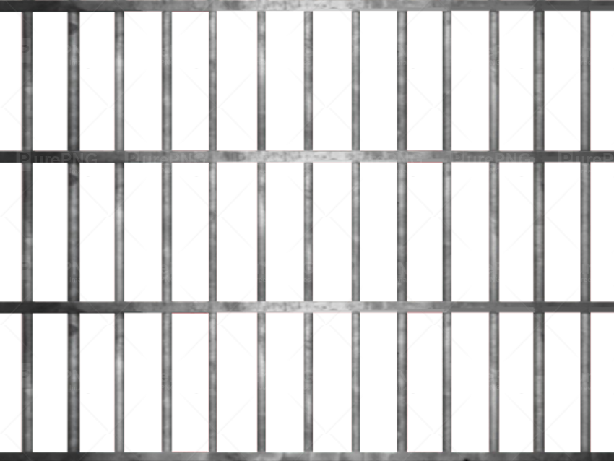
When investors do not collaborate
Prisoners’ dilemma

Slide 55
Solutions to removing the dilemma
Active Managers: Reduce the cost of active management
Passive Managers: Increase the cost of passive management

Slide 56
Solutions to removing the dilemma
Active Managers: Reduce the cost of active management
Passive Managers: Increase the cost of passive management
Regulator: Impose a levy on passive and give to active
This removes the impact of e

Slide 57
Solutions to removing the dilemma
Active Managers: Reduce the cost of active management
Passive Managers: Increase the cost of passive management
Regulator: Impose a levy on passive and give to active
This removes the impact of e
Levy = σφSR_{hi} + p_{hi}e where φ = (p_{hi}ν/σ)²
1 + φ
If e = 0.5% then levy = 11.8bps

Slide 58
The dilemma is removed

Slide 59
The levy forms an equilibrium

Slide 60


MARKET

Slide 61
Responsible investing
Trend: investors taking more responsibility for their investments (eg ESG, SRI)
Why no responsibility toward the market they are using?

Slide 62
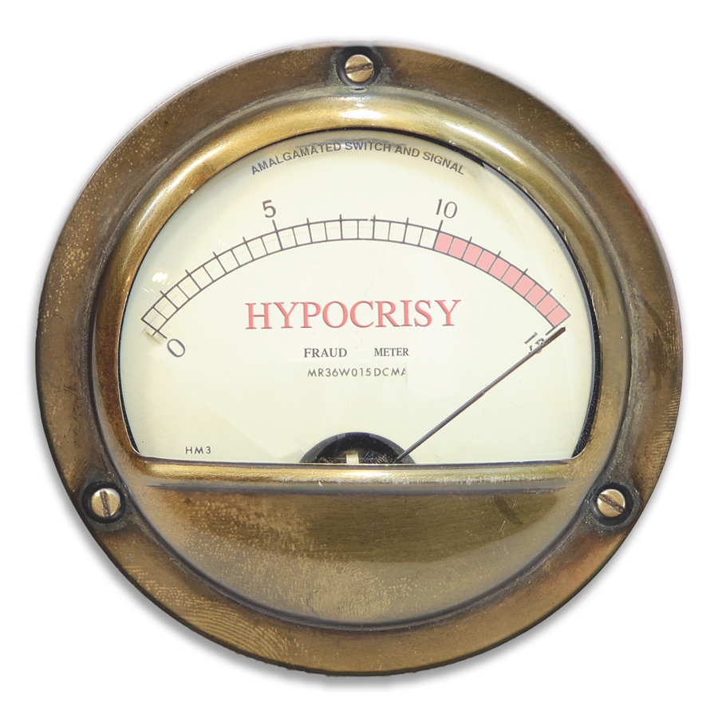
Responsible investing
Trend: investors taking more responsibility for their investments (eg ESG, SRI)
Why no responsibility toward the market they are using?

Slide 63
Conclusions
If investors affect market efficiency, portfolio construction must be reconsidered
Urge academia to identify SR(p)
If there is any kind of increase in SR when just a small proportion of the market is active,
Can we persuade passive investors to act responsibly?
If not, the prisoners’ dilemma will continue
Something is needed to break the prisoners’ dilemma
Levy?
If not, what?

Slide 64
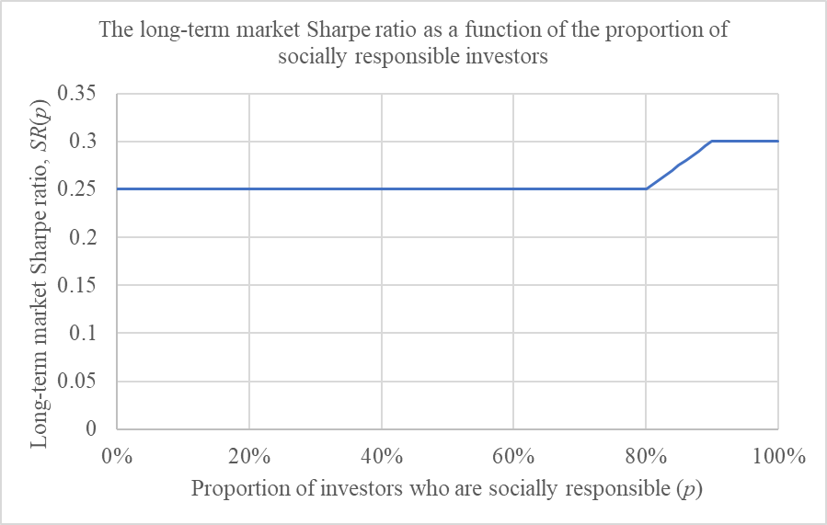

Slide 65
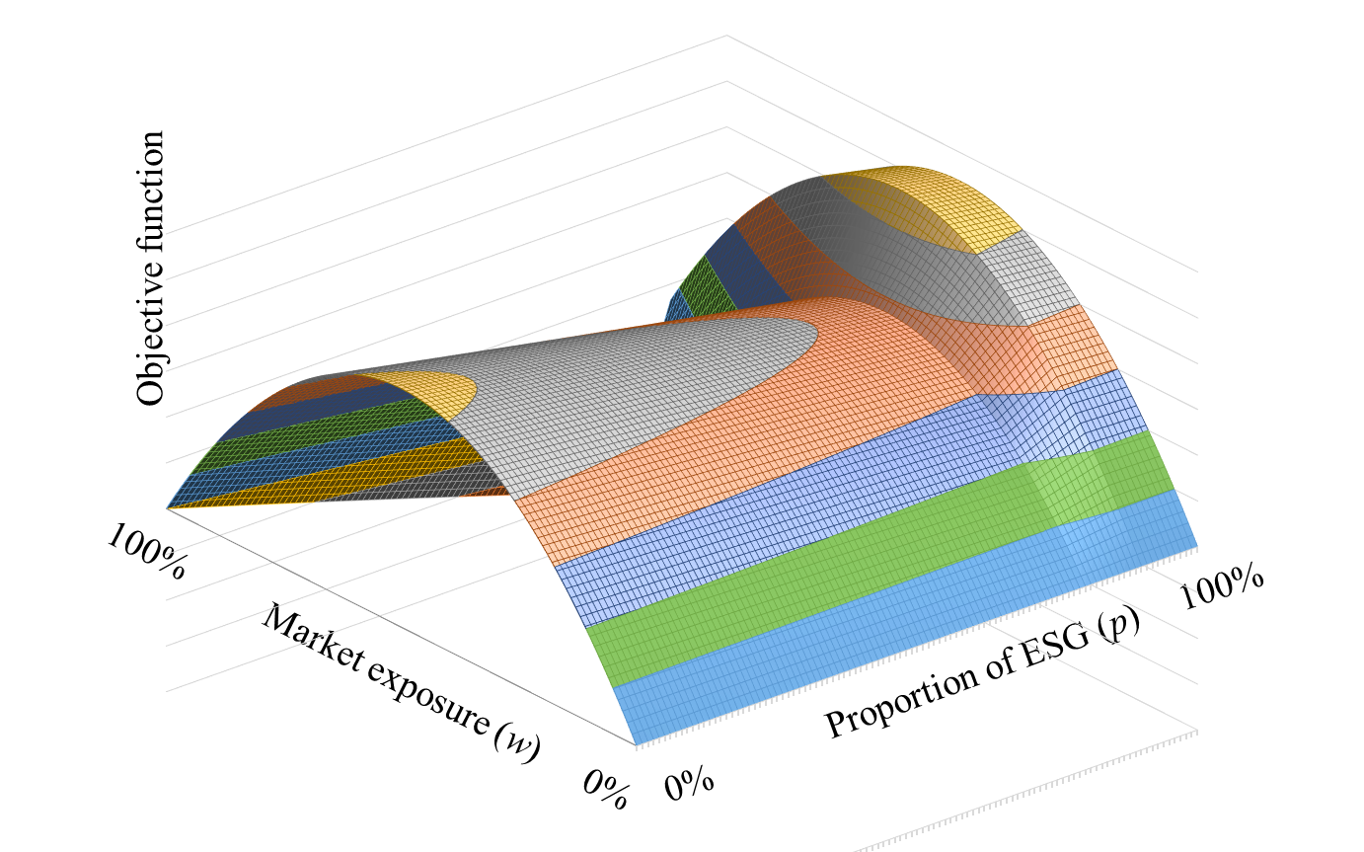
When ESG IR is negative:

