Slide 1
Industry Winners and Losers in Low Carbon
D Basu, G Garvey, S Guo,
R Zamani

Slide 2
Approach and Qualitative Results of Model

Slide 3
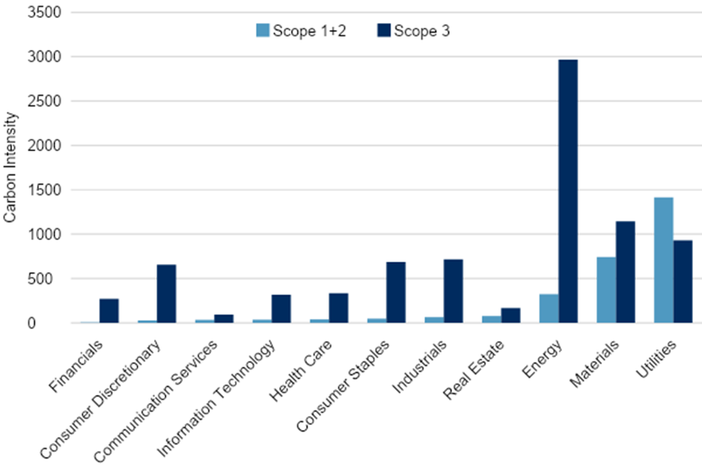
Green Investing Looks Easy!
Emissions/Revenue by GICS Sector, September 2022. TruCost/S&P

Slide 4
Our approach: What lower-emission alternatives are viable?
Production: do we have the inputs required?
Consumption: is the final mix acceptable to people?
Portfolio emissions are not the answer:
Stock market is not the world
Industry constraints control tracking error, not the climate
Scope n does not capture input requirements
Our approach: Leverage Environmentally Augmented IO tables
Leontief inverse ⇔ map from gross output to final consumption
Ensures the mix can be produced with current technology
Can also calibrate marginal utility of tech improvements
Exponential utility function defined on final consumption in each country
Current expenditure weights reveal relative importance of different goods
Entirely positive rather than normative

Slide 5
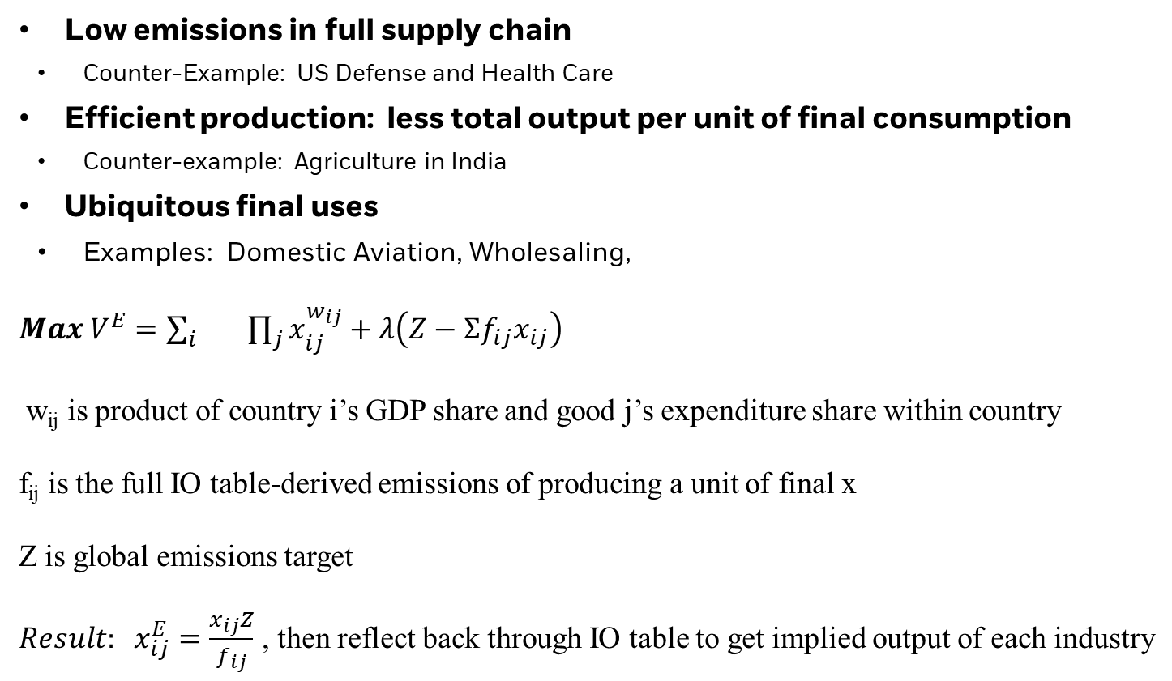
Three qualitative insights from model: Resilient local industries have
Low emissions in full supply chain
Counter-Example: US Defense and Health Care
Efficient production: less total output per unit of final consumption
Counter-example: Agriculture in India
Ubiquitous final uses
Examples: Domestic Aviation, Wholesaling,
${Max V}^{E}=\sum_{i}{} \prod_{j}{x_{ij}^{w_{ij}}}+λ\left(Z−Σf_{ij}x_{ij}\right)$
w_{ij} is product of country i’s GDP share and good j’s expenditure share within country
f_{ij} is the full IO table-derived emissions of producing a unit of final x
Z is global emissions target
${Result: x}_{ij}^{E}=\frac{x_{ij}Z}{f_{ij}}$ , then reflect back through IO table to get implied output of each industry

Slide 6
Workhorse data: IO table
Global, full economy
https://www.rug.nl/ggdc/valuechain/wiod/, https://stats.oecd.org/Index.aspx?DataSetCode=IOTS_2021
Can run any feature at the industry level through it (PPI, Emissions, ESENT, etc)
Not sure how this behaves with spotty pairwise relationships we get from other sources (Revere, Capiq)
Can get very granular with sources like https://www.bea.gov/industry/benchmark-input-output-data
Some intriguing hints at https://webster.bfm.com/Wiki/display/sae/Cash+Flow+Networks

Slide 7
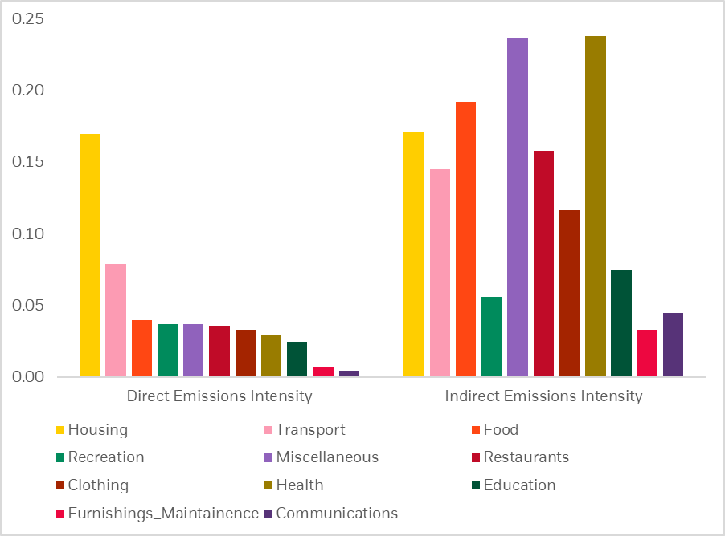
Emission Intensity, US Final Consumption 2016 Note: you can sum these to get total emissions

Slide 8
Big Spenders
Category | Country 1 | Country 2 | Country 3 | Country 4
Clothing | India | Italy | Brazil | Greece
Communications | China | Ireland | Hungary | Korea
Education | Canada | Germany | Sweden | Finland
Food at Home | India | Indonesia | Brazil | Mexico
Furnishings, Maintenance | Switzerland | Taiwan | Belgium | Austria
Health Care | USA | Great Britain | Germany | France
Housing | Australia | Portugal | China | Spain
Miscellaneous (Defense, Social Security) | USA | Germany | France | Russia
Recreation | Denmark | Hungary | Czech Republic | Ireland
Restaurants | Spain | Italy | Mexico | France
Transport | Greece | Hungary | Denmark | Norway

Slide 9
Ten Greenest FF 49 Industries in the US
Both Our Model and Direct Emissions | Direct Emissions Only | Our Model Only
Books, Fun, Hardw, PerSv, BusSv | Banks, Clothes, Hlth, Insur, RelEst | Aero, Meals, Retail, Rubber, Whlsl

Slide 10
Detailed Example

Slide 11
Add EmissionsEmissions
 | Food | IT | Autos | Final Uses | Output | Emissions (Intensity)
Food | 50 | 15 | 20 | 45 | 130 | 3 (0.23)
IT | 10 | 30 | 20 | 70 | 130 | 1 (0.077)
Autos | 0 | 15 | 20 | 95 | 130 | 1 (0.077)
Value Added | 70 | 70 | 70
Total Output | 130 | 130 | 130 | 210 | 390 | 5

Slide 12
Scope 3 with complete data
Upstream Scope 3 for Food= 10 units that Food sources from IT times emission intensity of IT =0.077
Downstream Scope 3 for Food =
15 units to IT times intensity of IT
+ 20 units to Autos times intensity of Autos = 0.26
Add up and you get 3.35 for Food, 1.84 for IT, 1.73 for Autos
Double Counting: Total > global emissions of 5.
How exactly is Food “responsible” for extra emissions?
 | Upstream Scope 3 | Downstream Scope 3 | All Scopes
Food | 0.077 | 0.27 | 3.35
IT | 0.46 | 0.38 | 1.84
Auto | 0.61 | 0.115 | 1.73

Slide 13
Our model: fix final $ consumption
Full Requirements per unit of consumption
Entries are per unit of consumption | Food | IT | Autos
Food | 1.66 | 0.30 | 0.36
IT | 0.17 | 1.37 | 0.28
Autos | 0.02 | 0.19 | 1.22
Results: emissions drop by 34%, utility falls by 9%, total output falls by 10%
 | Direct Emission | Consumption-Allocated Emissions | Current (Carbon Blind) Consumption | Carbon-aware Consumption*
Food | 3 | 2.25 | 45 | 30
IT | 1 | 1.275 | 70 | 83
Autos | 1 | 1.475 | 95 | 97

Slide 14
Test using energy prices

Slide 15
Idea: For users, high energy prices ≅≅ emissions constraint FRED Energy/non-Energy CPI. US 1975-2022

Slide 16
10- (Green) Industry Average Monthly Returns, 1996-2022

Slide 17
Time series regressions: equal weighted 10 industry returns
 | Full Model | Direct Emissions Only
Intercept | -0.0012 (0.32) | 0.0021 (0.62)
Mkt | 1.06 (45.3) | 1.11 (43.9)
Smb | 0.233 (6.06) | 0.238 (6.63)
Hml | 0.121 (3.32) | -0.023 (1.66)
Rmw | 0.289 (6.28) | -0.0032 (0.061)
Cma | 0.036 (0.0066) | 0.181 (2.22)
High Energy Price | 0.00042 (0.281) | -0.00392 (2.89)
Adj R² | 93% | 94%

Slide 18
Future Research

Slide 19
Extensions and improvements
Production
How much difference would best practice make in different industries?
Capital formation is tricky
International trade is all incorporated but some data is imputed from broader flows
Labor: we have assumed this just flows as required but generate job/occupational insights
Consumption
Better grouping and calibration: Our current approach was motivated by embarrassing result with autos
More general utility functions: how much do our results for substitution matter?

Slide 20
Quick derivation
Q=total output, A=scaled IO matrix, C=consumption, AQ = intermediate output
Leontief Inverse=A+A² +A³+.. But why?
Q=AQ+C
(IQ-AQ)=C
Q=(I-A)⁻¹ C
Total Output =Leontief Inverse* Consumption

