Slide 1
git@github.com:berkeley-gif/reshoot.git
example code for API access in PHP, JS, and R
slides
upload and share code during our little hackathon

Slide 2
How to use the API?
Browsable API
Start here ecoengine.berkeley.edu/api
Navigate through resources to find/construct the appropriate URL
Copy URL into your project code
Persistence!?

Slide 3
ecoengine.berkeley.edu/api/photos
Important parameters for today’s goals
?authors = Wieslander
?collection_code=VTM
?county=Mono
?begin_date=1937-12-20
?end_date=1940-12-03
?bbox=36,-119,37,-118
?page_size=200
?format=json overrides the content-type

Slide 4
ecoengine.berkeley.edu/api/photos
Important parameters for today’s goals
?authors = Wieslander
?collection_code=VTM
?county=Mono
?begin_date=1937-12-20
?end_date=1940-12-03
?bbox=36,-119,37,-118
?page_size=200
?format=json overrides the content-type

Slide 5
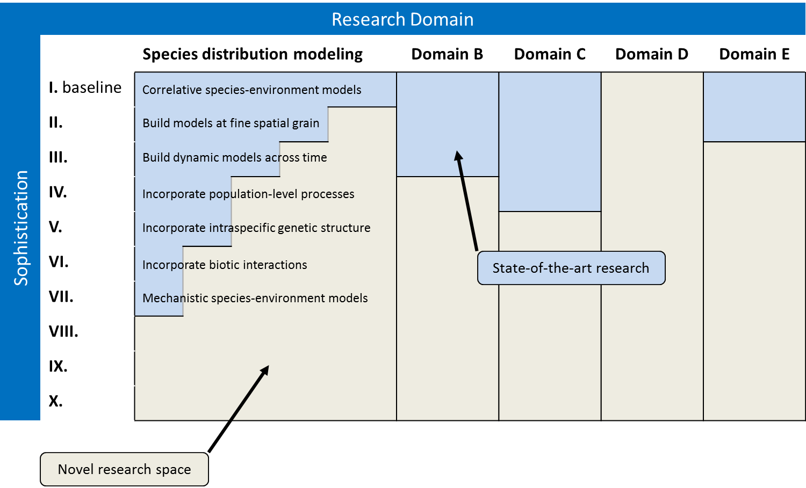
Advancing Research

