Slide 1
Journal Club Meeting
“Conserving energy and momentum in nonlinear dynamics: A simple implicit time integration scheme” by Klaus-Jürgen Bathe (2007)

Slide 2
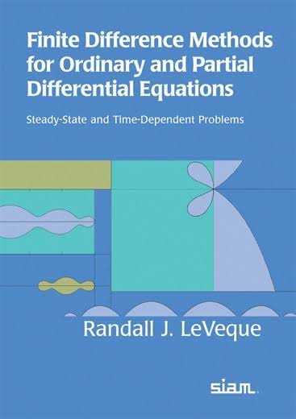

Fundamental Theorem of Finite Difference Methods
$$\underset{\begin{aligned}local truncation \\ error (LTE)\end{aligned}}{\underbrace{consistency}}+stability⟹\underset{global error}{\underbrace{convergence}}$$
“The global error simply refers to the error that we are attempting to bound. The LTE refers to the error in our finite difference approximation of derivatives and hence is something that can be easily estimated using Taylor series expansions. Stability is the magic ingredient that allows us to go from these easily computed bounds on the local error to the estimates we really want for the global error.”
“The challenge in analyzing finite difference methods for new classes of problems often is to find an appropriate definition of “stability” that allows one to prove convergence using the fundamental theorem. For nonlinear PDEs this frequently must be turned to each particular class of problems and relies on existing mathematical theory and techniques of analysis for this class of problems.”

Slide 3
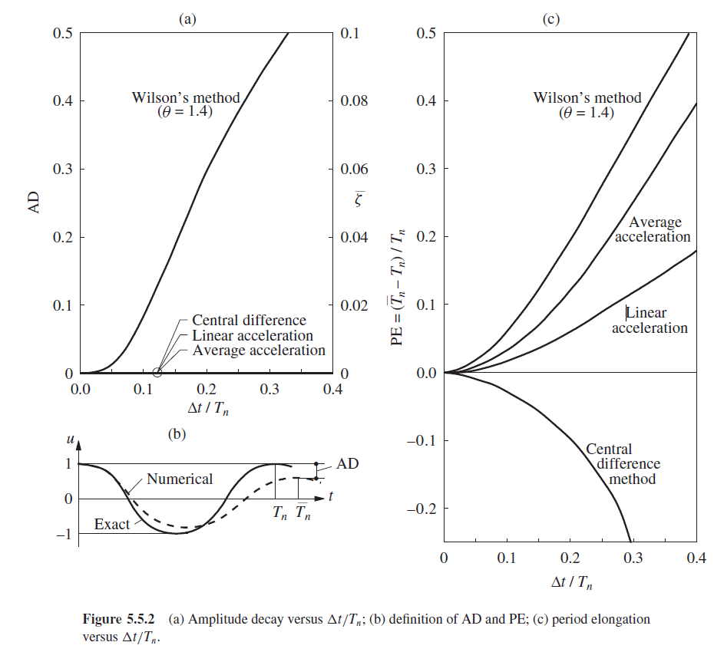
Linear Dynamic Problems
Accuracy
Newmark’s method: a single-step, second-order accuracy scheme (a special trapezoidal rule method).
Stability
Newmark’s method with constant average acceleration is unconditionally stable procedures, which leads to bounded solutions
regardless of the time-step length.
(Chopra, 2020)

Slide 4
Non-Linear Dynamic Problems
Accuracy
Stability
“In publications of time integration methods for linear dynamical systems, the main topic is the order of accuracy, because the criterion for unconditionally stability is easy to satisfy for most of the algorithms.
On the other hand, in the case of a non-linear dynamical system, the main interest in numerical dynamics is focused on the numerical stability of the algorithms. The reason for this change of interest is the problem of numerical stability in non-linear dynamics: Algorithms which are unconditional stable for linear dynamics often lose this stability in the non-linear case.
Instead, spectral stability is required, which is only a necessary condition for stable time integration schemes in non-linear dynamics. A sufficient condition in the non-linear regime is the conservation or decay of the total energy within a time step.” (Kuhl and Crisfield, 1999)
(Chopra, 2020)
Notes:
Disc for eigenvalue problem

Slide 5
Non-Linear Dynamic Problems
Once the stability is no long guarantee (i.e., size of time step matter), numerical damping or amplitude decay mentioned in Chopra’s book would play an important role in both stability and accuracy of the numerical integration method.
In other words, we somehow need Numerical Damping to stabilizes the numerical integration scheme by damping out the unwanted high frequency modes, which contains frequency that is much smaller than the time step that we can practically use.

Slide 6
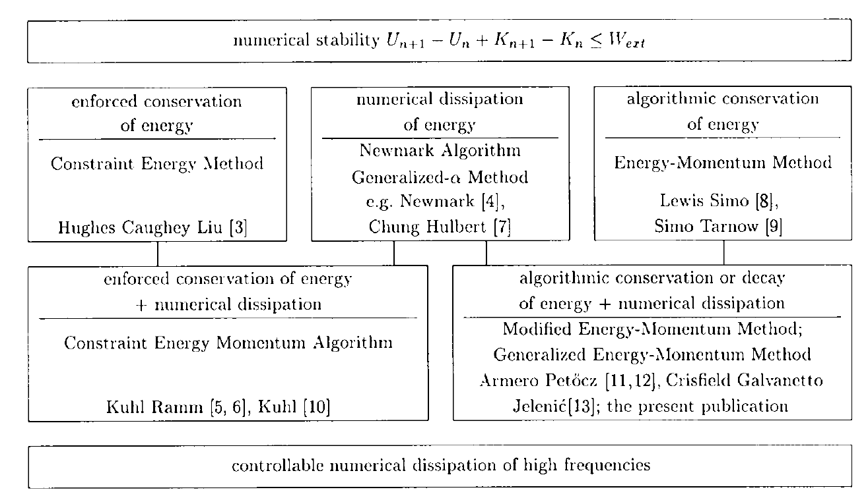
Numerical stability of Non-Linear Dynamic Problems

Slide 7
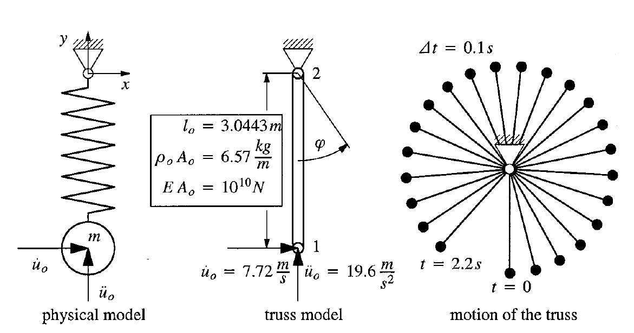
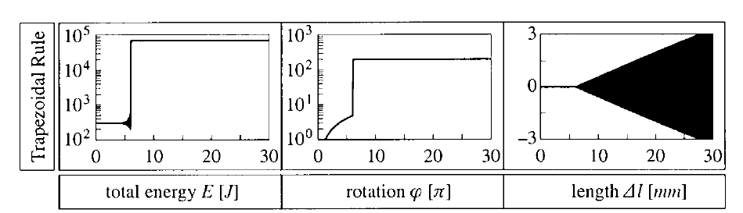

Slide 8
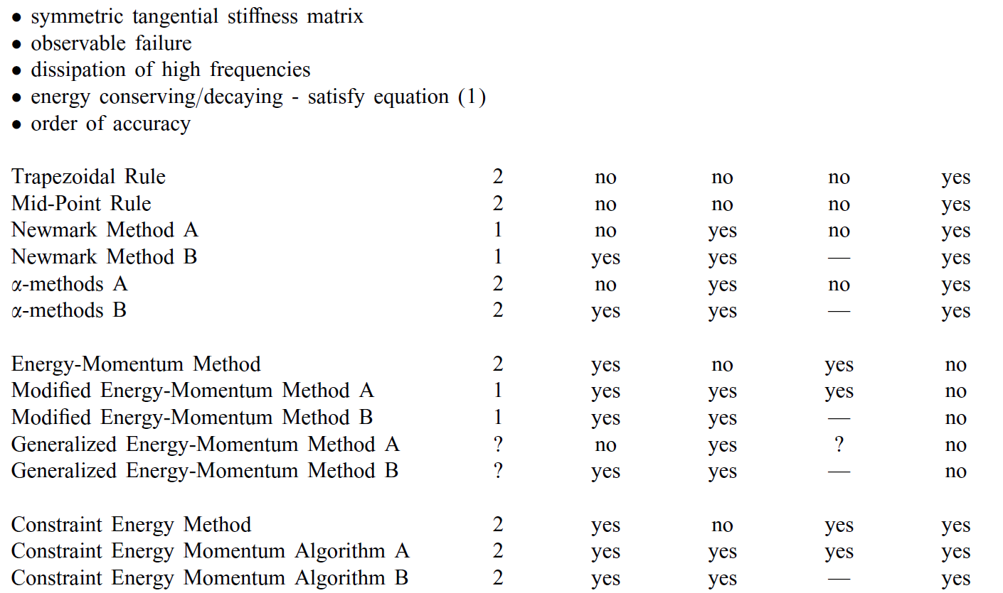



“High frequency modes which are inaccurately resolved
with the time step used may then deteriorate the overall solution accuracy. Also, these methods may result in non-symmetric tangent stiffness matrices and the solution of a scalar variable either at the integration points or over each element in an averaged sense. Hence, these integration schemes are computationally costly.” (Bathe, 2005)

Slide 9

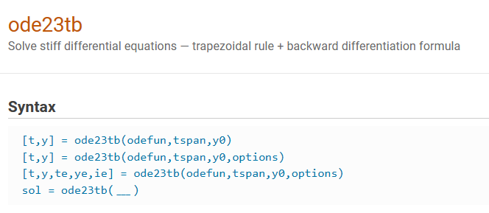
Stiff Differential Equation
Equations where certain implicit methods perform better, usually tremendously better, than explicit ones (Curtiss and Hirschfelder, 1952).
If the solution being sought is varying slowly, but there are nearby solutions that vary rapidly, so the numerical method must take small steps to obtain satisfactory results (Leveque, 2007).
trapezoidal rule + backward differentiation formula (TRBDF2):
A composite, single step, second-order accurate integration scheme with two sub-steps.
Stiff Differential Equations - MATLAB & Simulink (mathworks.com)
https://www.mathworks.com/help/matlab/math/solve-stiff-odes.html

Slide 10
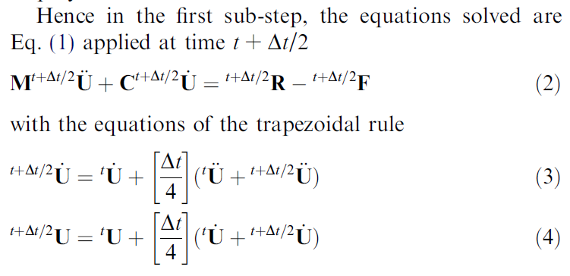
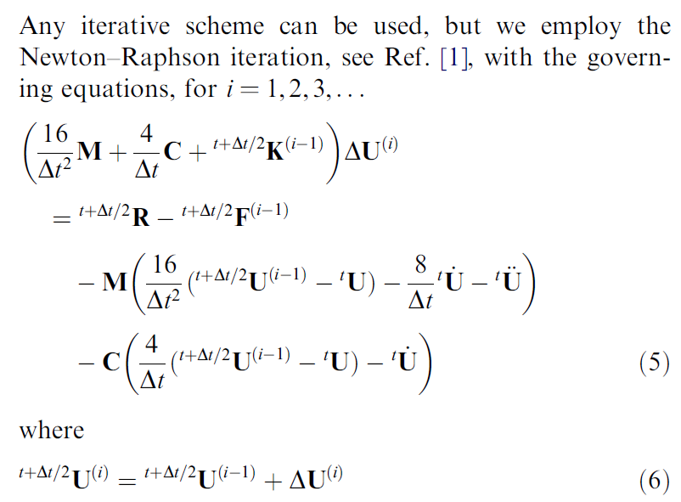
trapezoidal rule + backward differentiation formula (TRBDF2): 1st sub-step

Slide 11
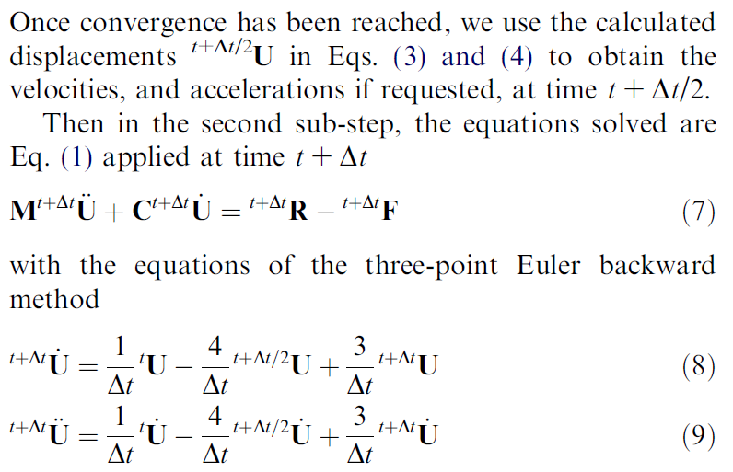
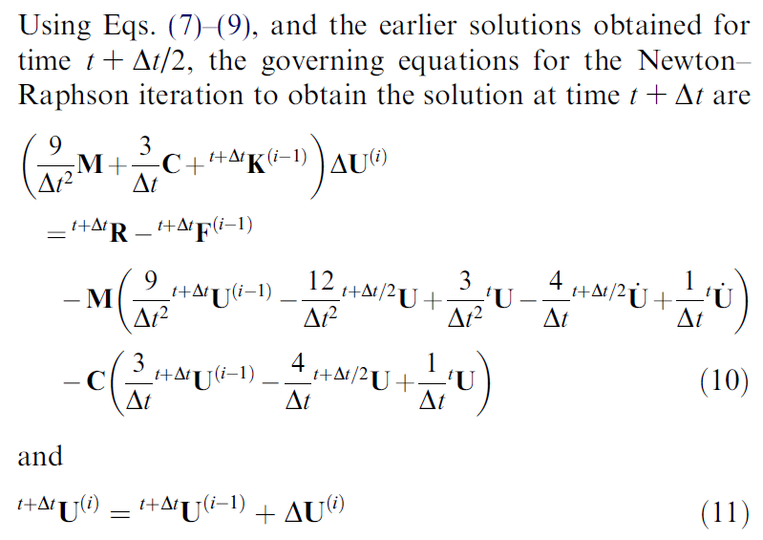
trapezoidal rule + backward differentiation formula (TRBDF2): 2nd sub-step

Slide 12
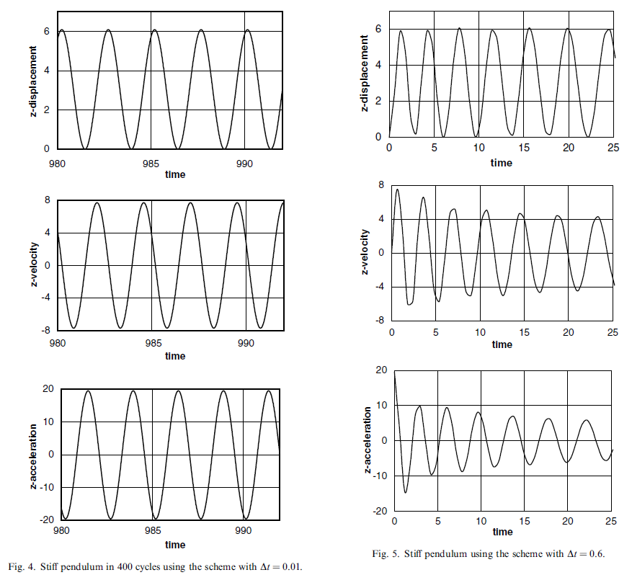
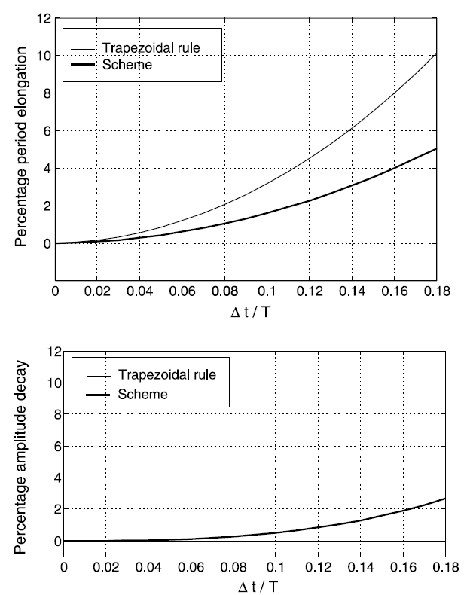
Stability
Conserving energy and linear/ angular momentum
Numerical damping
Slight damping from backward Euler

Slide 13
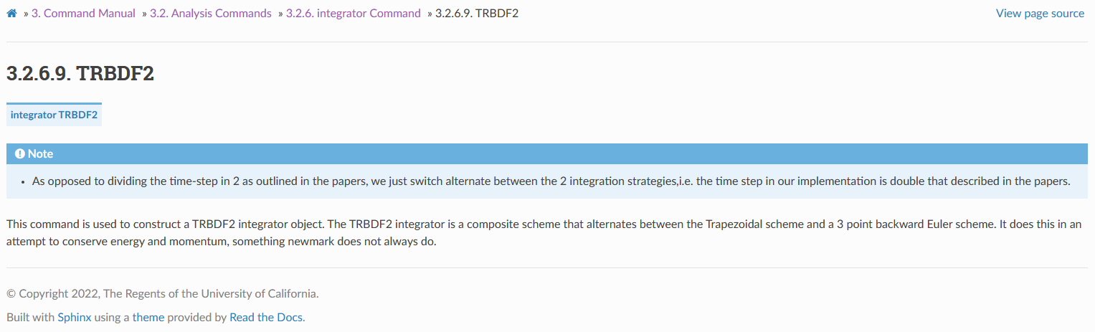
Discussion
The so-called large deformation “nonlinear dynamic” problems in the previous studies usually refer to geometrically nonlinear problem, but what about the case with material nonlinearity/ contact or impact problem?
In OpenSees, only the Generalized-alpha method and TRBDF2 can be found. I wonder why TRBDF2 doesn't receive more attention, at least in my experience? What about other schemes?

Slide 14
References
Simo, J. C., & Tarnow, N. (1992). The discrete energy-momentum method. Conserving algorithms for nonlinear elastodynamics. Zeitschrift für angewandte Mathematik und Physik ZAMP, 43, 757-792. (cited by 743, google scholar)
Kuhl, D., & Crisfield, M. (1999). Energy‐conserving and decaying algorithms in non‐linear structural dynamics. International journal for numerical methods in engineering, 45(5), 569-599. (cited by 454, google scholar)
Bathe, K. J., & Baig, M. M. I. (2005). On a composite implicit time integration procedure for nonlinear dynamics. Computers & Structures, 83(31-32), 2513-2524. (cited by 417, google scholar)
Bathe, K. J. (2007). Conserving energy and momentum in nonlinear dynamics: a simple implicit time integration scheme. Computers & structures, 85(7-8), 437-445. (cited by 457 , google scholar)
LeVeque, R. J. (2007). Finite difference methods for ordinary and partial differential equations: steady-state and time-dependent problems. Society for Industrial and Applied Mathematics.

