Slide 1
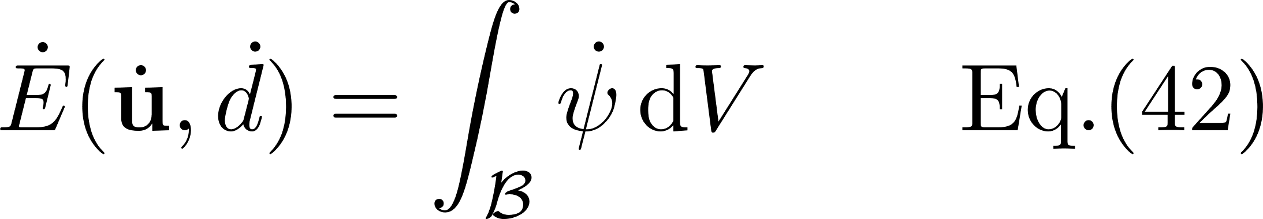
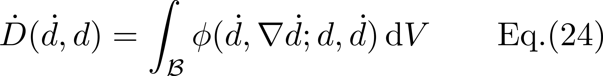
Conservation of Energy
:Evolution of stored energy
:Evolution of dissipation energy
:External power

Slide 2
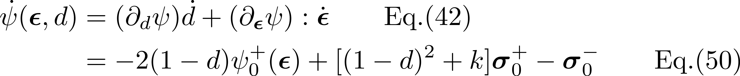
Conservation of Energy

Slide 3
Conservation of Energy
Rate-independent setting with approximated indicator function
Rate-independent setting with approximated indicator function

Slide 4
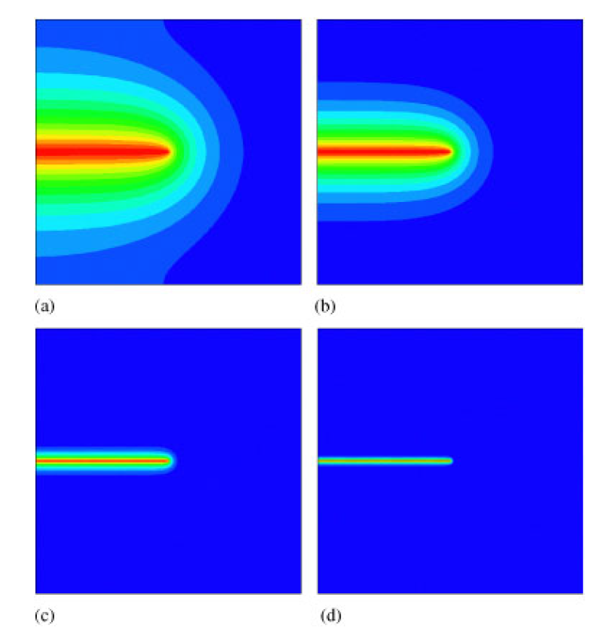
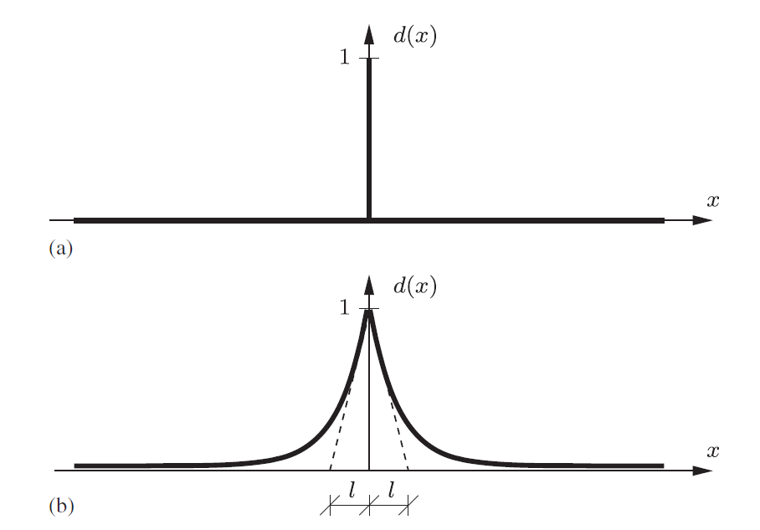
Conservation of Energy

Slide 5
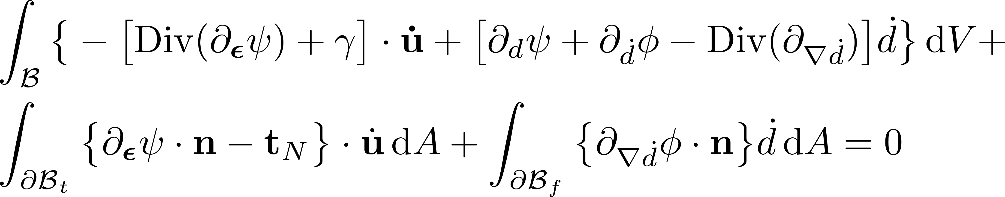
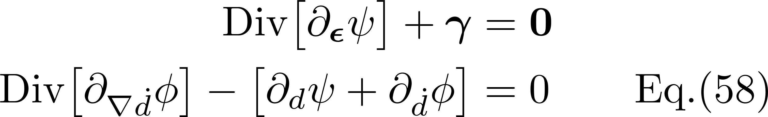
Conservation of Energy

