Slide 1
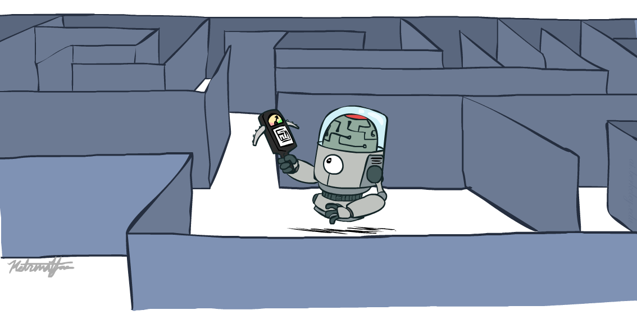
CS 188: Artificial Intelligence
Informed Search
Instructors: Stuart Russell and Dawn Song
University of California, Berkeley
Notes:
Please retain proper attribution and the reference to ai.berkeley.edu. Thanks!

Slide 2
Example: route-finding in Romania

Slide 3
What we would like to have happen
Guide search towards the goal instead of all over the place
Start
Goal
Start
Goal
Informed
Uninformed

Slide 4
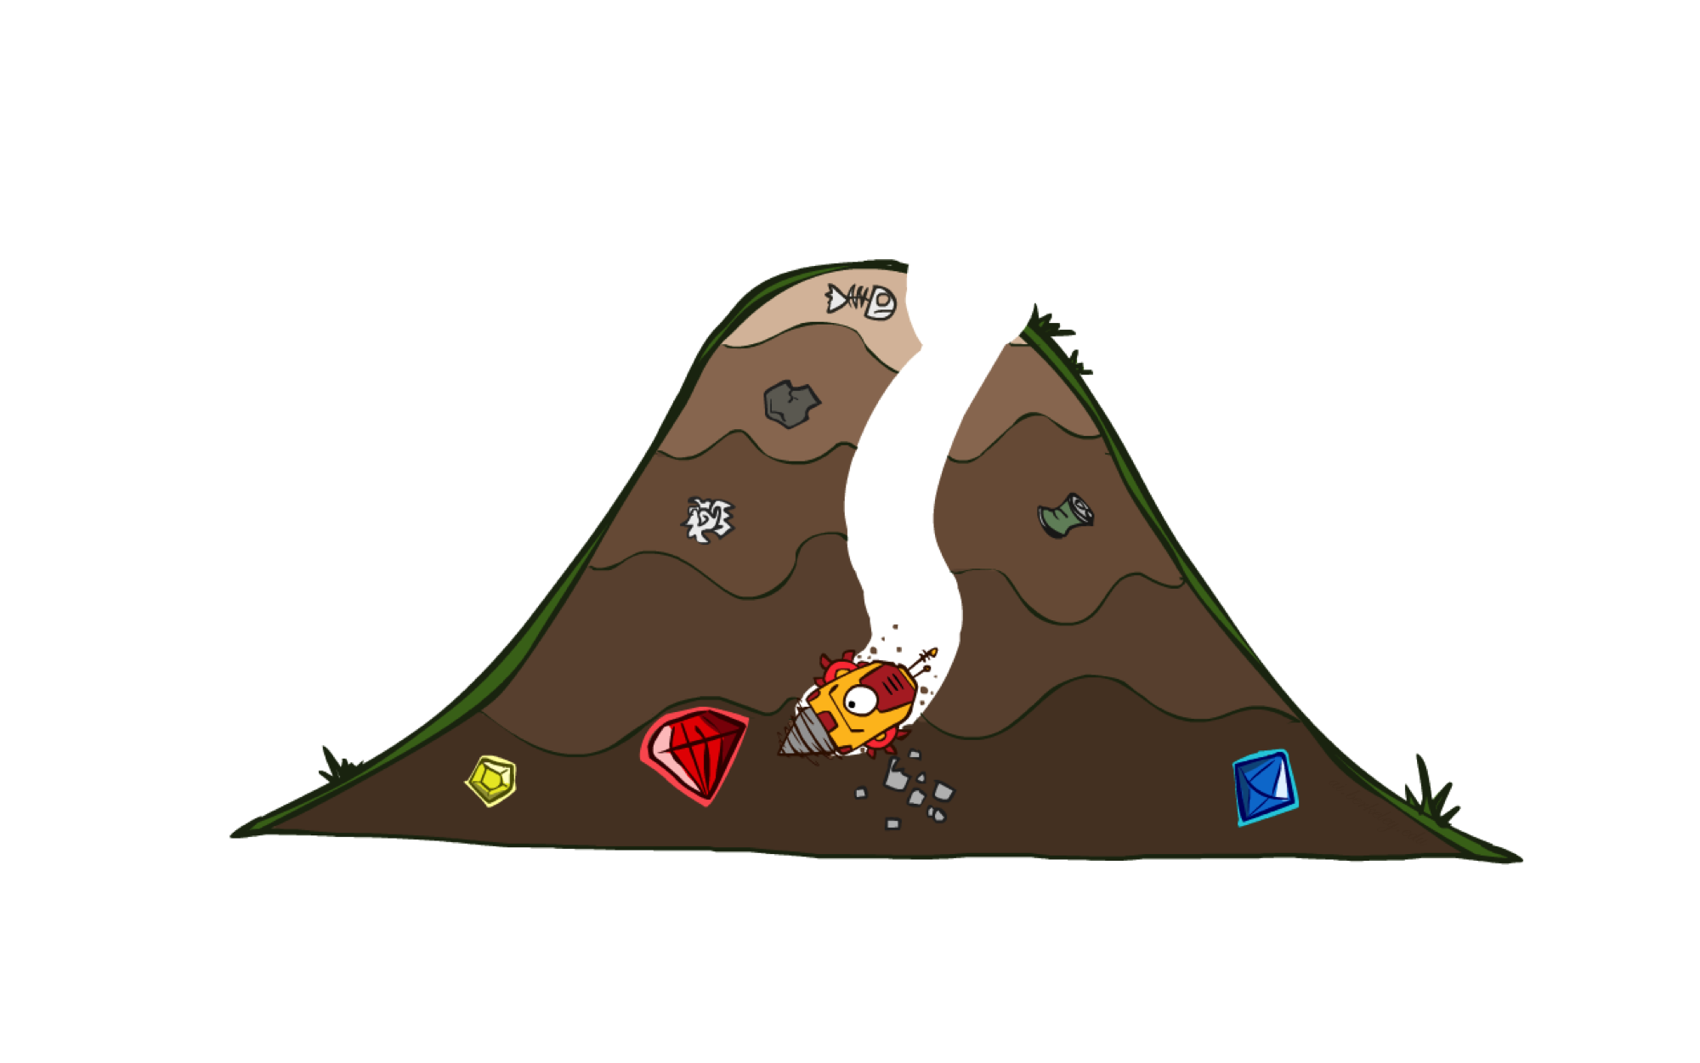
A* Search

Slide 5
A*: the core idea
Expand a node n most likely to be on the optimal path
Expand a node n s.t. the cost of the best solution through n is optimal
Expand a node n with lowest value of g(n) + h*(n)
g(n) is the cost from root to n
h*(n) is the optimal cost from n to the closest goal
We seldom know h*(n) but might have a heuristic approximation h(n)
A* = tree search with priority queue ordered by g(n) + h(n)

Slide 6
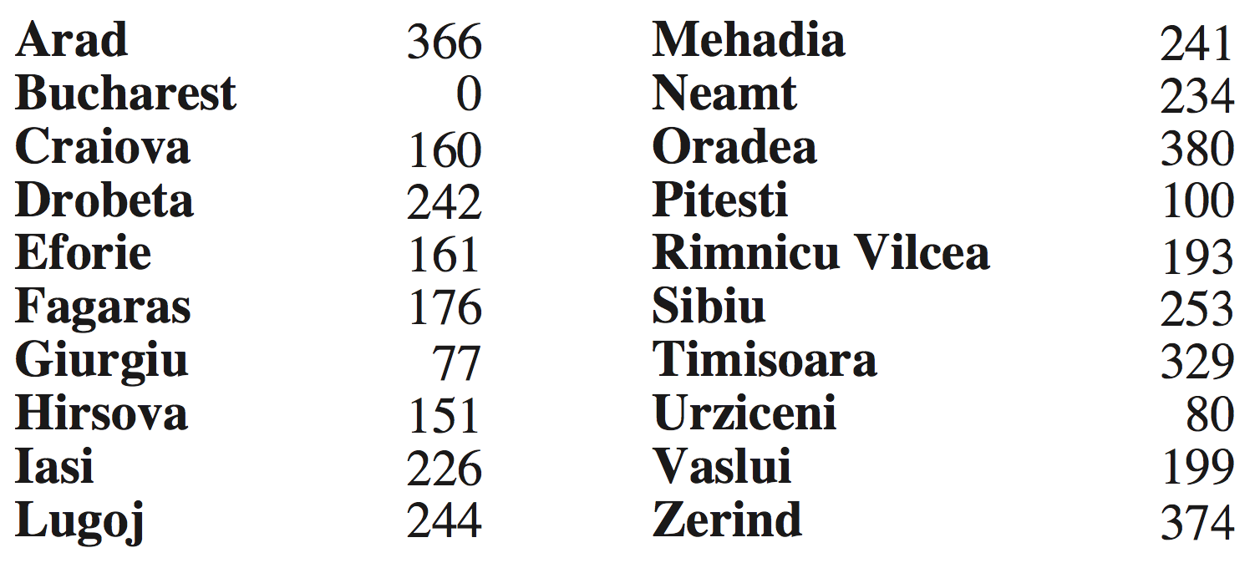
Example: route-finding in Romania
h(n) = straight-line distance to Bucharest

Slide 7
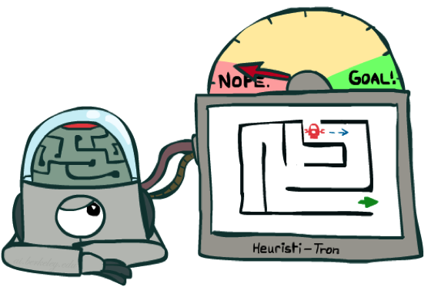
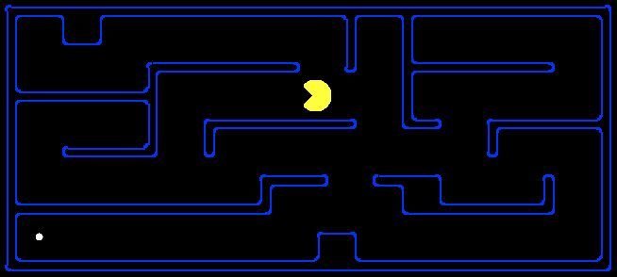
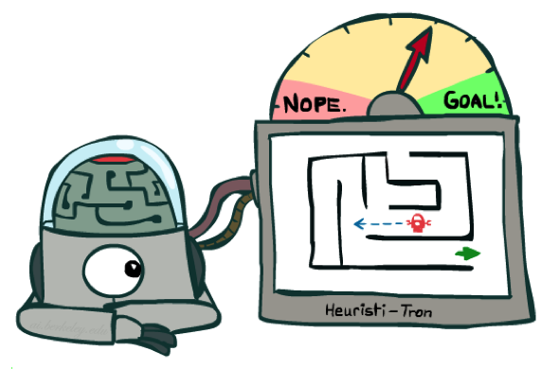
Example: pathing in Pacman
h(n) = Manhattan distance = |Δx| + |Δy|
Is Manhattan better than straight-line distance?
10
5
11.2

Slide 8
Is A* Optimal?
h = 6
1
A
3
S
h = 7
G
h = 0
5
What went wrong?
Actual bad solution cost < estimated good solution cost
We need estimates to be less than actual costs!

Slide 9

Admissible Heuristics

Slide 10
Admissible Heuristics
A heuristic h is admissible (optimistic) if:
0 ≤ h(n) ≤ h*(n)
where h*(n) is the true cost to a nearest goal
Example:
Finding good, cheap admissible heuristics is the key to success
15

Slide 11

Optimality of A* Tree Search

Slide 12
Optimality of A* Tree Search
Assume:
A is an optimal goal node
B is a suboptimal goal node
h is admissible
Claim:
A will be chosen for expansion before B
…
A
B

Slide 13
Optimality of A* Tree Search: Blocking
Proof:
Imagine B is on the frontier
Some ancestor n of A is on the frontier, too (maybe A itself!)
Claim: n will be expanded before B
f(n) is less than or equal to f(A)
…
n
A
B
f(n) = g(n) + h(n) Definition of f-cost
f(n) ≤ g(A) Admissibility of h
g(A) = f(A) h = 0 at a goal

Slide 14
Optimality of A* Tree Search: Blocking
Proof:
Imagine B is on the frontier
Some ancestor n of A is on the frontier, too (maybe A itself!)
Claim: n will be expanded before B
f(n) is less than or equal to f(A)
f(A) is less than f(B)
…
n
A
B
g(A) < g(B) Suboptimality of B
f(A) < f(B) h = 0 at a goal

Slide 15
Optimality of A* Tree Search: Blocking
Proof:
Imagine B is on the frontier
Some ancestor n of A is on the frontier, too (maybe A itself!)
Claim: n will be expanded before B
f(n) is less than or equal to f(A)
f(A) is less than f(B)
n is expanded before B
All ancestors of A are expanded before B
A is expanded before B
A* tree search is optimal
…
n
A
B
f(n) ≤ f(A) < f(B)

Slide 16
UCS vs A* Contours
Uniform-cost expands equally in all “directions”
A* expands mainly toward the goal, but does hedge its bets to ensure optimality
Start
Goal
Start
Goal

Slide 17
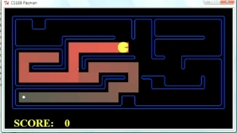
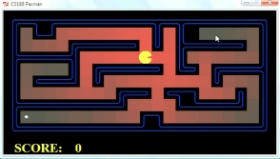
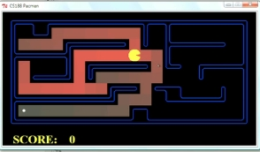
Comparison
Greedy (h)
Uniform Cost (g)
A* (g+h)

Slide 18
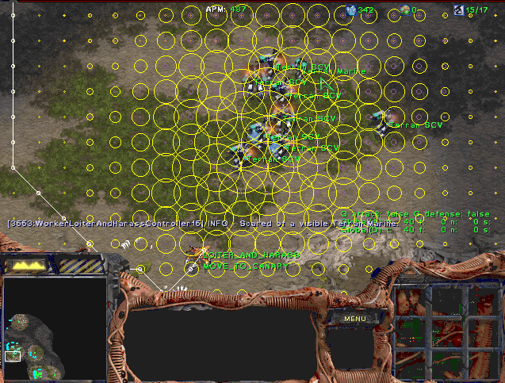
A* Applications
Video games
Pathing / routing problems
Resource planning problems
Robot motion planning
Language analysis
Machine translation
Speech recognition
Protein design
Chemical synthesis
…

Slide 19

Creating Heuristics

Slide 20
Creating Admissible Heuristics
Often, admissible heuristics are solutions to relaxed problems, where new actions are available
Problem P₂ is a relaxed version of P₁ if A₂(s) ⊇ A₁(s) for every s
Theorem: h₂*(s) ≤ h₁*(s) for every s, so h₂*(s) is admissible for P₁
15
366

Slide 21
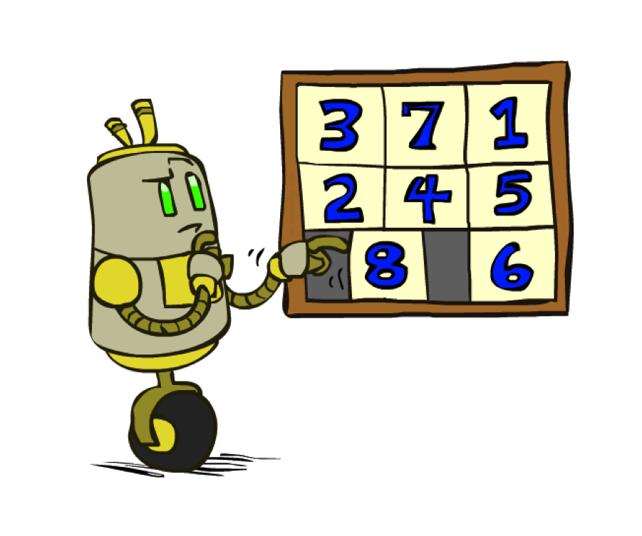
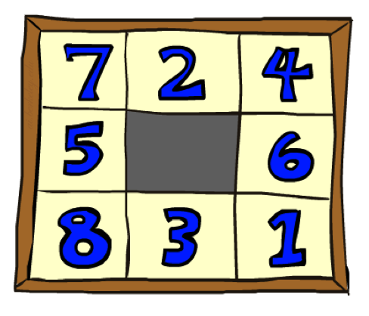
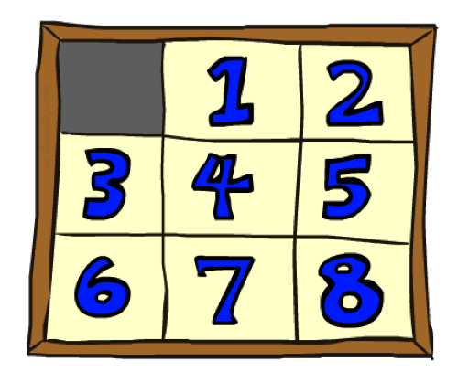
Example: 8 Puzzle
Start State
Actions
Goal State
What are the states?
How many states?
What are the actions?
What are the step costs?
Notes:
9! = 362,880 but 16! (15-puzzle) = 20 trillion, 25! = 10^25

Slide 22
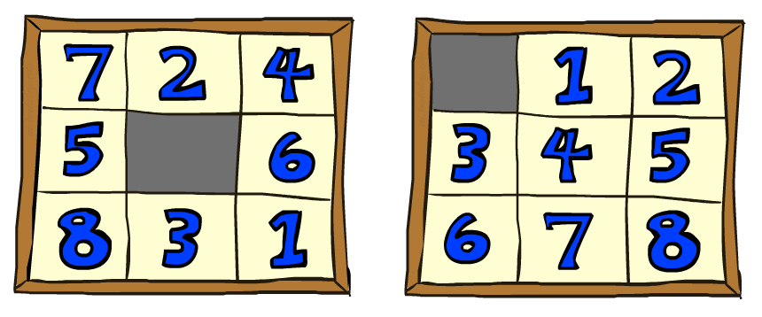

8 Puzzle I
Heuristic: Number of tiles misplaced
Why is it admissible?
h(start) =
8
Start State
Goal State
 | Average nodes expanded when the optimal path has…
 | …4 steps | …8 steps | …12 steps
UCS | 112 | 6,300 | 3.6 x 10⁶
A*TILES | 13 | 39 | 227
Statistics from Andrew Moore

Slide 23
8 Puzzle II
What if we had an easier 8-puzzle where any tile could slide any direction at any time, ignoring other tiles?
Total Manhattan distance
Why is it admissible?
h(start) =
Start State
Goal State
 | Average nodes expanded when the optimal path has…
 | …4 steps | …8 steps | …12 steps
A*TILES | 13 | 39 | 227
A*MANHATTAN | 12 | 25 | 73
3 + 1 + 2 + … = 18

Slide 24

Combining heuristics
Dominance: h₁ ≥ h₂ if
∀n h₁(n) ≥ h₂(n)
Roughly speaking, larger is better as long as both are admissible
The zero heuristic is pretty bad (what does A* do with h=0?)
The exact heuristic is pretty good, but usually too expensive!
What if we have two heuristics, neither dominates the other?
Form a new heuristic by taking the max of both:
h(n) = max( h₁(n), h₂(n))
Max of admissible heuristics is admissible and dominates both!
Example: number of knight’s moves to get from A to B
h1 = (Manhattan distance)/3 (rounded up to correct parity)
h2 = (Euclidean distance)/√5 (rounded up to correct parity)
h3 = (max x or y shift)/2 (rounded up to correct parity)
Notes:
Semi-lattice: x <= y <-> x = x ^ y

Slide 25
Optimality of A* Graph Search
This part is a bit fiddly,
sorry about that

Slide 26
A* Graph Search Gone Wrong?
State space graph
Search tree
h=4
A
S (0+2)
1
h=1
S
1
C
A (1+4)
B (1+1)
h=2
1
2
B
3
C (2+1)
C (3+1)
h=1
G
G (5+0)
G (6+0)
Simple check against expanded set blocks C
h=0
Fancy check allows new C if cheaper than old
but requires recalculating C’s descendants

Slide 27
Consistency of Heuristics
Main idea: estimated heuristic costs ≤ actual costs
Admissibility: heuristic cost ≤ actual cost to goal
h(A) ≤ h*(A)
Consistency: heuristic “arc” cost ≤ actual cost for each arc
h(A) – h(C) ≤ c(A,C)
or h(A) ≤ c(A,C) + h(C) (triangle inequality)
Consequences of consistency:
The f value along a path never decreases:
h(A) ≤ c(A,C) + h(C) => g(A) + h(A) ≤ g(A) + c(A,C) + h(C)
A* graph search is optimal
A
1
C
h=4
h=1
h=3
3
G

Slide 28
Optimality of A* Graph Search
Sketch: consider what A* does with a consistent heuristic:
Fact 1: In tree search, A* expands nodes in increasing total f value (f-contours)
Fact 2: For every state s, nodes that reach s optimally are expanded before nodes that reach s suboptimally
Result: A* graph search is optimal
…
f ≤ 1
f ≤ 2
f ≤ 3

Slide 29
Optimality
Tree search:
A* is optimal if heuristic is admissible
Graph search:
A* optimal if heuristic is consistent
Consistency implies admissibility
Most natural admissible heuristics tend to be consistent, especially if from relaxed problems

