Slide 1
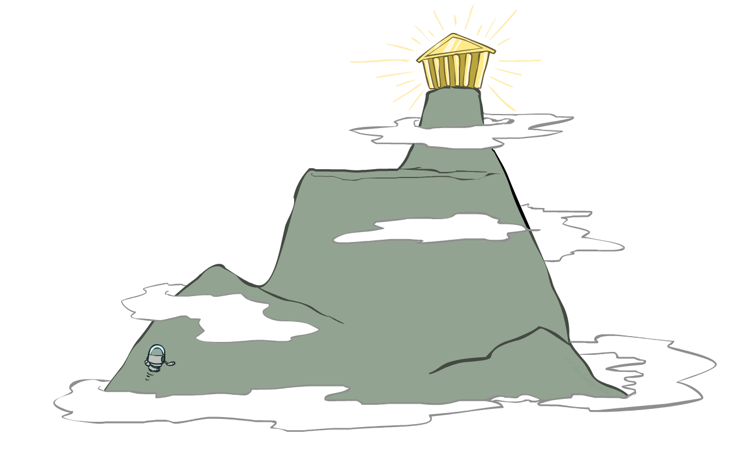
CS 188: Artificial Intelligence
Local search
Instructors: Stuart Russell and Dawn Song
University of California, Berkeley

Slide 2
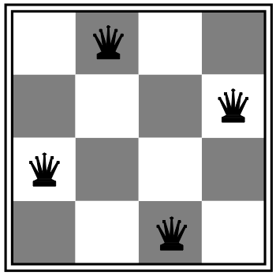
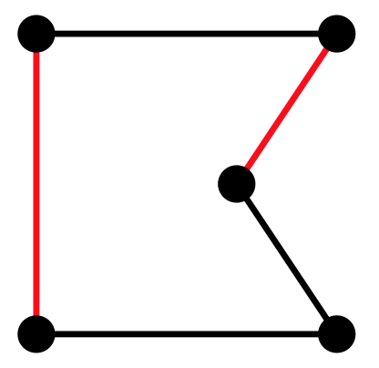
Local search algorithms
In many optimization problems, path is irrelevant; the goal state is the solution
Then state space = set of “complete” configurations; find configuration satisfying constraints, e.g., n-queens problem; or, find optimal configuration, e.g., travelling salesperson problem
In such cases, can use iterative improvement algorithms: keep a single “current” state, try to improve it
Constant space, suitable for online as well as offline search
More or less unavoidable if the “state” is yourself (i.e., learning)

Slide 3
Hill Climbing
Simple, general idea:
Start wherever
Repeat: move to the best neighboring state
If no neighbors better than current, quit

Slide 4
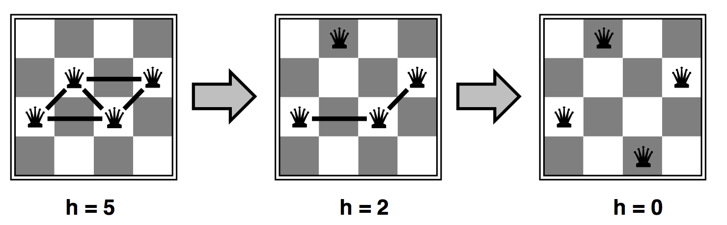
Heuristic for n-queens problem
Goal: n queens on board with no conflicts, i.e., no queen attacking another
States: n queens on board, one per column
Heuristic value function: number of conflicts

Slide 5
Hill-climbing algorithm
function HILL-CLIMBING(problem) returns a state
current ← make-node(problem.initial-state)
loop do
neighbor ← a highest-valued successor of current
if neighbor.value ≤ current.value then
return current.state
current ← neighbor
“Like climbing Everest in thick fog with amnesia”

Slide 6
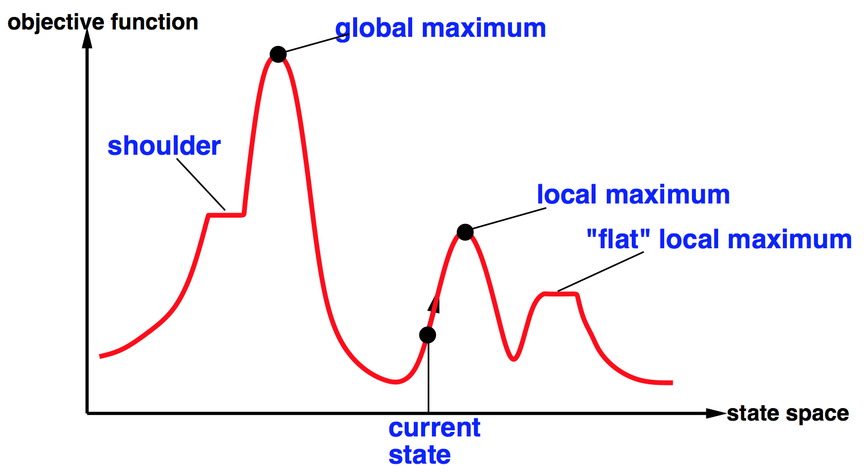


Global and local maxima
Random restarts
find global optimum
duh
Random sideways moves
Escape from shoulders
Loop forever on flat local maxima

Slide 7
Hill-climbing on the 8-queens problem
No sideways moves:
Succeeds w/ prob. 0.14
Average number of moves per trial:
4 when succeeding, 3 when getting stuck
Expected total number of moves needed:
3(1-p)/p + 4 =~ 22 moves
Allowing 100 sideways moves:
Succeeds w/ prob. 0.94
Average number of moves per trial:
21 when succeeding, 65 when getting stuck
Expected total number of moves needed:
65(1-p)/p + 21 =~ 25 moves
Moral: algorithms with knobs
to twiddle are irritating

Slide 8
Simulated annealing
Resembles the annealing process used to cool metals slowly to reach an ordered (low-energy) state
Basic idea:
Allow “bad” moves occasionally, depending on “temperature”
High temperature => more bad moves allowed, shake the system out of its local minimum
Gradually reduce temperature according to some schedule
Sounds pretty flaky, doesn’t it?

Slide 9

Simulated annealing algorithm
function SIMULATED-ANNEALING(problem,schedule) returns a state
current ← problem.initial-state
for t = 1 to ∞ do
T ←schedule(t) if T = 0 then return current next ← a randomly selected successor of current
∆E ← next.value – current.value if ∆E > 0 then current ← next else current ← next only with probability e^{∆E/T}

Slide 10
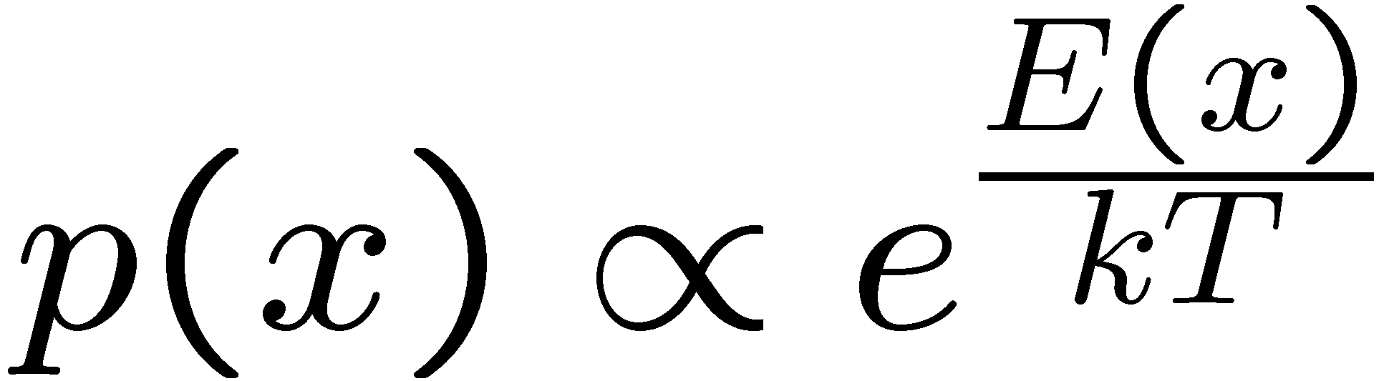
Simulated Annealing
Theoretical guarantee:
Stationary distribution (Boltzmann):
If T decreased slowly enough, will converge to optimal state!
Proof sketch (for reversible case: x→y iff y→x):
Let P(x), P(y) be the equilibrium occupancy probabilities at T
Let P(x→y) be the probability that state x transitions to state y
Assume E(y) > E(x) [and the algorithm seeks high values of E]

Slide 11
Simulated Annealing
Is this convergence an interesting guarantee?
Sounds like magic, but reality is reality:
The more downhill steps you need to escape a local optimum, the less likely you are to ever make them all in a row
“Slowly enough” may mean exponentially slowly
Random restart hillclimbing also converges to optimal state…
Simulated annealing and its relatives are a key workhorse in VLSI layout and other optimal configuration problems

Slide 12
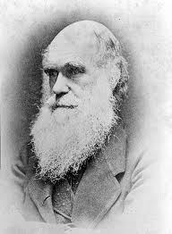
Local beam search
Basic idea:
K copies of a local search algorithm, initialized randomly
For each iteration
Generate ALL successors from K current states
Choose best K of these to be the new current states
Why is this different from K local searches in parallel?
The searches communicate! “Come over here, the grass is greener!”
What other well-known algorithm does this remind you of?
Evolution!
Or, K chosen randomly with
a bias towards good ones

Slide 13
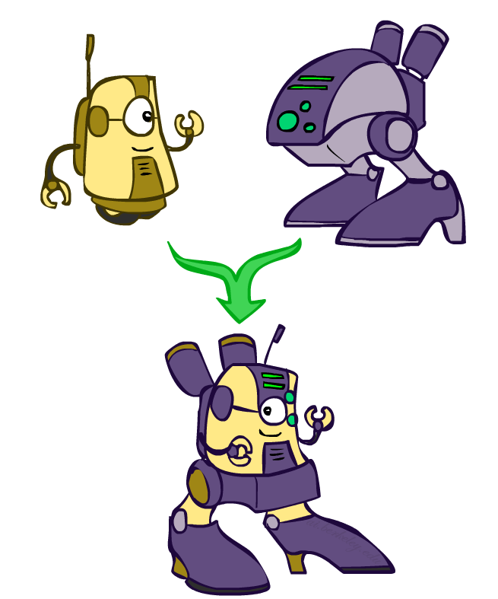
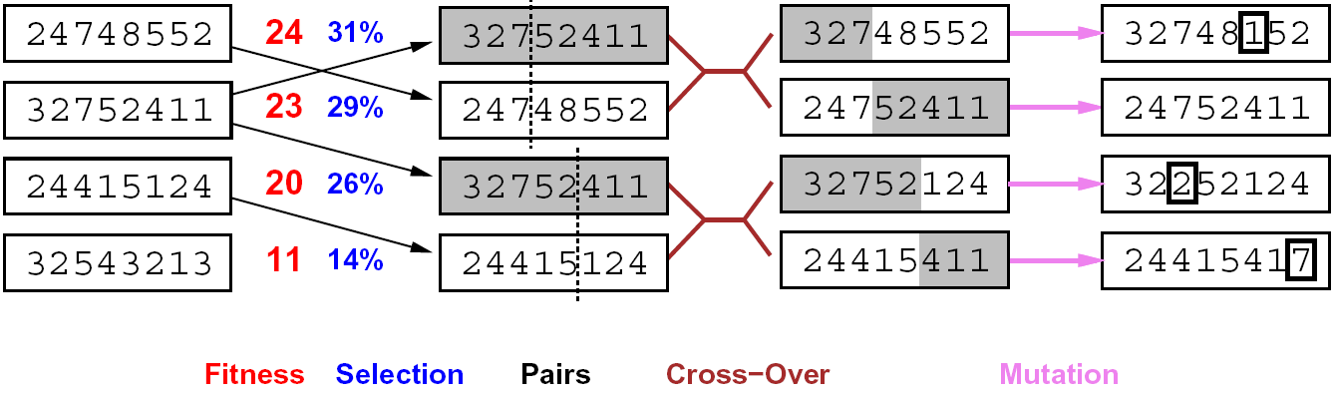
Genetic algorithms
Genetic algorithms use a natural selection metaphor
Resample K individuals at each step (selection) weighted by fitness function
Combine by pairwise crossover operators, plus mutation to give variety

Slide 14
Example: N-Queens
Does crossover make sense here?
What would mutation be?
What would a good fitness function be?

Slide 15
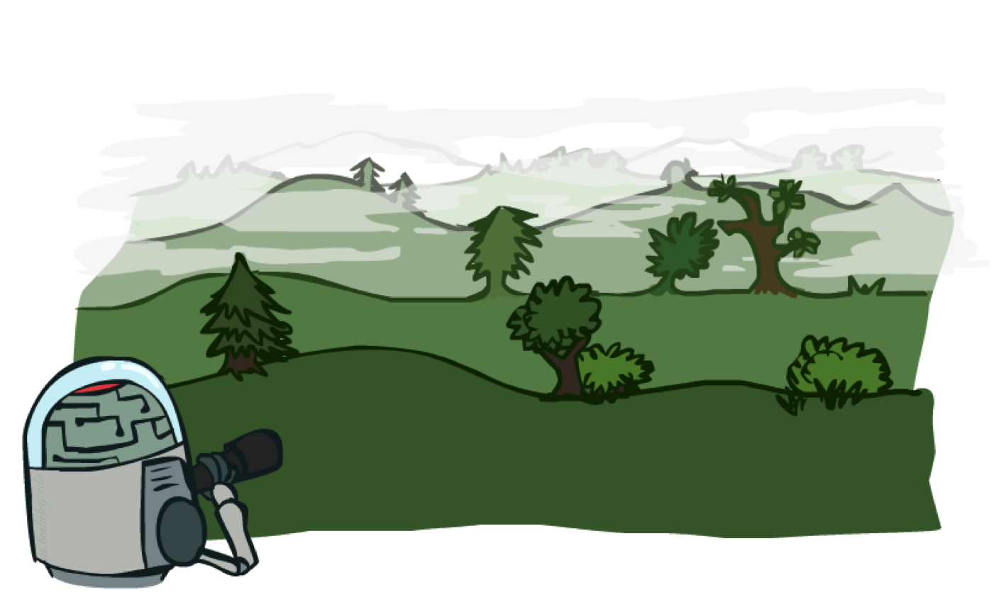
Local search in continuous spaces

Slide 16
Example: Siting airports in Romania
Place 3 airports to minimize the sum of squared distances from each city to its nearest airport
Airport locations
x = (x₁,y₁), (x₂,y₂), (x₃,y₃)
City locations (x_{c},y_{c})
C_{a} = cities closest to airport a
Objective: minimize
f(x) = Σ_{a} Σ_{c∈Ca} (x_{a} - x_{c})² + (y_{a} - y_{c})²

Slide 17
Handling a continuous state/action space
Discretize it!
Define a grid with increment δ , use any of the discrete algorithms
Choose random perturbations to the state
First-choice hill-climbing: keep trying until something improves the state
Simulated annealing
Compute gradient of f(x) analytically

Slide 18
Finding extrema in continuous space
Gradient vector ∇f(x) = (∂f/∂x₁, ∂f/∂y₁, ∂f/∂x₂, …)^{T}
For the airports, f(x) = Σ_{a} Σ_{c∈Ca} (x_{a} - x_{c})² + (y_{a} - y_{c})²
∂f/∂x₁ = Σ_{c∈C1} 2(x₁ - x_{c})
At an extremum, ∇f(x) = 0
Can sometimes solve in closed form: x₁ = (Σ_{c∈C1} x_{c})/|C₁|
Is this a local or global minimum of f?
Gradient descent: x ← x - α∇f(x)
Huge range of algorithms for finding extrema using gradients

Slide 19
Summary
Many configuration and optimization problems can be formulated as local search
General families of algorithms:
Hill-climbing, continuous optimization
Simulated annealing (and other stochastic methods)
Local beam search: multiple interaction searches
Genetic algorithms: break and recombine states
Many machine learning algorithms are local searches

