Slide 1

Bayes Net Syntax and Semantics

Slide 2

Bayes Net Syntax
A set of nodes, one per variable X_{i}
A directed, acyclic graph
A conditional distribution for each node given its parent variables in the graph
CPT (conditional probability table); each row is a distribution for child given values of its parents
P(G)
(1,1) | (1,2) | (1,3) | …
0.11 | 0.11 | 0.11 | …
G
C_{1,1}
C_{1,2}
C_{3,3}
G | P(C_{1,1} | G)
 | g | y | o | r
(1,1) | 0.01 | 0.1 | 0.3 | 0.59
(1,2) | 0.1 | 0.3 | 0.5 | 0.1
(1,3) | 0.3 | 0.5 | 0.19 | 0.01
…
Bayes net = Topology (graph) + Local Conditional Probabilities

Slide 3
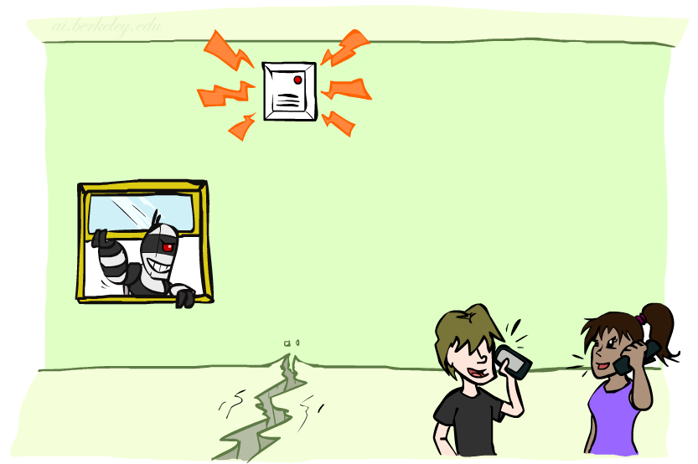
Example: Alarm Network
1
1
P(E)
true | false
0.002 | 0.998
P(B)
true | false
0.001 | 0.999
Burglary
Earthquake
B | E | P(A|B,E)
 |  | true | false
true | true | 0.95 | 0.05
true | false | 0.94 | 0.06
false | true | 0.29 | 0.71
false | false | 0.001 | 0.999
Alarm
4
Number of free parameters in each CPT:
Parent range sizes d₁,…,d_{k}
Child range size d
Each table row must sum to 1
(d-1) Π_{i} d_{i}
John calls
Mary calls
A | P(J|A)
 | true | false
true | 0.9 | 0.1
false | 0.05 | 0.95
A | P(M|A)
 | true | false
true | 0.7 | 0.3
false | 0.01 | 0.99
2
2
Notes:
demo

Slide 4
General formula for sparse BNs
Suppose
n variables
Maximum range size is d
Maximum number of parents is k
Full joint distribution has size O(d^{n})
Bayes net has size O(n .d^{k})
Linear scaling with n as long as causal structure is local

Slide 5
Bayes net global semantics
Bayes nets encode joint distributions as product of conditional distributions on each variable:
P(X₁,..,X_{n}) = ∏_{i} P(X_{i} | Parents(X_{i}))

Slide 6
Example
P(E)
true | false
0.002 | 0.998
P(b,¬e, a, ¬j, ¬m) =
P(B)
true | false
0.001 | 0.999
Burglary
Earthquake
P(b)
P(¬e)
P(a|b,¬e)
P(¬j|a)
P(¬m|a)
=.001x.998x.94x.1x.3=.000028
B | E | P(A|B,E)
 |  | true | false
true | true | 0.95 | 0.05
true | false | 0.94 | 0.06
false | true | 0.29 | 0.71
false | false | 0.001 | 0.999
Alarm
John calls
Mary calls
A | P(J|A)
 | true | false
true | 0.9 | 0.1
false | 0.05 | 0.95
A | P(M|A)
 | true | false
true | 0.7 | 0.3
false | 0.01 | 0.99

Slide 7
Conditional independence in BNs
Compare the Bayes net global semantics
P(X₁,..,X_{n}) = ∏_{i} P(X_{i} | Parents(X_{i}))
with the chain rule identity
P(X₁,..,X_{n}) = ∏_{i} P(X_{i} | X₁,…,X_{i-1})
Assume (without loss of generality) that X₁,..,X_{n} sorted in topological order according to the graph (i.e., parents before children), so Parents(X_{i}) ⊆ X₁,…,X_{i-1}
So the Bayes net asserts conditional independences P(X_{i} | X₁,…,X_{i-1}) = P(X_{i} | Parents(X_{i}))
To ensure these are valid, choose parents for node X_{i} that “shield” it from other predecessors

Slide 8
Example: Burglary
P(B)
true | false
0.001 | 0.999
P(E)
true | false
0.002 | 0.998
Burglary
Earthquake
Alarm
Burglary
?
Earthquake
?
?
Alarm
B | E | P(A|B,E)
 |  | true | false
true | true | 0.95 | 0.05
true | false | 0.94 | 0.06
false | true | 0.29 | 0.71
false | false | 0.001 | 0.999

Slide 9
Example: Burglary
P(A)
true | false
Alarm
Burglary
Earthquake
Alarm
?
?
A | B | P(E|A,B)
 |  | true | false
true | true
true | false
false | true
false | false
A | P(B|A)
 | true | false
true
false
Burglary
Earthquake
?
?
?

Slide 10
Conditional independence semantics
Every variable is conditionally independent of its non-descendants given its parents
Conditional independence semantics <=> global semantics

Slide 11
Markov blanket
A variable’s Markov blanket consists of parents, children, children’s other parents
Every variable is conditionally independent of all other variables given its Markov blanket

Slide 12
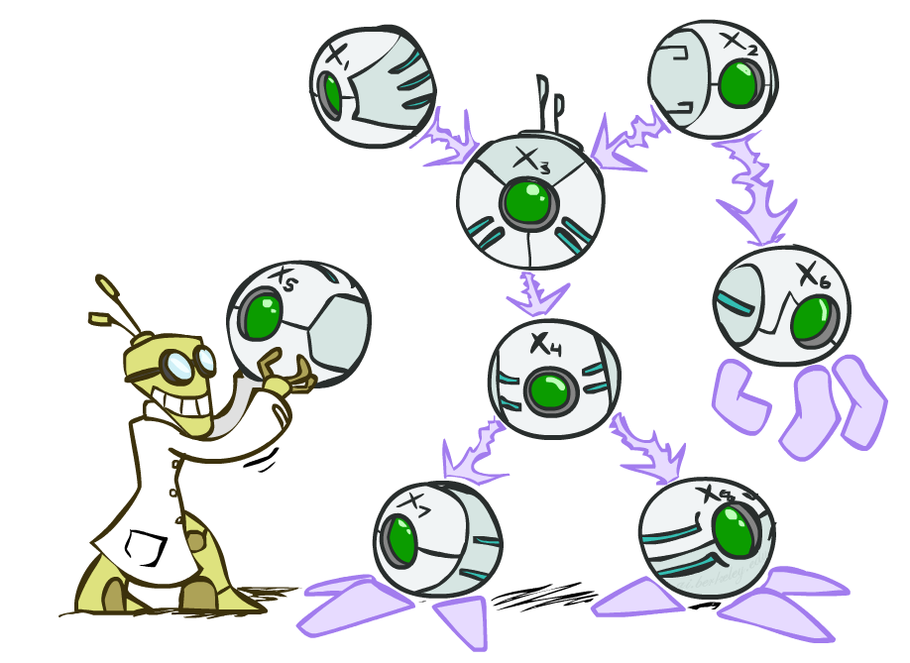
Summary
Independence and conditional independence are important forms of probabilistic knowledge
Bayes net encode joint distributions efficiently by taking advantage of conditional independence
Global joint probability = product of local conditionals
Local causality => exponential reduction in total size

Slide 13
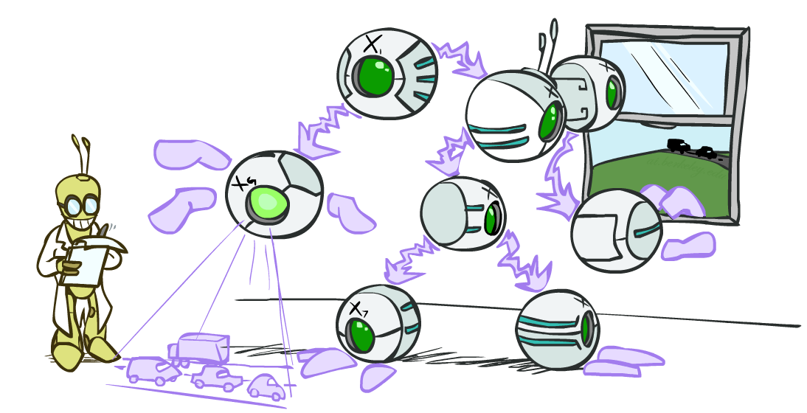
CS 188: Artificial Intelligence
Bayes Nets: Exact Inference
Instructor: Stuart Russell and Dawn Song --- University of California, Berkeley
Notes:
Please retain proper attribution, including the reference to ai.berkeley.edu. Thanks!

Slide 14

Bayes Nets
Part I: Representation
Part II: Exact inference
Enumeration (always exponential complexity)
Variable elimination (worst-case exponential complexity, often better)
Inference is NP-hard in general
Part III: Approximate Inference
Later: Learning Bayes nets from data

Slide 15

Inference
Inference: calculating some useful quantity from a probability model (joint probability distribution)
Examples:
Posterior marginal probability
P(Q|e₁,..,e_{k})
E.g., what disease might I have?
Most likely explanation:
argmax_{q,r,s} P(Q=q,R=r,S=s|e₁,..,e_{k})
E.g., what did he say?

Slide 16
Inference by Enumeration in Bayes Net
Reminder of inference by enumeration:
Any probability of interest can be computed by summing entries from the joint distribution: P(Q | e) = α ∑_{h} P(Q , h, e)
Entries from the joint distribution can be obtained from a BN by multiplying the corresponding conditional probabilities
P(B | j, m) = α ∑_{e,a} P(B, e, a, j, m)
= α ∑_{e,a} P(B) P(e) P(a|B,e) P(j|a) P(m|a)
So inference in Bayes nets means computing sums of products of numbers: sounds easy!!
Problem: sums of exponentially many products!
B
E
A
J
M

Slide 17
Can we do better?
Consider uwy + uwz + uxy + uxz + vwy + vwz + vxy +vxz
16 multiplies, 7 adds
Lots of repeated subexpressions!
Rewrite as (u+v)(w+x)(y+z)
2 multiplies, 3 adds
∑_{e,a} P(B) P(e) P(a|B,e) P(j|a) P(m|a)
= P(B)P(e)P(a|B,e)P(j|a)P(m|a) + P(B)P(¬e)P(a|B,¬e)P(j|a)P(m|a)
+ P(B)P(e)P(¬a|B,e)P(j|¬a)P(m|¬a) + P(B)P(¬e)P(¬a|B,¬e)P(j|¬a)P(m|¬a)
Lots of repeated subexpressions!

Slide 18
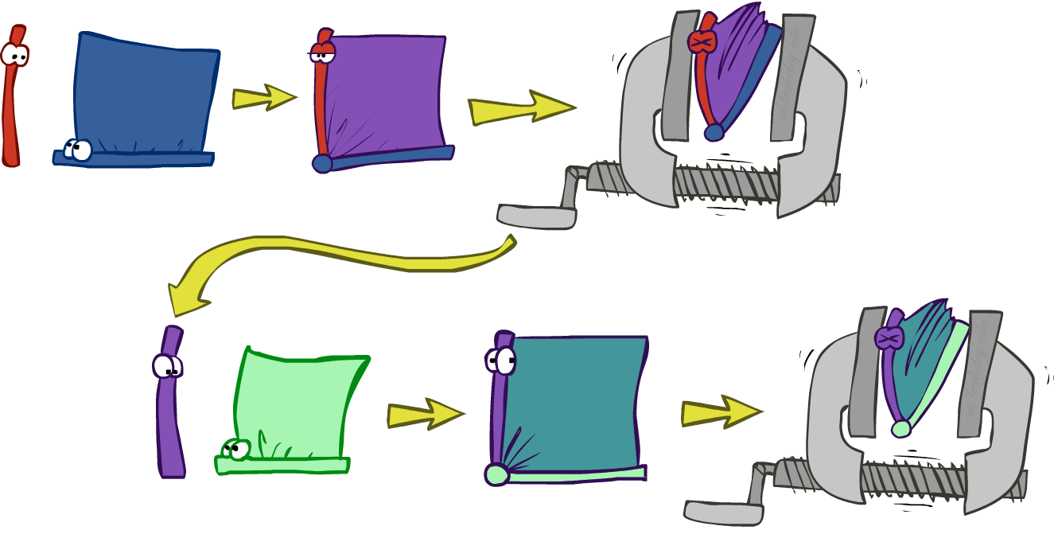
Variable elimination: The basic ideas
Move summations inwards as far as possible
P(B | j, m) = α ∑_{e,a} P(B) P(e) P(a|B,e) P(j|a) P(m|a)
= α P(B) ∑_{e} P(e) ∑_{a} P(a|B,e) P(j|a) P(m|a)
Do the calculation from the inside out
I.e., sum over a first, then sum over e
Problem: P(a|B,e) isn’t a single number, it’s a bunch of different numbers depending on the values of B and e
Solution: use arrays of numbers (of various dimensions) with appropriate operations on them; these are called factors

Slide 19
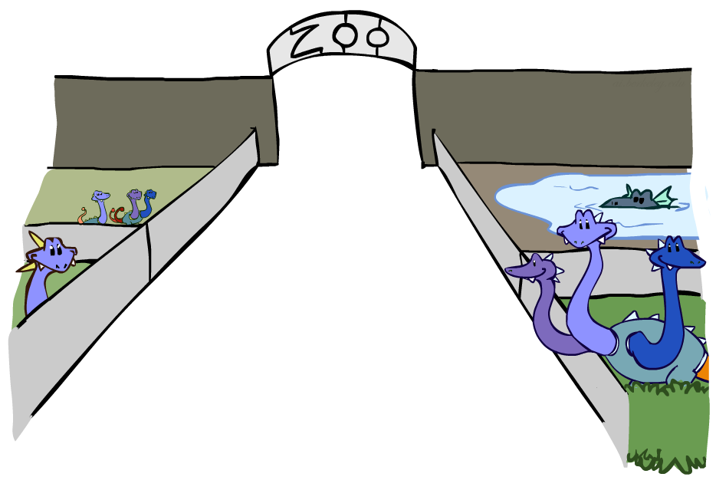
Factor Zoo

Slide 20

Factor Zoo I
Joint distribution: P(X,Y)
Entries P(x,y) for all x, y
|X|x|Y| matrix
Sums to 1
Projected joint: P(x,Y)
A slice of the joint distribution
Entries P(x,y) for one x, all y
|Y|-element vector
Sums to P(x)
P(A,J)
A \ J | true | false
true | 0.09 | 0.01
false | 0.045 | 0.855
P(a,J)
A \ J | true | false
true | 0.09 | 0.01
Number of variables (capitals) = dimensionality of the table

Slide 21
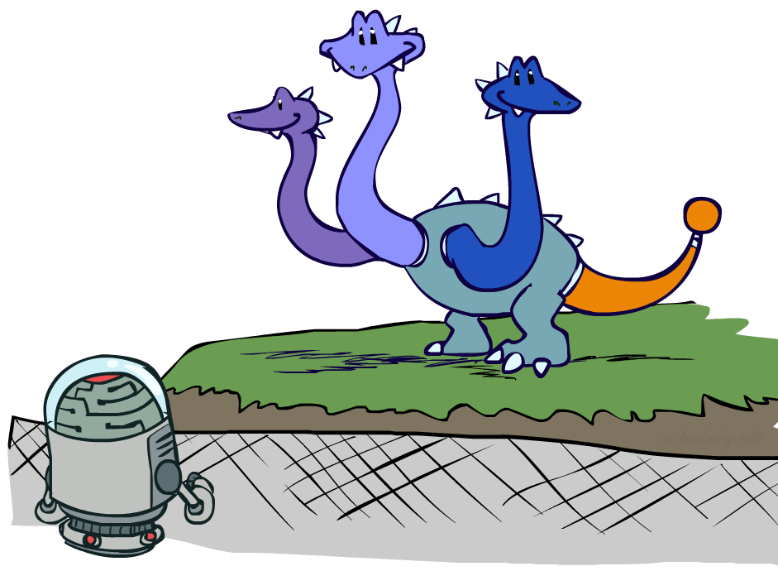
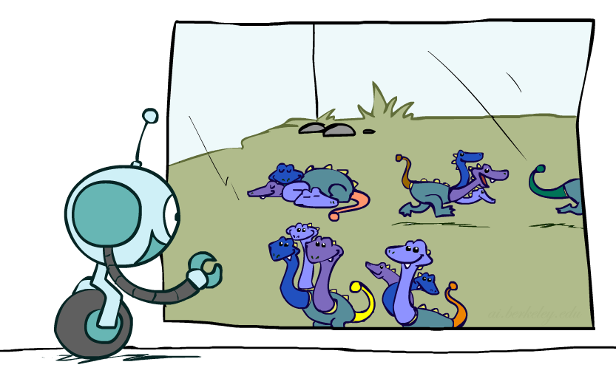
Factor Zoo II
P(J|a)
Single conditional: P(Y | x)
Entries P(y | x) for fixed x, all y
Sums to 1
Family of conditionals:
P(X |Y)
Multiple conditionals
Entries P(x | y) for all x, y
Sums to |Y|
A \ J | true | false
true | 0.9 | 0.1
P(J|A)
A \ J | true | false
true | 0.9 | 0.1
false | 0.05 | 0.95
} - P(J|a)
} - P(J|¬a)

Slide 22

Operation 1: Pointwise product
First basic operation: pointwise product of factors (similar to a database join, not matrix multiply!)
New factor has union of variables of the two original factors
Each entry is the product of the corresponding entries from the original factors
Example: P(J|A) x P(A) = P(A,J)
P(J|A)
P(A,J)
P(A)
A \ J | true | false
true | 0.9 | 0.1
false | 0.05 | 0.95
A \ J | true | false
true | 0.09 | 0.01
false | 0.045 | 0.855
true | 0.1
false | 0.9
x
=

Slide 23
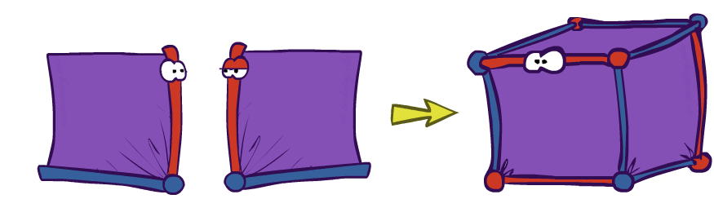
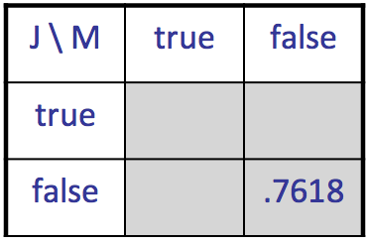
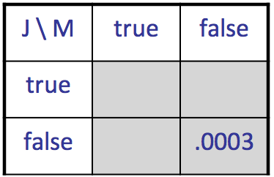
Example: Making larger factors
Example: P(A,J) x P(A,M) = P(A,J,M)
P(A,J,M)
P(A,J)
P(A,M)
A \ J | true | false
true | 0.09 | 0.01
false | 0.045 | 0.855
A \ M | true | false
true | 0.07 | 0.03
false | 0.009 | 0.891
x
=
A=false
A=true

Slide 24
Example: Making larger factors
Example: P(U,V) x P(V,W) x P(W,X) = P(U,V,W,X)
Sizes: [10,10] x [10,10] x [10,10] = [10,10,10,10]
I.e., 300 numbers blows up to 10,000 numbers!
Factor blowup can make VE very expensive

Slide 25
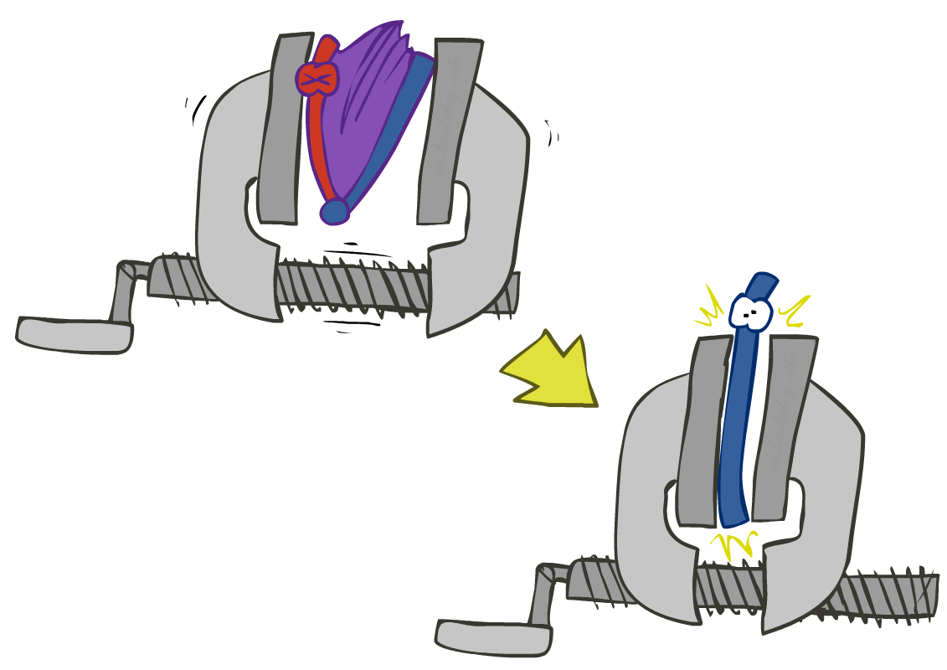
Operation 2: Summing out a variable
Second basic operation: summing out (or eliminating) a variable from a factor
Shrinks a factor to a smaller one
Example: ∑_{j} P(A,J) = P(A,j) + P(A,¬j) = P(A)
P(A,J)
P(A)
A \ J | true | false
true | 0.09 | 0.01
false | 0.045 | 0.855
Sum out J
true | 0.1
false | 0.9

Slide 26
Summing out from a product of factors
Project the factors each way first, then sum the products
Example: ∑_{a} P(a|B,e) x P(j|a) x P(m|a)
= P(a|B,e) x P(j|a) x P(m|a) +
P(¬a|B,e) x P(j|¬a) x P(m|¬a)

Slide 27

Variable Elimination

Slide 28
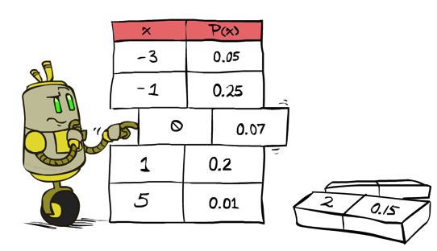
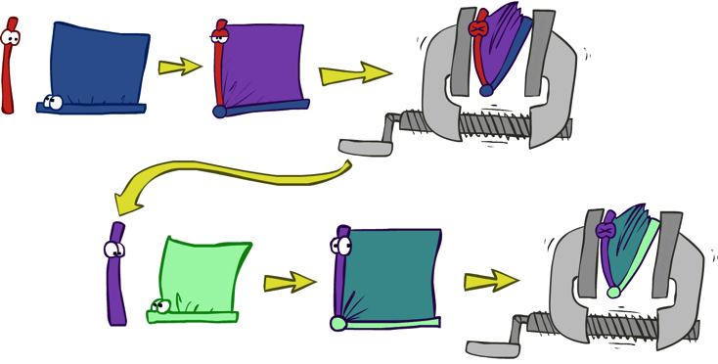

Variable Elimination
Query: P(Q|E₁=e₁,.., E_{k}=e_{k})
Start with initial factors:
Local CPTs (but instantiated by evidence)
While there are still hidden variables (not Q or evidence):
Pick a hidden variable H_{j}
Eliminate (sum out) H_{j} from the product of all factors mentioning H_{j}
Join all remaining factors and normalize
X α

Slide 29
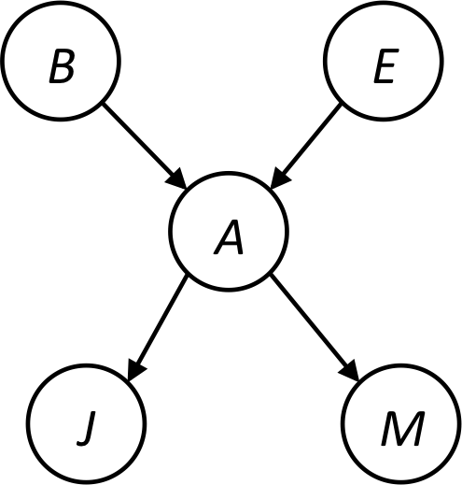


Example
Query P(B | j,m)
P(B) P(E) P(A|B,E) P(j|A) P(m|A)
Choose A
P(A|B,E)
P(j|A)
P(m|A)
P(j,m|B,E)
P(B) P(E) P(j,m|B,E)

Slide 30
Example
P(B) P(E) P(j,m|B,E)
Choose E
P(E)
P(j,m|B,E)
P(j,m|B)
P(B) P(j,m|B)
Finish with B
P(B)
P(j,m|B)
P(j,m,B)
Normalize
P(B | j,m)

Slide 31
Order matters
Z
Order the terms Z, A, B C, D
P(D) = α ∑_{z,a,b,c} P(z) P(a|z) P(b|z) P(c|z) P(D|z)
= α ∑_{z} P(z) ∑_{a} P(a|z) ∑_{b} P(b|z) ∑_{c} P(c|z) P(D|z)
Largest factor has 2 variables (D,Z)
Order the terms A, B C, D, Z
P(D) = α ∑_{a,b,c,z} P(a|z) P(b|z) P(c|z) P(D|z) P(z)
= α ∑_{a} ∑_{b} ∑_{c} ∑_{z} P(a|z) P(b|z) P(c|z) P(D|z) P(z)
Largest factor has 4 variables (A,B,C,D)
In general, with n leaves, factor of size 2^{n}
A
B
C
D

Slide 32
VE: Computational and Space Complexity
The computational and space complexity of variable elimination is determined by the largest factor (and it’s space that kills you)
The elimination ordering can greatly affect the size of the largest factor.
E.g., previous slide’s example 2^{n} vs. 2
Does there always exist an ordering that only results in small factors?
No!

Slide 33
Worst Case Complexity? Reduction from SAT
0.5
0.5
0.5
0.5
Variables: W, X, Y, Z
CNF clauses:
C₁ = W v X v Y
C₂ = Y v Z v ¬ W
C₃ = X v Y v ¬Z
Sentence S = C₁ ∧ C₂ ∧ C₃
P(S) > 0 iff S is satisfiable
=> NP-hard
P(S) = K x 0.5^{n} where K is the number of satisfying assignments for clauses
=> #P-hard
W
X
Y
Z
¬
¬
C₁
C₂
C₃
S
Notes:
Make this model simpler (no reason for fan-in constraint)

Slide 34
Polytrees
A polytree is a directed graph with no undirected cycles
For poly-trees the complexity of variable elimination is linear in the network size if you eliminate from the leave towards the roots

Slide 35
Bayes Nets
Part I: Representation
Part II: Exact inference
Enumeration (always exponential complexity)
Variable elimination (worst-case exponential complexity, often better)
Inference is NP-hard in general
Part III: Approximate Inference
Later: Learning Bayes nets from data

