Slide 1
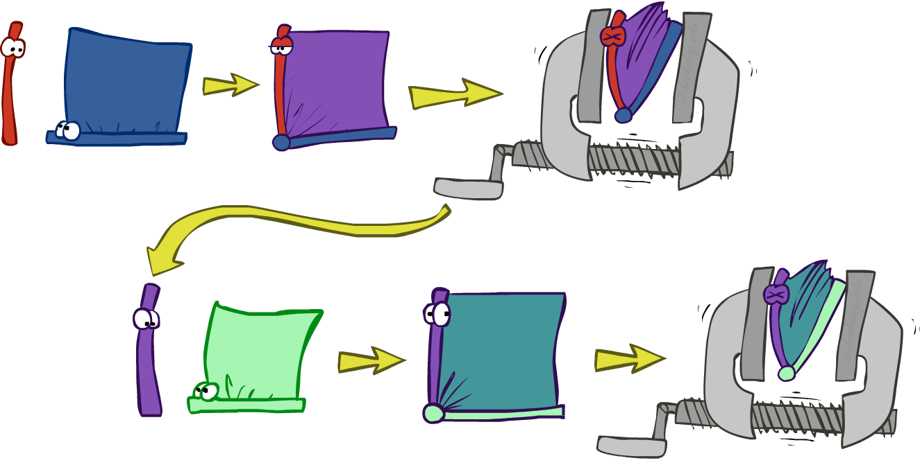
Variable elimination: The basic ideas
Move summations inwards as far as possible
P(B | j, m) = α ∑_{e,a} P(B) P(e) P(a|B,e) P(j|a) P(m|a)
= α P(B) ∑_{e} P(e) ∑_{a} P(a|B,e) P(j|a) P(m|a)
Do the calculation from the inside out
I.e., sum over a first, then sum over e
Problem: P(a|B,e) isn’t a single number, it’s a bunch of different numbers depending on the values of B and e
Solution: use arrays of numbers (of various dimensions) with appropriate operations on them; these are called factors

Slide 2
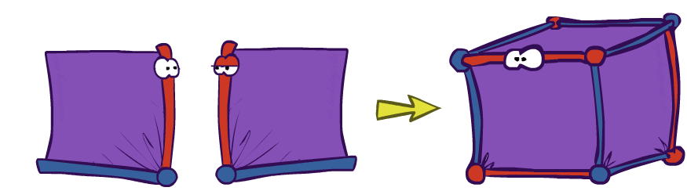
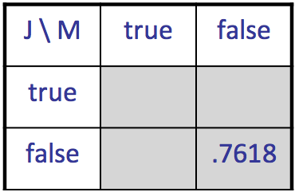
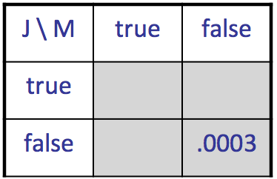
Operation 1: Pointwise product
First basic operation: pointwise product of factors (similar to a database join, not matrix multiply!)
New factor has union of variables of the two original factors
Each entry is the product of the corresponding entries from the original factors
Example: P(A,J) x P(A,M) = P(A,J,M)
P(A,J,M)
P(A,J)
P(A,M)
A \ J | true | false
true | 0.09 | 0.01
false | 0.045 | 0.855
A \ M | true | false
true | 0.07 | 0.03
false | 0.009 | 0.891
x
=
A=false
A=true

Slide 3
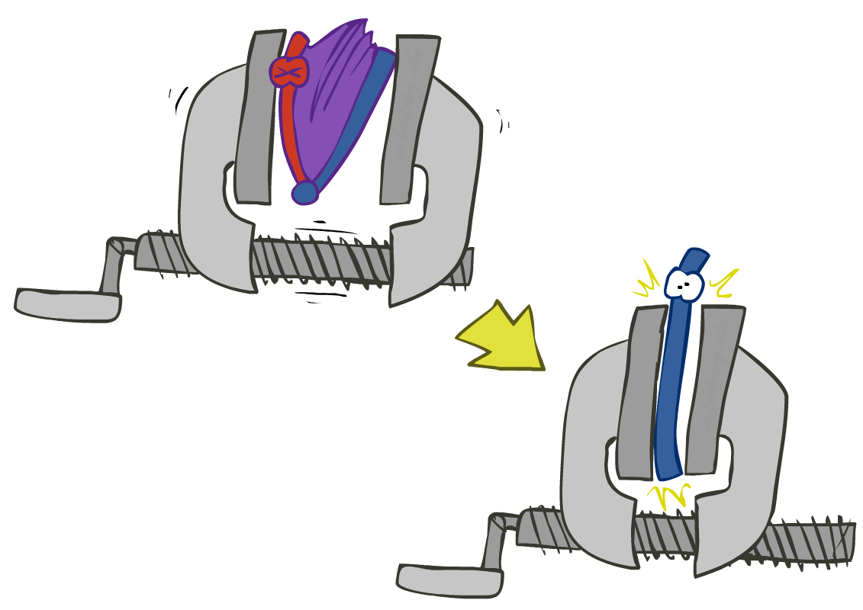
Operation 2: Summing out a variable
Second basic operation: summing out (or eliminating) a variable from a factor
Shrinks a factor to a smaller one
Example: ∑_{j} P(A,J) = P(A,j) + P(A,¬j) = P(A)
P(A,J)
P(A)
A \ J | true | false
true | 0.09 | 0.01
false | 0.045 | 0.855
Sum out J
true | 0.1
false | 0.9

Slide 4
Summing out from a product of factors
Project the factors each way first, then sum the products
Example: ∑_{a} P(a|B,e) x P(j|a) x P(m|a)
= P(a|B,e) x P(j|a) x P(m|a) +
P(¬a|B,e) x P(j|¬a) x P(m|¬a)

Slide 5

Variable Elimination

Slide 6
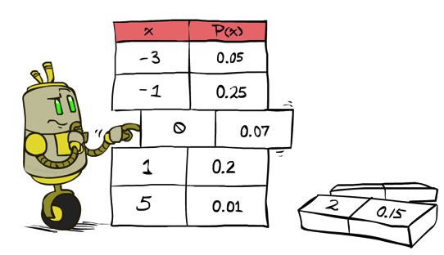
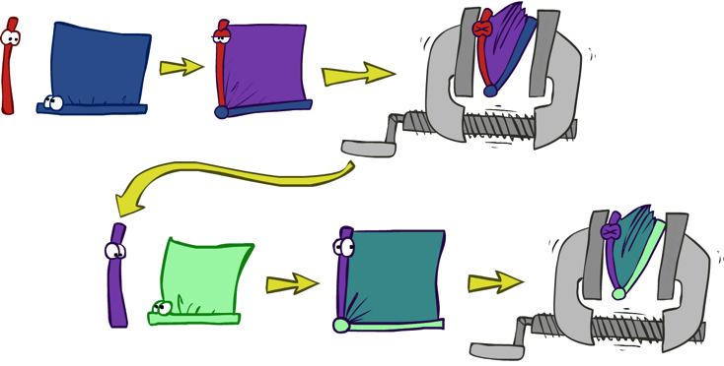

Variable Elimination
Query: P(Q|e)
Start with initial factors:
Local CPTs (but instantiated by evidence)
For each hidden variable H_{j}
Sum out H_{j} from the product of all factors mentioning H_{j}
Join all remaining factors and normalize
X α

Slide 7
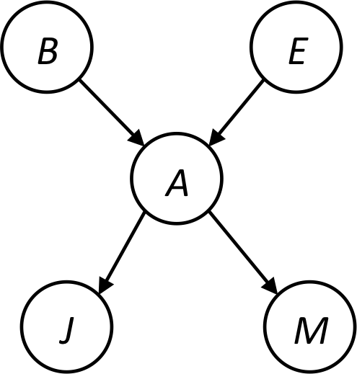


Example
Query P(B | j,m)
P(B) P(E) P(A|B,E) P(j|A) P(m|A)
Choose A
P(A|B,E)
P(j|A)
P(m|A)
P(j,m|B,E)
P(B) P(E) P(j,m|B,E)

Slide 8
Example
P(B) P(E) P(j,m|B,E)
Choose E
P(E)
P(j,m|B,E)
P(j,m|B)
P(B) P(j,m|B)
Finish with B
P(B)
P(j,m|B)
P(j,m,B)
Normalize
P(B | j,m)

Slide 9
Order matters
Z
Order the terms Z, A, B C, D
P(D) = α ∑_{z,a,b,c} P(z) P(a|z) P(b|z) P(c|z) P(D|z)
= α ∑_{z} P(z) ∑_{a} P(a|z) ∑_{b} P(b|z) ∑_{c} P(c|z) P(D|z)
Largest factor has 2 variables (D,Z)
Order the terms A, B C, D, Z
P(D) = α ∑_{a,b,c,z} P(a|z) P(b|z) P(c|z) P(D|z) P(z)
= α ∑_{a} ∑_{b} ∑_{c} ∑_{z} P(a|z) P(b|z) P(c|z) P(D|z) P(z)
Largest factor has 4 variables (A,B,C,D)
In general, with n leaves, factor of size 2^{n}
A
B
C
D

Slide 10
VE: Computational and Space Complexity
The computational and space complexity of variable elimination is determined by the largest factor (and it’s space that kills you)
The elimination ordering can greatly affect the size of the largest factor.
E.g., previous slide’s example 2^{n} vs. 2
Does there always exist an ordering that only results in small factors?
No!

Slide 11
Worst Case Complexity? Reduction from SAT
0.5
0.5
0.5
0.5
Variables: W, X, Y, Z
CNF clauses:
C₁ = W v X v Y
C₂ = Y v Z v ¬ W
C₃ = X v Y v ¬Z
Sentence S = C₁ ∧ C₂ ∧ C₃
P(S) > 0 iff S is satisfiable
=> NP-hard
P(S) = K x 0.5^{n} where K is the number of satisfying assignments for clauses
=> #P-hard
W
X
Y
Z
¬
¬
C₁
C₂
C₃
S
Notes:
Make this model simpler (no reason for fan-in constraint)

Slide 12
Polytrees
A polytree is a directed graph with no undirected cycles
For poly-trees the complexity of variable elimination is linear in the network size if you eliminate from the leaves towards the roots

Slide 13
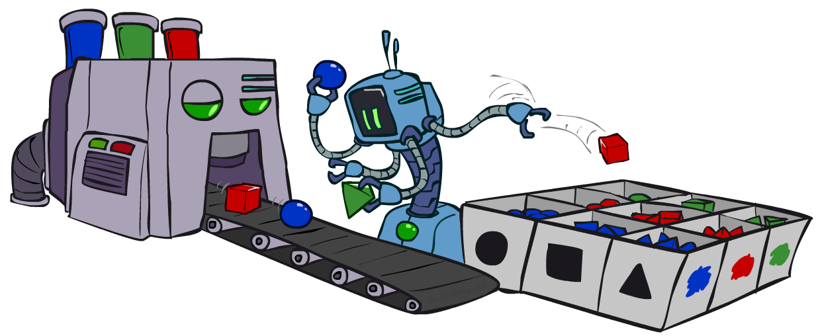
CS 188: Artificial Intelligence
Bayes Nets: Approximate Inference
Instructors: Stuart Russell and Dawn Song
University of California, Berkeley
Notes:
Please retain proper attribution, including the reference to ai.berkeley.edu. Thanks!

Slide 14

Sampling
Basic idea
Draw N samples from a sampling distribution S
Compute an approximate posterior probability
Show this converges to the true probability P
Why sample?
Often very fast to get a decent approximate answer
The algorithms are very simple and general (easy to apply to fancy models)
They require very little memory (O(n))
They can be applied to large models, whereas exact algorithms blow up

Slide 15
Example
Suppose you have two agent programs A and B for Monopoly
What is the probability that A wins?
Method 1:
Let s be a sequence of dice rolls and Chance and Community Chest cards
Given s, the outcome V(s) is determined (1 for a win, 0 for a loss)
Probability that A wins is
Problem: infinitely many sequences s !
Method 2:
Sample N sequences from P(s) , play N games (maybe 100)
Probability that A wins is roughly 1/N ∑_{i} V(s_{i}) i.e., fraction of wins in the sample
∑_{s} P(s) V(s)

Slide 16

Sampling basics: discrete (categorical) distribution
To simulate a biased d-sided coin:
Step 1: Get sample u from uniform distribution over [0, 1)
E.g. random() in python
Step 2: Convert this sample u into an outcome for the given distribution by associating each outcome x with a P(x)-sized sub-interval of [0,1)
Example
If random() returns u = 0.83, then the sample is C = blue
E.g, after sampling 8 times:
C | P(C)
red | 0.6
green | 0.1
blue | 0.3
0.0 ≤ u < 0.6, → C=red
0.6 ≤ u < 0.7, → C=green
0.7 ≤ u < 1.0, → C=blue
0.6
0.1
0.3

Slide 17
Sampling in Bayes Nets
Prior Sampling
Rejection Sampling
Likelihood Weighting
Gibbs Sampling

Slide 18
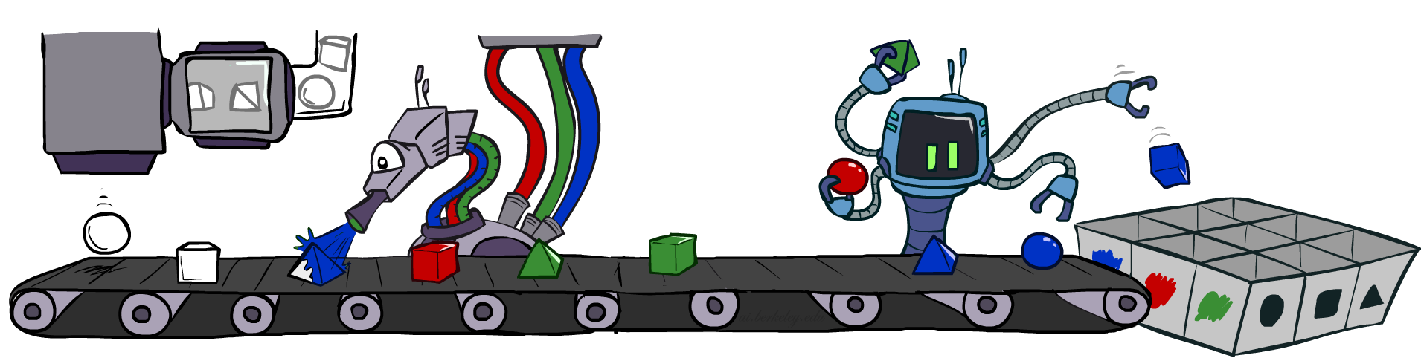
Prior Sampling

Slide 19
Prior Sampling
P(C)
c | 0.5
¬c | 0.5
Cloudy
P(S | C)
Cloudy
P(R | C)
c | s | 0.1
 | ¬s | 0.9
¬c | s | 0.5
 | ¬s | 0.5
c | r | 0.8
 | ¬r | 0.2
¬c | r | 0.2
 | ¬r | 0.8
Sprinkler
Sprinkler
Rain
Rain
P(W | S,R)
WetGrass
WetGrass
Samples:
s | r | w | 0.99
 |  | ¬w | 0.01
 | ¬r | w | 0.90
 |  | ¬w | 0.10
¬s | r | w | 0.90
 |  | ¬w | 0.10
 | ¬r | w | 0.01
 |  | ¬w | 0.99
c, ¬s, r, w
¬c, s, ¬r, w
…

Slide 20
Prior Sampling
For i=1, 2, …, n (in topological order)
Sample X_{i} from P(X_{i} | parents(X_{i}))
Return (x₁, x₂, …, x_{n})

Slide 21
Prior Sampling
This process generates samples with probability:
S_{PS}(x₁,…,x_{n}) =
…i.e. the BN’s joint probability
Let the number of samples of an event be N_{PS}(x₁,…,x_{n})
Estimate from N samples is Q_{N}(x₁,…,x_{n}) = N_{PS}(x₁,…,x_{n})/N
Then lim_{N→∞} Q_{N}(x₁,…,x_{n}) = lim_{N→∞} N_{PS}(x₁,…,x_{n})/N
= S_{PS}(x₁,…,x_{n})
= P(x₁,…,x_{n})
I.e., the sampling procedure is consistent
∏_{i} P(x_{i} | parents(X_{i})) = P(x₁,…,x_{n})

Slide 22
Example
We’ll get a bunch of samples from the BN:
c, ¬s, r, w
c, s, r, w
¬c, s, r, ¬w
c, ¬s, r, w
¬c, ¬s, ¬r, w
If we want to know P(W)
We have counts <w:4, ¬w:1>
Normalize to get P(W) = <w:0.8, ¬w:0.2>
This will get closer to the true distribution with more samples
Can estimate anything else, too
E.g., for query P(C| r, w) use P(C| r, w) = α P(C, r, w)
C
S
R
W

Slide 23
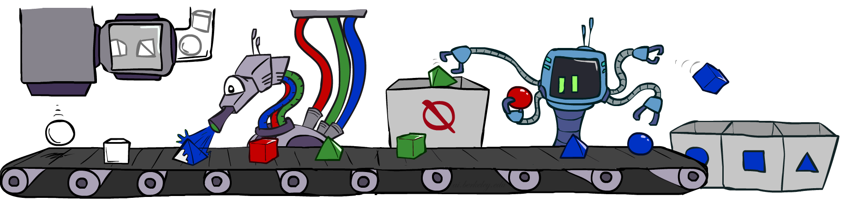
Rejection Sampling

Slide 24
Rejection Sampling
A simple modification of prior sampling for conditional probabilities
Let’s say we want P(C| r, w)
Count the C outcomes, but ignore (reject) samples that don’t have R=true, W=true
This is called rejection sampling
It is also consistent for conditional probabilities (i.e., correct in the limit)
C
S
R
W
c, ¬s, r, w
c, s, ¬r
¬c, s, r, ¬w
c, ¬s, ¬r
¬c, ¬s, r, w

Slide 25
Rejection Sampling
Input: evidence e₁,..,e_{k}
For i=1, 2, …, n
Sample X_{i} from P(X_{i} | parents(X_{i}))
If x_{i} not consistent with evidence
Reject: Return, and no sample is generated in this cycle
Return (x₁, x₂, …, x_{n})

Slide 26
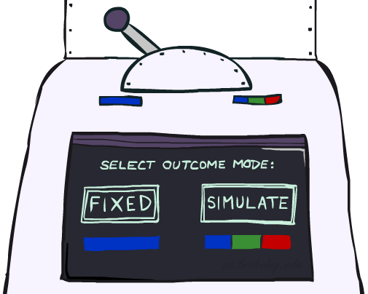
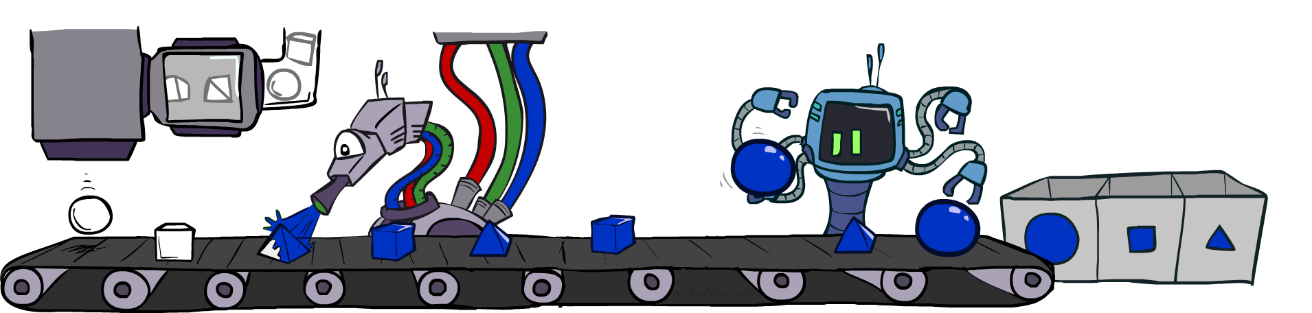
Likelihood Weighting

Slide 27
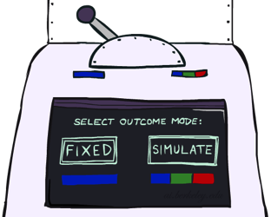


Likelihood Weighting
Problem with rejection sampling:
If evidence is unlikely, rejects lots of samples
Evidence not exploited as you sample
Consider P(Shape|Color=blue)
Idea: fix evidence variables, sample the rest
Problem: sample distribution not consistent!
Solution: weight each sample by probability of evidence variables given parents
pyramid, green
pyramid, red
sphere, blue
cube, red
sphere, green
pyramid, blue
pyramid, blue
sphere, blue
cube, blue
sphere, blue
Shape
Color
Shape
Color

Slide 28
Likelihood Weighting
P(C)
c | 0.5
¬c | 0.5
P(S | C)
Cloudy
P(R | C)
Cloudy
c | s | 0.1
 | ¬s | 0.9
¬c | s | 0.5
 | ¬s | 0.5
c | r | 0.8
 | ¬r | 0.2
¬c | r | 0.2
 | ¬r | 0.8
Sprinkler
Sprinkler
Rain
Rain
P(W | S,R)
WetGrass
Samples:
WetGrass
s | r | w | 0.99
 |  | ¬w | 0.01
 | ¬r | w | 0.90
 |  | ¬w | 0.10
¬s | r | w | 0.90
 |  | ¬w | 0.10
 | ¬r | w | 0.01
 |  | ¬w | 0.99
c
, s, , w
r
w = 1.0
x 0.1
x 0.99

Slide 29
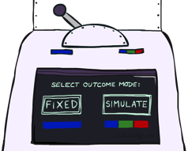
Likelihood Weighting
Input: evidence e₁,..,e_{k}
w = 1.0
for i=1, 2, …, n
if X_{i} is an evidence variable
x_{i} = observed value_{i} for X_{i}
Set w = w * P(x_{i} | parents(X_{i}))
else
Sample x_{i} from P(X_{i} | parents(X_{i}))
return (x₁, x₂, …, x_{n}), w

Slide 30
Likelihood Weighting
Sampling distribution if Z sampled and e fixed evidence
S_{WS}(z,e) = ∏_{j} P(z_{j} | parents(Z_{j}))
Now, samples have weights
w(z,e) = ∏_{k} P(e_{k} | parents(E_{k}))
Together, weighted sampling distribution is consistent
S_{WS}(z,e) ⋅ w(z,e) = ∏_{j} P(z_{j} | parents(Z_{j})) ∏_{k} P(e_{k} | parents(E_{k}))
= P(z,e)
Likelihood weighting is an example of importance sampling
Would like to estimate some quantity based on samples from P
P is hard to sample from, so use Q instead
Weight each sample x by P(x)/Q(x)
Cloudy
C
S
R
W

Slide 31
Likelihood Weighting
Likelihood weighting is good
All samples are used
The values of downstream variables are influenced by upstream evidence
Likelihood weighting still has weaknesses
The values of upstream variables are unaffected by downstream evidence
E.g., suppose evidence is a video of a traffic accident
With evidence in k leaf nodes, weights will be O(2^{-k})
With high probability, one lucky sample will have much larger weight than the others, dominating the result
We would like each variable to “see” all the evidence!

Slide 32
Quiz
Suppose I perform a random walk on a graph, following the arcs out of a node uniformly at random. In the infinite limit, what fraction of time do I spend at each node?
Consider these two examples:
a
a
b
c
b
c

