Slide 1

CS 188: Artificial Intelligence
Supplement on Gibbs Sampling Convergence
Instructors: Stuart Russell and Dawn Song
University of California, Berkeley
Notes:
Please retain proper attribution, including the reference to ai.berkeley.edu. Thanks!

Slide 2
Gibbs sampling
A particular kind of MCMC
States are complete assignments to all variables
Evidence variables E remain fixed, other variables X change
To generate the next state,
pick a variable X_{i} with probability ρ(i)
sample a value for it conditioned on all the other variables:
X_{i}’ ~ P(X_{i} | x₁,..,x_{i-1},x_{i+1},..,x_{n}, e) = P(X_{i} | x_{-i}, e)
In a Bayes net, P(X_{i} | x_{-i}, e) = P(X_{i} | markov_blanket(X_{i}))
Theorem: Gibbs sampling is consistent*
Provided all Gibbs distributions are bounded away from 0 and 1 and variable selection is fair

Slide 3
Gibbs Sampling Example: P( S | r)
Step 1: Fix evidence
R = true
Step 3: Repeat
Choose a non-evidence variable X
Resample X from P(X | markov_blanket(X))
Step 2: Initialize other variables
Randomly
C
C
S
r
S
r
W
W
C
C
C
C
C
C
S
r
S
r
S
r
S
r
S
r
S
r
W
W
W
W
W
W
Sample S ~ P(S | c, r, ¬w)
Sample C ~ P(C | s, r)
Sample W ~ P(W | s, r)
Notes:
Better animation

Slide 4
Markov chain given s, w

Slide 5
Why does it work? Overview
Suppose we run it for a long time and predict the probability of reaching any given state at time t: π_{t}(x₁,...,x_{n}) or π_{t}(x)
Each Gibbs sampling step (pick a variable, resample its value) applied to a state x has a probability k(x → x’) of reaching a next state x’
So π_{t+1}(x’) = ∑_{x} k(x → x’) π_{t}(x) (standard Markov chain prediction step)
When the process is in equilibrium π_{t+1} = π_{t} = π so π(x’) = ∑_{x} k(x → x’) π(x)
This has a unique* solution π = P(x|e)

Slide 6
Detailed balance
More specifically, π(x) = P(x|e) satisfies detailed balance:
For every pair of states x, x’, π(x’) k(x’ → x) = π(x) k(x → x’)
Detailed balance implies that π is the stationary distribution for k:
∑_{x} π(x’) k(x’ → x) = ∑_{x} π(x) k(x → x’)
π(x’) ∑_{x} k(x’ → x) = ∑_{x} π(x) k(x → x’)
π(x’) = ∑_{x} π(x) k(x → x’)

Slide 7
What is the transition probability k(x → x’)?
C
C
Case 1: x, x’ differ in two or more variables
Then k(x’ | x) = 0, ⇒ detailed balance
Case 2: x, x’ identical
Then detailed balance becomes
π(x) k(x → x) = π(x) k(x → x)
Case 3: x, x’ differ in variable X_{i}
Then k(x → x’) = P(X_{i} chosen) P(X_{i} samples x’_{i})
= ρ(i) P(x’_{i} | x_{-i},e)
S
r
S
r
W
W
✅
C
C
S
r
S
r
W
W
✅
C
C
S
r
S
r
W
W

Slide 8
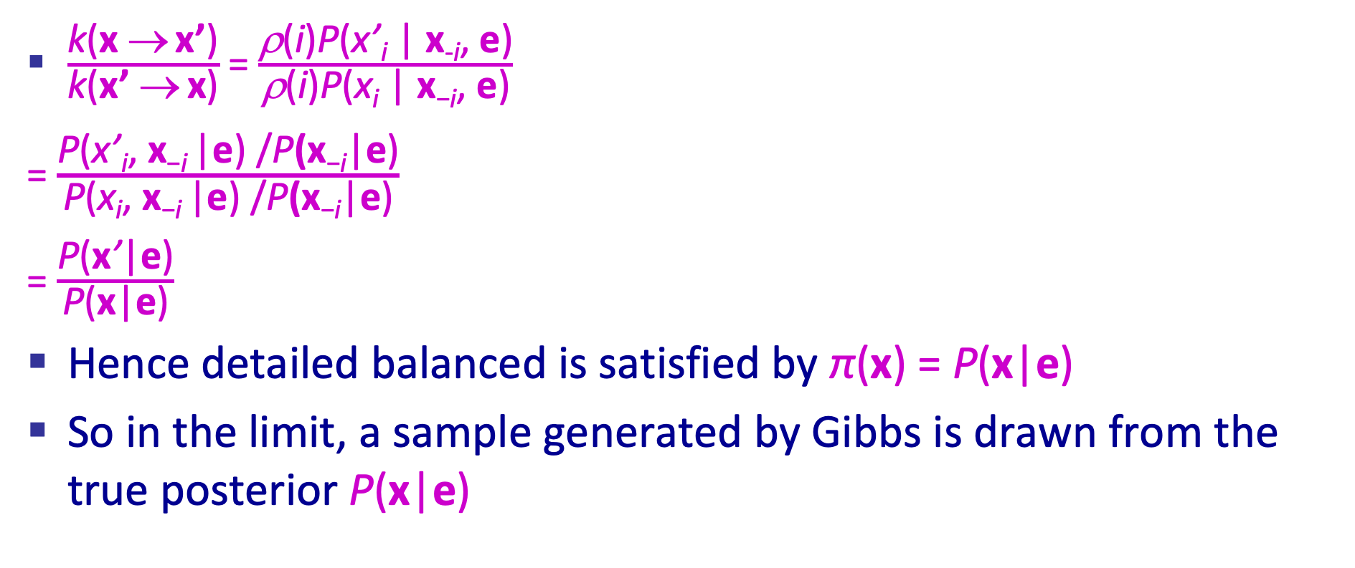
Detailed balance for Case 3
$\frac{\text{k}\text{(}\text{x} \text{→} \text{x}\text{’}\text{)}}{\text{k}\text{(}\text{x}\text{’ }\text{→} \text{x}\text{)}}$ = $\frac{\text{}\text{(}\text{i}\text{)}\text{P}\text{(}\text{x}\text{’}\text{i}\text{ | }\text{x}\text{-}\text{i}\text{, }\text{e}\text{)}}{\text{}\text{(}\text{i}\text{)}\text{P}\text{(}\text{x}\text{i}\text{ | }\text{x}\text{−}\text{i}\text{, }\text{e}\text{)}}$
= $\frac{\text{P}\text{(}\text{x}\text{’}\text{i}\text{,} \text{x}\text{−}\text{i} \text{|}\text{e}\text{)} \text{/}\text{P}\text{(}\text{x}\text{−}\text{i}\text{|}\text{e}\text{)}}{\text{P}\text{(}\text{x}\text{i}\text{,} \text{x}\text{−}\text{i} \text{|}\text{e}\text{)} \text{/}\text{P}\text{(}\text{x}\text{−}\text{i}\text{|}\text{e}\text{)}}$
= $\frac{\text{P}\text{(}\text{x}\text{’}\text{|}\text{e}\text{)}}{\text{P}\text{(}\text{x}\text{|}\text{e}\text{)}}$
Hence detailed balanced is satisfied by π(x) = P(x|e)
So in the limit, a sample generated by Gibbs is drawn from the true posterior P(x|e)
✅

