Slide 1
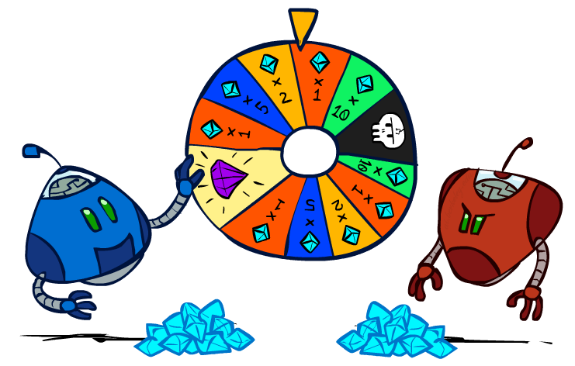
CS 188: Artificial Intelligence
Rational Decisions
Instructor: Stuart Russell and Dawn Song
University of California, Berkeley
Notes:
Please retain proper attribution and the reference to ai.berkeley.edu. Thanks!

Slide 2

Utilities

Slide 3

Maximum Expected Utility
Principle of maximum expected utility:
A rational agent should choose the action that maximizes its expected utility, given its knowledge
Questions:
Where do utilities come from?
How do we know such utilities even exist?
How do we know that averaging even makes sense?
What if our behavior (preferences) can’t be described by utilities?

Slide 4
The need for numbers
0
40
20
30
x²
0
1600
400
900
For worst-case minimax reasoning, terminal value scale doesn’t matter
We just want better states to have higher evaluations (get the ordering right)
The optimal decision is invariant under any monotonic transformation
For average-case expectimax reasoning, we need magnitudes to be meaningful

Slide 5

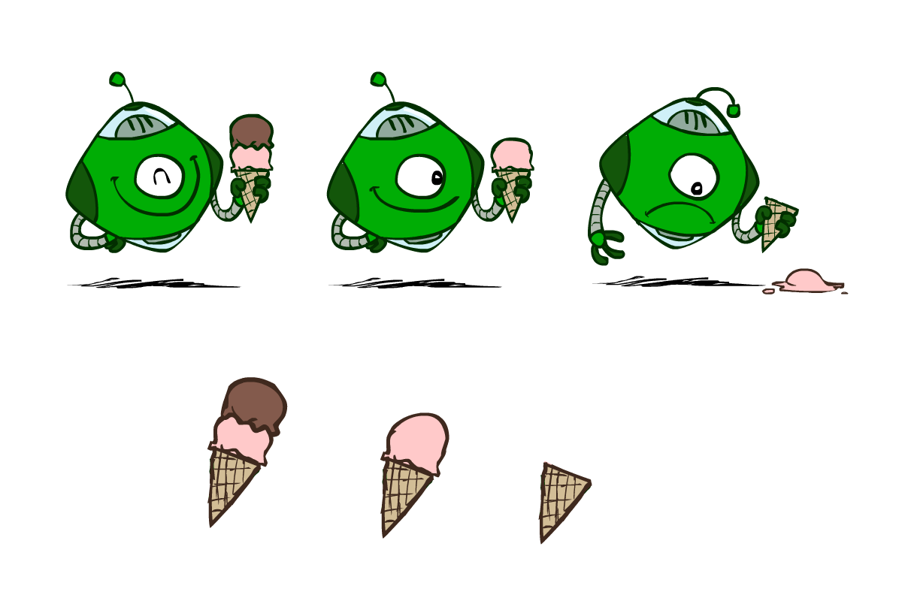
Utilities
Utilities are functions from outcomes (states of the world) to real numbers that describe an agent’s preferences
Where do utilities come from?
In a game, may be simple (+1/-1)
Utilities summarize the agent’s goals
Theorem: any “rational” preferences can be summarized as a utility function
We hard-wire utilities and let behaviors emerge
Why don’t we let agents pick utilities?
Why don’t we prescribe behaviors?

Slide 6

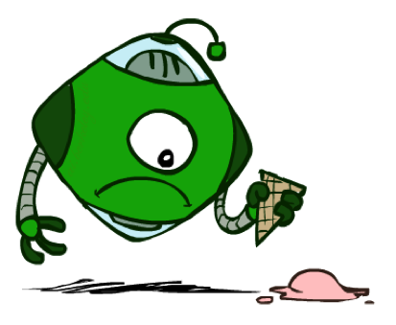

Utilities: Uncertain Outcomes
Getting ice cream
Get Single
Get Double
Oops
Whew!

Slide 7
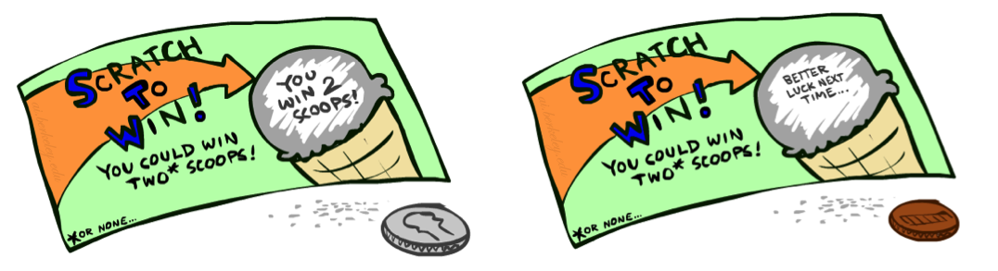
Preferences
A Prize
A Lottery
An agent must have preferences among:
Prizes: A, B, etc.
Lotteries: situations with uncertain prizes
L = [p, A; (1-p), B]
Notation:
Preference: A > B
Indifference: A ~ B
A
p 1-p
A B

Slide 8
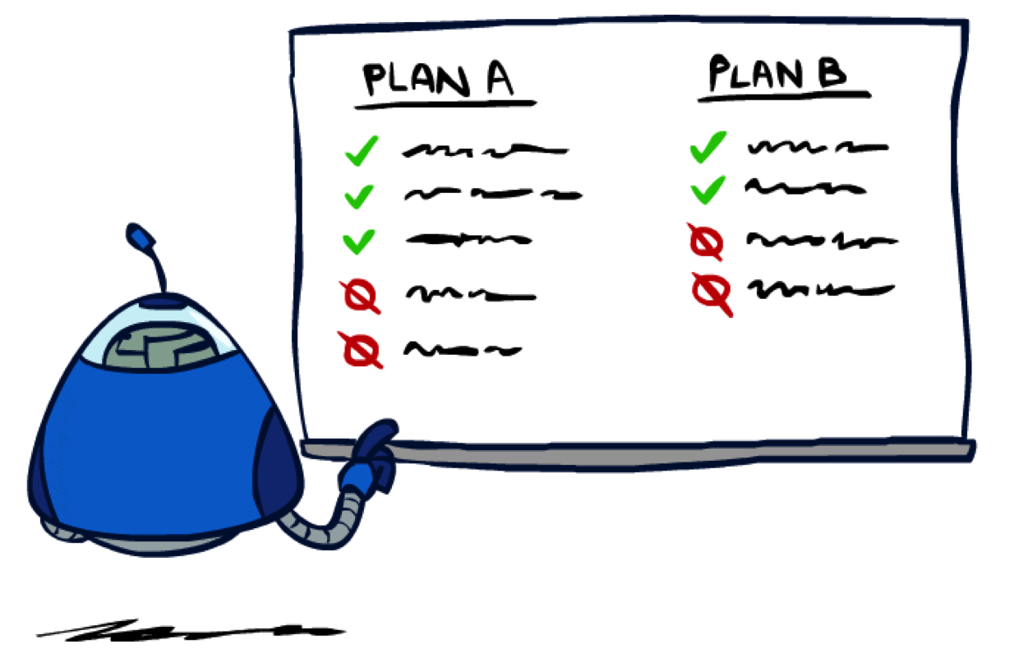
Rationality

Slide 9
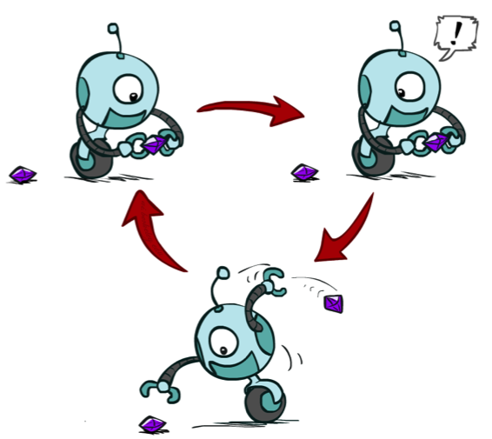
Rational Preferences
We want some constraints on preferences before we call them rational, such as:
For example: an agent with intransitive preferences can
be induced to give away all of its money
If B > C, then an agent with C would pay (say) 1 cent to get B
If A > B, then an agent with B would pay (say) 1 cent to get A
If C > A, then an agent with A would pay (say) 1 cent to get C
Axiom of Transitivity: (A > B) ∧ (B > C) ⇒ (A > C)
Notes:
Apple, banana, carrot

Slide 10

Rational Preferences
The Axioms of Rationality
Orderability:
(A > B) ∨ (B > A) ∨ (A ~ B)
Transitivity:
(A > B) ∧ (B > C) ⇒ (A > C)
Continuity:
(A > B > C) ⇒ ∃p [p, A; 1-p, C] ~ B
Substitutability:
(A ~ B) ⇒ [p, A; 1-p, C] ~ [p, B; 1-p, C]
Monotonicity:
(A > B) ⇒
(p ≥ q) ⇔ [p, A; 1-p, B] ≥ [q, A; 1-q, B]
Theorem: Rational preferences imply behavior describable as maximization of expected utility

Slide 11
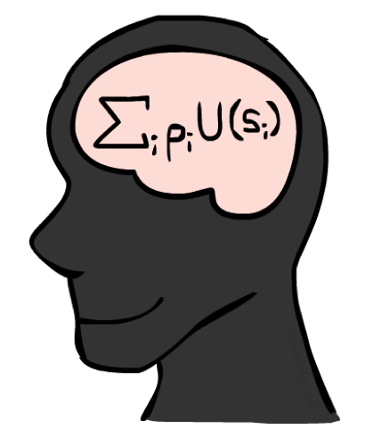
MEU Principle
Theorem [Ramsey, 1931; von Neumann & Morgenstern, 1944]
Given any preferences satisfying these constraints, there exists a real-valued
function U such that:
U(A) ≥ U(B) ⇔ A ≥ B
U([p₁,S₁; … ; p_{n},S_{n}]) = p₁U(S₁) + … + p_{n}U(S_{n})
I.e. values assigned by U preserve preferences of both prizes and lotteries!
Optimal policy invariant under positive affine transformation U’ = aU+b, a>0
Maximum expected utility (MEU) principle:
Choose the action that maximizes expected utility
Note: rationality does not require representing or manipulating utilities and probabilities
E.g., a lookup table for perfect tic-tac-toe

Slide 12
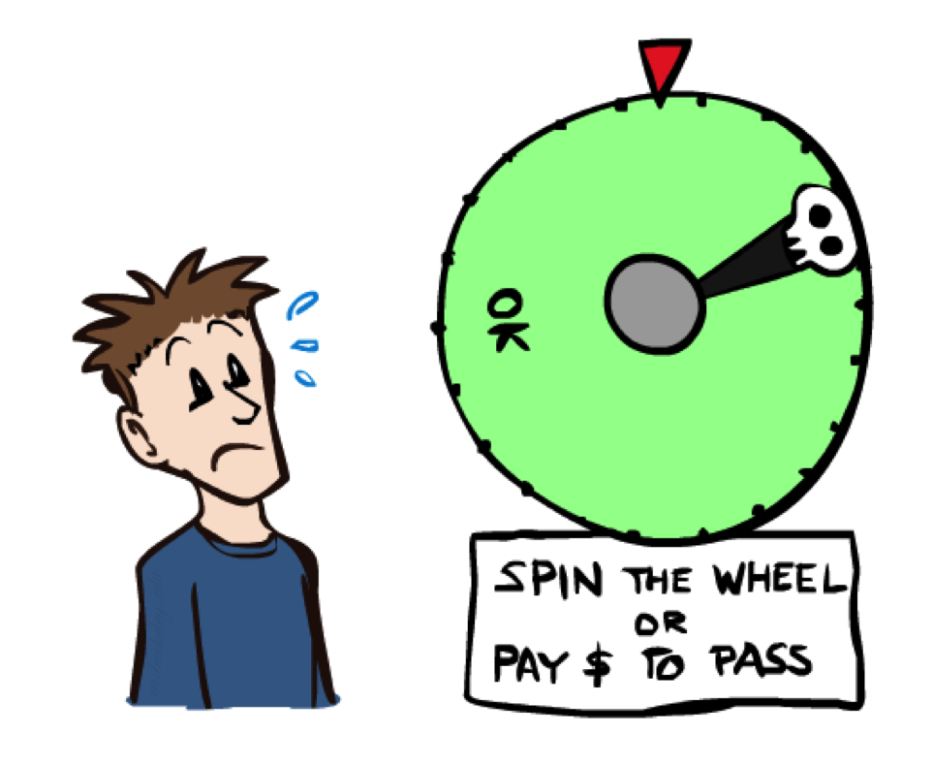
Human Utilities

Slide 13


Human Utilities
Utilities map states to real numbers. Which numbers?
Standard approach to assessment (elicitation) of human utilities:
Compare a prize A to a standard lottery L_{p} between
“best possible prize” u_{T} with probability p
“worst possible catastrophe” u⊥ with probability 1-p
Adjust lottery probability p until indifference: A ~ L_{p}
Resulting p is a utility in [0,1]
Pay $50
0.999999 0.000001
No change
Instant death

Slide 14
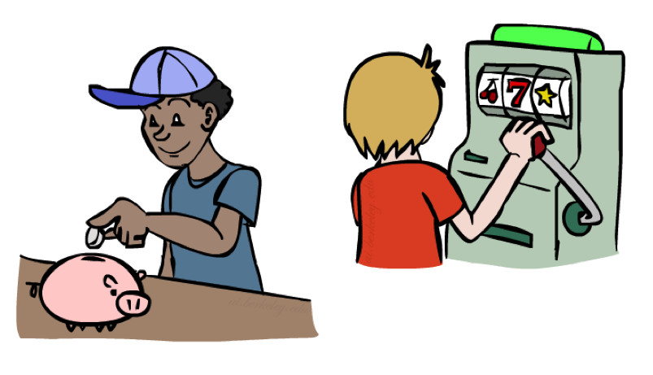
Money
Money does not behave as a utility function, but we can talk about the utility of having money (or being in debt)
Given a lottery L = [p, $X; (1-p), $Y]
The expected monetary value EMV(L) = pX + (1-p)Y
The utility is U(L) = pU($X) + (1-p)U($Y)
Typically, U(L) < U( EMV(L) )
In this sense, people are risk-averse
E.g., how much would you pay for a lottery ticket L=[0.5, $10,000; 0.5, $0]?
The certainty equivalent of a lottery CE(L) is the cash amount such that CE(L) ~ L
The insurance premium is EMV(L) - CE(L)
If people were risk-neutral, this would be zero!
Notes:
Draw Jensen’s for utility curve

Slide 15
Post-decision Disappointment: the Optimizer’s Curse
Usually we don’t have direct access to exact utilities, only estimates
E.g., you could make one of k investments
An unbiased expert assesses their expected net profit V₁,…,V_{k}
You choose the best one V*
With high probability, its actual value is considerably less than V*
This is a serious problem in many areas:
Future performance of mutual funds
Efficacy of drugs measured by trials
Statistical significance in scientific papers
Winning an auction
Suppose true net profit is 0
and estimate ~ N(0,1);
Max of k estimates:

