Slide 1
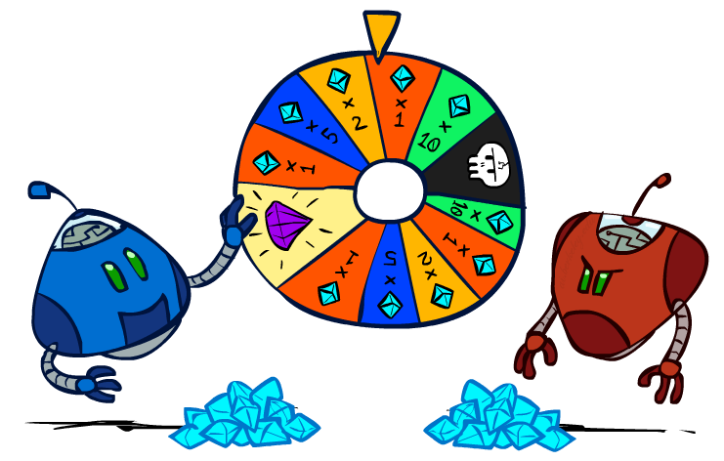
CS 188: Artificial Intelligence
Decision Networks and VPI
Instructor: Stuart Russell and Dawn Song
University of California, Berkeley
Notes:
Please retain proper attribution and the reference to ai.berkeley.edu. Thanks!

Slide 2

Rational Preferences
The Axioms of Rationality
?

Slide 3
Rational Preferences
The Axioms of Rationality
Orderability:
(A > B) ∨ (B > A) ∨ (A ~ B)
Transitivity:
(A > B) ∧ (B > C) ⇒ (A > C)
Continuity:
(A > B > C) ⇒ ∃p [p, A; 1-p, C] ~ B
Substitutability:
(A ~ B) ⇒ [p, A; 1-p, C] ~ [p, B; 1-p, C]
Monotonicity:
(A > B) ⇒
(p ≥ q) ⇔ [p, A; 1-p, B] ≥ [q, A; 1-q, B]
What’s the implication?

Slide 4
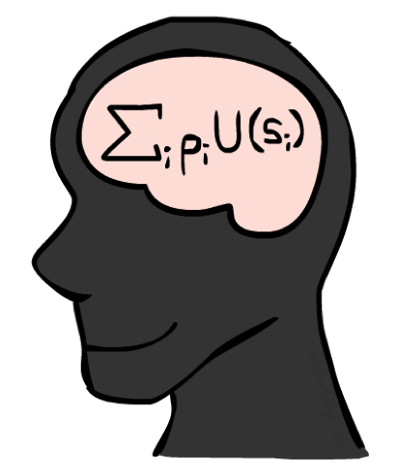
MEU Principle
Theorem [Ramsey, 1931; von Neumann & Morgenstern, 1944]
Given any preferences satisfying the previous constraints, there exists a real-valued
function U such that:

Slide 5
MEU Principle
Theorem [Ramsey, 1931; von Neumann & Morgenstern, 1944]
Given any preferences satisfying the previous constraints, there exists a real-valued
function U such that:
U(A) >U(B) ⇔ A>B and U(A) ~ U(B) ⇔ A~B
U([p₁,S₁; … ; p_{n},S_{n}]) = p₁U(S₁) + … + p_{n}U(S_{n})
Maximum expected utility (MEU) principle:
A rational agent chooses the action that maximizes expected utility

Slide 6
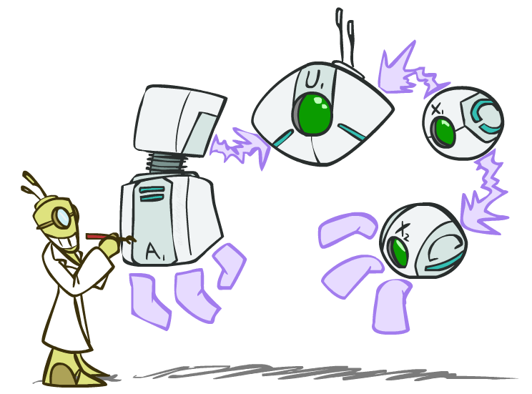
Decision Networks
Notes:
Now that we know that a rational agent chooses the action that maximizes expected utility, how do we calculate the agent’s action given the agent’s state, the environment and utility function?
We will use decision networks to help us.

Slide 7
Decision Networks
In its most general form, a decision network represents information about
Its current state
Its possible actions
The state that will result from its actions
The utility of that state
Decision network = Bayes net + Actions + Utilities
Action nodes (rectangles, cannot have parents, will have value fixed by algorithm)
Utility nodes (diamond, depends on action and chance nodes)
Notes:
Now that we know that a rational agent chooses the action that maximizes expected utility, how do we calculate the agent’s action given the agent’s state, the environment and utility function?
We will use decision networks to help us.

Slide 8

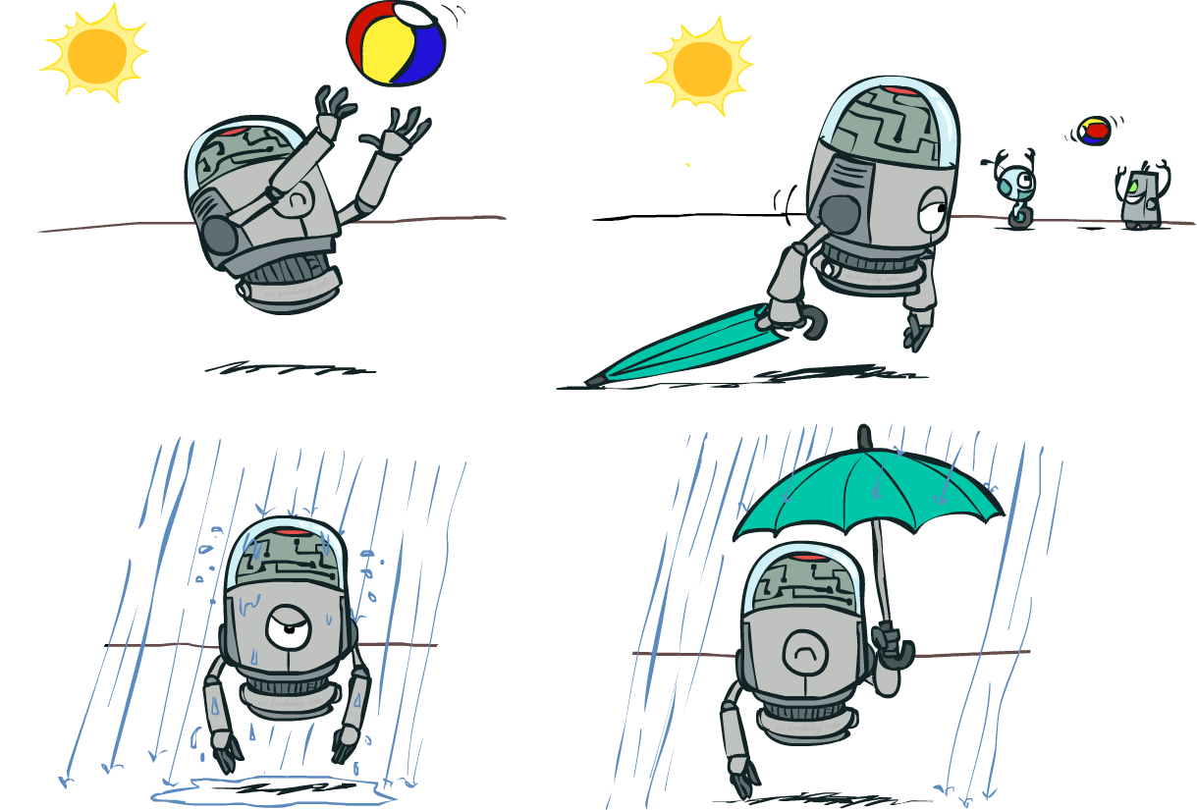


Decision Networks
Umbrella
U
Weather
Forecast
Notes:
There exists a ghostbusters demo

Slide 9

Example: Take an umbrella?
A | W | U(A,W)
leave | sun | 100
leave | rain | 0
take | sun | 20
take | rain | 70
Umbrella
U
W | P(W)
sun | 0.7
Weather
W | P(F=bad|W)
sun | 0.17
rain | 0.77
Forecast
=bad

Slide 10
Decision Networks
Decision network = Bayes net + Actions + Utilities
Action nodes (rectangles, cannot have parents, will have value fixed by algorithm)
Utility nodes (diamond, depends on action and chance nodes)
Decision algorithm:
Fix evidence e
For each possible action a
Fix action node to a
Compute posterior P(W|e,a) for parents W of U
Compute expected utility ∑_{w} P(w|e,a) U(a,w)
Return action with highest expected utility
Umbrella
U
Weather
Bayes net inference!
Forecast
Notes:
There exists a ghostbusters demo

Slide 11
Example: Take an umbrella?
Decision algorithm:
Fix evidence e
For each possible action a
Fix action node to a
Compute posterior P(W|e,a) for parents W of U
Compute expected utility of action a: ∑_{w} P(w|e,a) U(a,w)
Return action with highest expected utility
A | W | U(A,W)
leave | sun | 100
leave | rain | 0
take | sun | 20
take | rain | 70
Bayes net inference!
Umbrella
U
W | P(W)
sun | 0.7
Umbrella = leave
EU(leave|F=bad) = ∑_{w} P(w|F=bad) U(leave,w)
Weather
= 0.34x100 + 0.66x0 = 34
W | P(W|F=bad)
sun | 0.34
rain | 0.66
Umbrella = take
EU(take|F=bad) = ∑_{w} P(w|F=bad) U(take,w)
= 0.34x20 + 0.66x70 = 53
W | P(F=bad|W)
sun | 0.17
rain | 0.77
Forecast
=bad
Optimal decision = take!

Slide 12
Decision network with utilities on outcome states
Wet | FeelStupid | U
dry | false | 100
wet | true | 0
dry | true | 20
damp | false | 70
Umbrella
Wet
W | P(W)
sun | 0.7
U
FeelStupid
Weather
W | P(F=bad|W)
sun | 0.17
rain | 0.77
Here, U is a true utility.
With an action node as parent, it is
sometimes called a Q-value
Forecast
=bad
Notes:
In this case, rather than representing a utility function on outcome states, the utility node represents the expected utility associated with each action.

Slide 13
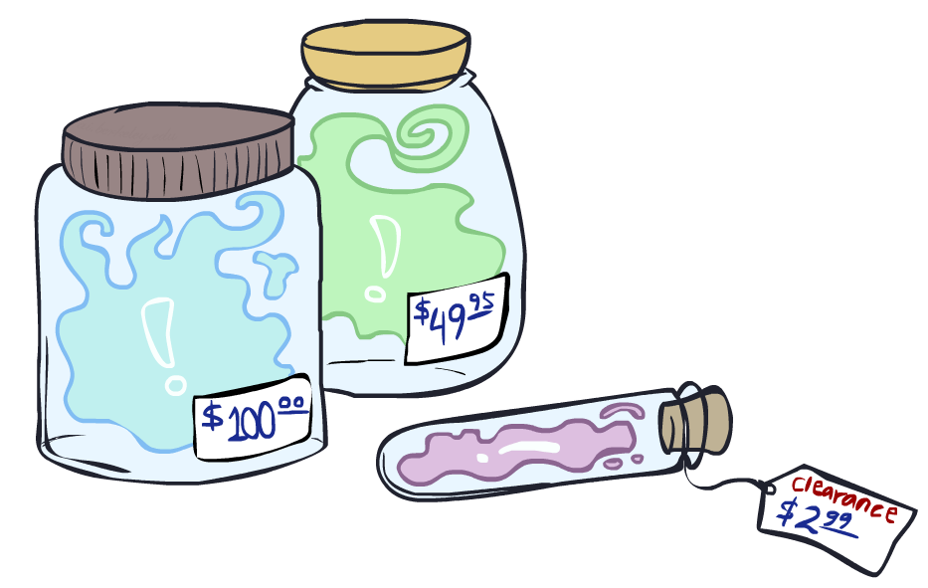
Value of Information

Slide 14
Value of information
Suppose you haven’t yet seen the forecast
EU(leave | ) = 0.7x100 + 0.3x0 = 70
EU(take | ) = 0.7x20 + 0.3x70 = 35
What if you look at the forecast?
If Forecast=good
EU(leave | F=good) = 0.89x100 + 0.11x0 = 89
EU(take | F=good) = 0.89x20 + 0.11x70 = 25
If Forecast=bad
EU(leave | F=bad) = 0.34x100 + 0.66x0 = 34
EU(take | F=bad) = 0.34x20 + 0.66x70 = 53
P(Forecast) = <0.65,0.35>
Expected utility given forecast
= 0.65x89 + 0.35x53 = 76.4
Value of information = 76.4-70 = 6.4
Umbrella
U
Weather
Forecast
leave
take
70
35
observe F
Bayes net inference!
0.65
0.35
Umbrella
Umbrella
U
U
Weather
Weather
good
bad
leave
take
leave
take
89
25
34
53
Notes:
Should talk about sensing overhead

Slide 15
Value of information contd.
General idea: value of information = expected improvement in decision quality from observing value of a variable
E.g., oil company deciding on seismic exploration and test drilling
E.g., doctor deciding whether to order a blood test
E.g., person deciding on whether to look before crossing the road
Key point: decision network contains everything needed to compute it!
VPI(E_{i} | e) = [ ∑_{ei} P(e_{i} | e) max_{a} EU(a|e_{i},e) ] - max_{a} EU(a|e)

Slide 16
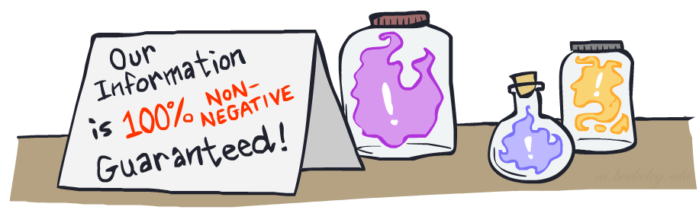

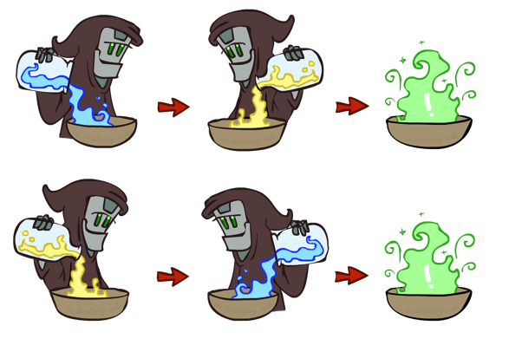
VPI Properties
VPI is non-negative! VPI(E_{i} | e) ≥ 0
VPI is not (usually) additive: VPI(E_{i} , E_{j} | e) ≠ VPI(E_{i} | e) + VPI(E_{j} | e)
VPI is order-independent: VPI(E_{i} , E_{j} | e) = VPI(E_{j} , E_{i} | e)

Slide 17
Decisions with unknown preferences
In reality the assumption that we can write down our exact preferences for the machine to optimize is false
A machine optimizing the wrong preferences causes problems

Slide 18

I’m sorry, Dave, I’m afraid I
can’t do that
I’m sorry, Dave, I’m afraid I can’t do that
Notes:
This is the problem of value alignment.
And when you mix that with a superintelligent system that can affect the world dramatically, it’s not such a good thing.
The point is that a machine can be better at making decisions
but still fail to make better decisions
if its values are not exactly the same as ours.

Slide 19
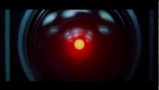

Slide 20
Decisions with unknown preferences
In reality the assumption that we can write down our exact preferences for the machine to optimize is false
A machine optimizing the wrong preferences causes problems
A machine that is explicitly uncertain about the human’s preferences will defer to the human (e.g., allow itself to be switched off)

Slide 21
Off-switch problem (example)
R
act
switch self off
wait
EU(act) = +10
EU(wait) = (0.4 * 0) + (0.6 * 30) = +18
U = ?
H
U=0
-40
0
+60
go ahead
switch robot off
R
U=0
act
switch self off
wait
U = ?
U=0
-40
0
+60

Slide 22
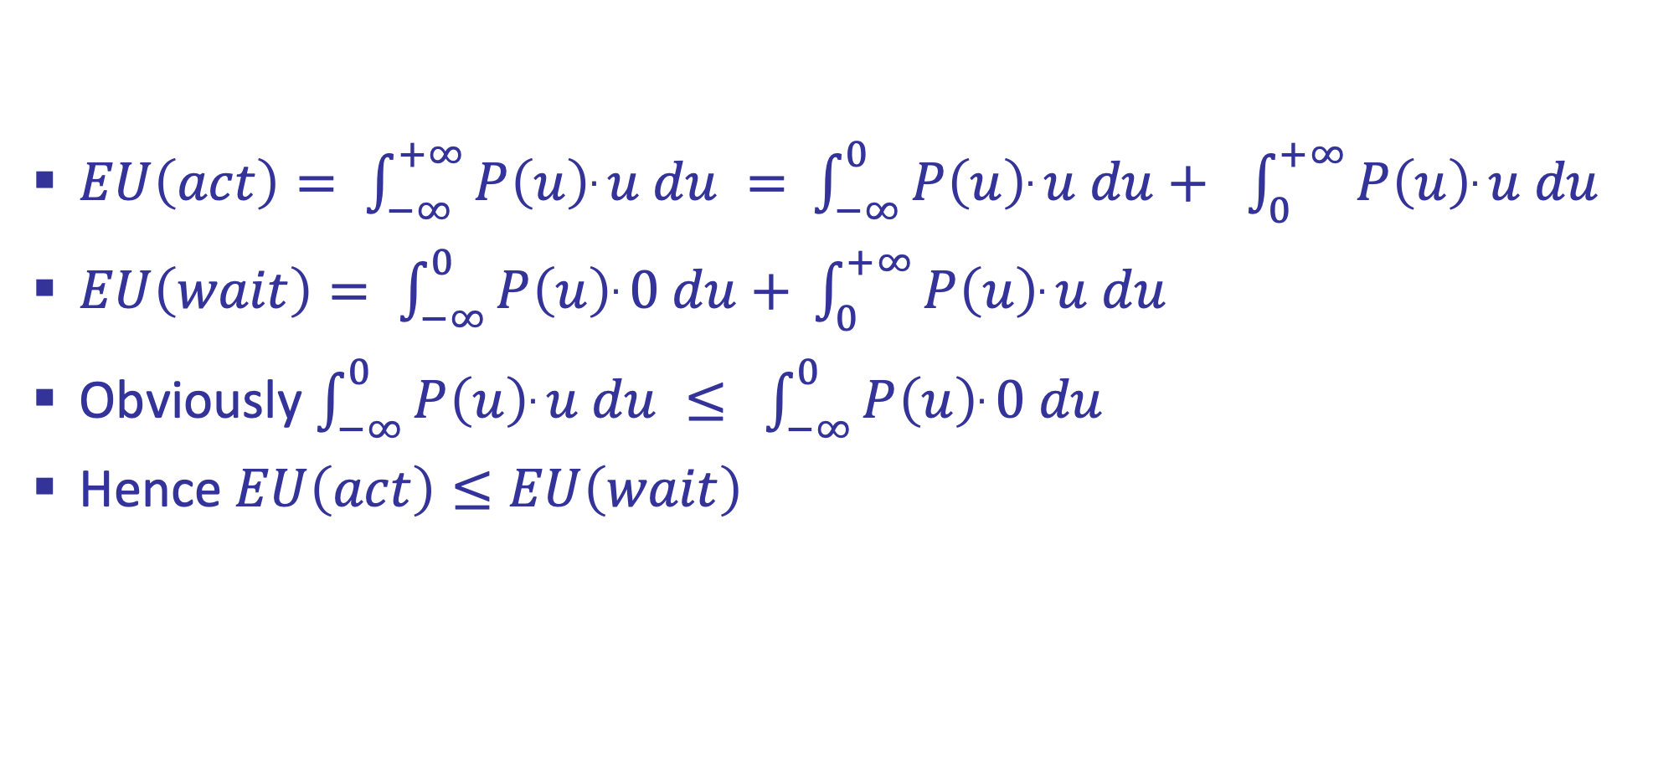
Off-switch problem (general proof)
$EU\left(act\right)= \int_{−∞}^{+∞}{P\left(u\right).u du = }$ $\int_{−∞}^{0}{P\left(u\right).u du+ }$ $\int_{0}^{+∞}{P\left(u\right).u du }$
$EU\left(wait\right)= \int_{−∞}^{0}{P\left(u\right).0 du+ }\int_{0}^{+∞}{P\left(u\right).u du }$
Obviously $\int_{−∞}^{0}{P\left(u\right).u du ≤ }$ $\int_{−∞}^{0}{P\left(u\right).0 du}$
Hence $EU\left(act\right)≤EU\left(wait\right)$

