Slide 1
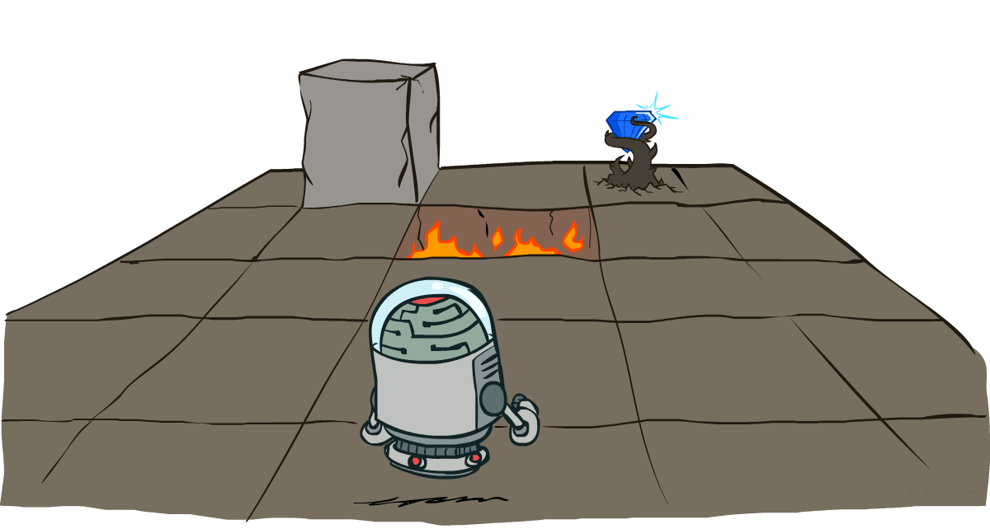
CS 188: Artificial Intelligence
Markov Decision Processes
Instructor: Stuart Russell and Dawn Song
University of California, Berkeley
Notes:
Please retain proper attribution and the reference to ai.berkeley.edu. Thanks!

Slide 2
Recap: Decision Networks
What is a decision network?
Notes:
There exists a ghostbusters demo

Slide 3
Recap: Decision Networks
Decision network = Bayes net + Actions + Utilities
Action nodes (rectangles, cannot have parents, will have value fixed by algorithm)
Utility nodes (diamond, depends on action and chance nodes)
Decision network represents a decision problem, containing all the information needed to for the agent to decide
Umbrella
U
Weather
What types of decisions?
Forecast
Notes:
There exists a ghostbusters demo

Slide 4
Recap: Decision Networks
Decision network = Bayes net + Actions + Utilities
Action nodes (rectangles, cannot have parents, will have value fixed by algorithm)
Utility nodes (diamond, depends on action and chance nodes)
Decision network represents a decision problem, containing all the information needed to for the agent to decide
What action to take given evidence e
Decision algorithm
Fix evidence e
For each possible action a
Fix action node to a
Compute posterior P(W|e,a) for parents W of U
Compute expected utility ∑_{w} P(w|e,a) U(a,w)
Return action with highest expected utility
Umbrella
U
Weather
Forecast
Notes:
There exists a ghostbusters demo

Slide 5
Recap: Decision Networks
Decision network = Bayes net + Actions + Utilities
Action nodes (rectangles, cannot have parents, will have value fixed by algorithm)
Utility nodes (diamond, depends on action and chance nodes)
Decision network represents a decision problem, containing all the information needed to for the agent to decide
What action to take given evidence e
Decision algorithm
Value of information
VPI(E_{i} | e) = [ ∑_{ei} P(e_{i} | e) max_{a} EU(a|e_{i},e) ] - max_{a} EU(a|e)
Umbrella
U
Weather
Forecast
Notes:
There exists a ghostbusters demo

Slide 6
Decisions with unknown preferences
In reality the assumption that we can write down our exact preferences for the machine to optimize is false
A machine optimizing the wrong preferences causes problems

Slide 7

I’m sorry, Dave, I’m afraid I
can’t do that
I’m sorry, Dave, I’m afraid I can’t do that
Notes:
This is the problem of value alignment.
And when you mix that with a superintelligent system that can affect the world dramatically, it’s not such a good thing.
The point is that a machine can be better at making decisions
but still fail to make better decisions
if its values are not exactly the same as ours.

Slide 8


Slide 9
Decisions with unknown preferences
In reality the assumption that we can write down our exact preferences for the machine to optimize is false
A machine optimizing the wrong preferences causes problems
A machine that is explicitly uncertain about the human’s preferences will defer to the human (e.g., allow itself to be switched off)

Slide 10
Off-switch problem (example)
R
act
switch self off
wait
EU(act) = +10
EU(wait) = (0.4 * 0) + (0.6 * 30) = +18
U = ?
H
U=0
-40
0
+60
go ahead
switch robot off
R
U=0
act
switch self off
wait
U = ?
U=0
-40
0
+60

Slide 11
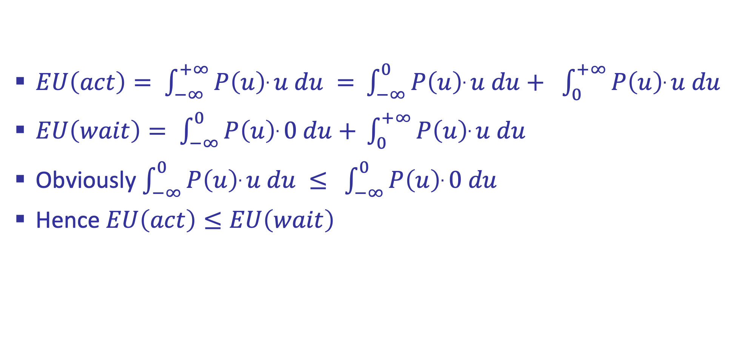
Off-switch problem (general proof)
$EU\left(act\right)= \int_{−∞}^{+∞}{P\left(u\right).u du = }$ $\int_{−∞}^{0}{P\left(u\right).u du+ }$ $\int_{0}^{+∞}{P\left(u\right).u du }$
$EU\left(wait\right)= \int_{−∞}^{0}{P\left(u\right).0 du+ }\int_{0}^{+∞}{P\left(u\right).u du }$
Obviously $\int_{−∞}^{0}{P\left(u\right).u du ≤ }$ $\int_{−∞}^{0}{P\left(u\right).0 du}$
Hence $EU\left(act\right)≤EU\left(wait\right)$

Slide 12
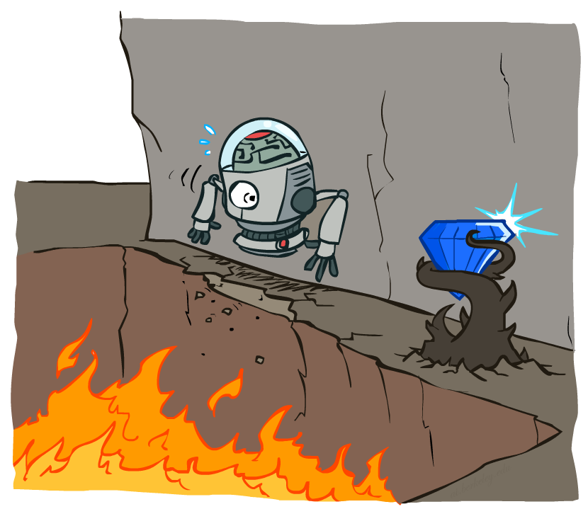
Sequential decisions under uncertainty
So far, decision problem is one-shot --- concerning only one action
Sequential decision problem: agent’s utility depends on a sequence of actions

Slide 13
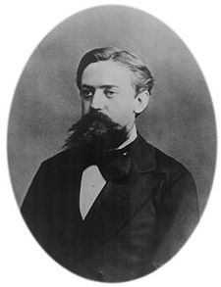

Markov Decision Process (MDP)
Environment history: [s₀, a₀, s₁, a₁, …, s_{t}]
“Markov” generally means that given the present state, the future and the past are independent
For Markov decision processes, “Markov” means action outcomes depend only on the current state
This is just like search, where the successor function could only depend on the current state (not the history)
Andrey Markov (1856-1922)
Notes:
Like search: successor function only depended on current state
Can make this happen by stuffing more into the state;
Very similar to search problems: when solving a maze with food pellets, we stored which food pellets were eaten

Slide 14
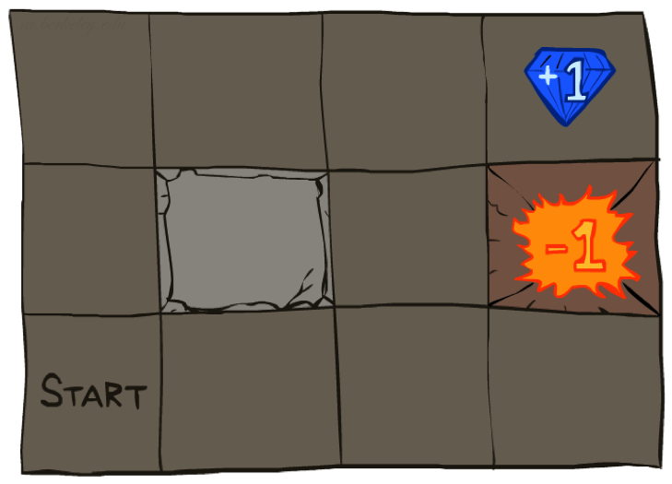




Markov Decision Process (MDP)
An MDP is defined by:
A set of states s ∈ S
A set of actions a ∈ A
A transition model T(s, a, s’)
Probability that a from s leads to s’, i.e., P(s’| s, a)
A reward function R(s, a, s’) for each transition
A start state
Possibly a terminal state (or absorbing state)
Utility function which is additive (discounted) rewards
MDPs are fully observable but probabilistic search problems
[Demo – gridworld manual intro (L8D1)]
Notes:
In search problems: did not talk about actions, but about successor functions --- now the information inside the successor function is unpacked into actions, transitions and reward
Write out S, A, example entry in T, entry in R
Reward function different from the book : R(s,a,s’)
In book simpler for equations, but not useful for the projects.
Need to modify expectimax a tiny little bit to account for rewards along the way, but that’s something you should be able to do, and so you can already solve MDP’s (not in most efficient way)

Slide 15
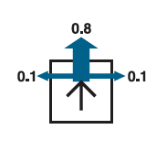
Example: Grid World
A maze-like problem
The agent lives in a grid
Walls block the agent’s path
Noisy movement: actions do not always go as planned
80% of the time, the action North takes the agent North (if there is no wall there)
10% of the time, North takes the agent West; 10% East
If there is a wall in the direction the agent would have been taken, the agent stays put
The agent receives rewards each time step
Small “living” reward r each step (can be negative)
Big rewards come at the end (good or bad)
Goal: maximize sum of rewards
Notes:
[cut demo of moving around in grid world program]

Slide 16

Policies
A policy π gives an action for each state, π: S → A
In deterministic single-agent search problems, we wanted an optimal plan, or sequence of actions, from start to a goal
For MDPs, we want an optimal policy π*: S → A
An optimal policy maximizes expected utility
An explicit policy defines a reflex agent
Notes:
Dan has a DEMO for this.

Slide 17
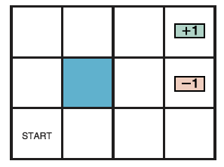
Optimal policy for r>0
r > 0

Slide 18
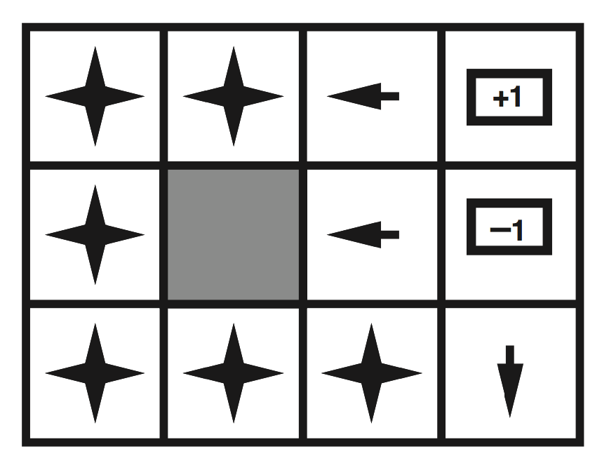
Optimal policy for r>0
r > 0

Slide 19
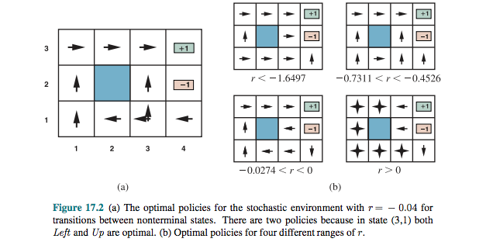
Sample Optimal Policies

Slide 20
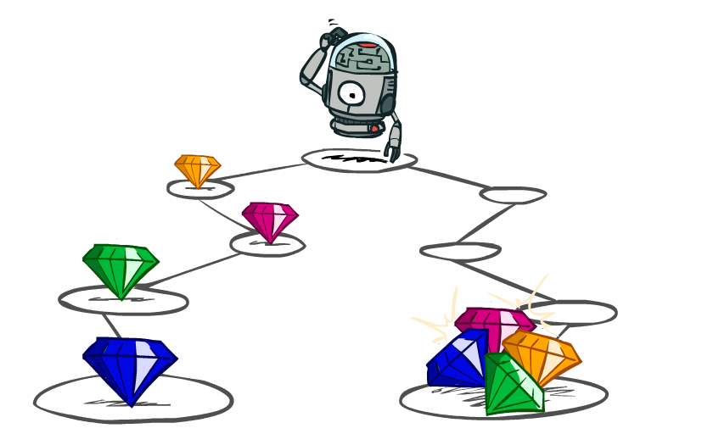
Utilities of Sequences

Slide 21
Utilities of Sequences
What preferences should an agent have over reward sequences?
More or less?
Now or later?
[1, 2, 2]
or
[2, 3, 4]
[0, 0, 1]
or
[1, 0, 0]

Slide 22
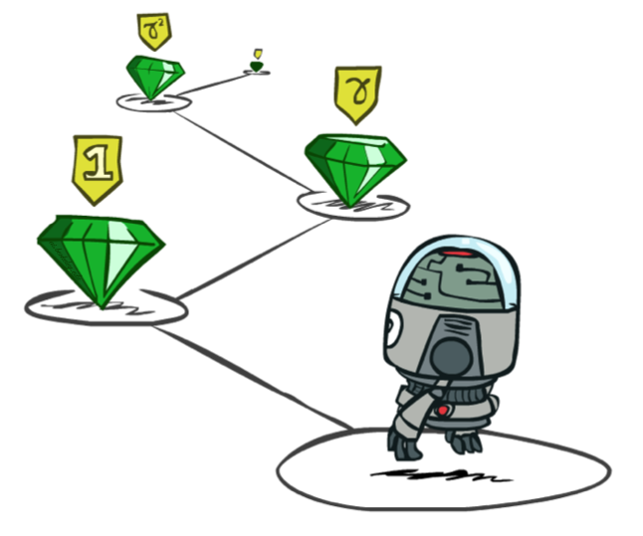


Stationary Preferences
Theorem: if we assume stationary preferences:
> > ,
⇔ >
then there is only one way to define utilities:
Additive discounted utility:
where γ ∈ [0,1] is the discount factor

Slide 23

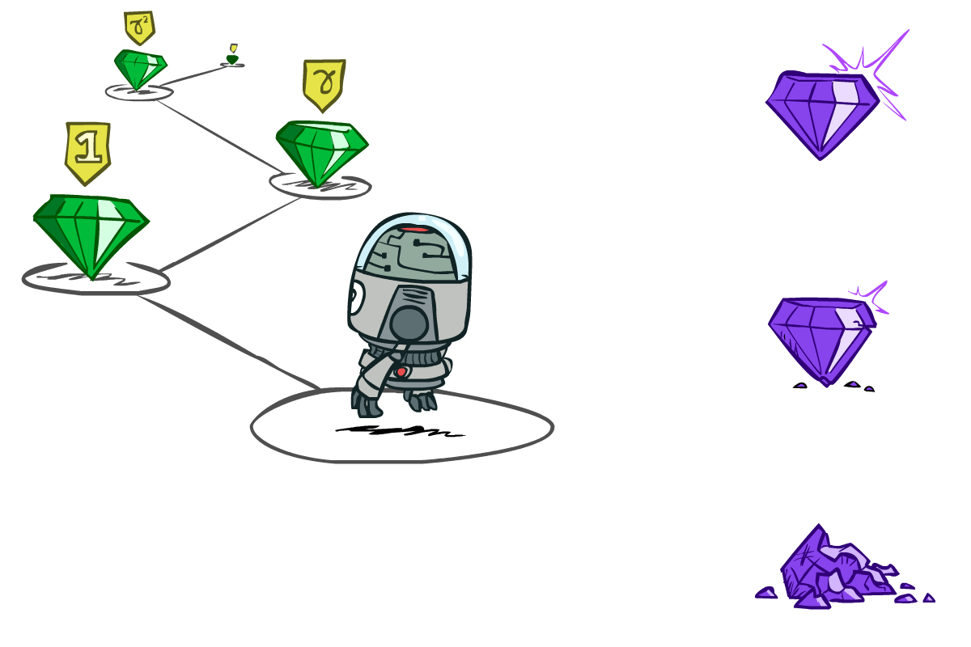
Discounting
Worth r now
Worth γr next step
Worth γ²r in two steps
Discounting with conveniently solves the problem of infinite reward streams!
Geometric series: 1 + γ + γ² + … = 1/(1 - γ)
Assume rewards bounded by ± R_{max}
Then r₀ + γr₁ + γ²r₂ + … is bounded by ± R_{max}/(1 - γ)
(Another solution: environment contains a terminal state; and agent reaches it with probability 1)

Slide 24


Quiz: Discounting
Given:
Actions: East, West, and Exit (only available in exit states a, e)
Transitions: deterministic
Quiz 1: For γ = 1, what is the optimal policy?
Quiz 2: For γ = 0.1, what is the optimal policy?
Quiz 3: For which γ are West and East equally good when in state d?
Notes:
Quiz 1: left, left, left
Quiz 2: left, left, right
Quiz 3: \gamma^3 * 10 = \gamma, \gamma = 0.1^1/2

Slide 25

The utility of a policy
Executing a policy π from any state s₀ generates a sequence
s₀, π(s₀), s₁, π(s₁), s₂, …
This corresponds to a sequence of rewards
R(s₀, π(s₀), s₁), R(s₁,π(s₁), s₂), …
This reward sequence happens with probability
P(s₁ | s₀, π(s₀)) x P(s₂ | s₁, π(s₁)) x …
The value (expected utility) of π in s₀ is written U^{π}(s₀)
It’s the sum over all possible state sequences of (discounted sum of rewards) x (probability of state sequence)
U^{π}(s₀) =
s₀
a₀
s₀, a₀
s₀,a₀,s₁
s₁

Slide 26
Optimal Quantities
The optimal policy:
π*(s) = optimal action from state s
Gives highest U^{π}(s) for any π
The value (utility) of a state s:
U*(s) = U^{π*}(s) = expected utility starting in s and acting optimally
The value (utility) of a q-state (s,a):
Q*(s,a) = expected utility of taking action a in state s and (thereafter) acting optimally
U*(s) = max_{a}Q*(s,a)
s
s is a state
a
(s, a) is a q-state
s, a
s,a,s’
(s,a,s’) is a transition
s’
Notes:
[Note: this demo doesn’t show anything in action, just pops up V and Q values.]

Slide 27


Bellman equations (Shapley, 1953)
The value/utility of a state is
The expected reward for the next transition plus the discounted value/utility of the next state, assuming the agent chooses the optimal action
Hence we have a recursive definition of value (Bellman equation):
Similarly, Bellman equation for Q-functions
U(s) =

