Slide 1
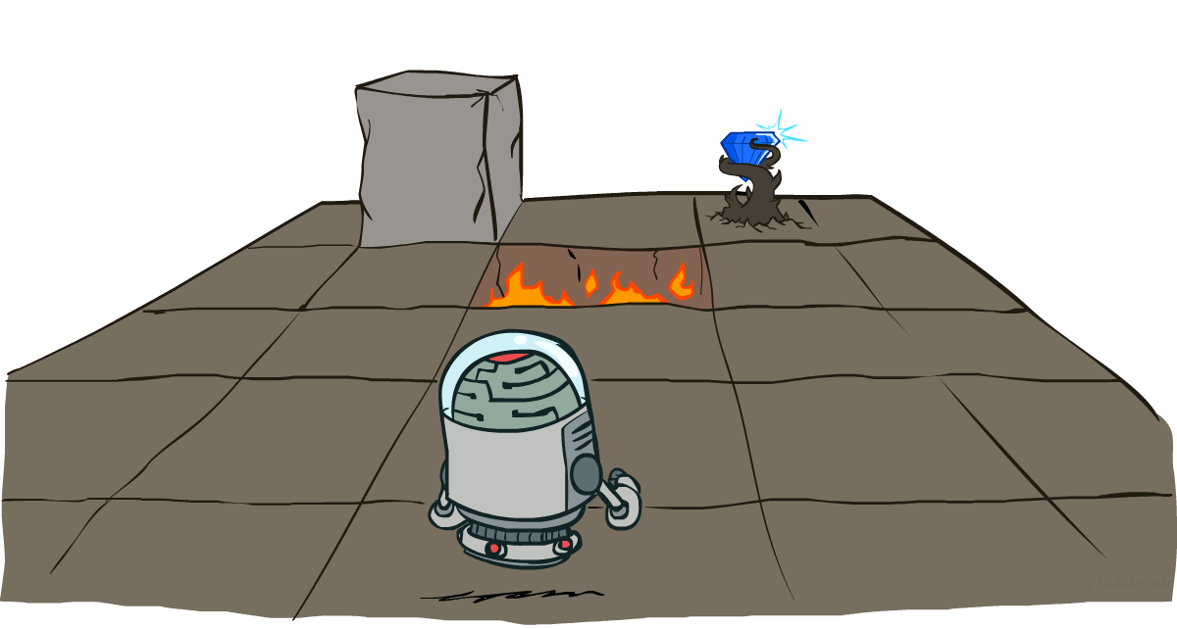
CS 188: Artificial Intelligence
MDP II: Value/Policy Iteration
Instructor: Stuart Russell and Dawn Song
University of California, Berkeley
Notes:
Please retain proper attribution and the reference to ai.berkeley.edu. Thanks!

Slide 2
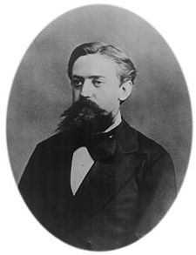
Recap: Markov Decision Process (MDP)
What is a Markov Decision Process?
Andrey Markov (1856-1922)
Notes:
Like search: successor function only depended on current state
Can make this happen by stuffing more into the state;
Very similar to search problems: when solving a maze with food pellets, we stored which food pellets were eaten

Slide 3
Recap: Markov Decision Process (MDP)
What is a Markov Decision Process?
State transition model is markov
Utility function is additive discounted rewards
An MDP is defined by:
A set of states s ∈ S
A set of actions a ∈ A
A transition model T(s, a, s’)
Probability that a from s leads to s’, i.e., P(s’| s, a)
A reward function R(s, a, s’) for each transition
A start state
Possibly a terminal state (or absorbing state)
Utility function which is additive discounted rewards
where γ ∈ [0,1] is the discount factor
Andrey Markov (1856-1922)
Notes:
Like search: successor function only depended on current state
Can make this happen by stuffing more into the state;
Very similar to search problems: when solving a maze with food pellets, we stored which food pellets were eaten

Slide 4

Recap: Policies
What is a policy?
Notes:
Dan has a DEMO for this.

Slide 5
Recap: Policies
A policy π gives an action for each state, π: S → A
For MDPs, we want an optimal policy π*: S → A
An optimal policy maximizes expected utility
Notes:
Dan has a DEMO for this.

Slide 6


Quiz: Discounting
Given:
Actions: East, West, and Exit (only available in exit states a, e)
Transitions: deterministic
Quiz 1: For γ = 1, what is the optimal policy?
Quiz 2: For γ = 0.1, what is the optimal policy?
Quiz 3: For which γ are West and East equally good when in state d?
Notes:
Quiz 1: left, left, left
Quiz 2: left, left, right
Quiz 3: \gamma^3 * 10 = \gamma, \gamma = 0.1^1/2

Slide 7

The utility of a policy
Executing a policy π from any state s₀ generates a sequence
s₀, π(s₀), s₁, π(s₁), s₂, …
This corresponds to a sequence of rewards
R(s₀, π(s₀), s₁), R(s₁,π(s₁), s₂), …
This reward sequence happens with probability
P(s₁ | s₀, π(s₀)) x P(s₂ | s₁, π(s₁)) x …
The value (expected utility) of π in s₀ is written U^{π}(s₀)
It’s the sum over all possible state sequences of (discounted sum of rewards) x (probability of state sequence)
U^{π}(s₀) =
s₀
a₀
s₀, a₀
s₀,a₀,s₁
s₁

Slide 8
Optimal Quantities
The optimal policy:
π*(s) = optimal action from state s
Gives highest U^{π}(s) for any π
The value (utility) of a state s:
U*(s) = U^{π*}(s) = expected utility starting in s and acting optimally
The value (utility) of a q-state (s,a):
Q*(s,a) = expected utility of taking action a in state s and (thereafter) acting optimally
U*(s) ? Q*(s,a)
s
s is a state
a
(s, a) is a q-state
s, a
s,a,s’
(s,a,s’) is a transition
s’
Notes:
[Note: this demo doesn’t show anything in action, just pops up V and Q values.]

Slide 9
Optimal Quantities
The optimal policy:
π*(s) = optimal action from state s
Gives highest U^{π}(s) for any π
The value (utility) of a state s:
U*(s) = U^{π*}(s) = expected utility starting in s and acting optimally
The value (utility) of a q-state (s,a):
Q*(s,a) = expected utility of taking action a in state s and (thereafter) acting optimally
U*(s) = max_{a}Q*(s,a)
s
s is a state
a
(s, a) is a q-state
s, a
s,a,s’
(s,a,s’) is a transition
s’
Notes:
[Note: this demo doesn’t show anything in action, just pops up V and Q values.]

Slide 10


Bellman equations (Shapley, 1953)
The value/utility of a state is
The expected reward for the next transition plus the discounted value/utility of the next state, assuming the agent chooses the optimal action
Hence we have a recursive definition of value (Bellman equation):
Similarly, Bellman equation for Q-functions
U(s) =

Slide 11
Solving MDPs
Value iteration
Policy iteration

Slide 12

Value Iteration

Slide 13
Value Iteration
Start with (say) U₀(s) = 0 and some termination parameter ε
Repeat until convergence (i.e., until all updates smaller than ε )
Do a Bellman update (essentially one ply of expectimax) from each state:
U_{k+1}(s) ← max_{a} ∑_{s’} P(s’ | a,s) [R(s,a,s’) + γU_{k}(s’) ]
Theorem: will converge to unique optimal values
Runtime per iteration?
Complexity of each iteration: O(S²A)
U ← BU
s
a
s,a
s,a,s’
s’
Notes:
Discuss computational complexity: S * A * S times number of iterations
Note: updates not in place [if in place, it means something else and not even clear what it means]

Slide 14

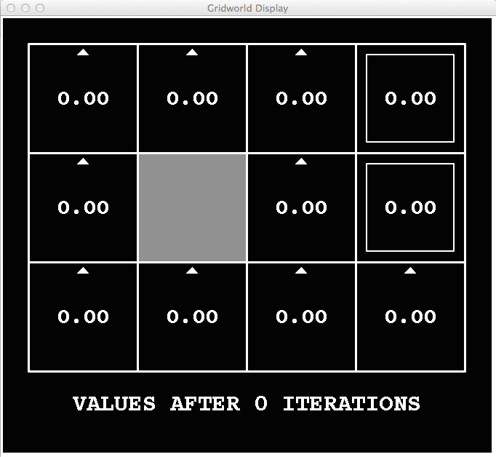
k=0
Noise = 0.2
Discount = 0.9
Living reward = 0
Notes:
Assuming zero living reward

Slide 15
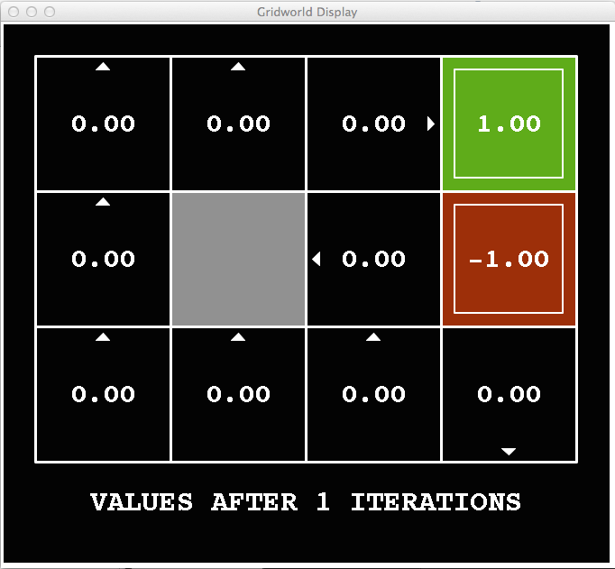
k=1
Noise = 0.2
Discount = 0.9
Living reward = 0
Notes:
Assuming zero living reward
Next: .8*.9=.72

Slide 16
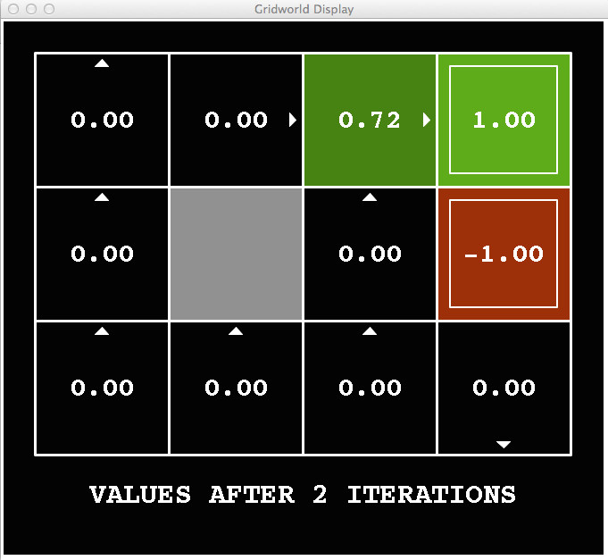
k=2
Noise = 0.2
Discount = 0.9
Living reward = 0
Notes:
Assuming zero living reward

Slide 17
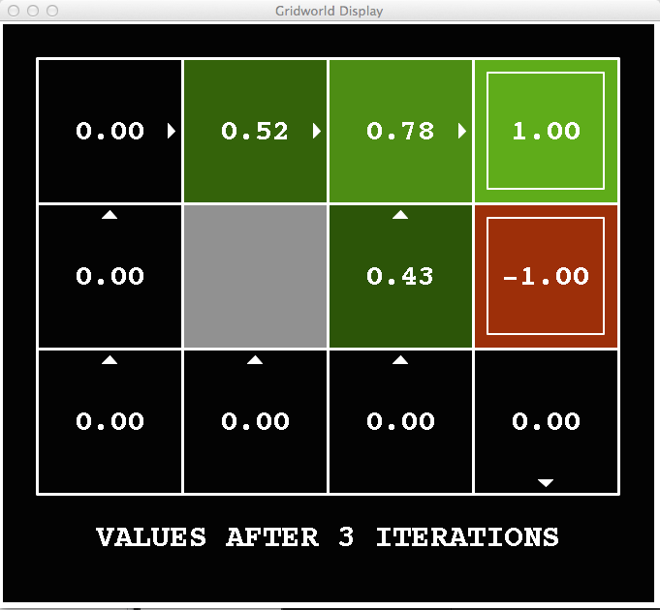
k=3
Noise = 0.2
Discount = 0.9
Living reward = 0
Notes:
Assuming zero living reward
Just went up – because you can try to get back now if you get carried out by the noise

Slide 18
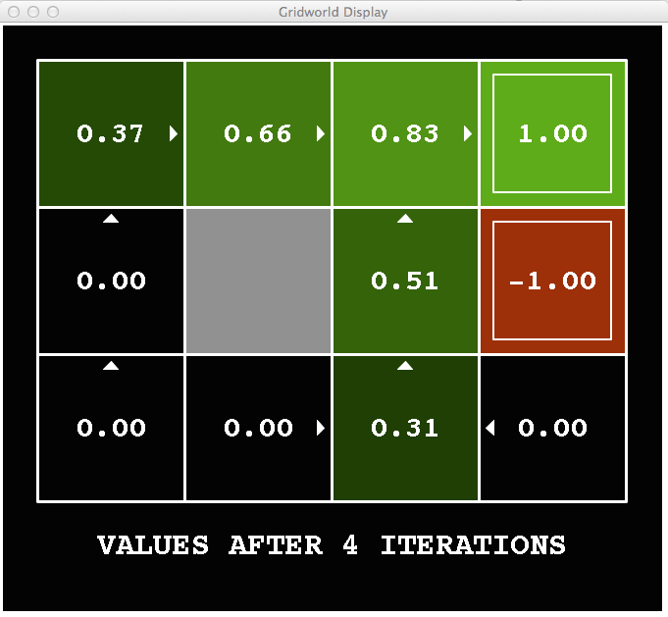
k=4
Noise = 0.2
Discount = 0.9
Living reward = 0
Notes:
Assuming zero living reward

Slide 19
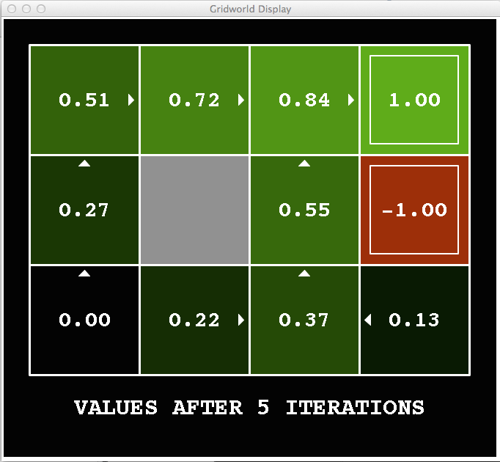
k=5
Noise = 0.2
Discount = 0.9
Living reward = 0
Notes:
Assuming zero living reward

Slide 20
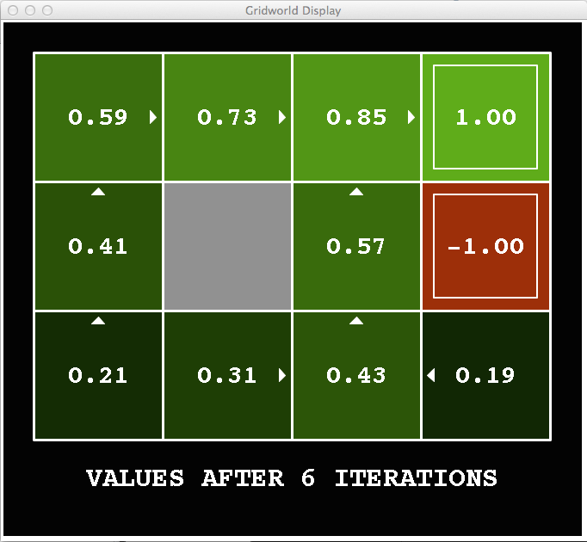
k=6
Noise = 0.2
Discount = 0.9
Living reward = 0
Notes:
Assuming zero living reward

Slide 21
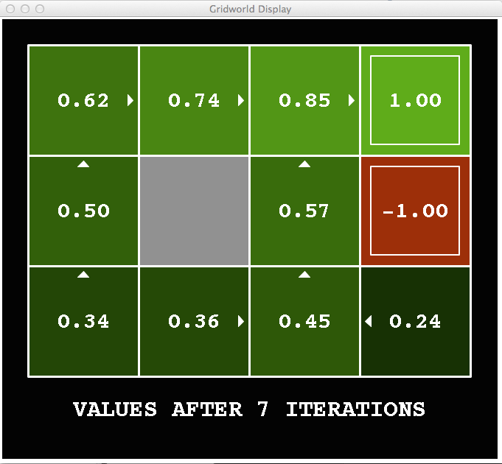
k=7
Noise = 0.2
Discount = 0.9
Living reward = 0
Notes:
Assuming zero living reward

Slide 22
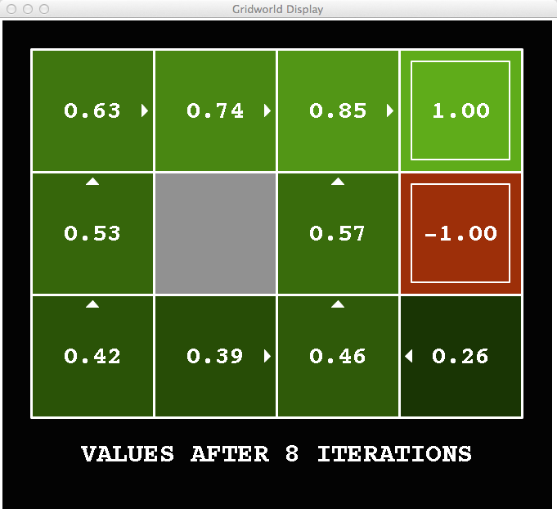
k=8
Noise = 0.2
Discount = 0.9
Living reward = 0
Notes:
Assuming zero living reward

Slide 23
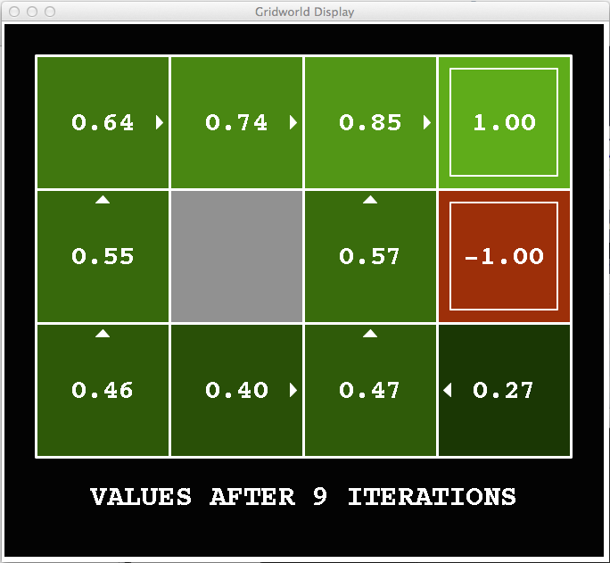
k=9
Noise = 0.2
Discount = 0.9
Living reward = 0
Notes:
Assuming zero living reward

Slide 24

k=10
Noise = 0.2
Discount = 0.9
Living reward = 0
Notes:
Assuming zero living reward

Slide 25

k=11
Noise = 0.2
Discount = 0.9
Living reward = 0
Notes:
Assuming zero living reward

Slide 26
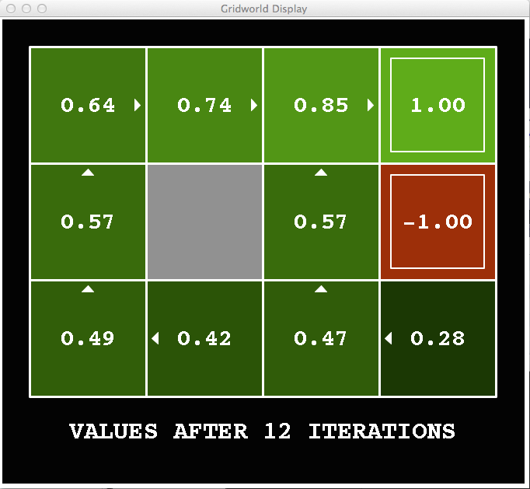
k=12
Noise = 0.2
Discount = 0.9
Living reward = 0
Notes:
Assuming zero living reward

Slide 27

k=100
Noise = 0.2
Discount = 0.9
Living reward = 0
Notes:
Assuming zero living reward

Slide 28
How do we know it will converge?*
New concept: contraction
If some operator F is a contraction by a factor, it brings any pair of objects closer to each other (according to some metric d( , ))
For any x, y d(Fx,Fy) ≤ c d(x,y) where c <1
If F is a contraction it has a unique fixed point z (i.e., Fz=z)
Proof: Suppose it had two fixed points z and z’
Then d(Fz,Fz’) = d(z,z’) violating the contraction property
Reminder: Value iteration is just U _{k+1} ← BU_{k}
The Bellman update B is a contraction by γ
Metric is the max norm: || V – W|| = max_{s} |V(s) – W(s)|
Proof: follows from definition of B, i.e., Bellman equation
E.g., Fx = x/2

