Slide 1
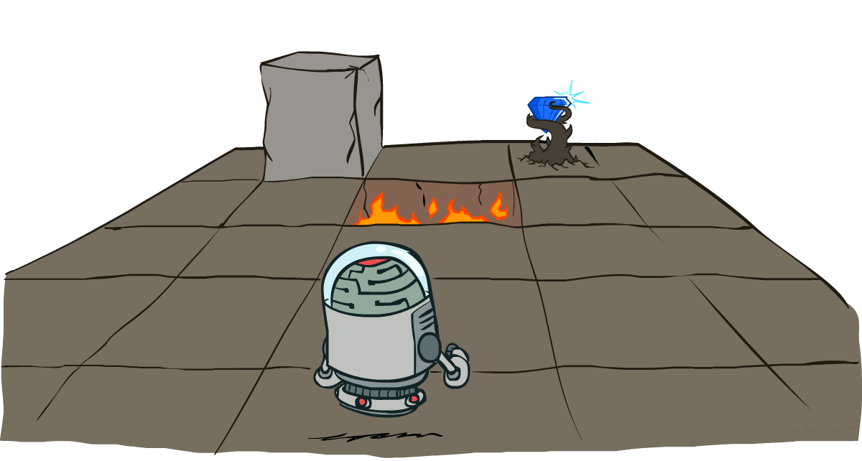
CS 188: Artificial Intelligence
MDP II: Value/Policy Iteration
Instructor: Stuart Russell and Dawn Song
University of California, Berkeley
Notes:
Please retain proper attribution and the reference to ai.berkeley.edu. Thanks!

Slide 2

Recap: Optimal Quantities
The value (expected utility) of π in s₀ is written U^{π}(s₀)
It’s the sum over all possible state sequences of (discounted sum of rewards) x (probability of state sequence)
U^{π}(s₀) =
The optimal policy:
π*(s) = optimal action from state s
Gives highest U^{π}(s) for any π
The value (utility) of a state s:
U*(s) = U^{π*}(s) = expected utility starting in s and acting optimally
The value (utility) of a q-state (s,a):
Q*(s,a) = expected utility of taking action a in state s and (thereafter) acting optimally
U*(s) = max_{a}Q*(s,a)

Slide 3


Recap: Bellman equations (Shapley, 1953)
The value/utility of a state is
The expected reward for the next transition plus the discounted value/utility of the next state, assuming the agent chooses the optimal action
Hence we have a recursive definition of value (Bellman equation):
Similarly, Bellman equation for Q-functions
U(s) =

Slide 4
Recap: Value Iteration
Start with (say) U₀(s) = 0 and some termination parameter ε
Repeat until convergence (i.e., until all updates smaller than ε )
Do a Bellman update (essentially one ply of expectimax) from each state:
U_{k+1}(s) ← max_{a} ∑_{s’} P(s’ | a,s) [R(s,a,s’) + γU_{k}(s’) ]
Theorem: will converge to unique optimal values
U ← BU
s
a
s,a
s,a,s’
s’
Notes:
Discuss computational complexity: S * A * S times number of iterations
Note: updates not in place [if in place, it means something else and not even clear what it means]

Slide 5
How do we know it will converge?*
New concept: contraction
If some operator F is a contraction by a factor, it brings any pair of objects closer to each other (according to some metric d( , ))
For any x, y d(Fx,Fy) ≤ c d(x,y) where c <1
If F is a contraction it has a unique fixed point z (i.e., Fz=z)
Reminder: Value iteration is just U _{k+1} ← BU_{k}
The Bellman update B is a contraction by γ
Metric is the max norm: || V – W|| = max_{s} |V(s) – W(s)|
Proof: follows from definition of B, i.e., Bellman equation
What’s the fixed point for B?
BU* = U*
E.g., Fx = x/2

Slide 6
How fast does VI converge?
Look at what happens to the distance between U _{k} and U *
|| U_{k+1} – U*|| ? || U_{k} – U*||

Slide 7
How fast does VI converge?
Look at what happens to the distance between U _{k} and U *
|| U_{k+1} – U*||
= || BU_{k} – U*|| (definition of U_{k+1} from VI update)
= || BU_{k} – BU*|| (U* is the fixed point of B)
≤ γ|| U_{k} – U*|| (B is a contraction by γ)
I.e., the error is reduced by at least a factor γ on every iteration
Exponentially fast convergence!
E.g., if γ=0.9, 22 iterations reduces error by 10
44 iterations reduces error by 100
220 iterations reduces error by 10¹⁰

Slide 8
How do we know the answer is (nearly) right?
VI doesn’t usually converge exactly; stops when change < ε(1-γ)/γ
I.e., || U_{k+1} – U_{k}|| < ε(1-γ)/γ
What about || U_{k+1} – U*|| when || U_{k+1} – U_{k}|| < ε(1-γ)/γ?
We need some connection between || U_{k+1} – U_{k}|| and || U_{k+1} – U*||
Useful properties:
|| U_{k+1} – U*|| ≤ γ|| U_{k} – U*||
Triangle inequality!
|| U_{k} – U*|| ≤ || U_{k+1} – U_{k}|| + || U_{k+1} – U*||

Slide 9
How do we know the answer is (nearly) right?
VI doesn’t usually converge exactly; stops when change < ε(1-γ)/γ
I.e., || U_{k+1} – U_{k}|| < ε(1-γ)/γ
What about || U_{k+1} – U*|| when || U_{k+1} – U_{k}|| < ε(1-γ)/γ ?
We need some connection between || U_{k+1} – U_{k}|| and || U_{k+1} – U*||
Triangle inequality!
|| U_{k} – U*|| ≤ || U_{k+1} – U_{k}|| + || U_{k+1} – U*||
1/γ || U_{k+1} – U*|| ≤ || U_{k+1} – U_{k}|| + || U_{k+1} – U*||
(1/γ - 1) || U_{k+1} – U*|| ≤ || U_{k+1} – U_{k}||
(1/γ - 1) || U_{k+1} – U*|| < ε(1-γ)/γ
|| U_{k+1} – U*|| < ε
I.e., when we stop, the max-norm error in U_{k+1} is less than ε
B is a contraction by γ
Assume we have stopped

Slide 10
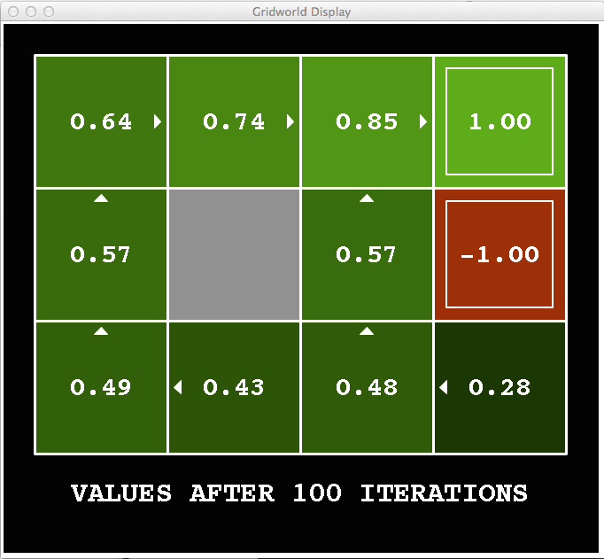
Wait! The agent needs a policy, not a value function!
How should the agent act given U (s)?
Maximize expected utility! (as if U is correct)
I.e., do a mini-expectimax (greedy one-step):
π_{U}(s) = argmax_{a} ∑_{s’} P(s’ | a,s) [R(s,a,s’) + γU(s’) ]
This is called policy extraction, since it finds the policy π_{U} implied by the values U

Slide 11
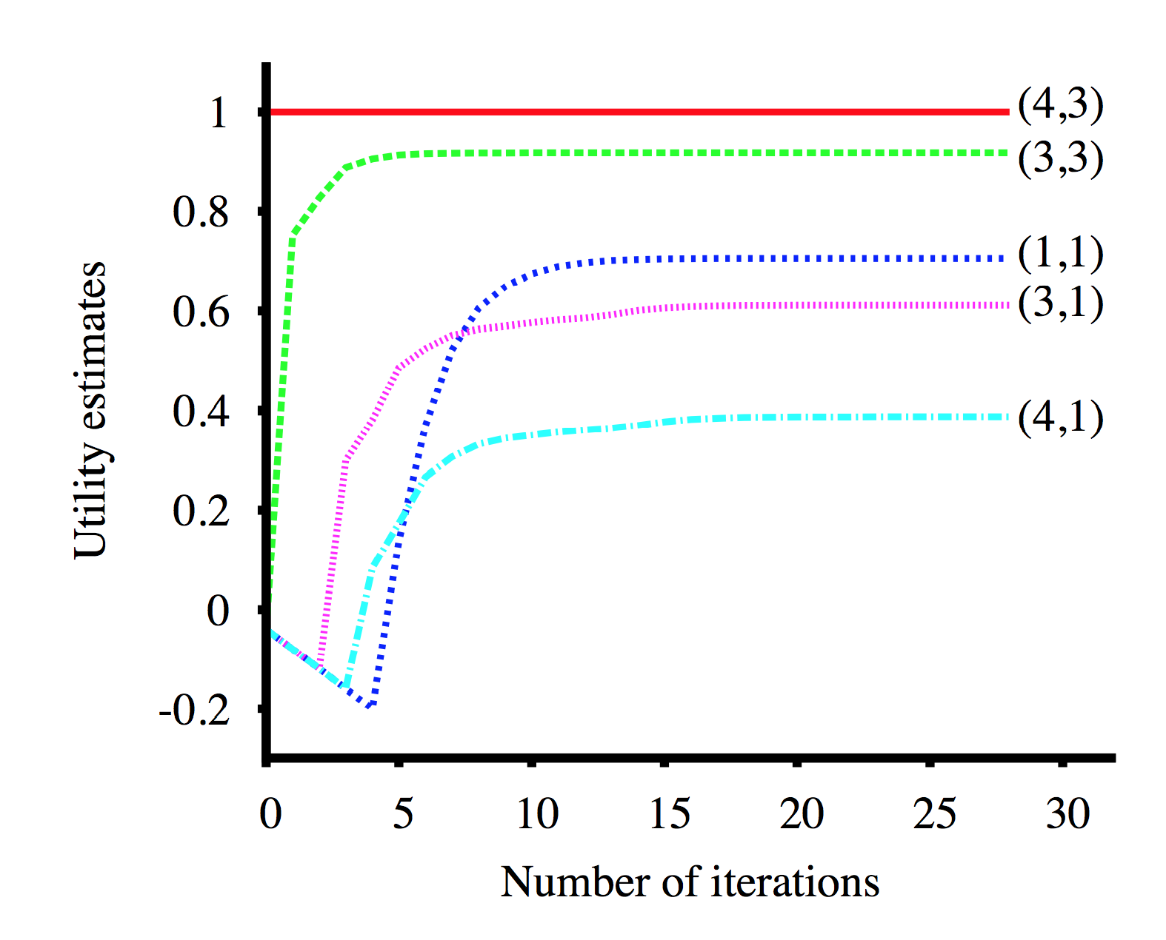
How good is the policy extracted from VI?
The quality of a policy π is measured by the policy loss || U^{π} – U*||
Let π_{k} = π_{Uk}i.e. the implied policy at step k; in case you were worried:
When || U_{k} – U*|| ≤ ε, policy loss is bounded: || U^{πk} – U*|| ≤ 2εγ/(1-γ)
Let’s measure the policy loss of π_{k} as we run VI:

Slide 12
Problems with Value Iteration
Value iteration repeats the Bellman updates:
U_{k+1}(s) ← max_{a} ∑_{s’} P(s’ | a,s) [R(s,a,s’) + γU_{k}(s’) ]
Problem 1: It’s slow – O(S²A) per iteration
Problem 2: The “max” at each state rarely changes
Problem 3: The policy often converges long before the values
s
a
s, a
s,a,s’
s’
Notes:
Demo steps through value iteration; snapshots of values shown on next slides.

Slide 13

Policy Iteration

Slide 14

k=12
Noise = 0.2
Discount = 0.9
Living reward = 0
Notes:
Assuming zero living reward

Slide 15
k=100
Noise = 0.2
Discount = 0.9
Living reward = 0
Notes:
Assuming zero living reward

Slide 16
Policy Iteration
Basic idea: make the implied policy in U explicit, compute its long-term implications for value
Repeat until no change in policy:
Step 1: Policy evaluation: calculate value U^{πk} for current policy π_{k}
Step 2: Policy improvement: extract the new implied policy π_{k+1} from U^{πk}
It’s still optimal!
Can converge (much) faster under some conditions

Slide 17

Policy Evaluation

Slide 18
Fixed Policies
Do the optimal action
Do what π says to do
s
s
a
π(s)
s, a
s, π(s)
s,a,s’
s, π(s),s’
s’
s’
Expectimax trees max over all actions to compute the optimal values
If we fixed some policy π(s), then the tree would be simpler – only one action per state
… though the tree’s value would depend on which policy we fixed

Slide 19

Utilities for a Fixed Policy
Another basic operation: compute the utility of a state s under a fixed (generally non-optimal) policy
Define the utility of a state s, under a fixed policy π:
U^{π}(s) = expected total discounted rewards starting in s and following π
Recursive relation (one-step look-ahead / Bellman equation):
s
π(s)
s, π(s)
s, π(s),s’
s’

Slide 20

Policy Evaluation
s
How do we calculate the U’s for a fixed policy π?
Idea 1: Turn recursive Bellman equations into updates
(like value iteration)
U₀^{π}(s) = 0
Efficiency: O(S²) per iteration
Idea 2: Without the maxes, the Bellman equations are just a linear system
Solve with Matlab (or your favorite linear system solver)
π(s)
s, π(s)
s, π(s),s’
s’

Slide 21

Policy Iteration

Slide 22
Policy Iteration
Evaluation: For fixed current policy π, find values with policy evaluation:
Iterate until values converge:
Improvement: For fixed values, get a better policy using policy extraction
One-step look-ahead:
P
s’ | s,a
U

Slide 23
Comparison
Both value iteration and policy iteration compute the same thing (all optimal values)
In value iteration:
Every iteration updates both the values and (implicitly) the policy
We don’t track the policy, but taking the max over actions implicitly recomputes it
In policy iteration:
We do several passes that update utilities with fixed policy (each pass is fast because we consider only one action, not all of them)
Policy evaluation reveals long-term effects of policy, unlike local value updates
After the policy is evaluated (looking at those long-term effects), a new policy is chosen (slow like a value iteration pass)
The new policy will be better (or we’re done)
Both are dynamic programs for solving MDPs
In fact, any fair sequence of value and/or policy updates on any states will converge to an optimal solution!

Slide 24
Summary: MDP Algorithms
So you want to….
Compute optimal values: use value iteration or policy iteration
Compute values for a particular policy: use policy evaluation
Turn your values into a policy: use policy extraction (one-step lookahead)
These all look the same!
They basically are – they are all variations of Bellman updates
They all use one-step lookahead expectimax fragments
They differ only in whether we plug in a fixed policy or max over actions

Slide 25

The Bellman Equations
How to be optimal:
Step 1: Take correct first action
Step 2: Keep being optimal

