Slide 1


CS 188: Artificial Intelligence
Learning III: Linear regression & Perceptron
Instructors: Stuart Russell and Dawn Song
University of California, Berkeley
Notes:
Please retain proper attribution, including the reference to ai.berkeley.edu. Thanks!

Slide 2
Recap: Decision Tree
Iterative process, select the most distinguishing/informative attribute to split on next
Entropy: measure uncertainty in a probability distribution ⟨p₁,…,p_{n}⟩ H(⟨p₁,…,p_{n}⟩) = _____________
Quiz: Higher entropy means _____ uncertainty. A. more B. less

Slide 3
Recap: Decision Tree
Iterative process, select the most distinguishing/informative attribute to split on next
Entropy: measure uncertainty in a probability distribution ⟨p₁,…,p_{n}⟩ H(⟨p₁,…,p_{n}⟩) = Σ_{i} –p_{i} log p_{i}
Information gain:
reduction on entropy with additional information
Learning decision tree:
Iterative process, selecting the attribute with the highest information gain to split on

Slide 4
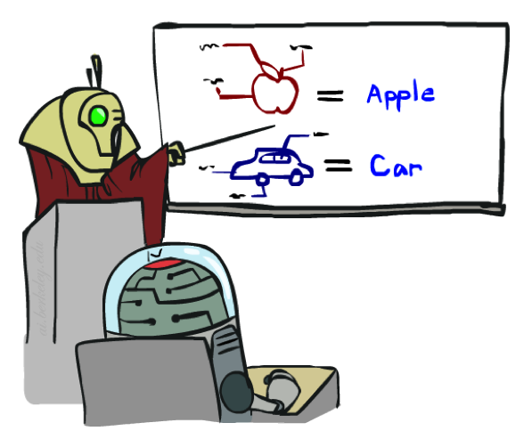


Recap: Model Selection & Hyperparameter Tuning
Data: labeled instances, e.g. emails marked spam/ham
Training set
Held out set
Test set
Features: attribute-value pairs which characterize each x
Experimentation cycle
Learn parameters (e.g. model probabilities) on training set
(Tune hyperparameters on held-out set)
Compute accuracy of test set
Very important: never “peek” at the test set!
Evaluation
Accuracy: fraction of instances predicted correctly
Overfitting and generalization
Want a classifier which does well on test data
Overfitting: fitting the training data very closely, but not generalizing well
Underfitting: fits the training set poorly
Training
Data
Held-Out
Data
(Validation set)
Test
Data

Slide 5
Supervised Learning
Classification = learning f with discrete output value
Regression = learning f with real-valued output value

Slide 6
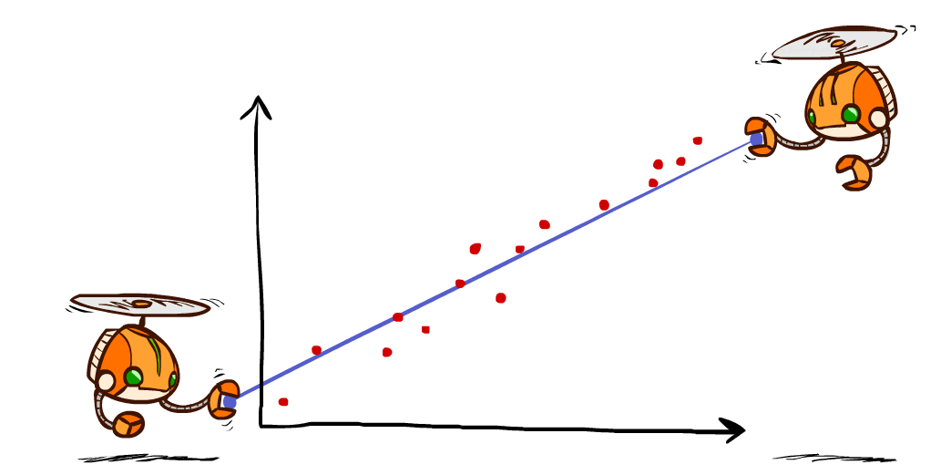
Linear Regression
Hypothesis family: Linear functions

Slide 7
Linear Regression
(x, y=f(x)), x: house size, y: house price
Berkeley house prices, 2009

Slide 8
Linear regression = fitting a straight line/hyperplane
40
h_{w}(x)
20
0
0
x
20
Prediction: h_{w}(x) = w₀ + w₁x
Berkeley house prices, 2009
Notes:
Figure 1: scatter(1:20,10+(1:20)+2*randn(1,20),'k','filled'); a=axis; a(3)=0; axis(a);

Slide 9
Prediction error
Error on one instance: y – h_{w}(x)
Error or “residual”
Observation y
Prediction h_{w}(x)
0
x
0
20
Notes:
Figure 1: scatter(1:20,10+(1:20)+2*randn(1,20),'k','filled'); a=axis; a(3)=0; axis(a);

Slide 10
Find w
Define loss function
Find w* to minimize loss function

Slide 11
Least squares: Minimizing squared error
L2 loss function: sum of squared errors over all examples
Loss = ____________________________
We want the weights w* that minimize loss
At w* the derivatives of loss w.r.t. each weight are zero:
∂Loss/∂w₀ = __________________________
∂Loss/∂w₁ = __________________________
Exact solutions for N examples:
w₁ = [NΣ_{j} x_{j}y_{j} – (Σ_{j} x_{j})(Σ_{j} y_{j})]/[NΣ_{j} x_{j}² – (Σ_{j} x_{j})²] and w₀ = 1/N [Σ_{j} y_{j} – w₁Σ_{j} x_{j}]
For the general case where x is an n-dimensional vector
X is the data matrix (all the data, one example per row); y is the column of labels
w* = (X^{T}X)⁻¹X^{T}y

Slide 12
Least squares: Minimizing squared error
L2 loss function: sum of squared errors over all examples
Loss = Σ_{j} (y_{j} – h_{w}(x_{j}))² = Σ_{j} (y_{j} – (w₀ + w₁x_{j}))²
We want the weights w* that minimize loss
At w* the derivatives of loss w.r.t. each weight are zero:
∂Loss/∂w₀ = – 2 Σ_{j} (y_{j} – (w₀ + w₁x_{j})) = 0
∂Loss/∂w₁ = – 2 Σ_{j} (y_{j} – (w₀ + w₁x_{j})) x_{j} = 0
Exact solutions for N examples:
w₁ = [NΣ_{j} x_{j}y_{j} – (Σ_{j} x_{j})(Σ_{j} y_{j})]/[NΣ_{j} x_{j}² – (Σ_{j} x_{j})²] and w₀ = 1/N [Σ_{j} y_{j} – w₁Σ_{j} x_{j}]
For the general case where x is an n-dimensional vector
X is the data matrix (all the data, one example per row); y is the column of labels
w* = (X^{T}X)⁻¹X^{T}y

Slide 13

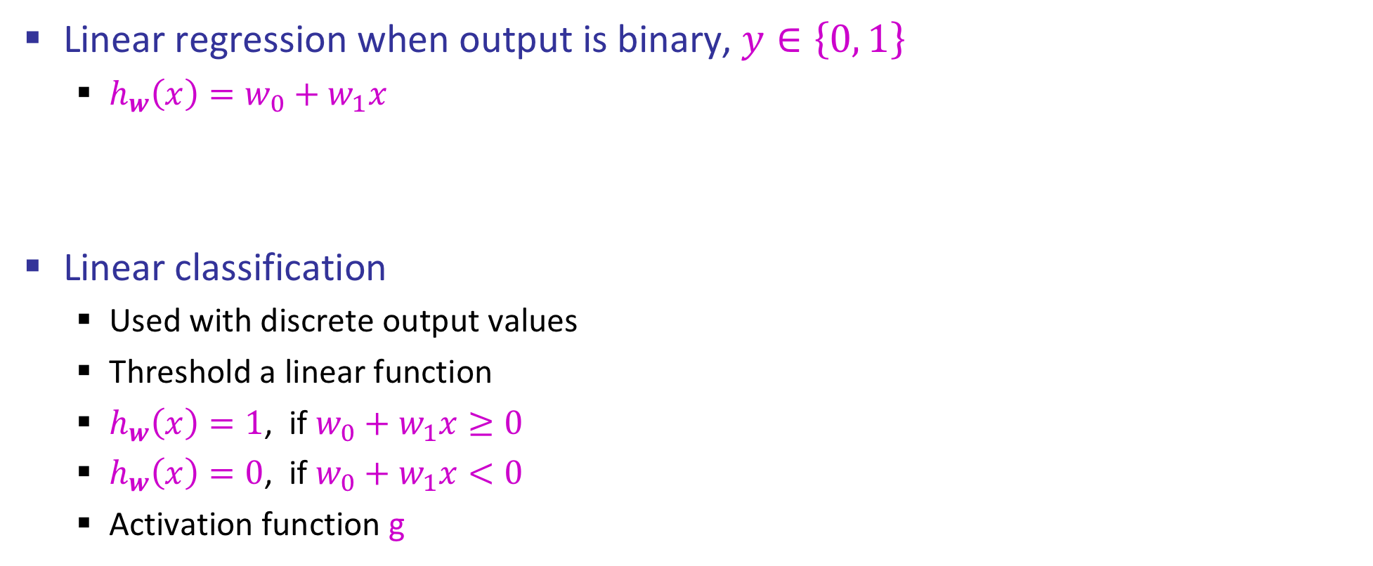

Regression vs Classification
Linear regression when output is binary, $y∈\left\{0, 1\right\}$
$h_{w}\left(x\right)=w_{0}+w_{1}x$
Linear classification
Used with discrete output values
Threshold a linear function
$h_{w}\left(x\right)=1$, if $w_{0}+w_{1}x≥0$
$h_{w}\left(x\right)=0$, if $w_{0}+w_{1}x<0$
Activation function g
y
$$w_{0}+w_{1}x$$
1
x
y
$$w_{0}+w_{1}x$$
$$g\left(w_{0}+w_{1}x \right)$$
1
x

Slide 14
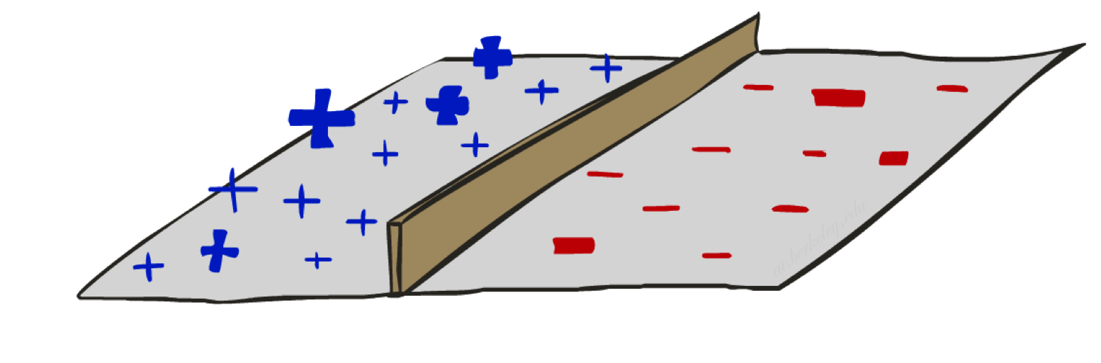
Threshold perceptron as linear classifier

Slide 15
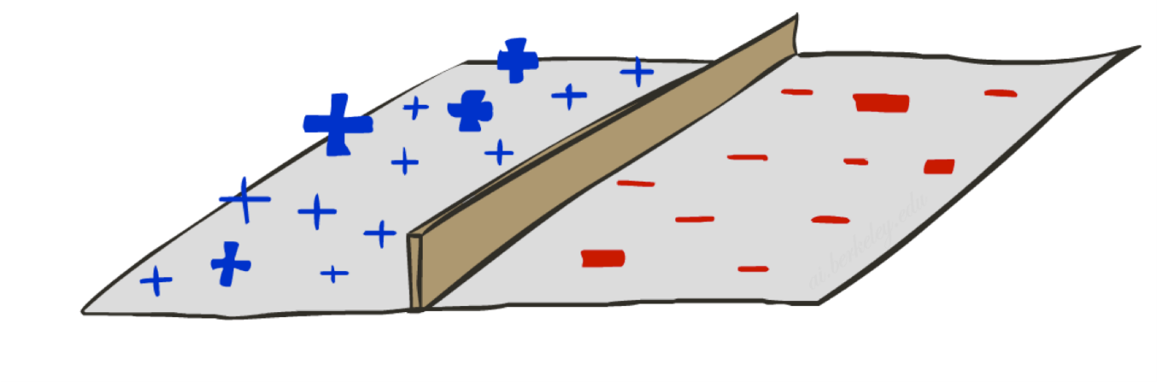
Binary Decision Rule
A threshold perceptron is a single unit that outputs
y = h_{w}(x) = 1 when w.x ≥ 0
= 0 when w.x < 0
In the input vector space
Examples are points x
The equation w.x=0 defines a hyperplane
One side corresponds to y=1
Other corresponds to y=0
money
w₀ : -3
w_{free} : 4
w_{money} : 2
2
y=1 (SPAM)
1
w.x=0
0
y=0 (HAM)
0
1
free

Slide 16
Example
Dear Stuart, I’m leaving Macrosoft
to return to academia. The money is
is great here but I prefer to be free
to do my own research; and I really
love teaching undergrads!
Do I need to finish
my BA first before applying?
Best wishes
Bill
money
w₀ : -3
w_{free} : 4
w_{money} : 2
2
y=1 (SPAM)
1
w.x=0
x₀ : 1
x_{free} : 1
x_{money} : 1
0
y=0 (HAM)
0
1
free
w.x = -3x1 + 4x1 + 2x1 = 3

Slide 17

Weight Updates
Need a different solution than before given the characteristic of perceptron

Slide 18
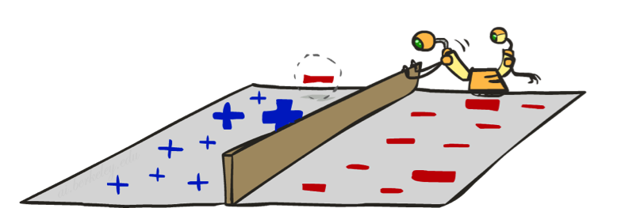
Perceptron learning rule
If true y ≠ h_{w}(x) (an error), adjust the weights
If w.x < 0 but the output should be y=1
This is called a false negative
Should increase weights on positive inputs
Should decrease weights on negative inputs
If w.x > 0 but the output should be y=0
This is called a false positive
Should decrease weights on positive inputs
Should increase weights on negative inputs
The perceptron learning rule does this:
w ← w + α (y – h_{w}(x)) x
learning rate
+1, -1, or 0 (no error)
Notes:
http://isl.ira.uka.de/neuralNetCourse/2004/VL_11_5/Perceptron.html

Slide 19
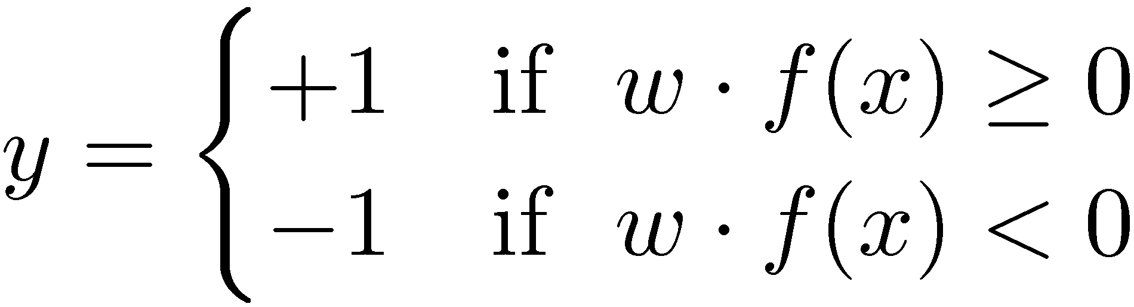

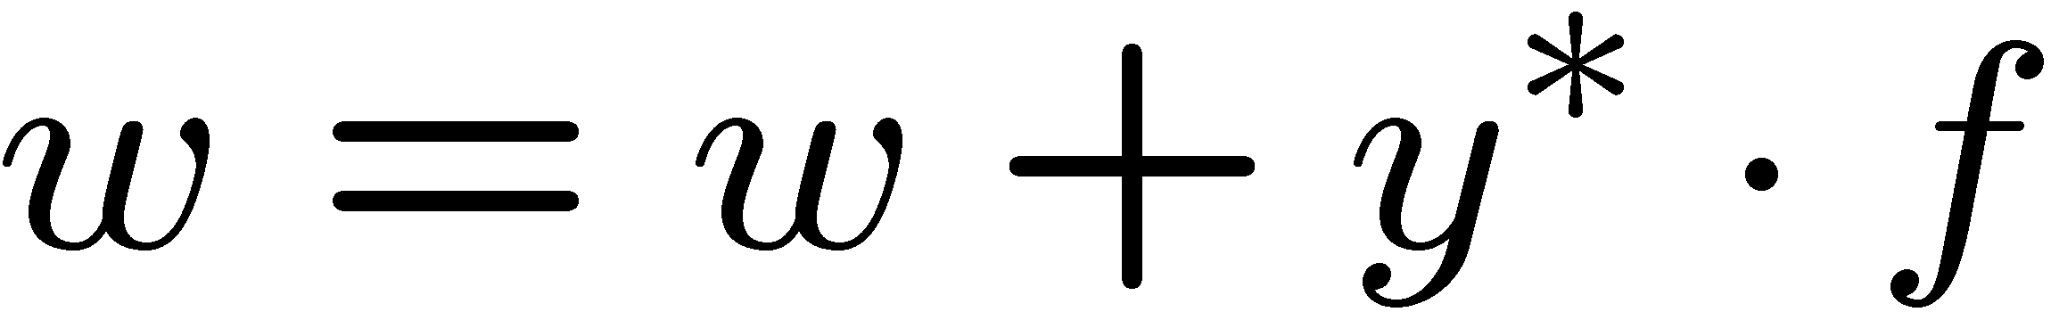
Perceptron Learning Rule (Different setup)
Start with weights = 0
For each training instance:
Classify with current weights
If wrong: adjust the weight vector by adding or subtracting the feature vector. Subtract if y is -1.
y = h_{w}(x) = 1 when w.x ≥ 0
= -1 when w.x < 0
y.x
x
x
Notes:
http://isl.ira.uka.de/neuralNetCourse/2004/VL_11_5/Perceptron.html

Slide 20
Example
Dear Stuart, I wanted to let you know
that I have decided to leave Macrosoft
and return to academia. The money is
is great here but I prefer to be free
to pursue more interesting research
and I really love teaching
undergraduates! Do I need to finish
my BA first before applying?
Best wishes
Bill
money
w₀ : -3
w_{free} : 4
w_{money} : 2
2
y=1 (SPAM)
1
w.x=0
x₀ : 1
x_{free} : 1
x_{money} : 1
0
y=0 (HAM)
0
1
free
w.x = -3x1 + 4x1 + 2x1 = 3
w ← w + α (y – h_{w}(x)) x
α = 0.5
w ← (-3,4,2) + 0.5 (0 – 1) (1,1,1)
= (-3.5,3.5,1.5)

Slide 21
Perceptron convergence theorem
Separable
A learning problem is linearly separable iff there is some hyperplane exactly separating positive from negative examples
Convergence: if the training data are separable, perceptron learning applied repeatedly to the training set will eventually converge to a perfect separator
Non-Separable

Slide 22

Example: Earthquakes vs nuclear explosions
63 examples, 657 updates required

Slide 23
Perceptron convergence theorem
Separable
A learning problem is linearly separable iff there is some hyperplane exactly separating +ve from –ve examples
Convergence: if the training data are separable, perceptron learning applied repeatedly to the training set will eventually converge to a perfect separator
Convergence: if the training data are non-separable, perceptron learning will converge to a minimum-error solution provided the learning rate α is decayed appropriately (e.g., α=1/t)
Non-Separable

Slide 24
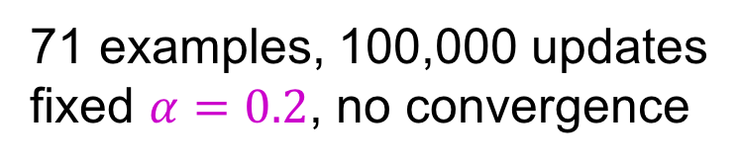
Perceptron learning with fixed α
71 examples, 100,000 updates
fixed $α=0.2$, no convergence

Slide 25
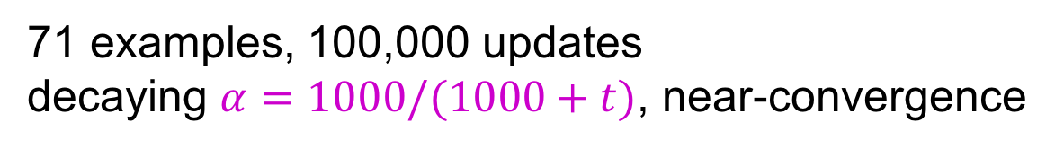
Perceptron learning with decaying α
71 examples, 100,000 updates
decaying $α=1000/(1000+t)$, near-convergence

Slide 26
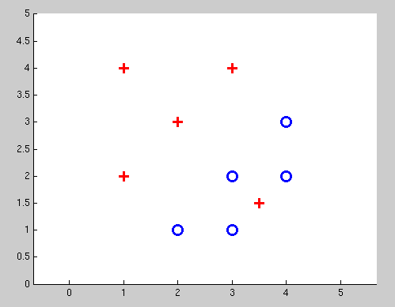
Non-Separable Case
Even the best linear boundary makes at least one mistake

Slide 27




Other Linear Classifiers
Perceptron is perfectly happy as long as it separates the training data
Logistic Regression
$$g_{sigmoid}\left(x\right)=\frac{1}{1+e^{−x}}$$
y
$$g_{Threshold}\left(w⋅x\right)$$
1
x
Support Vector Machines (SVM)
Maximize margin between boundary and nearest points
y
$$g_{sigmoid}\left(w⋅x\right)$$
1
x

Slide 28
Logistic Regression
Sigmoid function

