Slide 1


CS 188: Artificial Intelligence
Learning IV: Statistical learning & Naïve Bayes
Instructor: Stuart Russell and Dawn Song --- University of California, Berkeley
Notes:
Please retain proper attribution, including the reference to ai.berkeley.edu. Thanks!

Slide 2
Recap: Linear regression
40
h_{w}(x)
20
0
0
x
20
Prediction: h_{w}(x) = w₀ + w₁x
Berkeley house prices, 2009
Notes:
Figure 1: scatter(1:20,10+(1:20)+2*randn(1,20),'k','filled'); a=axis; a(3)=0; axis(a);

Slide 3
Recap: Linear Regression
What’s the loss function?
How to find w* to minimize loss function?

Slide 4
Recap: Linear Regression
L2 loss function: sum of squared errors over all examples
Loss = Σ_{j} (y_{j} – h_{w}(x_{j}))² = Σ_{j} (y_{j} – (w₀ + w₁x_{j}))²
Find w to minimize loss function (over N examples):
w₁ = [NΣ_{j} x_{j}y_{j} – (Σ_{j} x_{j})(Σ_{j} y_{j})]/[NΣ_{j} x_{j}² – (Σ_{j} x_{j})²] and w₀ = 1/N [Σ_{j} y_{j} – w₁Σ_{j} x_{j}]
For the general case where x is an n-dimensional vector
X is the data matrix (all the data, one example per row); y is the column of labels
w* = (X^{T}X)⁻¹X^{T}y

Slide 5
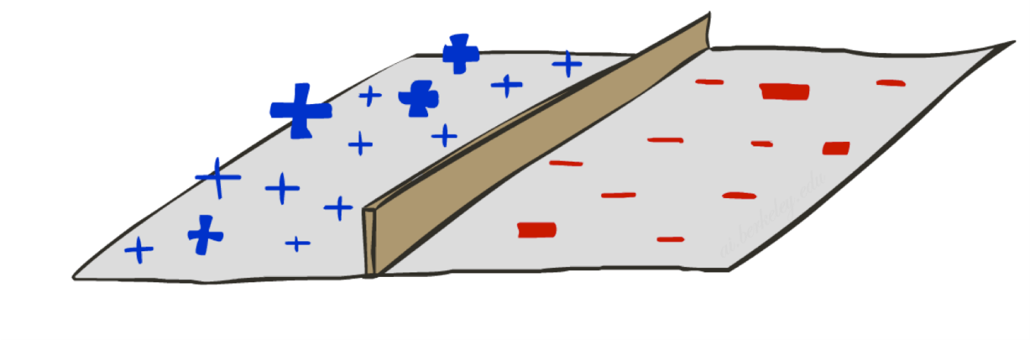
Recap: Perceptron
A threshold perceptron is a single unit that outputs
y = h_{w}(x) = 1 when w.x ≥ 0
= 0 when w.x < 0
In the input vector space
Examples are points x
The equation w.x=0 defines a hyperplane
One side corresponds to y=1
Other corresponds to y=0
Quiz:
What’s the direction for w?
money
w₀ : -3
w_{free} : 4
w_{money} : 2
2
y=1 (SPAM)
1
w.x=0
0
y=0 (HAM)
0
1
free

Slide 6
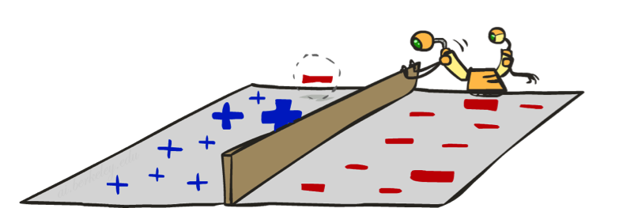
Recap: Perceptron learning rule
If true y ≠ h_{w}(x) (an error), adjust the weights
If w.x < 0 but the output should be y=1
This is called a false negative
Should increase weights on positive inputs
Should decrease weights on negative inputs
If w.x > 0 but the output should be y=0
This is called a false positive
Should decrease weights on positive inputs
Should increase weights on negative inputs
The perceptron learning rule:
w ← w + α (y – h_{w}(x)) x
Notes:
http://isl.ira.uka.de/neuralNetCourse/2004/VL_11_5/Perceptron.html

Slide 7
Perceptrons hopeless for XOR function

Slide 8
Basic questions
Which hypothesis space H to choose?
How to measure degree of fit?
How to trade off degree of fit vs. complexity?
“Ockham’s razor”
How do we find a good h?
How do we know if a good h will predict well?

Slide 9
Classical stats/ML: Minimize loss function
Which hypothesis space H to choose?
E.g., linear combinations of features: h_{w}(x) = w^{T}x
How to measure degree of fit?
Loss function, e.g., squared error Σ_{j} (y_{j} – w^{T}x)²
How to trade off degree of fit vs. complexity?
Regularization: complexity penalty, e.g., ||w||²
How do we find a good h?
Optimization (closed-form, numerical); discrete search
How do we know if a good h will predict well?
Try it and see (cross-validation, bootstrap, etc.)

Slide 10
Probabilistic: Max. likelihood, max. a priori
Which hypothesis space H to choose?
Probability model P(y | x,h) , e.g., Y ~ N(w^{T}x,σ²)
How to measure degree of fit?
Data likelihood Π_{j} P(y_{j} | x_{j},h)
How to trade off degree of fit vs. complexity?
Regularization or prior: argmax_{h} P(h) Π_{j} P(y_{j} | x_{j},h) (Max a Priori)
How do we find a good h?
Optimization (closed-form, numerical); discrete search
How do we know if a good h will predict well?
Empirical process theory (generalizes Chebyshev, CLT, PAC…);
Key assumption is (i)id

Slide 11
Bayesian: Computing posterior over H
Which hypothesis space H to choose?
All hypotheses with nonzero a priori probability
How to measure degree of fit?
Data probability, as for MLE/MAP
How to trade off degree of fit vs. complexity?
Use prior, as for MAP
How do we find a good h?
Don’t! Bayes predictor P(y|x,D) = Σ_{h} P(y|x,h) P(D|h) P(h)
How do we know if a good h will predict well?
Silly question! Bayesian prediction is optimal!!

Slide 12
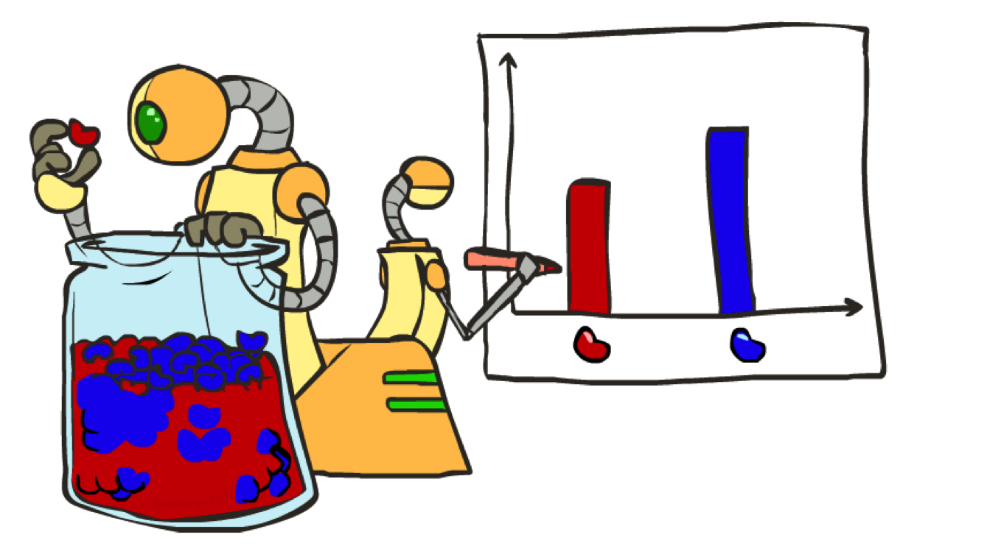
Parameter Estimation

Slide 13
Maximum Likelihood Parameter Estimation
Estimating the distribution of a random variable
E.g., here is a coin; what is the probability θ of heads?
Evidence x = x₁,…,x_{N}
E.g., three independent coin tosses X₁=heads, X₂=heads, X₃=tails
Likelihood: probability of the evidence P(x₁,…,x_{N} ; θ)
E.g., P(X₁=heads, X₂=heads, X₃=tails ; θ) = ___________
Maximum likelihood: What value θ_{ML} maximizes the likelihood?
Log likelihood: L(x; θ) = log P(x; θ)
E.g., L(x; θ) = _______________
θ_{ML} also maximizes the log likelihood and it’s easier to differentiate
∂L/∂θ = _____________
θ_{ML} = _______
For h heads and t tails, θ_{ML} = __________
This is the estimate that maximizes the likelihood of the data
H
H
T

Slide 14
Maximum Likelihood Parameter Estimation
Estimating the distribution of a random variable
E.g., here is a coin; what is the probability θ of heads?
Evidence x = x₁,…,x_{N}
E.g., three independent coin tosses X₁=heads, X₂=heads, X₃=tails
Likelihood: probability of the evidence P(x₁,…,x_{N} ; θ)
E.g., P(X₁=heads, X₂=heads, X₃=tails ; θ) = θ²(1-θ)
Maximum likelihood: What value θ_{ML} maximizes the likelihood?
Log likelihood: L(x; θ) = log P(x; θ)
E.g., L(x; θ) = 2 logθ + log(1-θ)
θ_{ML} also maximizes the log likelihood and it’s easier to differentiate
∂L/∂θ = 2/θ – 1/(1-θ) = 0
θ_{ML} = 2/3
For h heads and t tails, θ_{ML} = h/(h+t)
This is the estimate that maximizes the likelihood of the data
H
H
T

Slide 15


Unseen Events

Slide 16
Laplace Smoothing
Suppose we see three heads: is a θ_{ML} = 0 a reasonable estimate?
Laplace smoothing with strength α:
Pretend you saw every outcome α times before starting
θ_{Lap} = (h+α)/[(h+α) + (t+α)]
= (3+α)/(3+2α)
In general, for a K-valued variable:
θ_{k} = (N_{k}+α) / Σ_{k}(N_{k}+α) = (N_{k}+α) / (N + Kα)
For α>>N, θ_{k} tends to 1/K (uniform prior)
For α<<N, θ_{k} tends to N_{k} /N (ML estimate)
H
H
H

Slide 17

Probabilistic Classification

Slide 18
Example: Spam Filter
Input: an email
Output: spam/ham
Setup:
Get a large collection of example emails, each labeled “spam” or “ham”
Note: someone has to hand label all this data!
Want to learn to predict labels of new, future emails
Features: The attributes used to make the ham / spam decision
Words: FREE!
Text Patterns: $dd, CAPS
Non-text: SenderInContacts
…
Dear Sir.
First, I must solicit your confidence in this transaction, this is by virture of its nature as being utterly confidencial and top secret. …
TO BE REMOVED FROM FUTURE MAILINGS, SIMPLY REPLY TO THIS MESSAGE AND PUT "REMOVE" IN THE SUBJECT.
99 MILLION EMAIL ADDRESSES
FOR ONLY $99
Ok, Iknow this is blatantly OT but I'm beginning to go insane. Had an old Dell Dimension XPS sitting in the corner and decided to put it to use, I know it was working pre being stuck in the corner, but when I plugged it in, hit the power nothing happened.

Slide 19

Bayes net model for ham/spam
Class C of a document is spam or ham, with prior P(C)
Bag-of-words model: Each word W_{i} in the document is generated independently from a class-specific distribution P(W_{i} | C) over words
This is an example of a naïve Bayes model
C
P(C,W₁,…,W_{n}) = P(C) Π_{i} P(W_{i} | C)
W₁
W₂
W_{n}

Slide 20
Inference for Naïve Bayes
A Naïve Bayes model is a polytree, so solvable in linear time
To compute posterior distribution for class C given a document:
P(C | w₁,…,w_{n}) = α P(C,w₁,…,w_{n}) = α P(C) Π_{i} P(W_{i} | C)
I.e., multiply n+1 numbers, for each value of C, then normalize

Slide 21
Computing the class probabilities
 | P(w|spam) | P(w|ham) | Cum LogSpam | Cum LogHam
Word | 0.33333 | 0.66666 | -1.1 | -0.4
Stuart | 0.00002 | 0.00021 | -11.8 | -8.9
would | 0.00069 | 0.00084 | -19.1 | -16.0
you | 0.00881 | 0.00304 | -23.8 | -21.8
like | 0.00086 | 0.00083 | -30.9 | -28.9
to | 0.01517 | 0.01339 | -35.1 | -33.2
lose | 0.00008 | 0.00002 | -44.5 | -44.0
weight | 0.00016 | 0.00002 | -53.3 | -55.0
while | 0.00027 | 0.00027 | -61.5 | -63.2
you | 0.00881 | 0.00304 | -66.2 | -69.0
sleep | 0.00006 | 0.00001 | -76.0 | -80.5
α[e^{-76.0},e^{-80.5}] = [0.989,0.011]
Notes:
Tot columns are natural logs; final odds ratio is e^4.5

Slide 22
Parameter learning for Naïve Bayes
We need to estimate the following parameters:
P(C) = [θ_{C},1-θ_{C}], the prior over classes
ML estimate: relative frequencies in training set
P(W_{i} | C), the distribution for each word position given the class
For the bag-of-words model, this is the same for all positions
Parameters are θ_{k|c} = P(W_{i}=k | C=c) for each class c and each dictionary entry k
E.g., θ_{”you”|spam} = 0.00881 θ_{”you”|ham} = 0.00304
Estimated by measuring frequency of occurrence in ham and spam
Need Laplace smoothing! Many dictionary words may not appear in training set

