Slide 1
CS162 Operating Systems and Systems Programming Lecture 10 Scheduling 1: Concepts and Classic Policies

Slide 2
Goal for Today
if ( readyThreads(TCBs) ) {
nextTCB = selectThread(TCBs);
run( nextTCB );
} else {
run_idle_thread();
}
Discussion of Scheduling:
Which thread should run on the CPU next?
Scheduling goals, policies
Look at a number of different schedulers

Slide 3
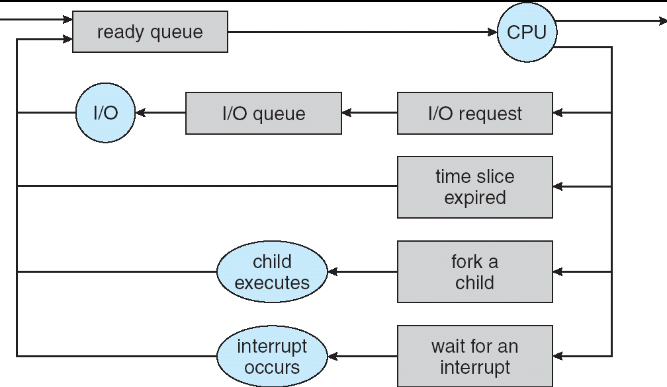
Recall: Scheduling
Question: How is the OS to decide which of several tasks to take off a queue?
Scheduling: deciding which threads are given access to resources from moment to moment
Often, we think in terms of CPU time, but could also think about access to resources like network BW or disk access

Slide 4
Scheduling: All About Queues

Slide 5
Scheduling Assumptions
Many implicit assumptions for CPU scheduling:
One program per user
One thread per program
Programs are independent
Clearly, these are unrealistic but they simplify the problem so it can be solved
For instance: is “fair” about fairness among users or programs?
If I run one compilation job and you run five, you get five times as much CPU on many operating systems
The high-level goal: Dole out CPU time to optimize some desired parameters of system
USER1
USER2
USER3
USER1
USER2
Time

Slide 6
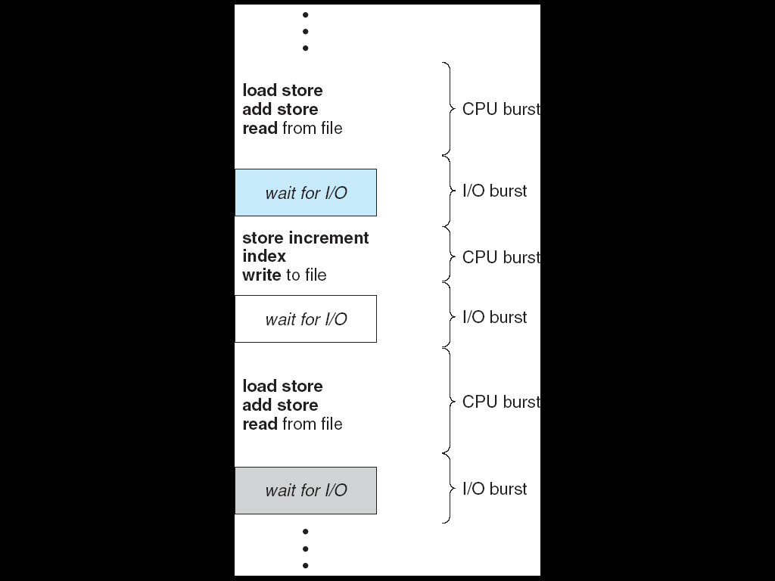
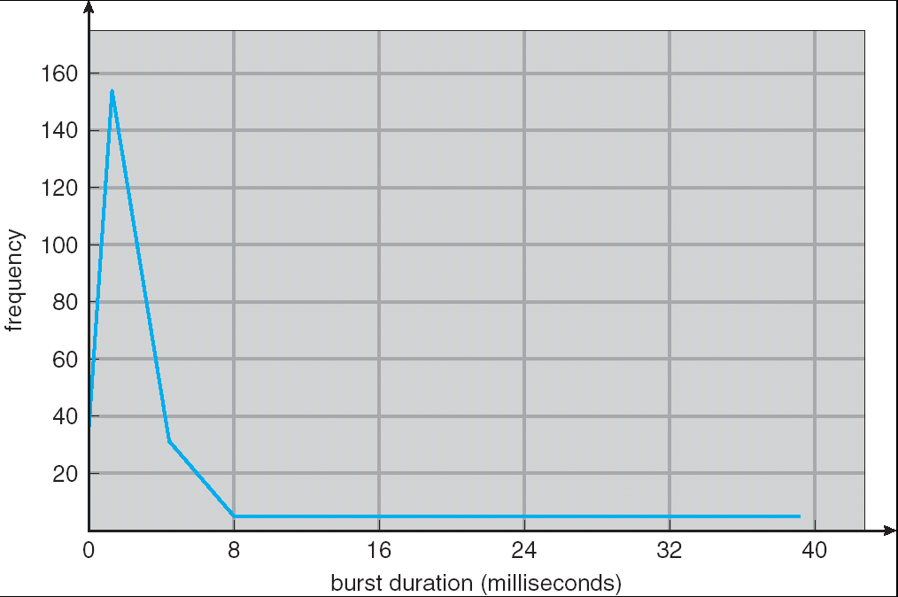
Assumption: CPU Bursts
Weighted toward small bursts
Execution model: programs alternate between bursts of CPU and I/O
Program typically uses the CPU for some period of time, then does I/O, then uses CPU again
Each scheduling decision is about which job to give to the CPU for use in next CPU burst
With timeslicing, thread may be forced to give up CPU before finishing current CPU burst

Slide 7
Scheduling Policy Goals/Criteria
Minimize Response Time
Minimize elapsed time to do an operation (or job)
Maximize Throughput
Maximize operations (or jobs) per second
Fairness
Share CPU among users in some equitable way

Slide 8
Scheduling Policy Goals/Criteria
Minimize Response Time
Minimize elapsed time to do an operation (or job)
Response time is what the user sees:
Time to echo a keystroke in editor
Time to compile a program
Real-time Tasks: Must meet deadlines imposed by World

Slide 9
Scheduling Policy Goals/Criteria
Maximize Throughput
Maximize operations (or jobs) per second
Throughput related to response time, but not identical:
Minimizing response time will lead to more context switching than if you only maximized throughput
Two parts to maximizing throughput
Minimize overhead (for example, context-switching)
Efficient use of resources (CPU, disk, memory, etc)

Slide 10
Scheduling Policy Goals/Criteria
Fairness
Share CPU among users in some equitable way
Fairness is not minimizing average response time:
Better average response time by making system less fair

Slide 11
Useful metrics
Waiting time for P: time before P got scheduled
Average waiting time: Average of all processes’ wait time.
Completion time (response time): Waiting time + Run time.
Average completion time (response time): Average of all processes' completion time

Slide 12
First-Come, First-Served (FCFS) Scheduling
First-Come, First-Served (FCFS)
Also “First In, First Out” (FIFO) or “Run until done”
In early systems, FCFS meant one program scheduled until done (including I/O)
Now, means keep CPU until thread blocks
Example: Process Burst Time P₁ 24 P₂ 3 P₃ 3
Suppose processes arrive in the order: P₁ , P₂ , P₃ The Gantt Chart for the schedule is:
Waiting time for P₁ = 0; P₂ = 24; P₃ = 27
Average waiting time: (0 + 24 + 27)/3 = 17
Average Completion time: (24 + 27 + 30)/3 = 27
Convoy effect: short process stuck behind long process
P₁
P₂
P₃
0
24
27
30

Slide 13
Convoy effect
Scheduled Task (process, thread)
time
Scheduling queue
Arrivals
With FCFS non-preemptive scheduling, convoys of small tasks tend to build up when a large one is running.

Slide 14
FCFS Scheduling (Cont.)
Example continued:
Suppose that processes arrive in order: P2 , P3 , P1 Now, the Gantt chart for the schedule is:
Waiting time for P1 = 6; P2 = 0; P3 = 3
Average waiting time: (6 + 0 + 3)/3 = 3
Average Completion time: (3 + 6 + 30)/3 = 13
In second case:
Average waiting time is much better (before it was 17)
Average completion time is better (before it was 27)
FIFO Pros and Cons:
Simple (+)
Short jobs get stuck behind long ones (-)
P₂
P₃
P₁
0
3
6
30

Slide 15
Round Robin (RR) Scheduling
FCFS Scheme: Potentially bad for short jobs!
Depends on submit order
If you are first in line at supermarket with milk, you don’t care who is behind you, on the other hand…
Round Robin Scheme: Preemption!
Each process gets a small unit of CPU time (time quantum), usually 10-100 milliseconds
After quantum expires, the process is preempted and added to the end of the ready queue.
n processes in ready queue and time quantum is q ⇒
Each process gets 1/n of the CPU time
In chunks of at most q time units
No process waits more than (n-1)q time units

Slide 16
The magic number
What should q be?
q large ⇒ FCFS
q small ⇒ Interleaved
q must be large with respect to context switch, otherwise overhead is too high (all overhead)

Slide 17
Example of RR with Time Quantum = 20
Example: Process Burst Time P₁ 53 P₂ 8 P₃ 68 P₄ 24
The Gantt chart is:
Waiting time for P₁= 0 + (68-20)+(112-88)=72 P₂=(20-0)=20 P₃=(28-0)+(88-48)+(125-108) + 0 =85 P₄=(48-0)+(108-68)=88
Average waiting time = (72+20+85+88)/4=66¼
Average completion time = (125+28+153+112)/4 = 104½
P₁
P₂
P₃
P₄
P₁
P₃
P₄
P₁
P₃
P₃
0
20
28
48
68
88
108
112
125
145
153

Slide 18
Decrease Response Time
T₁: Burst Length 10
T₂: Burst Length 1
Q = 10
Average Response Time = (10 + 11)/2 = 10.5
Q = 5
Average Response Time = (6 + 11)/2 = 8.5
T₁
T₂
0
10
11
T₁
T₂
T₁
0
5
6
11

Slide 19
Same Response Time
T₁: Burst Length 1
T₂: Burst Length 1
Q = 10
Average Response Time = (1 + 2)/2 = 1.5
Q = 1
Average Response Time = (1 + 2)/2 = 1.5
T₁
T₂
0
1
2
T₁
T₂
0
1
2

Slide 20
Increase Response Time
T₁: Burst Length 1
T₂: Burst Length 1
Q = 1
Average Response Time = (1 + 2)/2 = 1.5
Q = 0.5
Average Response Time = (1.5 + 2)/2 = 1.75
T₁
T₂
0
1
2
0
2

Slide 21
How to Implement RR in the Kernel?
FIFO Queue, as in FCFS
But preempt job after quantum expires, and send it to the back of the queue
How? Timer interrupt!
And, of course, careful synchronization
Project 2: Scheduling

Slide 22
Round-Robin Discussion
How do you choose time slice?
What if too big?
Response time suffers
What if time slice too small?
Throughput suffers!
Actual choices of timeslice:
Initially, UNIX timeslice one second:
Worked ok when UNIX was used by one or two people.
What if three compilations going on? 3 seconds to echo each keystroke!
Need to balance short-job performance and long-job throughput:
Typical time slice today is between 10ms – 100ms
Typical context-switching overhead is 0.1ms – 1ms
Roughly 1% overhead due to context-switching

Slide 23
Comparisons between FCFS and Round Robin
Assuming zero-cost context-switching time, is RR always better than FCFS?
Simple example: 10 jobs, each take 100s of CPU time RR scheduler quantum of 1s All jobs start at the same time
Completion Times:
Both RR and FCFS finish at the same time
Average response time is much worse under RR!
Bad when all jobs same length
Also: Cache state must be shared between all jobs with RR but can be devoted to each job with FIFO
Total time for RR longer even for zero-cost switch!
Job # | FIFO | RR
1 | 100 | 991
2 | 200 | 992
… | … | …
9 | 900 | 999
10 | 1000 | 1000

Slide 24
Earlier Example with Different Time Quantum
P₂
[8]
P₄
[24]
P₁
[53]
P₃
[68]
Best FCFS:
0
8
32
85
153
Quantum
P₁
P₂
P₃
P₄
Average
Wait
Time
Best FCFS
32
0
85
8
31¼
Q = 1
84
22
85
57
62
Q = 5
82
20
85
58
61¼
Q = 8
80
8
85
56
57¼
Q = 10
82
10
85
68
61¼
Q = 20
72
20
85
88
66¼
Worst FCFS
68
145
0
121
83½
Completion
Time
Best FCFS
85
8
153
32
69½
Q = 1
137
30
153
81
100½
Q = 5
135
28
153
82
99½
Q = 8
133
16
153
80
95½
Q = 10
135
18
153
92
99½
Q = 20
125
28
153
112
104½
Worst FCFS
121
153
68
145
121¾

Slide 25
Handling Differences in Importance: Strict Priority Scheduling
Priority 3
Job 1
Job 2
Job 3
Priority 2
Job 4
Priority 1
Priority 0
Job 5
Job 6
Job 7
Execution Plan
Always execute highest-priority runable jobs to completion
Each queue can be processed in RR with some time-quantum
Problems:
Starvation:
Lower priority jobs don’t get to run because higher priority jobs
Deadlock: Priority Inversion
Happens when low priority task has lock needed by high-priority task
Usually involves third, intermediate priority task preventing high-priority task from running
How to fix problems?
Dynamic priorities – adjust base-level priority up or down based on heuristics about interactivity, locking, burst behavior, etc…

Slide 26
Scheduling Fairness
What about fairness?
Strict fixed-priority scheduling between queues is unfair (run highest, then next, etc):
long running jobs may never get CPU
Urban legend: In Multics, shut down machine, found 10-year-old job ⇒ Ok, probably not…
Must give long-running jobs a fraction of the CPU even when there are shorter jobs to run
Tradeoff: fairness gained by hurting avg response time!

Slide 27
Scheduling Fairness
How to implement fairness?
Could give each queue some fraction of the CPU
What if one long-running job and 100 short-running ones?
Like express lanes in a supermarket—sometimes express lanes get so long, get better service by going into one of the other lines
Could increase priority of jobs that don’t get service
What is done in some variants of UNIX
This is ad hoc—what rate should you increase priorities?
And, as system gets overloaded, no job gets CPU time, so everyone increases in priority
⇒ Interactive jobs suffer

Slide 28
What if we Knew the Future?
Could we always mirror best FCFS?
Shortest Job First (SJF):
Run whatever job has least amount of computation to do
Sometimes called “Shortest Time to Completion First” (STCF)
Shortest Remaining Time First (SRTF):
Preemptive version of SJF: if job arrives and has a shorter time to completion than the remaining time on the current job, immediately preempt CPU
Sometimes called “Shortest Remaining Time to Completion First” (SRTCF)
These can be applied to whole program or current CPU burst
Idea is to get short jobs out of the system
Big effect on short jobs, only small effect on long ones
Result is better average response time

Slide 29
Discussion
SJF/SRTF are the best you can do at minimizing average response time
Provably optimal (SJF among non-preemptive, SRTF among preemptive)
Since SRTF is always at least as good as SJF, focus on SRTF
Comparison of SRTF with FCFS
What if all jobs the same length?
SRTF becomes the same as FCFS (i.e. FCFS is best can do if all jobs the same length)
What if jobs have varying length?
SRTF: short jobs not stuck behind long ones

Slide 30
Example to illustrate benefits of SRTF
A or B
C
C’s
I/O
C’s
I/O
C’s
I/O
Three jobs:
A, B: both CPU bound, run for week C: I/O bound, loop 1ms CPU, 9ms disk I/O
If only one at a time, C uses 90% of the disk, A or B could use 100% of the CPU
With FCFS:
Once A or B get in, keep CPU for two weeks
What about RR or SRTF?
Easier to see with a timeline

Slide 31
SRTF Example continued:
Disk Utilization:
9/201 ~ 4.5%
C
A
B
C
RR 100ms time slice
Disk Utilization:
~90% but lots of wakeups!
C’s
I/O
C’s
I/O
CABAB…
C
RR 1ms time slice
C’s
I/O
C’s
I/O
Disk Utilization:
90%
C
A
A
A
SRTF
C’s
I/O
C’s
I/O

Slide 32
SRTF Further discussion
Starvation
SRTF can lead to starvation if many small jobs!
Large jobs never get to run
Somehow need to predict future
How can we do this?
Some systems ask the user
When you submit a job, have to say how long it will take
To stop cheating, system kills job if takes too long
But: hard to predict job’s runtime even for non-malicious users
Bottom line, can’t really know how long job will take
However, can use SRTF as a yardstick for measuring other policies
Optimal, so can’t do any better
SRTF Pros & Cons
Optimal (average response time) (+)
Hard to predict future (-)
Unfair (-)

Slide 33
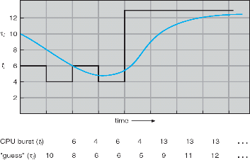
Predicting the Length of the Next CPU Burst
Adaptive: Changing policy based on past behavior
CPU scheduling, in virtual memory, in file systems, etc
Works because programs have predictable behavior
If program was I/O bound in past, likely in future
If computer behavior were random, wouldn’t help
Example: SRTF with estimated burst length
Use an estimator function on previous bursts: Let tn-1, tn-2, tn-3, etc. be previous CPU burst lengths. Estimate next burst τn = f(tn-1, tn-2, tn-3, …)
Function f could be one of many different time series estimation schemes (Kalman filters, etc)
For instance, exponential averaging τn = αtn-1+(1-α)τn-1 with (0<α≤1)

Slide 34
Lottery Scheduling
Yet another alternative: Lottery Scheduling
Give each job some number of lottery tickets
On each time slice, randomly pick a winning ticket
On average, CPU time is proportional to number of tickets given to each job
How to assign tickets?
To approximate SRTF, short running jobs get more, long running jobs get fewer
To avoid starvation, every job gets at least one ticket (everyone makes progress)
Advantage over strict priority scheduling: behaves gracefully as load changes
Adding or deleting a job affects all jobs proportionally, independent of how many tickets each job possesses

Slide 35
Lottery Scheduling Example (Cont.)
Lottery Scheduling Example
Assume short jobs get 10 tickets, long jobs get 1 ticket
What if too many short jobs to give reasonable response time?
If load average is 100, hard to make progress
One approach: log some user out
# short jobs/ # long jobs | % of CPU each short jobs gets | % of CPU each long jobs gets
1/1 | 91% | 9%
0/2 | N/A | 50%
2/0 | 50% | N/A
10/1 | 9.9% | 0.99%
1/10 | 50% | 5%

Slide 36
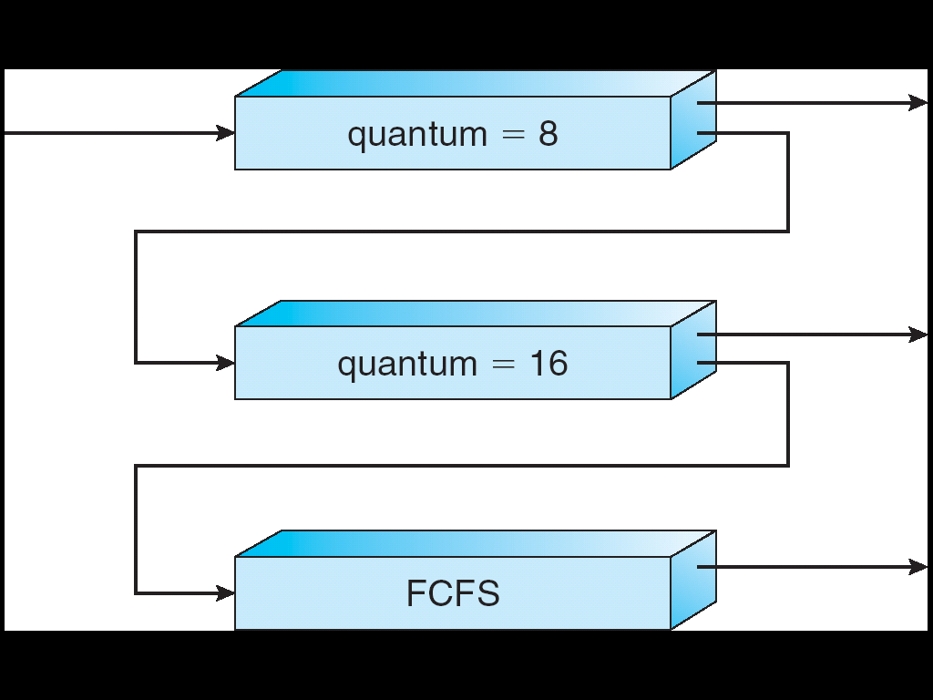
Multi-Level Feedback Scheduling
Multiple queues, each with different priority
Each queue has its own scheduling algorithm
e.g. foreground – RR, background – FCFS
Sometimes multiple RR priorities with quantum increasing exponentially (highest:1ms, next: 2ms, next: 4ms, etc)
Adjust each job’s priority as follows (details vary)
Job starts in highest priority queue
If timeout expires, drop one level. Otherwise, push up one level

Slide 37
Scheduling Details
Result approximates SRTF:
CPU bound jobs drop like a rock
Short-running I/O bound jobs stay near top
Scheduling must be done between the queues
Fixed priority scheduling:
serve all from highest priority, then next priority, etc.
Time slice:
each queue gets a certain amount of CPU time
e.g., 70% to highest, 20% next, 10% lowest

Slide 38
Scheduling Details
Countermeasure: user action that can foil intent of the OS designers
For multilevel feedback, put in a bunch of meaningless I/O to keep job’s priority high
Of course, if everyone did this, wouldn’t work!
Example of Othello program:
Playing against competitor, so key was to do computing at higher priority the competitors.
Put in printf’s, ran much faster!

Slide 39
Multi-Core Scheduling
Algorithmically, not a huge difference from single-core scheduling
Implementation-wise, helpful to have per-core scheduling data structures
Cache coherence
Affinity scheduling: once a thread is scheduled on a CPU, OS tries to reschedule it on the same CPU
Cache reuse

Slide 40
How to Handle Simultaneous Mix of Diff Types of Apps?
Consider mix of interactive and high throughput apps:
How to best schedule them?
How to recognize one from the other?
For instance, is Burst Time (observed) useful to decide which application gets CPU time?
Short Bursts ⇒ Interactivity ⇒ High Priority?
Assumptions encoded into many schedulers:
Apps that sleep a lot and have short bursts must be interactive apps – they should get high priority
Apps that compute a lot should get low(er?) priority, since they won’t notice intermittent bursts from interactive apps

Slide 41
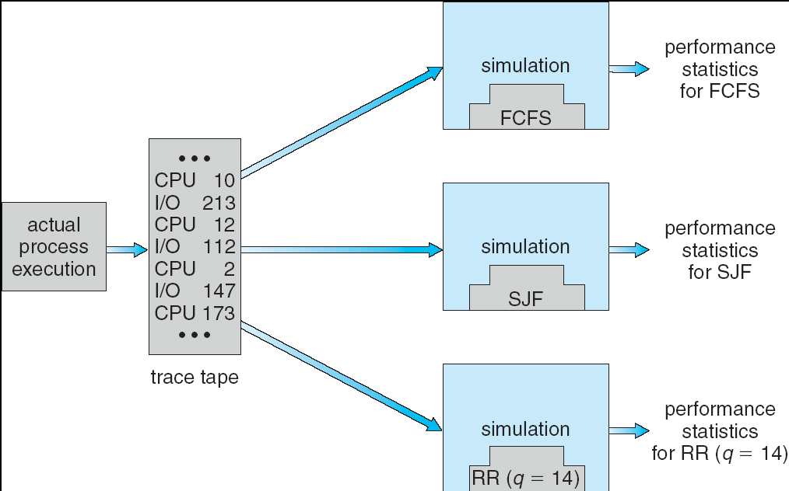
How to Evaluate a Scheduling algorithm?
Deterministic modeling
takes a predetermined workload and compute the performance of each algorithm for that workload
Queueing models
Mathematical approach for handling stochastic workloads
Implementation/Simulation:
Build system which allows actual algorithms to be run against actual data
Most flexible/general

Slide 42
So, Does the OS Schedule Processes or Threads?
Many textbooks use the “old model”—one thread per process
Usually it's really: threads (e.g., in Linux)
One point to notice: switching threads vs. switching processes incurs different costs:
Switch threads: Save/restore registers
Switch processes: Change active address space too!
Expensive
Disrupts caching

Slide 43
Conclusion
Round-Robin Scheduling:
Give each thread a small amount of CPU time when it executes; cycle between all ready threads
Pros: Better for short jobs
Shortest Job First (SJF)/Shortest Remaining Time First (SRTF):
Run whatever job has the least amount of computation to do/least remaining amount of computation to do
Pros: Optimal (average response time)
Cons: Hard to predict future, Unfair
Multi-Level Feedback Scheduling:
Multiple queues of different priorities and scheduling algorithms
Automatic promotion/demotion of process priority in order to approximate SJF/SRTF
Lottery Scheduling:
Give each thread a priority-dependent number of tokens (short tasks⇒more tokens)

