Slide 1
CS162 Operating Systems and Systems Programming Lecture 11 Scheduling 2: Case Studies, Real Time, and Forward Progress

Slide 2
Administrivia
Happy hour: by Friday 26/2, send us a picture with a beverage of your choice of you meeting in a group!
Submit midsemester survey. Extra credit point in the game if 80% of class does it!
Academic misconduct. More details on Piazza. Please come forward using the form
Project 1: Project code due tomorrow (26/2). Final report due Sunday (28/2)
Don’t forget to turn on camera for discussion sections!

Slide 3
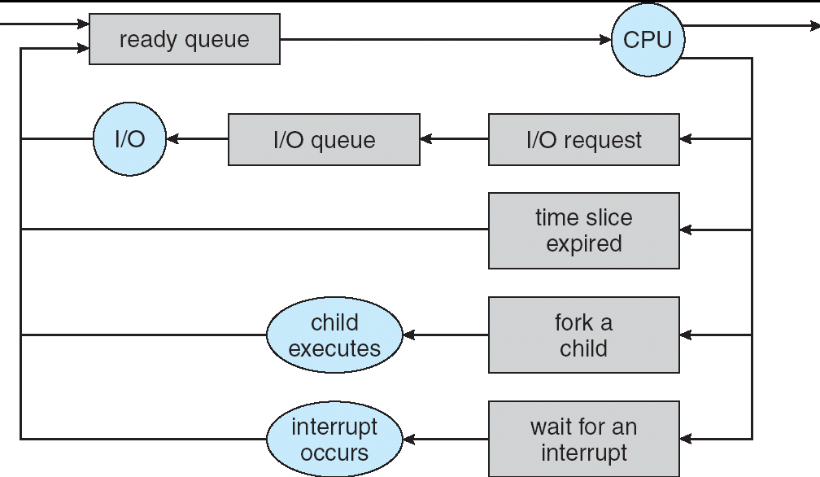
Recall: Scheduling
Question: How is the OS to decide which of several tasks to take off a queue?
Scheduling: deciding which threads are given access to resources from moment to moment
Often, we think in terms of CPU time, but could also think about access to resources like network BW or disk access

Slide 4
Recall: Scheduling Policy Goals/Criteria
Minimize Response Time
Minimize elapsed time to do an operation (or job)
Response time is what the user sees
Maximize Throughput
Maximize operations (or jobs) per second
Throughput related to response time, but not identical:
Minimizing response time will lead to more context switching than if you only maximized throughput
Two parts to maximizing throughput
Minimize overhead (for example, context-switching)
Efficient use of resources (CPU, disk, memory, etc)
Fairness
Share CPU among users in some equitable way
Fairness is not minimizing average response time:
Better average response time by making system less fair

Slide 5
Recall: Example of RR with Time Quantum = 20
Example: Process Burst Time P₁ 53 P₂ 8 P₃ 68 P₄ 24
The Gantt chart is:
Waiting time for P₁=(68-20)+(112-88)=72 P₂=(20-0)=20 P₃=(28-0)+(88-48)+(125-108)=85 P₄=(48-0)+(108-68)=88
Average waiting time = (72+20+85+88)/4=66¼
Average completion time = (125+28+153+112)/4 = 104½
P₁
P₂
P₃
P₄
P₁
P₃
P₄
P₁
P₃
P₃
0
20
28
48
68
88
108
112
125
145
153

Slide 6
Recall: What if we Knew the Future?
Shortest Job First (SJF):
Run whatever job has least amount of computation to do
Sometimes called “Shortest Time to Completion First” (STCF)
Shortest Remaining Time First (SRTF):
Preemptive version of SJF: if job arrives and has a shorter time to completion than the remaining time on the current job, immediately preempt CPU
Sometimes called “Shortest Remaining Time to Completion First” (SRTCF)
These can be applied to whole program or current CPU burst
Idea is to get short jobs out of the system
Big effect on short jobs, only small effect on long ones
Result is better average response time

Slide 7
History of Schedulers in Linux
O(n) scheduler
Linux 2.4 to Linux 2.6
O(1) scheduler
Linux 2.6 to 2.6.22
CFS scheduler
Linux 2.6.23 onwards

Slide 8
Case Study: Linux O(n) Scheduler
At every context switch:
Scan full list of processes in the ready queue
Compute relevant priorities
Select the best process to run
Scalability issues:
Context switch cost increases as number of processes increase
Single queue even in multicore systems

Slide 9
Case Study: Linux O(1) Scheduler
Kernel/Realtime Tasks
User Tasks
0
100
139
Next process to run is chosen in constant time
Priority-based scheduler with 140 different priorities
Real-time/kernel tasks assigned priorities 0 to 99 (0 is highest priority)
User tasks (interactive/batch) assigned priorities 100 to 139 (100 is highest priority)
Can be set using the nice system call.

Slide 10
Case Study: O(1) Scheduler – User tasks
Per priority-level, each CPU has two ready queues
An active queue, for processes which have not used up their time quanta
An expired queue, for processes who have
Timeslices/priorities/interactivity credits all computed when jobs finishes timeslice
Timeslice depends on priority – linearly mapped onto timeslice range
Like a multi-level queue (one queue per priority) with different timeslice at each level
Execution split into “Timeslice Granularity” chunks – round robin through priority

Slide 11
O(1) Scheduler – User tasks – Priority Adjustment
User-task priority adjusted ±5 based on heuristics
p->sleep_avg = sleep_time – run_time
Higher sleep_avg ⇒ more I/O bound the task, more reward (and vice versa)
Interactive Credit
Earned when a task sleeps for a “long” time
Spend when a task runs for a “long” time
IC is used to provide hysteresis to avoid changing interactivity for temporary changes in behavior
However, “interactive tasks” get special dispensation
To try to maintain interactivity
Placed back into active queue, unless some other task has been starved for too long…

Slide 12
Case Study: O(1) Scheduler – Real tasks
Real-Time Tasks
Always preempt non-RT tasks
No dynamic adjustment of priorities
Scheduling schemes:
SCHED_FIFO: preempts other tasks, no timeslice limit
SCHED_RR: preempts normal tasks, RR scheduling amongst tasks of same priority

Slide 13
Real-Time Scheduling
Goal: Predictability of Performance!
We need to predict with confidence worst case response times for systems!
In RTS, performance guarantees are:
Task- and/or class centric and often ensured a priori
In conventional systems, performance is:
System/throughput oriented with post-processing (… wait and see …)
Real-time is about enforcing predictability, and does not equal fast computing!!!

Slide 14
Real-Time Scheduling
Hard real-time: for time-critical safety-oriented systems
Meet all deadlines (if at all possible)
Ideally: determine in advance if this is possible
Earliest Deadline First (EDF), Least Laxity First (LLF), Rate-Monitonic Scheduling (RMS), Deadline Monotonic Scheduling (DM)
Soft real-time: for multimedia
Attempt to meet deadlines with high probability
Constant Bandwidth Server (CBS)

Slide 15
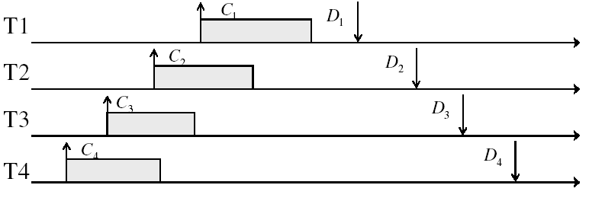
Example: Workload Characteristics
Tasks are preemptable, independent with arbitrary arrival (=release) times
Tasks have deadlines (D) and known computation times (C)
Example Setup:

Slide 16
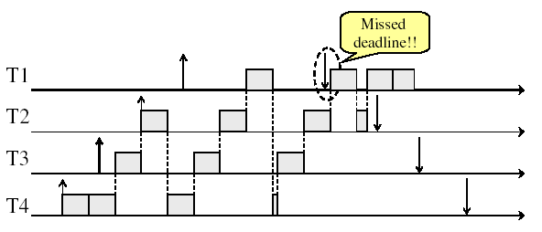
Example: Round-Robin Scheduling Doesn’t Work
Time

Slide 17

Earliest Deadline First (EDF)
Tasks periodic with period P and computation C in each period: ($P_{i}$, $C_{i}$) for each task $i$
Preemptive priority-based dynamic scheduling:
Each task is assigned a (current) priority based on how close the absolute deadline is (i.e. $D_{i}^{t+1}=D_{i}^{t}+P_{i}$for each task!)
The scheduler always schedules the active task with the closest absolute deadline
0
5
10
15

Slide 18
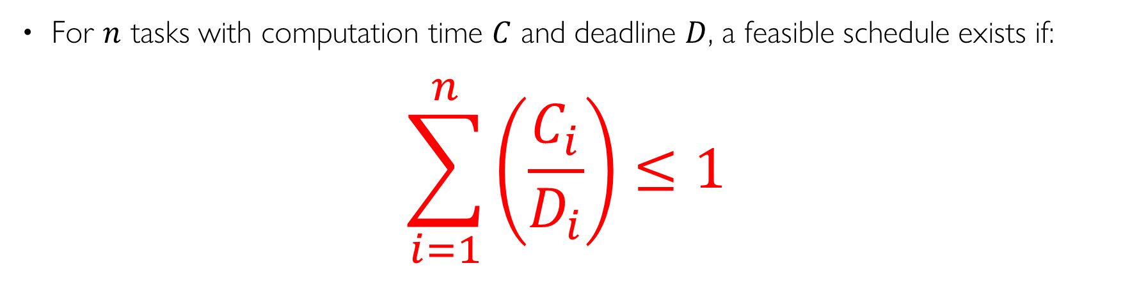
EDF Feasibility Testing
For $n$ tasks with computation time $C$ and deadline $D$, a feasible schedule exists if:
$$\sum_{i=1}^{n}{\left(\frac{C_{i}}{D_{i}}\right)}≤1$$
Case 1:
T1: (2,1) T2: (2,1)
½ + ½ = 1
Case 1:
T1: (2,2) T2: (2,1)
1 + ½ = 1.5

Slide 19
Ensuring Progress
Starvation: thread fails to make progress for an indefinite period of time
Starvation (this lecture) ≠ Deadlock (next lecture) because starvation could resolve under right circumstances
Deadlocks are unresolvable, cyclic requests for resources
Causes of starvation:
Scheduling policy never runs a particular thread on the CPU
Threads wait for each other or are spinning in a way that will never be resolved
Let’s explore what sorts of problems we might encounter and how to avoid them…

Slide 20
Strawman: Non-Work-Conserving Scheduler
A work-conserving scheduler is one that does not leave the CPU idle when there is work to do
A non-work-conserving scheduler could trivially lead to starvation
In this class, we’ll assume that the scheduler is work-conserving (unless stated otherwise)

Slide 21
Strawman: Last-Come, First-Served (LCFS)
Stack (LIFO) as a scheduling data structure
Late arrivals get fast service
Early ones wait – extremely unfair
In the worst case – starvation
When would this occur?
When arrival rate (offered load) exceeds service rate (delivered load)
Queue builds up faster than it drains
Queue can build in FIFO too, but “serviced in the order received”…

Slide 22
Is FCFS Prone to Starvation?
Scheduled Task (process, thread)
time
Scheduling Queue
arrivals
If a task never yields (e.g., goes into an infinite loop), then other tasks don’t get to run
Problem with all non-preemptive schedulers…
And early personal OSes such as original MacOS, Windows 3.1, etc

Slide 23
Is Round Robin (RR) Prone to Starvation?
Each of N processes gets ~1/N of CPU (in window)
With quantum length Q ms, process waits at most (N-1)*Q ms to run again
So a process can’t be kept waiting indefinitely
So RR is fair in terms of waiting time
Not necessarily in terms of throughput…

Slide 24
Is Priority Scheduling Prone to Starvation?
Priority 3
Job 1
Job 2
Job 3
Recall: Priority Scheduler always runs the thread with highest priority
Low priority thread might never run!
Starvation…
But there are more serious problems as well…
Priority inversion: even high priority threads might become starved
Priority 2
Job 4
Priority 1
Priority 0
Job 5
Job 6
Job 7

Slide 25
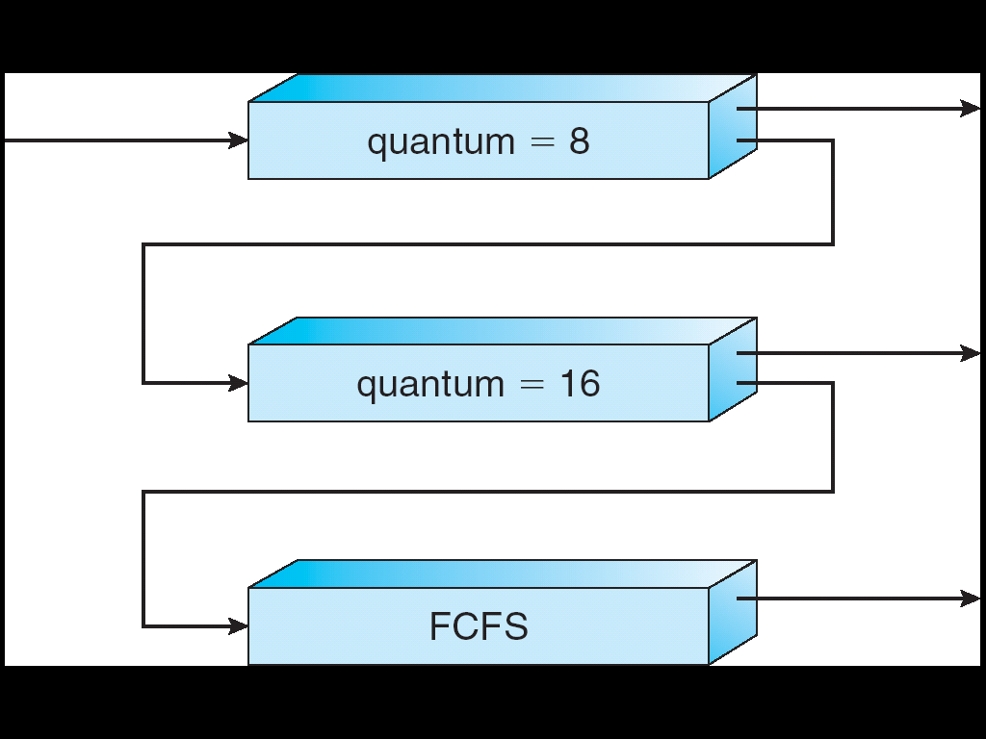
Are SRTF and MLFQ Prone to Starvation?
Long-Running Compute Tasks Demoted to Low Priority
In SRTF, long jobs are starved in favor of short ones
Same fundamental problem as priority scheduling
MLFQ is an approximation of SRTF, so it suffers from the same problem

Slide 26

Priority Inversion
Priority 3
Job 3
Priority 2
Job 2
Priority 1
Job 1
Acquire()
At this point, which job does the scheduler choose?
Job 3 (Highest priority)

Slide 27
Priority Inversion
Priority 3
Job 3
Acquire()
Priority 2
Job 2
Priority 1
Job 1
Job 3 attempts to acquire lock held by Job 1

Slide 28
Priority Inversion
Job 3
Blocked on Acquire
Priority 3
Priority 2
Job 2
Priority 1
Job 1
At this point, which job does the scheduler choose?
Job 2 (Medium Priority)
Priority Inversion

Slide 29
Priority Inversion
Where high priority task is blocked waiting on low priority task
Low priority one must run for high priority to make progress
Medium priority task can starve a high priority one
When else might priority lead to starvation or “live lock”?
High Priority
Low Priority
while (try_lock) {
…
}
lock.acquire(…)
…
lock.release(…)

Slide 30
One Solution: Priority Donation/Inheritance
Priority 3
Job 3
Acquire()
Priority 2
Job 2
Priority 1
Job 1
Job 3 temporarily grants Job 1 its “high priority” to run on its behalf

Slide 31
One Solution: Priority Donation/Inheritance
Job 3
Blocked on Acquire
Priority 3
Job 1
Release()
Priority 2
Job 2
Priority 1
Job 3 temporarily grants Job 1 its “high priority” to run on its behalf

Slide 32

Case Study: Martian Pathfinder Rover
July 4, 1997 – Pathfinder lands on Mars
First US Mars landing since Vikings in 1976; first rover
And then…a few days into mission…:
Multiple system resets occur to realtime OS (VxWorks)
System would reboot randomly, losing valuable time and progress
Problem? Priority Inversion!
Low priority task grabs mutex trying to communicate with high priority task:
Realtime watchdog detected lack of forward progress and invoked reset to safe state
High-priority data distribution task was supposed to complete with regular deadline
Original developers turned off priority donation !
Priority 2
Data Distribution Task: needs lock
Priority 1
Lots of random medium stuff
Priority 0
ASI/MET collector: grab lock

Slide 33
Cause for Starvation: Priorities?
The policies we’ve studied so far:
Always prefer to give the CPU to a prioritized job
Non-prioritized jobs may never get to run
But priorities were a means, not an end
Our end goal was to serve a mix of CPU-bound, I/O bound, and Interactive jobs effectively on common hardware
Give the I/O bound ones enough CPU to issue their next file operation and wait (on those slow discs)
Give the interactive ones enough CPU to respond to an input and wait (on those slow humans)
Let the CPU bound ones grind away without too much disturbance

Slide 34
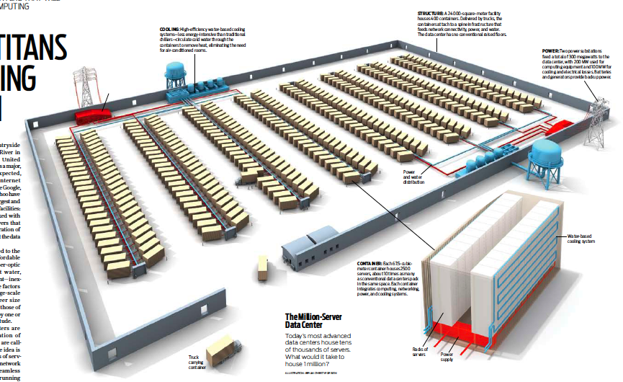
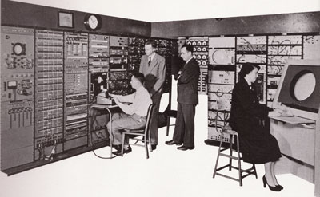
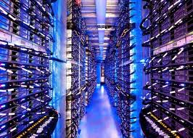
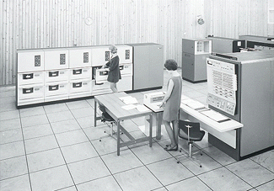
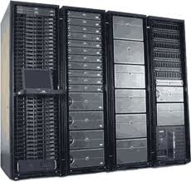
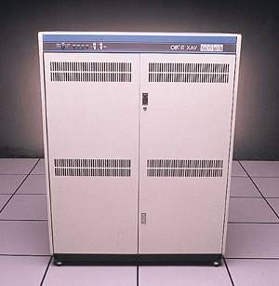
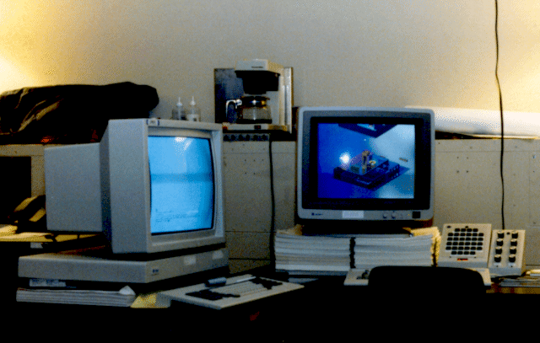

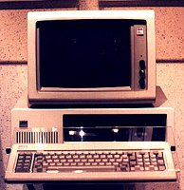





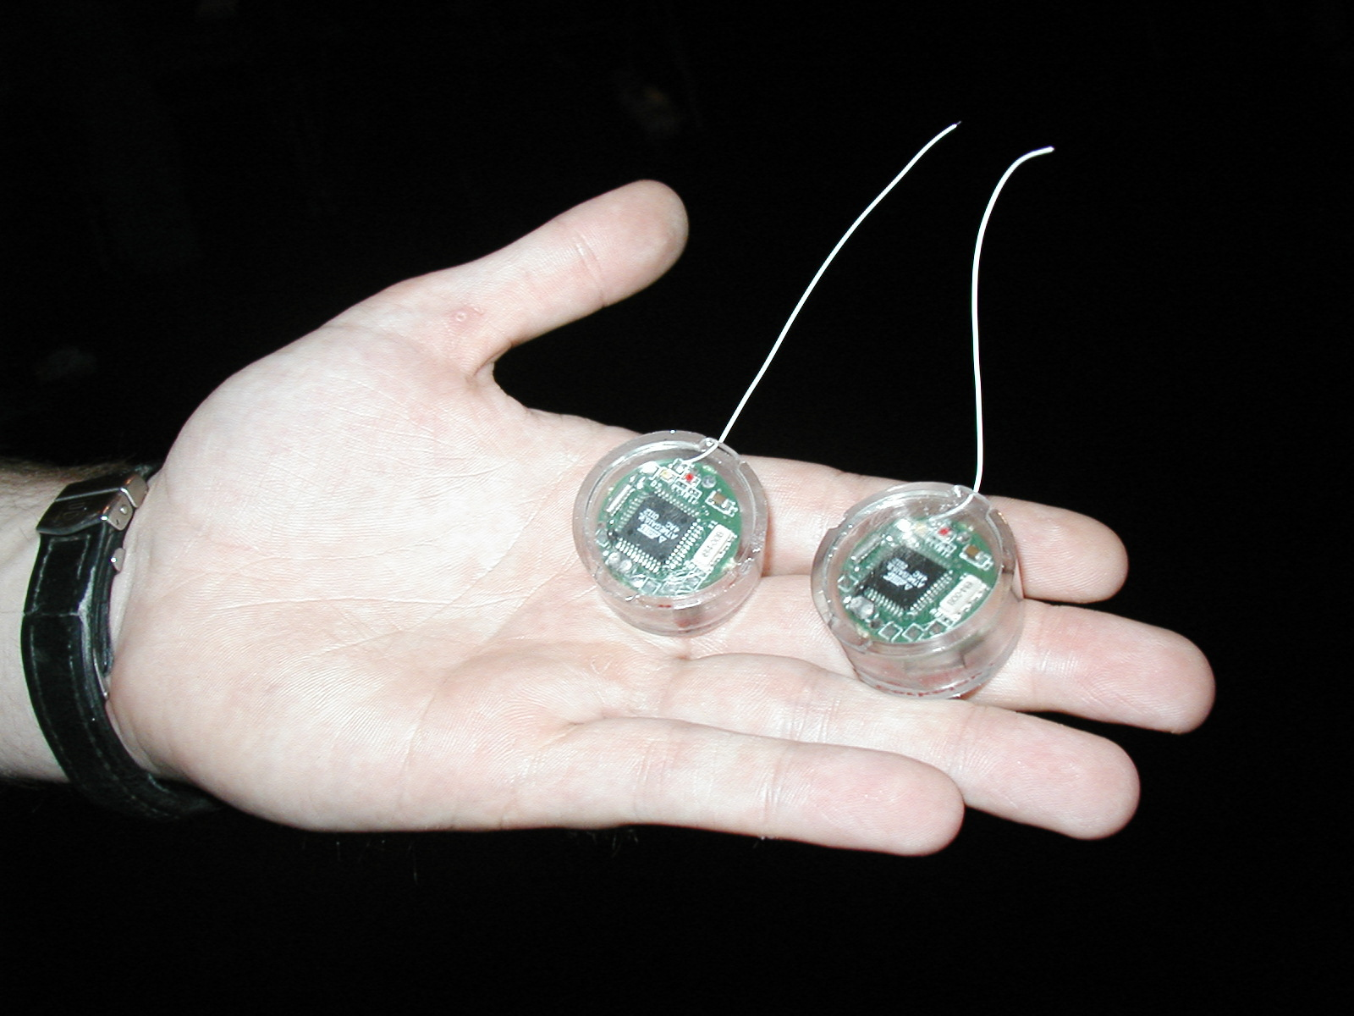
Recall: Changing Landscape…
Computers
Per Person
Number crunching, Data Storage, Massive Inet Services,
ML, …
1:10⁶
Mainframe
Bell’s Law: New computer class every 10 years
Mini
1:10³
Workstation
Productivity,
Interactive
PC
Laptop
1:1
PDA
Cell
Streaming from/to the physical world
10³:1
years
Mote!
The Internet of Things!

Slide 35
Changing Landscape of Scheduling
Priority-based scheduling rooted in “time-sharing”
Allocating precious, limited resources across a diverse workload
CPU bound, vs interactive, vs I/O bound
80’s brought about personal computers, workstations, and servers on networks
Different machines of different types for different purposes
Shift to fairness and avoiding extremes (starvation)
90’s emergence of the web, rise of internet-based services, the data-center-is-the-computer
Server consolidation, massive clustered services, huge flashcrowds
It’s about predictability, 95th percentile performance guarantees

Slide 36
Does prioritizing some jobs necessarily starve those that aren’t prioritized?

Slide 37
Key Idea: Proportional-Share Scheduling
The policies we’ve studied so far:
Always prefer to give the CPU to a prioritized job
Non-prioritized jobs may never get to run
Instead, we can share the CPU proportionally
Give each job a share of the CPU according to its priority
Low-priority jobs get to run less often
But all jobs can at least make progress (no starvation)

Slide 38
Recall: Lottery Scheduling
Q _{i}
Q _{i+1}
time
Given a set of jobs (the mix), provide each with a share of a resource
e.g., 50% of the CPU for Job A, 30% for Job B, and 20% for Job C
Idea: Give out tickets according to the proportion each should receive,
Every quantum (tick): draw one at random, schedule that job (thread) to run

Slide 39
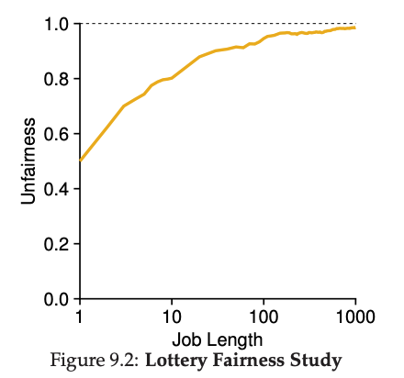
Unfairness
E.g., Given two jobs A and B of same run time (# Qs) that are each supposed to receive 50%,
U = finish time of first / finish time of last
As a function of run time

Slide 40
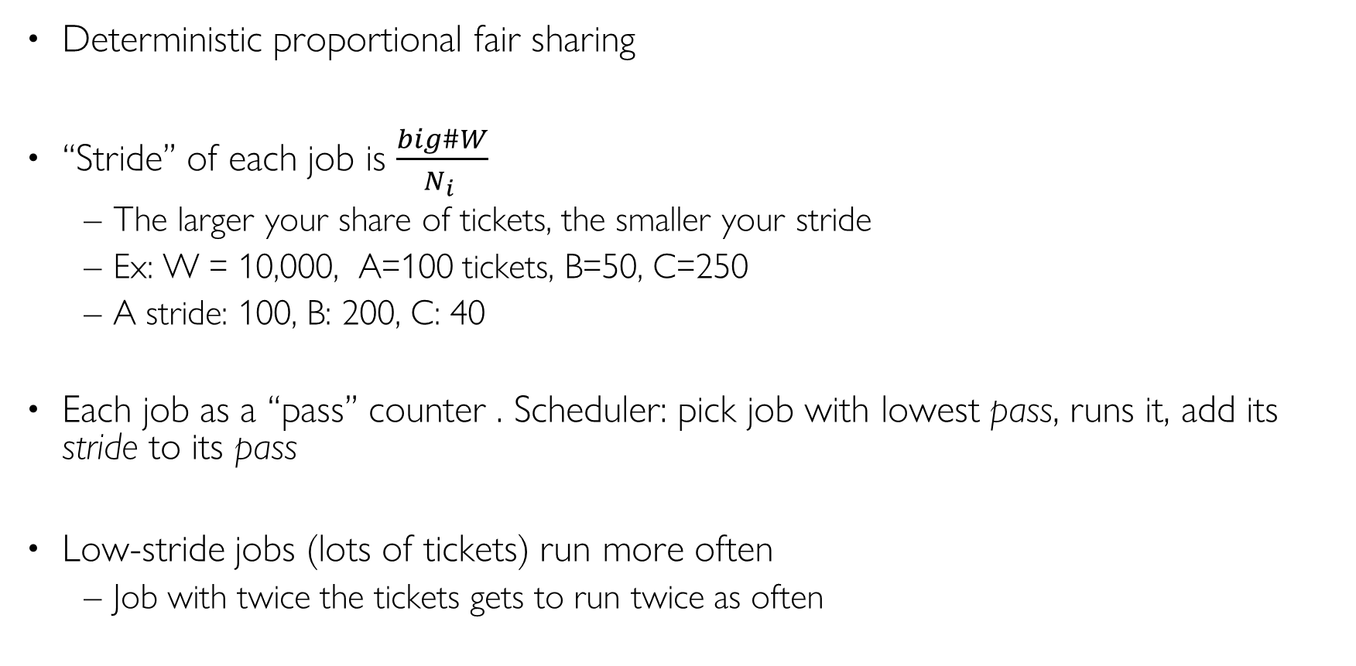
Stride Scheduling
Deterministic proportional fair sharing
“Stride” of each job is $\frac{big\#W}{N_{i} }$
The larger your share of tickets, the smaller your stride
Ex: W = 10,000, A=100 tickets, B=50, C=250
A stride: 100, B: 200, C: 40
Each job as a “pass” counter . Scheduler: pick job with lowest pass, runs it, add its stride to its pass
Low-stride jobs (lots of tickets) run more often
Job with twice the tickets gets to run twice as often

Slide 41
Stride Scheduling
W = 10,000, A=200 tickets, B=100 tickets, C=50 tickets
Strides:
50
100
200
Schedule
50
100
100
150
200
200
200
Ready Queue
100
100
150
200
200
200
250
200
200
200
200
200
250
300

Slide 42
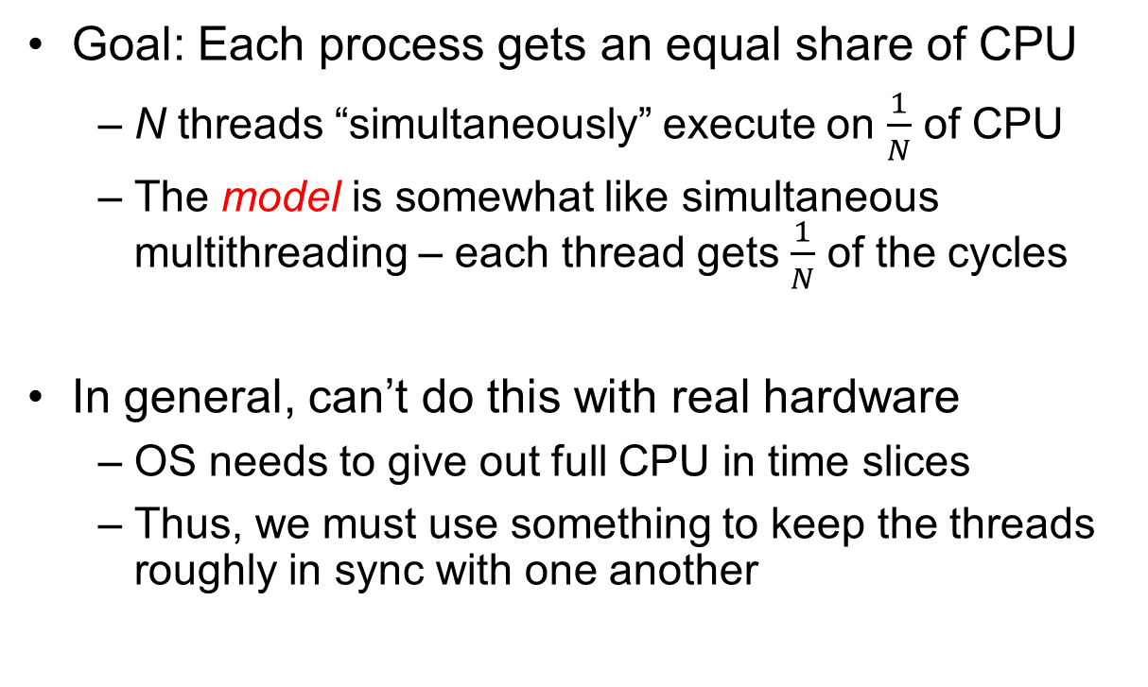

Linux Completely Fair Scheduler (CFS)
Goal: Each process gets an equal share of CPU
N threads “simultaneously” execute on $\frac{1}{N}$ of CPU
The model is somewhat like simultaneous multithreading – each thread gets $\frac{1}{N}$ of the cycles
In general, can’t do this with real hardware
OS needs to give out full CPU in time slices
Thus, we must use something to keep the threads roughly in sync with one another
Model: “Perfectly” subdivided CPU:
$$\frac{1}{N}$$
T₁
T₂
T₃
CPU Time

Slide 43

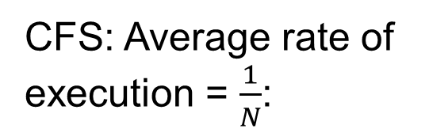
Linux Completely Fair Scheduler (CFS)
Basic Idea: track CPU time per thread
Scheduling Decision:
“Repair” illusion of complete fairness
Choose thread with minimum CPU time
Closely related to Fair Queueing
Use red-black tree for this…
O(log N) to add/remove threads, where N is number of threads
Sleeping threads don’t advance their CPU time, so they get a boost when they wake up again…
Get interactivity automatically!
CFS: Average rate of execution = $\frac{1}{N}$:
T₁
$$\frac{1}{N}$$
T₃
CPU Time
T₂

Slide 44
Linux CFS: Responsiveness/Starvation Freedom
In addition to fairness, we want low response time and starvation freedom
Make sure that everyone gets to run at least a bit!
Constraint 1: Target Latency
Period of time over which every process gets service
Quanta = Target_Latency / n
Target Latency: 20 ms, 4 Processes
Each process gets 5ms time slice
Target Latency: 20 ms, 200 Processes
Each process gets 0.1ms time slice (!!!)
Recall Round-Robin: large context switching overhead if slice gets to small

Slide 45
Linux CFS: Throughput
Goal: Throughput
Avoid excessive overhead
Constraint 2: Minimum Granularity
Minimum length of any time slice
Target Latency 20 ms, Minimum Granularity 1 ms, 200 processes
Each process gets 1 ms time slice

Slide 46
Aside: Priority in Unix – Being Nice
The industrial operating systems of the 60s and 70’s provided priority to enforced desired usage policies.
When it was being developed at Berkeley, instead it provided ways to “be nice”.
nice values range from -20 to 19
Negative values are “not nice”
If you wanted to let your friends get more time, you would nice up your job
Scheduler puts higher nice-value tasks (lower priority) to sleep more …
In O(1) scheduler, this translated fairly directly to priority (and time slice)
How does this idea translate to CFS?
Change the rate of CPU cycles given to threads to change relative priority

Slide 47
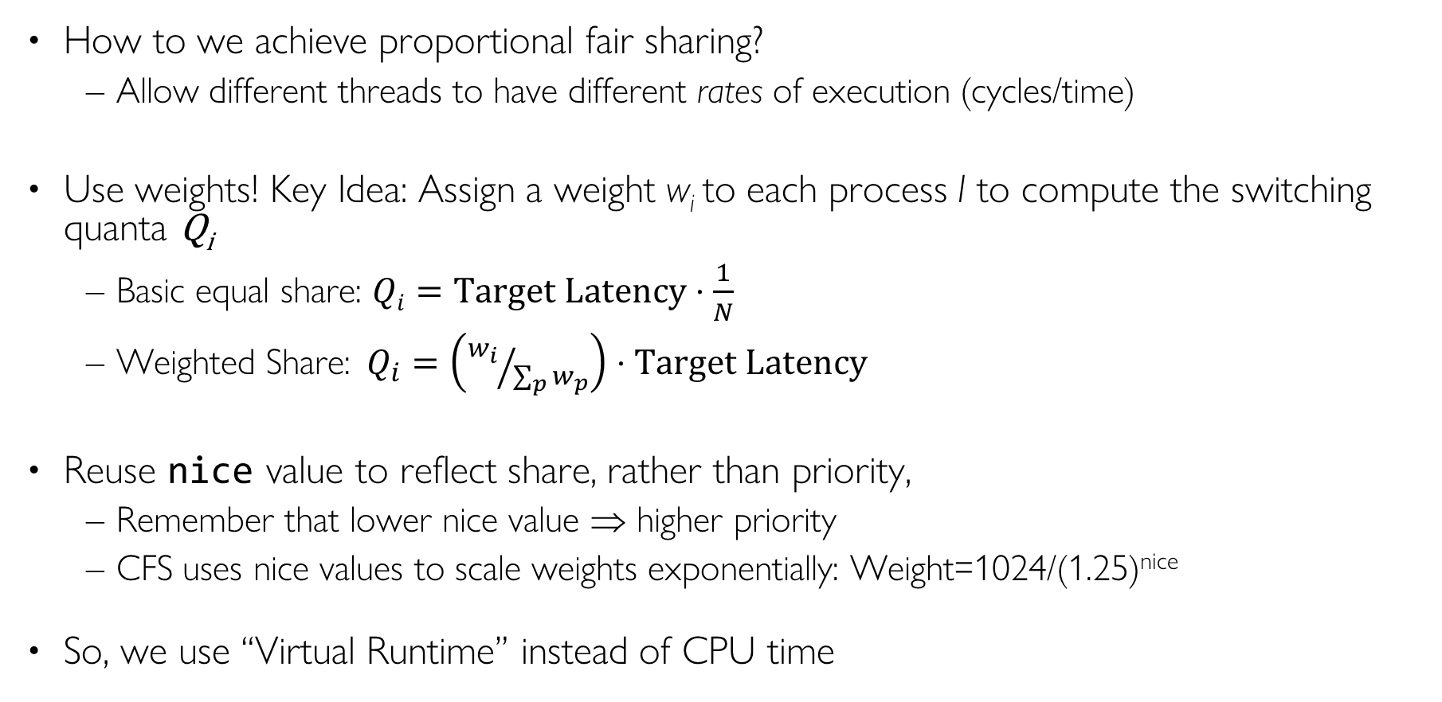
Linux CFS: Proportional Shares
How to we achieve proportional fair sharing?
Allow different threads to have different rates of execution (cycles/time)
Use weights! Key Idea: Assign a weight w_{i} to each process I to compute the switching quanta Q_{i}
Basic equal share: $Qi=Target Latency⋅\frac{1}{N}$
Weighted Share:$Q_{i}=\left({w_{i}}/{\sum_{p}{w_{p}}}\right)⋅Target Latency$
Reuse nice value to reflect share, rather than priority,
Remember that lower nice value ⇒ higher priority
CFS uses nice values to scale weights exponentially: Weight=1024/(1.25)^{nice}
So, we use “Virtual Runtime” instead of CPU time

Slide 48
Example: Linux CFS: Proportional Shares
Target Latency = 20ms
Minimum Granularity = 1ms
Example: Two CPU-Bound Threads
Thread A has weight 1
Thread B has weight 4
Time slice for A? 4 ms
Time slice for B? 16 ms

Slide 49
Linux CFS: Proportional Shares
16 (w_{B}=4)
B
Physical
CPU Time
Virtual
CPU Time
B
A
4 (w_{A}=1)
A
Track a thread's virtual runtime rather than its true physical runtime
Higher weight: Virtual runtime increases more slowly
Lower weight: Virtual runtime increases more quickly

Slide 50
Linux CFS: Proportional Shares
Scheduler’s Decisions are based on Virtual CPU Time
Use of Red-Black tree to hold all runnable processes as sorted on vruntime variable
O(1) time to find next thread to run (top of heap!)
O(log N) time to perform insertions/deletions
Cash the item at far left (item with earliest vruntime)
When ready to schedule, grab version with smallest vruntime (which will be item at the far left).

Slide 51
Choosing the Right Scheduler
I Care About: | Then Choose:
CPU Throughput | FCFS
Avg. Response Time | SRTF Approximation
I/O Throughput | SRTF Approximation
Fairness (CPU Time) | Linux CFS
Fairness – Wait Time to Get CPU | Round Robin
Meeting Deadlines | EDF
Favoring Important Tasks | Priority

Slide 52
Summary (1 of 2)
Scheduling Goals:
Minimize Response Time (e.g. for human interaction)
Maximize Throughput (e.g. for large computations)
Fairness (e.g. Proper Sharing of Resources)
Predictability (e.g. Hard/Soft Realtime)
Round-Robin Scheduling:
Give each thread a small amount of CPU time when it executes; cycle between all ready threads
Pros: Better for short jobs
Shortest Job First (SJF)/Shortest Remaining Time First (SRTF):
Run whatever job has the least amount of computation to do/least remaining amount of computation to do
Multi-Level Feedback Scheduling:
Multiple queues of different priorities and scheduling algorithms
Automatic promotion/demotion of process priority in order to approximate SJF/SRTF

Slide 53
Summary (2 of 2)
Realtime Schedulers such as EDF
Guaranteed behavior by meeting deadlines
Realtime tasks defined by tuple of compute time and period
Schedulability test: is it possible to meet deadlines with proposed set of processes?
Lottery Scheduling:
Give each thread a priority-dependent number of tokens (short tasks⇒more tokens)
Stride Scheduling
Always fair, unlike lotter scheduling:
Linux O(1) scheduler
Scales as number of processes grows
Became overly complex because of heuristics
Linux CFS Scheduler: Fair fraction of CPU
Approximates an “ideal” multitasking processor
Practical example of “Fair Queueing”

