Slide 1
CS162 Operating Systems and Systems Programming Lecture 16 Memory 4: Demand Paging Policies
March 16th, 2021
Profs. Natacha Crooks and Anthony D. Joseph
http://cs162.eecs.Berkeley.edu

Slide 2
Recall 61C: Average Memory Access Time
Proc
Used to compute access time probabilistically:
AMAT = Hit Rate_{L1} x Hit Time_{L1} + Miss Rate_{L1} x Miss Time_{L1}
Hit Rate_{L1} + Miss Rate_{L1} = 1 Hit Time_{L1} = Time to get value from L1 cache. Miss Time_{L1} = Hit Time_{L1} + Miss Penalty_{L1} Miss Penalty_{L1} = AVG Time to get value from lower level (DRAM)
So, AMAT = Hit Time_{L1} + Miss Rate_{L1} x Miss Penalty_{L1}
What about more levels of hierarchy?
AMAT = Hit Time_{L1} + Miss Rate_{L1} x Miss Penalty_{L1}
Miss Penalty_{L1} = AVG time to get value from lower level (L2) = Hit Time_{L2} + Miss Rate_{L2} x Miss Penalty_{L2} Miss Penalty_{L2} = Average Time to fetch from below L2 (DRAM)
AMAT = Hit Time_{L1} +
Miss Rate_{L1} x (Hit Time_{L2} + Miss Rate_{L2} x Miss Penalty_{L2})
And so on … (can do this recursively for more levels!)
L1 Cache
DRAM
Proc
L1 Cache
L2 Cache
DRAM

Slide 3
Recall: Caching Applied to Address Translation
Virtual
Address
TLB
Physical
Memory
CPU
Physical
Address
Cached?
Yes
No
Save
Result
Translate
(MMU)
Data Read or Write
(untranslated)
Question is one of page locality: does it exist?
Instruction accesses spend a lot of time on the same page (accesses sequential)
Stack accesses have definite locality of reference
Data accesses have less page locality, but still some…
Can we have a TLB hierarchy?
Sure: multiple levels at different sizes/speeds

Slide 4
Management & Access to the Memory Hierarchy
Managed in Hardware
Managed in Software - OS
?
Processor
Secondary Storage (Disk)
TLB
PT
L2 Cache
Registers
L1 Cache
Secondary Storage (SSD)
PT
PT
Main
Memory
(DRAM)
PT
TLB
L3 Cache (shared)
L2 Cache
Registers
L1 Cache
Accessed in Hardware
Speed (ns):
0.3
1
3
10-30
100
100,000 (0.1 ms)
10,000,000
(10 ms)
Size (bytes):
100Bs
10kBs
100kBs
MBs
GBs
100GBs
TBs
Notes:
The design goal is to present the user with as much memory as is available in the cheapest technology (points to the disk).
While by taking advantage of the principle of locality, we like to provide the user an average access speed that is very close to the speed that is offered by the fastest technology.
(We will go over this slide in details in the next lecture on caches).
+1 = 16 min. (X:56)

Slide 5
Recall: Demand Paging Mechanisms
PTE makes demand paging implementatable
Valid ⇒ Page in memory, PTE points at physical page
Not Valid ⇒ Page not in memory; use info in PTE to find it on disk when necessary
Suppose user references page with invalid PTE?
Memory Management Unit (MMU) traps to OS
Resulting trap is a “Page Fault”
What does OS do on a Page Fault?:
Choose an old page to replace
If old page modified (“D=1”), write contents back to disk
Change its PTE and any cached TLB to be invalid
Load new page into memory from disk
Update page table entry, invalidate TLB for new entry
Continue thread from original faulting location
TLB for new page will be loaded when thread continued!
While pulling pages off disk for one process, OS runs another process from ready queue
Suspended process sits on wait queue
Cache

Slide 6
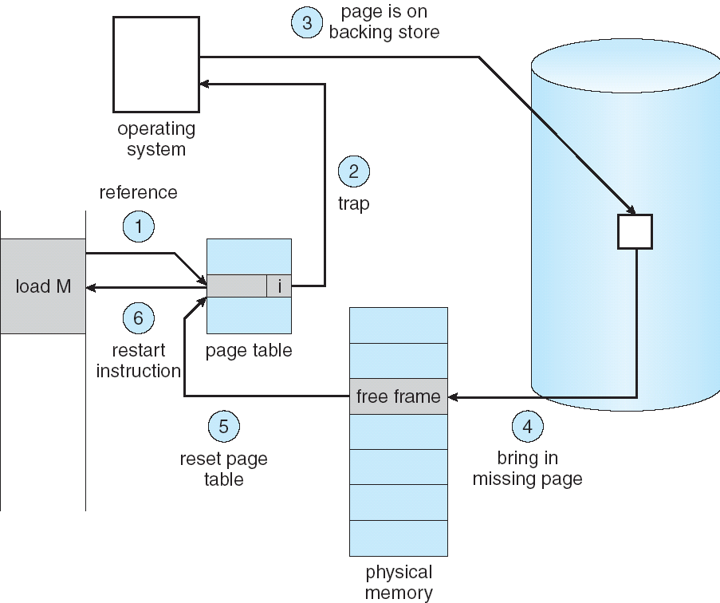
Recall: Steps in Handling a Page Fault

Slide 7
Some questions we need to answer!
During a page fault, where does the OS get a free frame?
Keeps a free list
Unix runs a “reaper” if memory gets too full
Schedule dirty pages to be written back on disk
Zero (clean) pages which haven’t been accessed in a while
As a last resort, evict a dirty page first
How can we organize these mechanisms?
Work on the replacement policy
How many page frames/process?
Like thread scheduling, need to “schedule” memory resources:
Utilization? fairness? priority?
Allocation of disk paging bandwidth

Slide 8
Recall: Working Set Model
As a program executes it transitions through a sequence of “working sets” consisting of varying sized subsets of the address space
Address
Time

Slide 9
Cache Behavior under WS model
1
new working set fits
Hit Rate
0
Cache Size
Amortized by fraction of time the Working Set is active
Transitions from one WS to the next
Capacity, Conflict, Compulsory misses
Applicable to memory caches and pages. Others ?

Slide 10
Another model of Locality: Zipf
Likelihood of accessing item of rank r is α 1/rª
Although rare to access items below the top few, there are so many that it yields a “heavy tailed” distribution
Substantial value from even a tiny cache
Substantial misses from even a very large cache

Slide 11
Demand Paging Cost Model
Since Demand Paging like caching, can compute average access time! (“Effective Access Time”)
EAT = Hit Rate x Hit Time + Miss Rate x Miss Time
EAT = Hit Time + Miss Rate x Miss Penalty
Example:
Memory access time = 200 nanoseconds
Average page-fault service time = 8 milliseconds
Suppose p = Probability of miss, 1-p = Probably of hit
Then, we can compute EAT as follows:
EAT = 200ns + p x 8 ms
= 200ns + p x 8,000,000ns
If one access out of 1,000 causes a page fault, then EAT = 8.2 μs:
This is a slowdown by a factor of 40!
What if want slowdown by less than 10%?
EAT < 200ns x 1.1 ⇒ p < 2.5 x 10⁻⁶
This is about 1 page fault in 400,000!

Slide 12
What Factors Lead to Misses in Page Cache?
Compulsory Misses:
Pages that have never been paged into memory before
How might we remove these misses?
Prefetching: loading them into memory before needed
Need to predict future somehow! More later
Capacity Misses:
Not enough memory. Must somehow increase available memory size.
Can we do this?
One option: Increase amount of DRAM (not quick fix!)
Another option: If multiple processes in memory: adjust percentage of memory allocated to each one!
Conflict Misses:
Technically, conflict misses don’t exist in virtual memory, since it is a “fully-associative” cache
Policy Misses:
Caused when pages were in memory, but kicked out prematurely because of the replacement policy
How to fix? Better replacement policy

Slide 14
Administrivia
Midterm 2: Coming up on Thursday 3/18 5-6:30PM
Topics: up and including Lecture 16: Scheduling, Deadlock, Address Translation, Virtual Memory, Caching, TLBs, Demand Paging
Will REQUIRE you to have your zoom proctoring setup working again
You must have screen sharing (entire desktop not just the browser), audio unmuted, and your camera working
Make sure to get your setup debugged and ready!
Review Session: Tuesday 3/16 (5-7pm)
See Piazza and/or CS162 website

Slide 16
Page Replacement Policies
Why do we care about Replacement Policy?
Replacement is an issue with any cache
Particularly important with pages
The cost of being wrong is high: must go to disk
Must keep important pages in memory, not toss them out
FIFO (First In, First Out)
Throw out oldest page. Be fair – let every page live in memory for same amount of time.
Bad – throws out heavily used pages instead of infrequently used
RANDOM:
Pick random page for every replacement
Typical solution for TLB’s. Simple hardware
Pretty unpredictable – makes it hard to make real-time guarantees
MIN (Minimum):
Replace page that won’t be used for the longest time
Great (provably optimal), but can’t really know future…
But past is a good predictor of the future …

Slide 17
Replacement Policies (Con’t)
LRU (Least Recently Used):
Replace page that hasn’t been used for the longest time
Programs have locality, so if something not used for a while, unlikely to be used in the near future.
Seems like LRU should be a good approximation to MIN.
How to implement LRU? Use a list:
On each use, remove page from list and place at head
LRU page is at tail
Problems with this scheme for paging?
Need to know immediately when page used so that can change position in list…
Many instructions for each hardware access
In practice, people approximate LRU (more later)
Page 6
Page 7
Page 1
Page 2
Head
Tail (LRU)

Slide 18
Example: FIFO (strawman)
Suppose we have 3 page frames, 4 virtual pages, and following reference stream:
A B C A B D A D B C B
Consider FIFO Page replacement:
FIFO: 7 faults
When referencing D, replacing A is bad choice, since need A again right away
Ref:
Page:
A
B
C
A
B
D
A
D
B
C
B
1
A
D
C
2
B
A
3
C
B

Slide 19
Example: MIN / LRU
Suppose we have the same reference stream:
A B C A B D A D B C B
Consider MIN Page replacement:
MIN: 5 faults
Where will D be brought in? Look for page not referenced farthest in future
What will LRU do?
Same decisions as MIN here, but won’t always be true!
Ref:
Page:
A
B
C
A
B
D
A
D
B
C
B
1
A
C
2
B
3
C
D

Slide 20
Is LRU guaranteed to perform well?
Consider the following: A B C D A B C D A B C D
LRU Performs as follows (same as FIFO here):
Every reference is a page fault!
Fairly contrived example of working set of N+1 on N frames
Ref:
Page:
A
B
C
D
A
B
C
D
A
B
C
D
1
A
D
C
B
2
B
A
D
C
3
C
B
A
D

Slide 21
When will LRU perform badly?
Consider the following: A B C D A B C D A B C D
LRU Performs as follows (same as FIFO here):
Every reference is a page fault!
MIN Does much better:
Ref:
Page:
A
B
C
D
A
B
C
D
A
B
C
D
1
A
D
C
B
2
B
A
D
C
3
C
B
A
D
Ref:
Page:
A
B
C
D
A
B
C
D
A
B
C
D
1
A
B
2
B
C
3
C
D

Slide 22
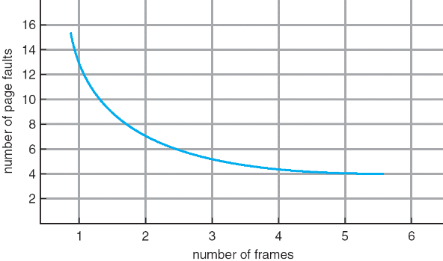
Graph of Page Faults Versus The Number of Frames
One desirable property: When you add memory the miss rate drops (stack property)
Does this always happen?
Seems like it should, right?
No: Bélády’s anomaly
Certain replacement algorithms (FIFO) don’t have this obvious property!

Slide 23
Adding Memory Doesn’t Always Help Fault Rate
Does adding memory reduce number of page faults?
Yes for LRU and MIN
Not necessarily for FIFO! (Called Bélády’s anomaly)
After adding memory:
With FIFO, contents can be completely different
In contrast, with LRU or MIN, contents of memory with X pages are a subset of contents with X+1 Page
Ref:
Page:
A
B
C
D
A
B
E
A
B
C
D
E
1
A
D
E
2
B
A
C
3
C
B
D
Ref:
Page:
A
B
C
D
A
B
E
A
B
C
D
E
1
A
E
D
2
B
A
E
3
C
B
4
D
C

Slide 25
Approximating LRU: Clock Algorithm
Set of all pages
in Memory
Single Clock Hand:
Advances only on page fault!
Check for pages not used recently
Mark pages as not used recently
Clock Algorithm: Arrange physical pages in circle with single clock hand
Approximate LRU (approximation to approximation to MIN)
Replace an old page, not the oldest page
Details:
Hardware “use” bit per physical page (called “accessed” in Intel architecture):
Hardware sets use bit on each reference
If use bit isn’t set, means not referenced in a long time
Some hardware sets use bit in the TLB; must be copied back to page TLB entry gets replaced
On page fault:
Advance clock hand (not real time)
Check use bit: 1→ used recently; clear and leave alone 0→ selected candidate for replacement

Slide 26
Clock Algorithm: More details
Set of all pages
in Memory
Single Clock Hand
Will always find a page or loop forever?
Even if all use bits set, will eventually loop all the way around ⇒ FIFO
What if hand moving slowly?
Good sign or bad sign?
Not many page faults
or find page quickly
What if hand is moving quickly?
Lots of page faults and/or lots of reference bits set
One way to view clock algorithm:
Crude partitioning of pages into two groups: young and old
Why not partition into more than 2 groups?

Slide 27
N^{th} Chance version of Clock Algorithm
N^{th} chance algorithm: Give page N chances
OS keeps counter per page: # sweeps
On page fault, OS checks use bit:
1 → clear use and also clear counter (used in last sweep)
0 → increment counter; if count=N, replace page
Means that clock hand has to sweep by N times without page being used before page is replaced
How do we pick N?
Why pick large N? Better approximation to LRU
If N ~ 1K, really good approximation
Why pick small N? More efficient
Otherwise might have to look a long way to find free page
What about “modified” (or “dirty”) pages?
Takes extra overhead to replace a dirty page, so give dirty pages an extra chance before replacing?
Common approach:
Clean pages, use N=1
Dirty pages, use N=2 (and write back to disk when N=1)

Slide 28
Recall: Meaning of PTE bits
Which bits of a PTE entry are useful to us for the Clock Algorithm? Remember Intel PTE:
The “Present” bit (called “Valid” elsewhere):
P==0: Page is invalid and a reference will cause page fault
P==1: Page frame number is valid and MMU is allowed to proceed with translation
The “Writable” bit (could have opposite sense and be called “Read-only”):
W==0: Page is read-only and cannot be written.
W==1: Page can be written
The “Accessed” bit (called “Use” elsewhere):
A==0: Page has not been accessed (or used) since last time software set A→0
A==1: Page has been accessed (or used) since last time software set A→0
The “Dirty” bit (called “Modified” elsewhere):
D==0: Page has not been modified (written) since PTE was loaded
D==1: Page has changed since PTE was loaded
PTE:
Page Frame Number
(Physical Page Number)
Free
(OS)
0
PS
D
A
PCD
PWT
U
W
P
31-12
11-9
8
7
6
5
4
3
2
1
0

Slide 29
Clock Algorithms Variations
Do we really need hardware-supported “modified” bit?
No. Can emulate it using read-only bit
Need software DB of which pages are allowed to be written (needed this anyway)
We will tell MMU that pages have more restricted permissions than the actually do to force page faults (and allow us notice when page is written)
Algorithm (Clock-Emulated-M):
Initially, mark all pages as read-only (W→0), even writable data pages. Further, clear all software versions of the “modified” bit → 0 (page not dirty)
Writes will cause a page fault. Assuming write is allowed, OS sets software “modified” bit → 1, and marks page as writable (W→1).
Whenever page written back to disk, clear “modified” bit → 0, mark read-only

Slide 30
Clock Algorithms Variations (continued)
Do we really need a hardware-supported “use” bit?
No. Can emulate it similar to above (e.g. for read operation)
Kernel keeps a “use” bit and “modified” bit for each page
Algorithm (Clock-Emulated-Use-and-M):
Mark all pages as invalid, even if in memory. Clear emulated “use” bits → 0 and “modified” bits → 0 for all pages (not used, not dirty)
Read or write to invalid page traps to OS to tell use page has been used
OS sets “use” bit → 1 in software to indicate that page has been “used”. Further: 1) If read, mark page as read-only, W→0 (will catch future writes) 2) If write (and write allowed), set “modified” bit → 1, mark page as writable (W→1)
When clock hand passes, reset emulated “use” bit → 0 and mark page as invalid again
Note that “modified” bit left alone until page written back to disk
Remember, however, clock is just an approximation of LRU!
Can we do a better approximation, given that we have to take page faults on some reads and writes to collect use information?
Need to identify an old page, not oldest page!
Answer: second chance list

Slide 31
Second-Chance List Algorithm (VAX/VMS)
LRU victim
Directly
Mapped Pages
Marked: RW
List: FIFO
Overflow
Second
Chance List
Marked: Invalid
List: LRU
Access
Page-in
From disk
New
Active Pages
New
SC Victims
Split memory in two: Active list (RW), SC list (Invalid)
Access pages in Active list at full speed
Otherwise, Page Fault
Always move overflow page from end of Active list to front of Second-chance list (SC) and mark invalid
Desired Page On SC List: move to front of Active list, mark RW
Not on SC list: page in to front of Active list, mark RW; page out LRU victim at end of SC list

Slide 32
Second-Chance List Algorithm (continued)
How many pages for second chance list?
If 0 ⇒ FIFO
If all ⇒ LRU, but page fault on every page reference
Pick intermediate value. Result is:
Pro: Few disk accesses (page only goes to disk if unused for a long time)
Con: Increased overhead trapping to OS (software / hardware tradeoff)
With page translation, we can adapt to any kind of access the program makes
Later, we will show how to use page translation / protection to share memory between threads on widely separated machines
History: The VAX architecture did not include a “use” bit. Why did that omission happen???
Strecker (architect) asked OS people, they said they didn’t need it, so didn’t implement it
He later got blamed, but VAX did OK anyway

Slide 33

Free List
Set of all pages
in Memory
Single Clock Hand: Advances as needed to keep freelist full (“background”)
D
D
Free Pages
For Processes
Keep set of free pages ready for use in demand paging
Freelist filled in background by Clock algorithm or other technique (“Pageout demon”)
Dirty pages start copying back to disk when enter list
Like VAX second-chance list
If page needed before reused, just return to active set
Advantage: faster for page fault
Can always use page (or pages) immediately on fault

Slide 35
Reverse Page Mapping (Sometimes called “Coremap”)
When evicting a page frame, how to know which PTEs to invalidate?
Hard in the presence of shared pages (forked processes, shared memory, …)
Reverse mapping mechanism must be very fast
Must track down all page tables pointing at given page frame when freeing a page
Must track down all PTEs when seeing if pages “active”
Implementation options:
For every page descriptor, keep linked list of page table entries that point to it
Management nightmare – expensive
Linux: Object-based reverse mapping
Link together memory region descriptors instead (much coarser granularity)

Slide 36
Allocation of Page Frames (Memory Pages)
How do we allocate memory among different processes?
Does every process get the same fraction of memory? Different fractions?
Should we completely swap some processes out of memory?
Each process needs minimum number of pages
Want to make sure that all processes that are loaded into memory can make forward progress
Example: IBM 370 – 6 pages to handle SS MOVE instruction:
instruction is 6 bytes, might span 2 pages
2 pages to handle from
2 pages to handle to
Possible Replacement Scopes:
Global replacement – process selects replacement frame from set of all frames; one process can take a frame from another
Local replacement – each process selects from only its own set of allocated frames

Slide 37
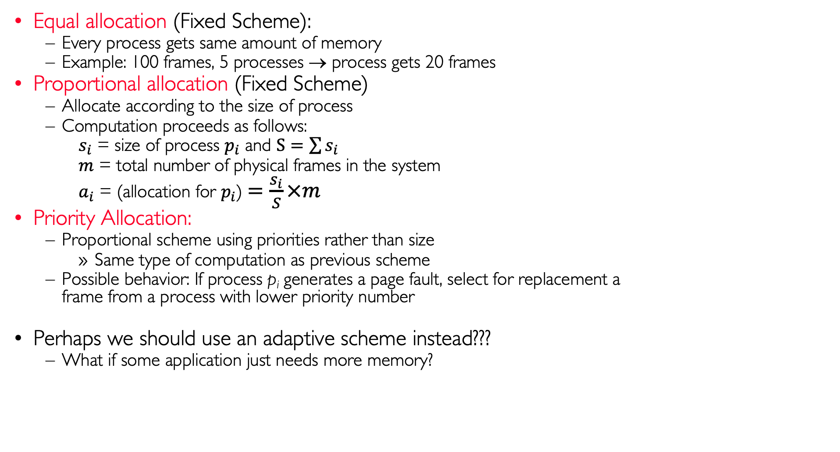
Fixed/Priority Allocation
Equal allocation (Fixed Scheme):
Every process gets same amount of memory
Example: 100 frames, 5 processes → process gets 20 frames
Proportional allocation (Fixed Scheme)
Allocate according to the size of process
Computation proceeds as follows:
$s_{i}$ = size of process $p_{i}$ and $S=\sum{s_{i}}$
$m$ = total number of physical frames in the system
$a_{i}$ = (allocation for $p_{i}$)$=\frac{s_{i}}{S}×m$
Priority Allocation:
Proportional scheme using priorities rather than size
Same type of computation as previous scheme
Possible behavior: If process p_{i} generates a page fault, select for replacement a frame from a process with lower priority number
Perhaps we should use an adaptive scheme instead???
What if some application just needs more memory?

Slide 38
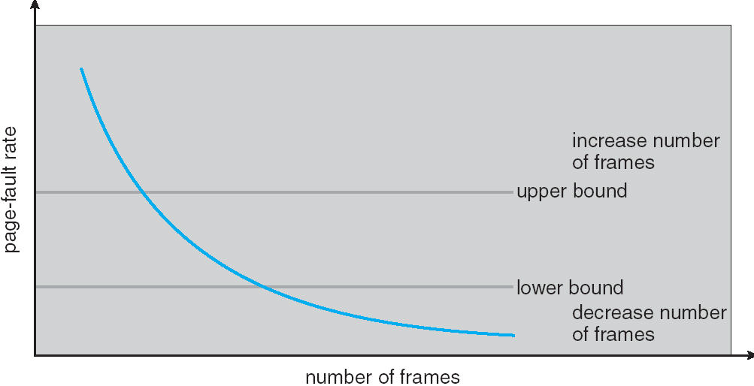
Page-Fault Frequency Allocation
Can we reduce Capacity misses by dynamically changing the number of pages/application?
Establish “acceptable” page-fault rate
If actual rate too low, process loses frame
If actual rate too high, process gains frame
Question: What if we just don’t have enough memory?

Slide 39
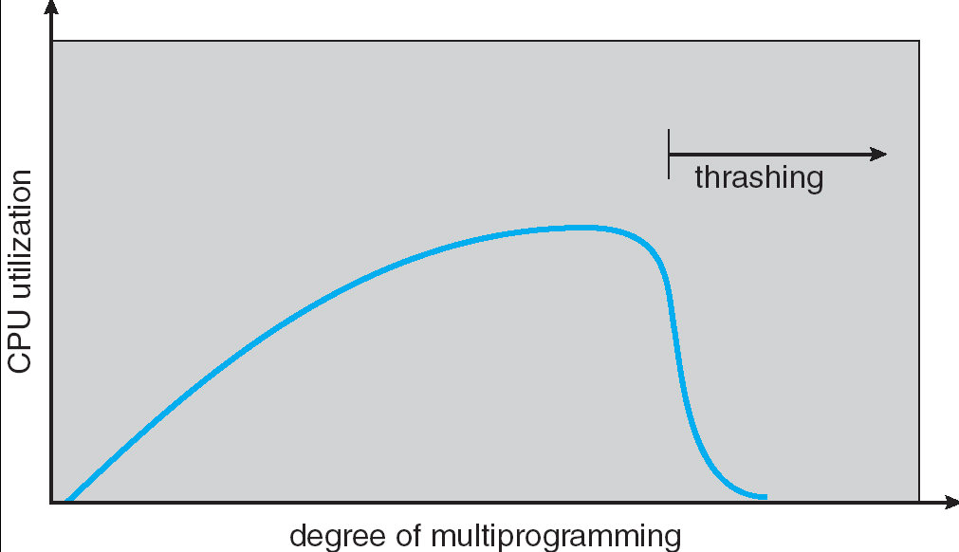
Thrashing
If a process does not have “enough” pages, the page-fault rate is very high. This leads to:
low CPU utilization
operating system spends most of its time swapping to disk
Thrashing ≡ a process is busy swapping pages in and out with little or no actual progress
Questions:
How do we detect Thrashing?
What is best response to Thrashing?
Notes:
Example: one program, touches 50 pages (each equally likely). Have only 40 physical page frames.
How bad is this?
- Does your program run at 80% speed?
- Does your program run at 20% speed?
Performance is really bad
If we have enough pages, 200 ns/ref, but if too few pages, assume every 5th page reference causes a page fault
= 4 refs x 200 ns
1 page fault x 10 ms for disk I/O
= 5 refs, 10 ms + 800 ns => 2 ms/ref (not 100 MIPS, but 500 IPS! Factor of 10,000)
Machine appears to have stopped!

Slide 40
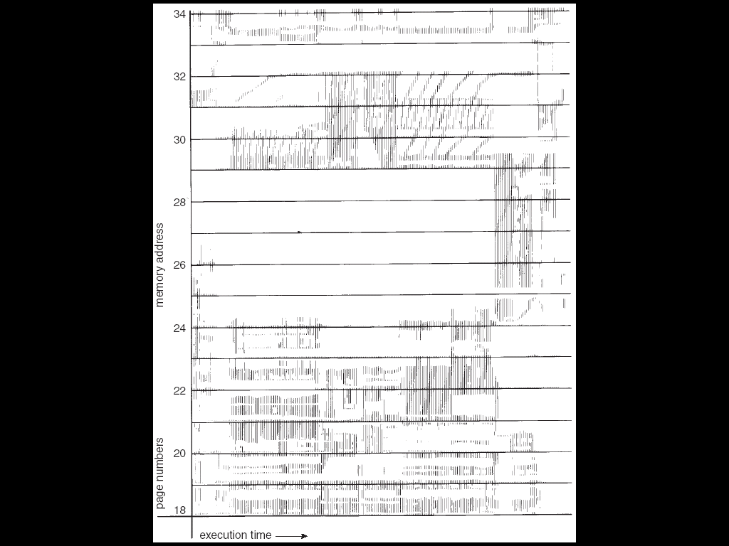
Locality In A Memory-Reference Pattern
Program Memory Access Patterns have temporal and spatial locality
Group of Pages accessed along a given time slice called the “Working Set”
Working Set defines minimum number of pages for process to behave well
Not enough memory for Working Set ⇒ Thrashing
Better to swap out process?

Slide 41
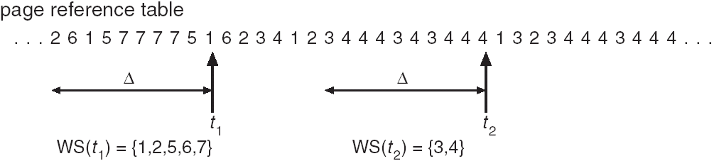
Working-Set Model
Δ ≡ working-set window ≡ fixed number of page references
Example: 10,000 instructions
WS_{i} (working set of Process P_{i}) = total set of pages referenced in the most recent Δ (varies in time)
if Δ too small will not encompass entire locality
if Δ too large will encompass several localities
if Δ = ∞ ⇒ will encompass entire program
D = Σ|WS_{i}| ≡ total demand frames
if D > m ⇒ Thrashing
Policy: if D > m, then suspend/swap out processes
This can improve overall system behavior by a lot!

Slide 42
What about Compulsory Misses?
Recall that compulsory misses are misses that occur the first time that a page is seen
Pages that are touched for the first time
Pages that are touched after process is swapped out/swapped back in
Clustering:
On a page-fault, bring in multiple pages “around” the faulting page
Since efficiency of disk reads increases with sequential reads, makes sense to read several sequential pages
Working Set Tracking:
Use algorithm to try to track working set of application
When swapping process back in, swap in working set

Slide 44
Linux Memory Details?
Memory management in Linux considerably more complex than the examples we have been discussing
Memory Zones: physical memory categories
ZONE_DMA: < 16MB memory, DMA-able on ISA bus
ZONE_NORMAL: 16MB → 896MB (mapped at 0xC0000000)
ZONE_HIGHMEM: Everything else (> 896MB)
Each zone has 1 freelist, 2 LRU lists (Active/Inactive)
Many different types of allocation
SLAB allocators, per-page allocators, mapped/unmapped
Many different types of allocated memory:
Anonymous memory (not backed by a file, heap/stack)
Mapped memory (backed by a file)
Allocation priorities
Is blocking allowed/etc.

Slide 45
Linux Virtual Memory Map (Pre-Meltdown)
0xFFFFFFFF
0xFFFFFFFFFFFFFFFF
Kernel Addresses
1GB
Kernel Addresses
128TiB
896MB Physical
64 TiB Physical
0xC0000000
User Addresses
0xFFFF800000000000
3GB Total
Empty
Space
“Canonical Hole”
0x00007FFFFFFFFFFF
128TiB
User
Addresses
0x00000000
0x0000000000000000
32-Bit Virtual Address Space
64-Bit Virtual Address Space

Slide 46
Pre-Meltdown Virtual Map (Details)
Kernel memory not generally visible to user
Exception: special VDSO (virtual dynamically linked shared objects) facility that maps kernel code into user space to aid in system calls (and to provide certain actual system calls such as gettimeofday())
Every physical page described by a “page” structure
Collected together in lower physical memory
Can be accessed in kernel virtual space
Linked together in various “LRU” lists
For 32-bit virtual memory architectures:
When physical memory < 896MB
All physical memory mapped at 0xC0000000
When physical memory >= 896MB
Not all physical memory mapped in kernel space all the time
Can be temporarily mapped with addresses > 0xCC000000
For 64-bit virtual memory architectures:
All physical memory mapped above 0xFFFF800000000000

Slide 47
Post Meltdown Memory Map
Meltdown flaw (2018, Intel x86, IBM Power, ARM)
Exploit speculative execution to observe contents of kernel memory 1: // Set up side channel (array flushed from cache) 2: uchar array[256 * 4096]; 3: flush(array); // Make sure array out of cache 4: try { // … catch and ignore SIGSEGV (illegal access) 5: uchar result = *(uchar *)kernel_address; // Try access! 6: uchar dummy = array[result * 4096]; // leak info! 7: } catch(){;} // Could use signal() and setjmp/longjmp 8: // scan through 256 array slots to determine which loaded
Some details:
Reason we skip 4096 for each value: avoid hardware cache prefetch
Note that value detected by fact that one cache line is loaded
Catch and ignore page fault: set signal handler for SIGSEGV, can use setjump/longjmp….
Patch: Need different page tables for user and kernel
Without PCID tag in TLB, flush TLB twice on syscall (800% overhead!)
Need at least Linux v 4.14 which utilizes PCID tag in new hardware to avoid flushing when change address space
Fix: better hardware without timing side-channels
Will be coming, but still in works

Slide 48
Summary
Replacement policies
FIFO: Place pages on queue, replace page at end
MIN: Replace page that will be used farthest in future
LRU: Replace page used farthest in past
Clock Algorithm: Approximation to LRU
Arrange all pages in circular list
Sweep through them, marking as not “in use”
If page not “in use” for one pass, then can replace
N^{th}-chance clock algorithm: Another approximate LRU
Give pages multiple passes of clock hand before replacing
Second-Chance List algorithm: Yet another approximate LRU
Divide pages into two groups, one of which is truly LRU and managed on page faults.
Working Set:
Set of pages touched by a process recently
Thrashing: a process is busy swapping pages in and out
Process will thrash if working set doesn’t fit in memory
Need to swap out a process

