Slide 1
CS162 Operating Systems and Systems Programming Lecture 2 Four Fundamental OS Concepts

Slide 2



Recall: What is an Operating System?
Referee
Manage protection, isolation, and sharing of resources
Resource allocation and communication
Illusionist
Provide clean, easy-to-use abstractions of physical resources
Infinite memory, dedicated machine
Higher level objects: files, users, messages
Masking limitations, virtualization
Glue
Common services
Storage, Window system, Networking
Sharing, Authorization
Look and feel

Slide 3
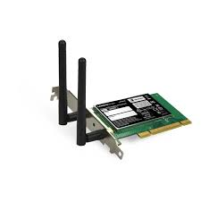
Recall: OS Protection
Compiled
Program 1
Compiled
Program 2
System Libs
System Libs
Compiler
Process 1
Process 2
Threads
Address Spaces
Files
Sockets
Threads
Address Spaces
Files
Sockets
Operating System
ISA
Processor
PgTbl
& TLB
Storage
Networks
Memory
Hardware
OS
Mem
I/O Ctrlr

Slide 4
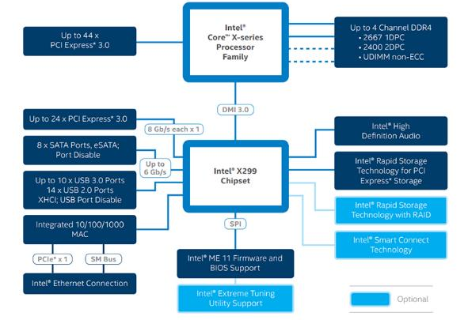
Recall: HW Functionality ⇒ great complexity!
Memory Channels
(High BW DRAM)
Really High Speed I/O (e.g. graphics)
Direct Media Interface (3.93 GBytes/sec)
High-Speed I/O devices (PCI Exp)
HD Audio
Disks (8 x SATA)
PCI/e Drives
Slower I/O (USB)
RAID 0/1/5/10
Integrated Ethernet
Smart Connect (autoupdate)
Intel Skylake-X I/O Configuration

Slide 5
Recall: Increasing Software Complexity
New Versions usually (much) larger older versions!
Cars getting really complex!
Millions of Lines of Code
(source https://informationisbeautiful.net/visualizations/million-lines-of-code/)

Slide 6
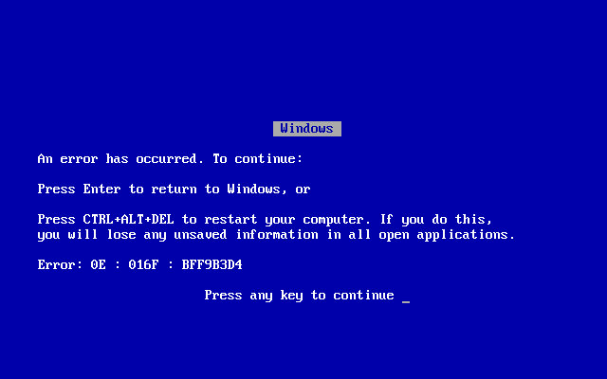

Complexity leaks into OS if not properly designed:
Buggy device drivers
Holes in security model or bugs in OS lead to instability and privacy breaches
Meltdown (2017)
Spectre (2017)
Version skew of libraries can lead to problems with application execution

Slide 7
OS Abstracts Underlying Hardware to help Tame Complexity
Application
Operating System
Hardware
Processor → Thread
Memory → Address Space
Disks, SSDs, … → Files
Networks → Sockets
Machines → Processes
OS as an Illusionist:
Remove software/hardware quirks (fight complexity)
Optimize for convenience, utilization, reliability, … (help the programmer)
For any OS area (e.g. file systems, virtual memory, networking, scheduling):
What hardware interface to handle? (physical reality)
What’s software interface to provide? (nicer abstraction)
Abstract Machine Interface
Physical Machine Interface

Slide 8
Today: Four Fundamental OS Concepts
Thread: Execution Context
Fully describes program state
Address space
Set of memory addresses accessible to program (for read or write)
Process: an instance of a running program
Protected Address Space + One or more Threads
Dual mode operation / Protection
Only the “system” has the ability to access certain resources

Slide 9
First OS Concept: Thread of Control
Thread: Single unique execution context
Program Counter, Registers, Execution Flags, Stack, Memory State
A thread is executing on a processor (core) when it is resident in the processor registers
A thread is suspended (not executing) when its state is not loaded (resident) into the processor
Processor state pointing at some other thread
Program counter register is not pointing at next instruction from this thread
Often: a copy of the last value for each register stored in memory

Slide 10
61 is back! Instruction Fetch/Decode/Execute
The instruction cycle
Memory
Processor
next
PC:
Instruction fetch
instruction
Decode
decode
Registers
Execute
ALU
data

Slide 11
Illusion of Multiple Processors
Multiplex in time
Threads are virtual cores
Contents of virtual core (thread):
Program counter, stack pointer
Registers
Where is “it” (the thread)?
On the real (physical) core, or
Saved in chunk of memory – called the Thread Control Block (TCB)
vCPU1
vCPU2
vCPU3
vCPU1
vCPU2
vCPU3
vCPU1
vCPU2
Shared Memory
Time
Programmer’s View

Slide 12
Illusion of Multiple Processors (Continued)
Consider:
At T1: vCPU1 on real core, vCPU2 in memory
At T2: vCPU2 on real core, vCPU1 in memory
What happened?
OS Ran, triggering a context switch
Saved PC, SP, … in vCPU1's thread control block (memory)
Loaded PC, SP, … from vCPU2's TCB, jumped to PC
T1
T2
vCPU1
vCPU2
vCPU3
vCPU1
vCPU2
vCPU3
vCPU1
vCPU2
Shared Memory
Time
Programmer’s View

Slide 13
Multiprogramming - Multiple Threads of Control
Proc 1
Proc 2
Proc n
stack
…
heap
OS
Static Data
code
stack
Thread Control Block (TCB)
Holds contents of registers when thread not running
Where are TCBs stored?
For now, in the kernel
PINTOS? – read thread.h and thread.c
heap
Static Data
code
stack
heap
Static Data
code

Slide 14
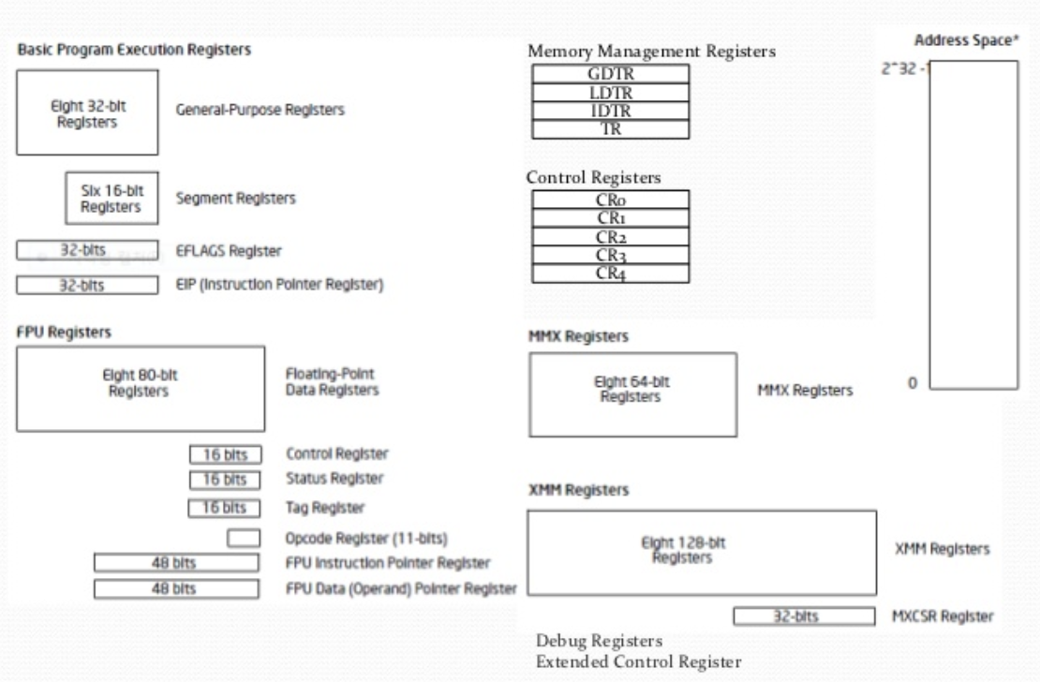
Registers: RISC-V ⇒ x86
Load/Store Arch (RISC-V)
with software conventions
Complex mem-mem arch (x86) with specialized registers and “segments”
cs61C does RISC-V. Will need to learn x86…
Section will cover this architecture

Slide 15
Second OS Concept: Address Space
Address space ⇒ the set of accessible addresses + state associated with them:
For 32-bit processor: 2³² = 4 billion (10⁹) addresses
For 64-bit processor: 2⁶⁴ = 18 quintillion (10¹⁸) addresses
What happens when you read or write to an address?
Perhaps acts like regular memory
Perhaps causes I/O operation
(Memory-mapped I/O)
Perhaps causes exception (fault)
Communicates with another program
….
0xFFF…
stack
heap
Static Data
code
0x000…

Slide 16
Address Space: In a Picture
0xFFF…
stack
PC:
SP:
heap
Processor
registers
Static Data
instruction
Code Segment
0x000…

Slide 17
Very Simple Multiprogramming
All vCPU's share non-CPU resources
Memory, I/O Devices
Each thread can read/write memory
Perhaps data of others, including OS!
Used in early days of computing or embedded systems.
vCPU1
vCPU2
vCPU3
vCPU1
vCPU2
Time

Slide 18
Simple Multiplexing has no Protection!
OS must protect user programs from one another
Prevent threads owned by one user from impacting threads owned by another user
Example: prevent one user from stealing secret information from another user
OS must protect itself from user programs
Reliability: compromising the operating system generally causes it to crash
Security: limit the scope of what threads can do
Privacy: limit each thread to the data it is permitted to access
Fairness: each thread should be limited to its appropriate share of system resources (CPU, memory)

Slide 19
What can the hardware do to help the OS protect itself from programs???

Slide 20
Simple Protection: Base and Bound (B&B)
0000…
0000…
code
code
Static Data
Static Data
heap
heap
stack
0100…
stack
Base
0010…
1000…
1000…
code
>=
Program
address
1010…
Static Data
heap
Bound
<
1100…
stack
1100…
FFFF…

Slide 21
Simple Protection: Base and Bound (B&B)
0000…
0000…
code
code
Static Data
Static Data
heap
heap
stack
0100…
stack
Base
0010…
1000…
1000…
code
>=
Program
address
1010…
Static Data
heap
Addresses translated when program loaded
Bound
<
1100…
stack
1100…
FFFF…

Slide 22
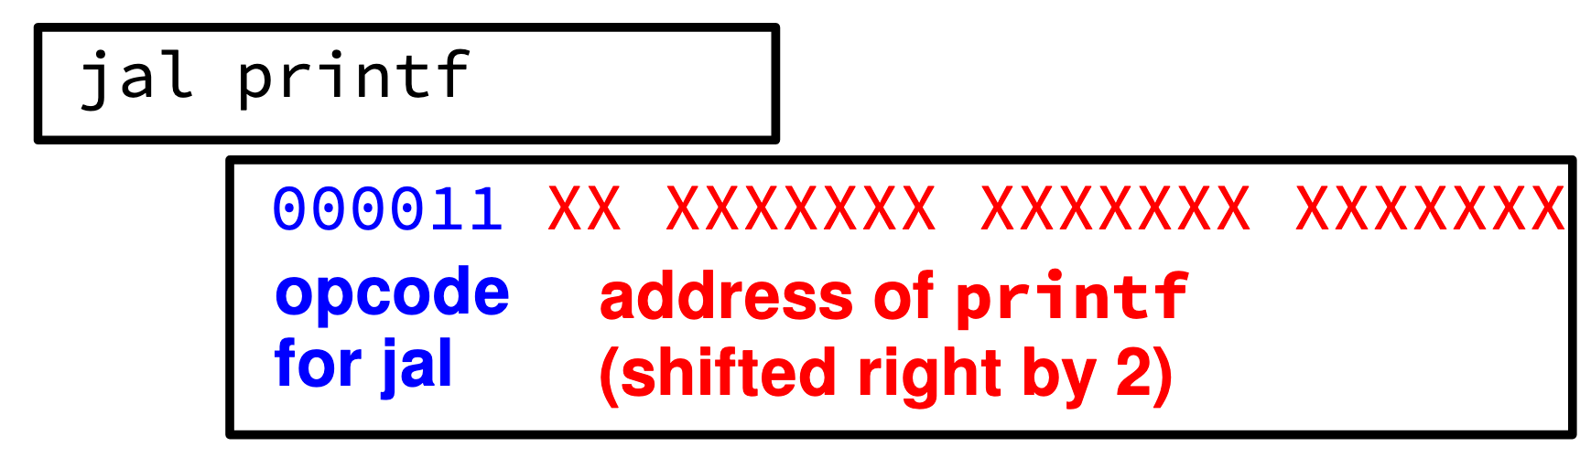
61C Review: Relocation
Compiled .obj file linked together in an .exe
All address in the .exe are as if it were loaded at memory address 00000000
File contains a list of all the addresses that need to be adjusted when it is “relocated” to somewhere else.

Slide 23
Simple address translation with Base and Bound
0000…
code
0000…
code
Static Data
heap
Addresses translated on-the-fly
Static Data
heap
stack
0100…
stack
Base Address
1000…
code
1000…
0010…
Program
address
0010…
Static Data
1010…
heap
Bound
<
Hardware relocation
stack
1100…
0100…
FFFF…

Slide 24
x86 – segments and stacks
code
Processor Registers
static data
CS
EIP
heap
SS
ESP
EAX
stack
DS
EBX
ES
ECX
CS:
code
EDX
EIP:
ESI
EDI
static data
Start address, length and access rights associated with each segment register
heap
SS:
ESP:
stack

Slide 25
Another idea: Address Space Translation
Program operates in an address space that is distinct from the physical memory space of the machine
“physical address”
0x000…
“virtual address”
Processor
translator
Memory
Registers
0xFFF…

Slide 26
Paged Virtual Address Space
Break the entire virtual address space into equal size chunks (i.e., pages)
All pages same size, so easy to place each page in memory!
Hardware translates address using a page table
Each page has a separate base
The “bound” is the page size
Special hardware register stores pointer to page table

Slide 27
Paged Virtual Address
Memory
Processor
Registers
<Page #>
Page Table
<Frame Addr>
instruction
<Page Offset>
Page (eg, 4 kb)
<Virtual Address> =
<Page #> <Page Offset>
PT Addr
Instructions operate on virtual addresses
Translated to a physical address through a Page Table by the hardware
Any Page of address space can be in any (page sized) frame in memory
Or not-present (access generates a page fault)
Special register holds page table base address (of the process)

Slide 28
Third OS Concept: Process
Definition: execution environment with restricted rights
(Protected) Address Space with One or More Threads
Owns memory (address space), file descriptors, sockets
Encapsulate one or more threads sharing process resources
Why processes?
Protected from each other! OS Protected from them
Processes provides memory protection
A process is a running program, with protection

Slide 29
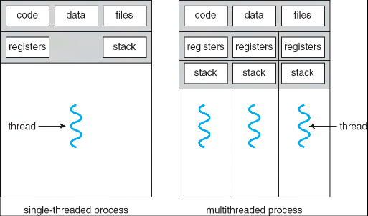
Single and Multithreaded Processes
Threads encapsulate concurrency
Address spaces encapsulate protection
Why have multiple threads per address space?
Parallelism: take advantage of actual hardware parallelism (e.g. multicore)
Concurrency: ease of handling I/O and other simultaneous events

Slide 30
Protection and Isolation
Processes provide protection and isolation
Reliability: bugs can only overwrite memory of process they are in
Security and privacy: malicious or compromised process can’t read or write other process’ data
Mechanisms:
Address translation: address space only contains its own data
BUT: why can’t a process change the page table pointer?
Or use I/O instructions to bypass the system?
Hardware must support privilege levels

Slide 31
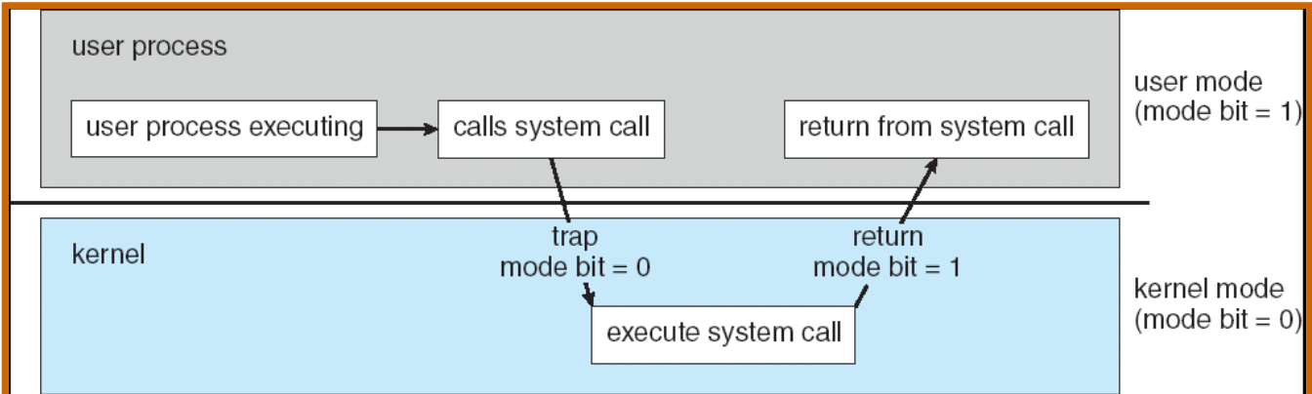
Fourth OS Concept: Dual Mode Operation
Hardware provides at least two modes
Kernel Mode (or “supervisor” mode)
User Mode
Certain operations are prohibited when running in user mode (privileged instructions)
Carefully controlled transitions between user mode and kernel mode

Slide 32
3 types of User ⇒ Kernel Mode Transfer
Syscall
Process requests a system service, e.g., exit
Like a function call, but “outside” the process
Interrupt
External asynchronous event triggers context switch
e. g., Timer, I/O device
Trap or Exception
Internal synchronous event in process triggers context switch
e.g., Protection violation (segmentation fault), Divide by zero, …

Slide 33
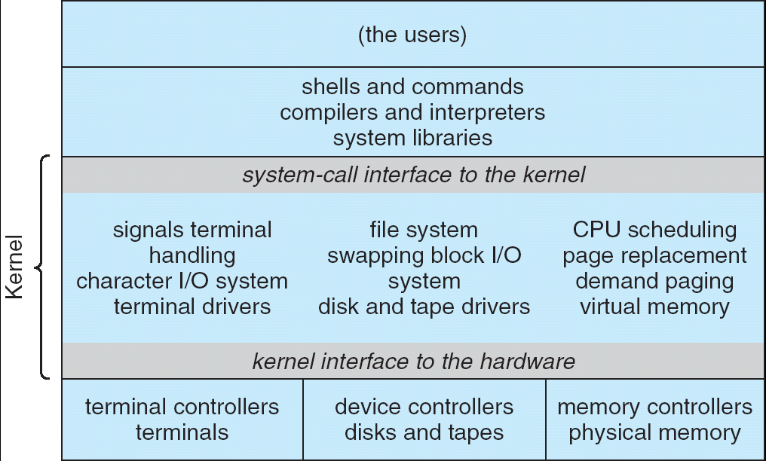
For example: UNIX System Structure
Applications
User Mode
Standard Libs
Kernel Mode
Hardware

Slide 34
User/Kernel (Privileged) Mode
User Mode
interrupt
exception
syscall
rtn
rfi
Kernel Mode
exec
Limited HW access
Full HW access

Slide 35
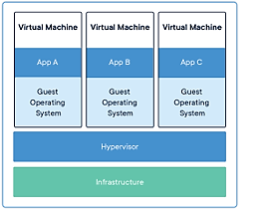
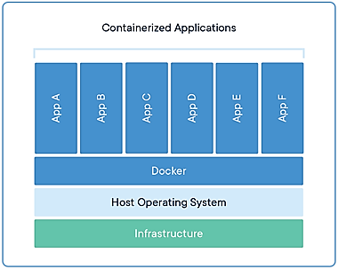
Additional Layers of Protection for Modern Systems
Additional layers of protection through virtual machines or containers
Run a complete operating system in a virtual machine
Package all the libraries associated with an app into a container for execution
More on these ideas later in the class

Slide 36
Tying it together: Simple B&B: OS loads process
0000…
Proc 1
Proc 2
Proc n
code
…
Static Data
OS
heap
stack
sysmode
1
1000…
code
Base
xxxx …
0000…
Static Data
Bound
xxxx…
FFFF…
heap
uPC
xxxx…
stack
1100…
PC
code
3000…
regs
Static Data
…
heap
stack
3080…
FFFF…

Slide 37
Simple B&B: OS gets ready to execute process
0000…
Proc 1
Proc 2
Proc n
code
RTU
…
Static Data
OS
heap
stack
sysmode
1
1000…
code
Base
1000 …
0000…
Static Data
Bound
1100…
FFFF…
heap
uPC
0001…
stack
1100…
Privileged Inst: set special registers
RTU (Return To Usermode)
PC
code
3000…
regs
00FF…
Static Data
…
heap
stack
3080…
FFFF…

Slide 38
Unprogrammed control transfers
User => Kernel mode transitions are examples of “unprogrammed control transfers”
How do we know what the address of the next instruction should be?
Will require support of lookup tables

Slide 39
Interrupt Vector
Address and properties of each interrupt handler
interrupt number (i)
intrpHandler_i () {
….
}

Slide 40
Simple B&B: User => Kernel
0000…
Proc 1
Proc 2
Proc n
code
…
Static Data
OS
heap
stack
sysmode
0
1000…
code
Base
1000 …
0000…
Static Data
Bound
1100…
FFFF…
heap
uPC
xxxx…
stack
1100…
PC
0000 1234
code
3000…
regs
00FF…
Static Data
…
heap
stack
3080…
FFFF…

Slide 41
Simple B&B: Interrupt
0000…
Proc 1
Proc 2
Proc n
code
…
Static Data
OS
heap
stack
sysmode
1
1000…
code
Base
1000 …
0000…
Static Data
Bound
1100 …
FFFF…
heap
uPC
0000 1234
stack
1100…
PC
IntrpVector[i]
code
3000…
regs
00FF…
Static Data
How to save registers and set up system stack?
…
heap
stack
3080…
FFFF…

Slide 42
Simple B&B: Switch User Process
0000…
Proc 1
Proc 2
Proc n
code
RTU
…
Static Data
OS
heap
stack
sysmode
1
1000…
1000 …
code
Base
3000 …
0000…
Static Data
1100 …
Bound
0080 …
FFFF…
heap
0000 1234
uPC
0000 0248
regs
stack
1100…
PC
0001 0124
00FF…
code
3000…
regs
00D0…
Static Data
…
heap
stack
3080…
FFFF…

Slide 43
Simple B&B: “resume”
0000…
Proc 1
Proc 2
Proc n
code
RTU
…
Static Data
OS
heap
stack
sysmode
0
1000…
1000 …
code
Base
3000 …
0000…
Static Data
1100 …
Bound
0080 …
FFFF…
heap
0000 1234
uPC
xxxx xxxx
regs
stack
1100…
PC
000 0248
00FF…
code
3000…
regs
00D0…
Static Data
…
heap
stack
3080…
FFFF…

Slide 44
Running Many Programs ???
We have the basic mechanism to
switch between user processes and the kernel,
the kernel can switch among user processes,
Protect OS from user processes and processes from each other
How do we decide which user process to run?
How do we represent user processes in the OS?
How do we pack up the process and set it aside?
How do we get a stack and heap for the kernel?

Slide 45
Conclusion: Four Fundamental OS Concepts
Thread: Execution Context
Single thread of execution
Address space (with or w/o translation)
Set of memory addresses accessible to program (for read or write)
Process: an instance of a running program
Protected Address Space + One or more Threads
Dual mode operation / Protection
Only the “system” has the ability to access certain resources

