Slide 1
CS162 Operating Systems and Systems Programming Lecture 20 Filesystems 2: Filesystem Case Studies (Con’t), Buffering
April 8th, 2021
Profs. Natacha Crooks and Anthony D. Joseph
http://cs162.eecs.Berkeley.edu

Slide 2

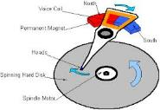




Recall: I/O and Storage Layers
Application / Service
High Level I/O
Streams
Low Level I/O
File Descriptors
What we covered in Lecture 4
Syscall
open(), read(), write(), close(), …
Open File Descriptions
File System
Files/Directories/Indexes
What we are covering…
I/O Driver
Commands and Data Transfers
What we previously covered…
Disks, Flash, Controllers, DMA

Slide 3
Recall: From Storage to File Systems
I/O API and
syscalls
Variable-Size Buffer
Memory Address
Logical Index, Typically 4 KB
File System
Block
Flash Trans. Layer
Hardware Devices
Sector(s)
Sector(s)
Sector(s)
Phys. Block
Phys Index., 4KB
Physical Index,
512B or 4KB
Erasure Page
HDD
SSD

Slide 4
Recall: Building a File System
File System: Layer of OS that transforms block interface of disks (or other block devices) into Files, Directories, etc.
Classic OS situation: Take limited hardware interface (array of blocks) and provide a more convenient/useful interface with:
Naming: Find file by name, not block numbers
Organize file names with directories
Organization: Map files to blocks
Protection: Enforce access restrictions
Reliability: Keep files intact despite crashes, hardware failures, etc.

Slide 5
Recall: User vs. System View of a File
User’s view:
Durable Data Structures
System’s view (system call interface):
Collection of Bytes (UNIX)
Doesn’t matter to system what kind of data structures you want to store on disk!
System’s view (inside OS):
Collection of blocks (a block is a logical transfer unit, while a sector is the physical transfer unit)
Block size ≥ sector size; in UNIX, block size is 4KB

Slide 6
Recall: Components of a File System
File path
Directory
Structure
File
Header
Structure
One Block = multiple sectors
Ex: 512 sector, 4K block
File number
“inumber”
Data blocks
“inode”
…

Slide 7
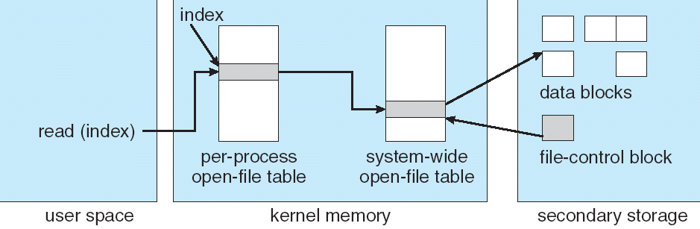
Recall: In-Memory File System Structures
fd
(fd)
inode
Open syscall: find inode on disk from pathname (traversing directories)
Create “in-memory inode” in system-wide open file table
One entry in this table no matter how many instances of the file are open
Read/write syscalls look up in-memory inode using the file handle

Slide 8
Recall: FAT (File Allocation Table) Properties
File is collection of disk blocks (“clusters”)
FAT is array of integers mapped 1-1 with disk blocks
Each integer is either:
Pointer to next block in file; or
End of file flag; or
Free block flag
File Number is index of root of block list for the file
Follow list to get block #
Directory must map name to block number at start of file
But: Where is FAT stored?
Beginning of disk, before the data blocks
Usually 2 copies (to handle errors)
FAT
Disk Blocks
0:
0:
File number
31:
File 31, Block 0
File 31, Block 1
File 31, Block 3
free
File 31, Block 2
N-1:
N-1:
memory

Slide 9
Recall: FAT Discussion
FAT
Disk Blocks
Suppose you start with the file number:
Time to find block?
Block layout for file?
Sequential access?
Random access?
Fragmentation?
Small files?
Big files?
0:
0:
File #1
31:
File 31, Block 0
File 31, Block 1
File 31, Block 3
free
File #2
File 31, Block 2
N-1:
N-1:
memory

Slide 10
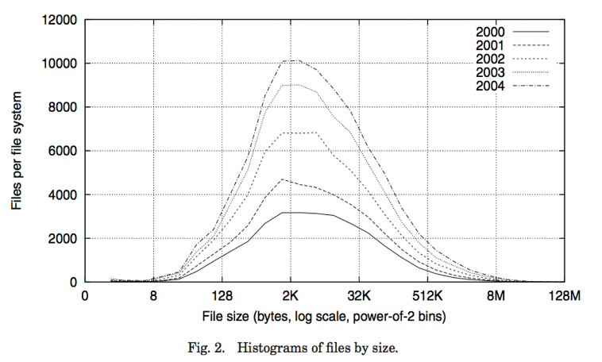
Recall: Observation #1: Most Files Are Small

Slide 11
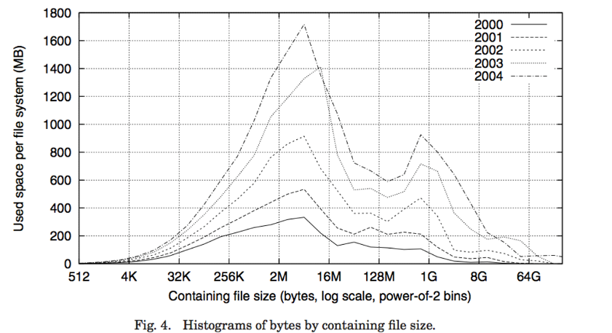
Recall: Observation #2: Most Bytes are in Large Files

Slide 12
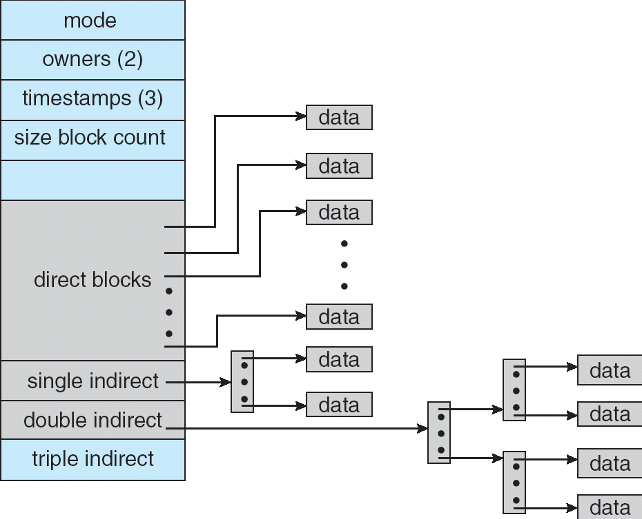
Recall: Multilevel Indexed Files (Original 4.1 BSD)
Sample file in multilevel indexed format:
10 direct ptrs, 1K blocks
How many accesses for block #23? (assume file header accessed on open)?
Two: One for indirect block, one for data
How about block #5?
One: One for data
Block #340?
Three: double indirect block, indirect block, and data
UNIX 4.1 Pros and cons
Pros: Simple (more or less) Files can easily expand (up to a point) Small files particularly cheap and easy
Cons: Lots of seeks Very large files must read many indirect block (Four I/Os per block!)

Slide 13
Recall: Fast File System (BSD 4.2, 1984)
Same inode structure as in BSD 4.1
same file header and triply indirect blocks like we just studied
Some changes to block sizes from 1024 ⇒ 4096 bytes for performance
Paper on FFS: “A Fast File System for UNIX”
Marshall McKusick, William Joy, Samuel Leffler and Robert Fabry
Off the “resources” page of course website – Take a look!
Optimization for Performance and Reliability:
Distribute inodes among different tracks to be closer to data
Uses bitmap allocation in place of freelist
Attempt to allocate files contiguously
10% reserved disk space
Skip-sector positioning (mentioned later)

Slide 14
Recall: UNIX 4.2 BSD FFS
Pros
Efficient storage for both small and large files
Locality for both small and large files
Locality for metadata and data
No defragmentation necessary!
Cons
Inefficient for tiny files (a 1-byte file requires both an inode and a data block)
Inefficient encoding when file is mostly contiguous on disk
Need to reserve 10-20% of free space to prevent fragmentation

Slide 16
Administrivia
Make sure to fill out post midterm survey
Let us know how we are doing or what we could improve
If you have any group issues going on, make sure you:
Make sure that your TA understands what is happing
Make sure that you reflect these issues on your group evaluations

Slide 17


Recall: CS 162 Collaboration Policy
Explaining a concept to someone in another group
Discussing algorithms/testing strategies with other groups
Discussing debugging approaches with other groups
Searching online for generic algorithms (e.g., hash table)
Sharing OR verbally discussing code/test cases with another group (or a teammate for HW)
Copying OR reading another group’s code or test cases
Copying OR reading online code or test cases from prior years
Helping someone in another group to debug their code
We compare all project submissions against prior year submissions and online solutions and will take actions (described on the course overview page) against offenders
Don’t put a friend in a bad position by asking for help that they shouldn’t give!

Slide 19
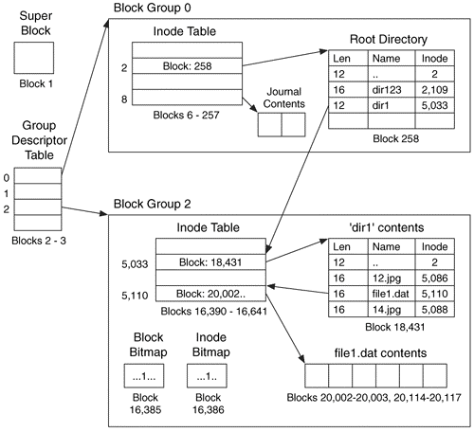
Linux Example: Ext2/3 Disk Layout
Disk divided into block groups
Provides locality
Each group has two block-sized bitmaps (free blocks/inodes)
Block sizes settable at format time: 1K, 2K, 4K, 8K…
Actual inode structure similar to 4.2 BSD
With 12 direct pointers instead of 10
Ext3: Ext2 with Journaling
Several degrees of protection with comparable overhead
We will talk about Journaling later
Example: create a file1.dat under /dir1/ in Ext3

Slide 20
Recall: Directory Abstraction
Directories are specialized files
Contents: List of pairs <file name, file number>
System calls to access directories
open / creat traverse the structure
mkdir /rmdir add/remove entries
link / unlink (rm)
libc support
DIR * opendir (const char *dirname)
struct dirent * readdir (DIR *dirstream)
int readdir_r (DIR *dirstream, struct dirent *entry, struct dirent **result)
/usr
/usr/lib
/usr/lib4.3
/usr/lib4.3/foo

Slide 21
Hard Links
Hard link
Mapping from name to file number in the directory structure
First hard link to a file is made when file created
Create extra hard links to a file with the link() system call
Remove links with unlink() system call
When can file contents be deleted?
When there are no more hard links to the file
Inode maintains reference count for this purpose
/usr
/usr/lib
/usr/lib4.3
/usr/lib4.3/foo

Slide 22
Soft Links (Symbolic Links)
Soft link or Symbolic Link or Shortcut
Directory entry contains the path and name of the file
Map one name to another name
Contrast these two different types of directory entries:
Normal directory entry: <file name, file #>
Symbolic link: <file name, destination file name>
OS looks up destination file name each time program accesses source file name
Lookup can fail (error result from open)
Unix: Create soft links with symlink syscall

Slide 23
Directory Traversal
inode
What happens when we open /home/cs162/stuff.txt?
“/” - inumber for root inode configured into kernel, say 2
Read inode 2 from its position in inode array on disk
Extract the direct and indirect block pointers
Determine block that holds root directory (say block 49358)
Read that block, scan it for “home” to get inumber for this directory (say 8086)
Read inode 8086 for /home, extract its blocks, read block (say 7756), scan it for “cs162” to get its inumber (say 732)
Read inode 732 for /home/cs162, extract its blocks, read block (say 12132), scan it for “stuff.txt” to get its inumber, say 9909
Read inode 9909 for /home/cs162/stuff.txt
Set up file description to refer to this inode so reads / write can access the data blocks referenced by its direct and indirect pointers
Check permissions on each directory’s inode AND the final inode
block 49358
2
“home”:8086
732
block 12132
“stuff.txt”:9909
8086
block 7756
“cs162”:732
Blocks of stuff.txt
9909
2
9099
“home”:8086
732
8086
“cs162”:732
“stuff.txt”:9909
memory

Slide 24
Large Directories: B-Trees (dirhash)
in FreeBSD, NetBSD, OpenBSD

Slide 26
Case Study: Windows NTFS

Slide 27
New Technology File System (NTFS)
Default on modern Windows systems
Variable length extents
Rather than fixed blocks
Instead of FAT or inode array: Master File Table
Like a database, with maximum of 1 KB size for each table entry
Everything (almost) is a sequence of <attribute:value> pairs
Including metadata and data
Each entry in MFT contains metadata and:
File’s data directly (for small files)
A list of extents (start block, size) for file’s data
For big files: pointers to other MFT entries with more extent lists

Slide 28
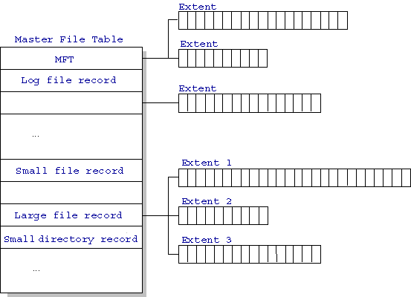
NTFS
Master File Table
Database with flexible 1KB entries for metadata/data
Variable-sized attribute records (data or metadata)
Extend with variable depth tree (non-resident)
Extents – variable length contiguous regions
Block pointers cover runs of blocks
Similar approach in Linux (ext4)
File create can provide hint as to size of file
Journaling for reliability
Discussed later
http://ntfs.com/ntfs-mft.htm

Slide 29
NTFS Small File: Data stored with Metadata
Create time, modify time, access time,
Owner id, security specifier, flags (RO, hidden, sys)
data attribute
Attribute list

Slide 30
NTFS Medium File: Extents for File Data

Slide 31
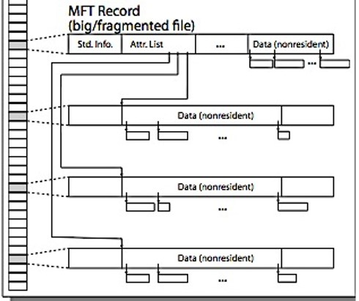
NTFS Large File: Pointers to Other MFT Records

Slide 32
NTFS Huge, Fragmented File: Many MFT Records

Slide 33
NTFS Directories
Directories implemented as B Trees – efficient for searching large directories
File’s number identifies its entry in MFT
MFT entry always has a file name attribute
Human readable name, file number of parent dir
Hard link? Multiple file name attributes in MFT entry

Slide 35
Memory Mapped files

Slide 36
Memory Mapped Files
Traditional I/O involves explicit transfers between buffers in process address space to/from regions of a file
This involves multiple copies into caches in memory, plus system calls
What if we could “map” the file directly into an empty region of our address space
Implicitly “page it in” when we read it
Write it and “eventually” page it out
Executable files are treated this way when we exec the process!!

Slide 37
Recall: Who Does What, When?
Process
virtual address
physical address
MMU
page#
PT
instruction
frame#
page fault
offset
retry
exception
frame#
Operating System
offset
update PT entry
Page Fault Handler
load page from disk
scheduler

Slide 38
Using Paging to mmap() Files
Process
virtual address
physical address
MMU
page#
PT
instruction
frame#
offset
retry
page fault
exception
Read File contents
from memory!
Operating System
Create PT entries
for mapped region
as “backed” by file
Page Fault Handler
File
scheduler
mmap() file to region of VAS

Slide 39
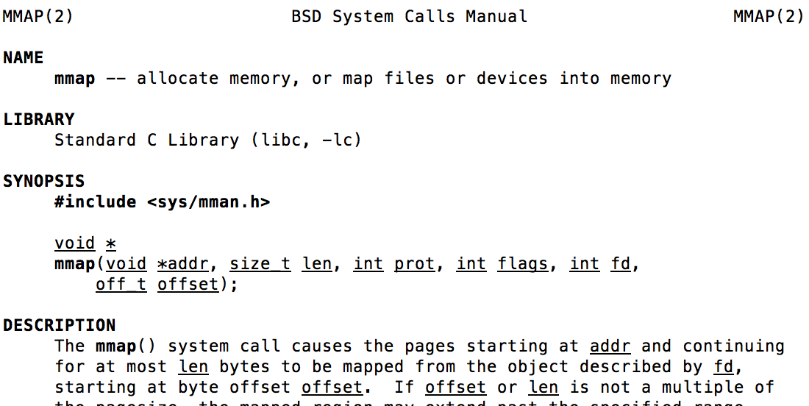
mmap() system call
May map a specific region or let the system find one for you
Tricky to know where the holes are
Used both for manipulating files and for sharing between processes

Slide 40
An mmap() Example
#include <sys/mman.h> /* also stdio.h, stdlib.h, string.h, fcntl.h, unistd.h */
int something = 162;
int main (int argc, char *argv[]) {
int myfd;
char *mfile;
printf("Data at: %16lx\n", (long unsigned int) &something);
printf("Heap at : %16lx\n", (long unsigned int) malloc(1));
printf("Stack at: %16lx\n", (long unsigned int) &mfile);
/* Open the file */
myfd = open(argv[1], O_RDWR | O_CREAT);
if (myfd < 0) { perror("open failed!");exit(1); }
/* map the file */
mfile = mmap(0, 10000, PROT_READ|PROT_WRITE, MAP_FILE|MAP_SHARED, myfd, 0);
if (mfile == MAP_FAILED) {perror("mmap failed"); exit(1);}
printf("mmap at : %16lx\n", (long unsigned int) mfile);
puts(mfile);
strcpy(mfile+20,"Let's write over it");
close(myfd);
return 0;
}
$ ./mmap test
Data at: 105d63058
Heap at : 7f8a33c04b70
Stack at: 7fff59e9db10
mmap at : 105d97000
This is line one
This is line two
This is line three
This is line four
$ cat test
This is line one
ThiLet's write over its line three
This is line four

Slide 41
Sharing through Mapped Files
VAS 1
VAS 2
0x000…
0x000…
instructions
instructions
data
data
File
heap
heap
Memory
stack
stack
OS
OS
0xFFF…
0xFFF…
Also: anonymous memory between parents and children
no file backing – just swap space

Slide 43
The buffer cache

Slide 44
Buffer Cache
Kernel must copy disk blocks to main memory to access their contents and write them back if modified
Could be data blocks, inodes, directory contents, etc.
Possibly dirty (modified and not written back)
Key Idea: Exploit locality by caching disk data in memory
Name translations: Mapping from paths→inodes
Disk blocks: Mapping from block address→disk content
Buffer Cache: Memory used to cache kernel resources, including disk blocks and name translations
Can contain “dirty” blocks (with modifications not on disk)

Slide 45
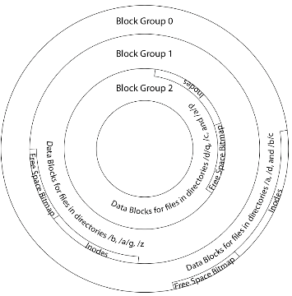
File System Buffer Cache
Data blocks
Disk
Reading
PCB
OS implements a cache of disk blocks for efficient access to data, directories, inodes, freemap
iNodes
file desc
Writing
Dir Data blocks
Free bitmap
Memory
Blocks
State
free
free

Slide 46
File System Buffer Cache: Open
Data blocks
Disk
Directory lookup repeat as needed:
load block of directory
search for map
Reading
PCB
iNodes
file desc
Writing
Dir Data blocks
Free bitmap
Memory
Blocks
State
free
free
rd
dir

Slide 47
File System Buffer Cache: Open
Data blocks
Disk
Directory lookup repeat as needed:
load block of directory
search for map
Create reference via open file descriptor
Reading
PCB
iNodes
file desc
Writing
Dir Data blocks
<name>:inumber
Free bitmap
Memory
Blocks
State
free
dir
inode
rd

Slide 48
File System Buffer Cache: Read?
Data blocks
Disk
Read Process
From inode, traverse index structure to find data block
load data block
copy all or part to read data buffer
Reading
PCB
iNodes
file desc
Writing
Dir Data blocks
<name>:inumber
Free bitmap
Memory
Blocks
State
free
dir
inode

Slide 49
File System Buffer Cache: Write?
Data blocks
Disk
Process similar to read, but may allocate new blocks (update free map), blocks need to be written back to disk; inode?
Reading
PCB
iNodes
file desc
Writing
Dir Data blocks
<name>:inumber
Free bitmap
Memory
Blocks
State
free
dir
inode

Slide 50
File System Buffer Cache: Eviction?
Data blocks
Disk
Blocks being written back to disc go through a transient state
Reading
PCB
iNodes
file desc
Writing
Dir Data blocks
<name>:inumber
Free bitmap
Memory
Blocks
State
free
dir
dirty
inode

Slide 51
Buffer Cache Discussion
Implemented entirely in OS software
Unlike memory caches and TLB
Blocks go through transitional states between free and in-use
Being read from disk, being written to disk
Other processes can run, etc.
Blocks are used for a variety of purposes
inodes, data for dirs and files, freemap
OS maintains pointers into them
Termination – e.g., process exit – open, read, write
Replacement – what to do when it fills up?

Slide 52
File System Caching
Replacement policy? LRU
Can afford overhead full LRU implementation
Advantages:
Works very well for name translation
Works well in general as long as memory is big enough to accommodate a host’s working set of files
Disadvantages:
Fails when some application scans through file system, thereby flushing the cache with data used only once
Example: find . –exec grep foo {} \;
Other Replacement Policies?
Some systems allow applications to request other policies
Example, ‘Use Once’:
File system can discard blocks as soon as they are used

Slide 53
File System Caching (con’t)
Cache Size: How much memory should the OS allocate to the buffer cache vs virtual memory?
Too much memory to the file system cache ⇒ won’t be able to run many applications
Too little memory to file system cache ⇒ many applications may run slowly (disk caching not effective)
Solution: adjust boundary dynamically so that the disk access rates for paging and file access are balanced

Slide 54
File System Prefetching
Read Ahead Prefetching: fetch sequential blocks early
Key Idea: exploit fact that most common file access is sequential by prefetching subsequent disk blocks ahead of current read request
Elevator algorithm can efficiently interleave prefetches from concurrent applications
How much to prefetch?
Too much prefetching imposes delays on requests by other applications
Too little prefetching causes many seeks (and rotational delays) among concurrent file requests

Slide 55
Delayed Writes
Buffer cache is a writeback cache (writes are termed “Delayed Writes”)
write() copies data from user space to kernel buffer cache
Quick return to user space
read() is fulfilled by the cache, so reads see the results of writes
Even if the data has not reached disk
When does data from a write syscall finally reach disk?
When the buffer cache is full (e.g., we need to evict something)
When the buffer cache is flushed periodically (in case we crash)

Slide 56
Delayed Writes (Advantages)
Performance advantage: return to user quickly without writing to disk!
Disk scheduler can efficiently order lots of requests
Elevator Algorithm can rearrange writes to avoid random seeks
Delay block allocation:
May be able to allocate multiple blocks at same time for file, keep them contiguous
Some files never actually make it all the way to disk
Many short-lived files!

Slide 57
Buffer Caching vs. Demand Paging
Replacement Policy?
Demand Paging: LRU is infeasible; use approximation (like NRU/Clock)
Buffer Cache: LRU is OK
Eviction Policy?
Demand Paging: evict not-recently-used pages when memory is close to full
Buffer Cache: write back dirty blocks periodically, even if used recently
Why? To minimize data loss in case of a crash

Slide 58
Dealing with Persistent State
Buffer Cache: write back dirty blocks periodically, even if used recently
Why? To minimize data loss in case of a crash
Linux does periodic flush every 30 seconds
Not foolproof! Can still crash with dirty blocks in the cache
What if the dirty block was for a directory?
Lose pointer to file’s inode (leak space)
File system now in inconsistent state ☹
Takeaway: File systems need
recovery mechanisms

Slide 59
File System Summary (1/2)
File System:
Transforms blocks into Files and Directories
Optimize for size, access and usage patterns
Maximize sequential access, allow efficient random access
Projects the OS protection and security regime (UGO vs ACL)
File defined by header, called “inode”
Naming: translating from user-visible names to actual sys resources
Directories used for naming for local file systems
Linked or tree structure stored in files
Look at actual file access patterns
Many small files, but large files take up all the space!

Slide 60
File System Summary (2/3)
4.2 BSD Multilevel Indexed Scheme
inode contains file info, direct pointers to blocks, indirect blocks, doubly indirect, etc..
NTFS: variable extents not fixed blocks, tiny files data is in header
File layout driven by freespace management
Optimizations for sequential access: start new files in open ranges of free blocks, rotational optimization
Integrate freespace, inode table, file blocks and dirs into block group
Deep interactions between mem management, file system, sharing
mmap(): map file or anonymous segment to memory
Buffer Cache: Memory used to cache kernel resources, including disk blocks and name translations
Can contain “dirty” blocks (blocks yet on disk)

