Slide 1
CS162 Operating Systems and Systems Programming Lecture 21 Filesystems 3: Reliability and Transactions
April 13th, 2021
Profs. Natacha Crooks and Anthony D. Joseph
http://cs162.eecs.Berkeley.edu

Slide 2
Recall: Components of a File System
File path
Directory
Structure
File
Header
Structure
One Block = multiple sectors
Ex: 512 sector, 4K block
File number
“inumber”
Data blocks
“inode”
…

Slide 3
Recall: FAT (File Allocation Table) Properties
File is collection of disk blocks (“clusters”)
FAT is array of integers mapped 1-1 with disk blocks
Each integer is either:
Pointer to next block in file; or
End of file flag; or
Free block flag
File Number is index of root of block list for the file
Follow list to get block #
Directory must map name to block number at start of file
But: Where is FAT stored?
Beginning of disk, before the data blocks
Usually 2 copies (to handle errors)
FAT
Disk Blocks
0:
0:
File number
31:
File 31, Block 0
File 31, Block 1
File 31, Block 3
free
File 31, Block 2
N-1:
N-1:
memory

Slide 4
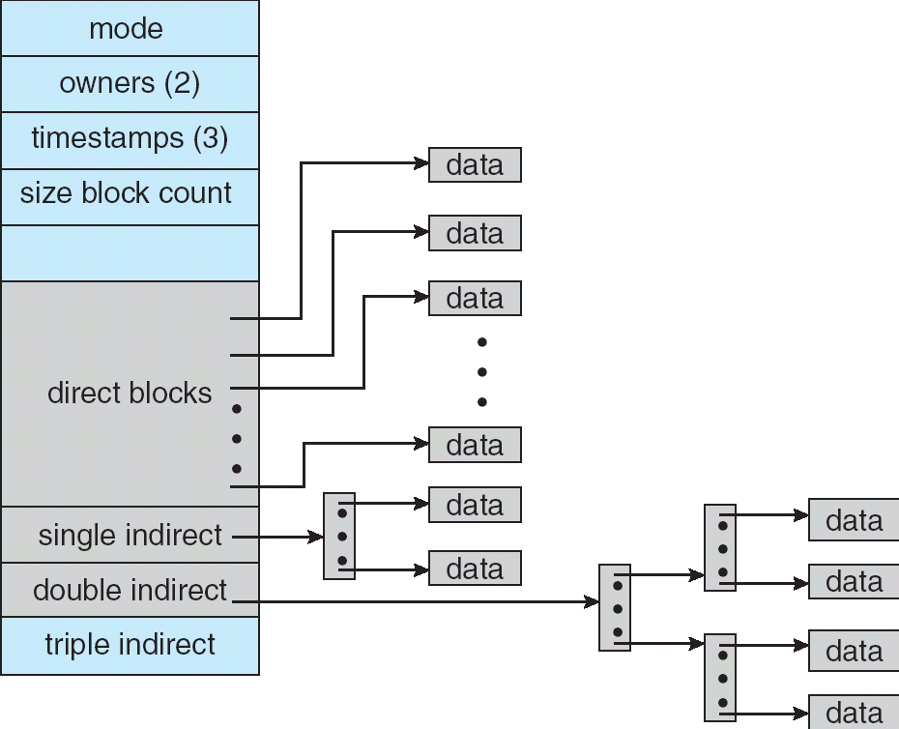
Recall: Multilevel Indexed Files (Original 4.1 BSD)
Sample file in multilevel indexed format:
10 direct ptrs, 1K blocks
How many accesses for block #23? (assume file header accessed on open)?
Two: One for indirect block, one for data
How about block #5?
One: One for data
Block #340?
Three: double indirect block, indirect block, and data
UNIX 4.1 Pros and cons
Pros: Simple (more or less) Files can easily expand (up to a point) Small files particularly cheap and easy
Cons: Lots of seeks Very large files must read many indirect block (Four I/Os per block!)

Slide 5
Recall: Fast File System (BSD 4.2, 1984)
Same inode structure as in BSD 4.1
same file header and triply indirect blocks like we just studied
Some changes to block sizes from 1024 ⇒ 4096 bytes for performance
Paper on FFS: “A Fast File System for UNIX”
Marshall McKusick, William Joy, Samuel Leffler and Robert Fabry
Off the “resources” page of course website – Take a look!
Optimization for Performance and Reliability:
Distribute inodes among different tracks to be closer to data
Uses bitmap allocation in place of freelist
Attempt to allocate files contiguously
10% reserved disk space
Skip-sector positioning (mentioned later)

Slide 6
Recall: UNIX 4.2 BSD FFS
Pros
Efficient storage for both small and large files
Locality for both small and large files
Locality for metadata and data
No defragmentation necessary!
Cons
Inefficient for tiny files (a 1-byte file requires both an inode and a data block)
Inefficient encoding when file is mostly contiguous on disk
Need to reserve 10-20% of free space to prevent fragmentation

Slide 7
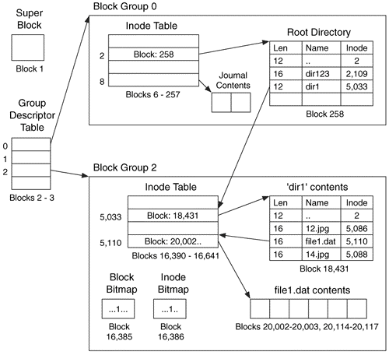
Recall: Linux Ext2/3 Disk Layout
Disk divided into block groups
Provides locality
Each group has two block-sized bitmaps (free blocks/inodes)
Block sizes settable at format time: 1K, 2K, 4K, 8K…
Actual inode structure similar to 4.2 BSD
With 12 direct pointers instead of 10
Ext3: Ext2 with Journaling
Several degrees of protection with comparable overhead
We will talk about Journaling Today!
Example: create a file1.dat under /dir1/ in Ext3

Slide 8
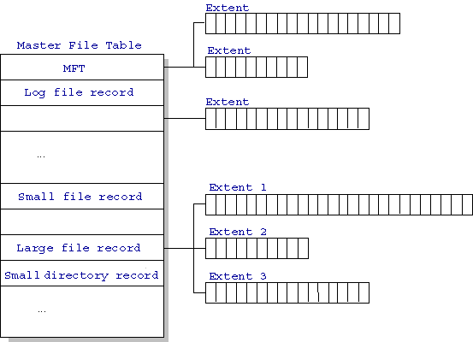
Recall: NTFS
Master File Table
Database with flexible 1KB entries for metadata/data
Variable-sized attribute records (data or metadata)
Extend with variable depth tree (non-resident)
Extents – variable length contiguous regions
Block pointers cover runs of blocks
Similar approach in Linux (ext4)
File create can provide hint as to size of file
Journaling for reliability
Discussed Today!
http://ntfs.com/ntfs-mft.htm

Slide 9
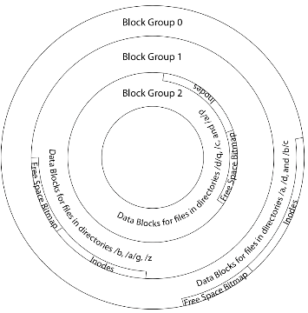
Recall: File System Buffer Cache
Data blocks
Disk
Reading
PCB
OS implements a cache of disk blocks for efficient access to data, directories, inodes, freemap
iNodes
file desc
Writing
Dir Data blocks
Free bitmap
Memory
Blocks
State
free
free

Slide 10
Recall: Delayed Writes
Buffer cache is a writeback cache (writes are termed “Delayed Writes”)
write() copies data from user space to kernel buffer cache
Quick return to user space
read() is fulfilled by the cache, so reads see the results of writes
Even if the data has not reached disk
When does data from a write syscall finally reach disk?
When the buffer cache is full (e.g., we need to evict something)
When the buffer cache is flushed periodically (in case we crash)

Slide 11
Recall: Delayed Writes (Advantages)
Performance advantage: return to user quickly without writing to disk!
Disk scheduler can efficiently order lots of requests
Elevator Algorithm can rearrange writes to avoid random seeks
Delay block allocation:
May be able to allocate multiple blocks at same time for file, keep them contiguous
Some files never actually make it all the way to disk
Many short-lived files!

Slide 12
Recall: Dealing with Persistent State
Buffer Cache: write back dirty blocks periodically, even if used recently
Why? To minimize data loss in case of a crash
Linux does periodic flush every 30 seconds
Not foolproof! Can still crash with dirty blocks in the cache
What if the dirty block was for a directory?
Lose pointer to file’s inode (leak space)
File system now in inconsistent state ☹
Takeaway: File systems need
recovery mechanisms

Slide 13
Important “ilities”
Availability: the probability that the system can accept and process requests
Measured in “nines” of probability: e.g., 99.9% probability is “3-nines of availability”
Key idea here is independence of failures
Durability: the ability of a system to recover data despite faults
This idea is fault tolerance applied to data
Doesn’t necessarily imply availability: information on pyramids was very durable, but could not be accessed until discovery of Rosetta Stone
Reliability: the ability of a system or component to perform its required functions under stated conditions for a specified period of time (IEEE definition)
Usually stronger than simply availability: means that the system is not only “up”, but also working correctly
Includes availability, security, fault tolerance/durability
Must make sure data survives system crashes, disk crashes, other problems

Slide 15
How to make File Systems more Durable?

Slide 16
How to Make File Systems more Durable?
Disk blocks contain Reed-Solomon error correcting codes (ECC) to deal with small defects in disk drive
Can allow recovery of data from small media defects
Make sure writes survive in short term
Either abandon delayed writes or
Use special, battery-backed RAM (called non-volatile RAM or NVRAM) for dirty blocks in buffer cache
Make sure that data survives in long term
Need to replicate! More than one copy of data!
Important element: independence of failure
Could put copies on one disk, but if disk head fails…
Could put copies on different disks, but if server fails…
Could put copies on different servers, but if building is struck by lightning….
Could put copies on servers in different continents…

Slide 17
RAID 1: Disk Mirroring/Shadowing
recovery
group
Each disk is fully duplicated onto its “shadow”
For high I/O rate, high availability environments
Most expensive solution: 100% capacity overhead
Bandwidth sacrificed on write:
Logical write = two physical writes
Highest bandwidth when disk heads and rotation synchronized (challenging)
Reads may be optimized
Can have two independent reads to same data
Recovery:
Disk failure ⇒ replace disk and copy data to new disk
Hot Spare: idle disk attached to system for immediate replacement

Slide 18
RAID 5+: High I/O Rate Parity
Stripe Unit
Data stripped across multiple disks
Successive blocks stored on successive (non-parity) disks
Increased bandwidth over single disk
Parity block (in green) constructed by XORing data bocks in stripe
P0=D0⊕D1⊕D2⊕D3
Can destroy any one disk and still reconstruct data
Suppose Disk 3 fails, then can reconstruct: D2=D0⊕D1⊕D3⊕P0
Can spread information widely across internet for durability
RAID algorithms work over geographic scale
D0
D1
D2
D3
P0
D4
D5
D6
P1
D7
Increasing
Logical Disk
Addresses
D8
D9
P2
D10
D11
D12
P3
D13
D14
D15
P4
D16
D17
D18
D19
D20
D21
D22
D23
P5
Disk 1
Disk 2
Disk 3
Disk 4
Disk 5

Slide 19
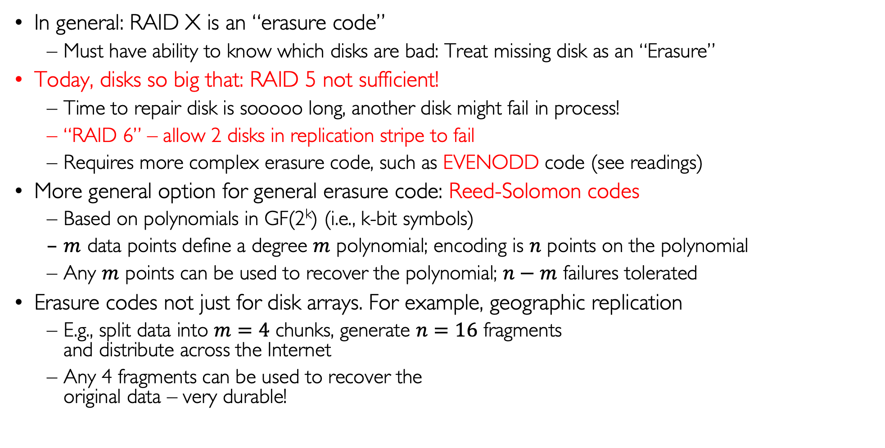
RAID 6 and other Erasure Codes
In general: RAID X is an “erasure code”
Must have ability to know which disks are bad: Treat missing disk as an “Erasure”
Today, disks so big that: RAID 5 not sufficient!
Time to repair disk is sooooo long, another disk might fail in process!
“RAID 6” – allow 2 disks in replication stripe to fail
Requires more complex erasure code, such as EVENODD code (see readings)
More general option for general erasure code: Reed-Solomon codes
Based on polynomials in GF(2^{k}) (i.e., k-bit symbols)
$m$ data points define a degree $m$ polynomial; encoding is $n$ points on the polynomial
Any $m$ points can be used to recover the polynomial; $n−m$ failures tolerated
Erasure codes not just for disk arrays. For example, geographic replication
E.g., split data into $m=4$ chunks, generate $n=16$ fragments and distribute across the Internet
Any 4 fragments can be used to recover the original data – very durable!

Slide 20
Higher Durability through Geographic Replication
Highly durable – hard to destroy all copies
Highly available for reads
Simple replication: read any copy
Erasure coded: read m of n
Low availability for writes
Can’t write if any one replica is not up
Or – need relaxed consistency model
Reliability? – availability, security, durability, fault-tolerance
Replica/Fragment #1
Replica/Fragment #2
Replica/Fragment #n

Slide 21
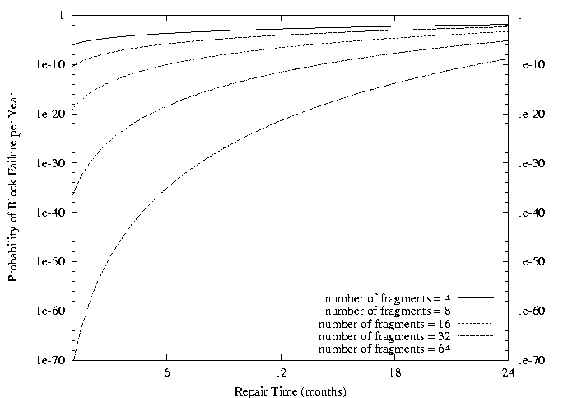
Use of Erasure Coding for High Durability/Overhead Ratio!
Fraction Blocks Lost
Per Year (FBLPY)
Exploit law of large numbers for durability!
6-month repair, FBLPY with 4x increase in total size of data:
Replication (4 copies): 0.03
Fragmentation (16 of 64 fragments needed): 10⁻³⁵

Slide 23
How to make File Systems more Reliable?

Slide 24
File System Reliability: (Difference from Block-level reliability)
What can happen if disk loses power or software crashes?
Some operations in progress may complete
Some operations in progress may be lost
Overwrite of a block may only partially complete
Having RAID doesn’t necessarily protect against all such failures
No protection against writing bad state
What if one disk of RAID group not written?
File system needs durability (as a minimum!)
Data previously stored can be retrieved (maybe after some recovery step), regardless of failure
But durability is not quite enough…!

Slide 25
Storage Reliability Problem
A single logical file operation can involve updates to multiple physical disk blocks
inode, indirect block, data block, bitmap, …
With sector remapping, single update to physical disk block can require multiple (even lower level) updates to sectors
At a physical level, operations complete one at a time
Want concurrent operations for performance
How do we guarantee consistency regardless of when crash occurs?

Slide 26
Threats to Reliability
Interrupted Operation
Crash or power failure in the middle of a series of related updates may leave stored data in an inconsistent state
Example: transfer funds from one bank account to another
What if transfer is interrupted after withdrawal and before deposit?
Loss of stored data
Failure of non-volatile storage media may cause previously stored data to disappear or be corrupted

Slide 27
Two Reliability Approaches
Careful Ordering and Recovery
Versioning and Copy-on-Write
FAT & FFS + (fsck)
Each step builds structure,
Data block ⇐ inode ⇐ free ⇐ directory
Last step links it into rest of FS
Recover scans structure looking for incomplete actions
ZFS, …
Version files at some granularity
Create new structure linking back to unchanged parts of old
Last step is to declare that the new version is ready

Slide 28
Reliability Approach #1: Careful Ordering
Sequence operations in a specific order
Careful design to allow sequence to be interrupted safely
Post-crash recovery
Read data structures to see if there were any operations in progress
Clean up/finish as needed
Approach taken by
FAT and FFS (fsck) to protect filesystem structure/metadata
Many app-level recovery schemes (e.g., Word, emacs autosaves)

Slide 29
Berkeley FFS: Create a File
Normal operation:
Allocate data block
Write data block
Allocate inode
Write inode block
Update bitmap of free blocks and inodes
Update directory with file name → inode number
Update modify time for directory
Recovery:
Scan inode table
If any unlinked files (not in any directory), delete or put in lost & found dir
Compare free block bitmap against inode trees
Scan directories for missing update/access times
Time proportional to disk size

Slide 30
Reliability Approach #2: Copy on Write File Layout
Recall: multi-level index structure lets us find the data blocks of a file
Instead of over-writing existing data blocks and updating the index structure:
Create a new version of the file with the updated data
Reuse blocks that don’t change much of what is already in place
This is called: Copy On Write (COW)
Seems expensive! But
Updates can be batched
Almost all disk writes can occur in parallel
Approach taken in network file server appliances
NetApp’s Write Anywhere File Layout (WAFL)
ZFS (Sun/Oracle) and OpenZFS

Slide 31
COW with Smaller-Radix Blocks
old version
new version
Write
If file represented as a tree of blocks, just need to update the leading fringe

Slide 32
Example: ZFS and OpenZFS
Variable sized blocks: 512 B – 128 KB
Symmetric tree
Know if it is large or small when we make the copy
Store version number with pointers
Can create new version by adding blocks and new pointers
Buffers a collection of writes before creating a new version with them
Free space represented as tree of extents in each block group
Delay updates to freespace (in log) and do them all when block group is activated

Slide 34
Transactions

Slide 35
More General Reliability Solutions
Use Transactions for atomic updates
Ensure that multiple related updates are performed atomically
i.e., if a crash occurs in the middle, the state of the systems reflects either all or none of the updates
Most modern file systems use transactions internally to update filesystem structures and metadata
Many applications implement their own transactions
Provide Redundancy for media failures
Redundant representation on media (Error Correcting Codes)
Replication across media (e.g., RAID disk array)

Slide 36
Transactions
Closely related to critical sections for manipulating shared data structures
They extend concept of atomic update from memory to stable storage
Atomically update multiple persistent data structures
Many ad-hoc approaches
FFS carefully ordered the sequence of updates so that if a crash occurred while manipulating directory or inodes the disk scan on reboot would detect and recover the error (fsck)
Applications use temporary files and rename

Slide 37
Key Concept: Transaction
A transaction is an atomic sequence of reads and writes that takes the system from consistent state to another.
Recall: Code in a critical section appears atomic to other threads
Transactions extend the concept of atomic updates from memory to persistent storage
transaction
consistent state 1
consistent state 2

Slide 38
Typical Structure
Begin a transaction – get transaction id
Do a bunch of updates
If any fail along the way, roll-back
Or, if any conflicts with other transactions, roll-back
Commit the transaction

Slide 39
“Classic” Example: Transaction
BEGIN; --BEGIN TRANSACTION
UPDATE accounts SET balance = balance - 100.00 WHERE name = 'Alice';
UPDATE branches SET balance = balance - 100.00 WHERE name = (SELECT branch_name FROM accounts WHERE name = 'Alice');
UPDATE accounts SET balance = balance + 100.00 WHERE name = 'Bob';
UPDATE branches SET balance = balance + 100.00 WHERE name = (SELECT branch_name FROM accounts WHERE name = 'Bob');
COMMIT; --COMMIT WORK
Transfer $100 from Alice’s account to Bob’s account

Slide 40
Concept of a log
One simple action is atomic – write/append a basic item
Use that to seal the commitment to a whole series of actions
Commit Tran N
Start Tran N
Get 10$ from account A
Get 7$ from account B
Get 13$ from account C
Put 15$ into account X
Put 15$ into account Y

Slide 42
Transactional Filesystems

Slide 43
Transactional Filesystems
Better reliability through use of log
Changes are treated as transactions
A transaction is committed once it is written to the log
Data forced to disk for reliability
Process can be accelerated with NVRAM
Although File system may not be updated immediately, data preserved in the log
Difference between “Log Structured” and “Journaled”
In a Log Structured filesystem, data stays in log form
In a Journaled filesystem, Log used for recovery

Slide 44
Journaling File Systems
Don’t modify data structures on disk directly
Write each update as transaction recorded in a log
Commonly called a journal or intention list
Also maintained on disk (allocate blocks for it when formatting)
Once changes are in the log, they can be safely applied to file system
e.g., modify inode pointers and directory mapping
Garbage collection: once a change is applied, remove its entry from the log
Linux took original FFS-like file system (ext2) and added a journal to get ext3!
Some options: whether or not to write all data to journal or just metadata
Other examples: NTFS, Apple HFS+, Linux XFS, JFS, ext4

Slide 45
Creating a File (No Journaling Yet)
Find free data block(s)
Find free inode entry
Find dirent insertion point
-----------------------------------------
Write map (i.e., mark used)
Write inode entry to point to block(s)
Write dirent to point to inode
Free space map
Data blocks
…
Inode table
Directory
entries

Slide 46
Creating a File (With Journaling)
Find free data block(s)
Find free inode entry
Find dirent insertion point
-----------------------------------------
[log] Write map (i.e., mark used)
[log] Write inode entry to point to block(s)
[log] Write dirent to point to inode
Free space map
Data blocks
…
Inode table
Directory
entries
tail
head
done
pending
start
commit
Log: in non-volatile storage (Flash or on Disk)

Slide 47
After Commit, Eventually Replay Transaction
All accesses to the file system first looks in the log
Actual on-disk data structure might be stale
Eventually, copy changes to disk and discard transaction from the log
Free space map
Data blocks
…
Inode table
Directory
entries
tail
tail
tail
tail
tail
head
done
pending
start
commit
Log: in non-volatile storage (Flash or on Disk)

Slide 48
Crash Recovery: Discard Partial Transactions
Upon recovery, scan the log
Detect transaction start with no commit
Discard log entries
Disk remains unchanged
Free space map
Data blocks
…
Inode table
Directory
entries
tail
head
done
pending
start
Log: in non-volatile storage (Flash or on Disk)

Slide 49
Crash Recovery: Keep Complete Transactions
Scan log, find start
Find matching commit
Redo it as usual
Or just let it happen later
Free space map
Data blocks
…
Inode table
Directory
entries
tail
head
done
pending
start
commit
Log: in non-volatile storage (Flash or on Disk)

Slide 50
Journaling Summary
Why go through all this trouble?
Updates atomic, even if we crash:
Update either gets fully applied or discarded
All physical operations treated as a logical unit
Isn’t this expensive?
Yes! We're now writing all data twice (once to log, once to actual data blocks in target file)
Modern filesystems journal metadata updates only
Record modifications to file system data structures
But apply updates to a file’s contents directly

Slide 52
Log Structured Filesystems

Slide 53
The Log Structured File System (LFS)
Log Structured File System:
The LOG IS the storage
Log: One continuous sequence of blocks that wrap around whole disk
Inodes put into log when changed and point to new data in the log
Simple example:
Create two new files:
dir1/file1 and dir2/file2
Must write new data blocks for files and for new information in directories
LFS writes everything sequentially
Unix FFS requires 10 non-sequential writes (inodes written twice for ease of recovery)
Paper on resources page!
Sprite LFS
Unix FFS

Slide 54
Going Further – Log Structured File Systems
The log IS what is recorded on disk
File system operations logically replay log to get result
Create data structures to make this fast
On recovery, replay the log
Index (inodes) and directories are written into the log too
Large, important portion of the log is cached in memory
Relies on Buffer Cache to make reading fast
Do everything in bulk: log is collection of large segments
Each segment contains a summary of all the operations within the segment
Fast to determine if segment is relevant or not
Free space is approached as continual cleaning process of segments
Detect what is live or not within a segment
Copy live portion to new segment being formed (replay)
Garbage collection entire segment
No bit map

Slide 55
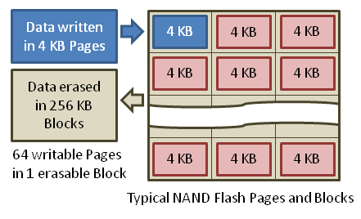
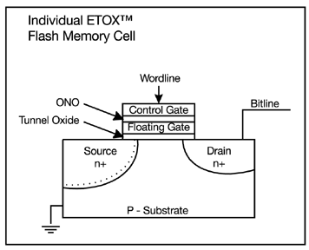
What about Flash Filesystems?
Cannot overwrite pages!
Must move contents to an erased page
Small changes ⇒ lots of rewriting of data/wear out!
Program/Erase (PE) Wear
Permanent damage to gate oxide at each flash cell
Caused by high program/erase voltages
Issues: trapped charges, premature leakage of charge
Need to balance how frequently cells written: “Wear Leveling”
Flash Translation Layer (FTL)
Translates between Logical Block Addresses (at OS level) and Physical Flash Page Addresses
Manages the wear and erasure state of blocks and pages
Tracks which blocks are garbage but not erased
Management Process (Firmware)
Keep freelist full, Manage mapping,
Track wear state of pages
Copy good pages out of mostly empty blocks before erasure
Single FLASH storage bit

Slide 56
Example Use of LFS: F2FS: A Flash File System
File system used on many mobile devices
Including the Pixel 3 from Google
Latest version supports block-encryption for security
Has been “mainstream” in Linux for several years now
Assumes standard SSD interface
With built-in Flash Translation Layer (FTL)
Random reads are as fast as sequential reads
Random writes are bad for flash storage
Forces FTL to keep moving/coalescing pages and erasing blocks
Sustained write performance degrades/lifetime reduced
Minimize Writes/updates and otherwise keep writes “sequential”
Start with Log-structured file systems/copy-on-write file systems
Keep writes as sequential as possible
Node Translation Table (NAT) for “logical” to “physical” translation
Independent of FTL
For more details, check out paper in Readings section of website
“F2FS: A New File System for Flash Storage” (from 2015)
Design of file system to leverage and optimize NAND flash solutions
Comparison with Ext4, Btrfs, Nilfs2, etc

Slide 57
Flash-Friendly on-Disk Layout
Main Area:
Divided into segments (basic unit of management in F2FS)
4KB Blocks. Each block typed to be node or data.
Node Address Table (NAT): Independent of FTL!
Block address table to locate all “node blocks” in Main Area
Updates to data sorted by predicted write frequency (Hot/Warm/Cold) to optimize FLASH management
Checkpoint (CP): Keeps the file system status
Bitmaps for valid NAT/SIT sets and Lists of orphan inodes
Stores a consistent F2FS status at a given point in time
Segment Information Table (SIT):
Per segment information such as number of valid blocks and the bitmap for the validity of all blocks in the “Main” area
Segments used for “garbage collection”
Segment Summary Area (SSA):
Summary representing the owner information of all blocks in the Main area

Slide 58
Normal LFS Index Structure: Forces Cascading Updates when Updating Data

Slide 59
F2FS Index Structure: Indirection and Multi-Head Logs Optimize Updates

Slide 60
Summary (1/2)
File system operations involve multiple distinct updates to blocks on disk
Need to have all or nothing semantics
Crash may occur in the midst of the sequence
Traditional file system perform check and recovery on boot
Along with careful ordering so partial operations result in loose fragments, rather than loss
Important system properties
Availability: how often is the resource available?
Durability: how well is data preserved against faults?
Reliability: how often is resource performing correctly?

Slide 61
Summary (2/2)
RAID: Redundant Arrays of Inexpensive Disks
RAID1: mirroring, RAID5: Parity block
Copy-on-write provides richer function (versions) with much simpler recovery
Little performance impact since sequential write to storage device is nearly free
Use of Log to improve Reliability
Journaled file systems such as ext3, NTFS
Transactions over a log provide a general solution
Commit sequence to durable log, then update the disk
Log takes precedence over disk
Replay committed transactions, discard partials

