Slide 1
CS162 Operating Systems and Systems Programming Lecture 24 RPC, Distributed File Systems

Slide 2
Recall: Distributed Applications Build With Messages
How do you actually program a distributed application?
Need to synchronize multiple threads, running on different machines
One Abstraction: send/receive messages
Interface:
Mailbox (mbox): temporary holding area for messages
Send(message,mbox)
Send message to remote mailbox identified by mbox
Receive(buffer,mbox)
Wait until mbox has message, copy into buffer, and return
Send
Network
Receive

Slide 3
Question: Data Representation
An object in memory has a machine-specific binary representation
Threads within a single process have the same view of what’s in memory
Easy to compute offsets into fields, follow pointers, etc.
In the absence of shared memory, externalizing an object requires us to turn it into a sequential sequence of bytes
Serialization/Marshalling: Express an object as a sequence of bytes
Deserialization/Unmarshalling: Reconstructing the original object from its marshalled form at destination

Slide 4
Simple Data Types
uint32_t x;
Suppose I want to write a x to a file
First, open the file: FILE* f = fopen(“foo.txt”, “w”);
Then, I have two choices:
fprintf(f, “%lu”, x);
fwrite(&x, sizeof(uint32_t), 1, f);
Neither one is “wrong” but sender and receiver should be consistent!

Slide 5
Machine Representation
Consider using the machine representation:
fwrite(&x, sizeof(uint32_t), 1, f);
How do we know if the recipient represents x in the same way?
For pipes, is this a problem?
What about for sockets?

Slide 6
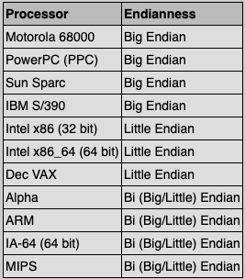
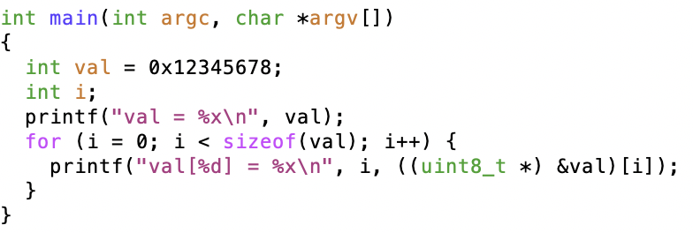
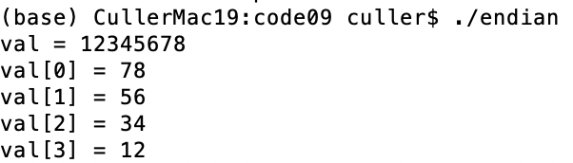
Endianness
For a byte-address machine, which end of a machine-recognized object (e.g., int) does its byte-address refer to?
Big Endian: address is the most-significant bits
Little Endian: address is the least-significant bits

Slide 7
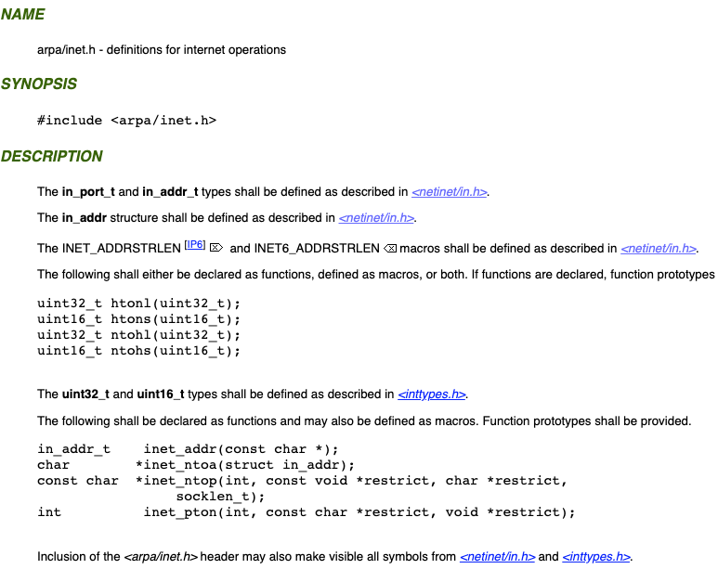
What Endian is the Internet?
Big Endian
Network byte order
Vs. “host byte order”

Slide 8
Dealing with Endianness
Decide on an “on-wire” endianness
Convert from native endianness to “on-wire” endianness before sending out data (serialization/marshalling)
uint32_t htonl(uint32_t) and uint16_t htons(uint16_t) convert from native endianness to network endianness (big endian)
Convert from “on-wire” endianness to native endianness when receiving data (deserialization/unmarshalling)
uint32_t ntohl(uint32_t) and uint16_t ntohs(uint16_t) convert from network endianness to native endianness (big endian)

Slide 9
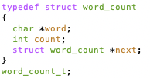
What About Richer Objects?
Consider word_count_t of Homework 0 and 1 …
Each element contains:
An int
A pointer to a string (of some length)
A pointer to the next element
fprintf_words writes these as a sequence of lines (character strings with \n) to a file stream
What if you wanted to write the whole list as a binary object (and read it back as one)?
How do you represent the string?
Does it make any sense to write the pointer?

Slide 10
Data Serialization Formats
Google Protobuffers, JSON and XML are commonly used in web applications
Lots of ad-hoc formats
{ “ faculty”:
[
{id: 1,
“name”: “Anthony”,
“lastname”: “Joseph”
},
{id: 2,
“name”: “Natacha”,
“lastname”: “Crooks”
}
]
}

Slide 11
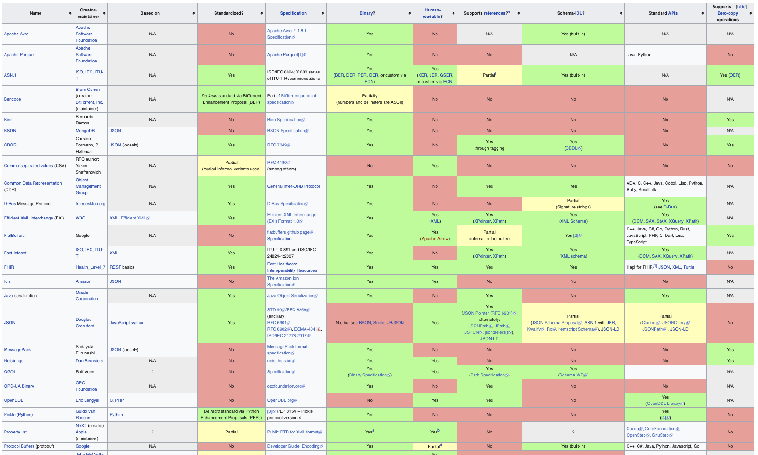
Data Serialization Formats

Slide 12
Remote Procedure Call (RPC)
Raw messaging is a bit too low-level for programming
Must wrap up information into message at source
Must decide what to do with message at destination
May need to sit and wait for multiple messages to arrive
And must deal with machine representation by hand
Another option: Remote Procedure Call (RPC)
Calls a procedure on a remote machine
Idea: Make communication look like an ordinary function call
Automate all of the complexity of translating between representations
Client calls: remoteFileSystem→Read("rutabaga");
Translated automatically into call on server: fileSys→Read("rutabaga");
Example: Java RMI

Slide 13
RPC Information Flow
bundle
args
Client (caller)
r = f(v1, v2);
call
Client
Stub
send
Packet
Handler
return
receive
unbundle
ret vals
Machine A
Network
Network
Machine B
bundle
ret vals
Server (callee)
res_t f(a1, a2)
return
Server
Stub
send
Packet
Handler
Server
Stub
call
receive
unbundle
args
unbundle
args

Slide 14
RPC Implementation
Request-response message passing (under covers!)
“Stub” provides glue on client/server
Client stub is responsible for “marshalling” arguments and “unmarshalling” the return values
Server-side stub is responsible for “unmarshalling” arguments and “marshalling” the return values.
Marshalling involves (depending on system)
Converting values to a canonical form, serializing objects, copying arguments passed by reference, etc.

Slide 15
RPC Details (1/3)
Equivalence with regular procedure call
Parameters ⇔ Request Message
Result ⇔ Reply message
Name of Procedure: Passed in request message
Return Address: mbox2 (client return mail box)
Stub generator: Compiler that generates stubs
Input: interface definitions in an “interface definition language (IDL)”
Contains, among other things, types of arguments/return
Output: stub code in the appropriate source language
Code for client to pack message, send it off, wait for result, unpack result and return to caller
Code for server to unpack message, call procedure, pack results, send them off

Slide 16
RPC Details (2/3)
Cross-platform issues:
What if client/server machines are different architectures/ languages?
Convert everything to/from some canonical form
Tag every item with an indication of how it is encoded (avoids unnecessary conversions)
How does client know which mbox (destination queue) to send to?
Need to translate name of remote service into network endpoint (Remote machine, port, possibly other info)
Binding: the process of converting a user-visible name into a network endpoint
This is another word for “naming” at network level
Static: fixed at compile time
Dynamic: performed at runtime

Slide 17
RPC Details (3/3)
Dynamic Binding
Most RPC systems use dynamic binding via name service
Name service provides dynamic translation of service → mbox
Why dynamic binding?
Access control: check who is permitted to access service
Fail-over: If server fails, use a different one
What if there are multiple servers?
Could give flexibility at binding time
Choose unloaded server for each new client
Could provide same mbox (router level redirect)
Choose unloaded server for each new request
Only works if no state carried from one call to next
What if multiple clients?
Pass pointer to client-specific return mbox in request

Slide 18
Problems with RPC: Non-Atomic Failures
Different failure modes in dist. system than on a single machine
Consider many different types of failures
User-level bug causes address space to crash
Machine failure, kernel bug causes all processes on same machine to fail
Some machine is compromised by malicious party
Before RPC: whole system would crash/die
After RPC: One machine crashes/compromised while others keep working
Can easily result in inconsistent view of the world
Did my cached data get written back or not?
Did server do what I requested or not?
Answer? Distributed transactions/2PC

Slide 19
Problems with RPC: Performance
RPC is not performance transparent:
Cost of Procedure call « same-machine RPC « network RPC
Overheads: Marshalling, Stubs, Kernel-Crossing, Communication
Programmers must be aware that RPC is not free
Caching can help, but may make failure handling complex

Slide 20



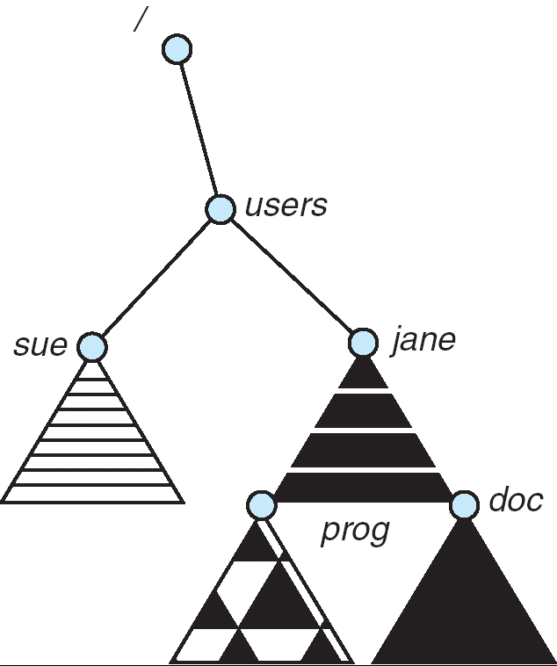
Distributed File Systems
Read File
Network
Data
Client
Server
Transparent access to files stored on a remote disk
Mount remote files into your local file system
Directory in local file system refers to remote files
e.g., /users/jane/prog/foo.c on laptop actually refers to /prog/foo.c on crooks.cs.berkeley.edu
Naming Choices:
[Hostname,localname]: Filename includes server
A global name space: Filename unique in “world”

Slide 21
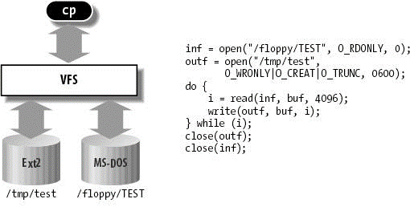
Virtual Filesystem Switch
VFS: Virtual abstraction of file system
Provides virtual superblocks, inodes, files, etc
Compatible with a variety of local and remote file systems
VFS allows the same system call interface (the API) to be used for different types of file systems
The API is to the VFS interface, rather than any specific type of file system

Slide 22
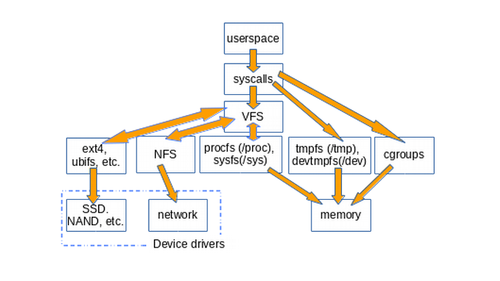
Example Linux mouting tree

Slide 23
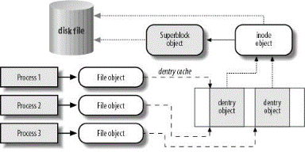
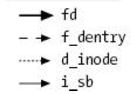
VFS Common File Model in Linux
Four primary object types for VFS:
superblock object: represents a specific mounted filesystem
inode object: represents a specific file
dentry object: represents a directory entry
file object: represents open file associated with process
There is no specific directory object (VFS treats directories as files)
May need to fit the model by faking it

Slide 24
Simple Distributed File System
Read (RPC)
Return (Data)
Client
Write (RPC)
Server
cache
ACK
Client
Remote Disk: Reads and writes forwarded to server
Use Remote Procedure Calls (RPC) to translate file system calls into remote requests
Advantage: Server provides consistent view of file system to multiple clients
Problems? Performance!
Going over network is slower than going to local memory
Lots of network traffic/not well pipelined
Server can be a bottleneck

Slide 25
Use of caching to reduce network load
Crash!
read(f1)
→V1
cache
Read (RPC)
read(f1)→V1
read(f1)→V1
F1:V1
Return (Data)
read(f1)→V1
Client
cache
Write (RPC)
Server
F1:V1
F1:V2
ACK
cache
write(f1)
→OK
F1:V2
read(f1)→V2
Client
Idea: Use caching to reduce network load
In practice: use buffer cache at source and destination
Advantage: if open/read/write/close can be done locally, don’t need to do any network traffic…fast!
Problems:
Failure:
Client caches have data not committed at server
Cache consistency!
Client caches not consistent with server/each other

Slide 26
Dealing with Failures
What if server crashes? Can client wait until it comes back and just continue making requests?
Changes in server's cache but not in disk are lost
What if there is shared state across RPC's?
Client opens file, then does a seek
Server crashes
What if client wants to do another read?
Similar problem: What if client removes a file but server crashes before acknowledgement?

Slide 27
Stateless Protocol
Stateless Protocol: A protocol in which all information required to service a request is included with the request
Even better: Idempotent Operations – repeating an operation multiple times is same as executing it just once (e.g., storing to a mem addr.)
Client: timeout expires without reply, just run the operation again (safe regardless of first attempt)
Recall HTTP: Also a stateless protocol
Include cookies with request to simulate a session

Slide 28
Case Study: Network File System (NFS)
Three Layers for NFS system
UNIX file-system interface: open, read, write, close calls + file descriptors
VFS layer: distinguishes local from remote files
Calls the NFS protocol procedures for remote requests
NFS service layer: bottom layer of the architecture
Implements the NFS protocol
NFS Protocol: RPC for file operations on server
Reading/searching a directory
manipulating links and directories
accessing file attributes/reading and writing files
Write-through caching: Modified data committed to server’s disk before results are returned to the client
lose some of the advantages of caching
time to perform write() can be long
Need some mechanism for readers to eventually notice changes! (more on this later)

Slide 29
NFS Continued
NFS servers are stateless; each request provides all arguments require for execution
E.g. reads include information for entire operation, such as ReadAt(inumber,position), not Read(openfile)
No need to perform network open() or close() on file – each operation stands on its own
Idempotent: Performing requests multiple times has same effect as performing them exactly once
Example: Server crashes between disk I/O and message send, client resend read, server does operation again
Example: Read and write file blocks: just re-read or re-write file block – no other side effects
Example: What about “remove”? NFS does operation twice and second time returns an advisory error
Failure Model: Transparent to client system
Is this a good idea? What if you are in the middle of reading a file and server crashes?
Options (NFS Provides both):
Hang until server comes back up (next week?)
Return an error. (Of course, most applications don’t know they are talking over network)

Slide 30
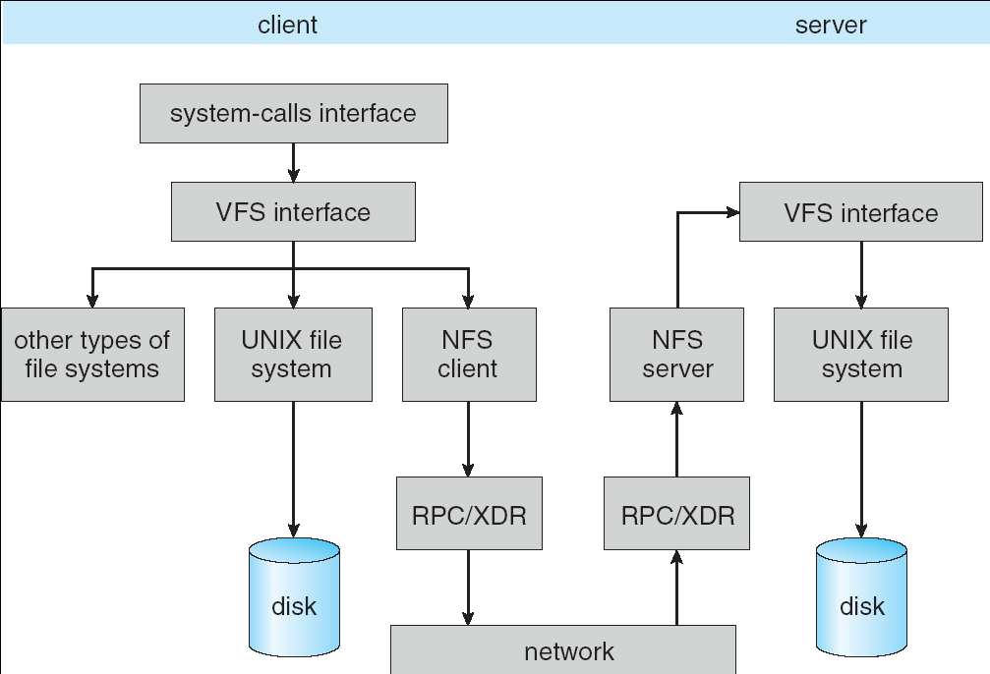
NFS Architecture

Slide 31
NFS Cache consistency
NFS protocol: weak consistency
Client polls server periodically to check for changes
Polls server if data hasn’t been checked in last 3-30 seconds (exact timeout it tunable parameter).
Thus, when file is changed on one client, server is notified, but other clients use old version of file until timeout.
What if multiple clients write to same file?
In NFS, can get either version (or parts of both)
Completely arbitrary!
cache
F1 still ok?
F1:V2
F1:V1
No: (F1:V2)
Client
cache
Write (RPC)
Server
F1:V2
ACK
cache
F1:V2
Client

Slide 32
Sequential Ordering Constraints
What sort of cache coherence might we expect?
i.e. what if one CPU changes file, and before it’s done, another CPU reads file?
Example: Start with file contents = “A”
What would we actually want?
Assume we want distributed system to behave exactly the same as if all processes are running on single system
If read finishes before write starts, get old copy
If read starts after write finishes, get new copy
Otherwise, get either new or old copy
For NFS:
If read starts more than 30 seconds after write, get new copy; otherwise, could get partial update
Client 1:
Read: gets A
Write B
Read: parts of B or C
Client 2:
Read: gets A or B
Write C
Client 3:
Read: parts of B or C
Time

Slide 33
NFS Pros and Cons
NFS Pros:
Simple, Highly portable
NFS Cons:
Sometimes inconsistent!
Doesn’t scale to large # clients
Must keep checking to see if caches out of date
Server becomes bottleneck due to polling traffic

Slide 34
Summary
Message passing and the challenges of serialization/deserialization
Remote Procedure Calls: abstraction of local computation on remote machines
Distributed File Systems using VFS
NFS: weak consistency but efficient

